Slide 1
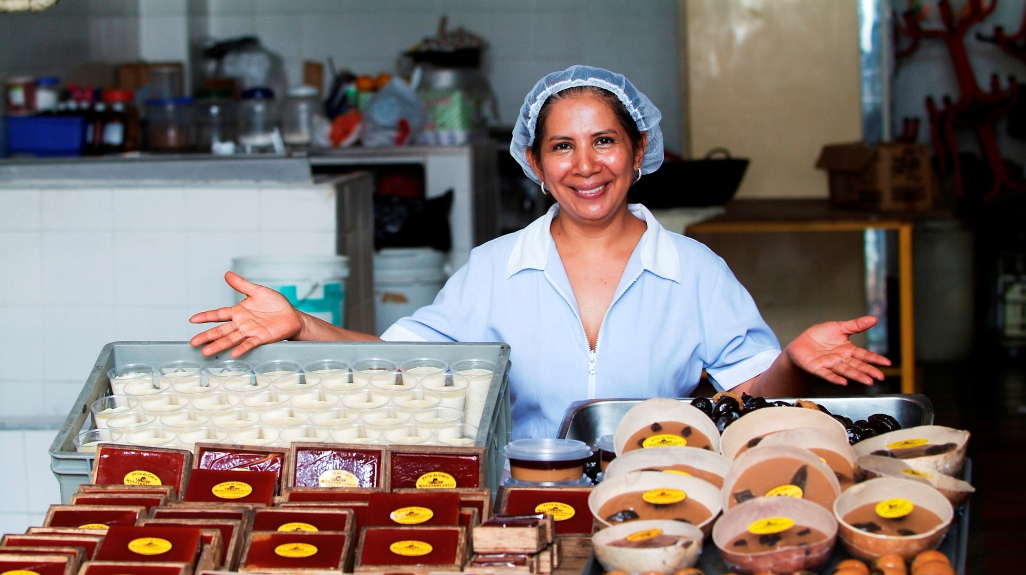
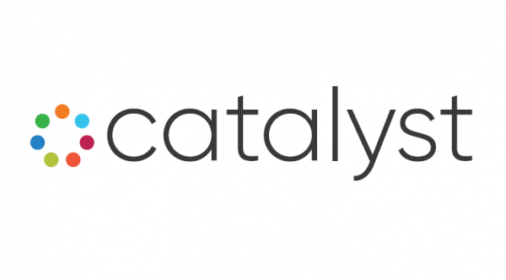
Minnesota Inclusive Growth Fund Sponsored by Catalyst
A collaborative effort to increase access to capital and support for small business in Minnesota focused on low/moderate income areas and under-served communities

Slide 2


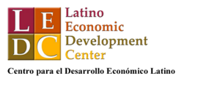


About Catalyst- the starting point for the MIGF
Catalyst is a collaboration between five leading Minnesota-based minority business support organizations (MBSO).
Catalyst's Mission: to increase the quantity and quality of stage-appropriate supports for minority businesses in Minnesota
Approach is collaborative and ecosystem-focused understanding that larger gains can be made through cooperation than competition
Strategy: to best support minority businesses in Minnesota requires that all the players that support them (across all sectors) are actively communicating and focused driving towards the same goals.
Urgent Need and Opportunity: The pandemic and civil unrest following the murder of George Floyd exposed the need for sustainable patient capital to support the rebuilding efforts of small businesses located in LMI and under-served communities served by Catalyst partners and other Fund Originators.

Slide 3
The Minnesota Inclusive Growth Fund is designed to equip community small business lenders with the support required to meet the unique rebuilding and recovery needs of their communities
Liquidity
Low-cost and flexible capital
Enables participating CDFIs to focus on new lending in their communities by providing them with liquidity and mitigating on-balance sheet risk
Provides CDFIs with the low-cost and flexible capital required to offer deeply affordable and flexible loans to small businesses
Operational Support
Sustainable and Scalable Partnership
Provides CDFIs with the financial resources through the origination fee and servicing fee to ensure they have operational capacity to execute on a high volume of loans
Builds a scalable source of financing that leverages and combines existing infrastructure, networks, and relationships to activate new recovery lending
Notes:
Liquidity
Operational support
New lending
Streamlined

Slide 4
This effort pools resources and leverages existing infrastructure to simplify execution and speed to market for businesses during this time of crisis
Loans, investments & grants…
…centralized and tailored…
…distributed through local partners…
…to the organizations that need it most
Minnesota Inclusive Growth Fund
Banks
Capital
Technical assistance
Foundations
Local small businesses affected by COVID-19
Technology Platform
Community based lenders / CDFIs
Individuals & Families

Slide 5
The Minnesota Inclusive Growth Fund will purchase loans originated by participating CDFI's to the Program
Minnesota Inclusive Growth Fund
(CRF Administered)
Banks + other Institutions
MEDA
Class A
(Senior debt)
~60%
AEDS
NEON
Recovery loans and assistance to small businesses across the state of Minnesota
Flexible working capital
Deeply affordable interest rates
Longer term to keep monthly payments low
Flexibility on eligibility requirements
LEDC
Foundation PRIs or EQ2s
Other Minnesota CDFI’s
Class B (Subordinate debt)
~20%
Grants
Loan Loss Reserves
~20%
Originating CDFIs will receive an origination and servicing fee along with any available technical assistance grants

Slide 6


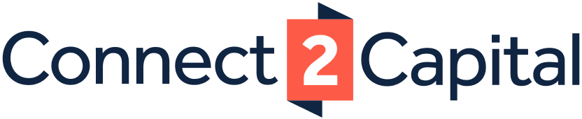
The participating CDFI lenders will originate new loans to small businesses that they can package and sell to a centralized special purpose vehicle
Minnesota Inclusive Growth Fund
Minnesota Inclusive Growth Fund Portal
CDFI
Application Process
Matching/Origination
Package and Sell to Fund
All interested small businesses will apply for a loan through a centralized portal
Eligible applicants will be matched with a community lender that best serves the small business; CDFI’s will either underwrite against the program’s criteria or leverage CRF lending services platform to originate and service loans
Once a loan is approved and closed, the CDFI will package the loan documentation and sell 95% of the loan to the Minnesota Inclusive Growth Fund, administered by CRF
The established CDFI’s will retain up to 5% of the loan on their balance sheet and maintain loan servicing

Slide 7
MIGF Loans: The loan products are tailored to meet the credit and capital needs of small businesses during post-COVID recovery
Recovery Loan – Micro Business
Growth Loan – Larger/Growth Business
Interest rate
For-profit small business: 5% fixed interest
Interest rate
For-profit small business: 5% fixed interest
Repayment term
60-month term:
0-12 months: interest only payments, paid monthly
13 to 60 months: interest and principal payments with flat payments on a 48-month schedule, paid monthly
Repayment term
60-month term:
0-12 months: interest only payments, paid monthly
13 to 60 months: interest and principal payments with flat payments on a 48-month schedule, paid monthly
Use of proceeds
Working capital including payroll, operating and emergency maintenance, utilities, rent, supplies, etc.
Use of proceeds
Capital Expenditures + Working Capital
Recourse
No collateral required
Recourse
Collateral will be required
Fees
3.5 percent origination fee paid to the originating lender
Application fee paid by borrower up to $250 depending on the transaction
Fees
3.5 percent origination fee paid to the originating lender
Application fee paid by borrower up to $500 depending on the transaction
Loan amount
Lesser of (a) $100,000 or (b) 3x average monthly revenue prior to the COVID-19 outbreak
Loan amount
$100,000 to $200,000
Note: The loan terms and conditions are Illustrative

Slide 8

THANK YOU & Questions

