Slide 1
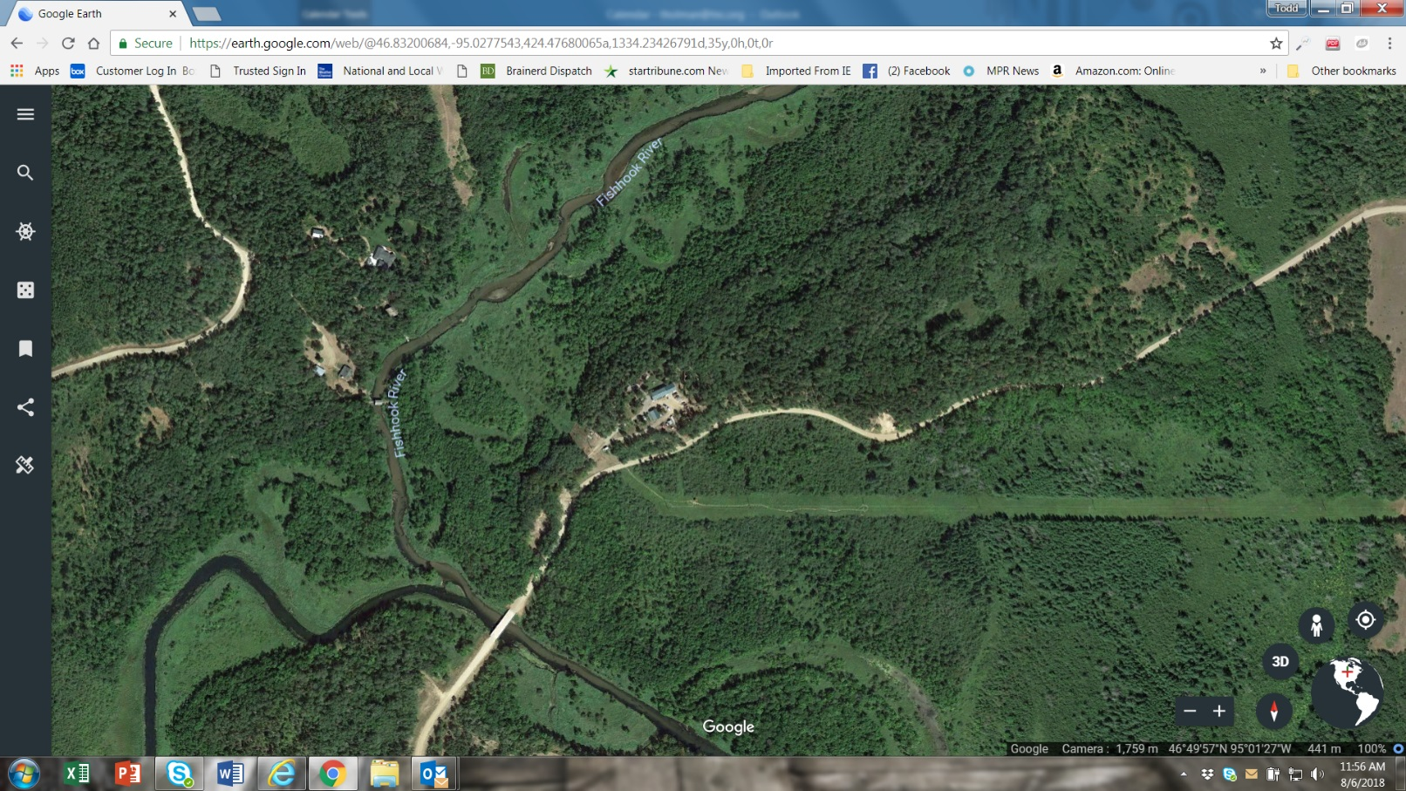
Mississippi Headwaters
Keeping Clean Water Clean

Slide 2
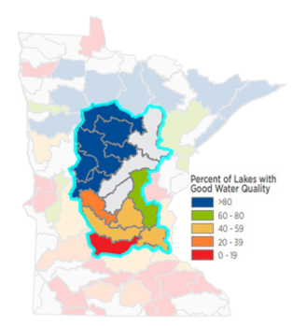
Mississippi Headwaters Basin
Science shows that of the 12 million acre basin, 1.5% of the land provides natural protection for water quality
1.3 million Minnesotans get drinking water from the basin, and 1.2 million get drinking water directly from the Mississippi River
This area supports a $2.3 billion tourism industry dependent on clean water for fishing, swimming, and other water sports
THE RISK: Conversion of land from its natural cover across the basin is a threat to water quality

Slide 3
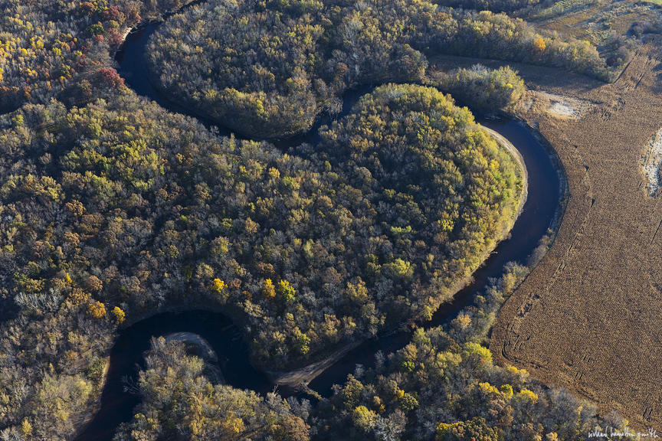
Maintaining Perennial Cover
Private forests & grasslands produce clean water, provide rangeland for grazers, forest products and food.
Grasslands used for grazing continue to be at risk of conversion
Large private family forests continue to be fragmented, developed and unmanaged
Restoration of these lands once they are developed costs more than protection now
Notes:
Rum River

Slide 4

Tools in the Healthy Water Protection Toolbox
HF 1079
Reinvest in Minnesota Working Grasslands Easement Program
Administered by the Board of Water and Soil Resources
Delivered by local Soil and Water Conservation Districts
Voluntary enrollment
Private grassland owners, ranchers/cattlemen eligible
Grazing continues
Private lands stay on local tax rolls
© Kelly Anderson, Department of Agriculture
Notes:
BWSR has effectively used RIM with agricultural producers for over 30 years.

Slide 5
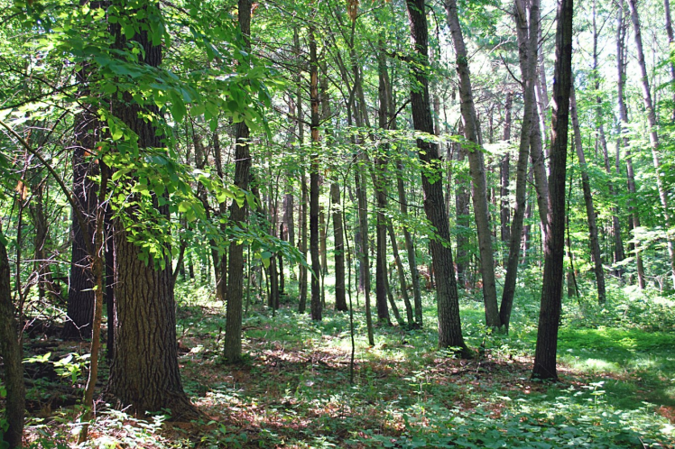
Tools in the Healthy Water Protection Toolbox
HF 1081
Forests for the Future
Conducted through Department of Natural Resources
Voluntary enrollment
Private forest-land owners are eligible
Promotes strategic conservation of private forests
Supports sustainable working forests for forest products
Forest harvest continues under management plan
© Department of Natural Resources Forests for the Future Program, Pine Moraine

Slide 6
If we invest in healthy water now, we can…
prevent degradation for 1/4th the cost of cleanup
protect drinking water sources for 2.5 million Minnesotans
maintain lakeshores that keep water clean
support a sustainable forest products industry
support grassland beef producers
ensure tourism, local businesses, and the recreation economy continue to thrive
prevent flooding and erosion
slow the spread of and prevent toxic algae blooms in lakes and bacteria in drinking water
Protect vital habitat

