Slide 1
David Parker, Ph.D Peter Nelson, Ph.D
Health and Human Services Finance Committee
April 10, 2018

Slide 2
Assess the Opportunity
Must answer two critical questions:
Is there a need? Is it a fit?
Development
Driven by experts, empirical research, and practitioners
Pilot and Refine
Feasibility?
Acceptability
Impact?
Finalize and Scale
Expansion and sustainability

Slide 3
Development
Driven by experts, empirical research, and practitioners
Iterative Development
Pilot and Refine
Feasibility?
Acceptability
Impact?

Slide 4
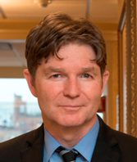
Dr. John Kelly
Addiction Medicine at Harvard Medical School
Recovery Corps Development Team
Measurement, outcomes, accountability
Most needed areas of “recovery capital”
Center for Advancing Research to Practice

