Slide 1
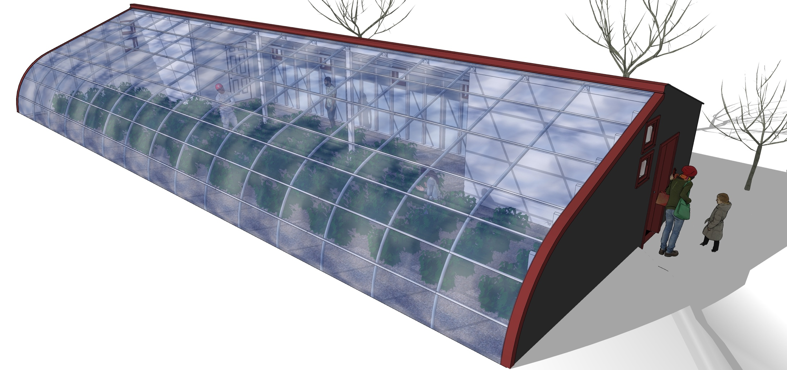
Deep Winter Greenhouses
How DWGs work
Who will use them
Why to expand program
Notes:
University of Minnesota Extension Regional Sustainable Development Partnerships Deep Winter Greenhouse program

Slide 2
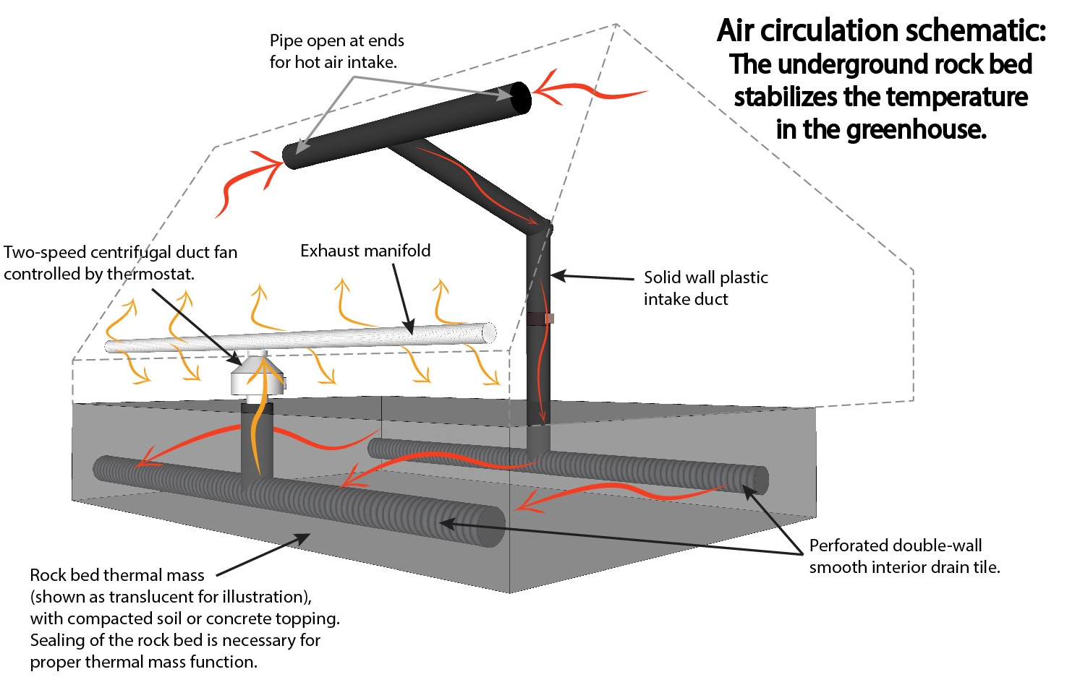
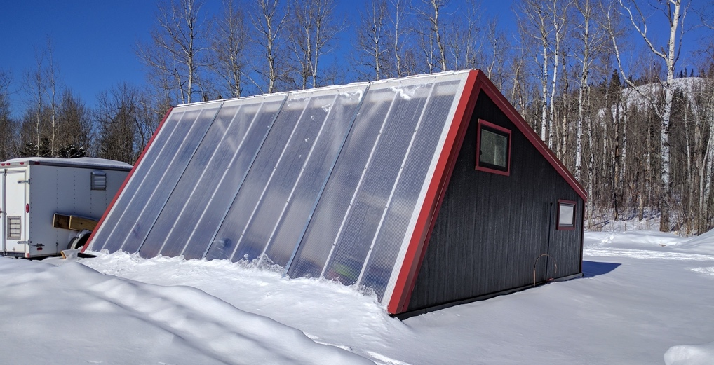
How the DWG works: Operations
Notes:
Solar heat collected through south-facing steeply sloped glazing angle. Air raises then drawn underground into thermal mass through duct work and fans. Thermal mass of crushed rock stored in insulated concrete foundation serves as a ‘heat battery’ and holds hot air to be used at night. (All Deep Winter Greenhouses require minimal backup heat to ensure crops don’t freeze during cloudy spells).

Slide 3
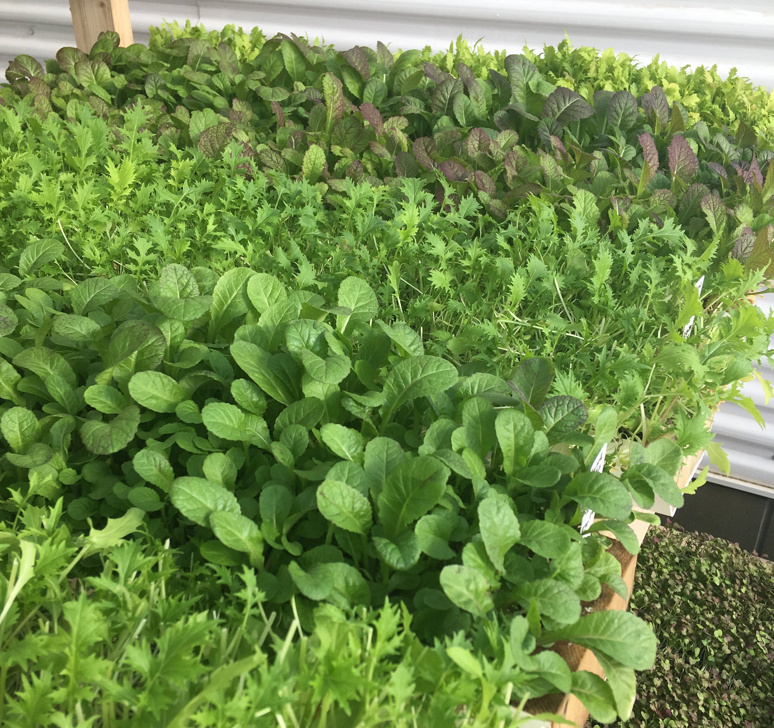
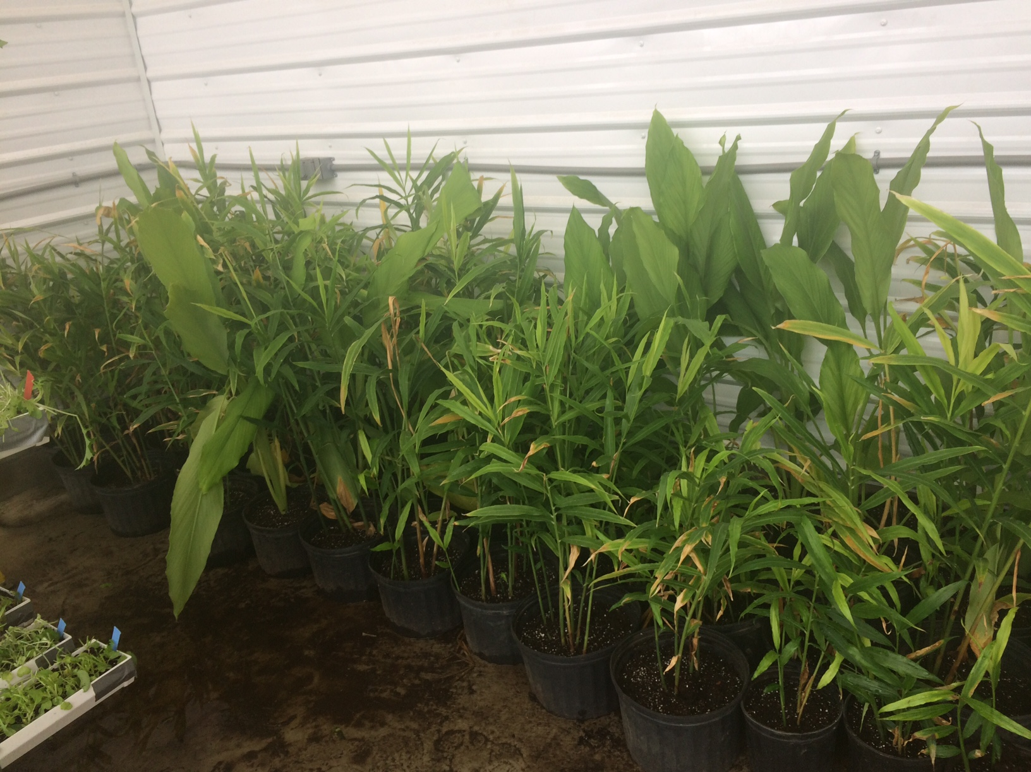
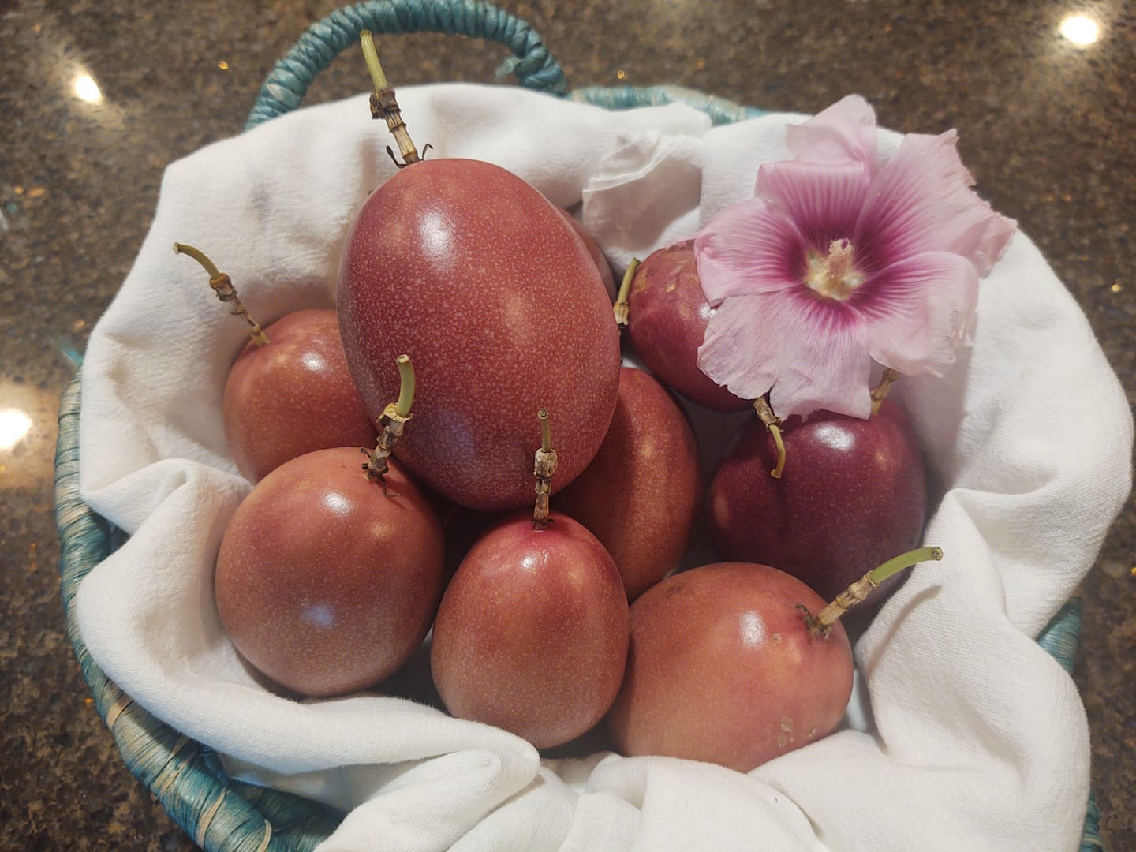
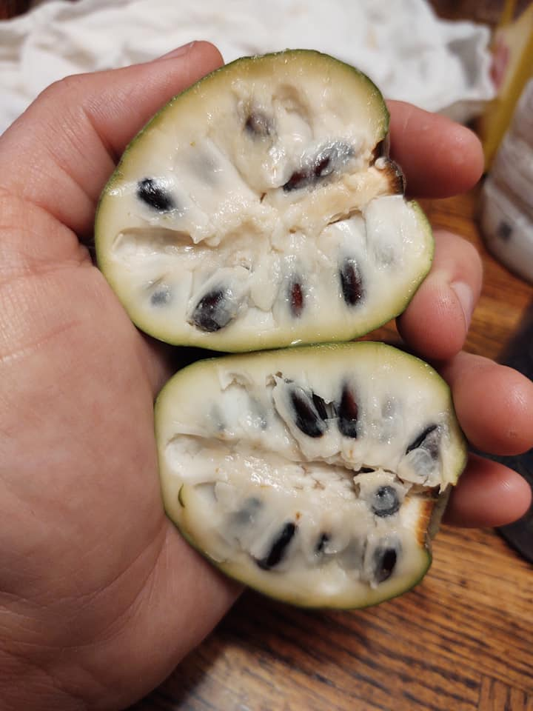
How the DWG works: Growing
Notes:
DWGs best for winter greens production
Others experiment with exotics: Ginger, turmeric, cherimoya, passion fruit

Slide 4
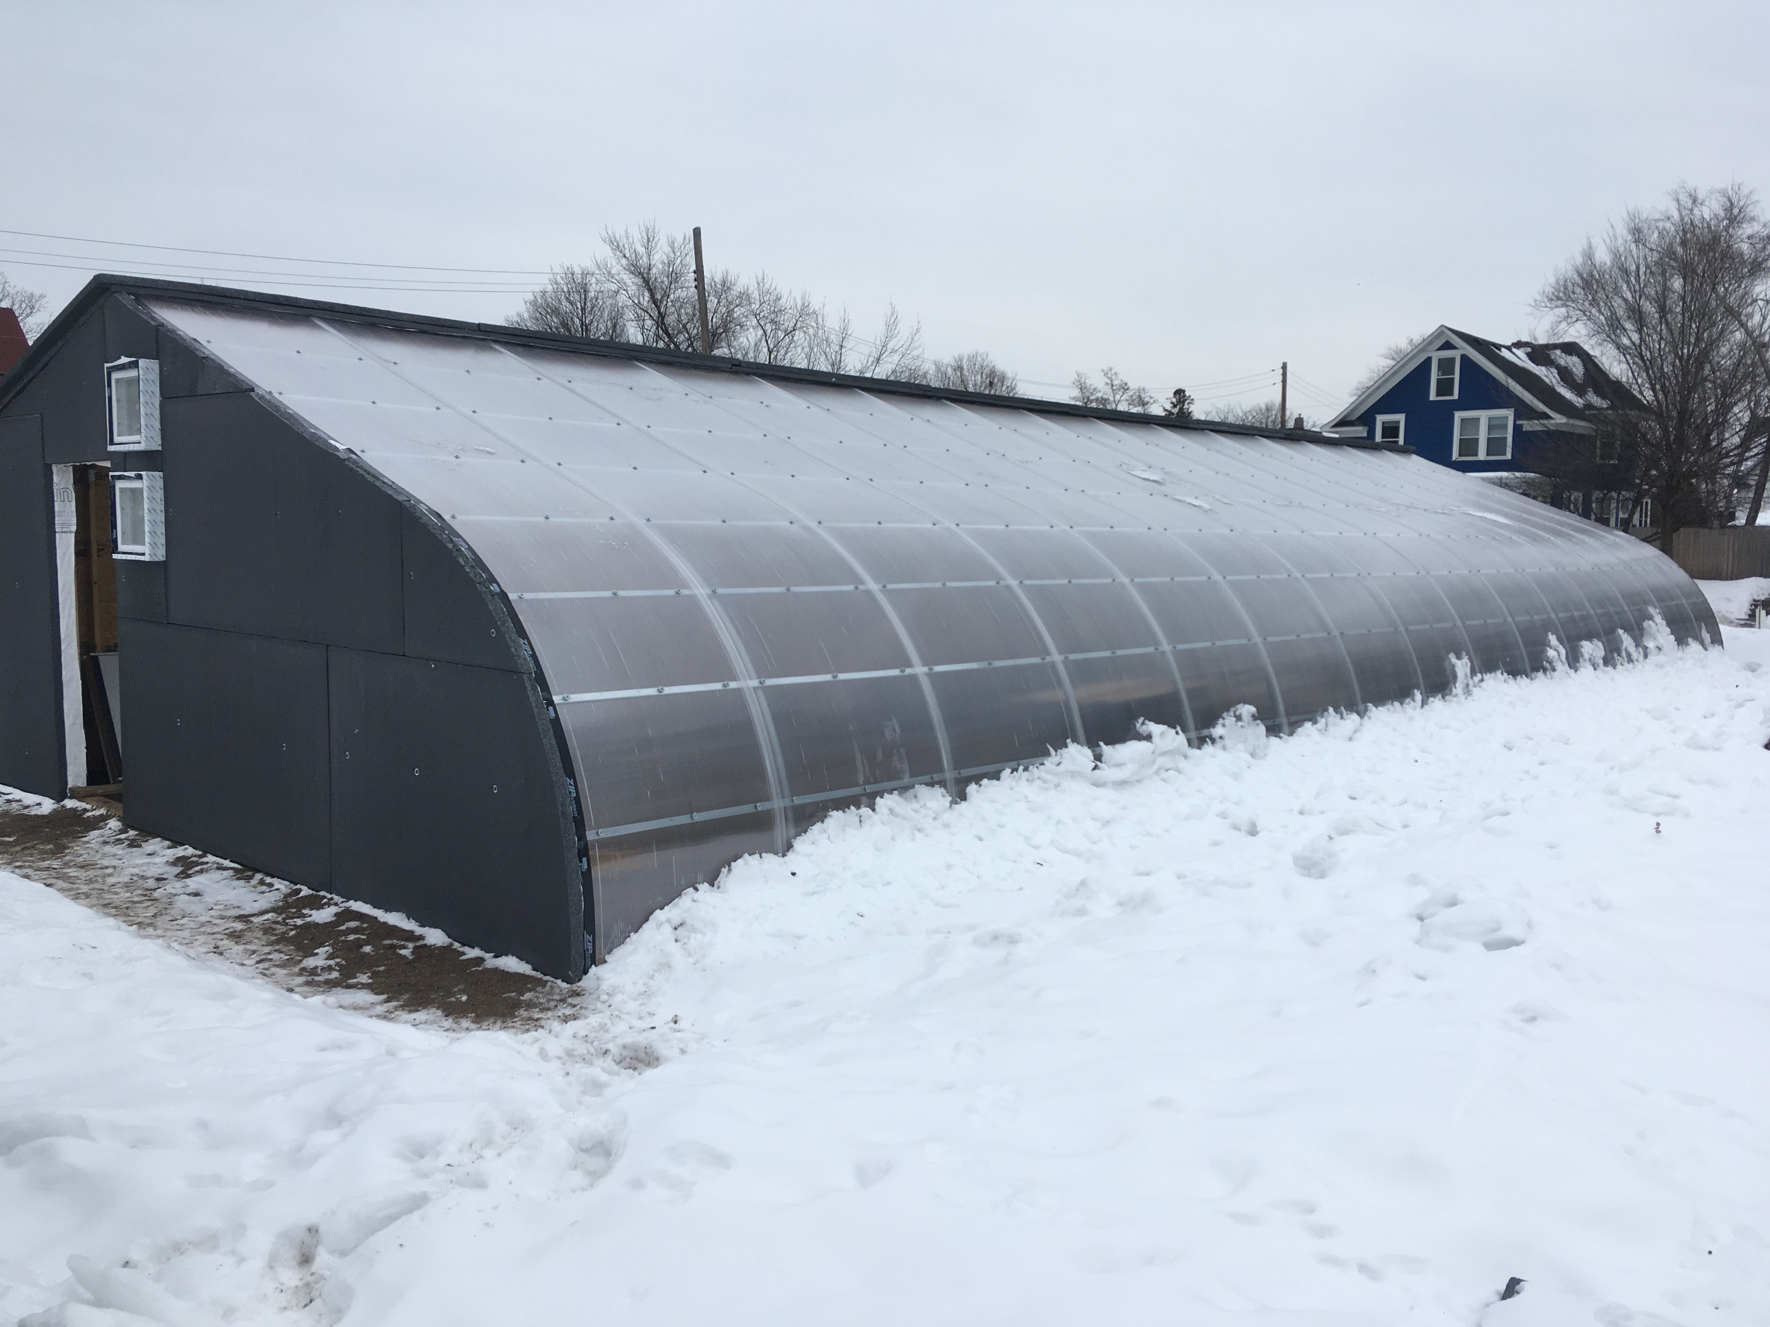
How the DWG works: Farm Scale DWG
Notes:
Farm scale DWG is priced and sized for small and medium farms.
Thermal mass of soil with skirt insulation and transit ducting, along with prefab hoophouse poles and streamlined stick frame construction dramatically reducing construction cost.

Slide 5
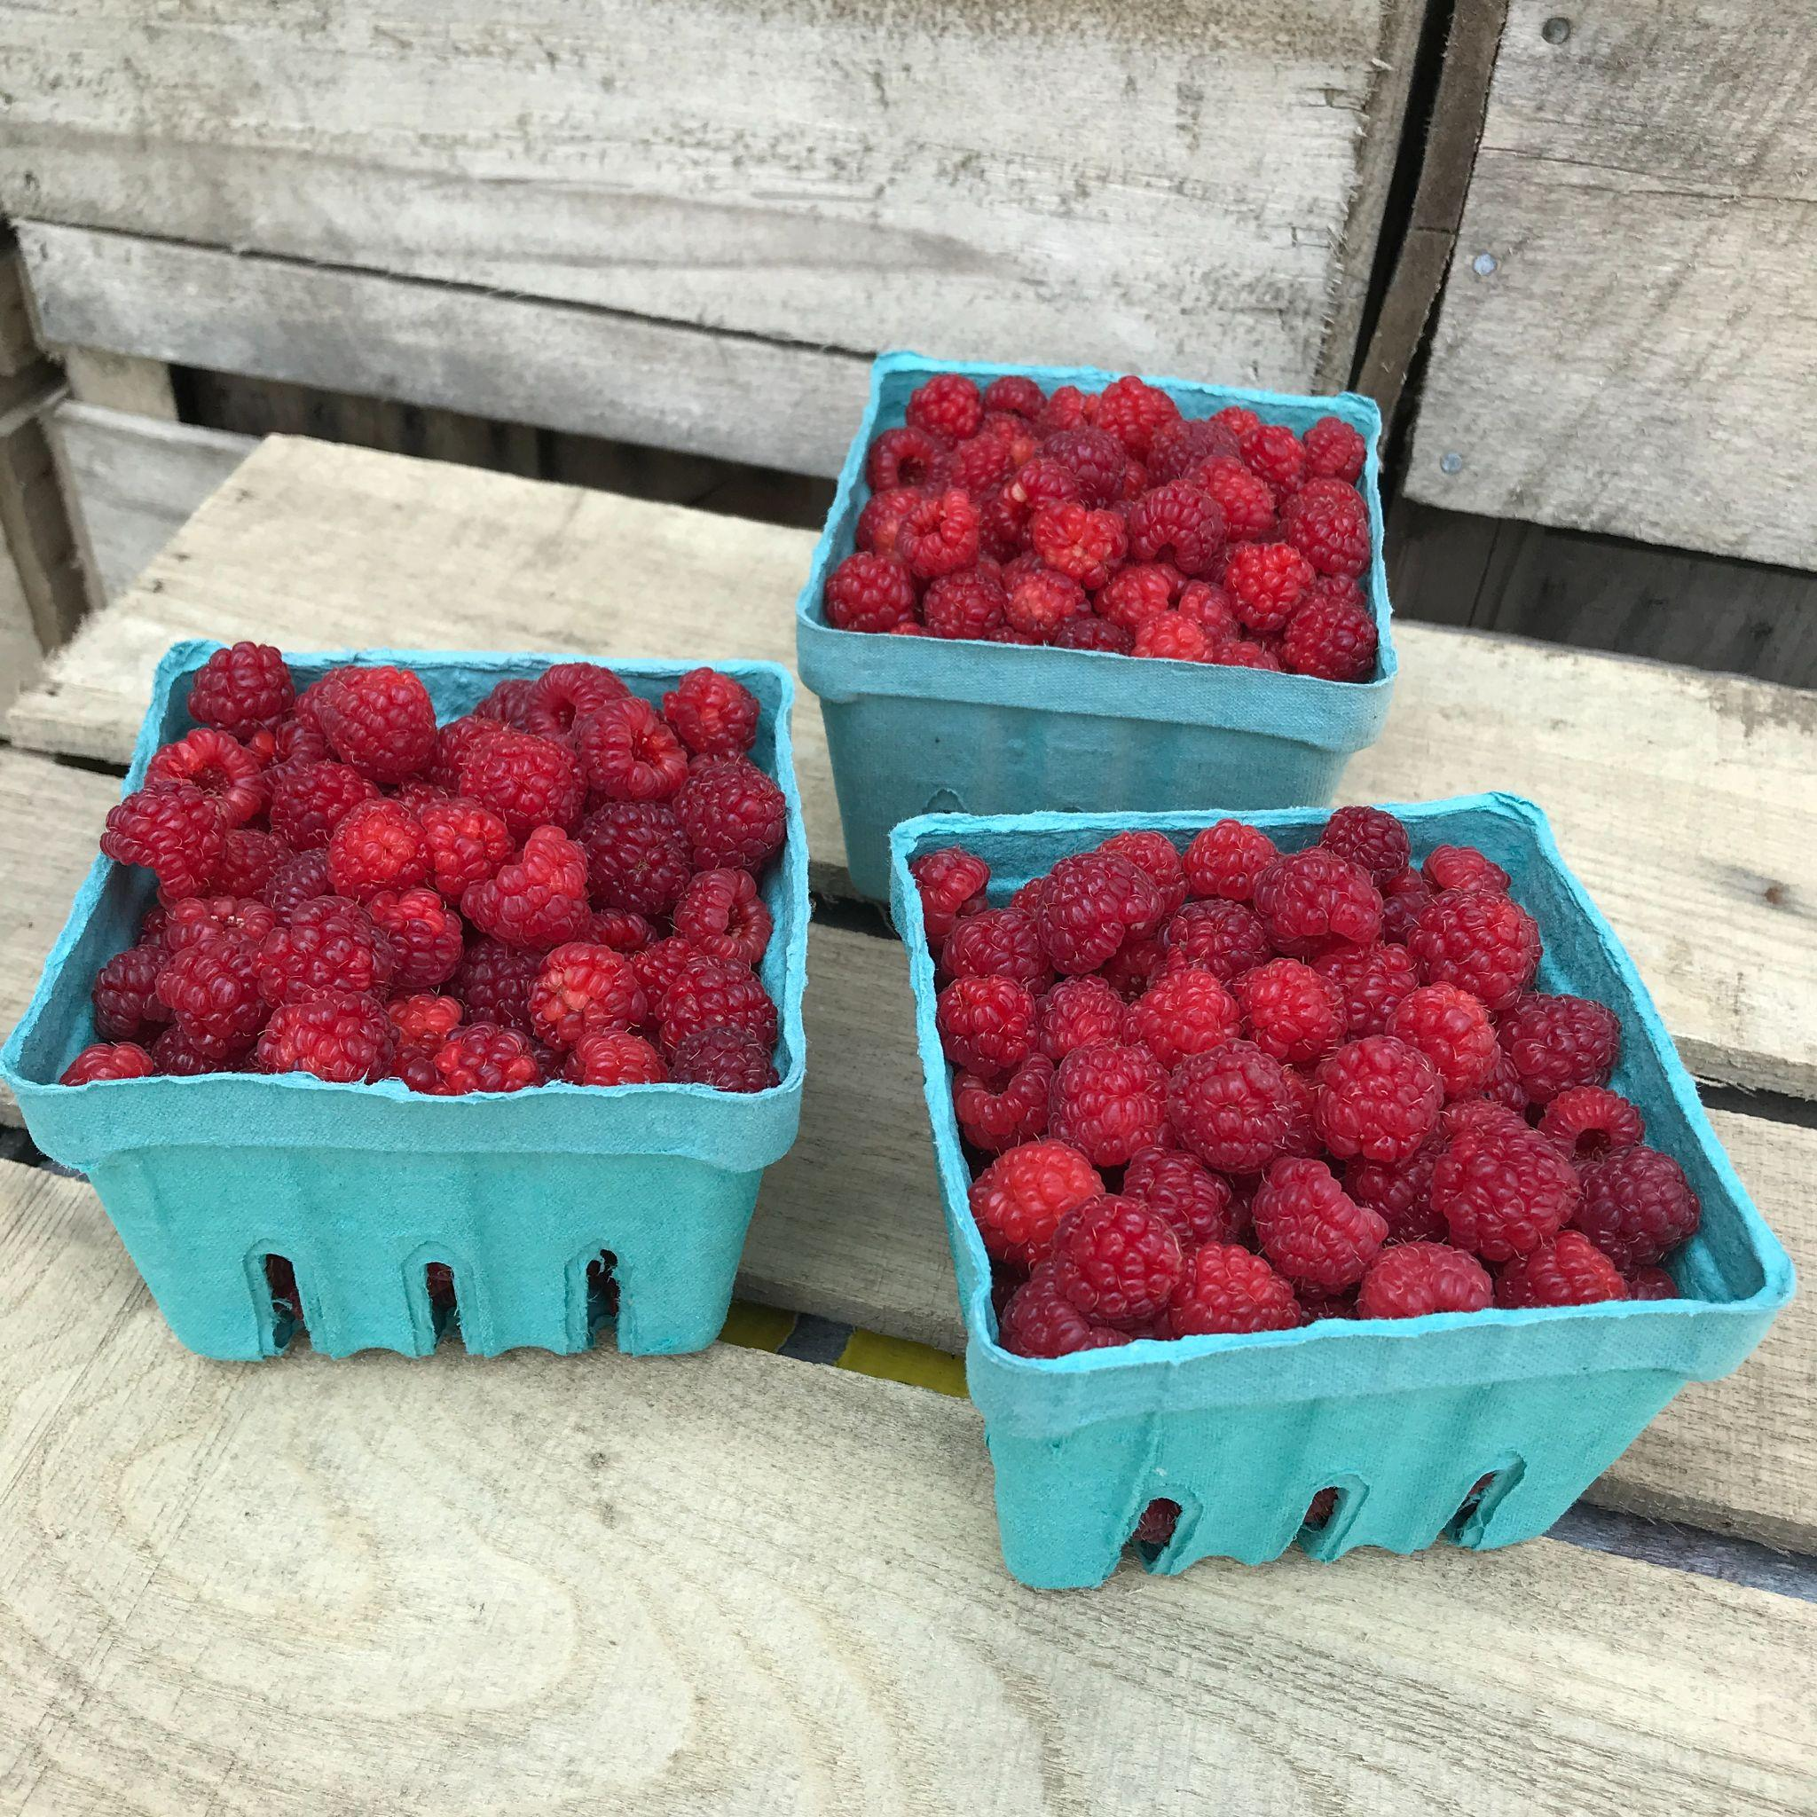
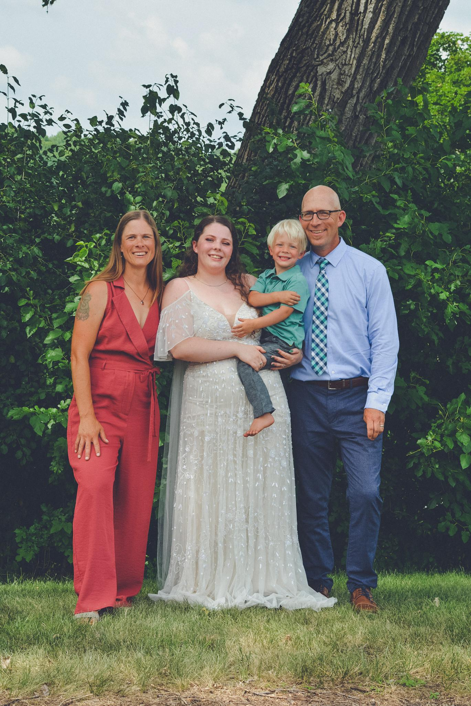
Who will use DWGs: Diversified small family farms
Notes:
Alternative Roots Farm has been a partner in RSDP’s DWG work for 6 years. Their early version Deep Winter Greenhouse has allowed their farm to generate revenues year-round.

Slide 6
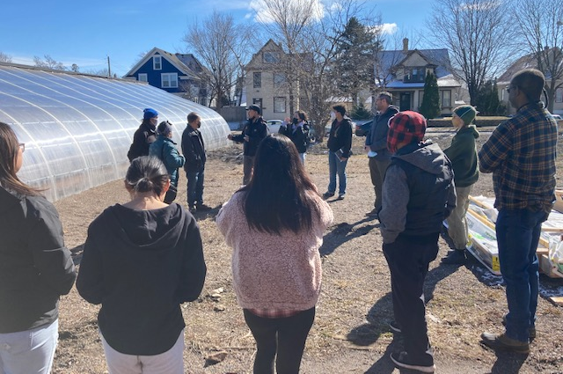
Who will use DWGs: Emerging Farmers
Notes:
Workshop with Minneapolis prototype with the Hmong American Farmer’s Association (HAFA)

Slide 7
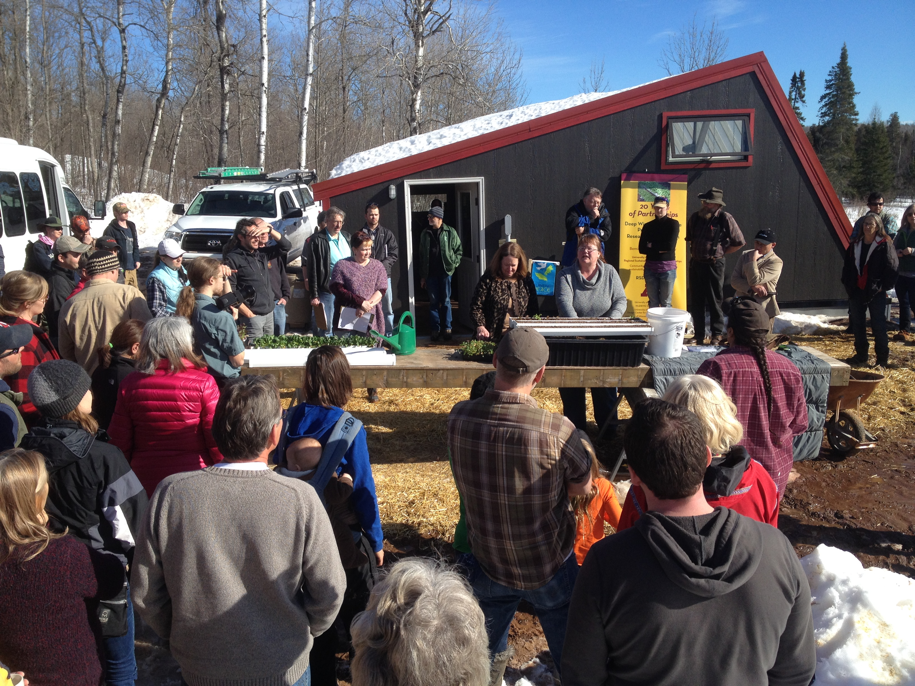
Why to expand program: Farm Scale DWG is ready for large scale deployment. To do that we need: 1. 6 demonstration facilities (operated by farmers) throughout MN 2. Research facility on campus 3. Staff for extension, research, outreach, maintenance, and student education
Economic output per winter greenhouse
Total sales (all plantings) | $14,138
Total operating costs (cost of seed, soil, and utilities) | $ 3,046
Net cash income from operations (Sales - operating costs) | $ 11,092
Annual ownership costs (assuming 20-year life) | $ 1,750
Net Revenue (Sales - operating and ownership costs) | $ 9,342
Notes:
The economics of the new Farm Scale DWG pencil out. (These figures are based on real-life experiences of DWG growers. The net revenues average to about $60/hour of labor at the scale of one FSDWG in operation for direct sale customers.
Extension RSDP’s work with the early DWG drew the interest of thousands in Minnesota, the Upper Midwest, Canada, and around the world.
We are positioned to work with farmers to demonstrate Farm Scale DWG to Minnesota and the world.

