Slide 1
The First 1,000 Days Matter: For Better or For Worse
Aaron Sojourner
Carlson School of Management
This research was supported by the Eunice Kennedy Shriver National Institute of Child Health & Human Development of the National Institutes of Health under Award Number P01HD065704. The content is solely the responsibility of the author and does not necessarily represent the official views of the National Institutes of Health. We also had support from the University of Minnesota Office of the Vice President of Research and Center for Urban & Regional Affairs.

Slide 2
People drive community success Wise investment in people can drive community success

Slide 3
Outline
Income-based gaps in skill open up early in life but are not inevitable
We ask the most when families have the least
New tools to understand MN families’ access to early care

Slide 4
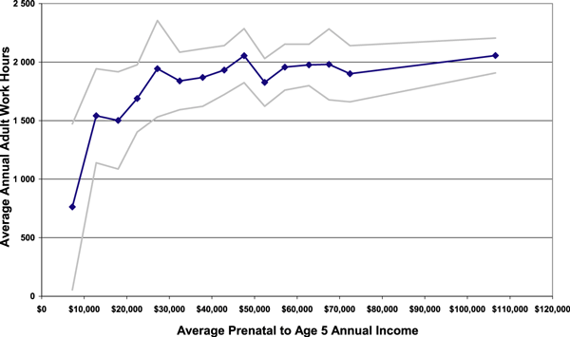
Early‐Childhood Poverty and Adult Employment
Child Development Volume 81, Issue 1, pages 306-325, 4 FEB 2010 DOI: 10.1111/j.1467-8624.2009.01396.x http://onlinelibrary.wiley.com/doi/10.1111/j.1467-8624.2009.01396.x/full#f2
Notes:
Adult work hours by early‐childhood income, with 95% confidence intervals.
© IF THIS IMAGE HAS BEEN PROVIDED BY OR IS OWNED BY A THIRD PARTY, AS INDICATED IN THE CAPTION LINE, THEN FURTHER PERMISSION MAY BE NEEDED BEFORE ANY FURTHER USE. PLEASE CONTACT WILEY'S PERMISSIONS DEPARTMENT ON PERMISSIONS@WILEY.COM OR USE THE RIGHTSLINK SERVICE BY CLICKING ON THE 'REQUEST PERMISSION' LINK ACCOMPANYING THIS ARTICLE. WILEY OR AUTHOR OWNED IMAGES MAY BE USED FOR NON-COMMERCIAL PURPOSES, SUBJECT TO PROPER CITATION OF THE ARTICLE, AUTHOR, AND PUBLISHER.

Slide 5
Income-based gaps open early & stabilize
Council of Economic Advisers (2016) Economic Report of the President: Chapter 4

Slide 6
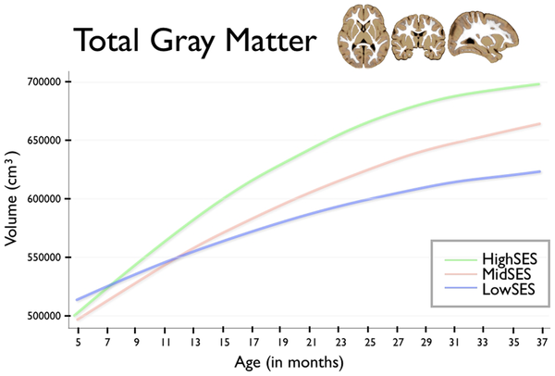
Income-based gaps open early (1)
Hanson JL, Hair N, Shen DG, Shi F, et al. (2013) Family Poverty Affects the Rate of Human Infant Brain Growth. PLoS ONE 8(12): e80954. doi:10.1371/journal.pone.0080954
http://www.plosone.org/article/info:doi/10.1371/journal.pone.0080954

Slide 7
Better early experiences can break these relationships

Slide 8
An experiment
The Infant Health & Development Program (IHDP) recruited a sample at birth and randomly assigned a treatment.
[Brooks-Gunn et al, 1994; McCarton et al, 1997; Gross et al, 1997]
Age 0-1: weekly home visit from staff
Age 1-3: child eligible for child development center (CDC)
Free
Full-day
High-quality, Abecedarian curriculum
Free transportation

Slide 9
The experimental sample (N = 985): IHDP
Ethnically and economically diverse sample but only included children born:
Low-birth weight (≤ 2.5 kg = 5.5 lbs)
Premature (≤ 37 wks)
In one of 8 research hospitals.
Starting January 7, 1985 until fully enrolled
Control = 608; Treatment = 377.

Slide 10
High LBW: little effect on “IQ” at start of child-care intervention
Average in control group
Duncan & Sojourner (2013) Journal of Human Resources : using ECLS-B weights

Slide 11
During child-care intervention: enormous effects on IQ measures
What do you think effects will be at:
Age-5?
Age-8?
Ag-18?
Average in control group
Duncan & Sojourner (2013) Journal of Human Resources : using ECLS-B weights

Slide 12
2 years after intervention end: large, positive effect at school-entry
Average in control group
Duncan & Sojourner (2013) Journal of Human Resources : using ECLS-B weights

Slide 13
5 years after intervention end: large, positive effect
Average in control group
Duncan & Sojourner (2013) Journal of Human Resources : using ECLS-B weights

Slide 14
15 years after intervention end: evidence of persistence
What do you think effects will be for higher-income?
Average in control group
Duncan & Sojourner (2013) Journal of Human Resources : using ECLS-B weights

Slide 15
For higher-income, effect on IQ trends much weaker
Average in same-income control group
Duncan & Sojourner (2013) Journal of Human Resources : using ECLS-B weights

Slide 16
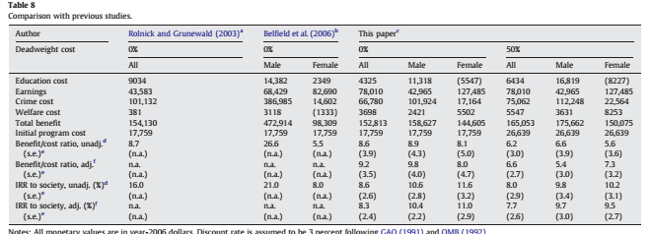
Returns can exceed those to stock market (5.8% since WW2)
Heckman et al (2010)

Slide 17
8% is much more than double 6%

Slide 18
Human capacities develop through process: Early experiences have lifelong consequences

Slide 19
2. We ask most when families have least
Least private resources early
Most private responsibility early

Slide 20
Current earning power

Slide 21
Access to future income

Slide 22
Least public investment in youngest: public expenditure per child
Notes:
Existing public policies provide the smallest investments when children are youngest

Slide 23
Publicly-financed care & education: 5 hours/child-wk under age 5
Notes:
Publicly-financed early care and education programs provide care for only about 5 hours per week on average for children under age 5.

Slide 24
No way to do it cheaply & well: parent’s income or another adult

Slide 25
What else could we possibly expect?
Crises in child care market
Shortages: not enough slots
Unaffordable: Prices too high & slots too far for families
Staff turnover or exits: child care workforce instability
Closings: weak incentives for suppliers to operate
Crises in young families’ budgets
Hard for parents to work or afford to stay home

Slide 26
Similar trends in Greater MN & Metro Family child care ↓, Centers & public ↑

Slide 27
Exits of family child care not just in MN
https://www.minneapolisfed.org/publications/fedgazette/child-care-availability-raises-concerns

Slide 28
Where are families with most need for better access to ECE services?
Family-centered view of the ECE market
Low access to ECE services marked by:
High costs: high prices and long travel times
Low quantity of services relative to presence of young children
Low quality
Proper diagnosis supports proper remedy.

Slide 29
Family Access Reports by community

Slide 30
Dimensions of ECE investment policy
 | CCAP | ELS | Head Start | VPK/SR
Ages | 0-4 | 3-4 | 0-4 | 3-4
Incomes | Low | Low | Low | Any
Prices to family | Co-pay | Co-pay | Free | Free
Delivery | Mixed | Mixed | Contractor | Schools
Quality assurance | Regs | Regs + Parent Aware | Perf. standards | School districts

Slide 31
Wrapping up
Early experiences have lifelong consequences. A scarce investment opportunity, not burden.
We ask the most of families when they have the least. Crises are entirely predictable.
Better analysis can improve decisions about where to invest private & public resources.

Slide 32
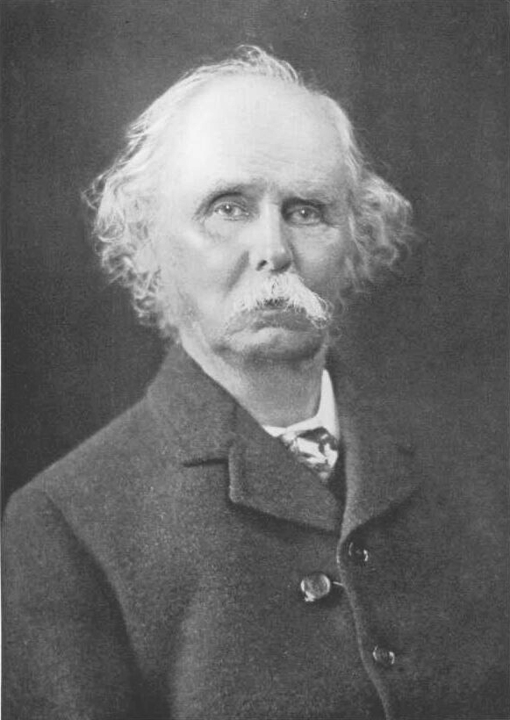
Thank you!
asojourn@umn.edu
The most valuable of all capital is that invested in human beings.
- Alfred Marshall, Principles of Economics

Slide 33
Appendix

Slide 34
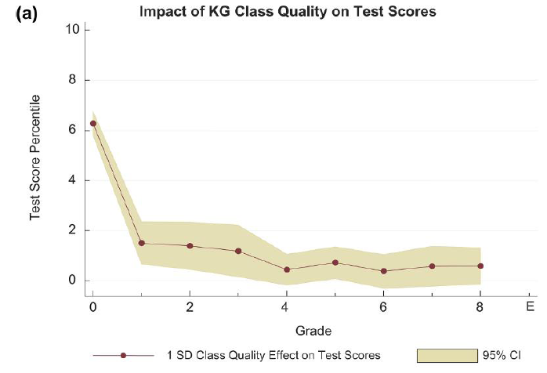
2. What about test-score fade-out?
Chetty et al (2013) How does your kindergarten classroom affect our earnings? Quarterly Journal of Economics

Slide 35
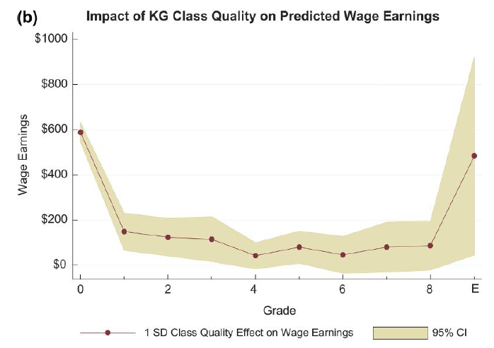
Earnings impacts despite score fade-out
Chetty et al (2013) How does your kindergarten classroom affect our earnings? Quarterly Journal of Economics

Slide 36
Income-based input gap opens early too
Hart & Risley (2003)

Slide 37
Trends for centers differ by state
https://www.minneapolisfed.org/publications/fedgazette/child-care-availability-raises-concerns

