Slide 1
Water Contamination Issues in SE Minnesota Karst Lands
E. Calvin Alexander Jr.
Morse-Alumni Professor Emeritus
Earth Sciences Department
University of Minnesota
Notes:
Legislative Water Commission on point on a lot of issues

Slide 2
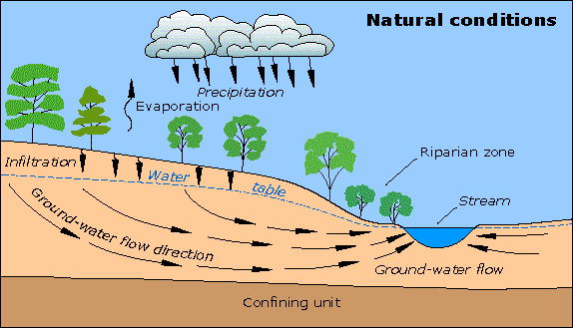
Groundwater
Source/well head protection
Nitrate
Viruses
Declining levels (overuse, climate, lack of recharge)
Groundwater flow in Minnesota Karst Lands are much more complex and rapid than the current conceptual and mathematical models imply.
Notes:
We take groundwater, drink it/flush toilets with it, the send it to WWTP and the river == not sustainable.

Slide 3
Minnesota Karst Lands
Karst forms in areas with soluble bedrock – limestone, dolomite and sandstones

Slide 4
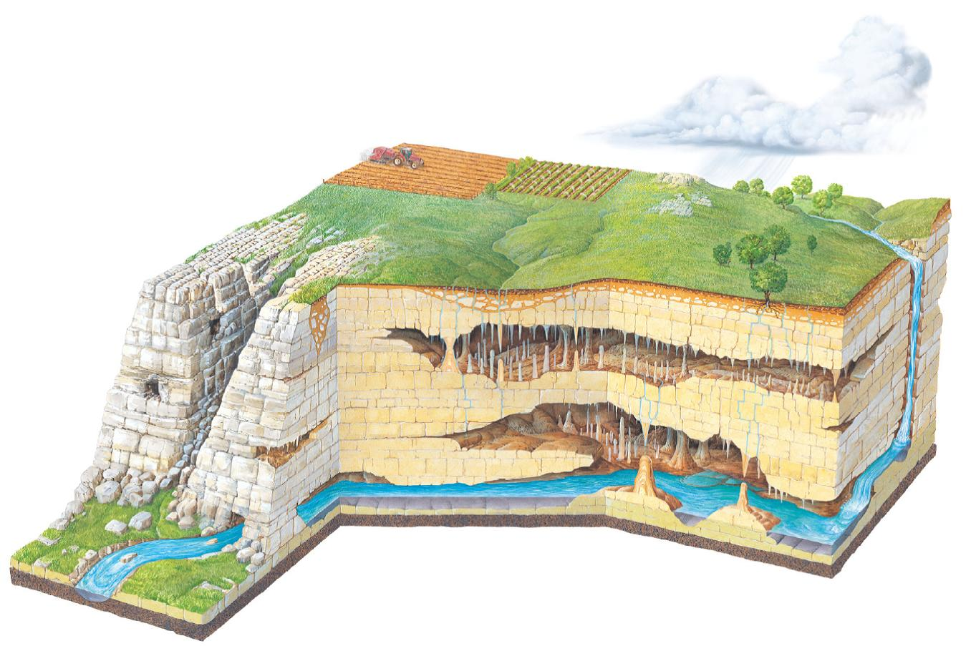
Water Movement in SE Minnesota Karst
Lascu & Feinberg (2012)

Slide 5
Triple Porosity Aquifers
1 – Channels or Conduits (rapid flow), 2 - Fractures, 3 – Matrix (storage)

Slide 6
The next five slides are modified from research presented by Runkel et al. at the Minnesota Geological Survey.

Slide 7
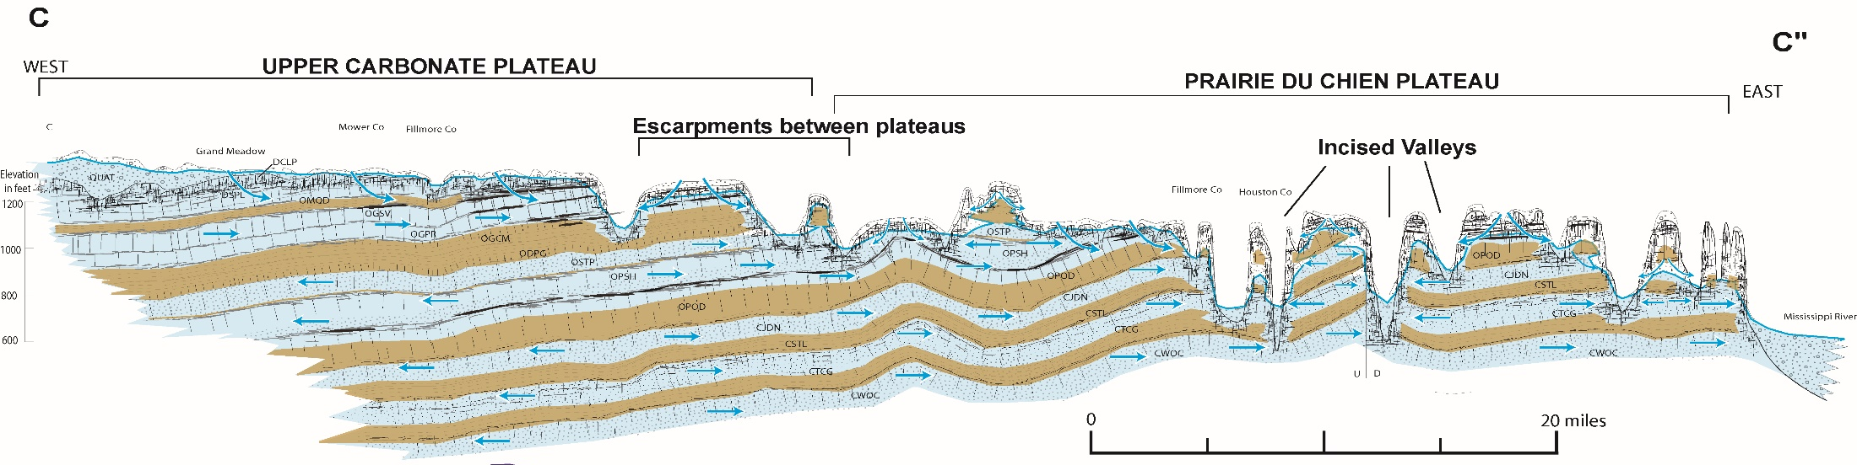
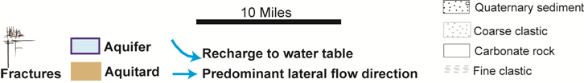
SE MN Regional Hydrostratigrapic Framework
Fracture & Conduit dominate flow – velocities up to miles per day.
Very rapid recharge through heavily fractured uppermost bedrock, sinkholes and macropores.
Stacked layer of aquifers and aquitards.
Rapid lateral flow especially along horizontal “fractures”.
Slower downward recharge to deeper aquifers through leaky aquitards.
Overall flow east toward the Mississippi River, but more complex locally.

Slide 8
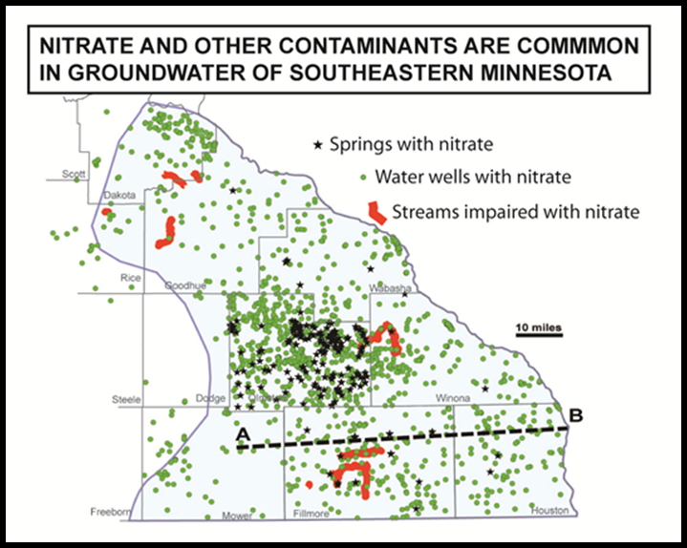
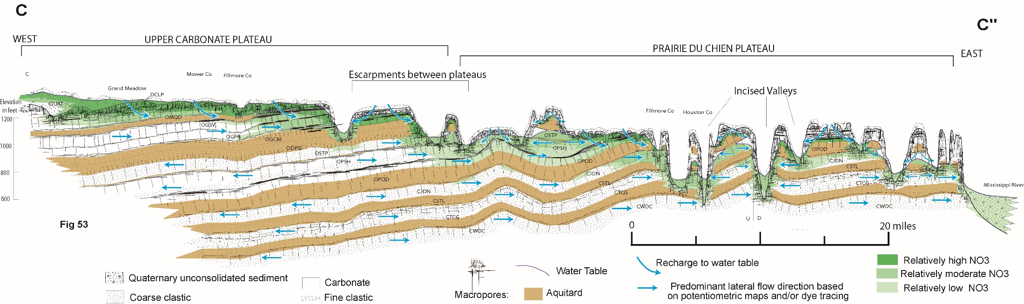
Generalized, regional Nitrate-N Contamination
Nitrates are rapidly transported to upper bedrock aquifer in this fractured karst system – time scales of minutes to hours.
Herbicides, pesticide, bacteria and viruses often accompany the nitrates.
Upper most bedrock aquifers contaminated with 5-15 ppm nitrate-N and new water wells can no longer be developed in the near surface aquifers.
Deeper aquifers recharge from the shallow aquifers and are showing increasing levels of pollution.

Slide 9
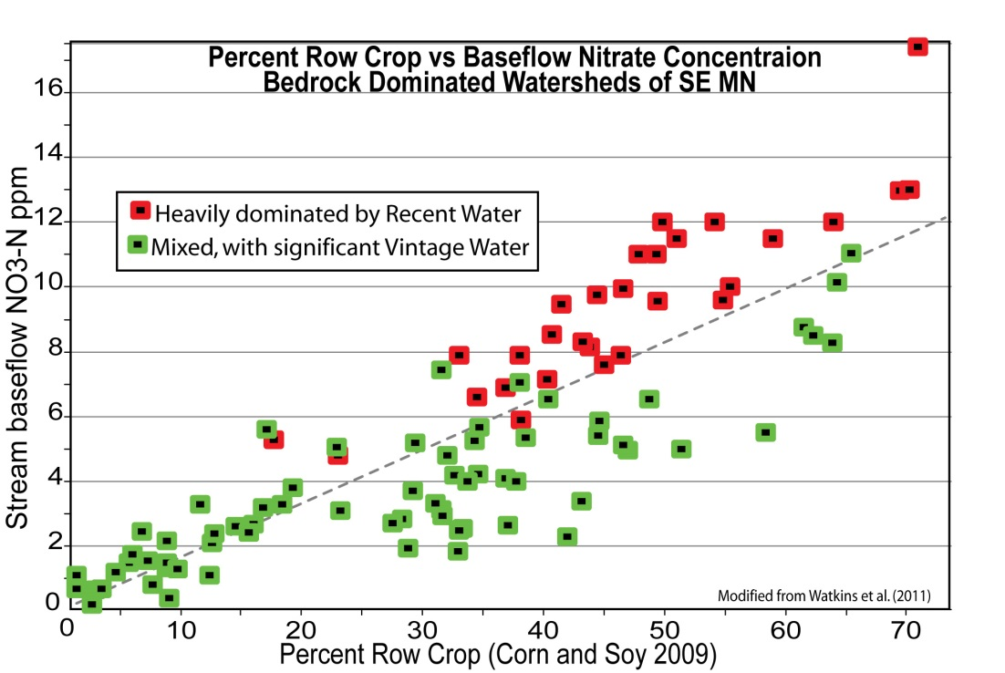
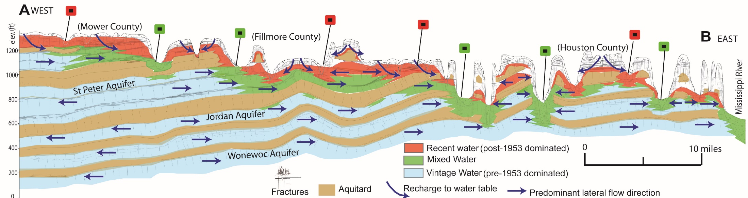
Nitrate-N Levels and Row Crop Agriculture.
Nitrate-N levels in surface streams and springs are strongly correlated with the fraction of the watershed in row crop agriculture.
Mixing with deeper, longer residence time groundwater and account for much of the scatter in the correlation.
This has implications for the pace at which various parts of the system respond to land use practice changes.

Slide 10
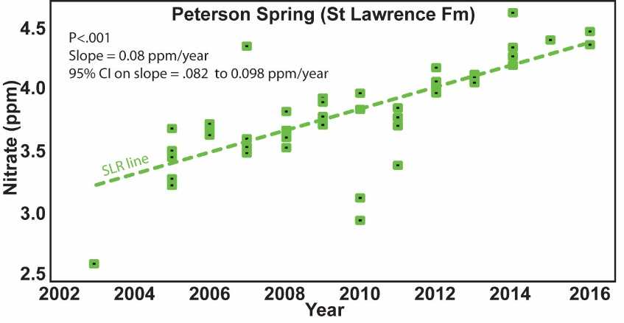
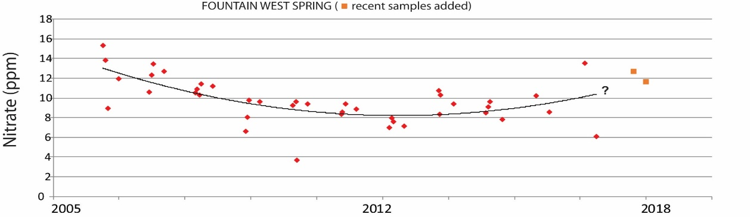
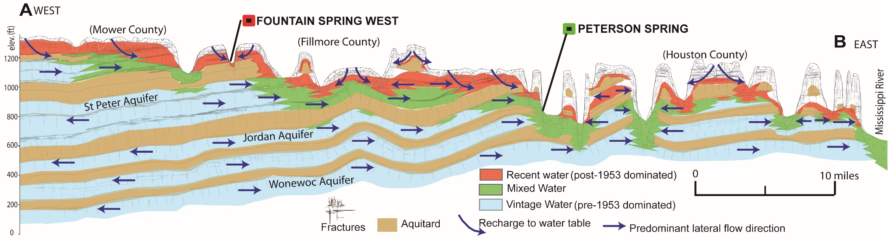
Which Decade Is Being Monitored ?
Peterson Spring drains the Jordan Sandstone and its nitrate is low but linearly increasing with time.
Fountain West Spring drains the Galena Limestone and it nitrate is high and varies a lot in response to individual recharge events and wet or dry years.
MDA data

Slide 11
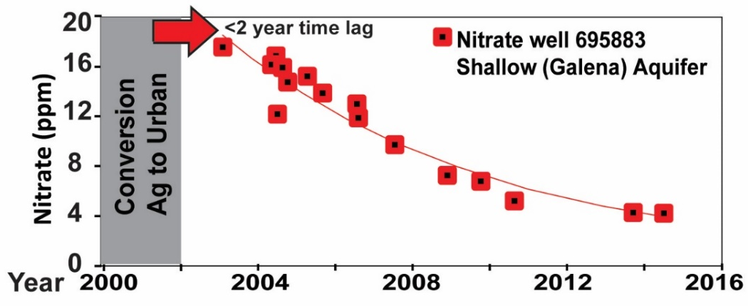

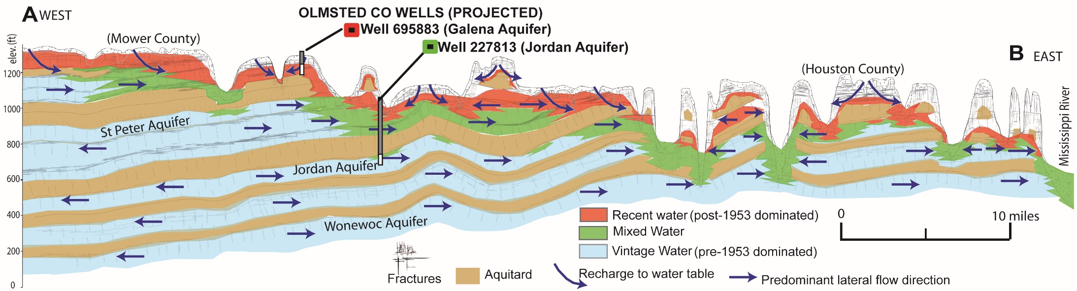
Time Lags in Nitrate and Sulfate Trends in Well Water
Rochester Area, Olmsted County
Stonehedge Development – conversion from Ag to Urban land use.
2 year time lag followed by rapid decrease in Nitrate-N in a shallow (Galena Formation) bedrock aquifer.
Response to environmental loading changes show an approximately 40 year lag time for pollutants in a pumped municipal in a deep (Jordan) aquifer.
Factor of 6 increase in nitrogen fertilizer application rates in the 1960.
50% increase in the sulfur emmisions – from power plants and factories burning coal.

Slide 12
Observations
Shallow ground (and surface) waters in Minnesota Karst Lands are highly susceptible to contamination from human activities on the land surface.
In Southeast Minnesota Karst Lands the major source of pollutants is agriculture.
In the greater Metro area Karst Lands the major sources of pollutants are industrial and urban.
Shallow aquifers are polluted on time scales as short as minutes to days.
Deeper aquifers recharge on longer time scales are being polluted as increased pumping accelerates recharge from the shallower aquifers.

Slide 13
Many of the models and rules and regulations based on those conceptual and computer models do not adequately describe the rapid and highly variable movement of surface and ground waters in karst regions.

