Slide 1

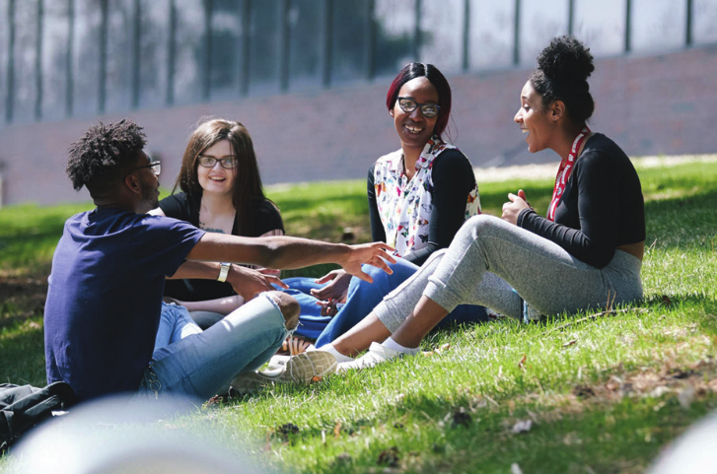
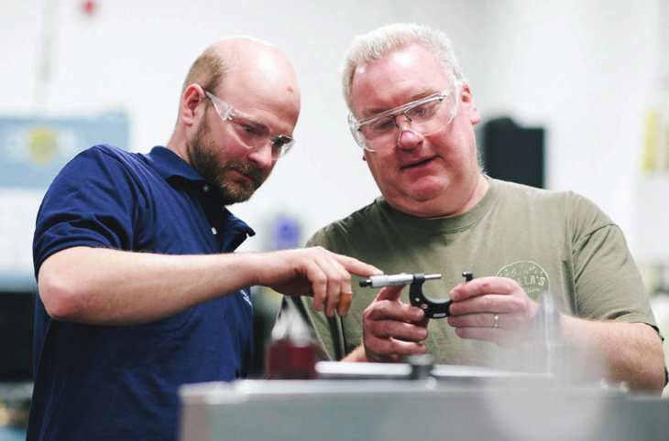
January 15, 2019

Slide 2
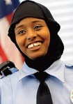

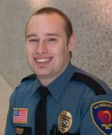
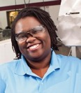
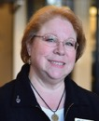
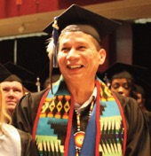

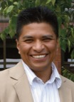


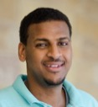
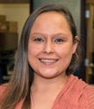

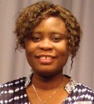
Minnesota State Vision
It is the core value of the Minnesota State Colleges and Universities to provide an opportunity for all Minnesotans to create a better future for themselves, for their families, and for their communities.

Slide 3
Overview of today’s discussion
Minnesota State: Vision
Vision Mission Goals
Governance Commitments Commitments
Who we are Who we serve Accountability Measures
Workforce Challenges & Opportunities

Slide 4
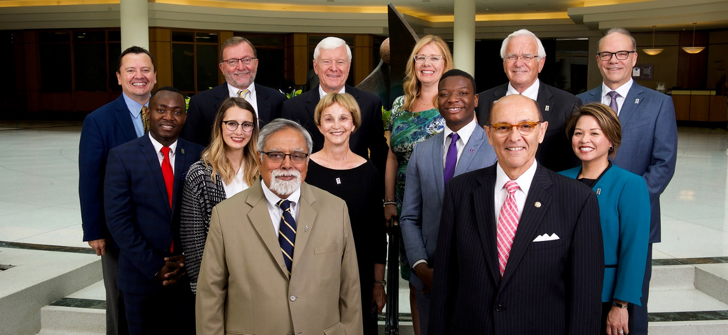
Governance
Minnesota State: Vision
15 member Board of Trustees
Appointed by Governor and confirmed by Senate
8 Trustees from Congressional districts;
4 at-large (6-year terms)
3 student Trustees (2-year terms)
Minnesota State Trustees: Abdulrahmane Abdul-Aziz; Ashlyn Anderson; Alex Cirillo; Jay Cowles, Vice Chair; Dawn Erlandson; Robert Hoffman; Jerry Janezich; Roger Moe, Treasurer; April Nishimura; Rudy Rodriguez; George Soule; Louise Sundin; Cheryl Tefer; Michael Vekich, Chair; Samson Williams

Slide 5

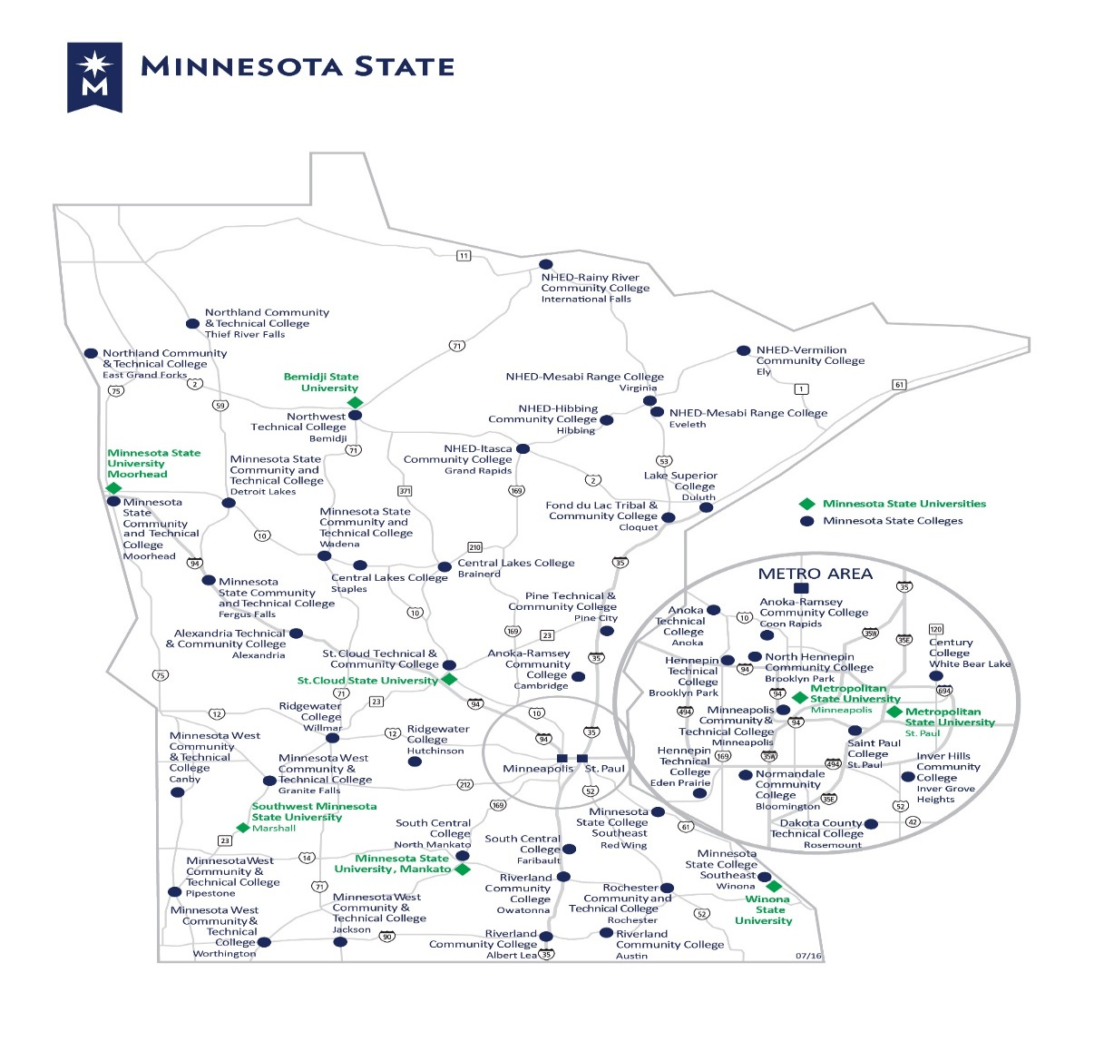
Minnesota State: Vision
We Are
375,000 Students annually
245,000 in credit classes
100,000+ in non-credit programs
59% in greater Minnesota
120,000 from underrepresented groups
43,900 first generation students
9,200 veterans
37 Colleges and Universities with
54 Campuses
7 universities
30 colleges
47 Communities across the State
From International Falls to Worthington
Enrollment ranges from 482 to 17,581 FYE

Slide 6
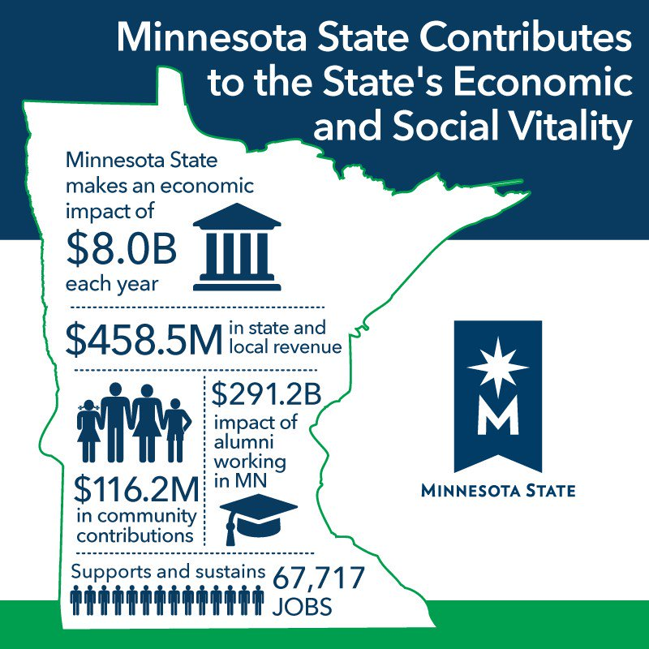
Minnesota State: Vision

Slide 7
Minnesota State Mission
The core commitments of Minnesota State Colleges and Universities are to:
ensure access to an extraordinary education for all Minnesotans
be the partner of choice to meet Minnesota’s workforce and community needs
deliver to students, employers, communities and taxpayers the highest value/most affordable higher education option

Slide 8
We are committed to:
Minnesota State: Mission
The success of our students and the changing needs of learners – the very people who will be the workforce of tomorrow
Diversity, equity and inclusion as we respond to a demographic shift and welcome an increasing number of students from populations traditionally underserved by higher education
Financial and programmatic sustainability of our campuses

Slide 9
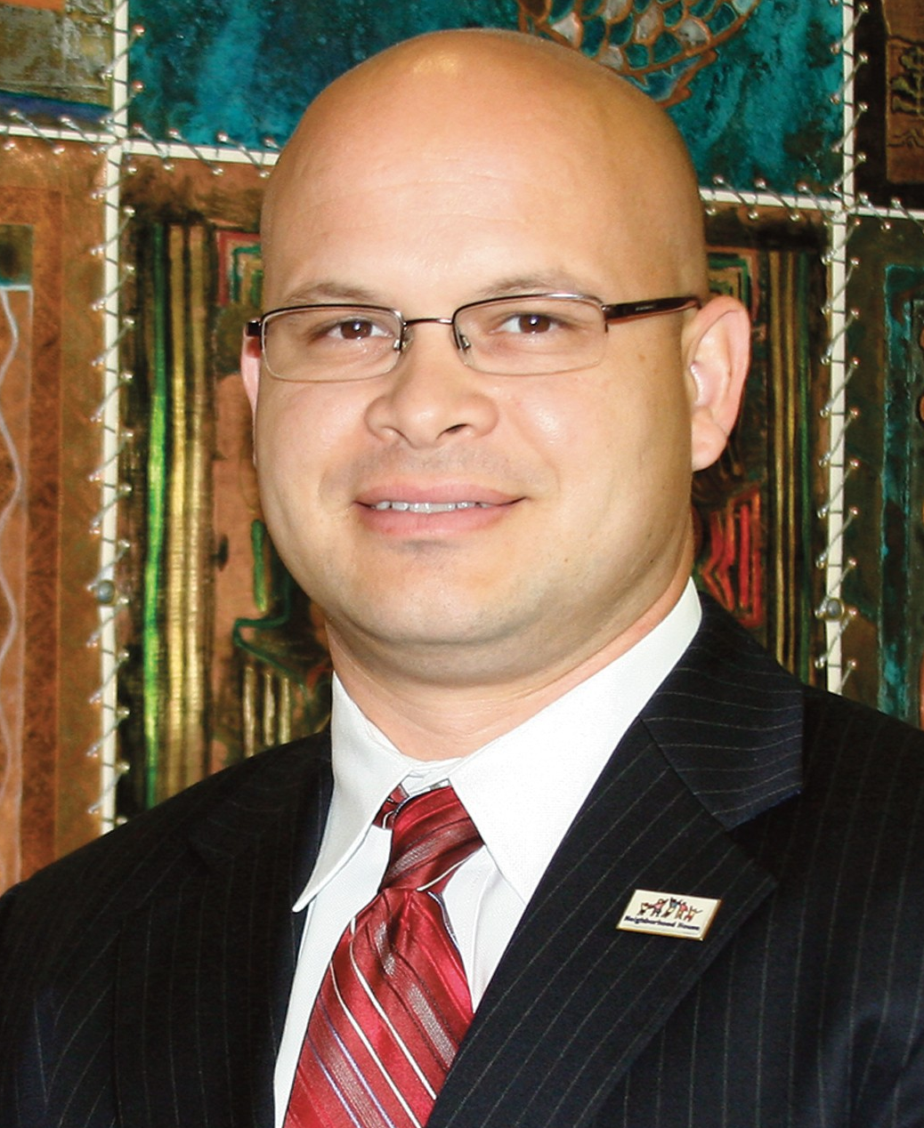


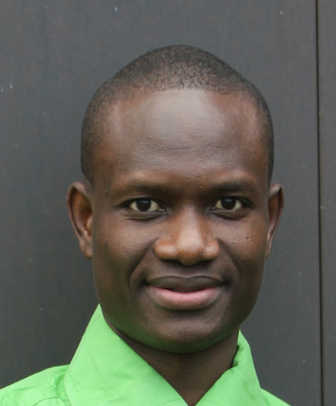
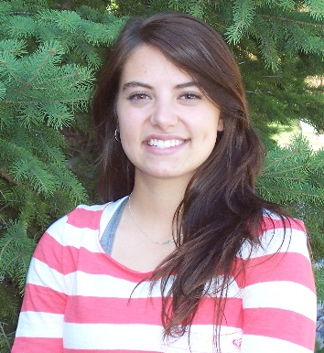
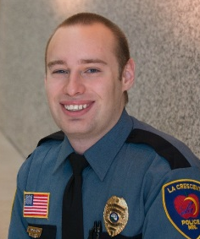
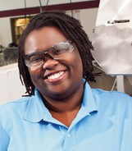
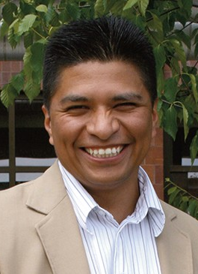
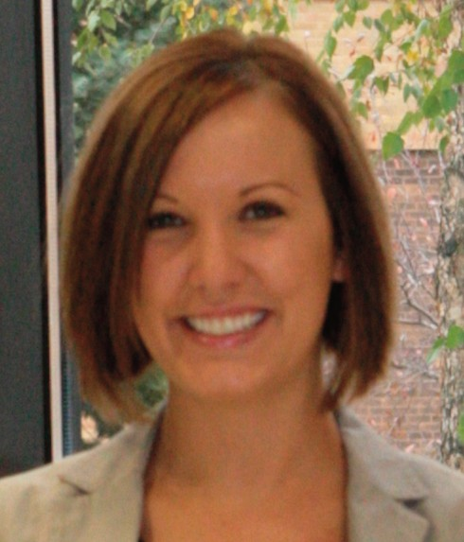
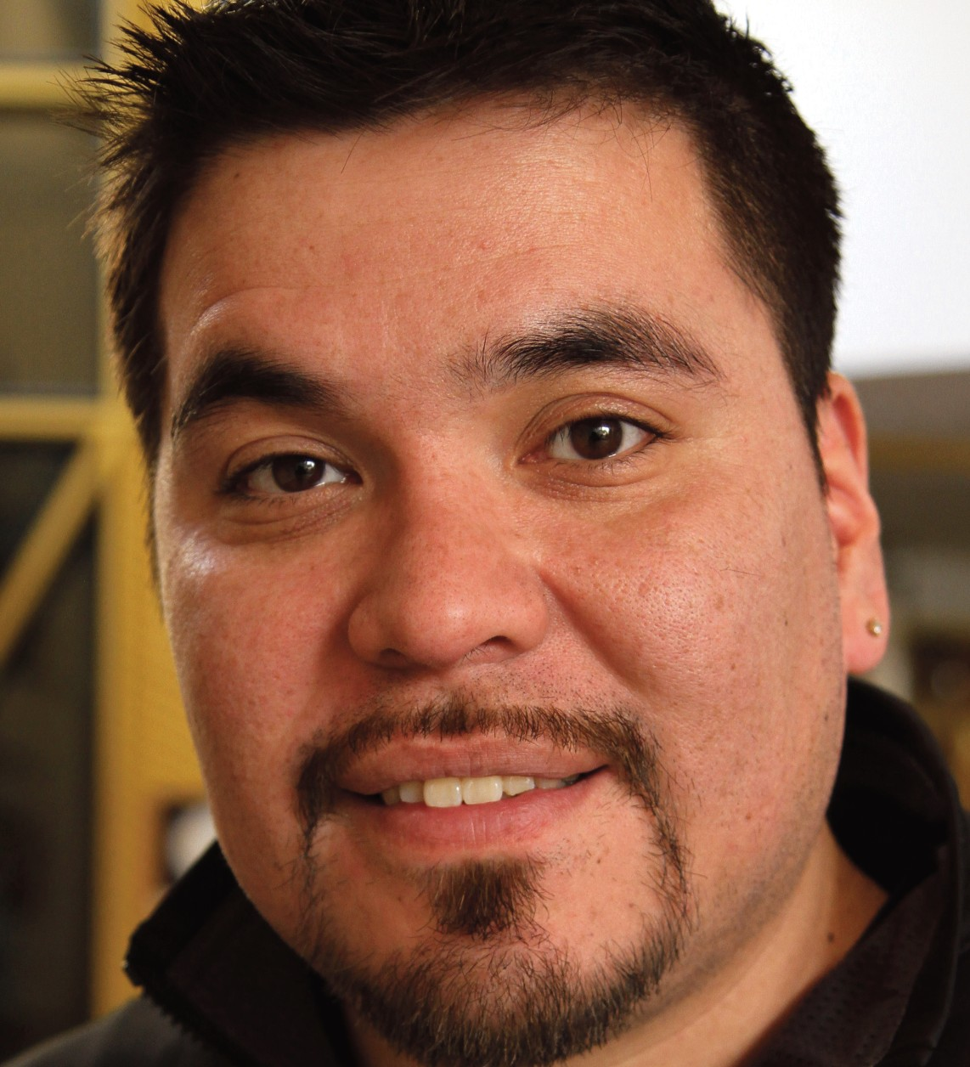

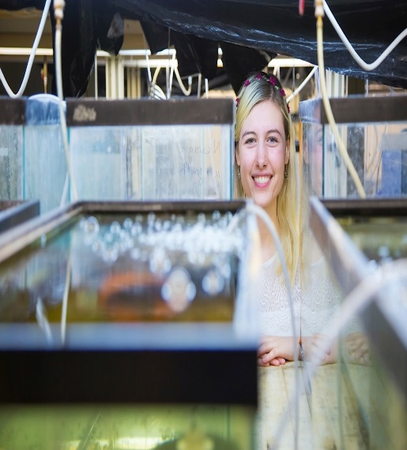
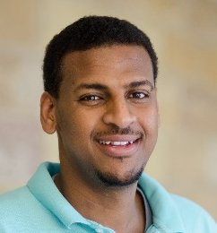

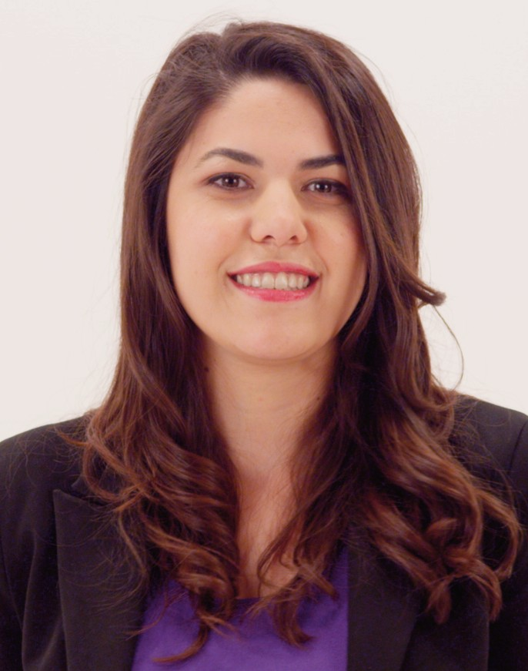
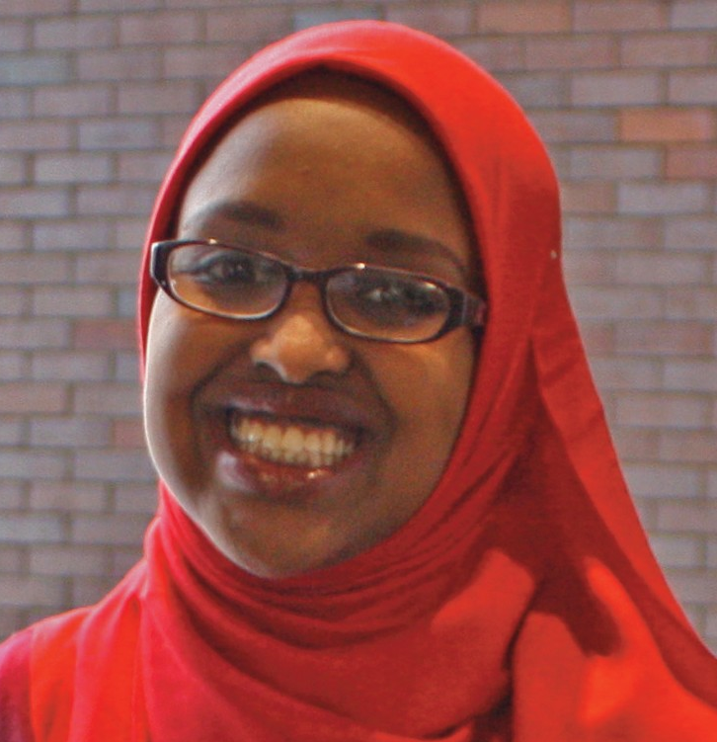

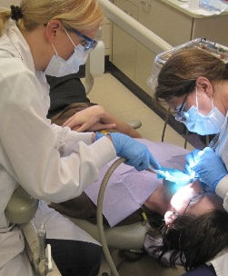
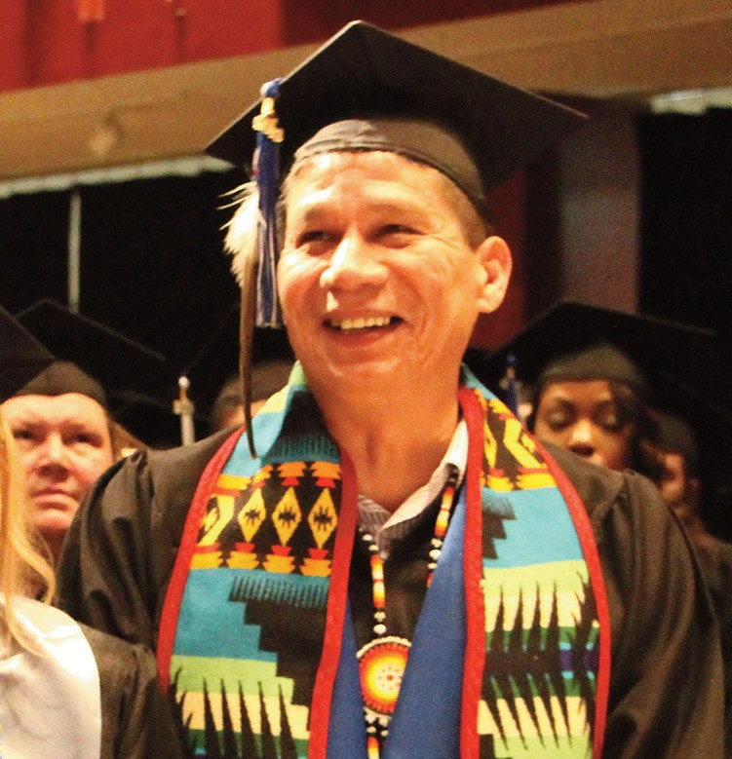
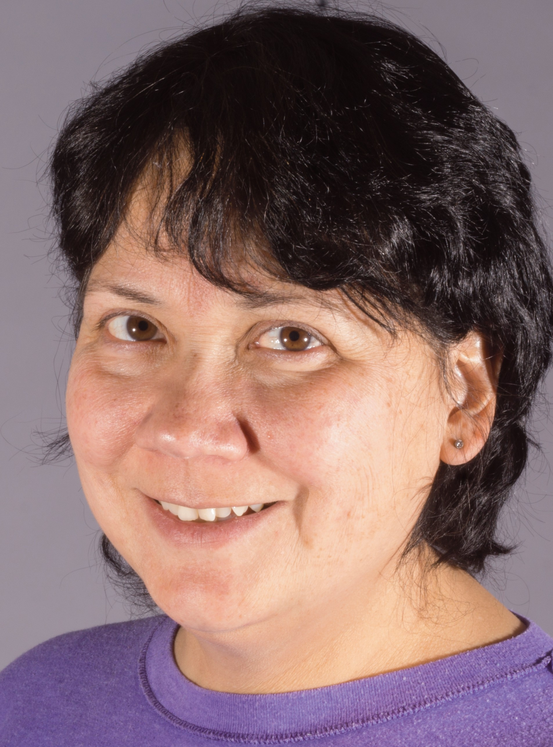
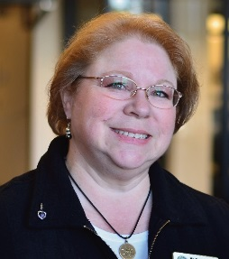

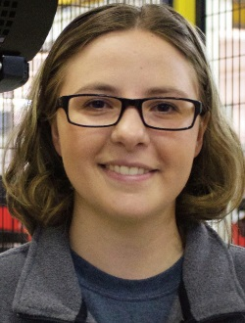
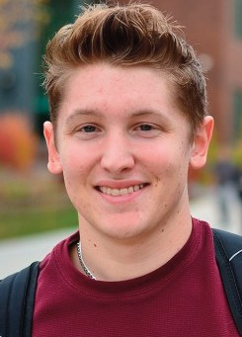
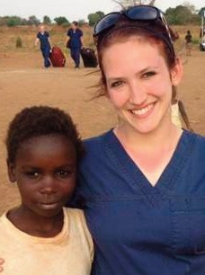

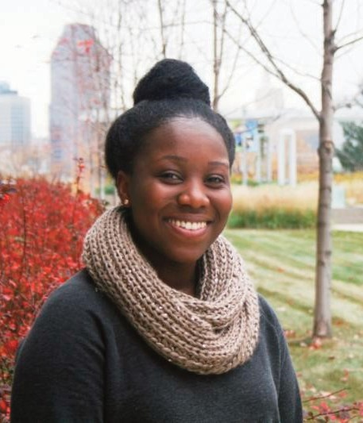

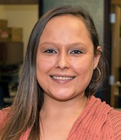
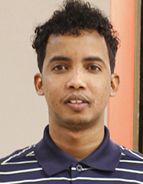
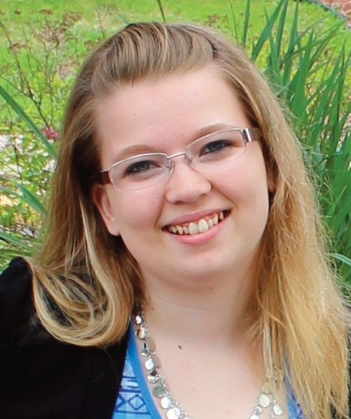
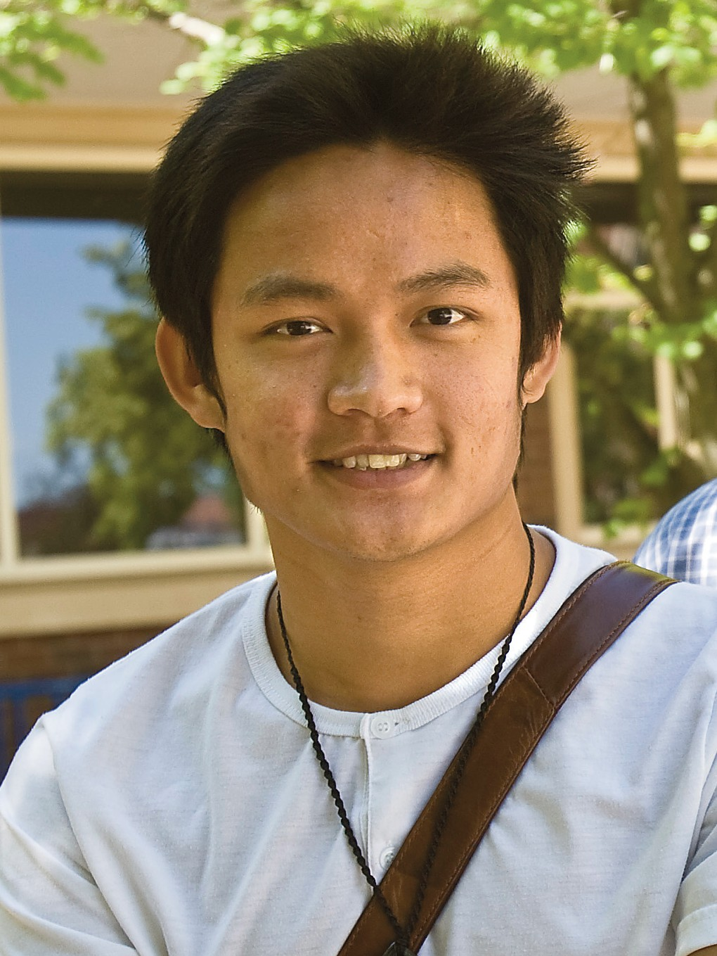
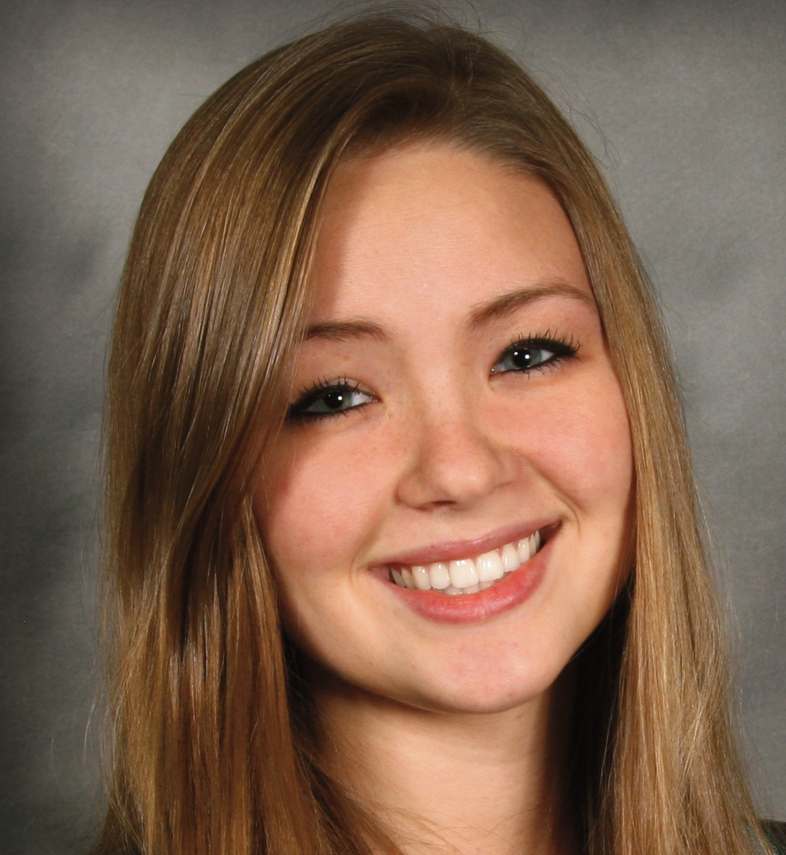

Our Students

Slide 10
Educating All of Minnesota
Minnesota State: Mission
Fiscal Year 2018
244,825 Credit Students
Twin Cities
42%
Central
12%
Northeast
7%
Southwest
Northwest
15%
Southeast
15%
9%
Source: System Office Research – Academic and Student Affairs

Slide 11
Minnesota State: Mission
Educating 58% of Minnesota’s Undergraduates

Slide 12
Only one-third of our students are traditional first time undergraduates
Minnesota State: Mission
Total Credit Headcount = 244,825
Fiscal Year 2018
Source: System Office Research – Academic and Student Affairs

Slide 13
Minnesota State: Mission
We educate the entire talent pipeline
39,000 graduates annually
3,800+ academic programs, from certificate to applied doctorate
683 programs entirely online
12,700+ students transfer from a system college to a system university
15,400+ customized/specialty/occupational and professional classes

Slide 14
Students of color and American Indian students comprise an increasing percentage of students
Minnesota State: Mission
Students of Color & American Indian: 2009 = 47,545 2018 = 65,799 Increase = 38.4%
Other Students: 2009 = 211,736 2018 = 179,026 Decrease = -15.4%
Source: System Office Research – Academic and Student Affairs
Notes:
.

Slide 15
Minnesota State: Mission
We educate…
9 out of 10 mechanics
9 out of 10 in manufacturing
8 out of 10 in law enforcement
2 out of 3 nurses
7 out of 10 in trades
6 out of 10 in agriculture
1/2 of all teachers
1/2 of IT professionals
1/2 of all business graduates

Slide 16
Minnesota State: Mission
Minnesota State Partnership Tour
By the numbers…so far
22 stops
August - November
67 legislators and staff
600+ attendees
What we heard:
Our colleges and universities are vital community partners and sources of innovation
Labor shortage pervasive – our industries need more graduates with the right skills
Affordability key to serving current and future students

Slide 17
We are committed to:
Minnesota State: Mission
The success of our students and the changing needs of learners – the very people who will be the workforce of tomorrow
Diversity, equity and inclusion as we respond to a demographic shift and welcome an increasing number of students from populations traditionally underserved by higher education
Financial and programmatic sustainability of our campuses

Slide 18


Goal: Student Success
Minnesota State: Goals
Joyce Ester, President

Slide 19

Goal: Diversity and Inclusion
Minnesota State: Goals
Scott Olson, President

Slide 20






Goal: Financial Sustainability
Minnesota State: Goals
Bill Maki, President

Slide 21
Minnesota State: Goals
Performance accountability
College and University Performance Measures
Access to an extraordinary education
Student Success
Affordability
Diversity
Community and workforce needs
Credentials awarded and job placement
Continuing education and customized training
High value and cost effectiveness
Efficient use of resources
Stewardship of resources
Development of new resources
Allocation Framework distributes state funds based on performance
Cost management
Improved student performance
Enrollment performance
Campus collaboration and cooperation

Slide 22
Minnesota State: Goals
We are the solution to Minnesota’s challenges
Technology
An educated workforce prepared for the jobs of the future
Demographic changes/changing student profile
Affordability
First generation
Working adults
More part-time attendance

