Slide 1
Department of Corrections Budget Overview
Commissioner Paul Schnell Chris Dodge, Chief Financial Officer
Notes:
Change the Minnesota logo to your agency logo

Slide 2
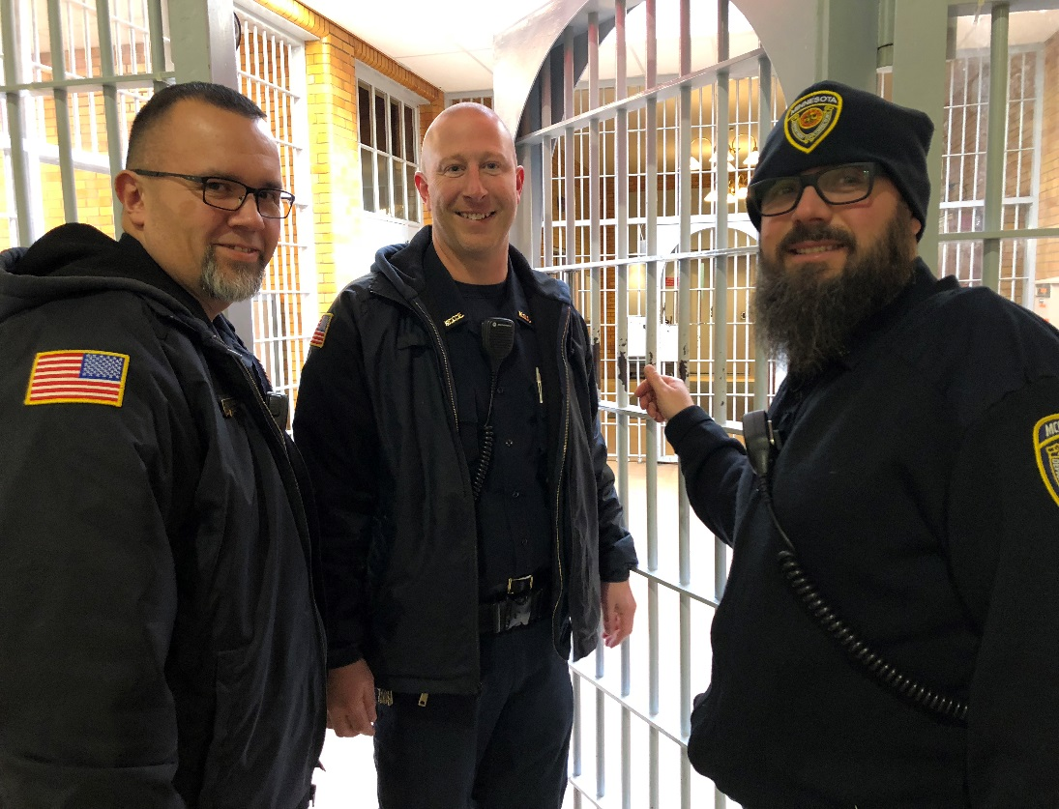
Department of Corrections
Mission: Reduce recidivism by promoting offender change through proven strategies during safe and secure incarceration and effective community supervision

Slide 3
Overview – FY2019 General Fund
Total DOC General Fund Budget $588.139M
Represents 2.5% of the State’s total general fund budget
96% General Fund

Slide 4
Overview – FY2019 General Fund

Slide 5
Responsible Budget Protecting Minnesotans
1. OPERATING ADJUSTMENT $28.336M
2. PRISON SECURITY AND SAFETY $45.282M
3. OFFENDER HEALTH CARE $ 8.383M
4. INTEGRATED CASE MANAGEMENT $ 2.304M
5. INTENSIVE SUPERVISED RELEASE $ 9.600M

Slide 6
BUDGET FOR ONE MINNESOTA
6. PRE-TRIAL ASSESSMENT AND SUPERVISION $ 8.175M
7. VICTIM NOTIFICATION AND JUVENILE CORRECTIONAL MANAGAMENT SYSTEM $ 2.300M
8. ELECTRONIC MONITORING AND TRANSITIONAL HOUSING $ 3.000M
9. CORRECTIONS OPIOD TREATMENT PROVISION $ 1.930M
10. REDUCING RECIDIVISM THROUGH CONNECTING FAMILIES AND REENTRY PROGRAMS $ 2.000M

Slide 7
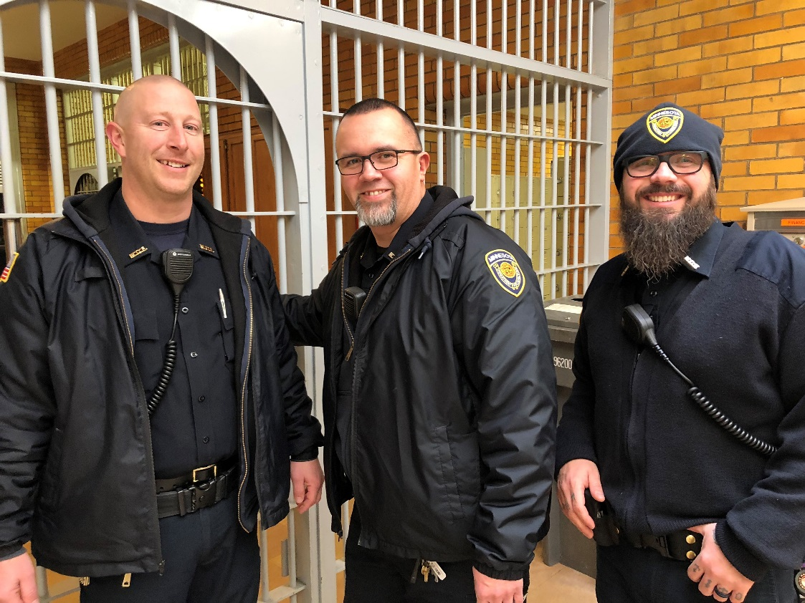
OPERATING ADJUSTMENT

Slide 8
OPERATING ADJUSTMENT
FY20 | FY21
$ 10.558M | $17.778M
Current funding levels do not support increased compensation costs. This increase will allow us to maintain our current operations. Without it, critical rehabilitative programming will be impacted and our ability to promote offender change for a safe and secure Minnesota will be diminished.
Operating adjustment includes:
Employer contributions for health insurance and pension funds
Federal and state tax obligations
Other salary and compensation-related cost increases

Slide 9
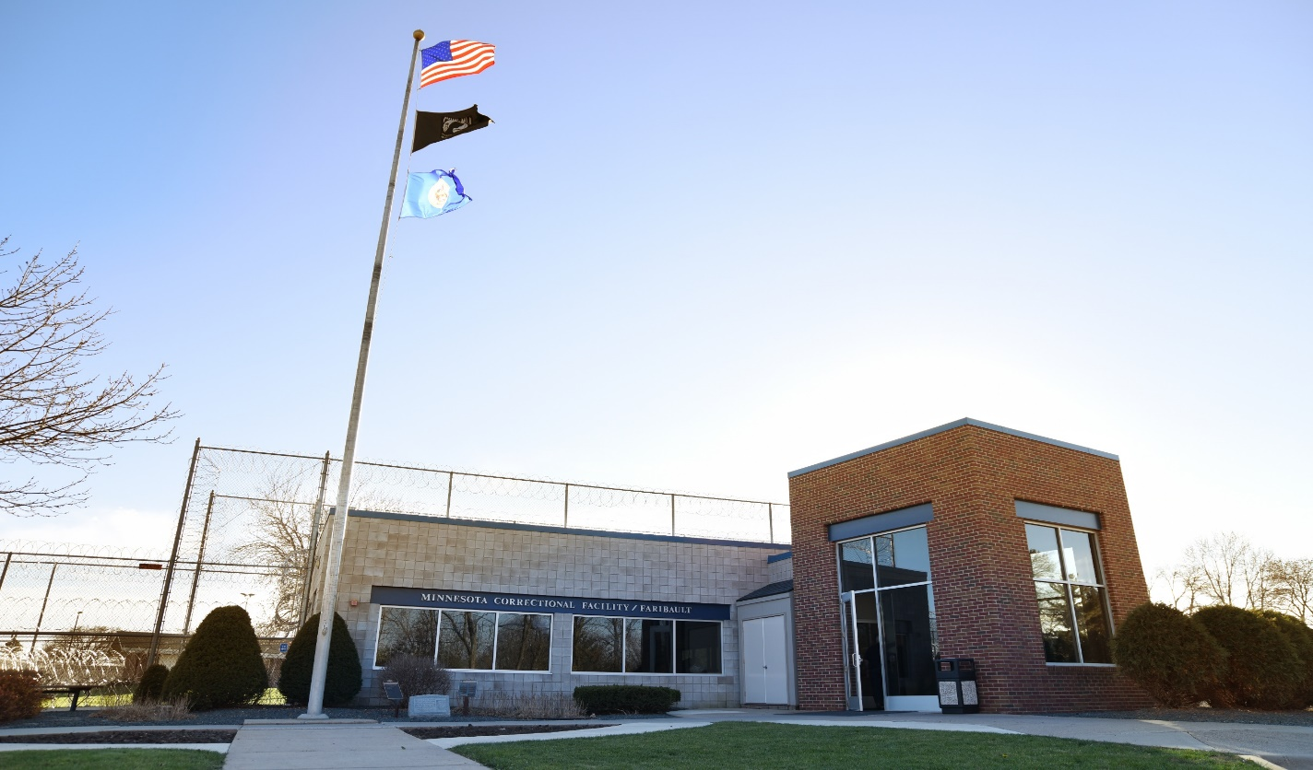
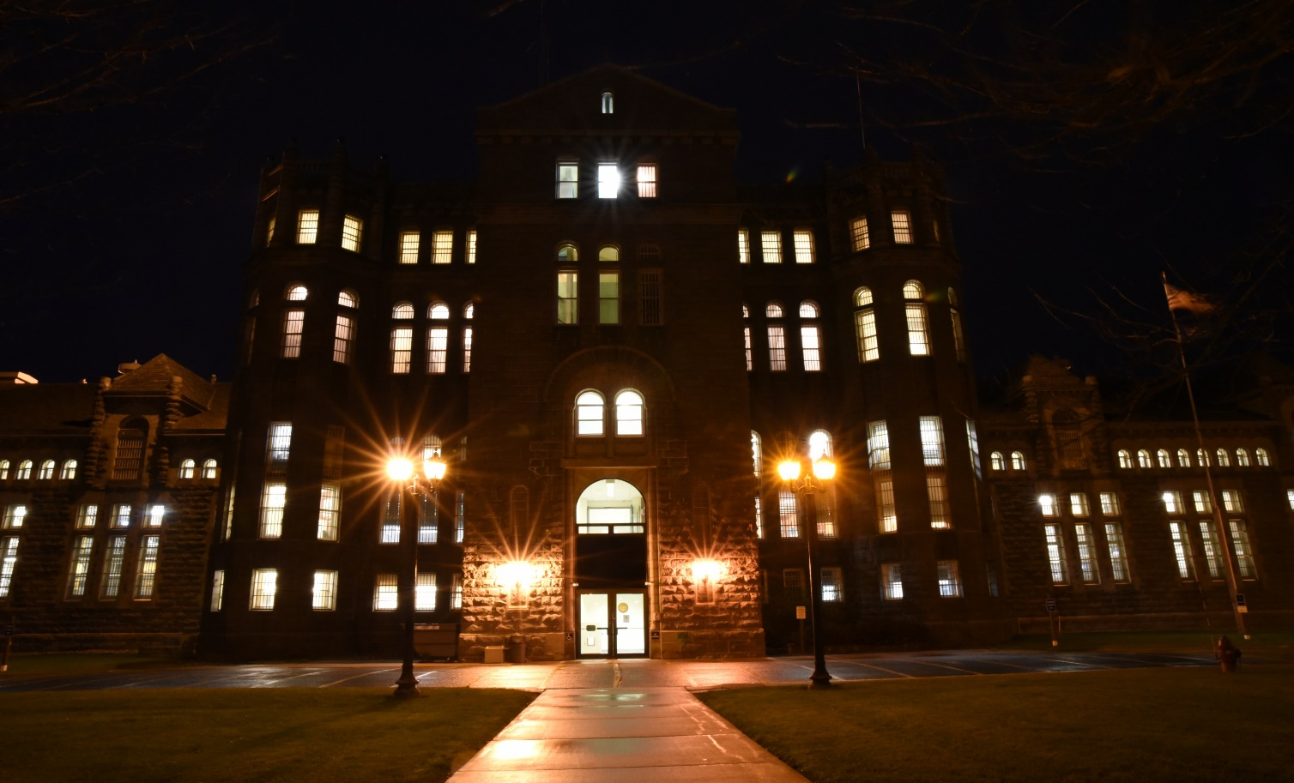
PRISON SECURITY AND SAFETY

Slide 10
PRISON SECURITY AND SAFETY
DOC prison operations are demanding, complex, and multifaceted. Our ten correctional facilities across the state house almost 10,000 offenders. It is essential to provide environments that are safe and secure for staff, offenders, and the public.
FY20 | FY21
$ 20.463M | $ 24.819M
STAFFING
SECURITY INFRASTRUCTURE/TECHNOLOGY MODERNIZATION
RESTRICTIVE HOUSING

Slide 11
PRISON SECURITY AND SAFETY: STAFFING
A comprehensive staffing analysis developed by the National Institute of Corrections identified current correctional officer staffing levels are inadequate. Staffing is critical for safety and also for rehabilitation as programming and treatment depends on it.
Creates safer and more secure prison environments
Increases safety in Minnesota communities by ensuring rehabilitative programming and important treatment can be provided
Increases staffing for operations and programming, including 120 correctional officers

Slide 12
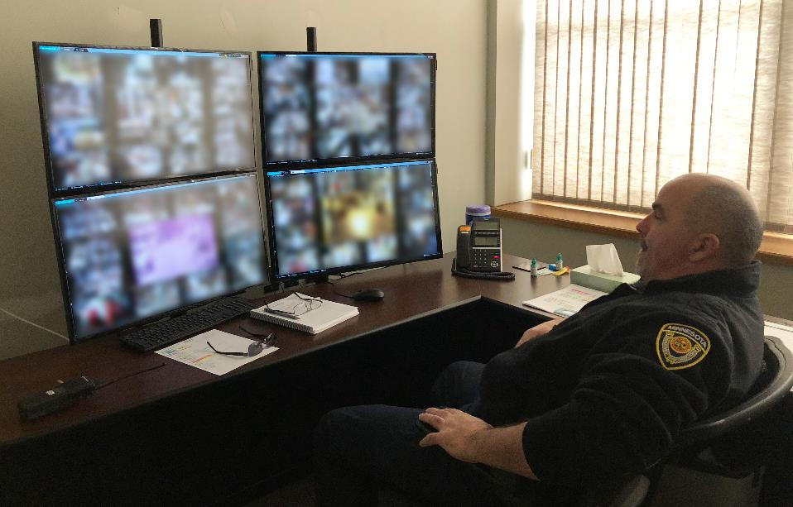
PRISON SECURITY AND SAFETY: SECURITY INFRASTRUCTURE AND TECHNOLOGY MODERNIZATION
Our security systems are integral to safety inside of our facilities. DOC also develops and supports over 150 applications used by the Department, county corrections, local law enforcement and other criminal justice entities, and supports over 5,000 workstations and 400 servers.
Invests one-time funding to update or replace critical security systems such as cameras, cell door controls, and perimeter protections
Invests in updates and modernization for systems facing obsolescence to ensure system security and data privacy are not compromised

Slide 13
PRISON SECURITY AND SAFETY: RESTRICTIVE HOUSING
Throughout the nation, correctional agencies are recognizing the need to improve restrictive housing policy and practices for better outcomes. These initiatives are staff intensive.
Allows for safety in prisons and invests in evidence-based practices that can reduce recidivism and offender misconduct
Provides cognitive skills therapy and mental health counseling at multiple facilities
Increases caseworkers and behavioral health staff

Slide 14
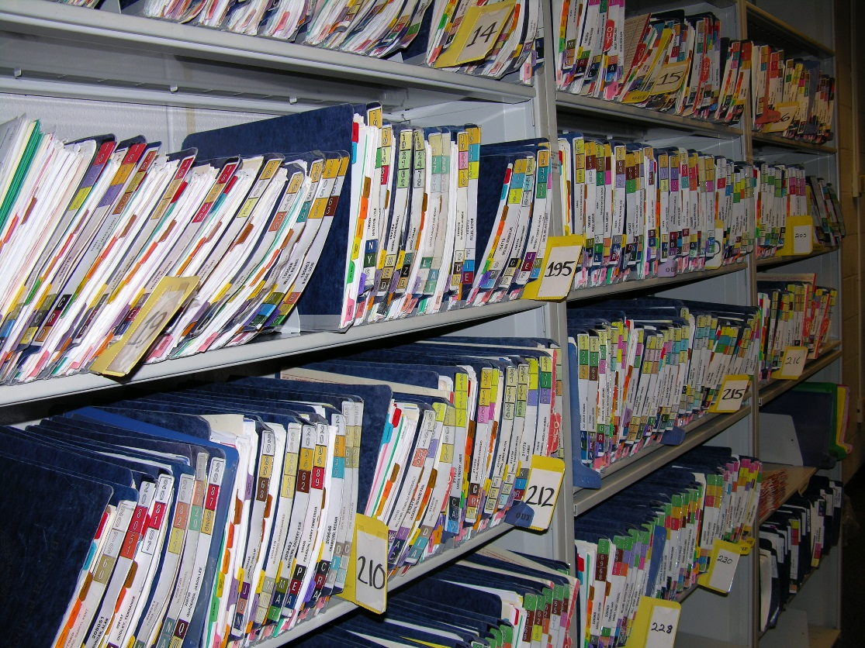
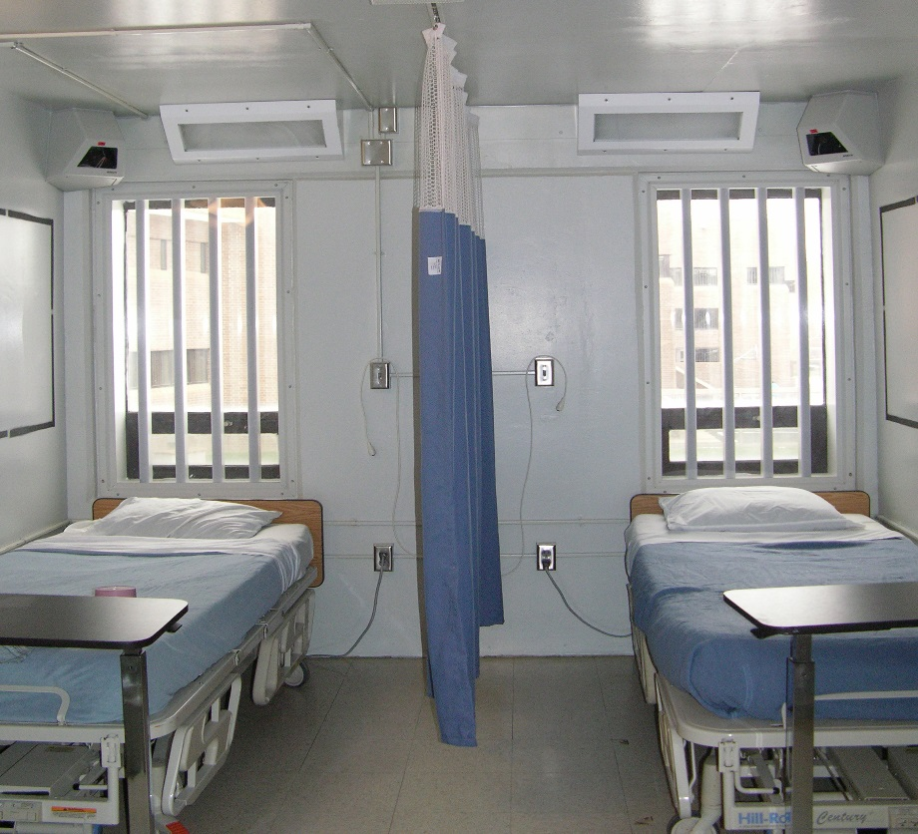
OFFENDER HEALTH CARE

Slide 15
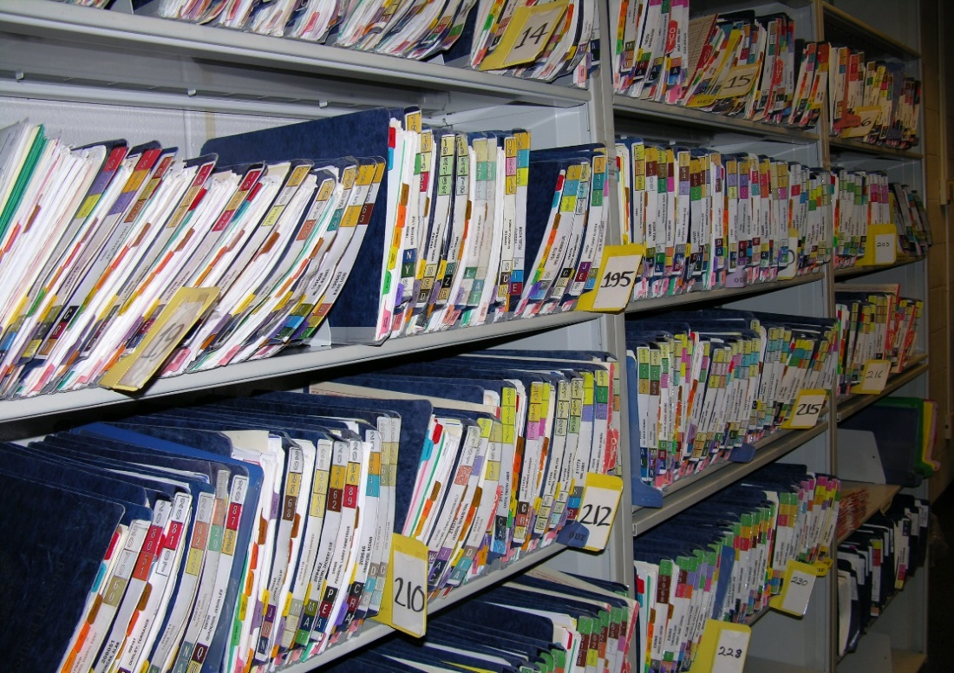
OFFENDER HEALTH CARE
Our current health services are not sufficient to meet the complex growing medical needs of offenders. We have a constitutional obligation and a public health and safety responsibility to provide health care to our incarcerated population which is less healthy than the general public.
FY20 | FY21
$ 2.951M | $ 5.432M
Funds Offender Health Care contract to fulfill contractual obligations
Expands important medical and nursing services
Expands 24/7 Nursing
Provides access to a Electronic Health Records System – mandated by state and federal laws

Slide 16
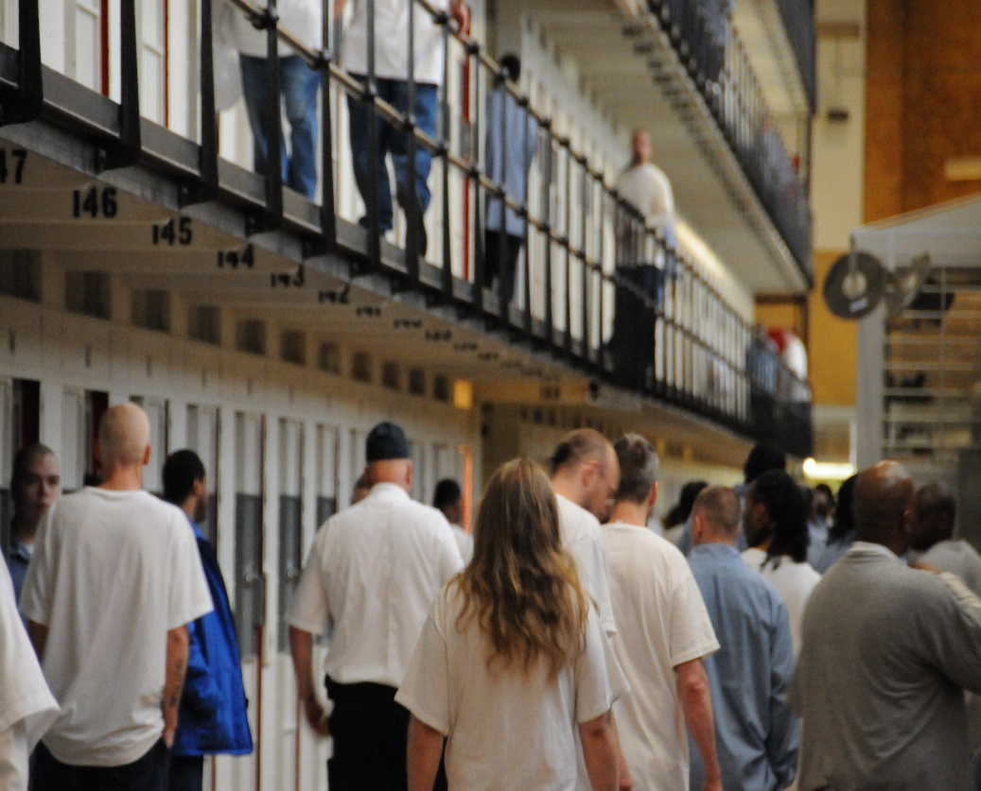
INTEGRATED CASE MANAGEMENT

Slide 17
INTEGRATED CASE MANAGEMENT
Integrated (Intensive) Case Management (ICM) creates one to one, opportunities to motivate and teach offenders prosocial behaviors and skills. Through manageable caseload sizes, staff actively work with high-risk offenders using evidence-based, positive behavioral approaches, proven to be an effective intervention for rehabilitation of high need offenders.
Invests in increasing the provision of strategies proven to reduce recidivism to over 40% of offenders with high-risk to recidivate
Provides much-needed cognitive based interventions to a high-risk population during incarceration so we can ensure safer communities upon release
FY20 | FY21
$ 0.642M | $ 1.662M

Slide 18
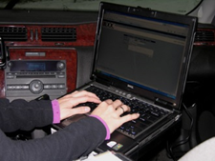
PRE-TRIAL ASSESSMENT AND SUPERVISION

Slide 19
PRE-TRIAL ASSESSMENT AND SUPERVISON
Currently, MN DOC only provides post-conviction supervision. Recent policy changes by the Minnesota Judicial Branch to reduce disparities in statewide pre-trial detention rates have resulted in significant need for pre-trial supervision across Minnesota, including in many communities that currently have none.
Provides for pre-trial supervision services across the state
Ensures individuals are supervised in the community appropriately based on risk calculated by validated assessment tools
FY20 | FY21
$ 2.725M | $5.45M

Slide 20
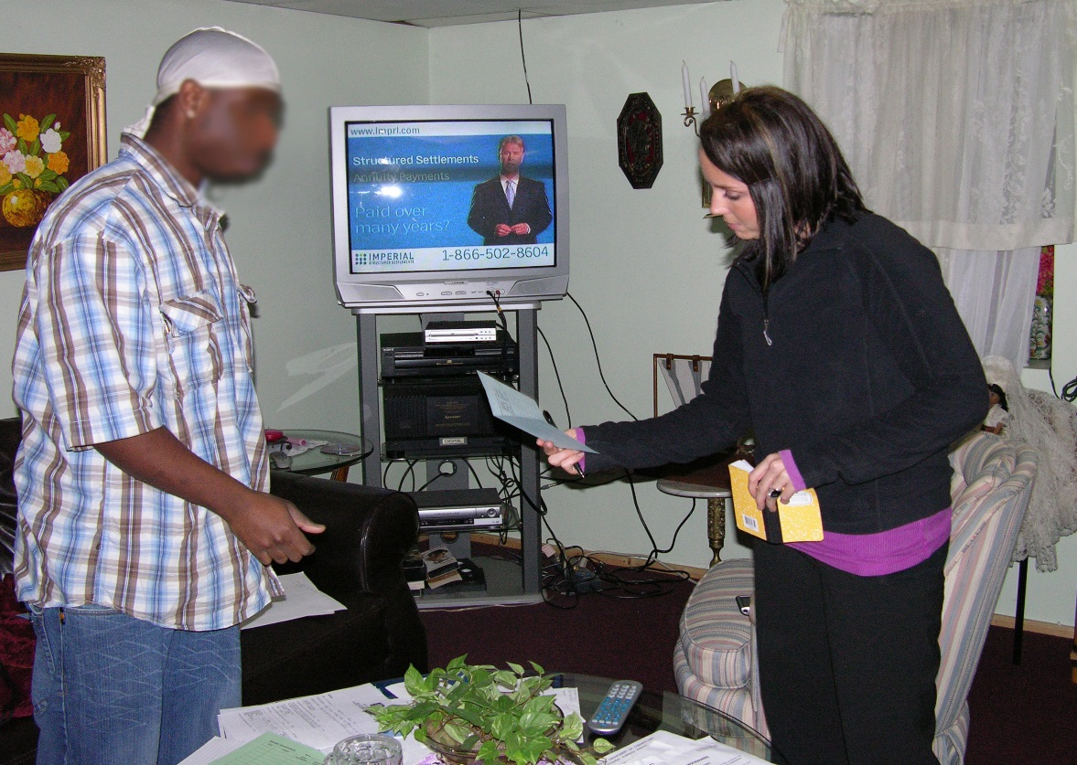
INTENSIVE SUPERVISED RELEASE

Slide 21
INTENSIVE SUPERVISED RELEASE
Intensive Supervised Release (ISR) agents provide 24/7 supervision to offenders at the highest risk for violence and sexual assault, including predatory offenders. An adequate complement of ISR supervision agents, equipped with the proper communication devices, is essential to ensure the safety of our agents and of the public.
FY20 | FY21
$ 3.2M | $ 6.4M
Improves safety by working in pairs, allowing agents to better address at-risk behaviors, keeping our agents and communities safe
Invests in safety supplies such as radios that can be used in areas with no cellphone coverage

Slide 22
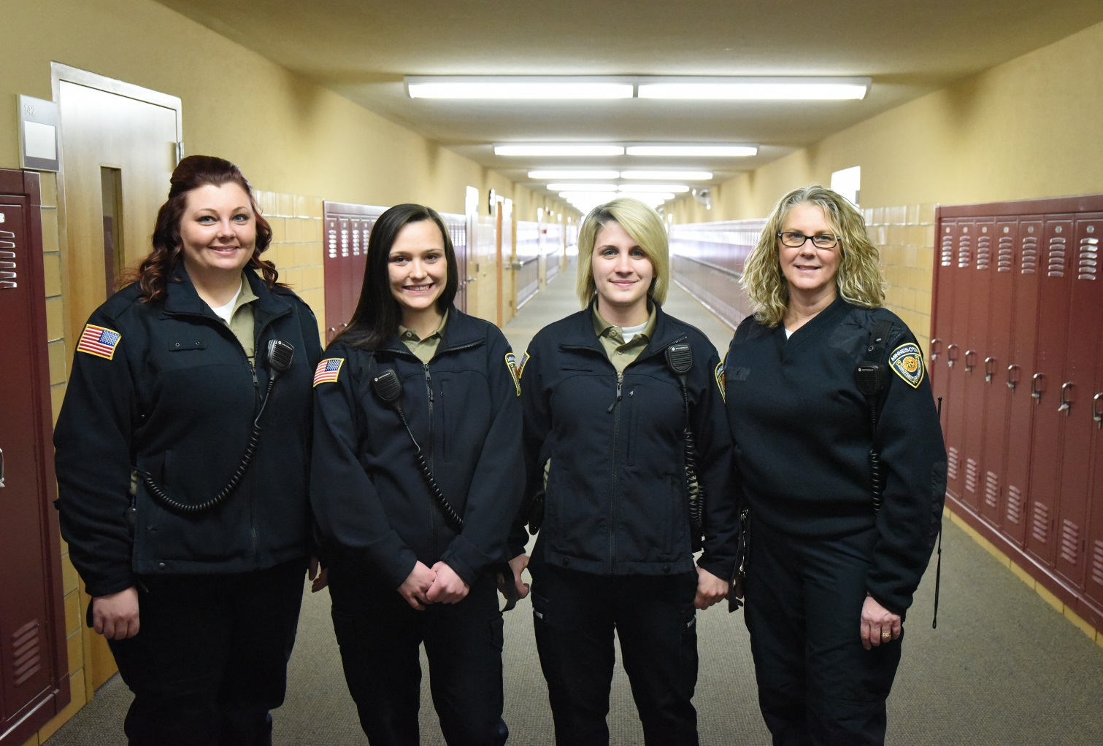
VICTIM NOTIFICATION AND JUVENILE CORRECTIONAL RECORDS MANAGEMENT SYSTEM

Slide 23
VICTIM NOTIFICATION AND JUVENILE CORRECTIONAL RECORDS MANAGEMENT SYSTEM
The new victim notification system will securely and accurately provide victim notifications as required by state statute, be a source of information for victim and community safety, and empower victims. DOC’s twenty year old Juvenile Management System is incompatible with current technological standards.
Allocates funds to complete the victim notification system
Invests in upgrading the nearly obsolete juvenile management system and brings it up to current electronic records standards
FY20 | FY21
$ 1.688M | $ 0.612M

Slide 24
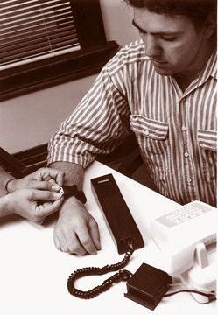
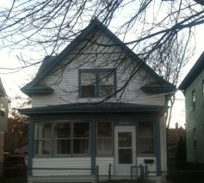
ELECTRONIC MONITORING AND TRANSITIONAL HOUSING FOR HIGH-RISK OFFENDERS

Slide 25
ELECTRONIC MONITORING AND TRANSITIONAL HOUSING FOR HIGH-RISK OFFENDERS
Ensuring that electronic monitoring and transitional housing options exist for our highest risk offenders is linked to public safety. There has been significant increase in the use of electronic monitoring and the need for transitional housing.
Provides for electronic monitoring to meet current needs
Allows for increased transitional housing opportunities for high-risk offenders, preventing homelessness which is critical for an ISR agent’s ability to supervise effectively
FY20 | FY21
$ 1.5M | $ 1.5M

Slide 26
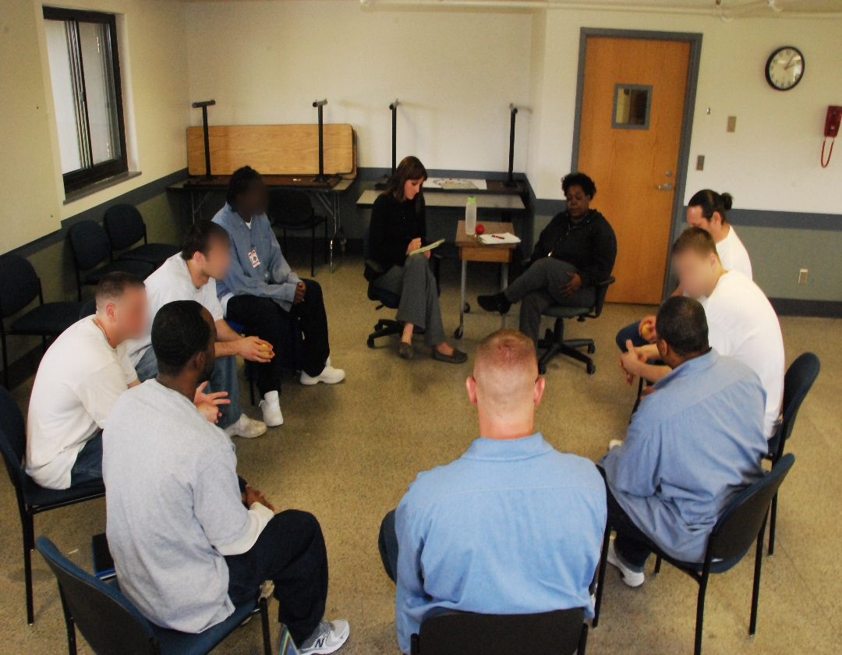
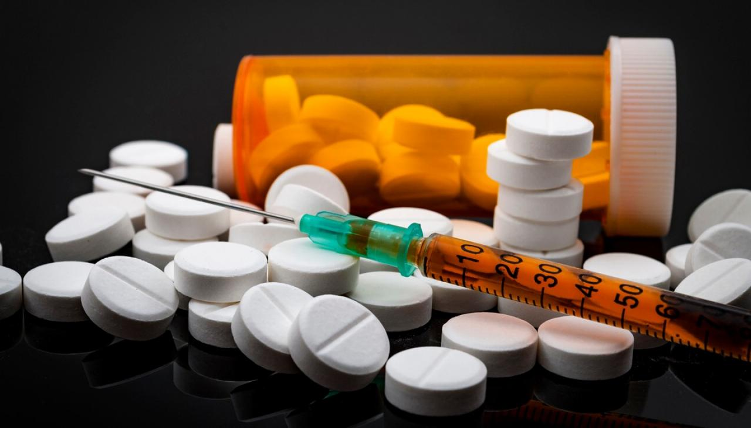
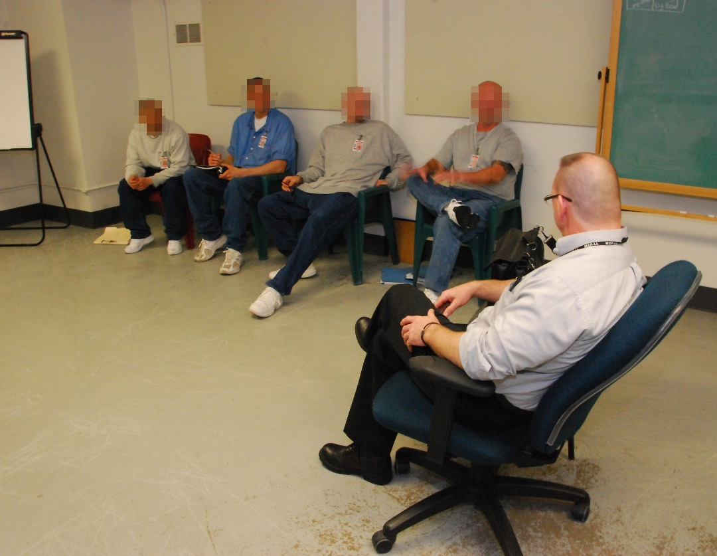
CORRECTIONS OPIOD TREATMENT PROVISIONS

Slide 27
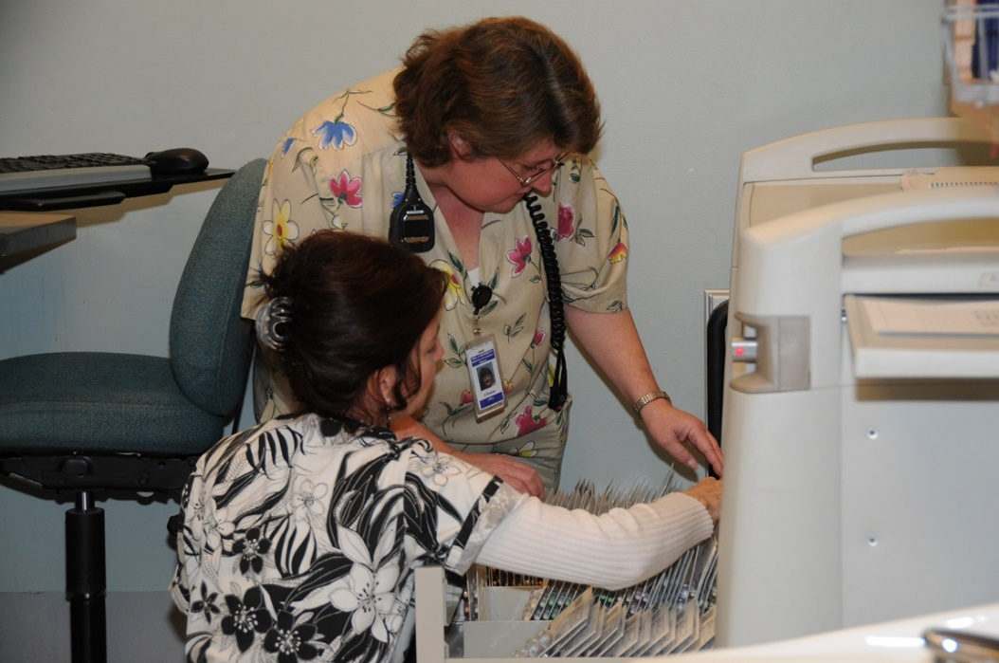
CORRECTIONS OPIOD TREATMENT PROVISIONS
Opioid addiction has a detrimental impact on communities throughout Minnesota, and an increasing number of people are coming into the DOC system with opioid addictions. Providing opioid treatment programs and other services to those who are incarcerated and under supervision in our communities is critical to battling this epidemic.
Invests in pre-release planning services and the establishment of a Medication Assisted Treatment (MAT) program
FY20 | FY21
$ 0.965M | $ 0.965M

Slide 28
Reducing Recidivism Through Connecting Families and Reentry Programs

Slide 29
REDUCING RECIDIVISM THROUGH CONNECTING FAMILIES AND RE-ENTRY PROGRAMS
An investment in successful reentry planning, parenting programs for those nearing release, and transportation for children to visit their parents is integral for their prosperity and to reducing recidivism.
Invests in transportation services to reduce visiting barriers for children of incarcerated offenders
Improves parenting skills for incarcerated parents
Delivers culturally specific reintegration services for incarcerated Native American population
FY20 | FY21
$ 1M | $ 1M

