Slide 1



A Joint Request from:
Leech Lake Tribal College
Red Lake Nation College
White Earth Tribal & Community College
State Funding
for Minnesota
Tribal Colleges

Slide 2

Q&A from 3/16/2022
QUESTION #1
Q: What do the Sovereigns need Minnesota State funding for?
A: Federal funding to Tribal Colleges covers only the bare minimum, leaving many operational issues.
Chronic understaffing - Staff members commonly fulfill 2-3 roles
Salaries are 50-80% of other Minnesota public colleges resulting in burnout and higher turnover, on top of other rural HR challenges.
There is no funding for Infrastructure, e.g. housing, wellness center, storage facilities, etc.
LLTC Dendrology class 2022
Almost 100% of Tribal College students live in poverty,
so tuition & fees cannot be increased to provide more funding.

Slide 3
Tuition Comparison
Sample of Minnesota Colleges | 2019/20 Annual Tuition/Fees
Carleton College | $57,111
Augsburg University | $34,293
University of Minnesota - Twin Cities | $15,142
Bemidji State University | $8,941
Normandale Community College | $5,964
Minnesota Tribal Colleges | Annual Tuition/Fees
Red Lake Nation College | $5,770
White Earth Tribal & Community College | $5,275
Leech Lake Tribal College | $5,020
Source: MN Office of Higher Ed

Slide 4
Funding Inequity
For the past 30 years, Tribal Colleges have been the only public schools in Minnesota required to educate Minnesota residents without any state public operational and capital funding.
Native Americans living in Minnesota are essentially dual citizens –
citizens of their Tribal Nation and also residents of the State of Minnesota.
Those who attend Tribal Colleges in Minnesota are the only Minnesota residents who are NOT supported by operational funding at the public school of their choice.
This educational inequity is unfair and is contrary to Minnesota’s constitutional laws, statutes, and policies intended to prevent any discrimination in education based on race, nationality, or minority status.

Slide 5
Q&A from 3/16/2022
QUESTION #2
Q: Why don’t the Tribal Colleges just ask for one year of funding?
Maybe they could seek full funding in next year’s budget?
A: Like every other public institution of higher education in Minnesota, Tribal Colleges have an urgent annual need for funding. This funding should be part of the regular MN higher education annual budget.
Would any other public college or university in Minnesota be able to operate without State funding? Probably not.
Tribal Colleges have gone without State funding for almost 30 years.
Postponing funding further or limiting it to one year is unreasonable and unjust.

Slide 6
Q&A from 3/16/2022
QUESTION #3
Q: Why would we fund the Tribal Colleges if we have no accountability from them at all?
A: Tribal Colleges are currently required to provide the State with all student data and information because of State funding of individual Native students and the Minnesota Indian Scholarship Program. The State already receives reports of enrollment, degrees conferred, FTE, completion and graduation rates.
The State of Minnesota currently has the same accountability for Tribal Colleges as it has with all MN public schools. This will continue.

Slide 7
Top 7 Reasons to Approve Funding
1 | To Adhere to Minnesota Law, Statutes, & Policies
2 | Tribal Colleges are Public Institutions
3 | Equity between Native & Non-Native Students
4 | To Help Address Historical Social/Racial Inequities
5 | The Timing is Right during a State Budget Surplus
6 | Tiny Investment with Huge Return
7 | The Need is Particularly Urgent after COVID-19 Impacts

Slide 8

To Adhere to Minnesota Law, Statutes, & Policies
Reason

Slide 9
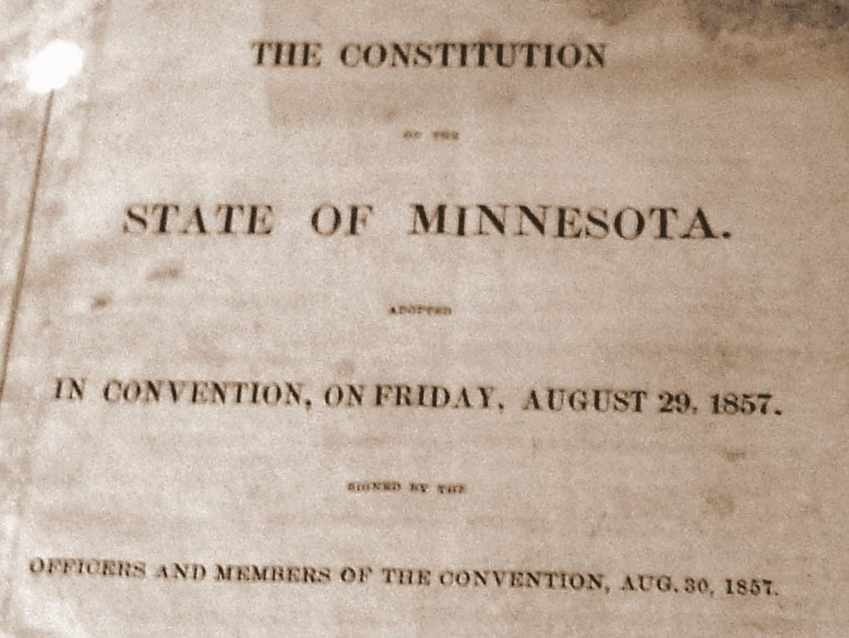
Constitution of the State of Minnesota
ARTICLE 1
BILL OF RIGHTS
Sec. 2. RIGHTS AND PRIVILEGES.
No member of this state shall be disfranchised or deprived of any of the rights or privileges secured to any citizen thereof, unless by the law of the land or the judgment of his peers.
Cover of the first printing of the Minnesota Constitution, 1857.Jonathunder | Wikimedia Commons

Slide 10
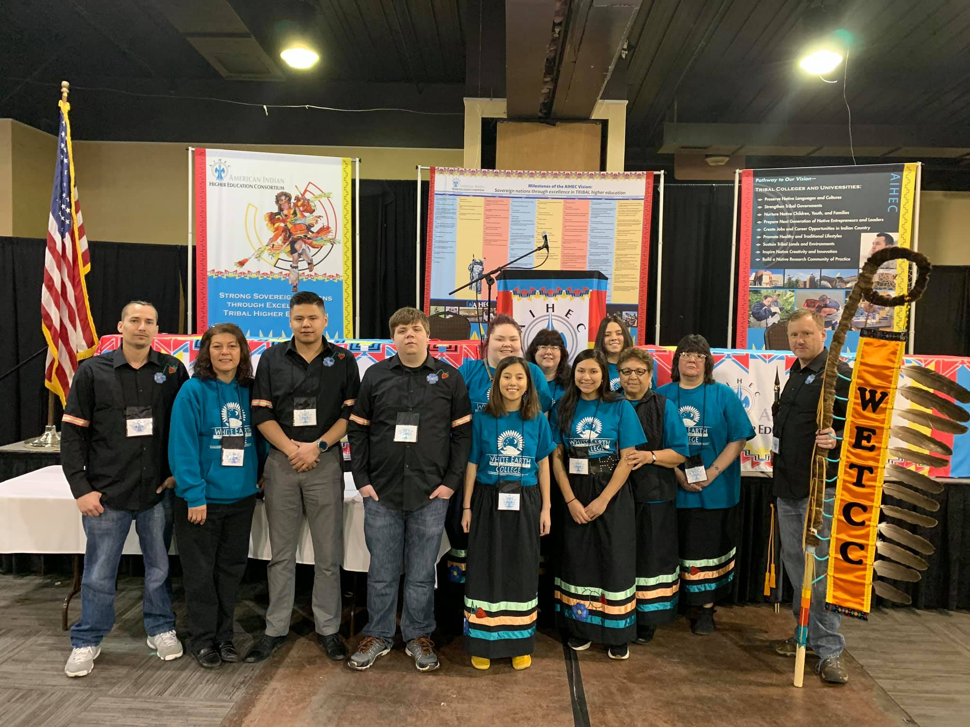
Minnesota Human Rights Act
The Minnesota Human Rights Act (MHRA) prohibits discrimination on the basis of race, color, creed, religion, national origin, sex, age, marital status, status with regard to public assistance, sexual orientation, or disability.
It prohibits discrimination in employment, housing, public accommodations, public services, education, credit, and business based on protected class, such as: race, religion, disability, national origin, sex, marital status, familial status, age, sexual orientation, and gender identity.
Minn. Stat. § 363A.01
White Earth Tribal & Community College AIHEC Club 2019

Slide 11
MDE Statement on Descrimination
The MN Department of Education statement on Discrimination:
Discrimination means that an individual (or group) is being treated unfairly or unequally based on a protected characteristic. In Minnesota, these protected characteristics are race, color, creed, religion, national origin, sex, age, marital status, status with regard to public assistance, sexual orientation, or disability. Discrimination can occur as a result of stereotype or intentional discrimination, or it can occur when an organization’s policy or practice affects a group of people differently than it affects another group. Although everyone is protected from discrimination, discrimination occurs when you are treated differently because of a particular protected characteristic.
MN Tribal Colleges are being treated differently than all other
MN public colleges and, therefore, are being discriminated against,
by not receiving MN public funding for MN public schools.

Slide 12
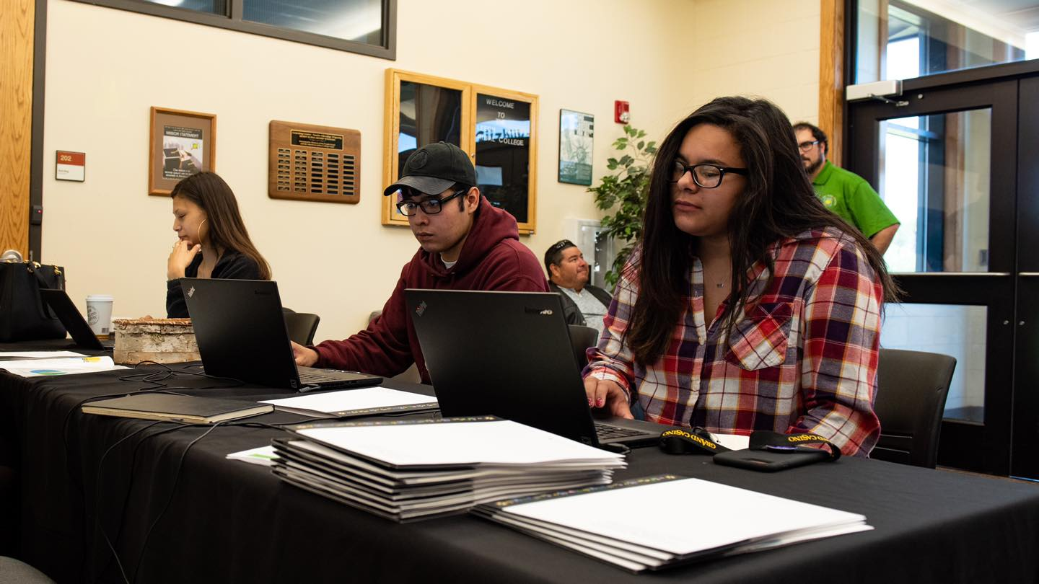
Tribal Colleges
are Public Institutions
Reason
Leech Lake Tribal College Students

Slide 13


Perpetual Misclassification
Tribal Colleges are public colleges. All receive federal funding, which requires that they be open to the public.
Tribal Colleges in Minnesota have been perpetually misclassified because the State form includes only two labels -- Public School and Private School. Because Tribal Colleges do not currently receive any state operational funding and are not included on the State list of public schools, they are not permitted to indicate, “Public.”
A third, “Public Tribal College,” option is needed
to correct this perpetual misclassification.

Slide 14

Equity between Native & Non-Native Students
Reason
Red Lake Nation College PSEO Students

Slide 15

Inconsistency and Inequity
Native students at Minnesota Tribal Colleges receive:
MN State Scholarships
MN Indian Scholarship Program (MISP)
Non-Native students at Minnesota Tribal Colleges receive:
MN Non-beneficiary Funding
This highlights the tremendous inequity
of Native students not being able to get supported with funding for their schools of choice
at MN Tribal Colleges.
PSEO Student at Red Lake Nation College

Slide 16
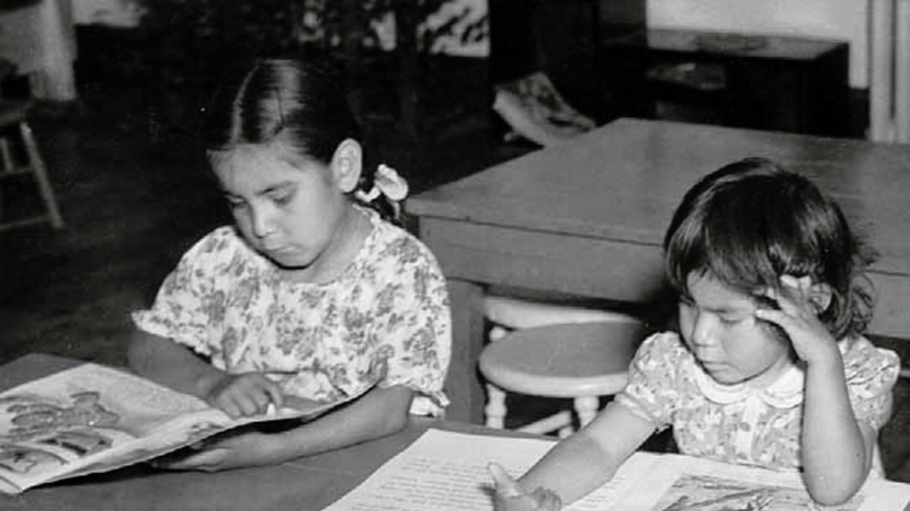
To Help Address Historical Social/Racial Inequities
Reason
Ponemah Indian School 1
Minnesota Historical Society

Slide 17
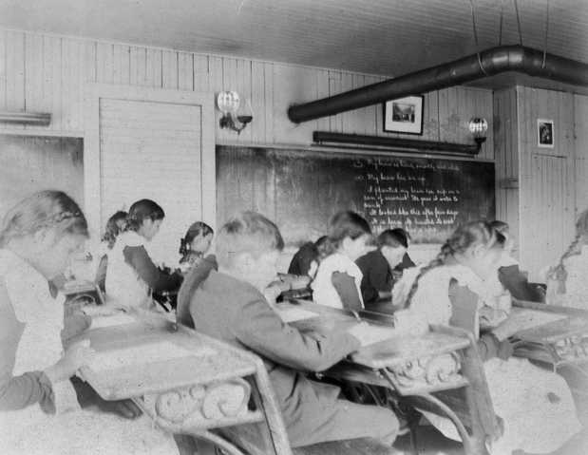
Historical Inequities
Minnesota exists on traditional, ancestral, and contemporary lands of Indigenous people. For almost two centuries, Natives has suffered the effects of loss of land, language, and culture and have been left with a legacy of intergenerational trauma and poverty.
Funding this proposal will help address the historical inequities and education issues which linger in Minnesota for Natives and Tribal Colleges.
Funding this Tribal College proposal
is the right thing to do
Intermediate students in an Indian boarding school at Beaulieu, Minnesota. C.1900.
Minnesota Historical Society

Slide 18

The Timing is Right - State Budget Surplus
Reason

Slide 19
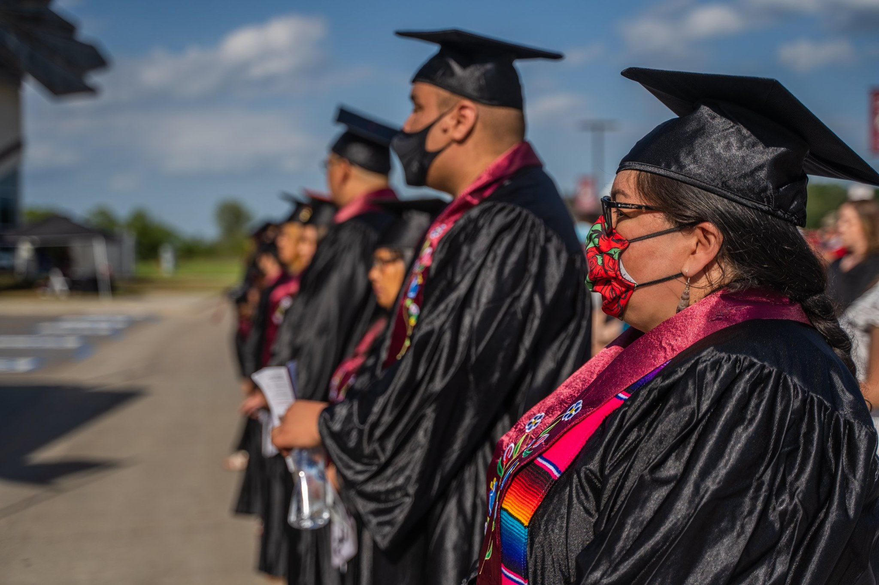
Chance to Close Education Gap
Minnesota currently has a $9 billion budget surplus.
There has been discussion of using the surplus to address the most urgent of educational issues in MN.
This is one of the most urgent of items. The timing is right to address it now.This is the perfect time to address the education gap in the state.
Without funding, the education gap
will only continue to grow.
2021 Red Lake Nation College Graduates

Slide 20

Tiny Investment
with Huge Return
Reason

Slide 21
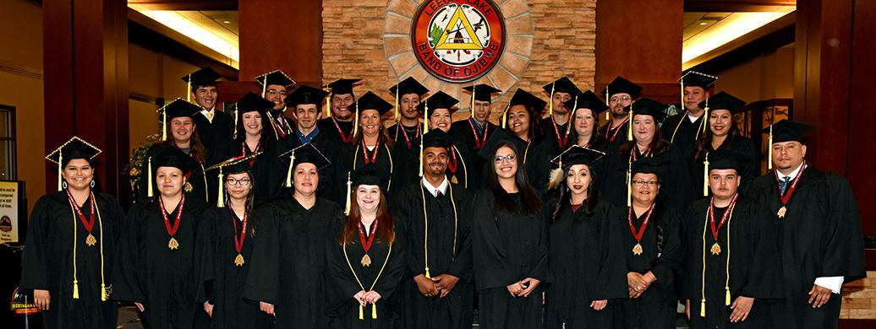
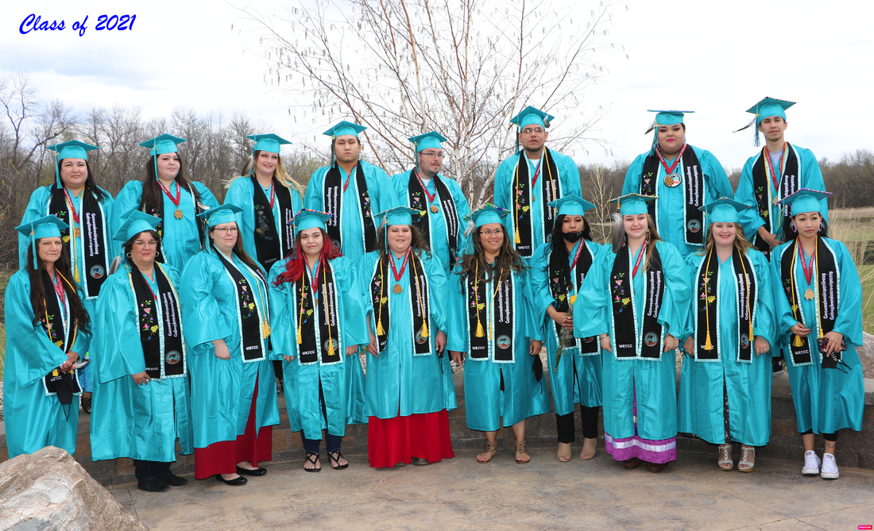
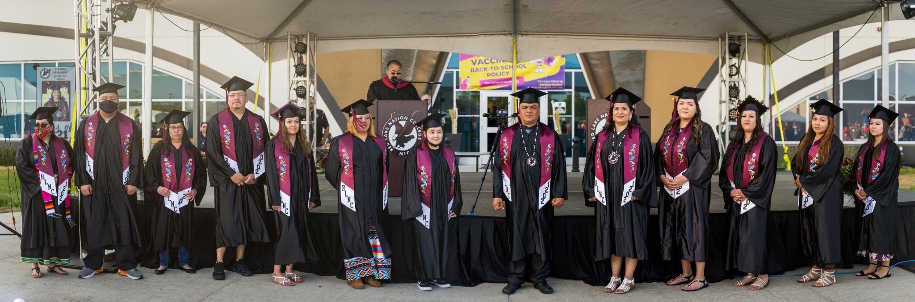
Tiny Investment with Huge Return
$3 million is a tiny investment for the most underserved of Minnesota residents in higher education, especially when compared to the approximate $1.1 billion 2022 budget allocation for the U of M and MN State system.
Our $3 million request is not even statistically significant relative to the total two-year $57 billion Minnesota State budget.
Return on Investment:
Tribal Colleges educate students out of poverty and assist them in becoming
productive workers and tax-paying citizens.
Top to Bottom: LLTC, WETCC, and RLNC Graduates

Slide 22
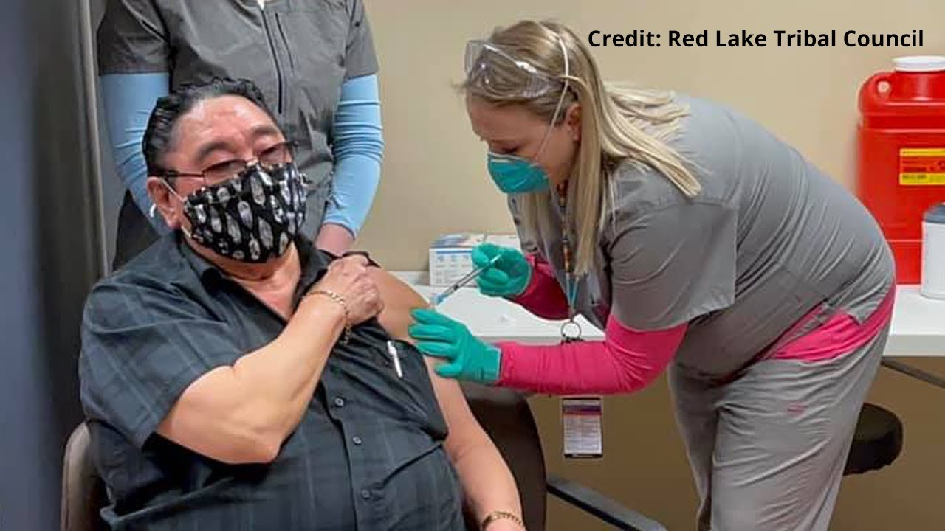
The Need is Particularly Urgent after COVID-19 Impacts
Reason

Slide 23

Urgent Need
Native communities have been disproportionately impacted by the COVID-19 pandemic. For example, according to the Centers for Disease Control and Prevention, (CDC) American Indian and Alaska Native people are 5.3 times more likely than white people to be hospitalized due to COVID-19, the largest disparity for any racial or ethnic group. COVID has forced higher IT costs for adaptation.
Recovery will take both time and money.
Native students and Tribal Colleges
have been overlooked for far too long.
Funding is urgently needed now.
RLNC Student

Slide 24
lltc.edu
rlnc.edu
wetcc.edu

