Slide 1
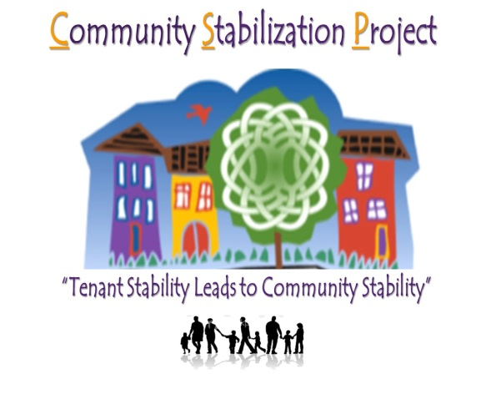
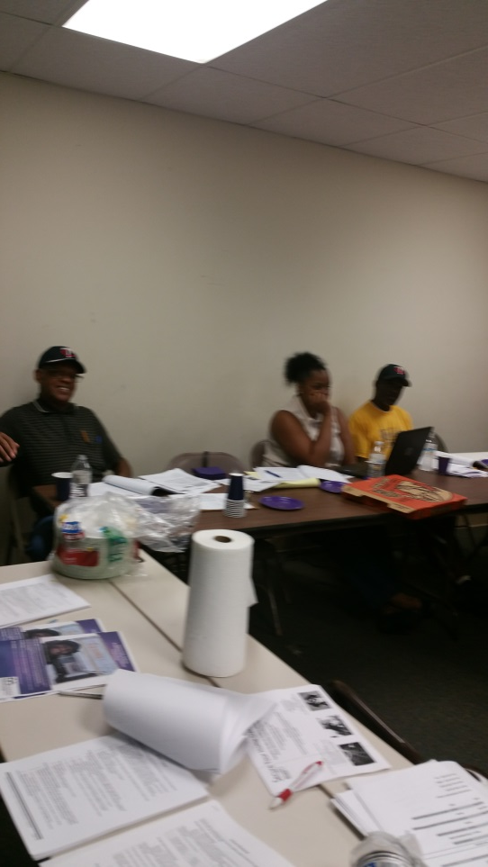
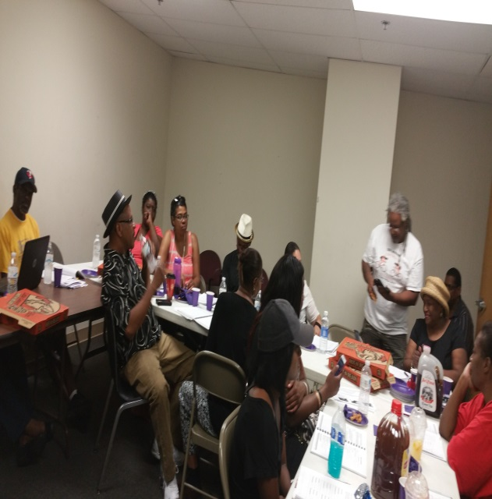
TENANT/LANDLORD EDUCATION WORKSHOP
Within each of us is a hidden store of energy. Energy we can release to compete in the marathon of life. Within each of us is a hidden store of courage, courage to give us the strength to face any challenge. Within each of us is a hidden store of determination. Determination to keep us in the race when all seems lost. — Roger Dawson
Community Stabilization Project
“RENT READY”
501 N. Dale St. Suite 203
Saint Paul, MN 55103
(651) 225-8778 Office
(651) 225 -4160 Fax
Email: csp501dale@gmail.com
Website: http://csp501dale.wix.com/communitystabproject
Notes:
To change this brochure, replace our sample content with your own. Or, if you'd rather start from a clean slate, press the New Slide button on the Home tab to insert a new page. Now enter your text and pictures in the empty placeholders. If you need more placeholders for titles, subtitles or body text, copy any of the existing placeholders, then drag the new one into place.
And did you notice we made fold marks for you? They are really light, but if you don’t like them showing on your brochure, select and delete them before you print.
<number>

Slide 2
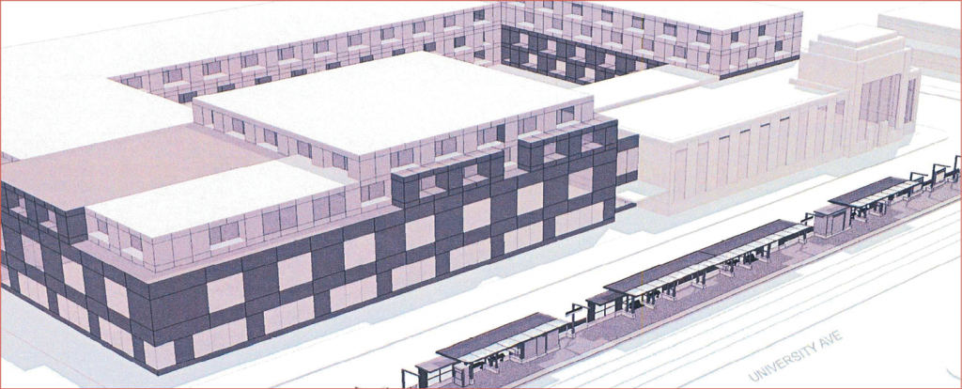
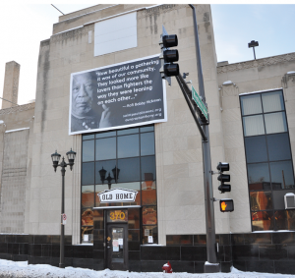
Service Benefits
“It is critical that we celebrate the cultural and ethnic roots of this neighborhood. One way in which we can do that is by seizing this moment of change [with the construction of the Green Line] as an opportunity for the community. We have the buying power, attractions, places of historical interest, and the business base to increase visitorship to the area and to make the neighborhood an even greater place to live and work.” –Nieeta Presely, Executive Director, ASANDC
Through our workshops we provides empowerment-based tenant counseling, education and assistance to help tenants learn their rights and take action to resolve housing problems.
Understanding tenant obligations and responsibilities
Rent Ready Certification
Referral to community resources and legal assistance
How to protect yourself knowing the Importance of documentation
Organization Membership
About us
Services Offered
Advocate Counselors offer free phone and walk-in tenant counseling services to assist families /individuals with questions about landlord-tenant laws and discuss strategies to prevent housing loss.
One on One Counseling
Removing housing barrels
Financial literacy
Homeless Prevention
The Community Stabilization Project (CSP) was established in 1989 as a collaborative project of the St. Paul Tenant’s Union, District Councils 7 and 8, the St. Paul Urban League and Southern Minnesota Regional Legal Services (SMRLS). The goal “Renter Stability Will Lead To Community Stability” that will lead to better outcomes in the undeserved underrepresented,Communities seriously substandard rental properties which landlords refused to improve. CSP has had twenty three years of success fostering co-operation between tenants and landlords to ensure adequate clean, safe, affordable housing and good quality of life in Saint Paul.
Key Clients
Our reliability and award-winning customer service earned us an impressive client list including:
Tenants/Community Residents
Landlords / Leasing Agencies
Organizations
Business
Notes:
To change this brochure, replace our sample content with your own. Or, if you'd rather start from a clean slate, press the New Slide button on the Home tab to insert a new page. Now enter your text and pictures in the empty placeholders. If you need more placeholders for titles, subtitles or body text, copy any of the existing placeholders, then drag the new one into place.
And did you notice we made fold marks for you? They are really light, but if you don’t like them showing on your brochure, select and delete them before you print.
<number>

