Slide 1

MN Rural Finance Authority and AgBMP
Matt McDevitt, Ag Finance Supervisor

Slide 2
Beginning Farmer Tax Credit
Governor Dayton signed into law on May 30 2018
Effective January 1, 2018
Similar to programs in Iowa and Nebraska, Minnesota 1st state to include the sale of ag assets

Slide 3
Beginning Farmer Tax Credit
The credit to the agricultural asset owner is as follows:
Take a credit against the tax due
5% of the lesser of the sale price or fair market value of the agricultural asset up to a maximum of $32,000;
10% of the gross rental income in each of the 1st, 2nd, and 3rd years of the rental agreement, up to a maximum of $7,000 per year, or
15% of the cash equivalent of the gross rental income in each of the 1st, 2nd, and 3rd years of a share rent agreement, up to a maximum of $10,000 per year.

Slide 4
Beginning Farmer Tax Credit
Definitions:
Agricultural Asset = Ag land, livestock, facilities, buildings, and machinery
Owner of agricultural asset = Individual, trust, or pass-through entity. Cannot be a C Corp, equipment dealer, or livestock dealer

Slide 5
Beginning Farmer Tax Credit
Requirements of the beginning farmer:
Resident of MN (resident means an “individual”)
Has farmed less than 10 years (Schedule F)
Must be farming land in MN
Asset owner cannot be family or family of a spouse or family of a partner, member, shareholder, or trustee
(grandparents, parents, children, grandchildren, brothers, sisters)
Has a net worth below $851,000
Does majority of the farm labor and management
Agrees to enroll in a farm financial management course

Slide 6
Beginning Farmer Tax Credit
Steps to apply:
MN Department of Agriculture website
Beginning Farmer and Asset Owner to complete applications
RFA will issue a tax certificate

Slide 7
Beginning Farmer Tax Credit
Tax year 2018, capped at $5 million
Tax year 2019-2023, capped at $6 million
For 2021 there is about $15.3 million available
Sunset 12/31/2023

Slide 8
Beginning Farmer Tax Credit
Stats through first 3 years:
 | 2018
378 | Beginning Farmers |  | $ in credits | $361,717
440 | Asset Owners |  | $ in credits | $2,277,607
 | 2019
527 | Beginning Farmers |  | $ in credits | $544,127
584 | Asset Owners |  | $ in credits | $2,710,529
 | 2020
444 | Beginning Farmers |  | $ in credits | $536,377
633 | Asset Owners |  | $ in credits | $2,677,526

Slide 9
Beginning Farmer Management Tax Credit
Beginning farmer gets a tax credit for participating in a farm financial management program
Credit is equal to 100% of the cost of the program not to exceed $1,500 per year
Up to 3 years
Can also use Beginning Farmer FBM Scholarship

Slide 10
MN Rural Finance Authority Loan Programs

Slide 11
RFA History
Established in 1986 with the Restructure Loan Program
Beginning Farmer Loan Program in 1987
Aggie Bond in 1991
Ag Improvement Loan Program in 1992
Livestock Expansion Loan Program in 1994
Revolving account for Stock Loan Program in 1994
Methane Digester Loan Program in 2002
Livestock Equipment Loan Program in 2005
Disaster Recovery Loan Program in 2007
Pilot Agricultural Microloan Program in 2012
Farm Opportunity Loan Program in 2015

Slide 12
Purpose of RFA and Main Audience
Provide eligible Minnesota farmers affordable financing under terms and conditions not available from other credit sources.
Beginning farmers
Livestock producers
Farmers facing financial adversity
All farmers
Full time farmer = Majority of income comes from farming

Slide 13
Goals of RFA
Help Minnesota farmers
Help local institutions be competitive
Lower interest rates
Share risk
Manage local lending limits
Easy to use and prompt approval process
Utilize local lenders supporting loan documentation

Slide 14

How Are We Funded?
Sale of State Bonds
(RFA has to pay these back)
* $50 Million appropriation in 2020
- Beginning Farmer & Seller Assisted-Tax Exempt
- Agriculture Improvement- Tax Exempt/Taxable
- Livestock Expansion- Taxable
- Restructure II- Taxable
Allocation of Federal Tax-Exempt Bonds (Paper transactions)
- Aggie Bond
Dedicated Revolving Account (Repayments go back into the account)
- Disaster - Microloan
- Livestock Equipment - Farm Opportunity
- Value Added Ag Product

Slide 15
RFA Program Overview
RFA Performance Measures (1986 to 2020)
3,385 loans issued totaling $302 million
Losses taken on 21 loans (0.002% of total)
Currently have 703 active loans with balance of over $98.8 million

Slide 16
How We Work
We participate with local lenders
We take 45 % of the loan
Local lender does most of the paperwork
The local lender lends all of the money and we “buy” our 45% from them after the loan closes
The borrower pays the lender, the lender pays us
Loans contain 5-year prepayment penalty

Slide 17
Steps In Applying
Lender and applicant fill out application – available on website
Applicant pays $50 application fee
Lender sends packet to RFA Office in St Paul
Application
$50 Application fee
Lenders loan narrative/proposal and risk rating analysis
Updated financial statements and cash flow
Copies of last 2 – 3 years taxes including Schedule F
Appraisal of secured property
RFA will process, approve loan participation and send approval letter
Lender closes loans and sends signed copies of loan agreements and mortgage to RFA
RFA sends out funds for participation amount and amortization schedule to loan payments

Slide 18
Beginning Farmer and Seller Assisted
Help beginning, entry level farmers purchase real estate.
Can be bare land, farm site, or 5 acres with a barn
Net Worth can not exceed $851,000 (indexed for inflation)
Loan is limited to 45 percent of a qualifying loan to a maximum of $400,000 from RFA
Max debt per acre (80 acres x $3500 x 45%)
2.00% RFA interest rate for 10 years
Program may be used more than once
Enrollment in farm management program
Obtain life insurance to cover loan amount

Slide 19
Beginning Farmer Example
A young farmer is buying a 15-acre farm site with a home, barns, and pasture for his beef cattle operation.
Creditor | Dollars | Interest Rate | Lien Position
Purchase Price | $200,000
Down Payment | $40,000
Remaining Credit Needed | $160,000
RFA’s 45% | $72,000 | 2.00% | Shared First
Lender’s 55% | $88,000 | 4.50% | Shared First

Slide 20
FSA/RFA Working Together for Minnesota Farmers
Memorandum of Understanding
For Beginning Farmers:
FSA agrees to waive the 1% origination fee
FSA agrees to issue 95% Guarantees
Applies to regular or “Down Payment D-FO” loans
RFA will do a 20-year balloon on loans including FSA Beginning Farmer Down Payment Program

Slide 21
FSA/RFA Working Together for Minnesota Farmers
FSA/RFA Example Using The Beginning Farmer Loan Program $500,000 Purchase Price $25,000 Down payment (5% down)
Creditor | Dollars | Interest Rate | Lien Position
Credit Needed | $475,000
FSA DownPayment | $225,000 | 1.50% | Second
Remaining Credit Needed | $250,000
RFA’s 45% | $112,500 | 2.00% | Shared First
Lender’s 55% | $137,500 | 5.00% +/- | Shared First

Slide 22
Agricultural Improvement
Used to finance improvements to the farm for any ag related purpose, such as livestock buildings, grain handling facilities, machine storage, and manure systems
Net Worth can not exceed $851,000 (indexed for inflation)
Loan is limited to 45 percent of a qualifying loan to a maximum of $400,000 from RFA
2.25% RFA interest rate for 10 years

Slide 23
Livestock Expansion
Creates affordable financing for new state-of-the-art livestock production facilities
Used for new hog barns, poultry barns, cattle barns, robotic milkers, etc.
Net Worth that does not exceed $1,809,000 (indexed for inflation)
Loan is limited to 45 percent of a qualifying loan up to a maximum of $525,000 from RFA
2.50% RFA interest rate for 10 years

Slide 24
Restructure II
Restructure loans help farmers reorganize their farm debt to improve cash flow
Net Worth that does not exceed $1,809,000 (indexed for inflation)
Loan is limited to 45 percent of a qualifying loan up to a maximum of $525,000 from RFA
2.50% RFA interest rate for 10 years

Slide 25
Disaster Recovery Loan
State or Federal declared disaster, or a disaster area as determined by the RFA Board
Help farmers affected by recent disasters for farm expenses not covered by insurance
Used to help clean up, replace feedstock and other inputs, or repair buildings
Can be used to purchase watering systems during a drought disaster
Cover the loss of revenue when there is a contagious disease (animal or human)

Slide 26
Disaster Recovery Loan
Loan is limited to 45 percent of a qualifying loan to a maximum of $200,000 from RFA
0% RFA interest rate
No payment required in first two years
No maximum net worth
Collateral is negotiable

Slide 27
Disaster Recovery Loan
57 Disaster Recovery loans issued for $3.7 million
6 loans for $860K have been issued to cover loss of revenue due to Covid-19
Multiple hazards have been added Legislatively over the past 3 years

Slide 28
Livestock Equipment
Help beginning farmers purchase livestock related equipment, facilities and improvements
Net Worth can not exceed $484,266 (indexed for inflation)
Loan is limited to 45 percent of a qualifying loan to a maximum of $100,000 from RFA
2.00% RFA interest rate
Must be principal owner of livestock for which the equipment will be used

Slide 29
Farm Opportunity Loan
Used to purchase machinery/ equipment to:
- Add value to crops or livestock
- Adopt best management practices
- Reduce or improve management of ag inputs
- Increase production of on-farm energy
No maximum net worth requirement
Individual loan 45% up to $100,000
Group loan 45% up to $250,000
2.00% RFA interest rate for 10 years

Slide 30
Value Added Agriculture Product Program
This program is designed to provide financing for farmers with limited capital who want to buy stock in a cooperative proposing to build or purchase and operate an agricultural product processing facility in Minnesota.
The RFA will participate in loans at 45% of the loan up to a maximum of $40,000.

Slide 31
Methane Digester Loan
The purpose is to help finance the purchase of necessary equipment and the construction of a system that will utilize manure to produce electricity.
No net worth requirement
Individual loan 45% up to $250,000
0% interest rate for up to 10 years
Loan may be used as a match for Federal loans or grants

Slide 32
Odds and Ends
Prepayment penalty starts at 10%, then reduces 2% per year
A borrower may pay additional principal of 10% of the loan amount without penalty
All RFA loans should have a loan term of no more than 10 years (except when using FSA BFDP)
Can be amortized longer

Slide 33
Agricultural Best Management Practices Loan Program (AgBMP)
Program Basics
Local Water Quality Improvements
Pollution Problems
Drinking Water Standard
Odor
Local Governments
Water resource managers
Local Lenders
Local Borrowers

Slide 34
Agricultural Best Management Practices Loan Program (AgBMP)
Program Terms
MAXIMUM $200,000 total per person at any given time
Up to a maximum of a 10-year term
AgBMP Program lends the money at 0%
The lender then can charge a maximum of 3% interest + customary fees
The program has had a 100% repayment rate. Never lost a dollar.

Slide 35
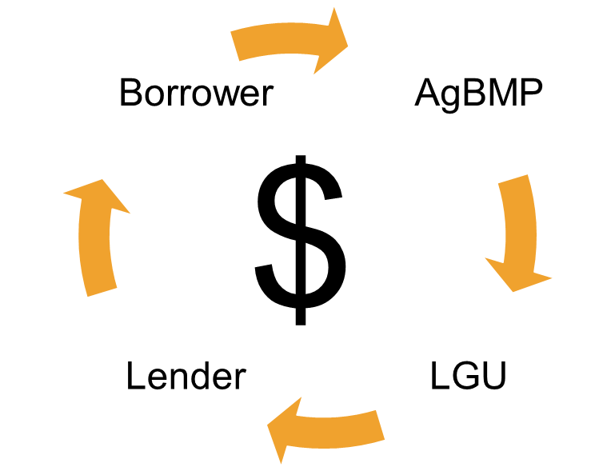
Agricultural Best Management Practices Loan Program (AgBMP)
It is a Loan
Not a GRANT Revolving Loans
REPAID
Revolving - $$$

Slide 36
Agricultural Best Management Practices Loan Program (AgBMP)
Who Does What?
LGU approves effective project
LENDER evaluate the creditworthiness
MDA Manages funds and contracts
BORROWER implements the project and REPAYS

Slide 37


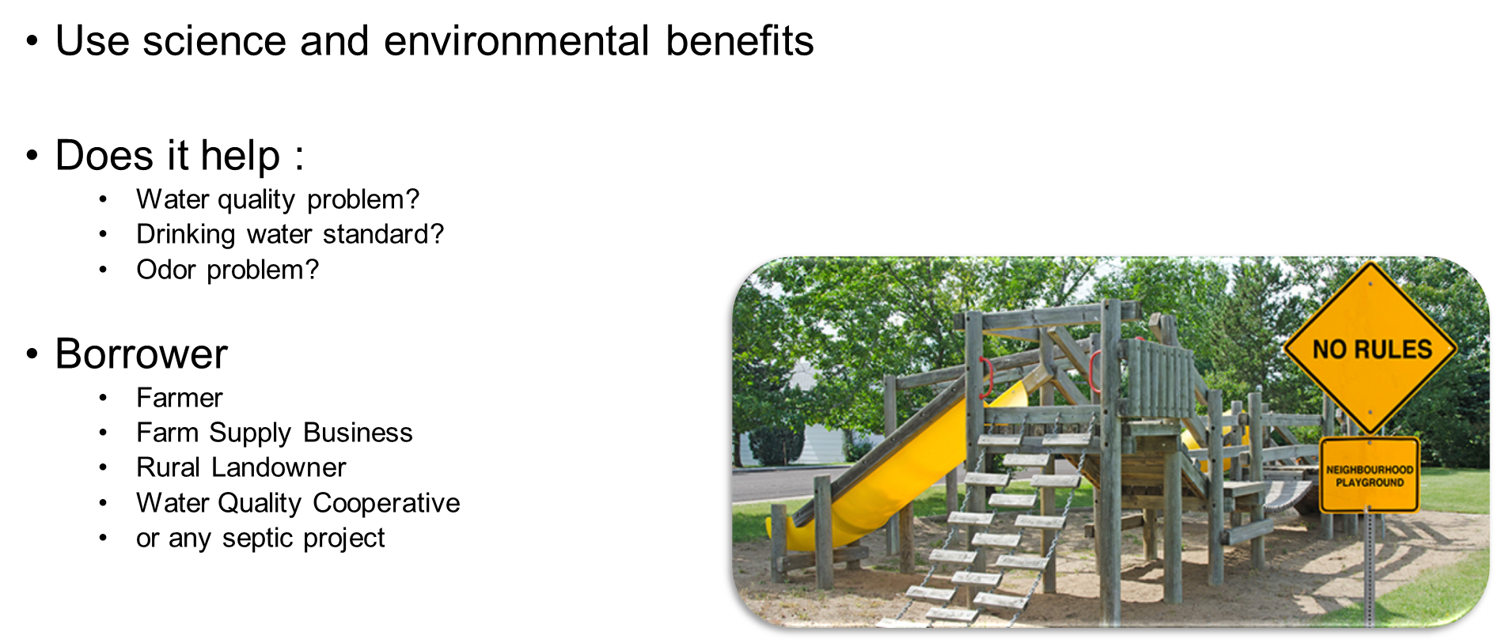
Agricultural Best Management Practices Loan Program (AgBMP)

Slide 38
Agricultural Best Management Practices Loan Program (AgBMP)
Outcome Based Example Past Practices
Ag Waste Management Structural Erosion Control Other Practices Conservation Tillage Septics Systems
Bedding Management Buffer Strip –Non-Feedlots Alternative Ground Cover Conservation Tillage Equipment SSTS upgrades
Buffer Strip-Feedlots Clean Water Diversions Alternative Energy Conservation Planting Equipment
Clean Water Diversions-Feedlots Erosion Control – General Brownfield Restoration Conservation Chopping Equipment
Composting In-Channel Practices Chemical Containment
Diet Management Control Sediment and Water Control Basins Chemical Irrigation Control
Feedlot Improvements Seeding Critical Areas Chemical Application system
Livestock pasture management Stabilization- Rivers/Ditches/Streams/Waterways Connection to Central Water
Manure Handling Equipment Terracing Floodplain Protection

Slide 39
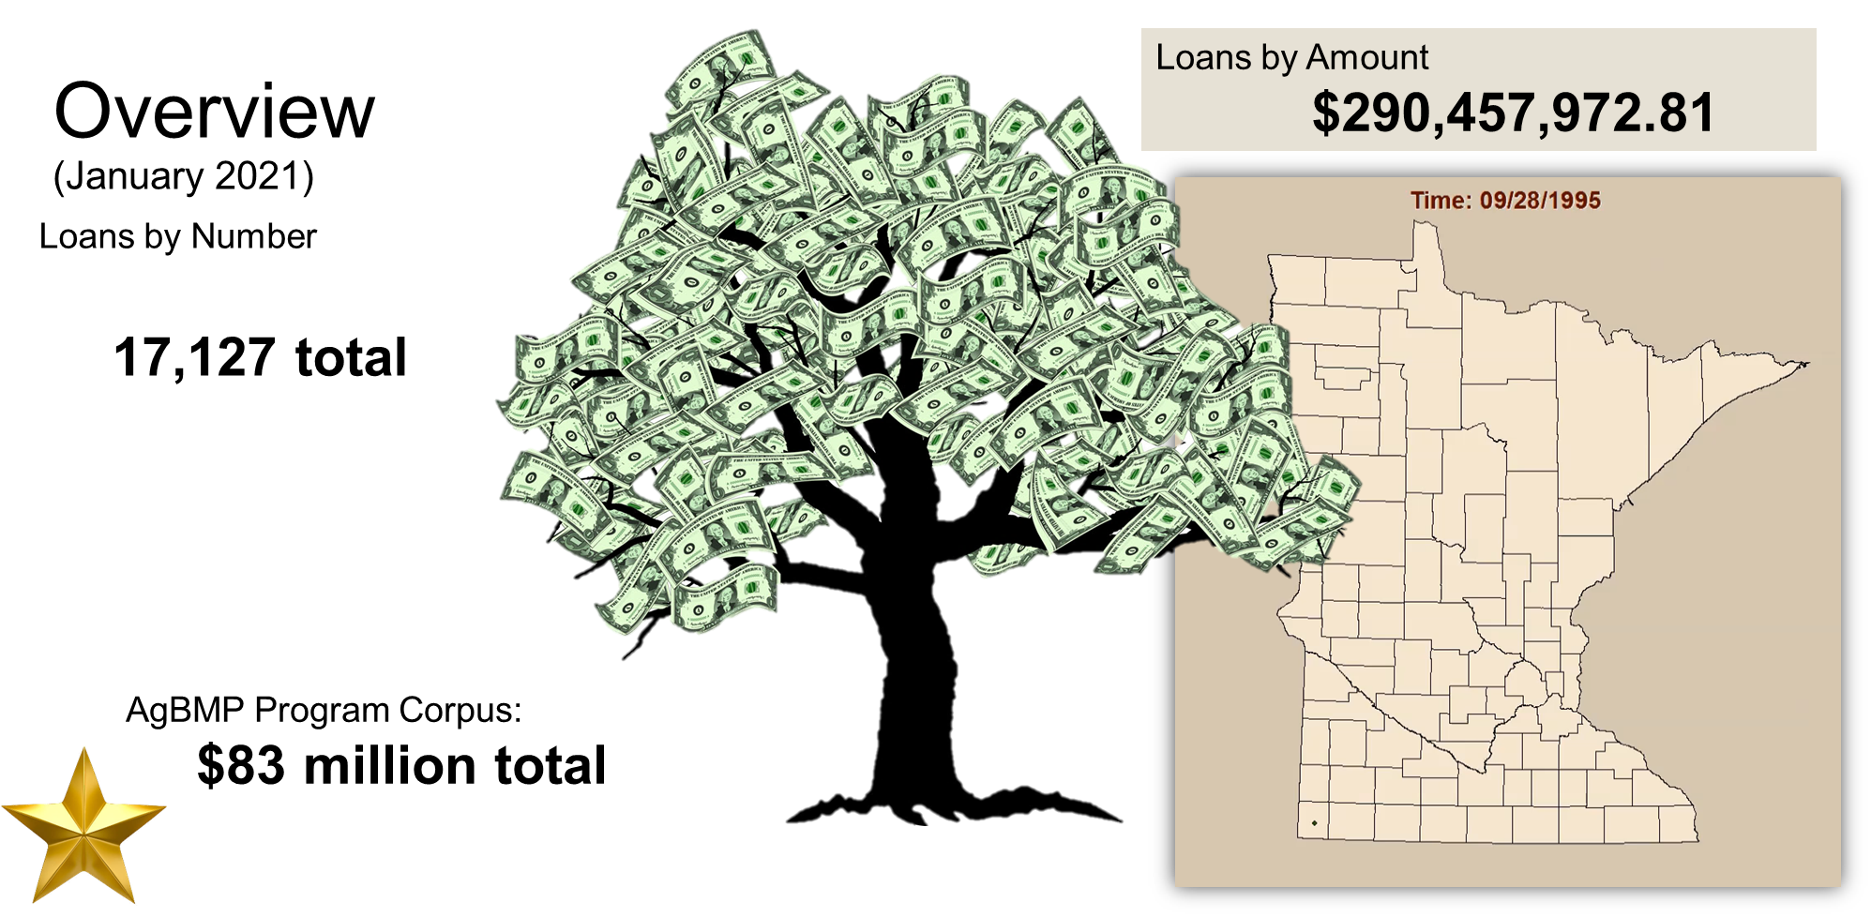
Agricultural Best Management Practices Loan Program (AgBMP)

Slide 40
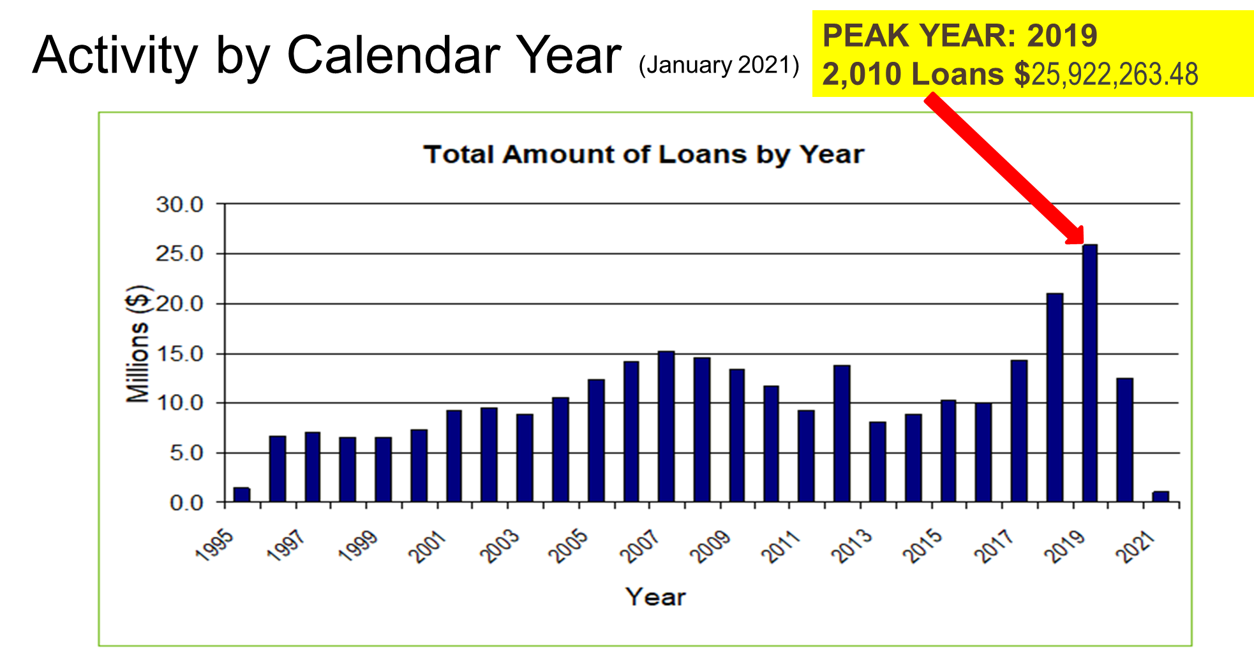
Agricultural Best Management Practices Loan Program (AgBMP)

Slide 41
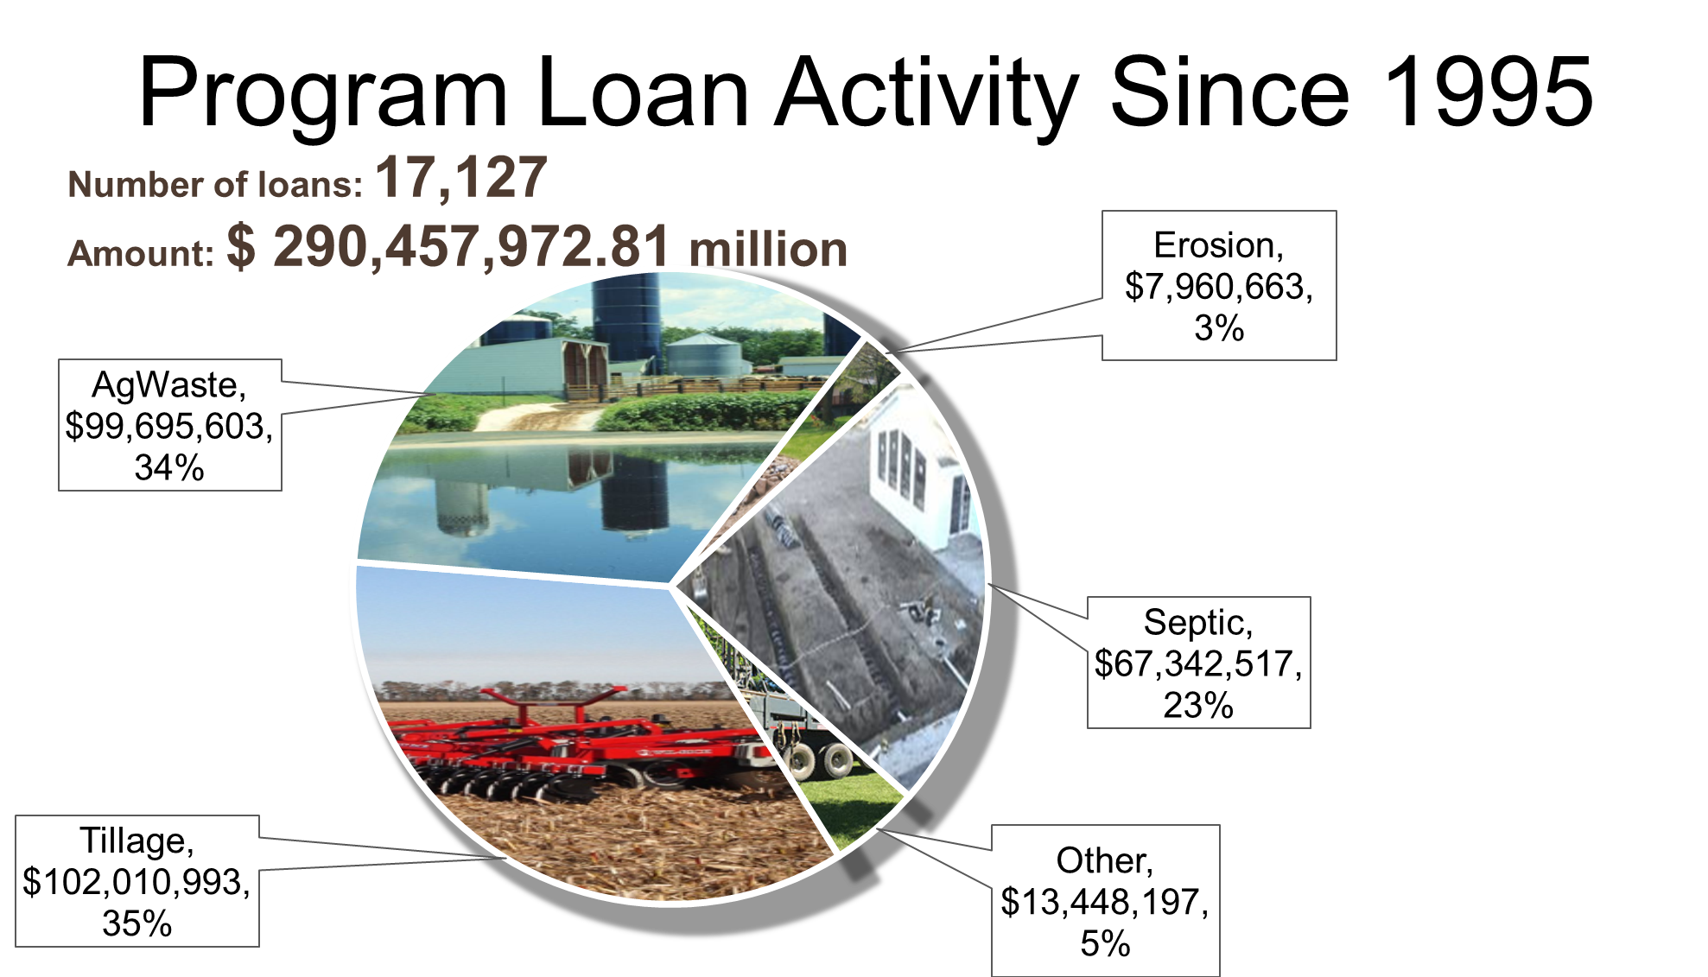
Agricultural Best Management Practices Loan Program (AgBMP)

Slide 42
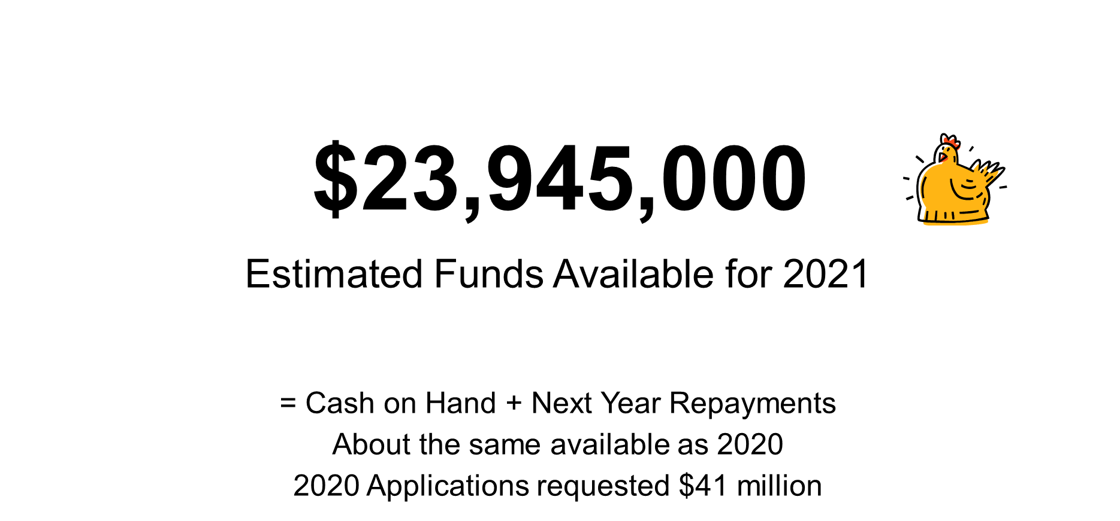
Agricultural Best Management Practices Loan Program (AgBMP)

Slide 43
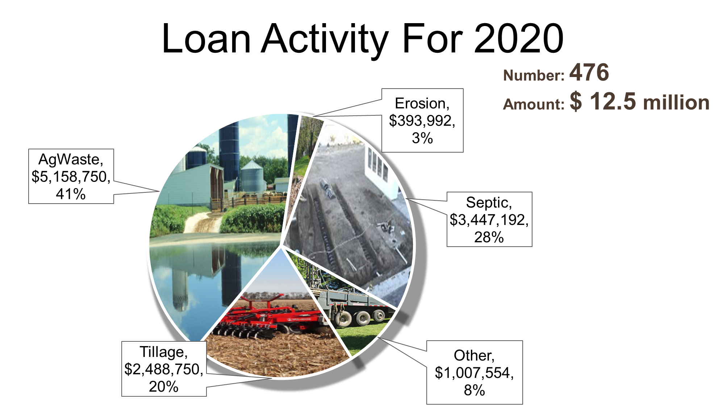
Agricultural Best Management Practices Loan Program (AgBMP)

Slide 44
Thank You
Any Questions?

