Slide 1
County Transportation 101 Emily Pugh Transportation & Infrastructure Policy Analyst

Slide 2
What is AMC?
A Voluntary Association of Minnesota’s 87 Counties Since 1909
The Voice of County Government in Minnesota
An Education, Training & Communication Resource for Counties and County Officials
Notes:
Roads eligible for CSAH system are regionally significant enough to justify a state contribution

Slide 3
CSAH System
County State Aid Highway System (CSAH)
30,600 miles of roadway – 67% of total county mileage
County Roads – 14,500 miles of roadway, 33% of mileage
Main Revenue Sources:
Highway User Tax Distribution Fund (HUTDF)
Property tax, local option taxes for local matches
Notes:
Roads eligible for CSAH system are regionally significant enough to justify a state contribution

Slide 4
Background Information
Town Bridges
$16M
Gas Tax
$899M
Collections, DNR, Public Safety, etc.
$27M
Total Local S Share
120,629 miles
89.1%
40.7% VMT
Total County Share
45,000 miles
33.5%
24.7% VMT
Source:
Mn/DOT Traffic
Data and Analysis
Town Roads
$30.8M
5% Distribution
$101M
License Fees
$724.2M
Flex Highway
$54M
Highway User Tax Distribution Fund
$2.064B
Trunk Highway (62%)
$1.192B
Motor Vehicle Sales Tax
$435M
County State Aid
(29%)
$553M
Interest
$5M
Regular Distribution
$1.9B
Municipal State Aid (9%)
$173M
Notes:
This slide is a simplification – it shows how funding for our highway systems in Minnesota is generated, and how it is distributed.
Starting on the GREEN- this is funds generated through 3 Main taxes….GAS TAX is largest – 28.6 Cents per gallon raises $875 Million every year.
Also here is License Tab Fees and Motor Vehicle Sales Taxes.
For total revenue of $1.8 Billion
Right off the top about $112 Million is set aside for the DNR, Public Safety, Townships and for highway turnbacks.
The remaining $1.7 Billion is distributed as shown in the Golden color. This distribution is set in the State Constitution at 62% going to the State Trunk Highway System, 29% going to the County State Aid Highway System, and 9% going to the Municipal State Aid Highway system. The MSA System is a network of city streets in cities with populations over 5000.

Slide 5
Highway Funds
Highway User Tax Distribution Fund (HUTDF)
Established under the MN Constitution
Distributes funds to state and local highways
Contains dedicated highway revenue
Motor fuels tax
Registration tax
Motor vehicle sales tax

Slide 6
Highway Revenue Sources
Motor Fuels Tax
100% constitutional dedication to roads.
Total rate for gasoline and diesel = 28.5 cents per gallon.
Registration Tax (tab fees)
100% constitutional dedication to roads.
Annual tax on vehicles registered in MN.
Tax rate for passenger auto: $10 plus 1.25% of the base value of the vehicle, depreciated annually.
Minimum set at $35.

Slide 7
Highway Revenue Sources
Motor Vehicle Sales Tax (MVST)
Rate of 6.5% tax on vehicles sales, in lieu of a general sales tax.
Constitutionally dedicated to transportation.
Statutorily allocated.
60% for highways
40% for transit
36% metropolitan transit area
4% Greater MN transit

Slide 8
Highway Funds
HUTDF Distribution
95% distribution
62% Trunk Highway Fund
29% County State Aid Highway (CSAH) Fund
9% Municipal State-Aid Street (MSAS) Fund
5% set-aside
16% town bridge account
30.5% town road account
53.5% flexible highway account
Allocation of 5% formula can only be changed every 6 years, last was in 2009

Slide 9
Flexible Highway Account
Current Flexible Highway Account
Funding is typically split 50/50 between Metro and Greater MN
Uses
First Priority - Turnbacks: fixing up and turning over trunk highways to local units of government.
Second Priority – Local roads (safety improvements, routes of regional significance).
Note: to date, all funding in this account has gone towards turnback projects

Slide 10
Local Funding
In addition to state aid funds, local roads are financed through:
Property taxes
Assessments
Local options
Wheelage tax
Sales tax

Slide 11
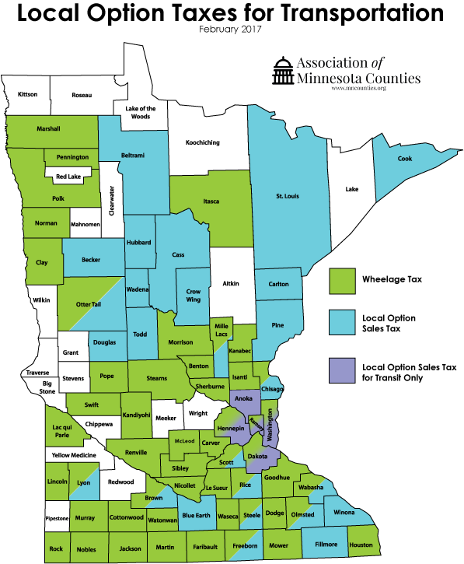

Slide 12
Local Option Sales Tax
Rate: Up to ½ of 1 percent on retail sales within the county, and $20 per vehicle excise tax
Use: A specific transportation project, transit capital expenditures as well as operating costs
How Enacted: by County Board approval – a county not imposing a county sales tax as part of CTIB
27 counties have adopted: Becker, Beltrami, Blue Earth, Brown, Carlton, Cass, Chisago, Cook, Crow Wing, Douglas, Fillmore, Freeborn, Hubbard, Lyon, Mille Lacs, Nicollet, Olmsted, Otter Tail, Pine, Rice, St. Louis, Scott, Steele, Todd, Wabasha, Wadena, Winona (Cook County as of 4/1/17).

Slide 13
Wheelage Tax
Rate: $10 per vehicle charge on vehicles housed in the county
Collection: With annual tab fees
Use: Highway purposes; intended for local roads or CSAH matches
How enacted: By County Board approval. In 2018 will be able to collect amounts up to $20.
51 counties have adopted.

Slide 14
Other Highway Funding Sources
Motor Vehicle Lease Sales Tax
Rate of 6.875% on passenger vehicles leases
Statutory allocation
First $32M to the General Fund
50% of remaining to suburban ring counties
50% of remaining to Greater MN Transit

Slide 15
Bonds
Trunk Highway Bonds
Used for trunk highways only – Corridors of Commerce Program, Transportation Economic Development (TED).
Debt Service must not exceed 20% of revenue in the Trunk Highway Fund.
General Obligation Bonds
Funds many modes – rail, transit, airports, ports and waterways, roads and bridges, wetland mitigation.
Can be funded through a program or by earmark
Establish programs supported by counties:
Local Road Improvement Program
Local Bridge Replacement Program
Local Road Wetland Replacement Program

Slide 16
Federal Aid
Amount of funding that is available is determined by the Federal Transportation Bill – FAST Act
A local match or contribution is required
Reimbursement
Funding is important in delivering much needed projects

Slide 17
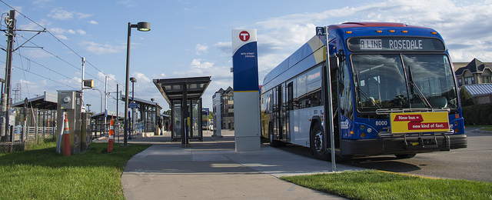
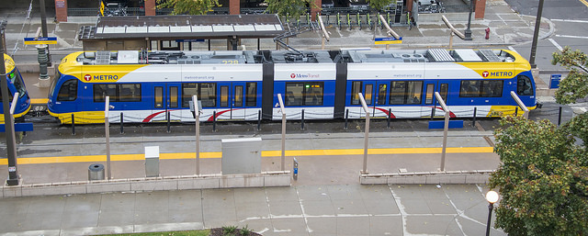
Transit

Slide 18
Transit Finance
Transit Provided By Local Units of Government
Twin Cities metro area
Metropolitan Council
Suburban providers (opt-outs)
Independent providers
Variety of transit systems and service in Greater MN
City-only and county-only service
Service across multiple counties

Slide 19
Transit Finance
Sources of Greater MN Transit Funding:
Federal aid
State sources
General Fund
Motor Vehicle Lease Sales Tax
Motor Vehicle Sales Tax
General Obligation bonds
Local effort (property, sales tax)
Fare box recovery

Slide 20
Transit Finance
Sources of Metro Area Transit Funding – Operating:
Federal aid
State Sources
General Fund
MVST allocation
Fare box recovery
Property taxes

Slide 21
Transit Finance
Sources of Metro Area Transit Funding – Capital:
0.25% transit sales tax
Authorized local option sales tax
For transitway capital and ½ of operating costs
Administered by county joint powers board: CTIB
Hennepin, Ramsey, Anoka, Dakota, Washington
Federal aid
Local Property Tax levy, County Regional Rail Authorities
State General Fund, and GO bonding

Slide 22
AMC Priorities
TRANSPORTATION FUNDING
AMC supports a comprehensive transportation funding package that includes new revenue for roads, bridges, and transit.
The solution should be comprehensive (multi-modal), balanced (regionally and between modes), sustainable (on-going funding), and dedicated (constitutionally for roads and statutorily for transit).

Slide 23
AMC Priorities
LOCAL ROAD WETLAND REPLACEMENT PROGRAM
AMC supports the immediate need for short-term cash funding for the Local Road Wetland Replacement Program (LRWRP) and long-term continued funding of the program.
BWSR will need approximately $5 million in cash to buy wetland credits from private wetland banks to meet immediate LRWRP obligations, as well as $10 million in bonding authorization to recapitalize its wetland banks to meet LRWRP obligations in future years.

Slide 24
Contact Information
Emily Pugh
Transportation & Infrastructure
Policy Analyst
651-789-4339
epugh@mncounties.org

