Slide 1


Evolving Commercial PACE Programs
Clean Energy Economy Minnesota
House Energy & Climate Finance and Policy Division | February 21, 2019

Slide 2
Clean Energy Economy MN (CEEM)
What we’re about
CEEM is an industry-led nonprofit organization dedicated to strengthening Minnesota’s clean energy business ecosystem.
Our mission
Provide educational leadership, collaboration, and policy analysis that accelerates clean energy market growth and smart energy policies.
We promote the business case for energy efficiency and clean energy to drive innovation and expand markets.

Slide 3
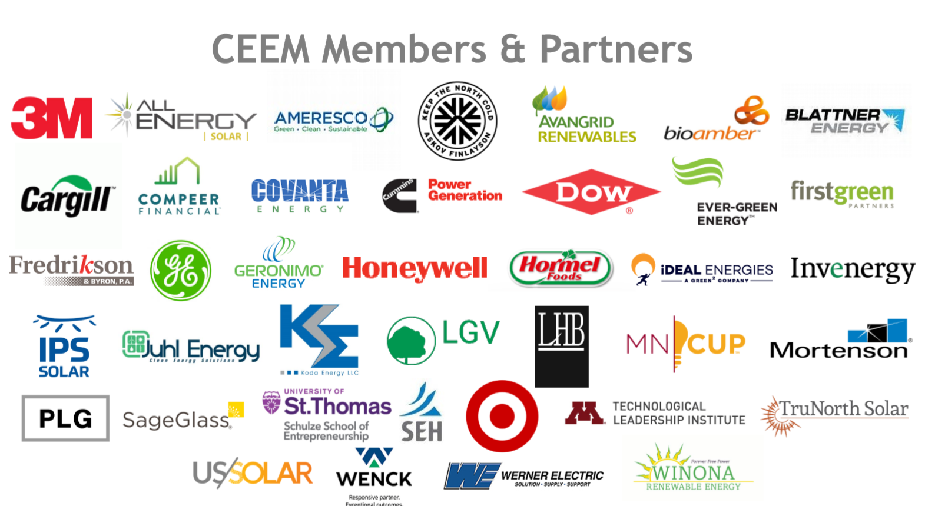

Slide 4
Policy Discussion
What opportunities does Commercial PACE provide?
H.F. No. 1360:
  Responds to increasing business demand for access to clean energy options
  Recognizes program successes
  Recognizes and adjusts market barriers for commercial financing of clean energy
  Leverages common practices for assessing value of property already in use

Slide 5
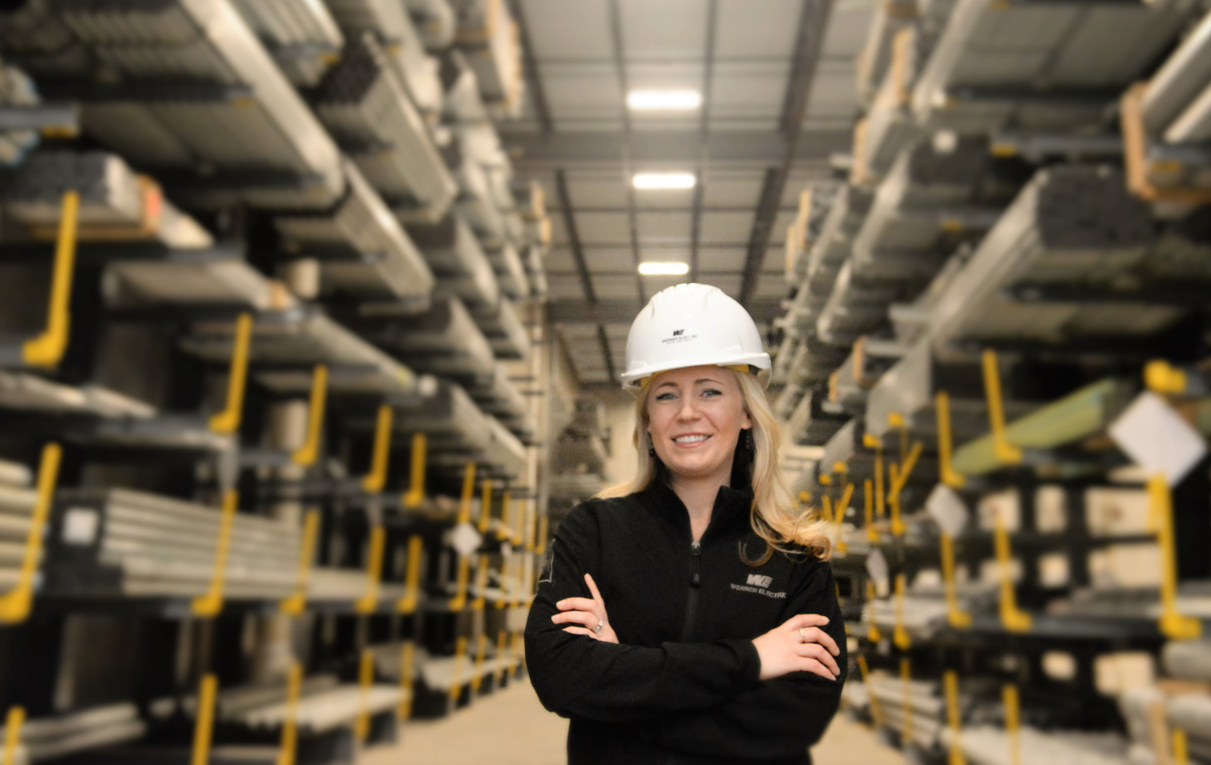
Clean Energy Jobs in Minnesota
59,000+ Minnesotans work in clean energy
Clean energy jobs grew 2x faster than overall job growth in 2017
40% of clean energy jobs are in Greater MN
Small businesses drive the clean energy sector
Source: Clean Jobs Midwest, 2018
Notes:
According to 2018 Clean Jobs Midwest report, 72.4% of firms employ fewer than 20 employees

Slide 6
Contact Information
Benjamin Stafford, Director of Policy & Public Affairs
Clean Energy Economy MN
bstafford@cleanenergyeconomymn.org

