Slide 1
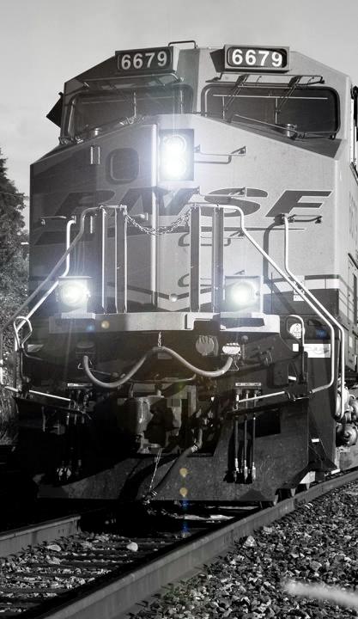
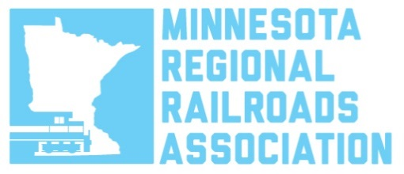
Railroad Safety Update
House Transportation Committee
February 2, 2017

Slide 2
Rail is safe and getting safer
Freight railroads are “common carriers” required by federal law to carry all legal cargo, including crude oil and other hazardous materials
99.997% of hazmat carloads are moved without a train accident-related release
Rail accidents have dropped by 45% since 2000 and 80% since 1980, along with employee injuries, and grade crossing collisions, as private rail investment has increased steadily

Slide 3
INVESTMENTS IN SAFETY & INFRASTRUCTURE
Across the US, freight railroads have invested $600 billion in their network since 1980 and spend nearly 18% of their revenue on capital expenditures, 6 times more than the average manufacturer
In 2015 & 2016, Minnesota’s railroads invested approximately $700 million in private capital improvements
UP invested $108 million in track, bridge and equipment upgrades in Minnesota
CP made $136 million investments in upgrading and improvements to its Minnesota operations
BNSF invested more than $700 million in last 4 years in MN network and plans another $85mm in MN in 2017

Slide 4
Prevention and mitigation
  Increased Track Inspections - BNSF inspects tracks and bridges more often than required by the FRA. Most BNSF key routes inspected four times weekly and busiest routes daily
  Increased Trackside Safety Technology
  Operations - lower Speeds for Key Trains - BNSF operates at maximum of 35 mph through municipalities of 100,000+ if DOT-111 cars in train, 50 mph maximum elsewhere
  Operations - during a train meet, a Key Train holds main track when possible
  Operations - certain trains carrying HAZMAT must be inspected following an emergency braking application

Slide 5
Prevention and mitigation
Rail Risk-Based Traffic Routing Technology
Use PHMSA’s Rail Corridor Risk Management System, 27 risk factors defining the “most safe and secure” routes
  Safer Tank Cars
    New tank car standards in effect for tank cars built after Oct. 1, 2015: Increased thickness, thermal protection, full-height head shield
Unattended Trains
    Crude oil trains left unattended require specific job safety briefing between train crew and train dispatcher
    Locomotive Cab Securement: Key Trains left unattended have reverser removed and cab doors locked

Slide 6
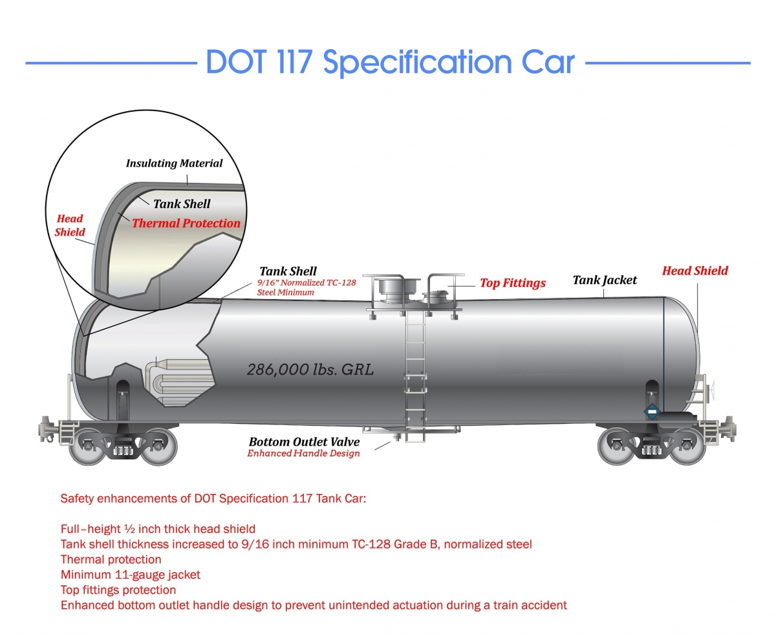
Mitigation - New Tank Car Standards
Tank Cars for High-Hazard Flammable Trains (HHFT)
New tank cars built after Oct. 1, 2015, must meet enhanced DOT 117 design or performance criteria
        Increased thickness from 7/16” to 9/16” steel
        Thermal protection required
        Jacketing with minimum 11-gauge steel and weather-tight
        Full-height Head Shield - ½” thick

Slide 7
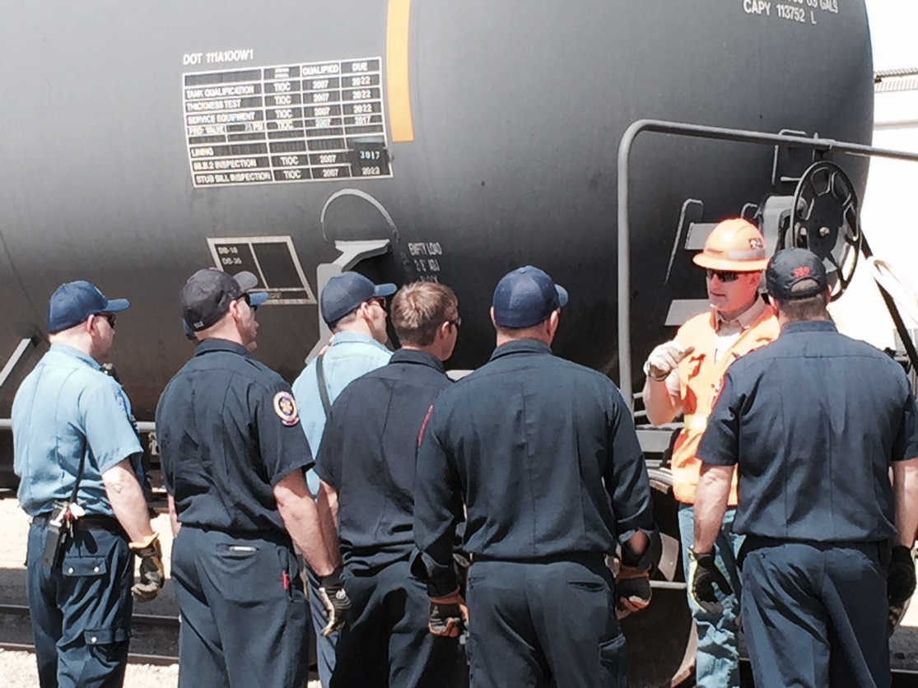
TRAINING & LOCAL Coordination
Railroads have provided 1st first responder training for decades
7,000+ 1st responders trained by railroads in 2014-16
Railroads also pay DPS $1.25 million/year to provide similar training

Slide 8
Training and local coordination
Commodity flow studies are available for emergency managers & fire chiefs upon request. And now more information available:
      Railroads send state emergency response commissions Bakken crude traffic of 1 million+ gallons
      BNSF’s new www.bnsfhazmat.com as one-stop shop for training, response information for first responders
      AskRail app for first responders

Slide 9
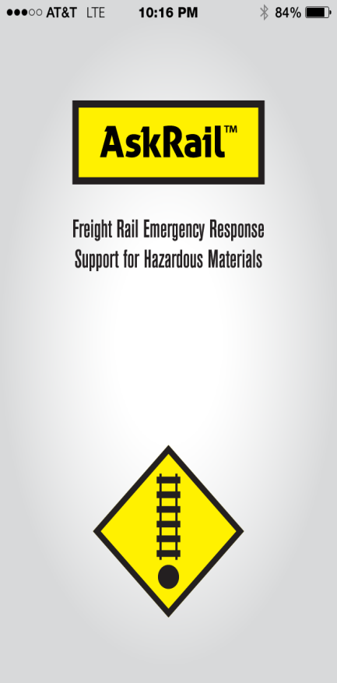
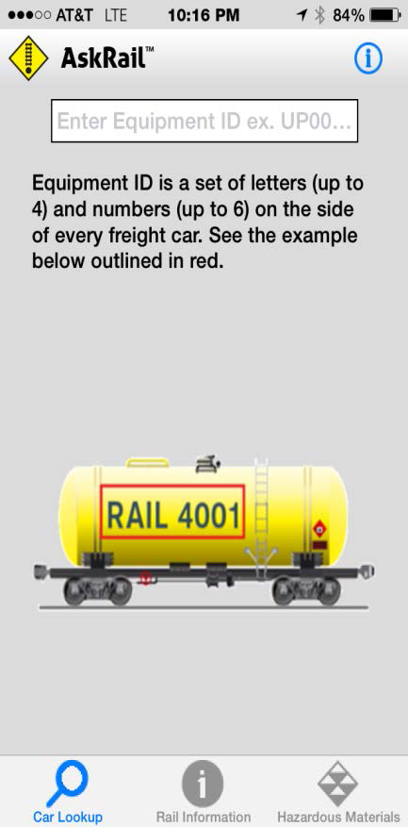
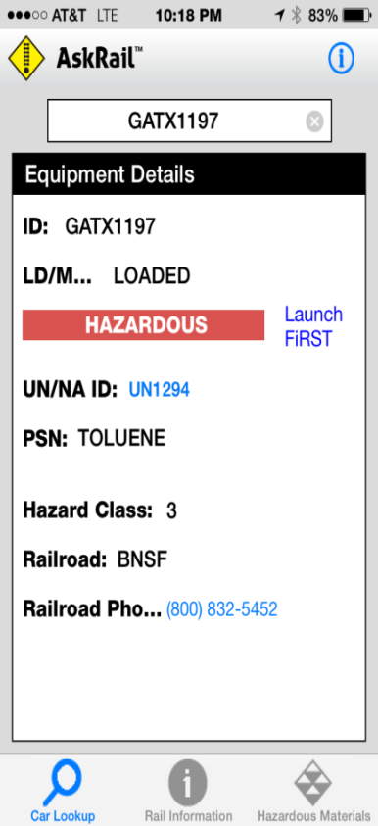
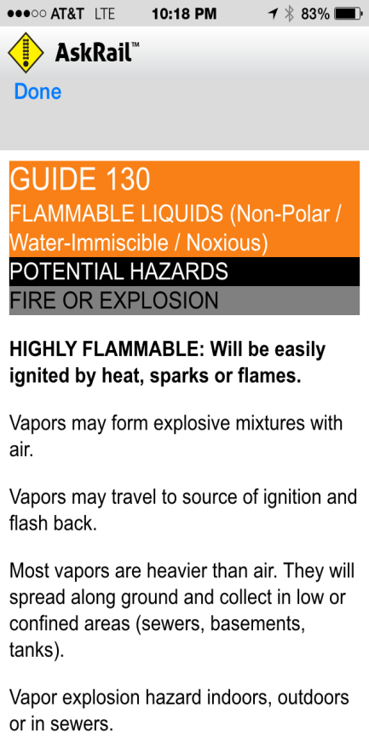
AAR “AskRail”– single car view

Slide 10
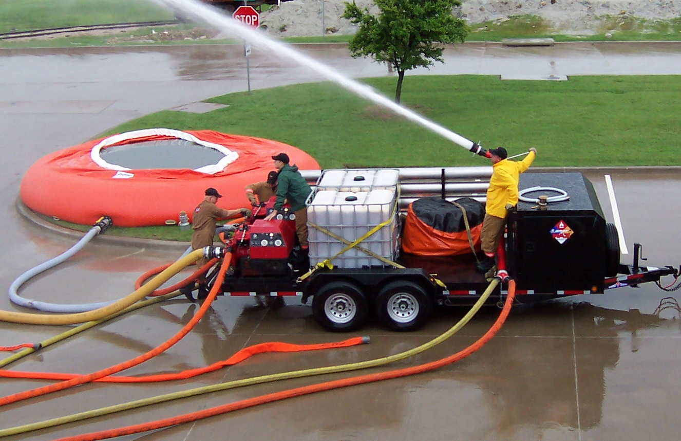
Fire trailer Equipment
(4) 12’ sections of hard suction hose for water supply
(2) 10,000 gallon bladders for water supply
Monitor nozzle mounted onto trailer
(2) 750-gpm Darley portable pumps
Every appliance and adapter for any situation
(2) 275-gallon totes of AR-AFFF foam
1100’ of fire hose

Slide 11
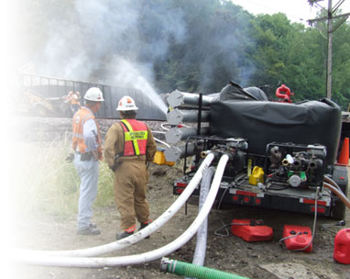
Resources to the scene
Fleet of industrial
fire-fighting foam trailers
Emergency breathing
air trailers
Chlorine kits
Midland kits
Air monitoring assets

Slide 12

Vancouver
Manitoba
Seattle
Whitefish
Great Falls
Portland
Pasco
Minot
Kennewick
Helena
Fargo
Superior
Billings
Hettinger
Mandan
Gillette
Minneapolis/
St. Paul
Klamath Falls
La Crosse
Guernsey
Alliance
Sioux City
Chicago
Richmond
Salt Lake City
McCook
Lincoln
Galesburg
Stockton
Fresno
Denver
Kansas City
St. Louis
Bakersfield
Barstow
Winslow
Avard
Arkansas
City
Springfield
Los Angeles
Needles
Tulsa
San Bernardino
Belen
Clovis
Amarillo
Oklahoma
City
Memphis
Phoenix
Haslet
Birmingham
BNSF Hazmat Responder Locations
El Paso
Sweetwater
Ft. Worth
Teague
BNSF Hazmat Responder
Temple
Lafayette
New Orleans
Houston
** 260 BNSF HMERT Responders at 67 Locations
Updated June 2016

Slide 13
LEGISLATIVE ISSUES
Certification of Railroad Police Officers – only 2 states do not allow railroad officers to have police powers.
Compliment local police. Emphasis on criminal activity on railroad property.
Railroad information sharing legislation to improve communication, training and information sharing with
first responders and emergency managers
- currently SF210, Article 4 (bonding bill)

Slide 14
Questions?
“Stay on Track…”
Thank-you!

