Slide 1
HF 211- Loan forgiveness expansion

Slide 2
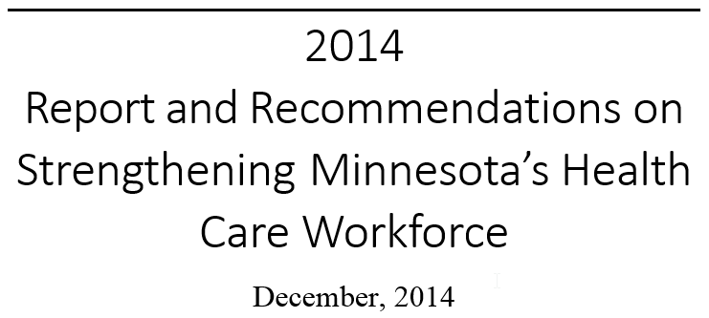

Slide 3
WORKFORCE COMMISSION FINDINGS:
Rural areas in Minnesota face a variety of challenges to attract and retain health professionals in many occupations.
WORKFORCE COMMISSION RECOMMENDATIONS:
The legislature should support continuation, and growth where warranted, of proven programs with measurable outcomes like loan forgiveness.

Slide 4
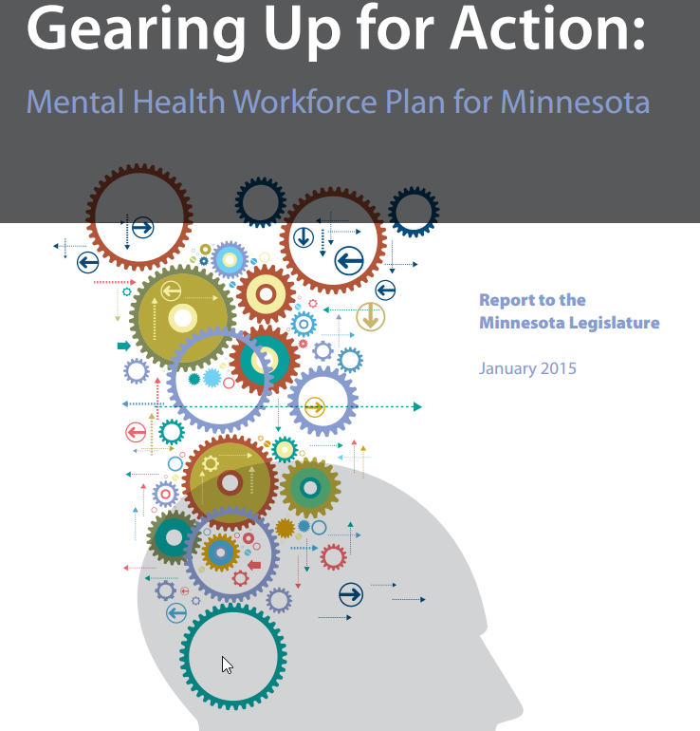
Mental Health Workforce Plan for Minnesota Report to the Minnesota Legislature January 2015
Demand for mental health providers will be exacerbated by combined challenges of:
an aging mental health workforce
ongoing discrimination associated with mental illnesses,
low wages,
increasing regulations
costs of education and training
Recommendation 19:
Add mental health professionals to the Minnesota Health Professionals Loan Forgiveness program and increase funding

Slide 5
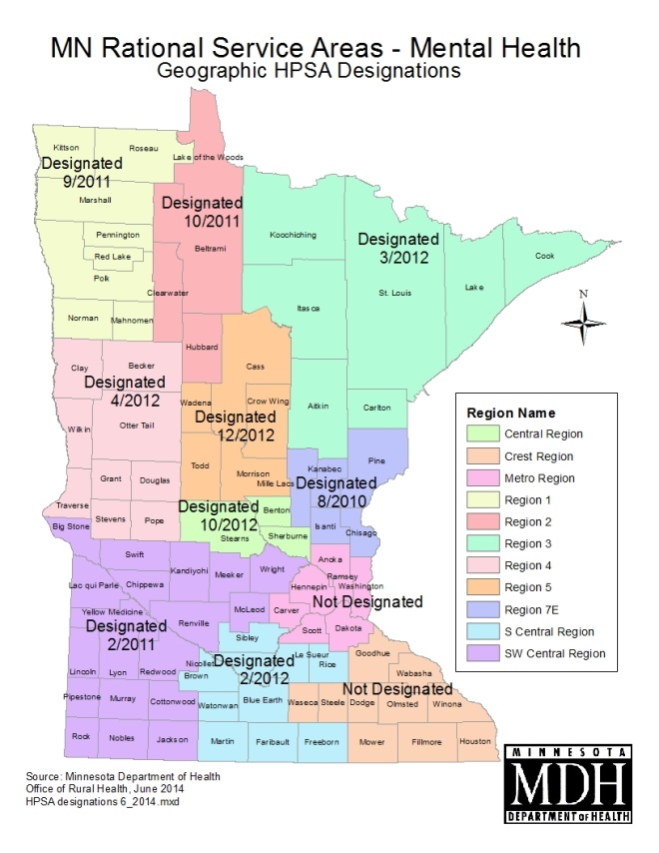
Mental Health HPSA requires a psychiatrist to population ratio of 35,000 to 1

Slide 6
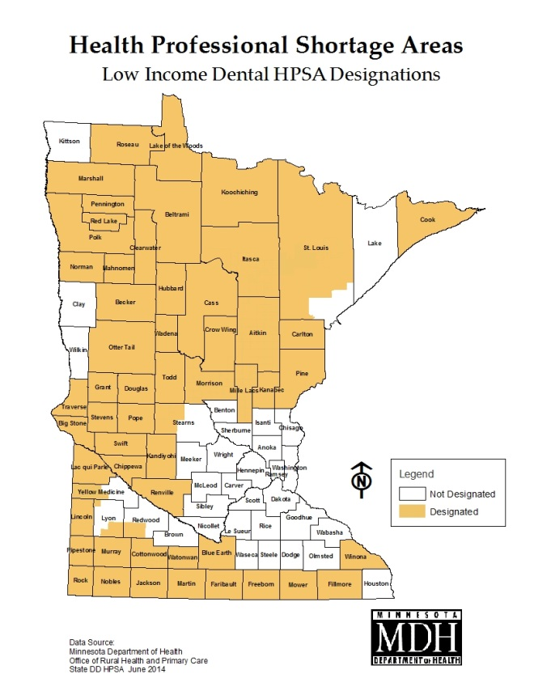
Low Income Dental HPSA requires a dentist to population ratio of 4,000 to 1

Slide 7
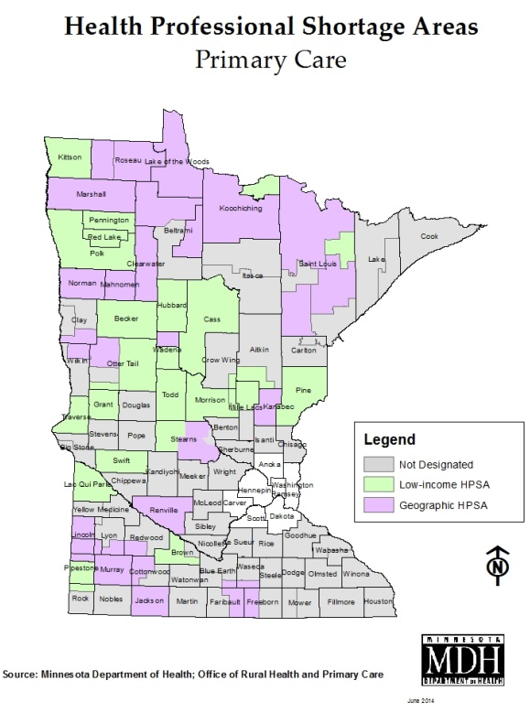
Primary Care Health Professional Shortage Area requires a physician to population ratio of 3,500 to 1

Slide 8
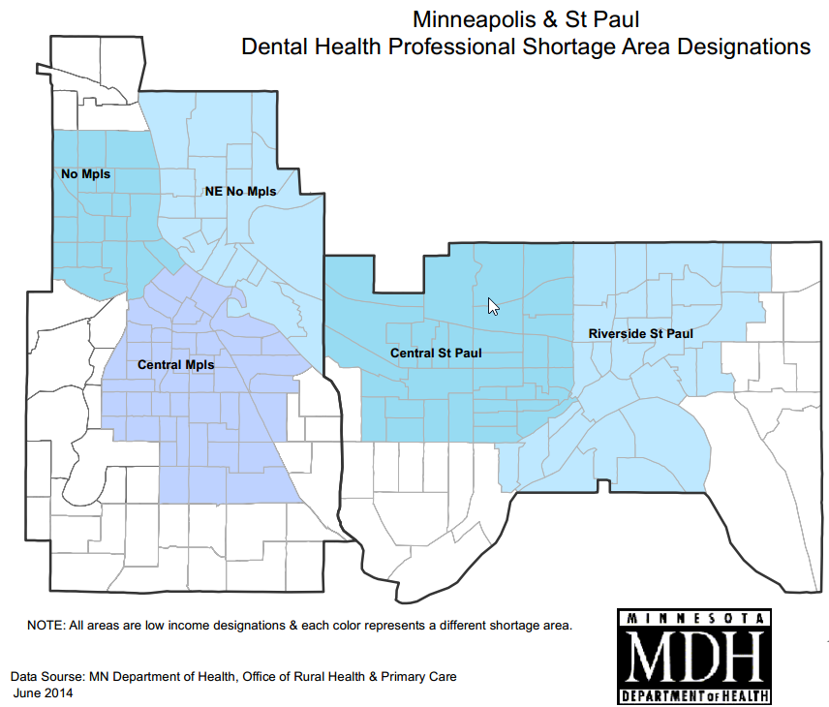
Low Income Dental HPSA requires a dentist to population ratio of 4,000 to 1

Slide 9
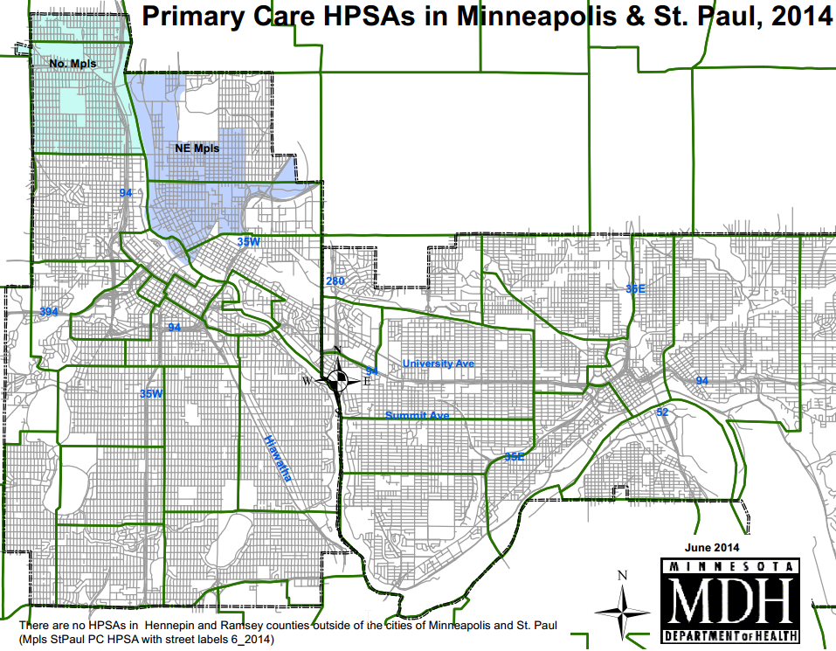
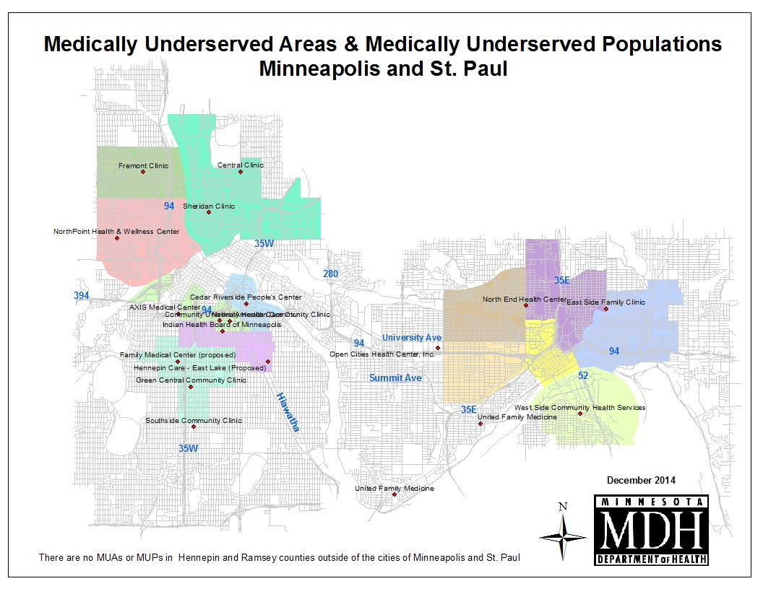
Primary Care Health Professional Shortage Area requires a physician to population ratio of 3,500 to 1

Slide 10
Bringing Health Care to the Heartland: An Evaluation of Minnesota’s Loan Forgiveness Program
“An effective program that meets its goals of recruiting providers to underserved areas, and that is an influential factor in recipients’ decision of where to practice after graduation.”
88% of physicians and 93% of physician assistants and nurse practitioners are still in the same or a similar location; most remain in rural areas after 15 and 20 years.
Loan forgiveness participants report that the program has a major effect on their choice of practice location.

Slide 11
What the bill does
Increases funding and the number of loan forgiveness participants to rural and underserved areas.
Adds rural mental health professionals, public health nurses and dental therapists to the loan forgiveness program
IMPACT
Over 200 new health care providers to rural Minnesota over four years, including 60 primary care physicians, nurse practitioners and physician assistants, 50 registered nurses to nursing homes, and 30 dentists, pharmacists and nursing faculty.
60 mental health professionals, public health nurses and dental therapists, all for rural areas.

Slide 12
Minnesota Loan Forgiveness Program
Profession | Average Student Debt | Annual Award Amount | 4-Year Award Amount
Physician | $169,900 | $25,000 | $100,000
Dentists | $206,100 | $30,000 | $120,000
Pharmacist | $133,700 | $20,000 | $80,000
“Midlevel” Practitioners | $82,900 | $12,000 | $48,000
Nurses/Public Health Nurses* | $34,000 | $5,000 | $20,000
Nurse/Allied Health Faculty | $61,000 | $9,000 | $36,000
Dental Therapists* | $69,000 | $10,000 | $40,000
Mental Health Professionals (Blended)* | $64,000 | $10,000 | $40,000
* Proposed additions in SF 3 – public health nurses, dental therapists, mental health professionals

