Slide 1
Healthcare Pricing Transparency HF57,58,59
Representative Steve Elkins
rep.steve.elkins@house.mn

Slide 2
Overview
The Big Picture

Slide 3
Why?
Is there anything else that we buy that can cost us hundreds or even thousands of dollars where we would feel like it’s normal and acceptable to place our order with the understanding that we’ll only learn what the price is going to be after we’ve taken delivery, while accepting an obligation to pay whatever price is asked after the fact?
Why do we accept this when buying healthcare?

Slide 4
The Big Picture
HF57
Hospitals & “Shoppable” Services
Builds on CMS Hospital Pricing Rule
Reveals List Prices and Actual Price Ranges
Chargemaster List Price
Self Pay Price
Median Reimbursement Rate
Min/Max Rate
Comprehensive
Healthcare Price Reporting
HF 58
Drugs
Builds on HF 1246 (Morrison)
Reveals List Prices
Wholesale Acquisition Cost (WAC)
Average Wholesale Price (AWP)
Medicare Drug Spending Data
Public Information
Medicare/Medicaid Reimbursement Rates
Public Information
HF 59
Services & Drugs
Builds on Existing All Payer Claims Database
Reveals Prices Paid on Actual Claims

Slide 5
Credits
Thanks to the Staffs of these Organizations for their advice and assistance in the development of these bills:
NCSL (National Conference of State Legislatures)
NASHP (National Academy for State Health Policy)
United States of Care
Minnesota Department of Health
Minnesota Department of Human Services

Slide 6
HF59 All Payers Claims Database
Steve Elkins | Representative HD 49B

Slide 7
Minnesota All Payer Claims Database
The All-Payer Claims Database (APCD) is a repository of healthcare claims records submitted to MDH by Minnesota Health Plans.
APCDs are promoted under federal law, and many states have them
Their purpose is to support medical research and reporting
All APCD data is “de-identified” – all Personally Identifiable Information (PII) has been stripped out.
Usage of the Minnesota APCD has been limited because, under current State Law …
Only semi-annual submissions are required so much of the data is “stale”
Some plan administrators withhold data from employer financed “ERISA” plans, so the scope of the data is incomplete.
APCD data cannot be used for price reporting because of earlier negative experiences with using stale, incomplete data for this purpose. (Provider Peer Group reporting)

Slide 8
Objectives of HF 59
Improve latency of the data by requiring monthly submissions
Most health plans already do – it’s actually easier because the data volumes are more manageable
Leverage language in Federal No Surprises Act encouraging the submission of ERISA plan data to improve the scope of the data.
Allow the improved data to be used for reporting of actual pricing by procedure and provider
Reporting by both provider and health plan is prohibited by federal law to preserve the confidentiality of negotiated rates.
Supplement the reporting of published price data required by HF 57 and HF58.
Note: Congress has appropriated a grant of $2.5 million per state to fund these types of initiatives

Slide 9
HF 59 Key Stakeholders
The Key Stakeholders consulted in the Development of HF58 include:
Minnesota Department of Health
Minnesota Hospital Association
Minnesota Medical Association
Minnesota Chamber of Commerce
Testifiers
Minnesota Department of Health
Minnesota Medical Association
Minnesota Chamber of Commerce

Slide 10
HF57 Hospitals & Shoppable Medical Services
Steve Elkins | Representative HD 49B

Slide 11
HF 57: Shoppable Medical Services Prices
The foundation of HF 57 is the second version of the CMS Hospital Price Transparency Rule, first enacted in 2018.
The new version of the Rule was effective Jan 1, 2021 and requires hospitals to post the following information on their websites:
Their “Chargemaster” list prices for each service
Their Cash Prices for the uninsured for each service
The Median Price received by the hospital for each service
The Minimum and Maximum Prices received by the hospital for each service
The current reimbursement rates for each health plan for that service
… in a “Machine Readable” format (Excel, CSV, …) that can be imported into a spreadsheet or database.

Slide 12
HF 57: Shoppable Medical Services Prices
Problem: Each hospital is posting the data in its own unique format, which thwarts the use of the data for price comparison purposes.
Hennepin Health HCMC file Layout
Allina Abbot Northwestern file layout:
?
Notes:
CPT 70490 Computed tomography, soft tissue neck; without contrast material

Slide 13
HF 57: Shoppable Medical Services Prices
The Solution:
Require all hospitals to use the same format for their “Machine Readable” files
Require hospitals to transmit these files to the MN Dept of Health
Fund the MN Dept of Health to compile the files into a single database for comparison purpose, focusing on the creation of price comparisons for “Shoppable Services” (e.g., Imaging, Orthopedics)
Extend the requirement to other providers of these shoppable services (e.g., Orthopedics, Radiology, etc.)

Slide 14
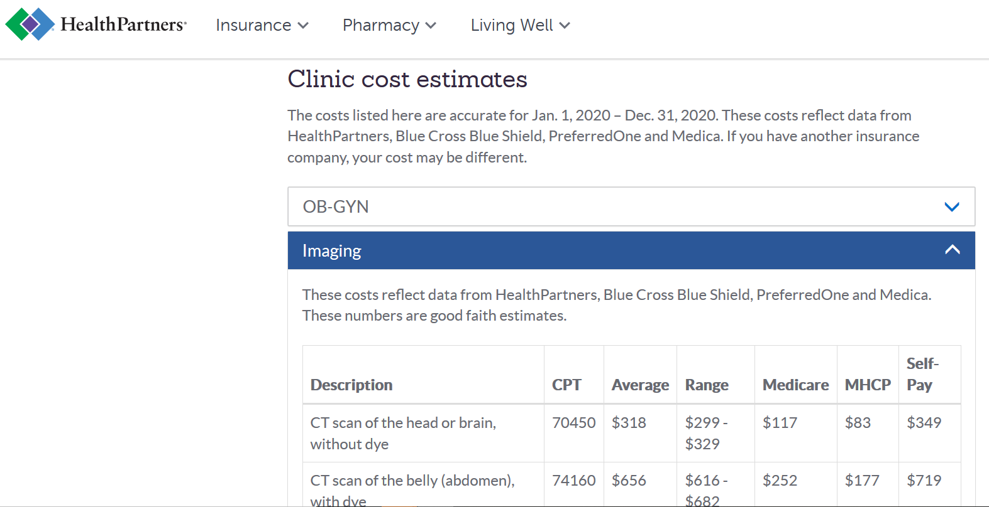
The Goal of HF57: Comprehensive, Accessible and Understandable Health Care Prices for Patients
The CMS Rule also requires “a display of shoppable services in a consumer-friendly format.”
This presentation of price information for a selection of “Shoppable Services” by Health Partners/Park Nicollet is exemplary in its presentation; however, only a limited number of prices are presented.

Slide 15
HF 57 Key Stakeholders
The Key Stakeholders consulted in the Development of HF57 include:
Minnesota Department of Health
Minnesota Medical Association
Minnesota Hospital Association
Outpatient Surgical Centers
Specialty Medical Practices
Orthopedics (e.g., TCO)
Radiology (e.g., CDI)
Testifiers
Minnesota Hospital Association

Slide 16
HF58 Drug List Prices
Steve Elkins | Representative HD 49B

Slide 17
Progression of Drug Price Regulation Bills
2019 HF Mann
PBM Regulation
2020 HF Morrison
Drug Price Transparency 1
2020 HF Elkins
Drug Price Transparency 2
2020 HF Cantrell
Drug Formulary Stabilization
2021 HF 58 Elkins
Drug Price Transparency 2
Drug Formulary Stabilization
Under HF 58 both Manufacturers and PBMS/Plans would be required to file their offerings in advance and honor them for the duration of the next calendar year.

Slide 18
The Annual Health Plan Development Cycle
When consumers enroll in a health plan during Fall open enrollment, the inclusion of their prescribed drugs in each Plan’s formulary at a particular price point is a key decision criteria.
Consumers have right to expect that the representation of their drug’s coverage will be honored over the course of the plan year by the Plan and its Pharmacy Benefit Manager (PBM).
Plans and their PBMs cannot honor that commitment, while maintaining reasonable premiums, unless the Manufacturers are also bound to honor price commitments over the same period.
Manufacturers Set WAC
PBM Negotiates Discounts/Rebates with Manufacturers
Insurers Develop and File Plans with Commerce Dept
Patients Select Plans during Open Enrollment
Plans Become Effective and Patients Submit claims

Slide 19
The Essence of HF58- Price Transparency
Every January, as soon as the Plans and their Formularies are locked in, the drug manufacturers all raise their prices.
How can we expect the Plans and their PBMs to honor their drug formularies when the manufacturers raise their prices as soon as the Plans go into effect?
HF57 would require the Manufacturers to notify the Plans and PBMs of their price increases, in advance, (Article 1) so that the Plans and PBMs can bake next year’s drug prices into their plan formularies and then honor them (Article 2).
HF57 does not restrict the ability of Manufacturers to set their own prices.

Slide 20
Drug Price Filing Requirements of HF58
HF 58 Requires Drug Manufacturers to notify the Minnesota Department of Health of their list price increases in advance and directs MDH to publish those prices to the public
WAC (Wholesale Acquisition Cost)
Nominally, the Wholesale Acquisition Cost is the “List Price” for sales by the Manufacturer to Wholesalers.
In practice it is also the “reference price” used to calculate discounts, rebates and commissions throughout the drug value chain.
AWP (Average Wholesale Price)
Nominally, Average Wholesale Price is the “Suggested Retail Price” of the drug.
In practice, it roughly guides the price at which the Wholesalers sell to the Retailers and the PBMs reimburse the Retailers.
Both WAC and AWP are starting points for negotiation
Both WAC and AWP are established by the Manufacturers
Over half of brand name drug purchases by patients are at prices tied to the WAC through co-insurance payments expressed as a percentage of the WAC.
These reference prices are widely disseminated throughout the trade by drug data aggregators such as First Data Bank and Wolters-Kluwer (Medi-Span)
They are not “Trade Secrets” in any sense of the word

Slide 21
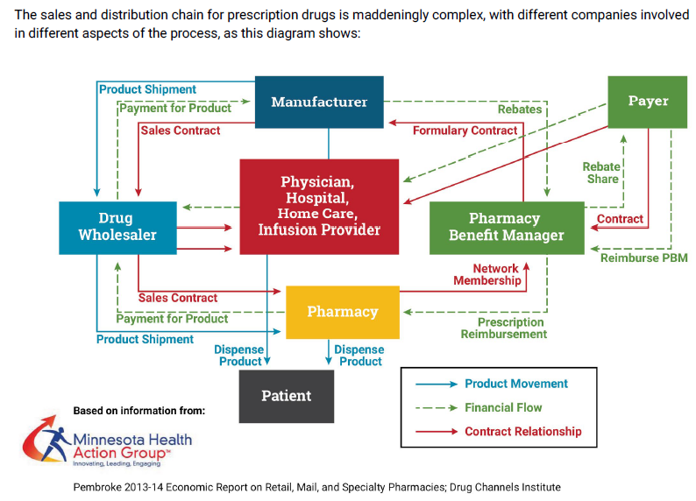
WAC and AWP in The Pharmaceutical Value Chain
The Drug Value Chain is exceptionally complex.
Drug Manufacturers only net about half of their gross “Wholesale Acquisition Cost” (WAC) on average.
Much of the balance is absorbed by the myriad of intermediaries in the value chain that lie between the manufacturer and the patient.
At every step in the process, the discounts, rebates or commissions earned by intermediaries are expressed as a percentage of the WAC or the AWP (Average Wholesale Price).
Over half of all patients prescribed expensive brand name drugs pay a coinsurance amount that is expressed as a percentage of the WAC.
GPO
GPO
PSAO
GoodRx

Slide 22
Outstanding Issues
Exclusion for wholesaler convenience repackaging operations
Access to specified drug codes
ATC (Anatomical Therapeutic Chemical Class)
Non-Proprietary (WHO Standard)
Most Manufacturers don’t carry ATC in their own databases
GPI (Generic Product Identifier)
Matches chemically identical drugs
Proprietary to Wolters-Kluwer (Medi-span) There may be licensing issues
Most Manufacturers don’t carry GPI in their own databases
Should Generic Drugs be excluded?

Slide 23
HF 58 Key Stakeholders
The Key Stakeholders consulted in the Development of HF58 include:
Minnesota Department of Health
Pharmacy Benefit Managers
Prime Therapeutics
Cigna/Express Scipts
OptumRx
Health Plans
Health Partners
Blue Cross/Blue Shield MN
Manufacturers
PHrMA
Generic Manufacturers
Wholesalers
Amerisource Bergen
Testifiers
Prime Therapeutics

Slide 24
HF 58 Reference Materials
The Prescription Drug Landscape, Explored (Pew Trusts)
A TANGLED WEB: AN EXAMINATION OF THE DRUG SUPPLY AND PAYMENT CHAINS (US Senate Report)
Report of the Minnesota Attorney General’s Advisory Task Force on Lowering Pharmaceutical Drug Prices (MN Attorney General)
Drug Channels (Adam Fein)
Patients for Affordable Drugs

Slide 25
Thank You

