Slide 1


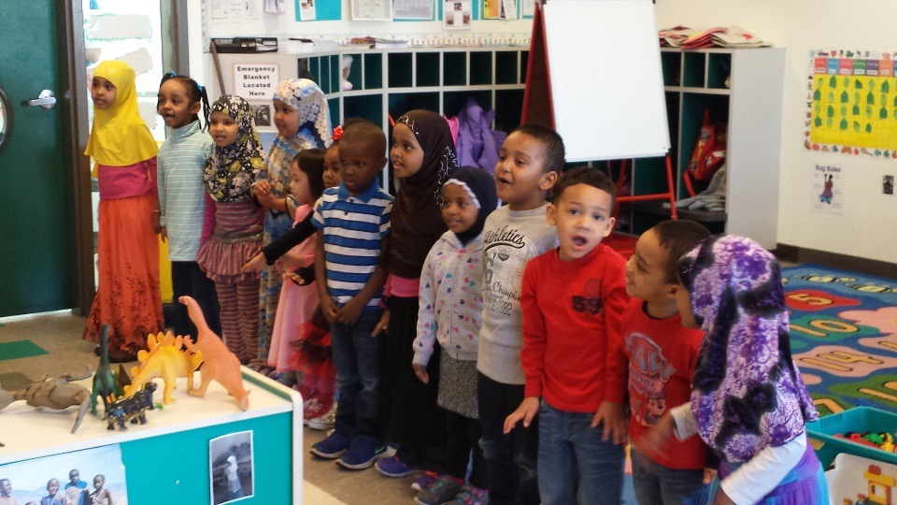
Voluntary Pre-Kindergarten House Finance Committee
January 17, 2017

Slide 2

Overview
VPK Goals and Purpose
Selection Process Summer 2016 –Ranking, Funding and Participation Overview
Funding Model Overview
FY18 Application Process January 2017
Implementation of Voluntary Pre-kindergarten Statutory Requirements

Slide 3
Historical Early Childhood Education Investments
Pre-2011
Early Childhood and Family Education
School Readiness
2011/2012
Began Early Childhood Scholarships
2013/2014
All-day Kindergarten
Increased funding for Early Childhood Scholarships
Increased funding for ECFE and School Readiness
2015/2016
VPK
School Readiness
Head Start
Early Learning Scholarships
Parent Aware
Parent-Child Home Visiting

Slide 4
Voluntary Pre-Kindergarten
Purpose:
Prepare children for success as they enter kindergarten the following year.
Goals:
Access to high-quality early learning programs for 4-year-olds, regardless of their ability to pay.
Reduce educational achievement gaps.
Help ensure every child is ready to succeed in school and life.
To provide school based choice for families
Align Prek-3 curriculum
Align services for EL and Special Education

Slide 5
FY17 Funding
$25 million allocated by 2016 legislature to school districts, charter schools or a combination thereof to establish a voluntary pre-k program
The total funding was divided into four buckets based on percentage of state kindergarten enrollment:
Minneapolis and St. Paul public school districts (10%)
Other school districts located in the metropolitan equity region (40%)
School districts located in the rural equity region (43%)
Approved charter schools (7%)

Slide 6

Statutory Criteria
Within each group, applications ordered by rank based on the following criteria as outlined in statute:
Concentration of kindergarten students eligible for free or reduced-price lunches by school site on October 1 of the previous school year.
Presence or absence of a three- or four-star Parent Aware rated child care and Head Start program within the school district or close proximity of the district.

Slide 7
FY17 Applications Received
MDE received applications from over 184 school districts and charter schools with a total of 260 sites.
Application requests included funding for over 10,000 children.
More than 230 participants joined one of three webinars explaining selection process.
Over 200 emails received during the application period from 94 unique individuals.

Slide 8
FY17 Program Selection
Applications available first week of June and due July 1st.
Decisions made by statutorily required deadline of Aug. 1 through an application and ranking process.
The capped allocation allowed approval of funding for 74 districts and charter schools at 102 sites and approximately 3,300 children
Funding not available for 109 districts and charters that applied for over 6,800 students at 122 sites
Once a school district or charter school site receives funding, funding is guaranteed in future years provided that all program requirements are met.

Slide 10

Funding Model Overview
Funding Model:
Formula Driven with cap on state total aid entitlement
Students at participating sites generate up to 0.6 pupil unit
All pupil-driven formulas apply
Enrollment generated by voluntary pre-K is added to the district/charter existing student data for calculating revenues and aids.

Slide 11
FY18 Application Process
Current statute requires applications for the following year be submitted by January 30th.
Current application process opened on January 4, 2017.
All applications are due by 4:00 p.m. on January 30, 2017.
Currently funded programs must confirm their intent to continue the program and inform MDE of any changes.
Unfunded districts or charter schools are encouraged to submit new applications.
Four webinars have been hosted with over 250 attendees.

Slide 12
Thank You
Questions?

