Slide 1
Perry Aasness, VP Legislative Affairs Compeer Financial Presentation to Minnesota House Agriculture and Food Finance and Policy Committee
Farm Credit Associations Serving Minnesota
Farm Credit supports agriculture and rural communities with reliable, consistent credit and financial services, today and tomorrow

Slide 2
Farm Credit in Minnesota Today
Compeer Financial and AgCountry Farm Credit Services are the two Farm Credit member-owned cooperatives providing credit and financial services to help support agriculture and rural communities in Minnesota.
Our cooperatives are part of the Farm Credit system, which serves 500,000 member-borrowers nationwide, providing $253 billion in loans and related services.
System is exclusively dedicated to supporting agriculture and rural communities & is the largest such lender, providing more than a third of the credit to farmers and rural residents.
We have maintained financial strength, continue to serve our customers during good times and bad, and have a high quality loan portfolio.

Slide 3
We are Member Owned
Farm Credit is owned by those we serve.
Members have a say in the Association, and financial performance often results in payment of patronage dividends to members.
Association boards are primarily elected borrower directors.
Appointed directors bring financial expertise and other perspectives/strengths to the board.
There are more than 60 associations nationwide.

Slide 4
About Compeer Financial
Formed: July, 2017
Merger between AgStar Financial Services, 1st Farm Credit Services, and Badgerland Financial
Vision: Trusted financial services provider advancing agriculture and rural America
Mission: Enriching agriculture and rural America
Territory: 144 counties in Minnesota, Illinois and Wisconsin
Clients & Member owners: More than 43,000
Employees: Approximately 1,200
Notes:
Vision – What do we want Compeer Financial to become? – Trusted financial services provider advancing agriculture and rural America.
Mission – What are we focused on doing day to day? – Enriching agriculture and rural America.

Slide 5
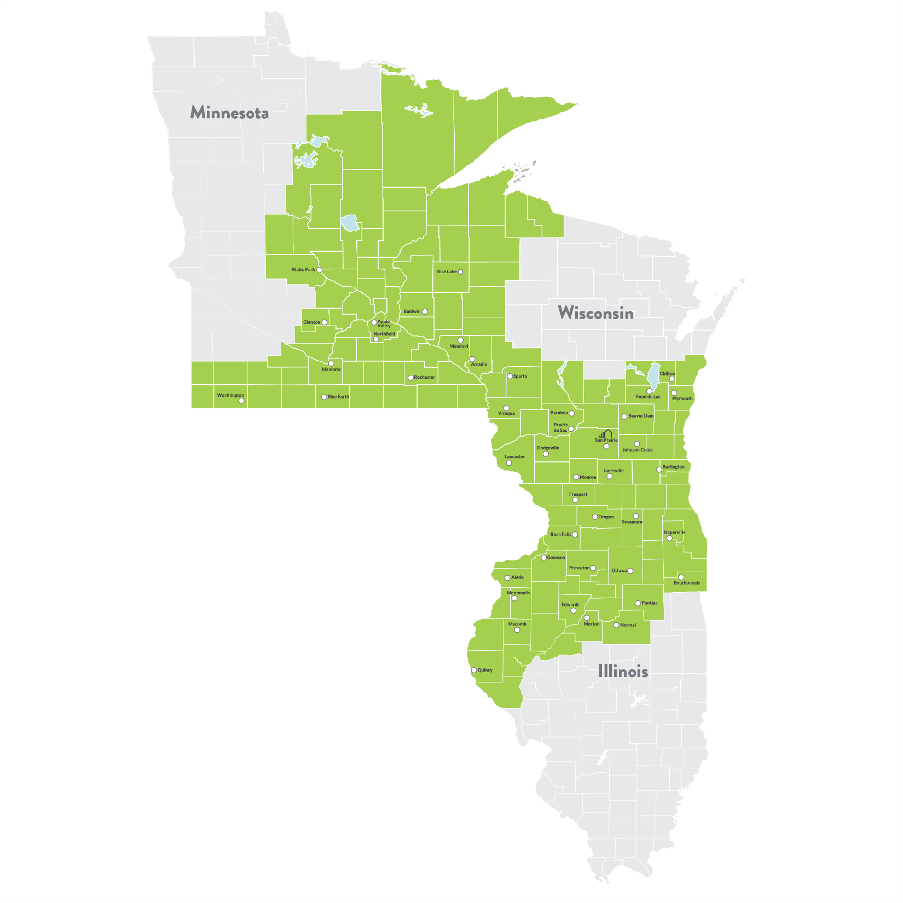
Our Territory
Based in the Upper Midwest
144 counties in Illinois, Minnesota and Wisconsin
Headquarters: Sun Prairie, Wis.

Slide 6
Current economic environment for farmers in 2019
Ag economy facing challenges across the board
Dairy sector most impacted
Large supplies of commodities are depressing prices
Uncertainty of U.S. trade agreements/tariffs a key factor
Depressed commodity markets leaving many farmers & ranchers with below break-even prices
Farmers & ranchers of all ages, experience levels, and sizes are facing increased economic hardship
New Farm Bill will provide some assistance, but implementation delayed due to fed government shutdown

Slide 7
Proactive steps we’re taking to assist our customers through challenging economic times
Review client financial information with them to help better understand their costs of production and ways to improve their operations:
We emphasize the importance of customers having accurate financial records to help identify true costs of production
If certain costs are out of line, we discuss the reasons and options in making changes
We compare customer costs of production data to that of their peers (and Farm Business Management numbers) to help benchmark their operations
We want to position our customers to help them make the best financial decisions for both the short and long term benefit of their farming operations
When appropriate, work with customers to restructure their loan accounts:
Principle deferment, re-amortization of debt, utilization of USDA FSA loan guarantees and RFA programs

Slide 8
What we’re doing to assist our customers through challenging economic times
Educational seminars for customers:
Risk management, marketing, financial analysis, etc.
Groundbreakers: Focused on young and beginning farmers
Annie’s Project: Focused on strengthening women’s roles in farming
Increased patronage payments to our farmer owners in 2019:
Total patronage payments in 2019 are estimated to be $150 million, a $42 million increase from 2018

Slide 9
Mental health of our farmer customers is a top priority:
Training has been provided for Compeer employees to spot issues and assist customers dealing with financial stress in their operations
The Minnesota Farm Credit associations (Compeer Financial and AgCountry, FCS) support additional state funding to provide mental health assistance to farmers

Slide 10
Questions?
Thank You!

