Slide 1
Explore Minnesota Overview Presentation
John Edman - Explore Minnesota Director
Minnesota House Environment and Natural Resources Finance Division
January 29, 2019

Slide 2
Explore Minnesota Mission
To inspire consumers and facilitate their travel to and within Minnesota

Slide 3
Agency overview
Separate Non-Cabinet Agency
Approximately 46.5 Full-Time Equivalents
Offices in Brainerd, Duluth, Thief River Falls, Medford and St. Paul
Six Staffed Welcome Centers
Guided By 28-Member Advisory Council

Slide 4
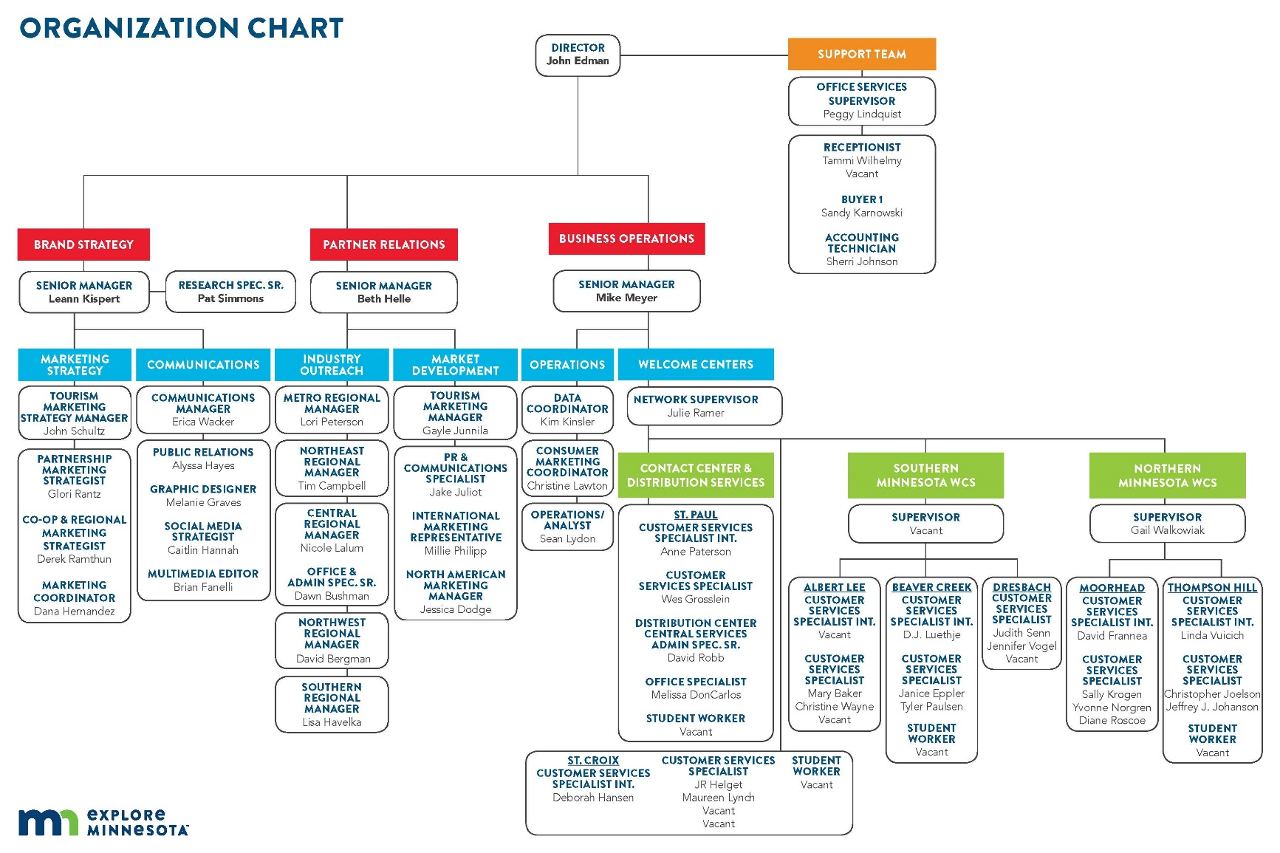
Organizational structure

Slide 5
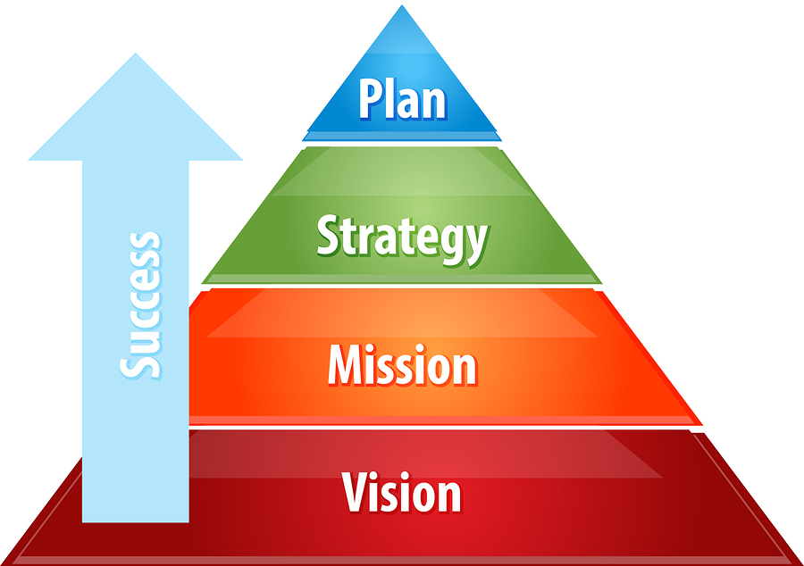
Strategic Imperatives
Drive Sustainable Economic Growth
Create Innovative Marketing & Brand Awareness
Increase Consumer Reach & Engagement
Provide Personalized Service
Enhance Stakeholder Collaboration

Slide 6
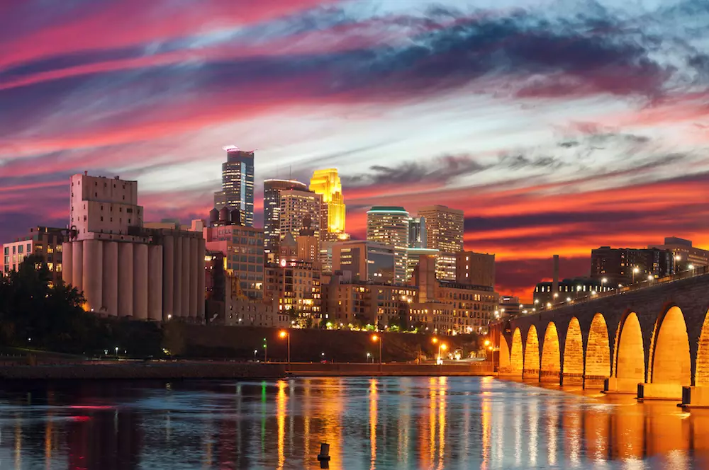
Drive Economic vitality
Grow gross leisure and hospitality sales to $17.2 billion*
Grow leisure and hospitality jobs to 280,000*
Grow leisure and hospitality sales tax revenue to $1.1 billion*
*projections through 2019

Slide 7
Create Innovative Advertising
Achieve 7-to-1 return on investment of our advertising *
Generate annual incremental traveler spending of $390 million*
Achieve annual incremental visitation of 3.5 million*
*projected direct results of our advertising campaign

Slide 8
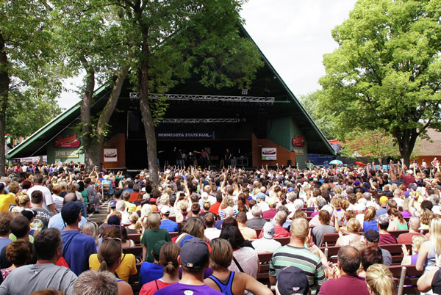
Increase Consumer Reach
Drive 4.5 million visits annually to exploreminnesota.com
Inspire 250,000 uses of #OnlyinMN on social media annually
Increase email subscriptions by 50,000 annually
Increase earned media impressions by 250 million annually

Slide 9
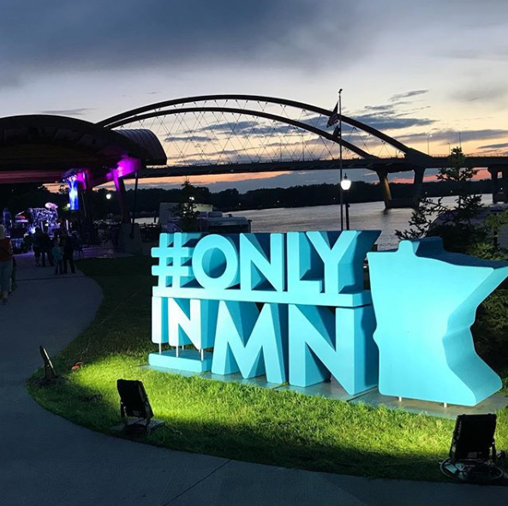
Provide Personalized Service
Provide personalized service to 3.2 million customers annually
Make information readily available in the customers’ preferred format
Achieve positive customer satisfaction levels of 3.75/4

Slide 10
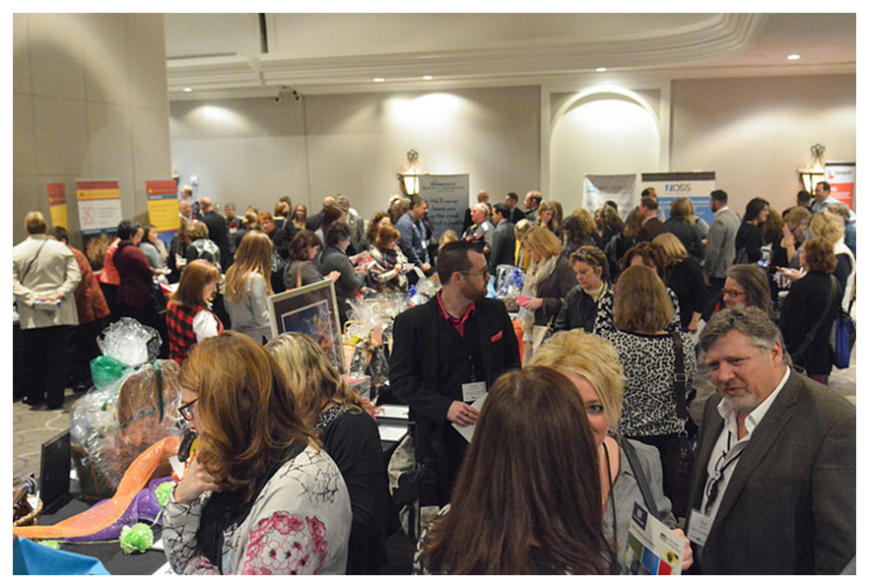
Enhance Stakeholder collaboration
Enhance public/ private partnerships to surpass $5 million in annual match dollars
Achieve 90% industry satisfaction levels of EMT services

Slide 11
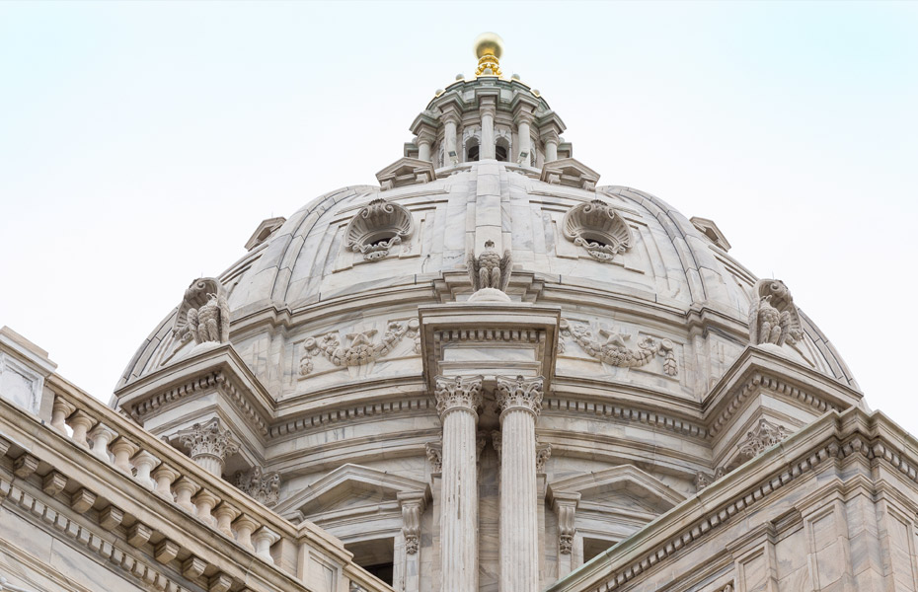
FY 18/19 Budget
Base budget
FY18-$13,684,000
FY19 -$13,732,000
$27,416,000
Incentive funding of $500,000 per FY if we hit our match requirement.
$6 private sector match - $1 general fund
Event grant program
$900,000 for FY 18-19
Website/technology enhancement
$500,000 for FY 18-19

Slide 12
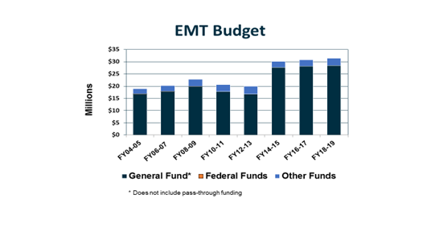
Explore Minnesota Budget History

Slide 13
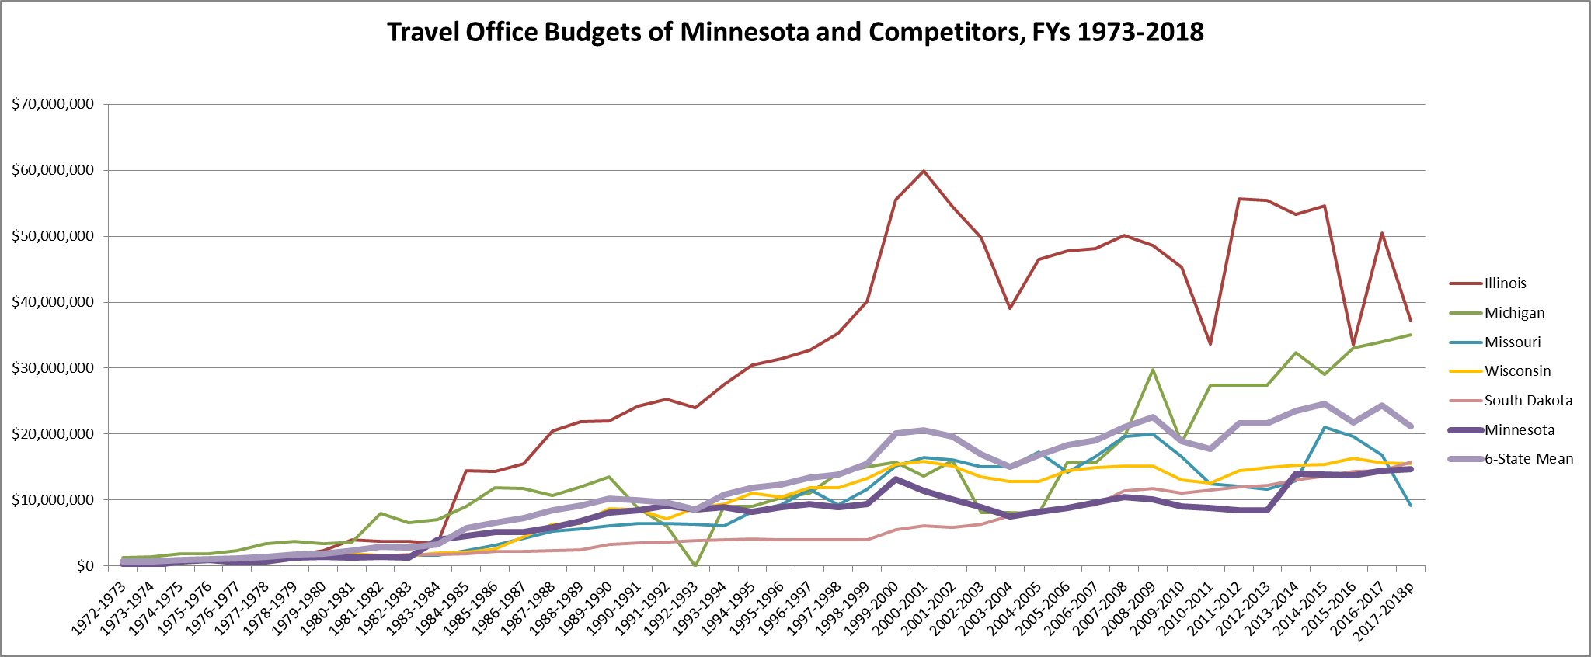
Travel budgets of Minnesota and competitors, fy 1973 -2018

Slide 14
State Tourism Office Budgets in U.S.

Slide 15
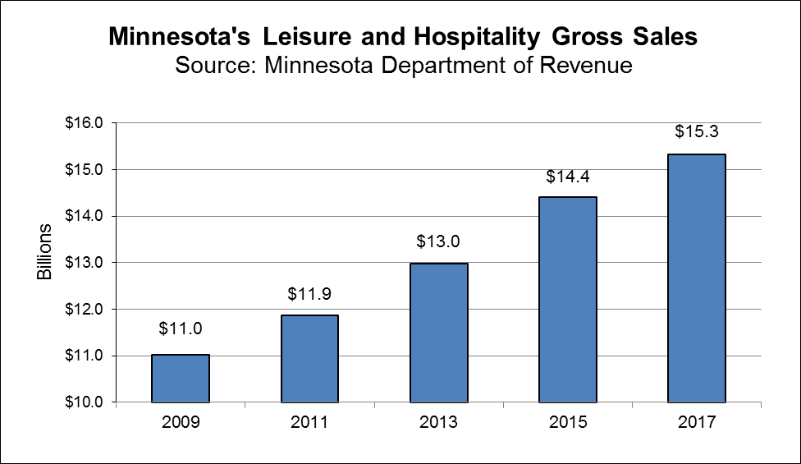
Leisure and Hospitality Gross Sales*
*Minnesota Department of Revenue

Slide 16
Leisure and Hospitality state sales tax*
*Minnesota Department of Revenue

Slide 17
Leisure and Hospitality Jobs*
*Bureau of Labor Statistics

Slide 18
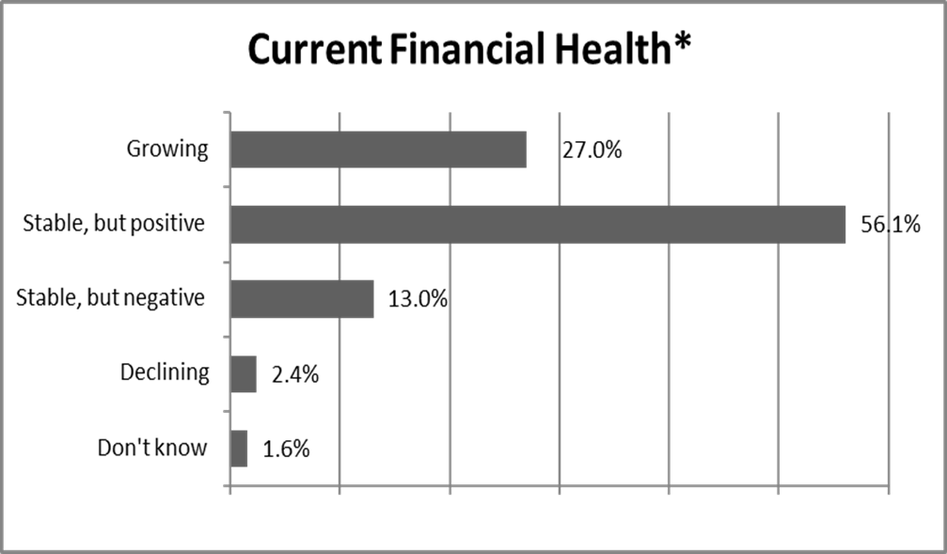
Current Financial Health*

Slide 19
Spring/Summer 2018

Slide 20
Media breakouts

Slide 21
Delivering Broadcast via digital

Slide 22
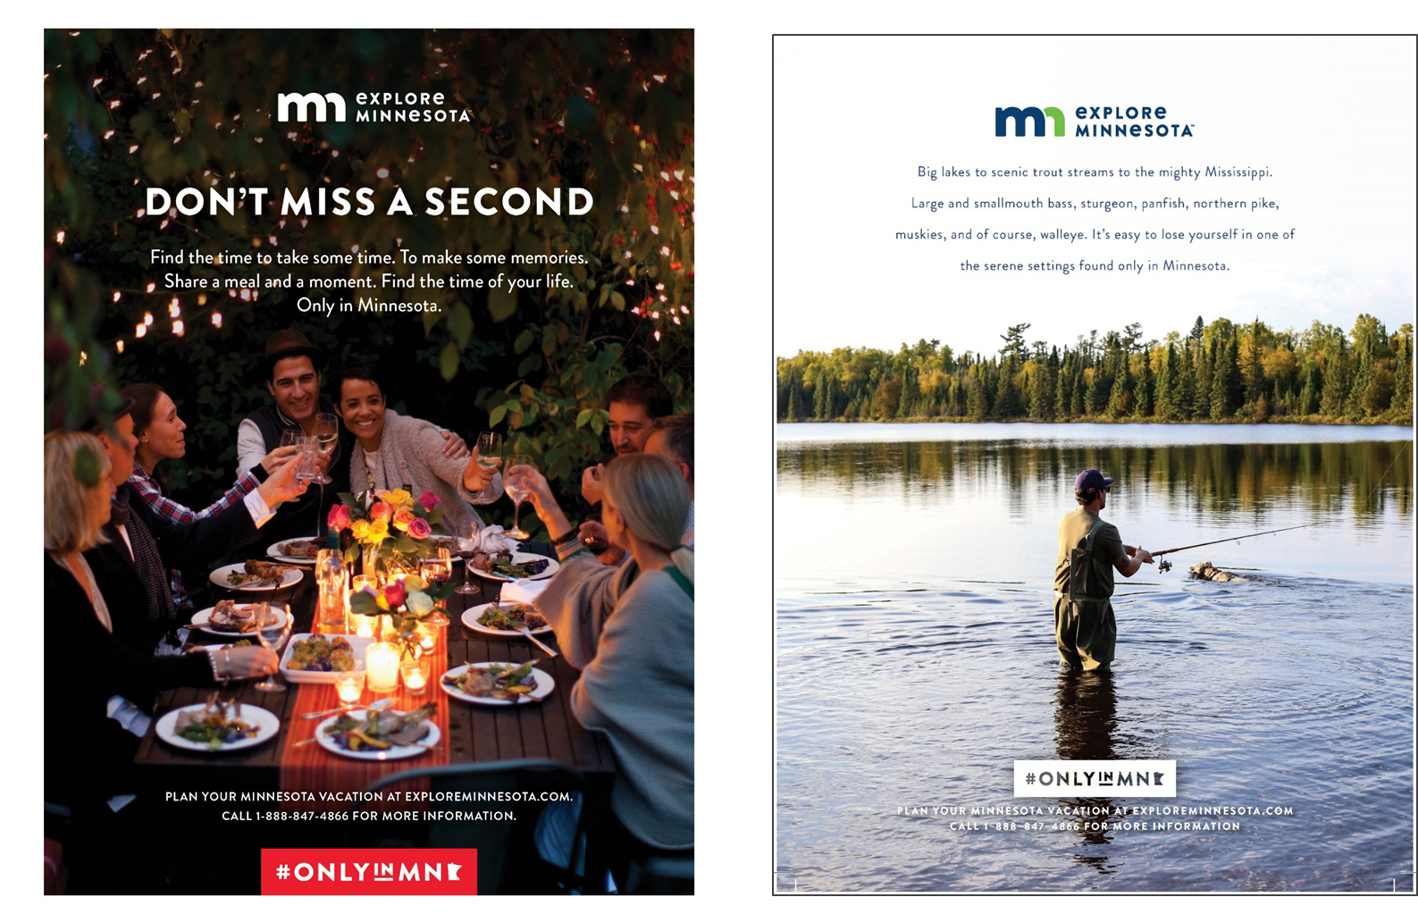
National and Regional Print

Slide 23
Out-of-Home

Slide 24
Television

Slide 25
Embracing diversity in Minnesota
Embrace rich cultural heritage
LBGTQ, Native American, travelers with disabilities, major ethnic groups
Diversity reflected in content and marketing imagery, tactics and vendors
Ads produced in Spanish, Hmong and Somali languages

Slide 26
FY18 Media results

Slide 27
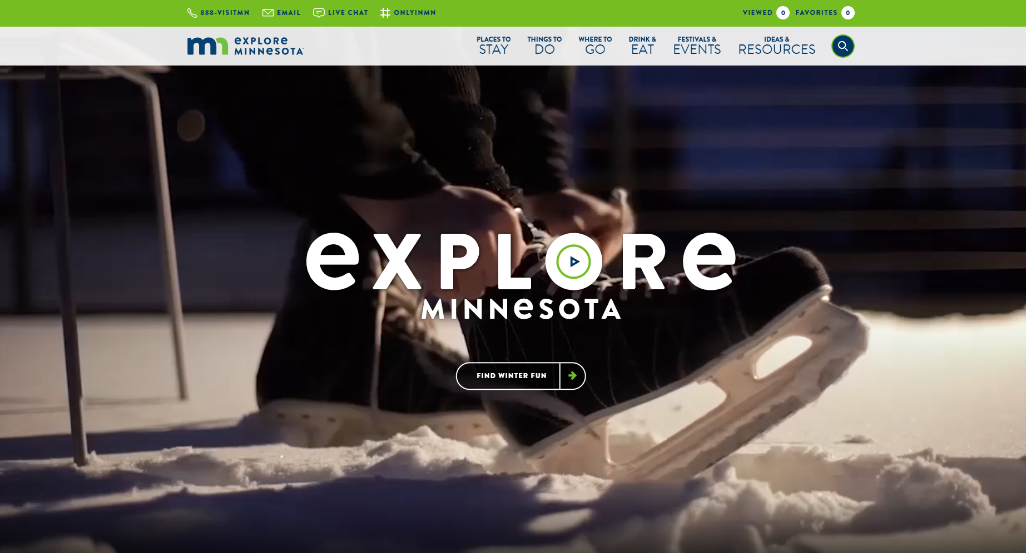
2018 website stats
4.9 million visits*
1.3 million business listing views
71% of visitors are new visitors
66% are on smartphone or tablet
*Google analytics, Oct. 11, 2017 to October 10, 2018

Slide 28
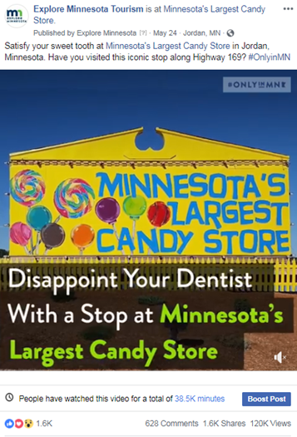
Social Media in 2018
Audience grew by 15.7%
Over 65,000 new followers across all platforms
Instagram fastest-growing platform
Generated 272,145 website visits
1.6 million minutes of video viewed
Over 1 million engagements
625 million impressions

Slide 29
2018 grant programs
Over $1.6 million in grants awarded in 2018
Marketing, events, and sports/meetings programs
Programs simplified and flexible
Over 120 organization grants
48% of marketing applications and awards were for greater Minnesota

Slide 30
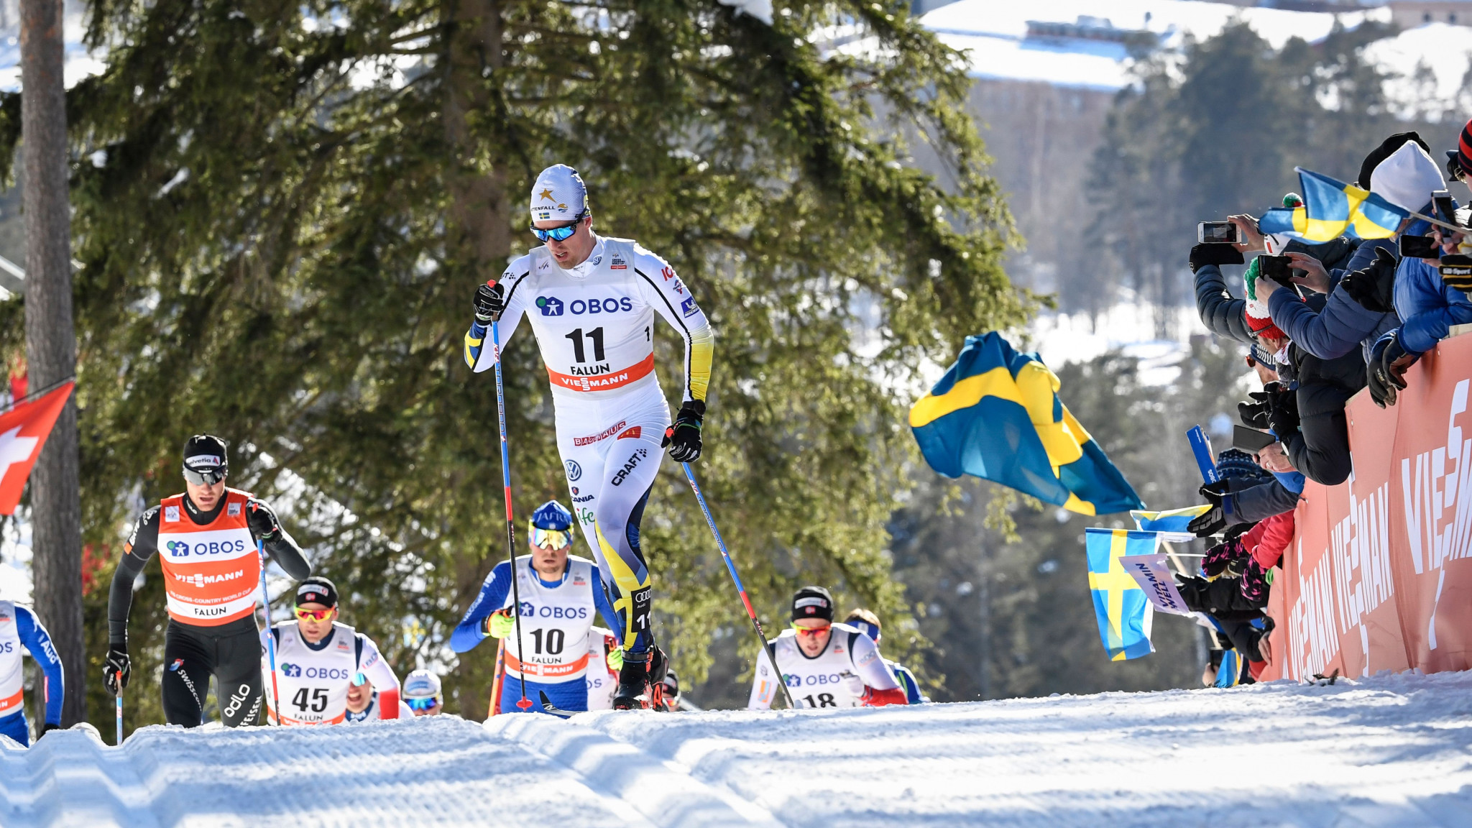
2018 Events program
Highly successful and in-demand
$900k for special events grants awarded by July 2018
$248,000 for 9 events in greater Minnesota
$651,000 for 10 events in 7-county metro area

Slide 31
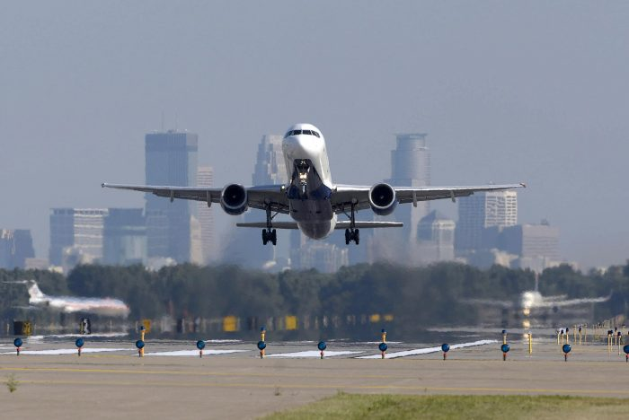
International Marketing 2018
International travel expected to grow to 21% from 2015 to 2021
Three new international flights in 2019 – Seoul, Dublin, Beijing
2017 MSP international arrivals passengers 1,112,488
Explore Minnesota international strategy focused – consumer & media based

Slide 32
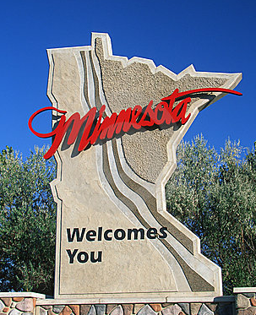
Welcome centers 2018
11 state and partnership centers
Mall of America and MSP Airport Partnerships
52 Affiliate welcome centers
Nearly 4 million customers served in 2018
Increase of 25% over 2017
MN Sportsmen’s Show and Northwest Sport Show in 2018

Slide 33
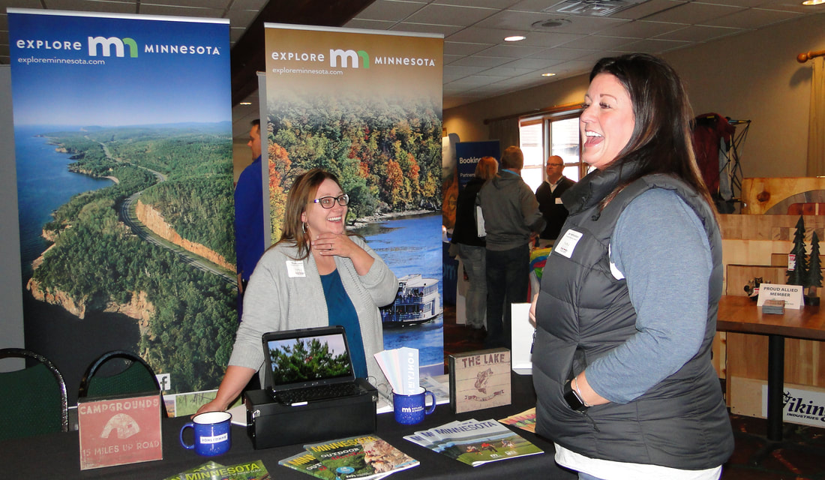
Customer/Industry satisfaction
Customer Service Scores – Average 3.8 out of 4when asked if satisfied with service received via phone, mail, live chat, and at Welcome Centers
Industry Satisfaction Scores – 87% positive industry ratings from most recent industry satisfaction survey
Industry Listening Sessions planned for 2019 to assist with strategic planning for 2020/2021 calendar year

Slide 34
Match report

Slide 35
Incremental impacts due to advertising
Incremental Trips | 3.5M
Incremental Visitor Spending | $415.5M
Incremental Taxes | $40.7M

Slide 36
Bottom line 2018

Slide 37
Setting Stage for 2019
New staff, new energy, new partners
Web audit for best-in-class website
Ad agency review to be the best
New creative campaign
New media strategy
Build on our success

Slide 38
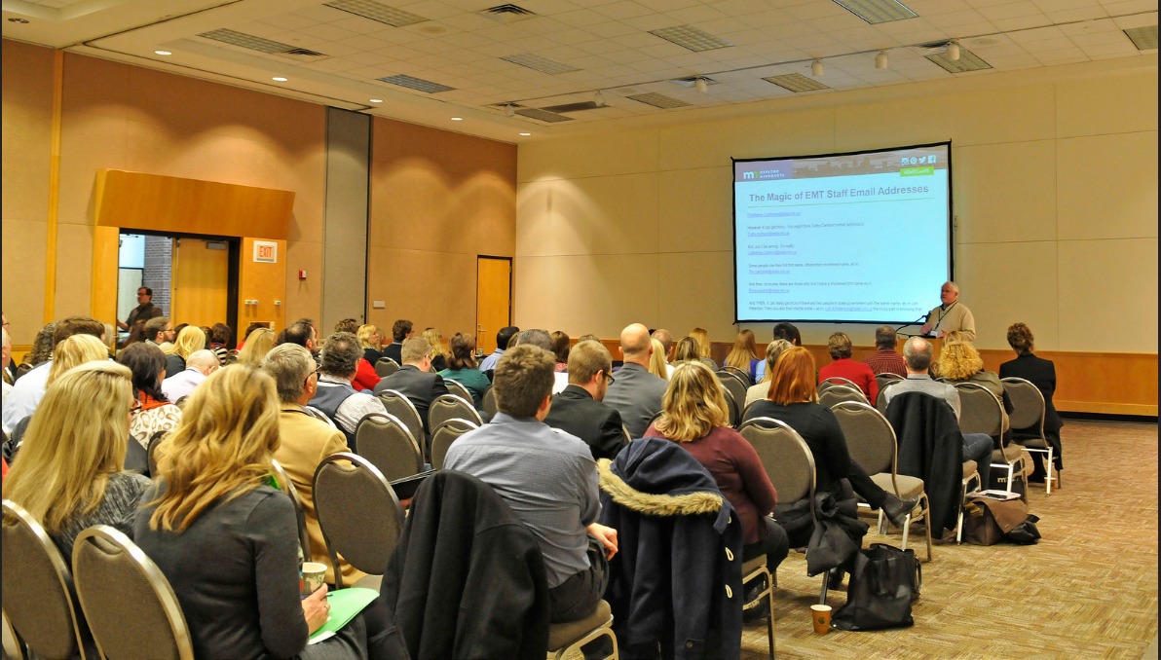
2019 Industry Listening sessions
Tour throughout the state in early 2019
Sessions in all five regions
Bureaus, attractions, businesses, individuals
Leading to 2020-2021 Strategic Plan
Commitment to conduct on annual basis

Slide 39
Tourism Works
2018 was a great year for Minnesota tourism
Next year promises to be even better: New campaign, new creative, new strategy, new tools, and measured results
Cereal box – Impact of travel in counties through the state

Slide 40
John.edman@state.mn.us
651-757-1844

