Slide 1

House
Greater Minnesota Economic
& Workforce Development
Policy Committee
January 29, 2015

Slide 2
Our Mission:
  Minnesota Housing finances affordable housing for low- and moderate-income households while fostering strong communities.

Slide 3
Our Current Environment
Need for affordable housing is large and growing
  600,000 households are cost-burdened
  8,000 - 10,000 Minnesotans are homeless
  Low rental vacancy rates
  Rising construction costs
  Growing preservation needs
  Foreclosure rate declining
  Barriers to accessing homeownership
Notes:
600,000 households are cost-burdened, and nearly 500,000 lower income households are cost burdened
While we are making progress, there are still 10,000 Minnesotans who are homeless on any given night
Vacancy rates are extremely low, currently 2.6% in metro area (anything under 4% is considered low)
We know there are communities in Greater Minnesota with vacancy rates near 0
Median incomes have declined while rents have gone up
We also have aging housing stock that is in need of preservation
In many communities in Greater Minnesota, more than half the housing stock is more than 50 years old
The foreclosure rate has declined to pre-housing crisis levels. The number of foreclosures in 2013 was just below the number of foreclosures in 2006.
While we still have one of the highest homeownership rates in the country, the gap between white households and households of color is the worst in the country

Slide 4
Our Strategic Priorities
Preserve federally-subsidized rental housing
Promote and support successful homeownership
Address specific and critical needs in rental housing markets
Prevent and end homelessness
Prevent foreclosures and support community recovery
Notes:
Strategic Plan
Affordable Housing Plan

Slide 5
Sources of Funding
Source: 2014 Affordable Housing Plan | Total Funding: $794,841,013

Slide 6
State Appropriations
No state appropriations are used for agency administrative costs
56% of state appropriations serve households with median annual incomes below $12,000
61% serve households with median annual incomes below $19,500

Slide 7
Uses of All Funding Sources
Total:
62,789 households
Source: Minnesota Housing 2013 Program Assessment

Slide 8
Program Delivery
Nearly all assistance provided through network of private delivery partners
  Lenders
  Developers/Property Managers
  Social Service Providers
Programs accessed through a variety of delivery methods
  Consolidated RFP, pipeline basis
  We do not own and operate any housing
Notes:
Work with statewide delivery partners to carry out programs
Explain our consolidated RFP process

Slide 9
Our Impact
62,789 households served in 2013
2,089 units of new affordable rental units and affordable rental units preserved
  75% of renters assisted had an annual income under $20,000
2,765 mortgages, 23% to households of color
  In 2014, we have increased to 26% HHs of color
  Median annual income of homebuyers assisted $48,500
$782 million total resources allocated

Slide 10
Our Housing Continuum
Homelessness Prevention
Supportive Housing
Affordable Rental Housing
Affordable Homeownership
Prevent homelessness before it begins
Median annual income of households served: $9,000
Permanent supportive housing for households experiencing homelessness
Median income of households served: $8,000 - $10,000
New construction or acquisition and rehabilitation of affordable rental housing
Preservation of existing affordable housing
Median income of households served: $8,000 - $22,000
First time homebuyer loans
Home improvement loans
Single family development
Median income of households served: $20,000 - $63,000

Slide 11
FY 2016-17 Budget
Program | FY 14-15 Base | FY 16-17 Base | FY 16-17 Governor’s Proposal
Challenge | $18,406,000 | $25,850,000 | $25,850,000
Housing Trust Fund | $20,552,000 | $22,942,000 | $23,292,000
Bridges | $5,676,000 | $5,676,000 | $8,176,000
Family Homeless Prevention | $15,724,000 | $17,038,000 | $17,038,000
Homeownership Assistance Fund | $1,660,000 | $1,770,000 | $1,770,000
Preservation (PARIF) | $8,436,000 | $8,436,000 | $8,436,000
Rental Rehabilitation Loans | $6,275,000 | $7,486,000 | $7,486,000
Homeownership Rehab Loans | *$8,544,000 | $5,544,000 | $5,544,000
HECAT | $1,582,000 | $1,714,000 | $1,714,000
Capacity Building | $750,000 | $750,000 | $1,540,000
Special Initiatives | $890,000 | $890,000 | 0
TOTAL | $101,495,000 | $98,096,000 | $100,846,000
* FY 14-15 base for Homeownership Rehab Loans includes $3 million in special appropriations for disaster assistance.

Slide 12
Minnesota Housing and
Workforce Housing
Economic Development and Housing Challenge Program (Challenge) - a resource for communities since 1999
Challenge in Greater Minnesota 2010-2014:
  382 units of affordable rental housing
  368 homeownership opportunities
Challenge income limits:
  80% statewide media income ($58,000) for rental housing
  115% of statewide median income ($82,000) for homeownership

Slide 13
Minnesota Housing and
Workforce Housing
HOME, Housing Infrastructure Bonds, and Low Income Housing Tax Credits also support housing development in Greater Minnesota
Low Income Housing Tax Credits in Greater Minnesota 2010-2014:
  830 units of new construction housing

Slide 14
Different Areas, Different Needs
Experience shows these are the key elements of success for meeting unique housing needs across the state:
Housing Study
Housing Dialogues
Build relationships with development community
Prioritize needs
Get technical assistance and submit applications

Slide 15
Housing Study
Gaining a better understanding of housing needs and current market dynamics is an important first step.
Geography | City of Worthington | City of Duluth | City of Austin | Roseau County | Lake of the Woods County
Population | 12,764 | 86,128 | 24,718 | 15,629 | 4,045
Year of study | 2013 | 2014 | 2013 | 2012 | 2013
Affordable rental | 170-175 | 2842 | 80-100 | 76 | 30-32
Market rental | 80-85 | 1092 | 139-190 | 172 | 6-8
Entry level home ownership | 60-70 | 180 | 37 | 35 | 14-16

Slide 16
Housing & Community Dialogues
2015
Willmar
Crookston
Alexandria
Montevideo
Saint Cloud
Faribault
Cloquet
2014
Iron Range
Bemidji
Winona
Fergus Falls
Austin
Also participated in Duluth housing summit partnering with local organizations
2013
Mankato
Worthington
Brainerd
We also participated in the Olmstead County housing summit

Slide 17
Other Housing Discussions
Duluth Housing Summit
Olmstead County Housing Summit
Workforce Housing discussions in Roseau, Thief River Falls, Worthington, Jackson
Minnesota Housing Partnership Institutes
MN Association of Development Organizations, MN Economic Development Association

Slide 18
  Relationships in the
  Development Community
Example: Roseau workforce housing
  Housing study proved a market need existed
  Minnesota Housing brought experienced developers to the table
  Developers worked with local stakeholders to create and submit housing proposals
  Application was funded and is in progress

Slide 19
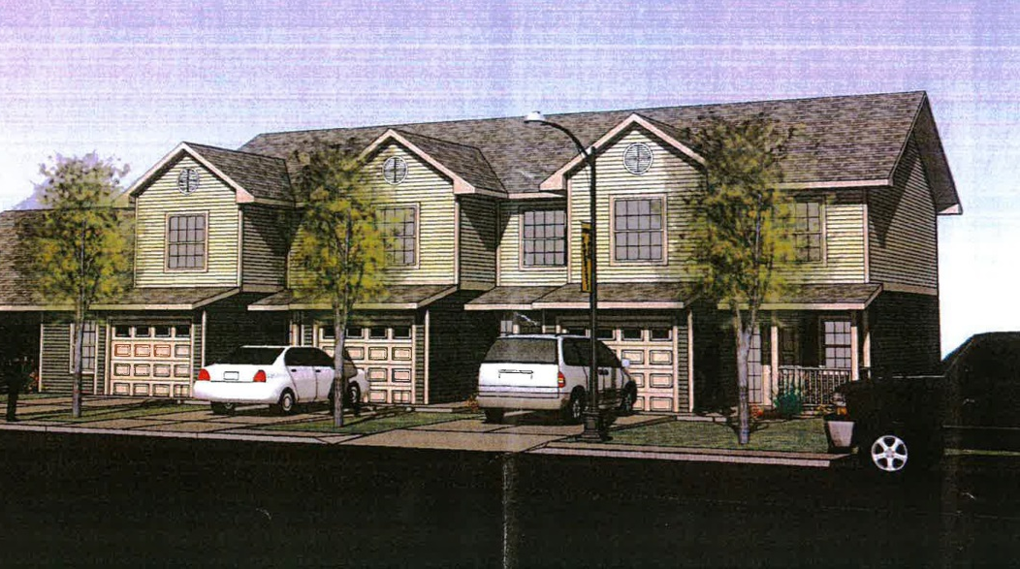
  Thief River Falls
Housing study shows low vacancy rates, long commute times and 100+ open positions at one employer alone
Need for affordable workforce housing cited as key to city’s economic health
Series of meetings with local stakeholders identify priorities and educate community on what affordable housing is and isn’t
River Pointe Townhomes

Slide 20
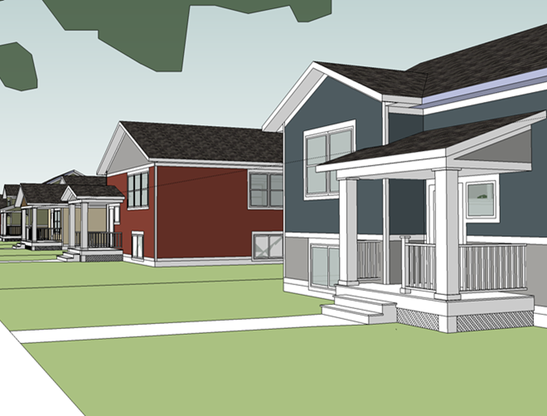
  Thief River Falls
24 units of rental housing funded through Housing & Job Growth Initiative
41 units of investor equity driven rental development using local resources and funding from Greater Minnesota Housing Fund
Single Family developer leveraged contributions from city, Homark Homes, Digi-Key, and Housing and Job Growth Initiative
Building a Better Neighborhood

Slide 21
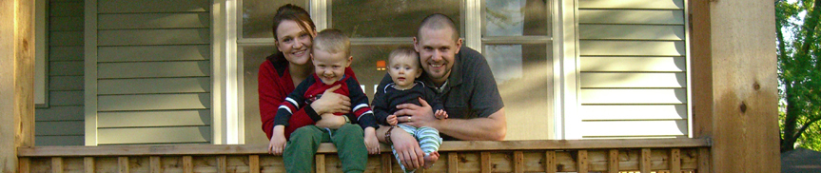
Continuing Challenges and
Our Strategies

Slide 22
Homeownership Gap
Minnesota has the 3rd highest homeownership rate in the nation
We also have the 3rd worst disparity in homeownership rates between white households and households of color
Notes:
States with higher homeownership rates: West Virginia and Delaware
States with higher homeownership disparities: Connecticut and Wisconsin

Slide 23
MN: Homeownership Rates by Race and Ethnicity
Source: Census Bureau, 2000 Census and American Community Survey (2001-2013)

Slide 24
Homeownership Gap
Minnesota Housing sets goals for serving households of color with mortgage programs
  This year 26% of households served are households of color, exceeding our goal
  The overall market served approximately 10% households of color
  We recently started Homeownership Capacity pilot program aimed at working in the community to close homeownership gap

Slide 25
Too Many Minnesotans Pay Too Much for Housing
28% of Minnesotans pay more than 30% of their income for housing (600,000 households)
  Declined from 30% of Minnesotans in 2013
More than 250,000 lower income renters are cost-burdened
  Only 100,000 fixed affordable units

Slide 26
Percentage of Cost-Burdened Households in Minnesota
Source: Census Bureau, 2000 Decennial Census and American Community Survey (2001-2013)

Slide 27
Too Many Minnesotans are Homeless
8,000-10,000 Minnesotans are homeless on a given night
  Almost half are children and youth
  The number of chronically homeless and homeless veterans has declined
    – We make progress when we focus our efforts

Slide 28
Notes:
We have seen a 39% decline in chronic homelessness since 2010.
We have seen a 47% decline in veterans homelessness since 2010.

Slide 29
Too Many Minnesotans are Homeless
The Minnesota Interagency Council on Homelessness has adopted statewide Heading Home Plan to Prevent and End Homelessness
  Plan includes many low cost/no cost items
New investments in Supportive Housing
  State Capital Investment allowed us to finance 689 units of new supportive housing this year
Future focus will emphasize families and youth

Slide 30
Our Impact
Stable, affordable, high quality housing is a platform for success
Our efforts support key state priorities:
  Education
  Jobs and Workforce Development
  Better Government

Slide 31
For More Information
Contact:
Mary Tingerthal
mary.tingerthal@state.mn.us
651.296.5738
Ryan Baumtrog
ryan.baumtrog@state.mn.us
651.296.9820
www.mnhousing.gov

