Slide 1

Minnesota Milk 2019 House Ag Update

Slide 2
Minnesota Milk 2019 Update
Introduction of Minnesota’s dairy industry relative to U.S.
Where dairy is moving
Minnesota economic impact
Minnesota Milk
Midwest Dairy
Milk margins 101
Growth of exports the previous 15 years
Change in costs, revenue
Federal Farm Bill 101
State of Minnesota involvement in dairy

Slide 3
Minnesota Milk
Formed in 1977 by northwestern Minnesota dairymen
Originally called the Red River Valley Milk Pool, headquarters were in Moorhead, Minn.
2000 was the first time MMPA hired full time staff
Minnesota Milk Goals and Objectives
Improve and build upon a positive business climate for dairy in Minnesota.
Showcase that Minnesota is a great place for dairy.
Maintain and build brand recognition of Minnesota Milk.
Maintain fiscal responsibility to our members

Slide 4
MMPA Board of Directors
President: Dave Buck, Goodhue (District 8)
Vice President: Shelly DePestel, Lewiston (Statewide)
Secretary: Bob Dombeck, Perham (District 3)
Treasurer: Rick Smith, Adams (District 11)
District 1: Kristine Spadgenske, Menahga
District 2: Marianne Peterson, Pine City
District 4: Ron Miller, Little Falls
District 5: Kindra Carlson, Pennock
District 6: Tom Sedgeman, Sauk Centre
District 7: Garrett Luthens, Hutchinson,
District 9: Rod Schulze, Holland
District 10: Paul Daley, Pine Island
Statewide: Aaron Vogt, Sauk Centre
Statewide: Pat Lunemann, Clarissa

Slide 5


Minnesota Milk Staff
Daryn McBeth, contract lobbyist (top left)
Lucas Sjostrom, Executive Director (bottom left)
Shannon Seifert, Membership Director (mid-right)
Jenna Davis, Education and Events Director (mid-bottom
Brittney Arnold, Program Assistant (top right)
Dr. Marin Bozic, contract economist (bottom right)

Slide 6



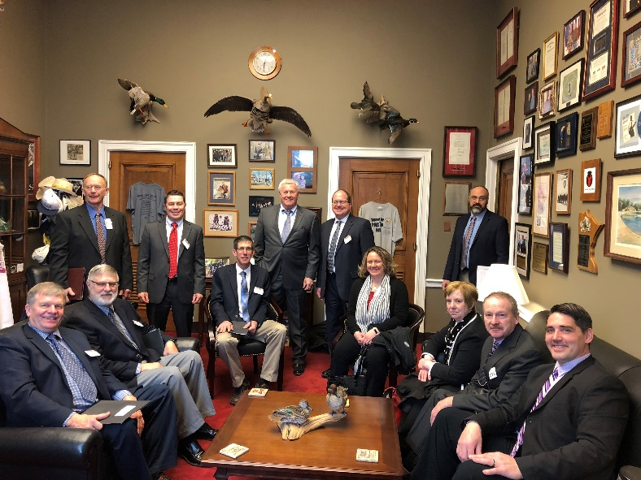
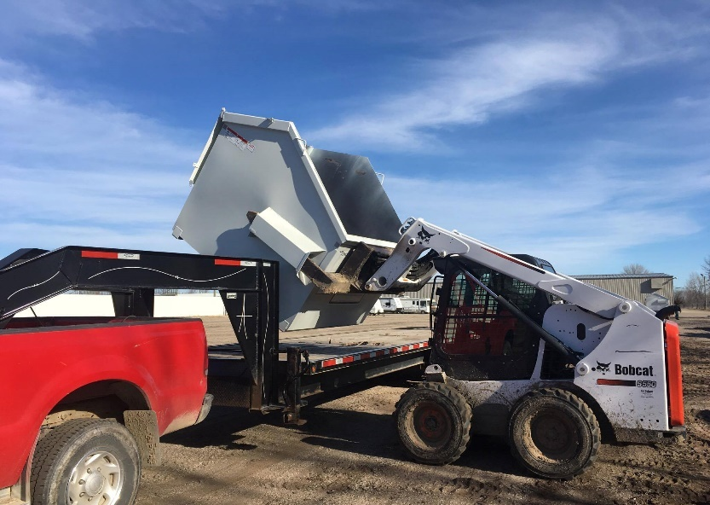
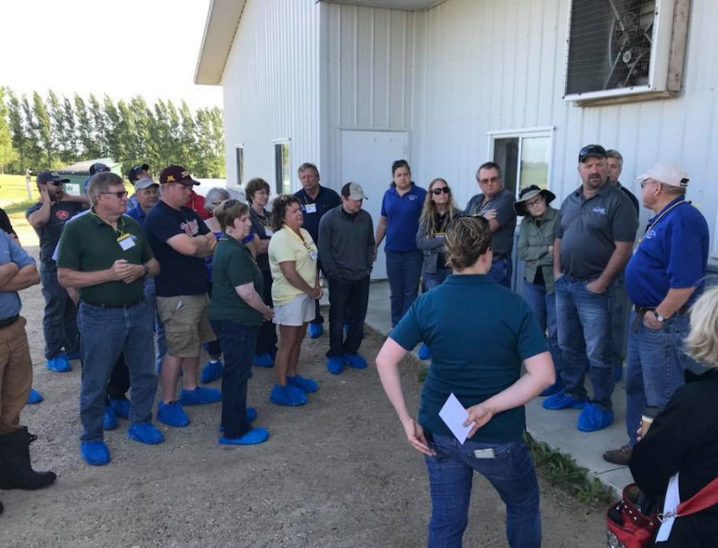
Minnesota Milk
Policy
Membership
Education/
Events

Slide 7
Minnesota Milk 2019 House Ag Update

Slide 8
Milk Pricing
Class I Price = (Class I skim milk price x 0.965) + (Class I butterfat price x 3.5)
Class II Price = (Class II skim milk price × 0.965) + (Class II butterfat price × 3.5)
Class III Price = (Class III skim milk price × 0.965) + (Butterfat price × 3.5)
Class IV Price = (Class IV skim milk price × 0.965) + (Butterfat price × 3.5)
Somatic Cell Adjustment Rate = Cheese price × 0.0005 rounded to the fifth decimal place. Rate is per 1,000 somatic cell count difference from 350,000.

Slide 9

Required Reading: Men to Remember
Jean Baptiste Faribault – first cattle in 1820
History of Minnesota Dairy Industry – the Butter state
Land O’Lakes (begun in St. Paul-1921)
First District Association (1894-Litchfield)
40,344 cows in 1860
1,863,000 cows in 1945
450,000 cows today
How Minnesota cooperatives bailed out the federal government during the Great Depression
Professor Theophilus Levi Haecker (Univ. of Minn.)
Arrived in 1891
Became a cooperative evangelist built on quality
Farmers added $0.05 to $0.07 to their $0.10 per pound through cooperating and increasing quality

Slide 10
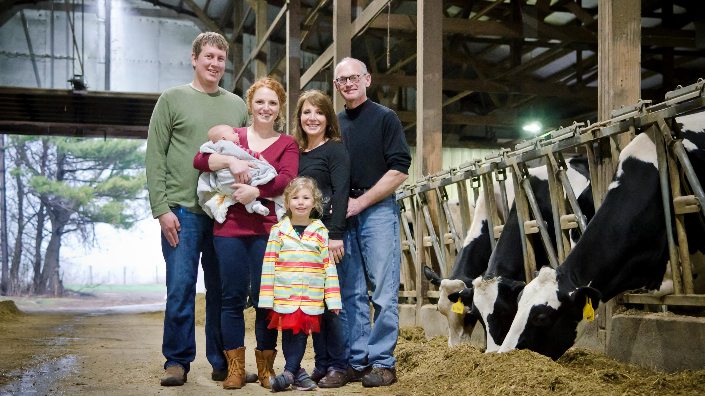
Introduction: Lucas Sjostrom and Minnesota Milk

Slide 11
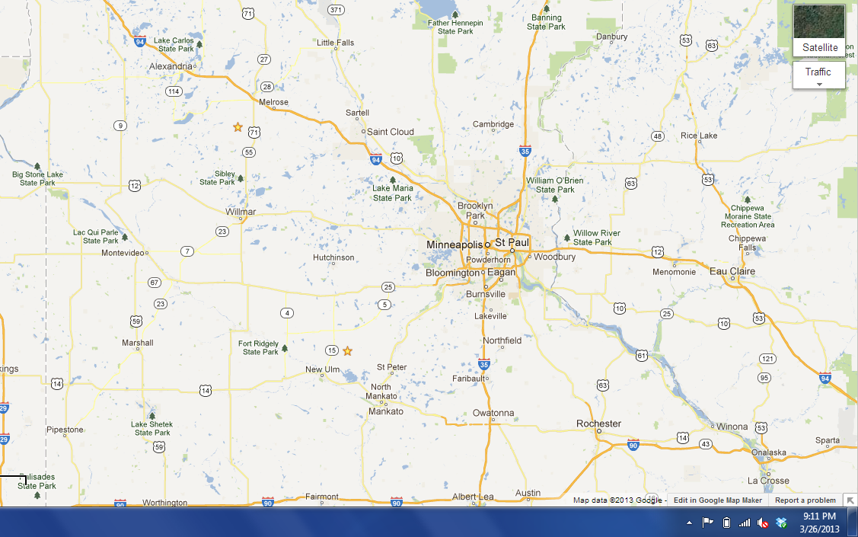

Slide 12
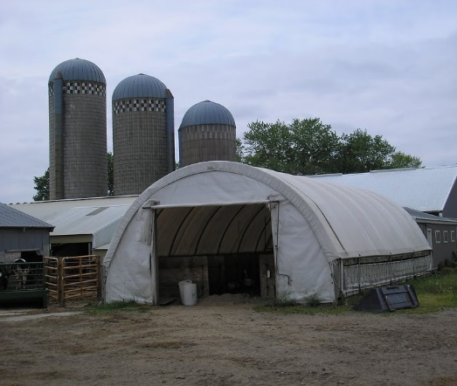
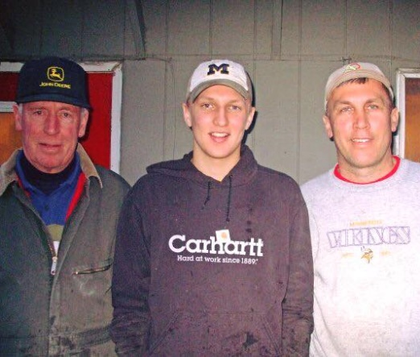
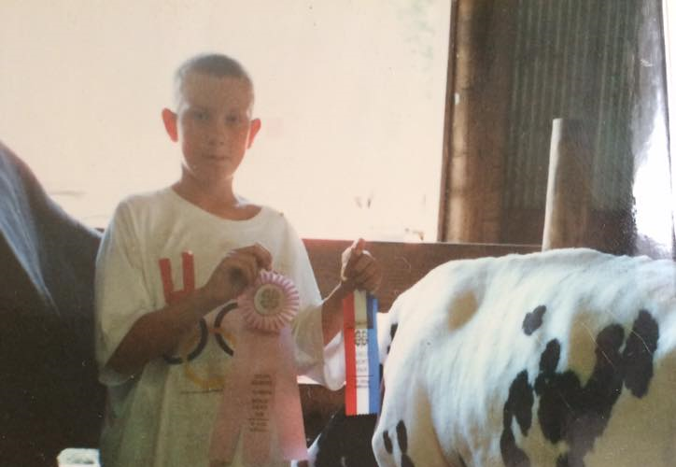
Sjostrom Farms
Three generation dairy – my brother, dad, and Grandpa still working together every day
Raise dairy cattle, cash crops, custom hauling, round-baling and forage harvesting (corn silage)
Grew from 60 cows to 80 cows in my 18 years at home

Slide 13
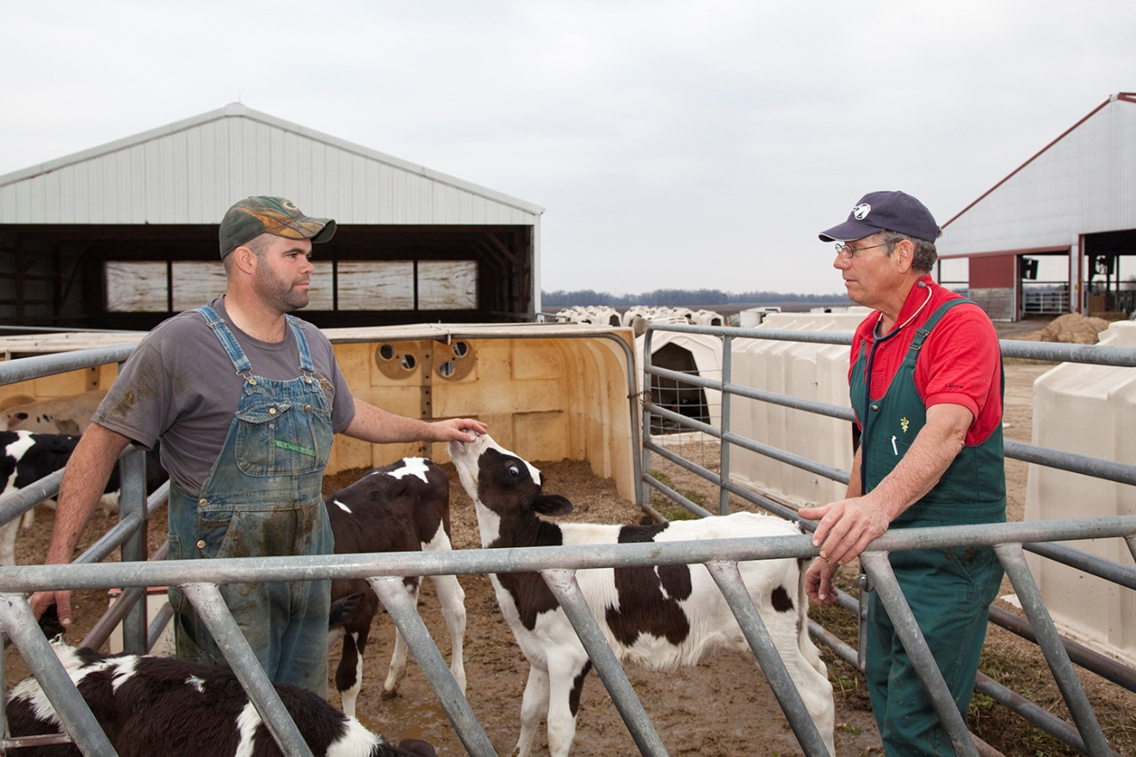

Slide 14

Smith Hall

Slide 15

2x = twice as smart??

Slide 16
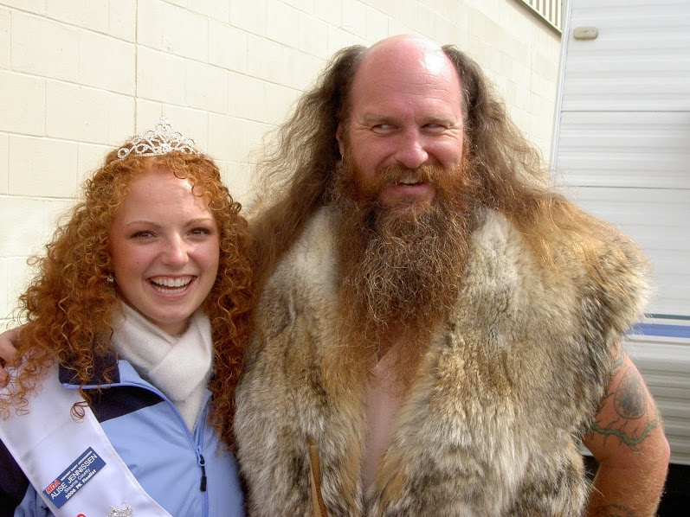

Slide 17
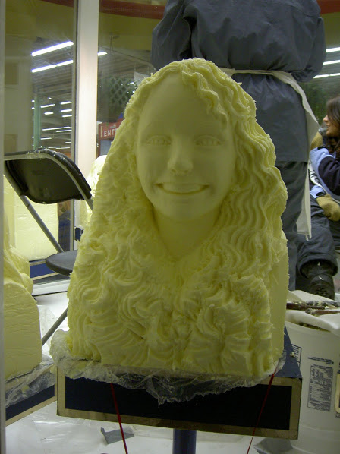

Slide 18


Slide 19
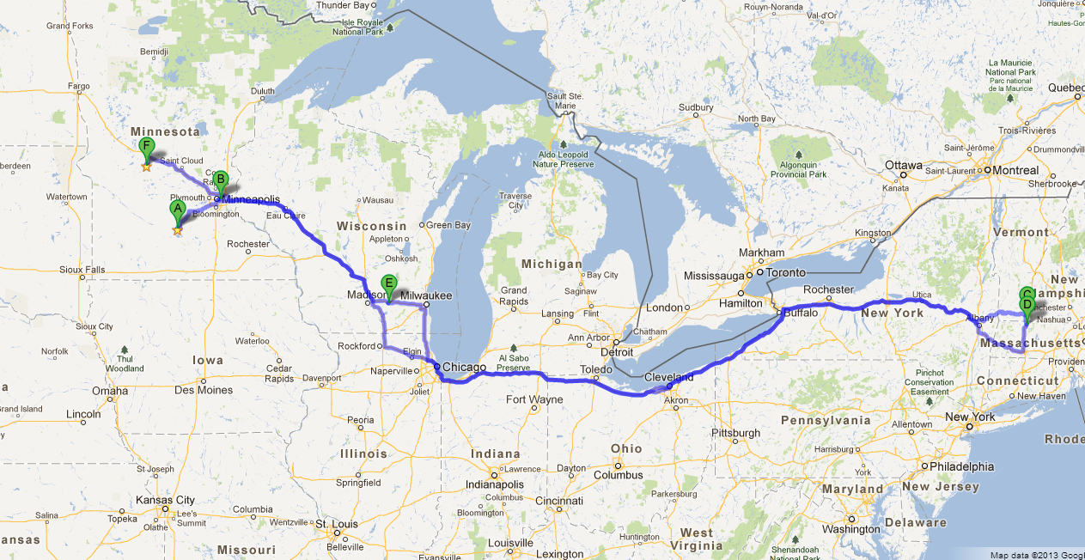
Agriculture can take you places!

Slide 20
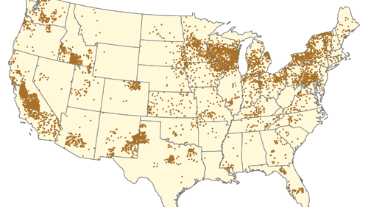
Current Dairy Cow Distribution (2011)
Source: Hoard’s Dairyman

Slide 21
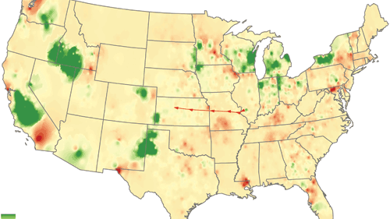
Current Dairy Cow Movements 2001-2011
Source: Hoard’s Dairyman

Slide 22
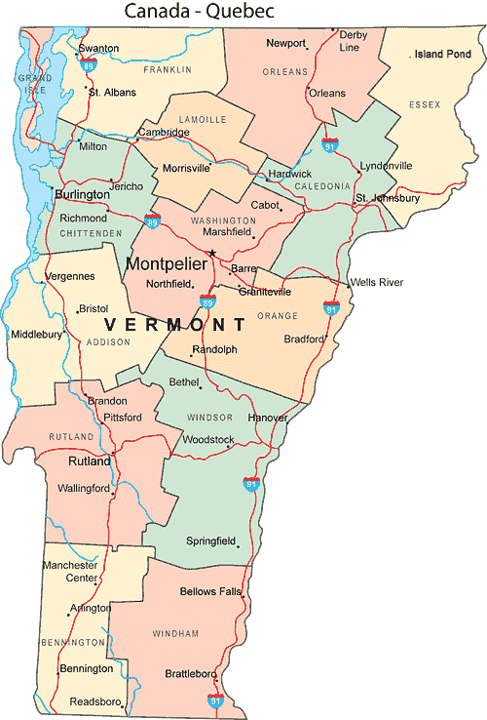
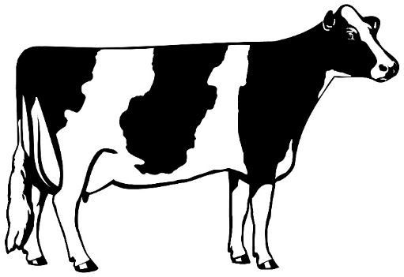
Vermont population:
623,657
Dairy farms:
749 (#11)
Milk Production:
2.6 billion lbs. (#17)
Holstein Association

Slide 23
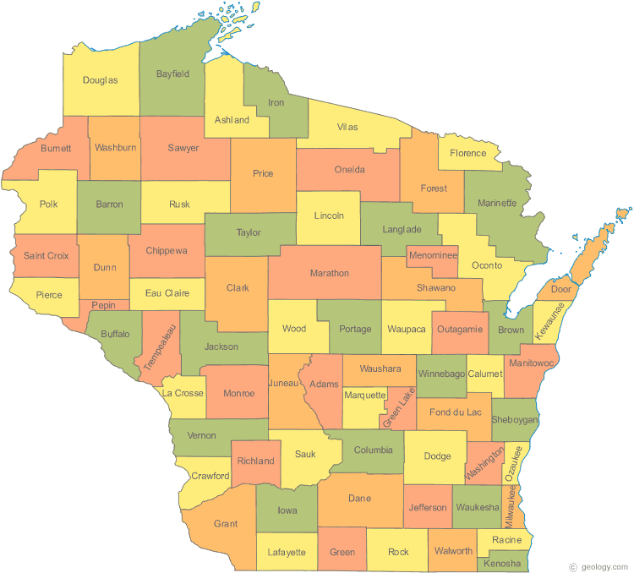
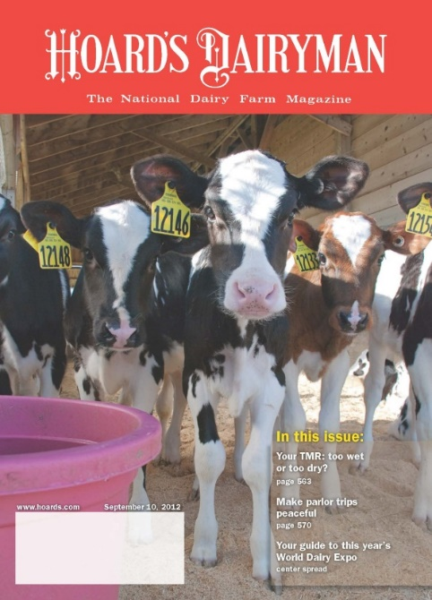
Wisconsin population:
5,840,000
Dairy farms:
8,372 (#1)
Milk Production:
30 billion pounds (#2)
Hoard’s Dairyman

Slide 24
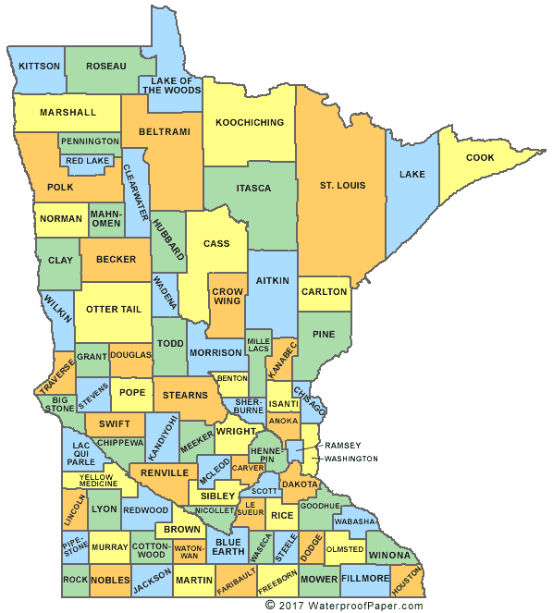
Minnesota population:
5,577,000
Dairy farms:
~2,700 (#4),450,000 cows
Milk Production:
9.9 billion lbs. (#8)
Counties in top 100 (May17):
Stearns #23
Stevens #70
Morrison #84
Winona #87

Slide 25
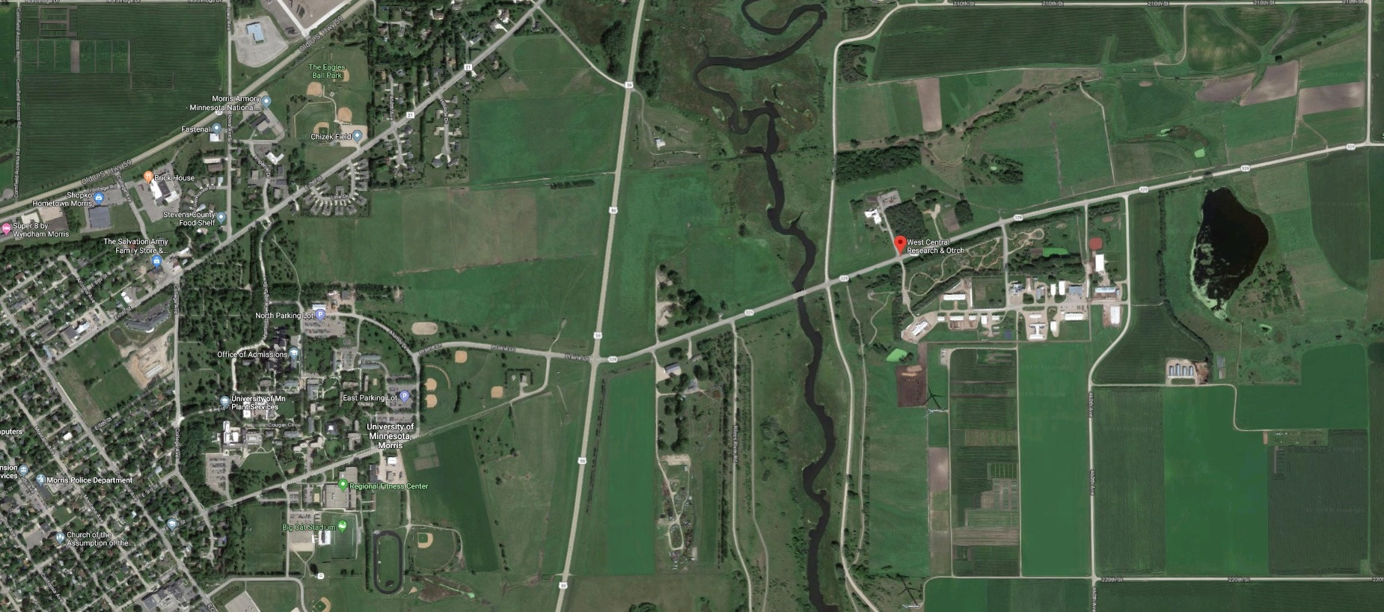
West Central Research and Outreach Center

Slide 26
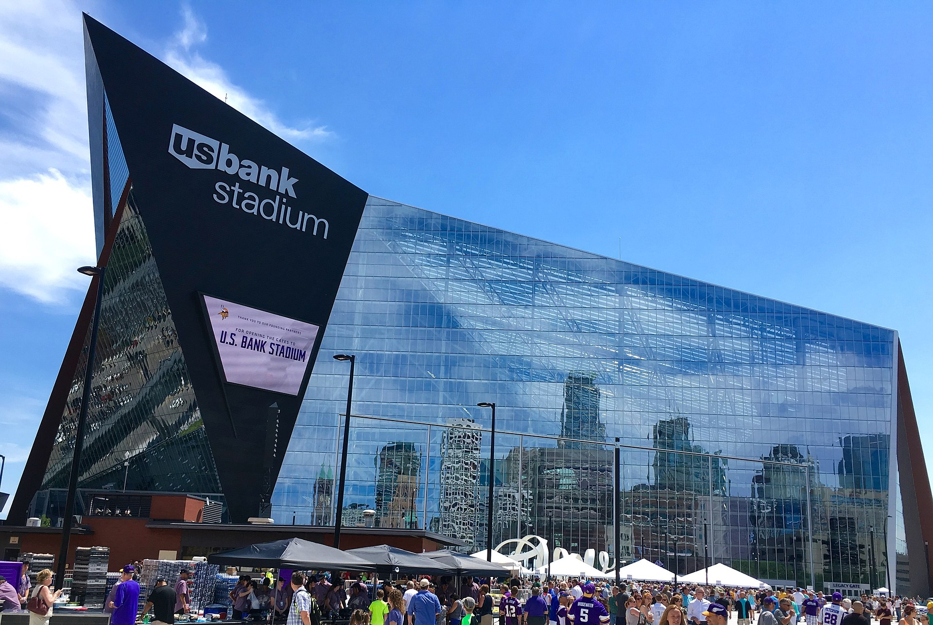
Minnesota Dairy Impact
Direct jobs – 24,950 (approximately 9,000 F.T.E. on-farm)
Additional 74,505 indirect jobs
99,455 jobs supported in Minnesota (1 of each 30 jobs in MN)
Dairy economic impact - $9.44 billion
$1.78 billion in federal taxes
$1.03 billion in state taxes
$26.92 billion value of products produced and sold
2.76% of Minnesota’s GDP
Source: International Dairy Foods Association

Slide 27
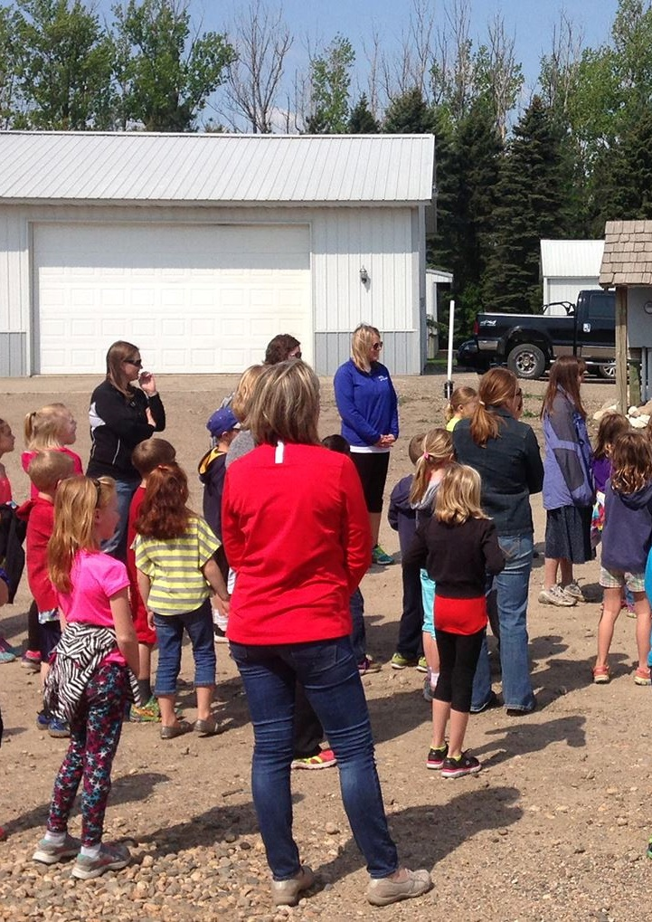

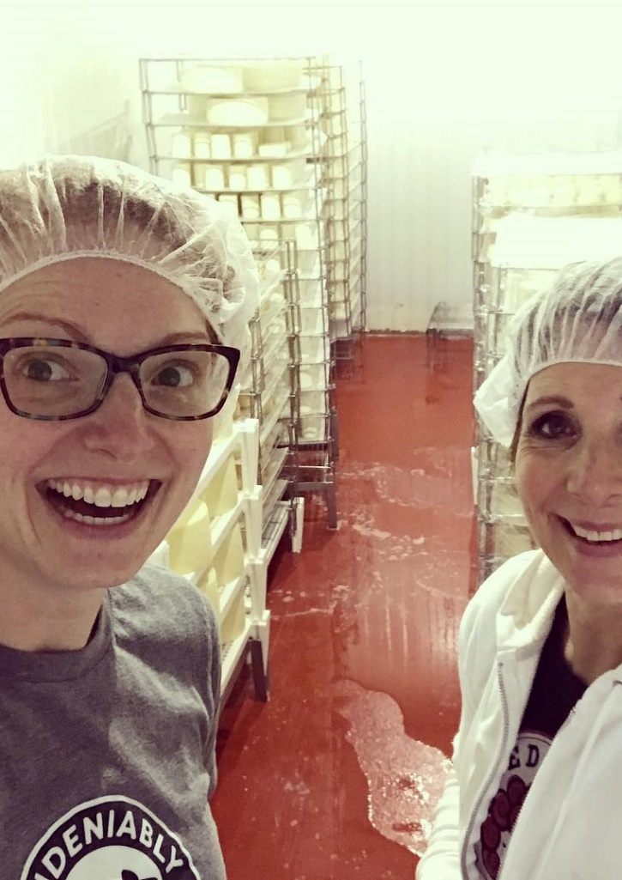

Redhead Creamery LLC/ Jer-Lindy Farms LLC

Slide 28
Jer-Lindy Farms and Redhead Creamery
$1,141,084 Jer-Lindy Farms, LLC, expenses in 2018 on 200 cows
$503,316.76 in feed, crops, straw and nutrient management (manure)
$79,774.71 in payroll costs (Not including 1.5 family members)
$75,952.34 in veterinary, bedding, milk quality, genetics, and hoof trimming
Other expenses: debt service, insurance, repairs, and family living
$520,012 Redhead Creamery, LLC, expenses in 2018
(8.5% of the milk from Jer-Lindy Farms, LLC)
$1.661 million total expenses from two enterprises and 200 cows
Minnesota Wild Rice
$2 million economic impact (source: DNR website)

Slide 29
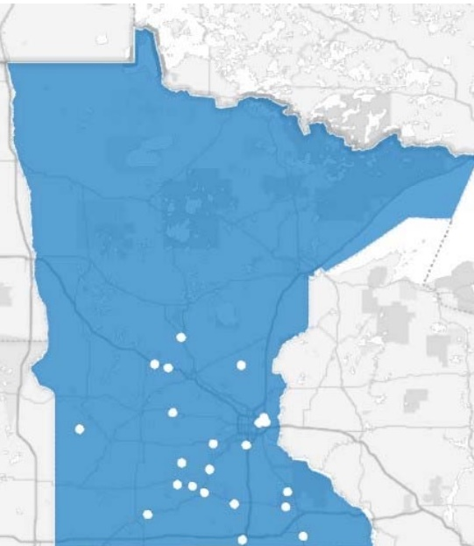
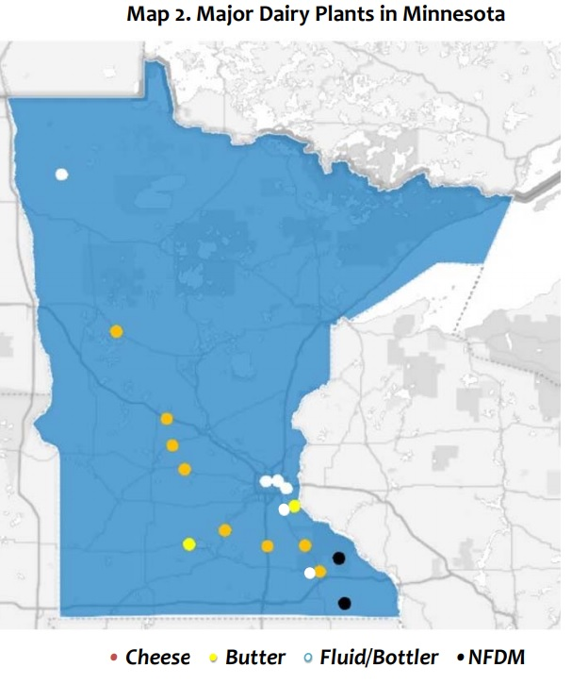
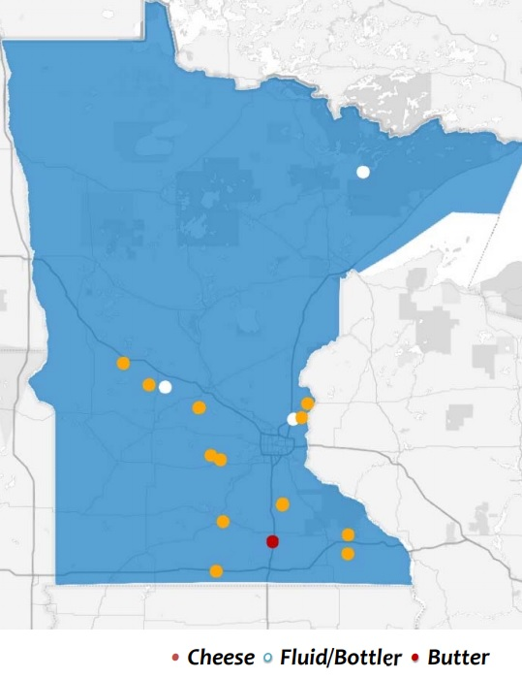
Dairy plants in Minnesota
Secondary Dairy Plants
Artisan Dairy Plants

Slide 30
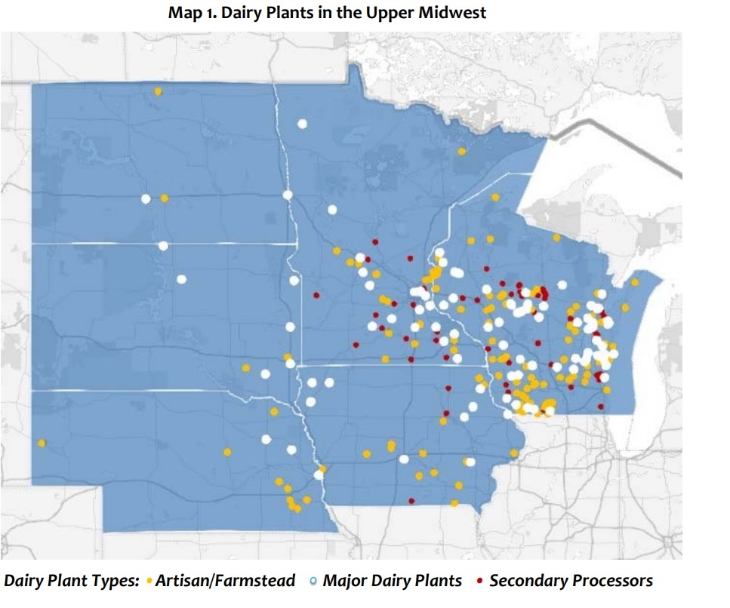
Dairy plants in the Upper Midwest

Slide 31
Today’s economics: Percent farms exiting nears 10%

Slide 32
Today’s situation
Lenders in Minnesota (in low-dairy areas) are choosing to exit out of their dairy portfolio entirely
Dairy farmers are dealing with mental health issues with a limited amount of help (and hope)
Potential new/future farmers are forced to work elsewhere when their family shuts their operation down for good

Slide 33
Opportunities ahead
Exports are leading the way
19% for one-month this year
Costs dramatically differ by farm size
New Farm Bill allows for those under 250 cows to compete
May be more risk for those 250-1,500 cow farms?
Minnesota can ensure all dairy farms have a leg up
Minnesota has opportunity to help stabilize our dairy industry

Slide 34
What does a cow generate (revenue)?
2017 average
$4,414.95 revenue/cow
2007
$3,970.32
1997
$2,389.20
Profit:
2009 – terrible year: $-201.56
2014 – great year: $1,226.93
Profit 2015-2017: $71.14/cow/year
$3,550 per 50 cows
$7,100 per 100 cows
$14,200 per 200 cows
$35,500 per 500 cows
Source: Minnesota Farm Business Management 1997, 2007, 2009, 2014, 2015, 2016 and 2017. About 400 farms per year in data set.

Slide 35
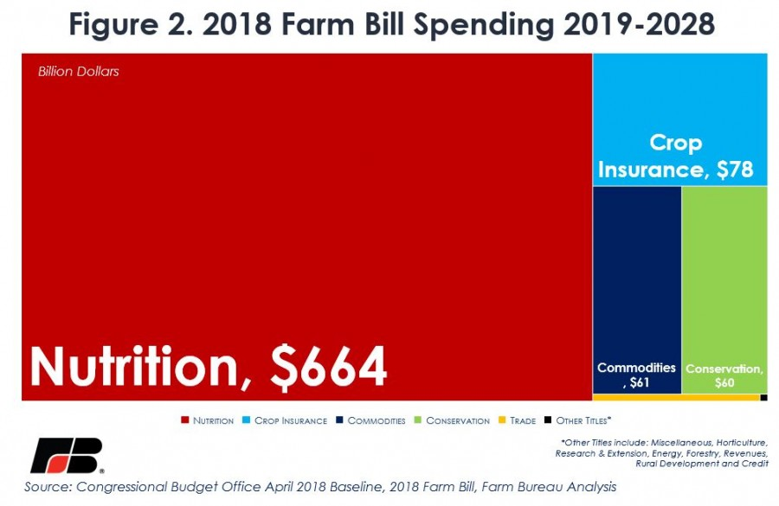
Farm Bill 101

Slide 36
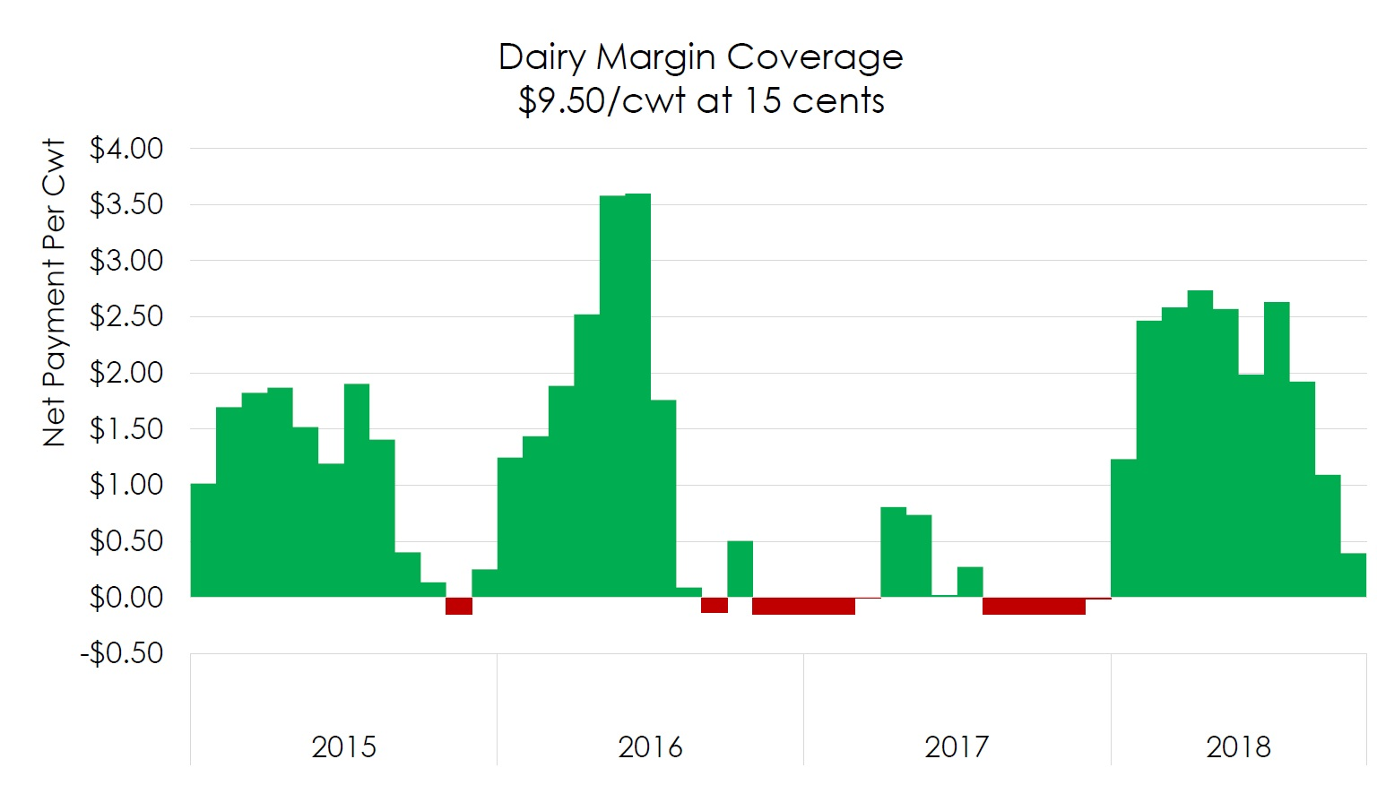

Slide 37
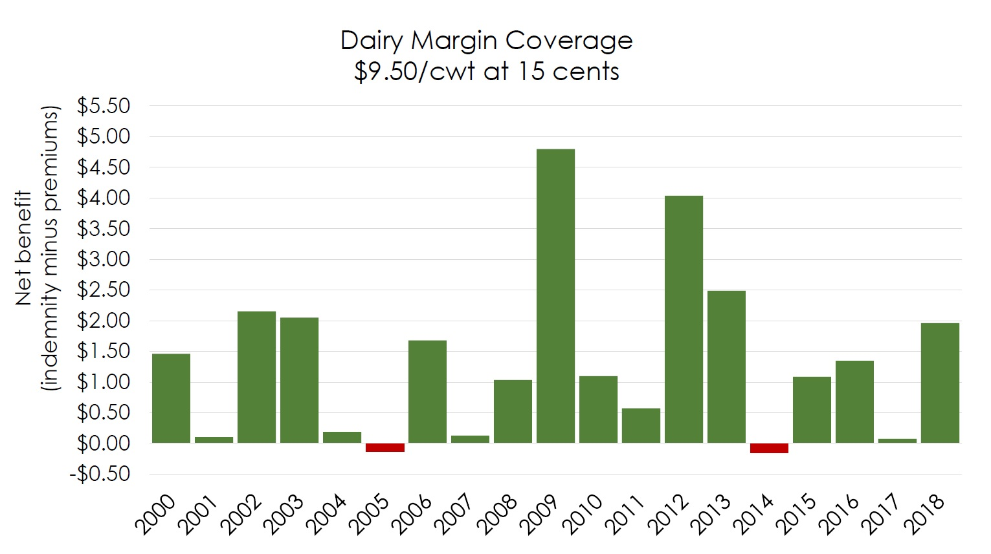

Slide 38
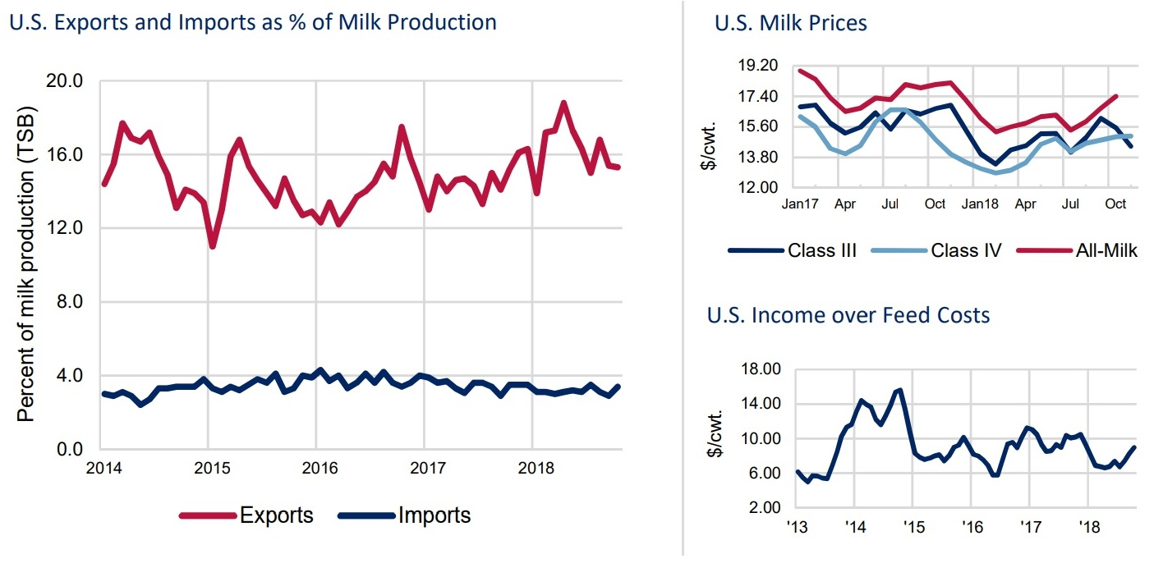
Macroeconomic factors

Slide 39


We export from here
Milk Specialties Global: 2018 Exporter of the Year Award winner. (Left to right) USDEC President and CEO Tom Vilsack, Dairy Foods Magazine Kathie Canning, Milk Specialties Global CEO Dave Lenzmeier and USDEC Chairman Paul Rovey.

Slide 40
Tariffs and trade deals
Tariffs
$1.5 billion on dairy for 2018
$3 billion if stayed for 2019
25% on cheese to Mexico
10% on yogurt to Canada
Provided about $29/cow in relief payments through MFP
USMCA
Resets ultrafiltered milk agreement (caused 9 farms in MN to lose market in 2017)
Provides limited access to Canada’s dairy market
Limits Canadian exports
Maintains structure with Mexico

Slide 41
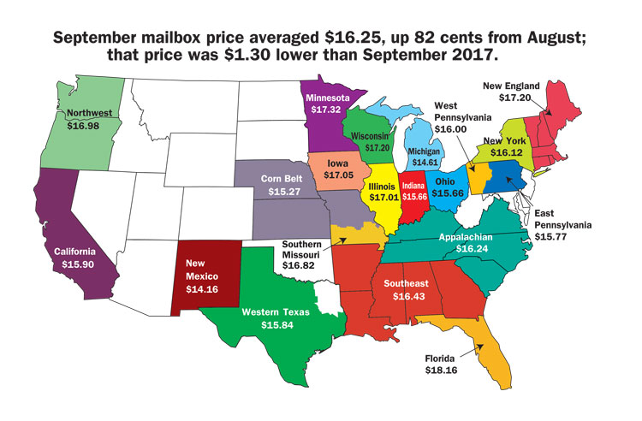
Mailbox milk prices
Source: Hoard’s Dairyman

Slide 42
Current Minnesota Dairy Programs
Livestock Investment Grants
90% dairy farmer investment with 10% state match
Minnesota Dairy Initiative
Seven full- and part-time staff around state to help create dairy teams
Dairy Planning Team Grants
Helps farmers
Regulatory:
Dairy Inspection
Every single dairy farm and plant inspected every six months (2x/year)

Slide 43
Dairy Stabilization Opportunities in 2019
Minnesota Milk suggests:
Support and encourage the environmental benefits dairy is already adding to the economy through nutrient management, alfalfa and other stewardship practices
-Farmers have voluntarily taken on many of these practices on their own and/or through government programs. Minnesota could help enhance the practices’ uptake.

Slide 44
Dairy Stabilization Opportunities in 2019
Minnesota Milk suggests:
Support and encourage the environmental benefits dairy is already adding to the economy through nutrient management, alfalfa and other stewardship practices
Help support federal insurance purchases
Small investment with huge potential
Farms with 225 cows would need $7,500 to purchase one year of insurance
Farms with 50 cows would need about $1,500

Slide 45
Dairy Stabilization Opportunities in 2019
Minnesota Milk suggests:
Support and encourage the environmental benefits dairy is already adding to the economy through nutrient management, alfalfa and other stewardship practices
Help support federal insurance purchases
Small investment with huge potential
Include section 199A (DPAD) in tax conformity bill
Was known as “Grain Glitch” – originally would have eliminated federal taxes, then fixed in spring 2018 to return to original intention
Aids all ag. cooperatives (milk, sugar beets, livestock and grain)
Domestic Production Activities Deduction solely for cooperatives

Slide 46
Dairy Stabilization Opportunities in 2019
Minnesota Milk suggests:
Support and encourage the environmental benefits dairy is already adding to the economy through nutrient management, alfalfa and other stewardship practices
Help support federal insurance purchases
Small investment with huge potential
Include section 199A (DPAD) in tax conformity bill
Domestic Production Activities Deduction solely for cooperatives
Enhance Livestock Investment Grants moving forward – entices farmers to reinvest in next generation
Require 90% investment by livestock farmer and 10% by state

Slide 47

Questions? Upcoming dairy events:
Midwest Dairy Ice Cream Social
January 31, 11 a.m. to 1 p.m.
Featuring Izzy’s Ice Cream!
All staff and legislators invited
Minnesota Milk Dairy Day at the Capitol
March 13, Legislative reception at 4 p.m.

Slide 48

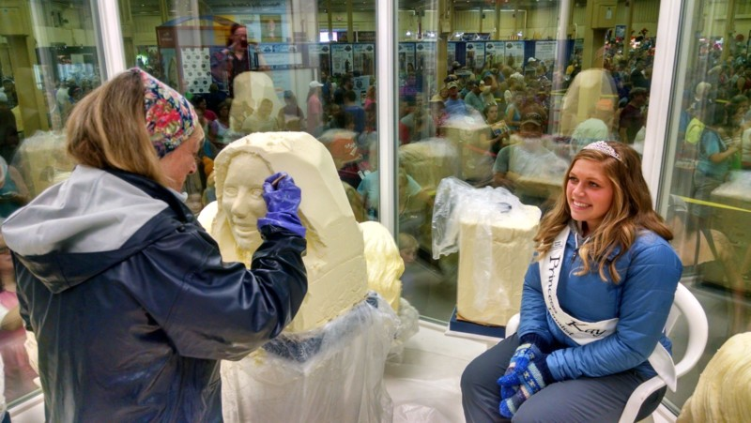
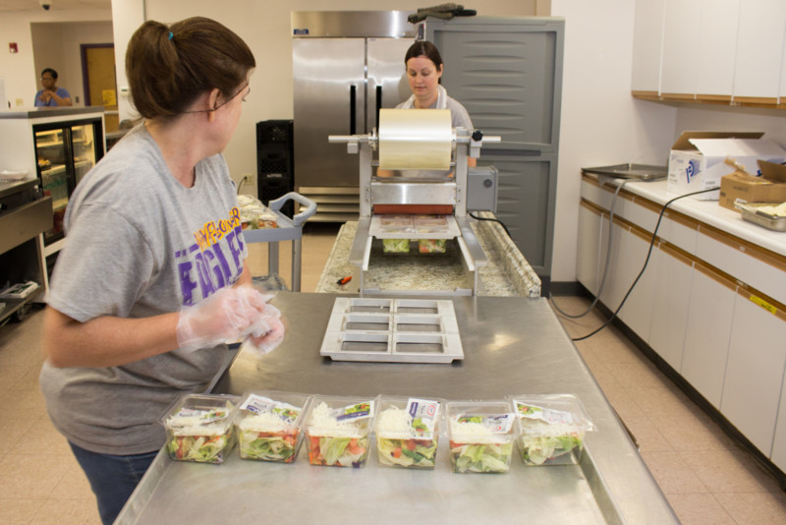


Slide 49
2018 Farm Bill Dairy Provisions
December 20, 2018
National Milk Producers Federation

Slide 50
New Bill Reflects NMPF Input
NMPF and state trade associations like Minnesota Milk worked with Congress last winter to allocate additional resources for dairy program, resulting in passage of budget act that increased dairy baseline by $800 million
Raised first tier of covered production to include each farm’s first 5 million pounds of annual milk production (about 217 cows) from 4 million pounds
Raised the catastrophic coverage level from $4.00 to $5.00 for the first tier of covered production for all dairy farmers
Reduced premium rates for the first 5 million pounds of production for more affordable coverage
Changed the margin calculation from a bi-monthly to a monthly basis
Program has generated approx. $250 million in payouts this year
NMPF then worked with Ag committee leaders to include other important improvements to 2018 Farm Bill

Slide 51
Dairy Margin Coverage Program
The 2018 Farm Bill rebrands the MPP as the Dairy Margin Coverage (DMC) program, and makes important changes in the safety net for farmers through:
improving the coverage level and premium rate structure
discounting future premiums and refunding past premiums
slashing premiums on catastrophic coverage levels for larger producers, and
eliminating the restrictions against covering milk in both the margin program and Livestock Gross Margin (LGM) insurance.

Slide 52
Margin Coverage Thresholds
DMC allows all dairy producers to insure margins on their Tier I (first 5 million pounds) production history at the new, higher levels of $8.50, $9.00 or $9.50.
These new coverage levels will rectify the significant deficiencies in the original MPP feed cost formula enacted by Congress
If producers select a Tier I margin coverage above $8, those with production history above 5 million pounds will be able to select any coverage level to cover their Tier II production history.
Those who select a Tier 1 margin of $8 or less will be required to cover enrolled Tier II production history at that same level. However, those selecting coverage at $8.50 or higher may choose any coverage level in Tier II.

Slide 53
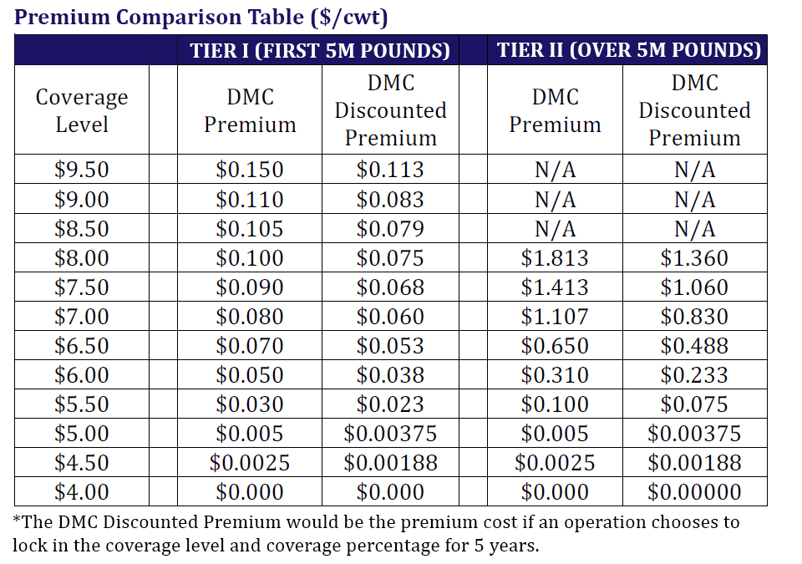

Slide 54
Premium Discounts
The DMC program allows producers to receive a 25-percent discount on premiums paid to USDA if they lock in their coverage for the entirety of the farm bill (calendar years 2019-2023)
Producers will be allowed to make a separate coverage decision for each tier of production history, meaning they can select the 5-year discount for Tier 1 while choosing their margin coverage threshold each year for Tier II

Slide 55
Premium Discounts
The 2018 Farm Bill allows dairy operations to receive a 75-percent credit of the net MPP premium paid to USDA (premium fees minus indemnity payments) from 2014‐2017 that will be applied to future DMC premiums
For farmers who do not wish to use that credit, they can receive 50 percent of their net premiums from 2014-2017 as a direct refund

Slide 56
Farm Milk Production History
Bill maintains existing production history calculations from the 2014 Farm Bill, allowing producers to use 2011, 2012 or 2013 as their base production level
A farm’s production history is indexed to national milk production growth through Jan. 1, 2019
Dairies not in operation in 2014 or earlier, as well as new dairies, will designate one year to establish milk production history

Slide 57
Farm Milk Production History – Coverage Range
Farms will be able to cover up to 95 percent of their production history, an increase from the 90-percent maximum in the MPP
DMC program reduces the current 25-percent minimum annual milk production coverage requirement down to 5 percent
Larger farms that may not have benefitted from the lower Tier I premium rates because of the 25-percent coverage requirement will have a better opportunity to cover only the production history that makes the most economic sense for them.

Slide 58
Expanded Flexibility
2018 Farm Bill allows operations to fully participate in both the DMC and Livestock Gross Margin (LGM) programs
DMC, LGM - no restriction, same milk in both
DMC, DRP - no restriction, same milk in both
DRP, LGM - can be in both, but not same milk
Producers who were locked out of MPP this year because they were contractually obligated to cover production under LGM will be able to retroactively sign up for MPP coverage for calendar year 2018 and benefit from the more attractive Tier I coverage and the payments generated this year

Slide 59
Class 1 Price Mover
USDA must change Class I mover pricing formula for skim milk in Federal Milk Marketing Orders from the previous higher of the Class III or Class IV (advanced) skim milk prices to the average of the Class III or Class IV (advanced) skim milk prices, plus $0.74/cwt
This will provide fluid processors and other milk marketers a better means to hedge Class I price risk using dairy futures markets
Between August 2017 and December 2018, this change would have resulted in an average $0.25-per-cwt. higher Class I mover than the previous “higher of” mover

Slide 60
What’s Next?
NMPF and state trade associations like Minnesota Milk will work closely with USDA to implement new program changes as expeditiously as possible
NMPF and state trade associations will provide additional information about DMC program as USDA begins taking Congress’ farm bill language and implementing the DMC program.
New rates and coverage will be effective Jan. 1, 2019.
Once producers sign up, their coverage will be retroactive to the beginning of 2019

Slide 61
Milk Pricing through FMMOs
Four classes
Advanced price (estimate) plus formulas (real) provide milk checks
Producers are paid minimum 2x/month
Cooperatives do not need to pay minimum (but often do to compete)

Slide 62
Milk Pricing: Class I - fluid
Class I Price = (Class I skim milk price x 0.965) + (Class I butterfat price x 3.5)
Class I Skim Milk Price = Higher of advanced Class III or IV skim milk pricing factors + applicable Class I differential
Class I Butterfat Price = Advanced butterfat pricing factor + (applicable Class I differential ÷ 100)
Advanced pricing factors are computed using applicable price formulas, except that product price averages are for two weeks.

Slide 63
Milk Pricing: Class II – yogurt/cream cheese
Class II Price = (Class II skim milk price × 0.965) + (Class II butterfat price × 3.5)
Class II Skim Milk Price = Advanced Class IV skim milk pricing factor + $0.70
Class II Butterfat Price = Butterfat price + $0.007
Class II Nonfat Solids Price = Class II skim milk price ÷ 9

Slide 64
Milk Pricing: Class III - cheese
Class III Price = (Class III skim milk price × 0.965) + (Butterfat price × 3.5)
Class III Skim Milk Price = (Protein price × 3.1) + (Other solids price × 5.9)
Protein Price = ((Cheese price – 0.2003) × 1.383) + ((((Cheese price – 0.2003) × 1.572) – Butterfat price × 0.9) × 1.17)
Other Solids Price = (Dry whey price – 0.1991) × 1.03
Butterfat Price = (Butter price – 0.1715) × 1.211

Slide 65
Milk Pricing: Class IV – powder/butter
Class IV Price = (Class IV skim milk price × 0.965) + (Butterfat price × 3.5)
Class IV Skim Milk Price = Nonfat solids price × 9
Nonfat Solids Price = (Nonfat dry milk price – 0.1678) × 0.99
Butterfat Price = (Butter price – 0.1715) × 1.211

Slide 66
Somatic Cell Adjustment Rate
Somatic Cell Adjustment Rate = Cheese price × 0.0005 rounded to the fifth decimal place. Rate is per 1,000 somatic cell count difference from 350,000.

