Slide 1
MNLARS Project Update
January 2017

Slide 2
MNLARS Mission
Mission
Need
Goals
To build and deliver the best secure driver and vehicle information system that is within budget, easy to use and maintain, and that allows for future enhancement.
Leaders
Budget
Early Years
Current
Forward
Outreach
Benefits
Schedule
Audit

Slide 3
Need for MNLARS
Mission
Need
The mainframe is a 30 year-old system, past its prime
2007 system analysis recommended replacement
Layering today’s security technology on an old system increases system vulnerability
Limited ability to accommodate change
Minor changes require major development effort
Changes to one function may unknowingly affect other functions
Goals
Leaders
Budget
Early Years
Current
Forward
Outreach
Benefits
Schedule
Audit

Slide 4
MNLARS Project Goals
Mission
1. Reduce transaction processing times.
Need
Goals
2. Improve data access, accuracy, consistency, and security.
Leaders
3. Improve customer assistance and communications.
Budget
4. Standardize processes.
Early Years
Current
5. Reduce paperwork and paper flow.
Forward
6. Increase customer convenience.
Outreach
Benefits
Schedule
Audit
Notes:
The goals of MNLARS have remained unchanged since the project began.
We want to:
Ensure the integrity of our data
Reduce reliance on redundant paperwork processing, which in turn reduces wait times for things like titles and special plates
Build a framework that accommodates change
Create a governance platform that incorporates enhancement development in regularly scheduled development cycles (one of the motor vehicle enhancements already in the works is electronic vehicle title and registration (EVTR) service – currently provided by CVR vendor
Make sure we are meeting the needs of Minnesotans

Slide 5
Leadership/Governance Partnership
Mission
Provides project leadership
Engages key business partners in planning
Key staff serve as subject matter experts
Need
Goals
Leaders
Budget
Early Years
Current
Provides project leadership
Works with business subject matter experts to develop and test software
Maintains aging legacy systems
Responsible for ongoing maintenance of MNLARS as each phase is implemented
Forward
Outreach
Benefits
Schedule
Audit
Notes:
In 2014 DVS and MN.IT assumed responsibility for the governance and development of MNLARS.
Since then they have been partners, managing and building MNLARS

Slide 6
Budget
Mission
 | FY16 | FY17 | FY18
Consultants | $ 8,600,000.00 | $ 16,229,850.00 | $ 15,834,250.00
Staff | $ 2,021,021.00 | $ 2,700,000.00 | $ 3,683,000.00
Rent and space needs | $ 206,292.00 | $ 300,000.00 | $ 300,000.00
Supplies, Misc, Other | $ 78,480.00 | $ 50,000.00 | $ 50,000.00
Insurance | $ 1,537.00 | $ 2,000.00 | $ 2,000.00
Statewide Indirect Costs | $ 68,106.00 | $ 73,000.00 | $ 73,000.00
Enterprise Data Center (EDC) & Identity Access Mgmt (IAM) | $ 975,443.00 | $ 2,890,000.00 | $ 6,313,000.00
 | $ 11,900,879.00 | $ 22,244,000.00 | $ 26,255,000.00
Need
Goals
Leaders
Budget
Early Years
Current
Forward
Outreach
Benefits
Schedule
Development Funding: Technology surcharge, which ended on June 30, 2016
Maintenance Costs: DVS and MN.IT establishing ongoing MNLARS operation costs
Audit

Slide 7
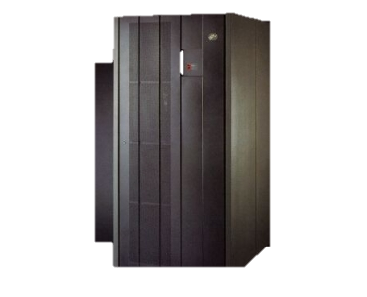
Early Years
Mission
2008
2009-10
2011-12
2014
Need
Goals
Leaders
Budget
Early Years
Current
Seeks funding to replace legacy system
Identifies requirements to replace mainframe
Searches for vendor to build MNLARS
Ends contract with HP and takes different track
Forward
Outreach
Benefits
Schedule
Audit
Notes:
MNLARS Updates to Legislators:
January 2009
January 2010
April 2011
February 2012
March 2013
July 2013
February 2014
July 2014
November 2014

Slide 8
Current Highlights
Mission
Need
2015
2016
Goals
Leaders
We started new development with MN.IT
Began outreach to deputy registrar
First system demo
Hands on session with deputy registrars
Added a practice and training phase
Live demonstration at MDRA Annual Meeting
Launched Read-Only phase in October
Started deputy registrar transition to new system
Budget
Early Years
Current
Forward
Outreach
Benefits
Schedule
Audit

Slide 9
Looking Forward
Mission
Need
2017
2018
Goals
Leaders
Start dealer transition to new system
Training for deputy registrars and DVS staff motor vehicle title & registration
Training/Practice Phase
Switch from Mainframe to MNLARS production
Development of motor vehicle add-ons
Development of driver’s license part of MNLARS
Begin driver’s license phased implementation
Finish driver’s license implementation
Retire legacy systems
Budget
Early Years
Current
Forward
Outreach
Benefits
Schedule
Audit

Slide 10
2016 MNLARS Stakeholder Outreach
Mission
DVS/MDRA Bi-monthly Strategy Meetings
DVS/MDRA Monthly Stakeholder Committee Meetings
DVS/MDRA Monthly Communication Team Meetings
Monthly MNLARS System Demonstration
MDRA representative imbedded in MNLARS team
Presentation at MDRA Annual Membership Meeting
Targeted Communication to deputy registrar office managers and Super Users
“Try It” sessions for deputy registrars and DVS staff
DVS/Dealer Association bi-monthly meetings
Data access training for the data use representatives at deputy registrars and government offices
New barcode reader for each office
Gathered IT contact information for each office
Need
Goals
Leaders
Budget
Early Years
Current
Forward
Outreach
Benefits
Schedule
Audit
Notes:
Key to a successful MNLARS rollout is stakeholder preparedness.
DVS/MNLARS outreach efforts in 2016 really focused on deputy registrars because they provide most of the motor vehicle face-to-face customer service
MNLARS puts the capture of accurate vehicle and ownership data upfront in the hands of deputy registrars.
MNLARS prevents deputy registrars from submitting transactions without certain information, such as reason for sales tax exemption, insurance information, odometer reading, etc.
Under the current system, missing elements are only caught by DVS staff after a deputy registrar has submitted the application

Slide 11
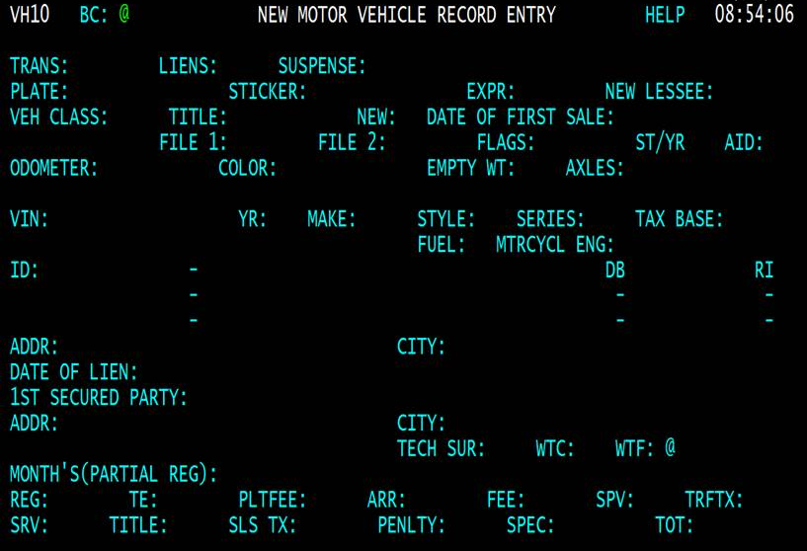
Notes:
Transitioning from Mainframe to MNLARS
Mainframe Drawbacks
No room on screens to accommodate any extra information we’d like collected
Limited character spacing for names and addresses
Limited space for number of owners/lienholders (only 2)
Next slide

Slide 12
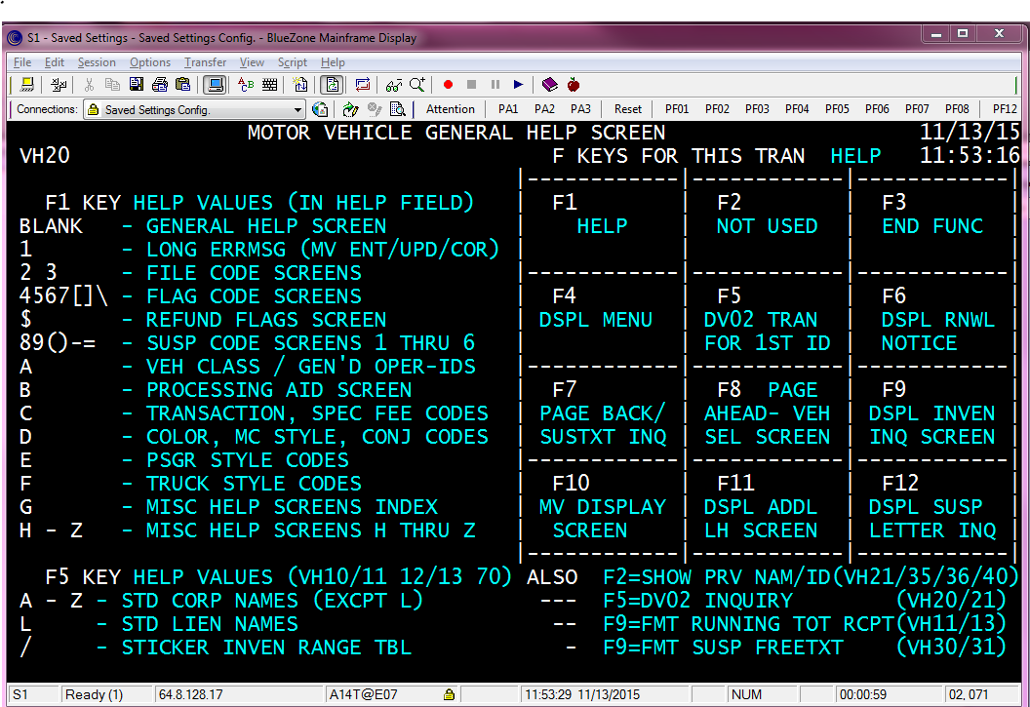
Notes:
Files, flags, registration class indicators, customer letter types etc., are all in codes – not only do they need to be entered as a code, they display on the record as a code.
If I click on Susp Code Screens (notice there are 6 of them), this is what I see.

Slide 13
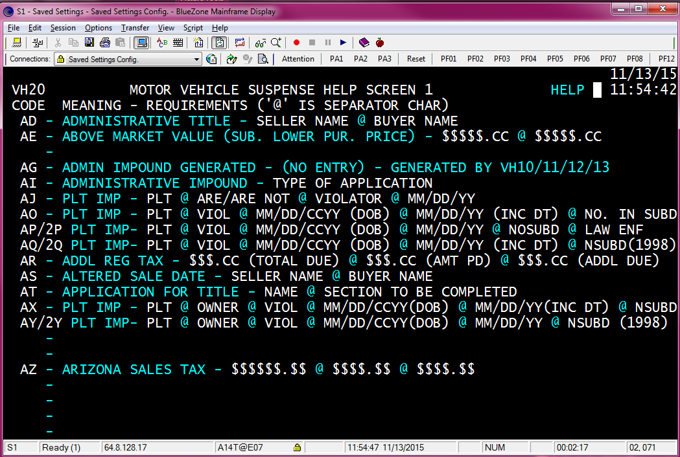
Notes:
The vehicle record displace the elements in white

Slide 14
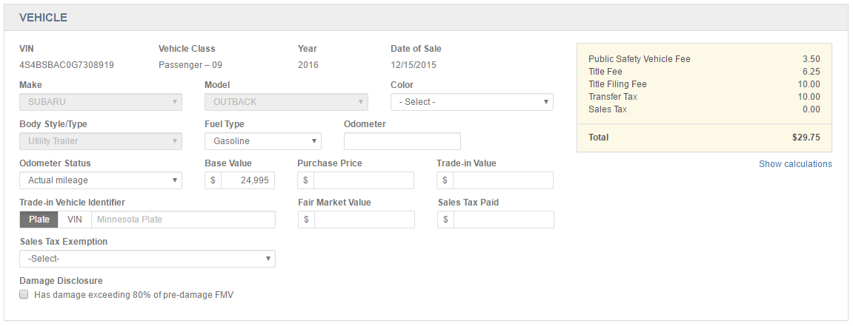
Notes:
MNLARS is able to capture more information such aas purchase price, trade in value, plate of trade in vehicle.
It keeps a running total of fees due.

Slide 15
Notes:
It allows deputy registrars to order most special plates not stocked in their office, directly from MINNCORR – reducing the time a customer has to wait for a special plate
If the county the vehicle is kept in has a wheelage tax, MNLARS adds the tax to the fees due
Able to add up to 12 owners

Slide 16
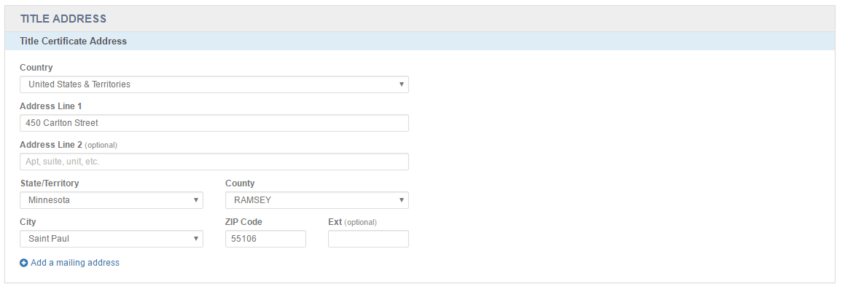
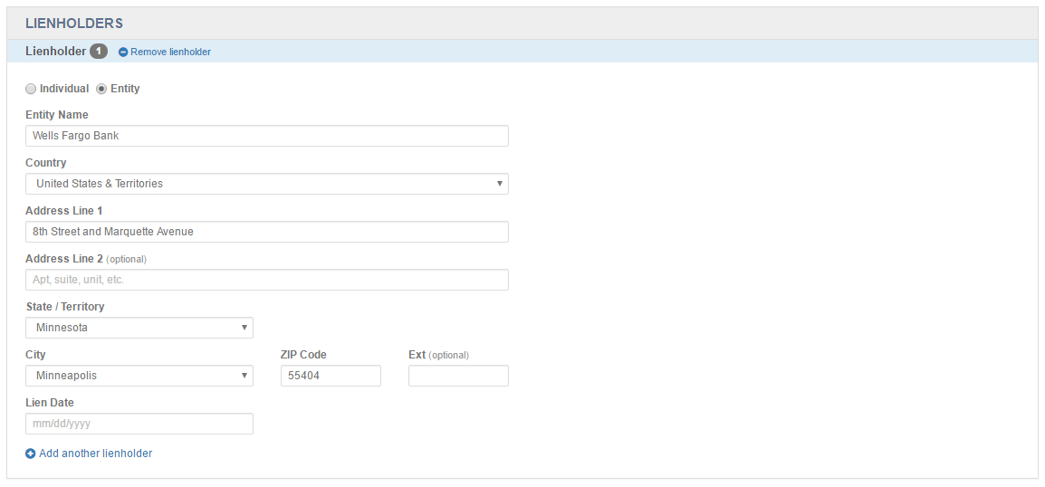
Notes:
Able to add a mailing address for vehicle transactions
Able to add and display up to 12 lienholders

Slide 17
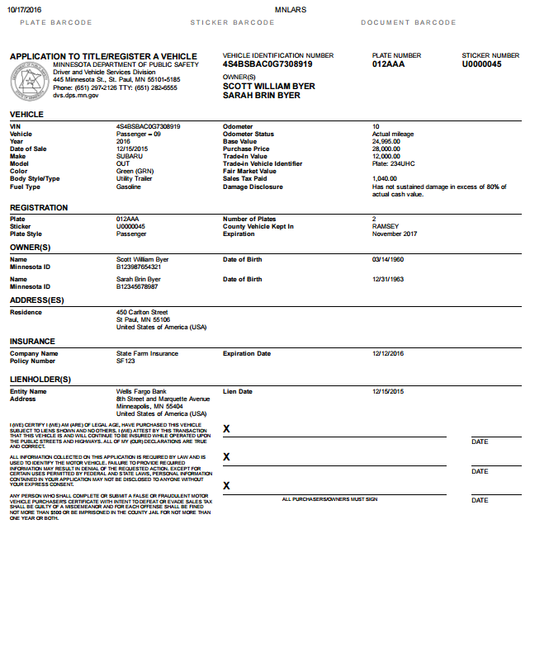
Notes:
Deputy registrars are able to print application for title from information they enter on MNLARS

Slide 18
Benefits
Mission
Need
MNLARS calculates all fees
MNLARS eliminates the need for a deputy registrar to prepare a daily financial report
MNLARS updates records in real time
MNLARS improves data accuracy with a user interface that employs system edits, drop downs, auto-fill fields etc.
MNLARS reduces letters to customer with required fields, such as insurance information, motorcycle engine number, odometer reading etc.
MNLARS improves user access security and data access auditing
MNLARS increases system stability
Goals
Leaders
Budget
Early Years
Current
Forward
Outreach
Benefits
Schedule
Audit

Slide 19
MNLARS Motor Vehicle Schedule
Mission
Need
Read Only – Implemented October 2016
Stands up MNLARS infrastructure (the foundation for the entire system)
Introduces the new user management system
Converts production data from mainframe to MNLARS
User group: authorized government and private entities that look at record information
Adoption Phase
Stand alone production-like practice environment
User group: Deputy registrars and DVS staff
MNLARS Production Phase – Implementation Spring 2017
Begins actual production activities in MNLARS
Closes (retires) the motor vehicle portions of the mainframe
User group: DVS staff, deputy registrars, dealers, and law enforcement
Goals
Leaders
Budget
Early Years
Current
Forward
Outreach
Benefits
Schedule
Audit
Notes:
Adoption Phase added for Deputy Registrars
Opportunity for deputy registrars to practice in MNLARS environment (non-production)
Removes the pressure of learning a new system while waiting on a customer
Allows deputy registrars to focus on transactions common to their office
Provides opportunity for deputy registrars to customize office practices based on real life experience with MNLARS
Significantly increases probability of successful transition to MNLARS for deputy registrars who fully engage

Slide 20
Audit
Mission
Overall Project Health
Need
Reporting period, Aug 27 – Nov. 25, 2016
Goals
Leaders
Budget
Summary Category | MNLARS Status
Cost | Green
Quality | Green
Schedule | Green
Scope | Green
Staffing | Yellow
Early Years
Current
Forward
Outreach
Benefits
Schedule
Audit
Notes:
Today, the health of the project is good.

