Slide 1

Science Museum of Minnesota
Minnesota House of Representatives
Environment and Natural Resources Finance Division Committee
January 29, 2019
Alison Brown, President and CEO

Slide 2
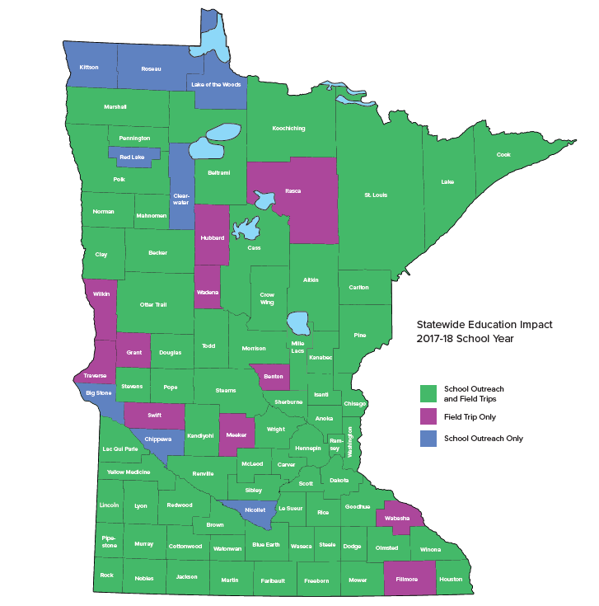
Serving 87 of 87 Minnesota Counties
Statewide School Initiative

Slide 3
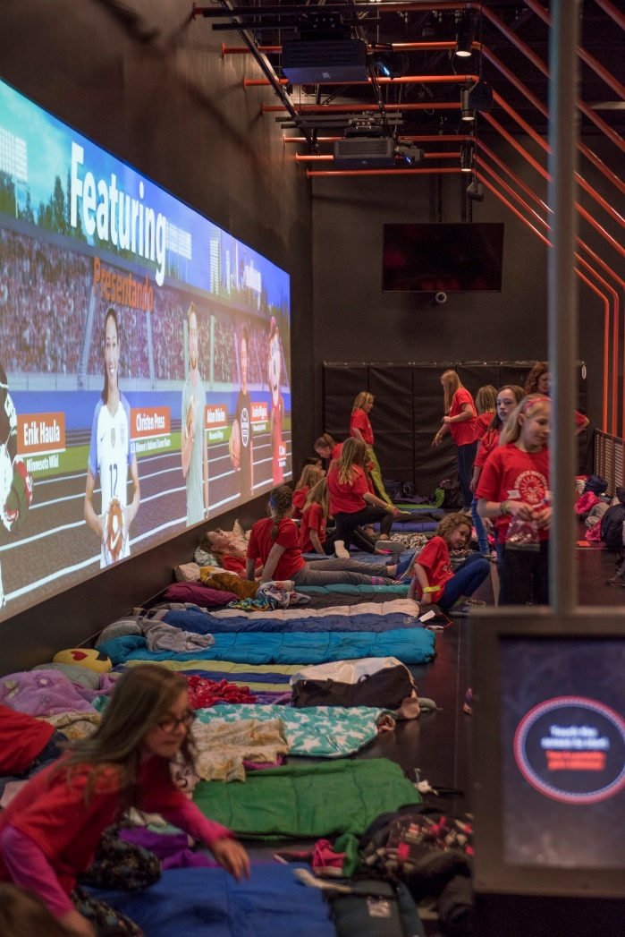
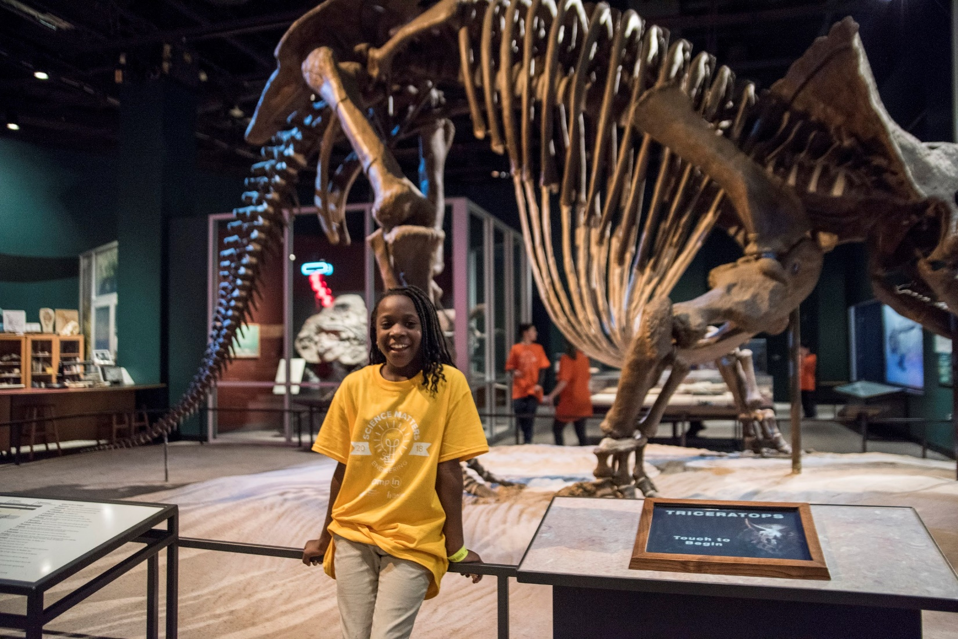
Statewide School Programming

Slide 4
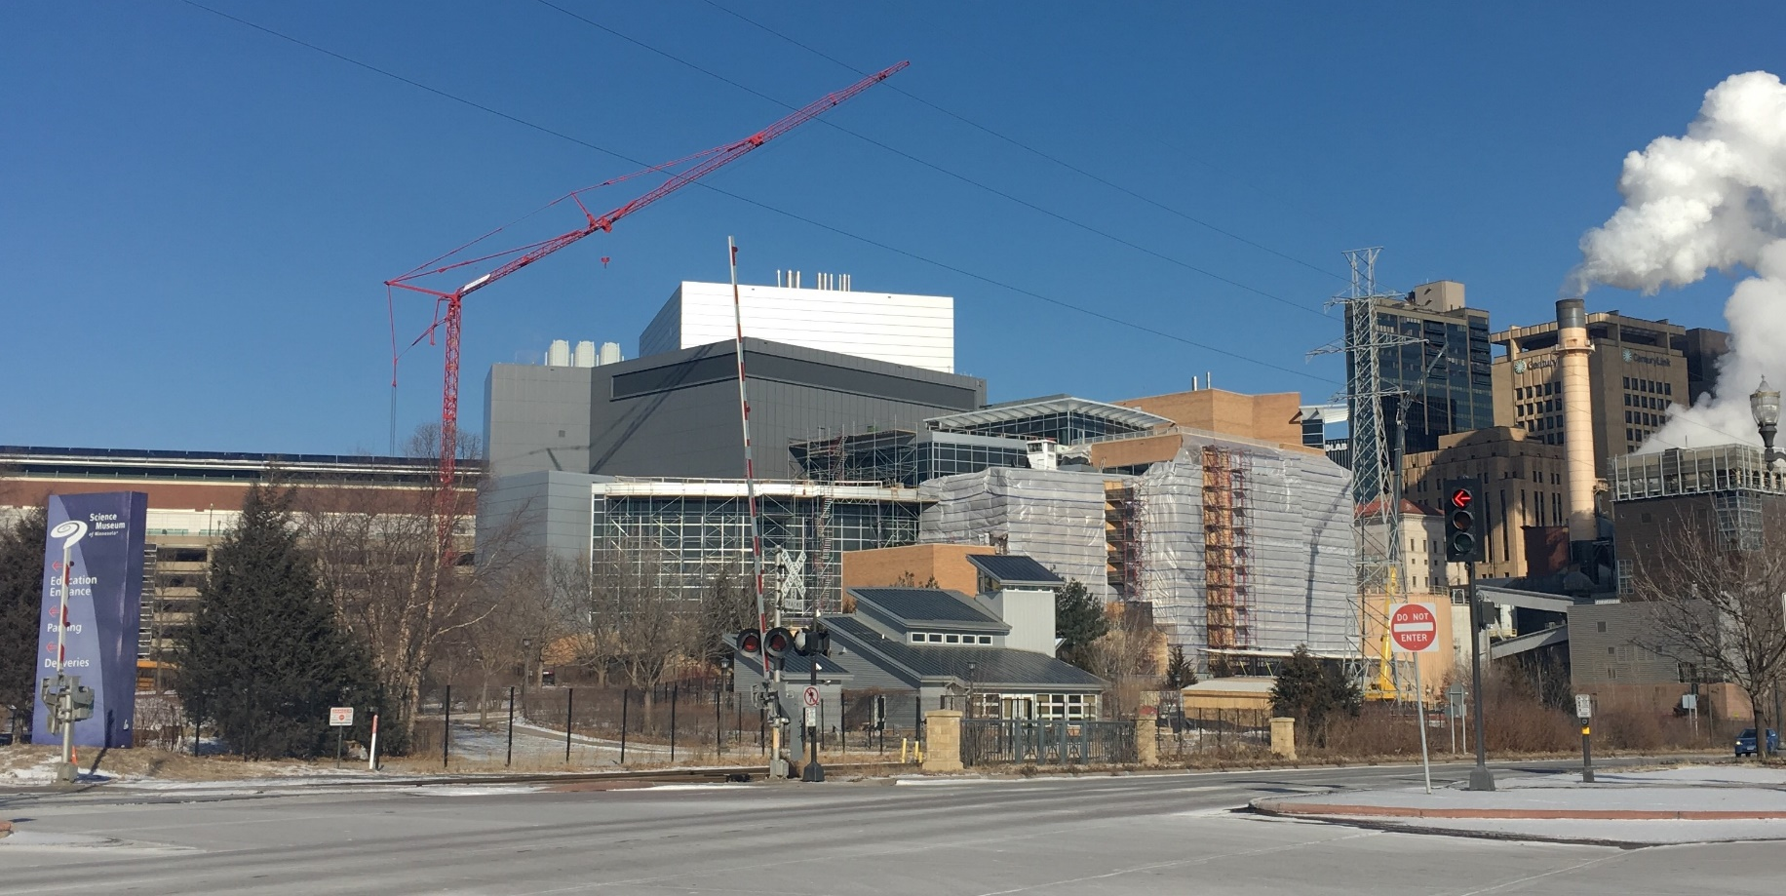
Building Preservation Project

Slide 5
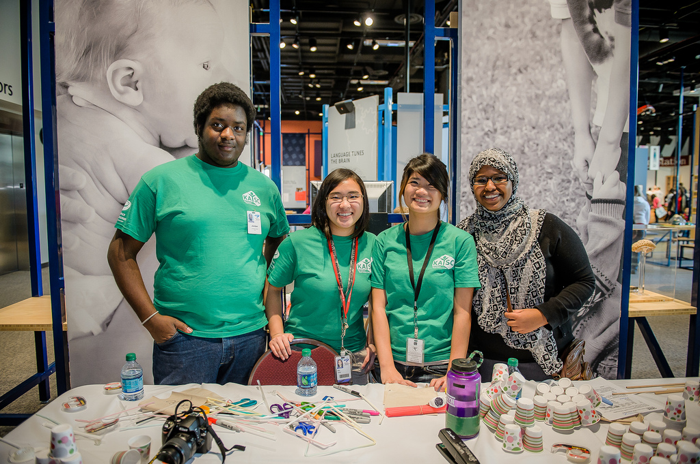
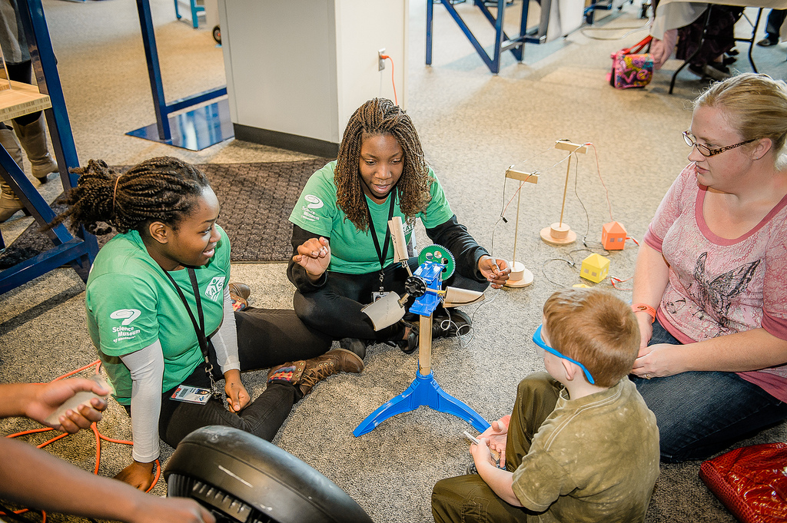
Advancing Equity & Access

Slide 6
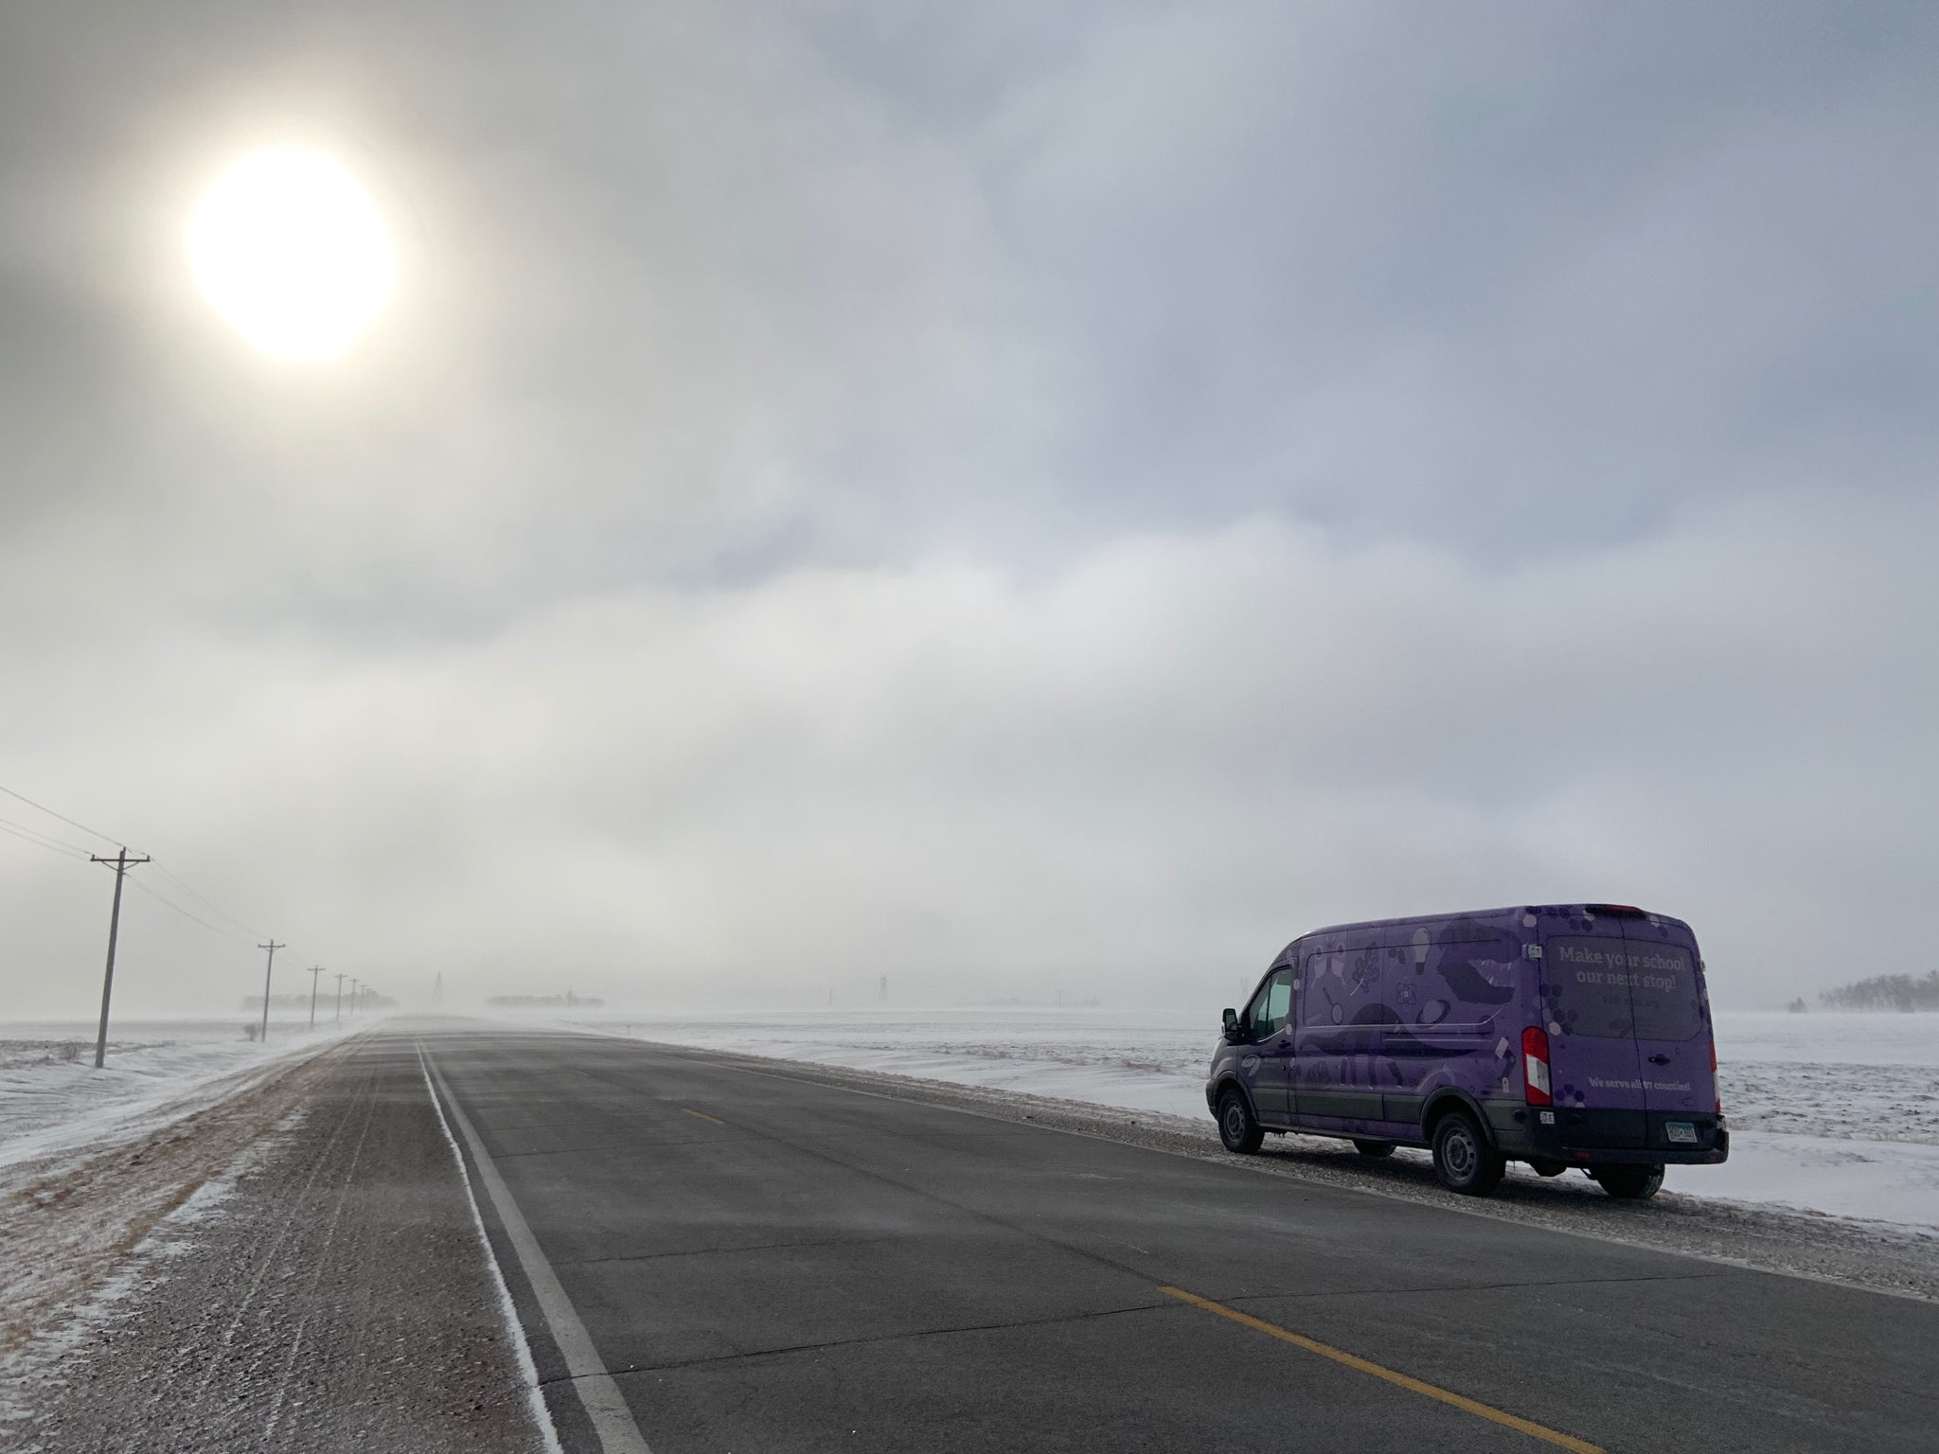
Thank You!

