Slide 1
February 13, 2017
System enrollment and financial overview
House Ways and Means Committee
Minnesota State

Slide 2
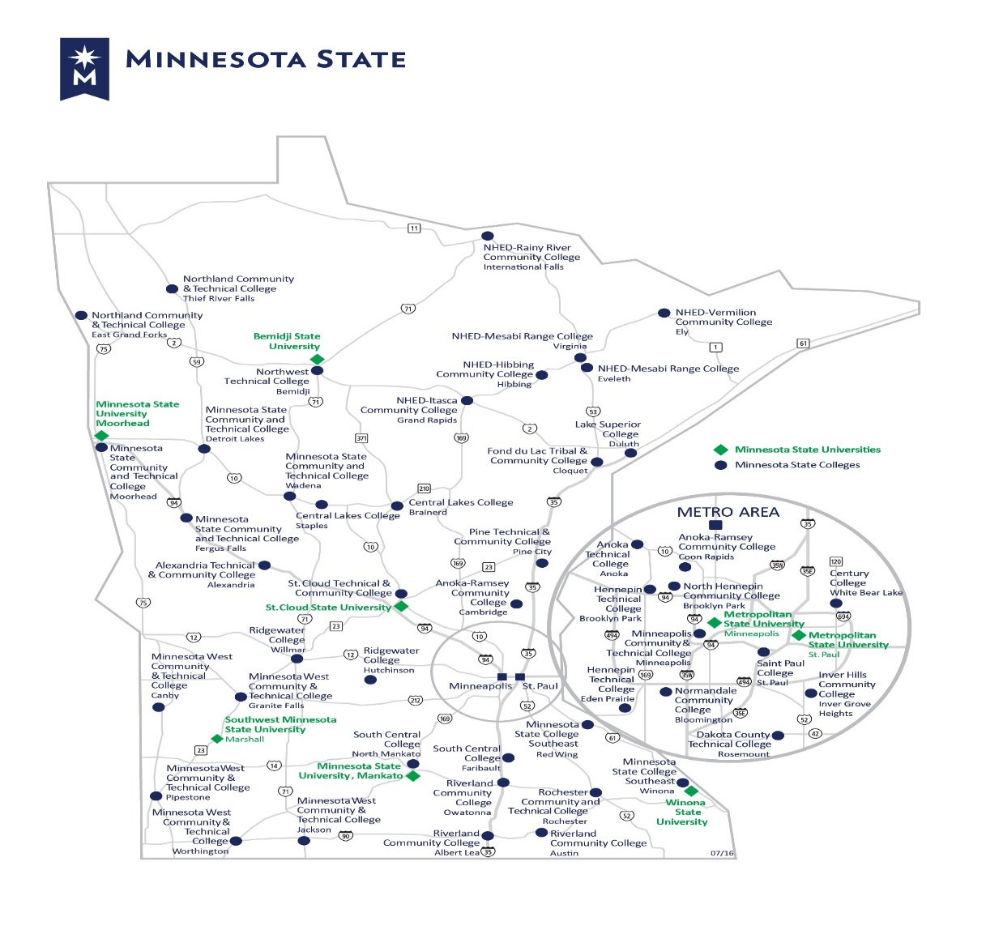
We Are
376,000 Students
254,000 in credit classes
122,000 in non-credit programs
59% in greater Minnesota
127,000 from underrepresented groups
48,500 first generation students
10,000 veterans
37 Colleges and Universities with
54 Campuses
7 universities
30 colleges
47 Communities across the State
From International Falls to Worthington
Enrollment ranges from 445 to 32,131
Notes:
[The enrollment figures in this slide have been updated to FY 2016. ]
Thank you for the opportunity to meet today.
I am joined by Deb Bednarz, Director of Financial Planning and Analysis and Craig Schoenecker, Director of Institutional research and effectiveness.
We look forward to sharing system summary information about enrollment, an update on the financial profile of our colleges and universities and a brief overview of our FY2018-FY2019 operating budget request.
You will find a data book at your place. This was provided to the Higher Education committee and their staff several weeks ago.
Minnesota State serves the entire state from International Falls to Granite Falls and 45 other communities across the state.
Our 37 colleges and universities are a key part of our state’s success. The innovation and services that our faculty and staff bring to students and businesses makes an impact today and years in the future. Our continued ability to serve the state is threatened by our financial outlook and we look forward to sharing more with you in the days ahead.

Slide 3
Enrollment overview

Slide 4
Our colleges and universities serve:
63,400 students of color and American Indian students
48,500 first-generation college students
84,000 low-income students
10,000 veterans
In each of these categories, our colleges and universities serve more students than all of Minnesota’s other higher education options combined.
Notes:
Who we serve is fundamentally different from other providers of higher education. Of the 254,000 students in degree-seeking programs, we serve:
63,400 students of color and American Indian students,
48,500 1st-generation college students,
84,000 low-income students, and
10,000 veterans or service members.
In each of these categories, our colleges and universities serve more students than all of Minnesota’s other higher education options combined.
We are a place of hope and opportunity. With open enrollment, anyone with a high school diploma or a GED has an opportunity to create a better future for themselves, for their families, and for their communities.

Slide 5
Educating all of Minnesota
Total Headcount = 376,176
fiscal year 2016
Source: System Office Research – Academic and Student Affairs
Notes:
We serve students across the state
39% of our students are in the metro area and 61% are on campuses outside the metro area. This distribution has been shifting gradually to the metro area colleges and universities over the past ten years.
High school students, high school graduates, graduate students, adult learners, workers and professionals
59% of college and 37% of university students enroll part-time
46% take one or more online courses and 15% are entirely online
7% enroll at more than one college or university in a year

Slide 6
Racial and ethnic diversity
Total American Indian and Students of Color = 63,423
Total Credit Headcount = 254,206
fiscal year 2016
Source: System Office Research – Academic and Student Affairs
Notes:
The racial ethnic diversity of our students brings significant assets to campus life and creates a dynamic community for learning together from one another. The racial-ethnic categories reported here are those used for reporting to the U.S. Department of Education and the Minnesota Office of Higher Education. Students who report more than one racial group are included in the two or more category and students who report that they are Hispanic are included in that category regardless of their race or races.
If we dig deeper into these categories, we find even more racial-ethnic diversity. American Indian students are the best example since almost three-quarters of them also reported another race or ethnicity:
Over 2,000 students indicated that they were American Indian and reported no other race or ethnicity are represented by the black slice of the pie.
Almost 3,700 additional students reported that they were American Indian and one or more other races and are included in the green “two or more” slice.
Over 2,000 American Indian students also reported that they were Hispanic and are included in the light green Hispanic slice of the pie.
So in total, there were more than 7,800 American Indian students enrolled in 2016.
About one-sixth of Asian students and one-sixth of Black students also reported another race or ethnicity and are included in the “two or more” slice.

Slide 7
Student of color and American Indian student enrollment has grown in all regions of the state
57%
Percent Increase in Students of Color & American Indian Students: 2007 to 2016
112%
12%
58%
61%
100%
Students of Color & American Indian: 2007 = 39,405 2016 = 63,423 Increase = 61.0%
Source: System Office Research – Academic and Student Affairs
Notes:
The growth in students of color and American Indian students at our colleges and universities has occurred in all regions of Minnesota.
Student of color and American Indian student credit headcount enrollment has increased by 50% or more in five of the six regions.

Slide 8
Enrollment in credit courses grew during the recession but has since fallen
Notes:
Enrollment grew 17.6% from the trough to the peak between 2006 and 2011
It has since declined 16.9% to 131,217 – or nearly pre-recession levels
This graphic has always struck me as a powerful image of the role our colleges and universities play in the state’s economy. You could lay the state’ unemployment graph right on top of this – as the unemployment rates moves, so too does our enrollment levels as people return to school for additional certifications – to finish degree work or gain new skills in response to changing labor market –
As the economy improves – our students finish their course work, or sometimes are recruited away – and return to the labor force.

Slide 9
Total headcount peaked during the recession and has decreased since fiscal year 2013 as the economy recovered
Source: System Office Research – Academic and Student Affairs
Notes:
You see slightly different trends, when examining credit vs non credit enrollment. Non credit enrollment is more often paid for by employers and so it trends with employment levels.

Slide 10
Credit headcount at the colleges and universities peaked during the recession and non-credit has decreased since
Source: System Office Research – Academic and Student Affairs
Notes:
You see different trends, when separately examining college and university credit and non-credit enrollment.
As is apparent here, the enrollment in both credit and non credit instruction was much more volatile at the colleges then the universities which makes sense, since college students are more likely older and in – or – out – of the workforce.
All of our colleges and universities have student recruitment and retention programs underway. Curriculum is being added and revised, scheduling modified, student success activities pursued and business and industry partnerships developed as we continue to strive to serve our communities all across the state.

Slide 11
Financial overview
Notes:
a few words about our financial performance and financial outlook

Slide 12
Minnesota’s higher education funding trails U.S. average significantly
Source: SHEEO (2015). SHEF FY 15. Estimates have been adjusted for inflation.
Notes:
I haven’t said much about the financial pressure our colleges and universities are under. I am saving that for our operating budget presentation. But I did want to share with you a slide that illustrates what has happened over the past 20 years.
This is not a Minnesota State Colleges and Universities slide, it’s a State of Minnesota slide.
This slide illustrates that Minnesota’s investment in public higher education lags the national average—though this was not always been the case.
In 1995, Minnesota’s per FYE funding for public higher education was 5% higher than then national average.
10 years later in 2005, Minnesota’s spending per FYE on an inflation-adjusted basis lagged the national average by 9%
and by 2015, the most recent year data are available, Minnesota lags the national average by 14%.
Between 1995 and 2015, Minnesota’s investment in higher education declined at twice the national average, a decline of 29% vs 14%.
Over
As of 2014:
Minnesota spends 25% less than the national average on its thirty community and technical colleges
Minnesota spends 24% less than the national average on its seven state universities
If we were funded at the national average for state universities in FY2014 we would have received an additional $71 million based on FY14 FYE enrollment [$5,336 - $4048 = $1,288 x 54,983 FYE = $70,818,104
If we were funded at the national average for state colleges we would have received an additional $113 million based on FY14 FYE enrollment [$5141 - $3876 = $1,265 x 89,541 FYE = $113,269,365]
Based on 2014 data, if our colleges and universities had been funded at the national average, our state support would have been $184M higher.
===========
Notes:
[Data source: State Higher Education Executive Officers (SHEEO) FY2015 data. : Data adjusted for inflation using the Higher Education Cost Adjustment (HECA). Full-time equivalent (FTE) enrollment equates student credit hours to full-time, academic year students, but excludes medical students. Educational appropriations are a measure of state and local support available for public higher education operating expenses including ARRA funds, and exclude appropriations for independent institutions, financial aid for students attending independent institutions, research, hospitals, and medical education. Net tuition revenue is calculated by taking the gross amount of tuition and fees, less state and institutional financial aid, tuition waivers or discounts, and medical student tuition and fees. Net tuition revenue used for capital debt service is included in the net tuition revenue figures above.]

Slide 13
Financial pressures threaten the ability of our campuses to serve students
Revenue
Between FY2008 and FY2017, state appropriation and tuition revenue combined increased an average of 1.17% per year. (State appropriation increased an average of 0.12% per year; tuition increased an average of 2.26% per year.)
Expenses
MMB negotiates fully 1/3 of our compensation costs and its results strongly influence the other 2/3 of our costs.
Our college, university, and system office administrative spending is among the lowest in the country: the system ranks 35th out of 50 states and DC in administrative spending per student FYE – 15% below the national average and below similar systems in all contiguous states (IA, WI, ND, SD).
The total number of employees, system-wide, has declined by 10.6%; only 3.1% (525) of the system-wide employees are administrators, down 9% since 2009.
The system office base budget has dropped from $43.5 million in FY2009 to $33.1 million in FY2016 (from 3.0% of the system-wide budget to 2.1%).
Notes:
LAURA
Our Board, chancellor Rosenstone and all of our presidents are committed to the financial health of our colleges and universities. The board’s position, like yours and like the governor’s, is that expenses and revenues have to balance. The board will approve budgets this spring when your work is done and they are committed to the approval of structurally balanced budgets for all of our colleges and universities –
As you can see on the screen – that has been hard to do these past years as compensation cost increases have outpaced our revenue increases .
The center of our request addressed these pressures with $143M in base support.
All of these funds would go to the campuses – nothing would stay in the system office.
The request would provide sufficient revenues to pay for a presumed 3% increase in total compensation costs and an 3% increase in operating inflation – things like fuel, equipment, etc. The request is structured as and additional $48 in FY18 and $95M in FY19. the structure is very important to us since it matches the way that our expenses increase.
-----

Slide 14
We have significantly reduced costs
Our college, university, and system office administrative spending is among the lowest in the country: the system ranks 33th out of 50 states and DC in administrative spending per student FYE – 11% below the national average and below similar systems in contiguous states (IA, WI, ND).
The total number of employees, systemwide, has been cut by 10.2% between FY2010 and FY2016; only 3.1% (525) of the systemwide employees are administrators, down by 9.5% since FY2010.
The system office base budget has dropped from $43.5 million in FY2009 to $33.1 million in FY2016 (from 3.0% of the system-wide budget to 2.1%).
Institutional support expenses across all campuses have fallen from 12.4% of total expenses in FY2011 to 11.8% in FY2015.
Notes:
We are in the bottom 10% of systems nationwide when looking at spending levels, across all categories.
Whether faculty ratios, admin spending, facilities maintenance or executive offices.
There are certainly still things for us to do to improve our efficiency and effectiveness, but the returns are modest in comparison to our challenge.
Notes:
======
Institutional support expenses across all campuses have fallen from 12.4% of total expenses in FY2011 to 11.8% in FY2015.

Slide 15
All funds budget ($’s in millions)
 |  |  | FY 2017 Budget | $ Change from FY2016 | % Change from FY2016
Revenues
 | General Fund |  | $1,576.8 | $8.0 | 0.5%
 | Other Funds |  | $382.6 | $(7.8) | (2.0%)
Total budgeted revenues |  |  | $1,959.4 | $.2 | 0.0%
Expenses
 | Compensation |  | $1,286.3 | $14.2 | 1.1%
 | Other operating costs |  | $662.4 | $(9.1) | (1.4%)
Total budgeted expenses |  |  | $1,948.7 | $5.1 | 0.3%
Budget balance |  |  | $10.7
Notes:
The system’s total budget in FY2017 is $1.9B – with $1.56B in the general fund. The general fund is where we carry all our core instruction, administration and student support and physical plant activities.
The other funds shown on this slide include student activities, health services, federal and state grants bookstores, parking ramps, residence halls and student unions and wellness centers.
The system’s operating budget was essentially flat from 2016 to 2017, increasing .3%. State support did not increase from 2016 to 2017 and tuition revenue declined with an enrollment dip, rate freezes at the universities and the 1% reduction at the colleges.
Since 2007, in inflation adjusted terms, the system total expenses have changed ½ of 1% on average per year.
Since 2011, expenses have declined an average of 1% per year (constant $)
In 2011, total expenses were $1.849 billion. In 2016 total expenses were $1.874 billion. A difference of less than ½ of 1 %. (unadjusted)
Over
=====
Notes:
The FY2016 financial statements report $2.3B in revenue, ($823M from students, $676M from state, $410M fed and state grant revenue and $391M all other) total assets of $3.2B and total expenses of $1.9B ( $1.3B compensation, $600M all other). Our results are reported as a part of the state of Minnesota Comprehensive Financial Statements as a component unit.
Expenditures by type for Minnesota State:
Salaries and benefits are the largest expenditure category, accounting for two thirds of total operating expenditures.
All other expenditures make up the remaining one-third percent share.
Purchased services: information technology maintenance and support; software licenses, rental and some purchases; utilities; trash and snow removal; travel expenses; advertising and marketing services; security services/law enforcement; legal services; professional and technical services, and other similar expenditures
Supplies: lab supplies, general supplies, non-capitalized equipment, some software purchases and other similar expenditures
Repairs and maintenance: repairs and alterations to buildings, equipment and furniture; maintenance contracts
The percent of expenditures accounted for by the various expenditure categories has remained relatively stable over time.

Slide 16
Financial outlook worsens significantly if the structural imbalance is not addressed
$s in millions | FY2016 | FY2017 | Total | FY2018 | FY2019 | Total
State Appropriation and Tuition Support
State Appropriation and Tuition Support | 50.0 | 50.0 | 100.0 | 50.0 | 50.0 | 100.0
University (Tuition Revenue) | 12.7 | 12.7 | 25.4 | 12.7 | 12.7 | 25.4
College (Tuition Revenue) | 0.0 | (4.3) | (4.3) | (4.3) | (4.3) | (8.6)
Total State Appropriation and Tuition Support | 62.7 | 58.4 | 121.1 | 58.4 | 58.4 | 116.8
Estimated Expenses
Compensation | 36.0 | 72.0 | 108.0 | 72.0 | 72.0 | 144.0
Other Operating Costs | 11.0 | 23.0 | 34.0 | 23.0 | 23.0 | 46.0
Total Estimated Expenses | 47.0 | 95.0 | 142.0 | 95.0 | 95.0 | 190.0
Revenues over/(under) estimated expenses | 15.7 | (36.6) | (20.9) | (36.6) | (36.6) | (73.2)
Notes:
We have two very strong challenges before us – the gap in the 2016-2017 state support --- and --- the consequence of the flat state support each year of this biennium.
We have just two sources of revenue: state support and tuition. If you add state support and tuition revenue together you will see two very important long term trends:
We have raised tuition and we have held spending per FYE nearly flat – tuition revenue has replaced some but not all of the state reductions.
In addition, the 2016-2017 appropriation was authorized as $50M each year, rather than the more traditional $30M in 2016 and $70M in 2017.
Consequently, we enter 2018 with a $37M annual structural gap or a two year structural gap of $72M.
It is our fervent hope that the legislature will provide us additional resources and authorize any increases in the historical 1/3 in the first year and 2/3rd in the second year. To do otherwise greatly stresses our financial planning.

Slide 17
Reallocation (cuts) trends
Notes:
Over the past five years, our revenue has increased an average of 2% per year while our compensation costs have increased an average of 4-5% per year.
In FY2017, with declining enrollment and flat state support, these pressures led to large reallocations and budget cuts.
Our colleges and universities have a hard hand – both revenue and expenses are strongly influenced by others and highly unpredictable. Regulatory and compliance costs increase every year as does the desire for stronger student services and campus life programs.
We reallocate both to cut budgets and to direct resources from lower to higher priorities. Over the past 9 years, our colleges and universities reallocated on averages $34.5M /year.
In just the past 5 years we have reallocated a total of $181M including $114M in absolute budget cuts. These cuts have eliminated jobs, closed programs and slowed technology and equipment replacement.
Our colleges and universities are under financial pressure that is not sustainable.

Slide 18
Reductions/Reallocations ($’s in thousands)
Category | # Layoffs & Vacancies Eliminated (FTE) | # of Programs Impacted | Dollar Amount
Suspended or closed programs | 9 | 8 | $1,132
Faculty positions | 121 | 132 | $15,650
Administrative/staff positions | 155 | 8 | $12,683
Equipment | 0 | 0 | $1,068
Repair & replacement | 0 | 0 | $365
Student services | 12 | 0 | $861
Other | 12 | 5 | $4,309
General operating budget | 0 | 0 | $2,688
Total reductions/reallocations | 309 | 153 | $38,756

Slide 19
Reinvestments and Cuts ($’s in thousands)
Category | # Positions Added/ Reassigned (FTE) | # Programs Impacted | Dollar Amount
Enhanced, redesigned, or new programs | 11 | 17 | $1,261
Added or reassigned faculty positions | 24 | 31 | $1,963
Added or reassigned admin/staff positions | 57 | 45 | $4,403
Equipment | 0 | 0 | $1,169
Invest facilities and/or R&R | 0 | 0 | $1,498
Student services | 2 | 0 | $1,329
Other | 3 | 2 | $3,129
Reinvestments subtotal | 93 | 91 | $14,631
Cuts made to balance the budget | 0 | 0 | $24,125
Total Reinvestments and Cuts | 93 | 91 | $38,756
Invests in direct mission activities |  |  | $11,085
Stems the growth in tuition and student fees |  |  | $26,837
supports programs that benefit students |  |  | $11,452

Slide 20
FY2018-FY2019 Operating budget request

Slide 21
Our FY18-FY19 request: three important goals
Protect programs and campuses so we can meet the workforce needs in communities across Minnesota
Reduce economic and racial disparities by protecting affordability, access and advancing student success
Provide the faculty, staff, and IT infrastructure needed to deliver these programs
Campus Support
ISRS
Next Gen
Student grants to reduce disparities
Total FY18-FY19 needs
$143 million
$25 million
$10 million
$178 million
Notes:
We came to you two years ago and asked for your support in beginning to reverse the trend in funding relationship and you gave us that support. Our FY2018-FY2019 request seeks to continue progress in restoration of the state’s historic investment in its human capital.
Our request seeks a compact with the state on behalf of our students – a compact that enables us to serve them in ways that will prepare them for the work that needs to be done in communities across the state – work that will enable business and industries to grow and Minnesota to be prosperous.
At a time when:
74% of the workforce will require some post-secondary education;
the most precious resource affecting our ability to recruit, retain, and grow businesses across the state is our human capital;
the economic vitality and future competitiveness of our state hinges more than ever before upon our ability to deliver the human capital needed for the jobs that need to be done;
communities that have traditionally been underserved by higher education – communities that will drive 70% of the state’s population growth over the next 25 years – need to be served better than ever before; AND
access to great programs preparing people for the jobs of the future is needed to build the world’s greatest workforce. . . .
We cannot afford to leave anyone behind.
We understand that this is a large request. But without $178 million in new revenue, the colleges and universities dedicated to meeting the state’s workforce needs will have to make substantial cuts in programs on campuses across the state. That outcome would be bad for people, bad for communities, and bad for Minnesota.
If fully funded, the board will hold undergraduate tuition flat in FY 2108 and FY 2019.

Slide 22
How important is state support?
State appropriation and student tuition are the two primary sources of funding for our colleges and universities
State appropriation sets constraints on available resources for:
Compensation
Program support and growth
Student support services
Technology and equipment
Solutions to challenges campuses are trying to address
New initiatives and investments
New partnerships
Innovations

Slide 23
ISRS Next Generation is a critical system investment that must be made
Replaces the system’s outdated 20-year old ISRS data system that is reaching its technological end of life
Plays a critical role in the success of our students – from applicant to graduate and nearly every process in between
Serves as the cornerstone data system for our enterprise and requires high security
Touches everyone and nearly every activity: application, registration, course schedule, housing, financial aid, transcripts, system finance, accounting, and HR
Notes:
The second element of our request concerns our core information system.
Minnesota State is the 4th largest higher education system in the country and operates one of the largest data systems.
Ours is a single system and a competitive advantage for us - Most state systems have multiple technology systems, often school by school.
We have been watching these other higher education systems, and the industry, carefully. We have concluded that we are now at the point where the risks of doing nothing, and the needs of our students and staff are too great.
Today our platform has 32 integrated modules, developed using a combination of 5 programming languages which support 376,000 students .
Our CIO hosted 32 listening sessions across the state ( 9/15 to 11/15). More than 1,000 faculty, staff and students gave him advice about the way forward. In addition an electronic survey tool generated 1,300 responses. All of this outreach told us: we need technology that:
(over)
Provides strong support for student advising, academic planning, career planning and student success techniques like on line tutoring
integrates all components of the current software in order to leverage all the data
We look forward to our time with the House higher education and Career __________Committee next week for a complete presentation.

Slide 24
Composite Financial Index
Notes:
The CFI is a metric promulgated by accrediting agencies as a tool for them to evaluate a very diverse group of higher education institutions across the region.
We introduced it to the committee last year and were asked to provide a brief update this year. It is key to understanding this measure to recognize that it is expressed based on the results of full accrual financial statements, which is not the world most public financial discussions occupy.
The most notable change is the incorporation of a change in accounting standards known as GASB 68 and 71.
The implementation of GASB 68 and 71 is happening across the public sector this year – cities, counties – schools – states. We were required to report the long term pension liability on our financial statements beginning in FY15 vs. only showing current year expenses and note disclosures which was prior GASB standard.

Slide 25
GASB Statement No. 68 effect
GASB 68 has 3 components on the statement of net position
Net pension liability of $364.8 million
Deferred inflow of resources of $225.6 million
with an offset to
Deferred outflows of resources ($116.0 million)
Total impact on net position $474.4 million
Compares to $519.1 million in FY15
Notes:
The impact of the new standards results in our now reporting a downward adjustment of $474.4m to our system net position following a $519.1 M downward adjustment in FY2015.
The changes in total net unfunded liability occur for several reasons, most common are the differences between actual and projected rates of return or changes in life expectancy assumptions in the actuarial work .

Slide 26
FY2016 Financial Summary
Most colleges and universities reported operating gain due to GASB adjustment. Underlying loss due to an enrollment decline
Campus budget reserves preserved – critical risk management strategy
Continued investments in building improvements and infrastructure - which help retain current and attract new students
Notes:
Overall conclusion of performance based on full accrual statement analysis:
Operating gain was $48.4M in FY2016, $4.9M in FY2015, this followed an operating loss of ($43.7M) in FY2014 and operating income of $2.0M in FY2013.
Strong campus leadership pursuing enrollment growth and cost control strategies
Total expenses increased by 0.3%, and total revenues increased by 2.6%.
Enrollment levels decreased by 2.8%, 3.8%, 3.6% and 2.3% in the past four years.
Net position increased by $118.0M in FY16 and decreased by $489M in FY15. This follows increases of $16M in FY14 and $91.1M in FY13.
The material difference between budgetary and full accrual results is the inclusion of depreciation expenses in the FS. There are other, smaller dollar value accruals as well including compensated absences, and OPEB and now GASB68 related effect on salaries and benefits expense.
Depreciation alone added $119M in expenses in FY2016. So while most C/U reported balanced budgets on a budgetary basis, the addition of $119M in depreciation expense swings the results negative
Over
Notes:
However, GASB 68 implementation reduced salaries and benefits expense in in FY2016 by $44.7M in FY16 and in FY2015 by $37.7 million. And debt service is about $40M –which is a cash basis expense that would offset the depreciation.
On a budgetary basis, C/U NOI before depreciation and GASB 68 implementation has ranged from $123M in 2016 to $172M in 2011. The last eight years have all been positive on a budgetary basis.

Slide 27
Composite Financial Index - CFI
FY2016 CFI = 2.22 (without GASB 68)
FY2015 CFI = 1.74 (without GASB 68)
FY2016 CFI = 1.50 (with GASB 68)
FY2015 CFI = 0.79 (with GASB 68)
Notes:
The Board has been a strong supporter of the CFI reporting discipline --- and a support of our goal of improving C/U and overall system performance with this number. As you can see above, the system shows improvement from 2015 to 2016, before the addition of the pension liabilities.
It has proven a very valuable tool for tracking financial performance across all the schools and from year to year.
The CFI calculation has been prepared with and without the GASB entries in order to provide year over year comparison data.
The CFI has two measures heavily weighted toward balance sheet performance and two measures weighted toward annual operating performance.

Slide 28
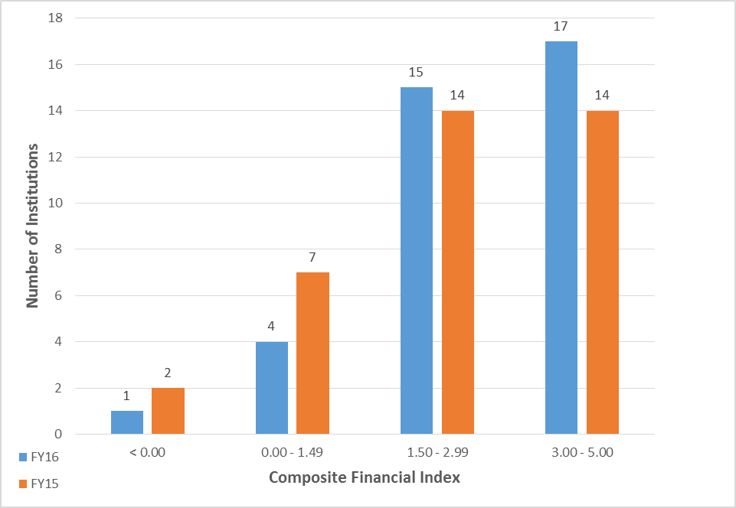
Composite Financial Index FY2016-2015
Notes:
Please note that this slide reads from left to right – the most recent year, 2016 is on the left.
What you see is improvement in the CFI scores from 2015 to 2016 – we have 5 C and U in 2016 that scored under 1.50 vs 9 in 2015. On the other end, we had 17 C/U above 3 in 2016 vs 14 in 2015. this is typically explained by increase in capital appropriations received.( it is booked when it comes out of construction work in progress)
Note: CFI increase could also be explained by increase in State approp in 15 over 16 received but not spent.

Slide 29
FY2016 Financial Summary
CFI varies amongst colleges and universities
CFI trends positive in FY 2015 and 2016, after declining the previous year due to falling enrollment
System CFI relatively flat in the two long term measurements, with small increases in the two short term measurements
Campuses displaying focused budgeting, planning and analysis
Notes:
Read slide –
The chancellor and the board have a financial monitoring process that examines each college and university’s long and short term trends. The FY2026 results are;

Slide 30
FY2016 Monitoring Results
4 colleges and 2 universities reported CFI below 1.50 based on 2 year average or less than .5 in most recent year
Financial plans are required for these 6 colleges and universities
Communication with campus leadership to discuss results
Notes:
Measurements modified from last year to make them more quickly responsive to budget and enrollment changes.
The financial plans include:
Specific performance goals identified
Updated FY2017 budget submitted
FY2018 preliminary budget outlook prepared
Enrollment projected for two years
CFI projected for two years
We have seen improvements across the board this year – the monitoring process is yielding action and remediation - Those are nice words for presidents and their teams making hard choices to cut budgets and restore balance between revenues and expenses.
Most of our colleges and universities are balancing budgets with a structural gap in revenues and declining enrollments – so very hard stuff for leadership.
Thank you – any questions ………….

Slide 31
System enrollment and financial overview

Slide 32
Extra Slides

Slide 33
Traditional PSEO and Concurrent Enrollment
Traditional PSEO - Post-secondary Education Options is an opportunity for eligible high school students to enroll in college or university courses that earn credits simultaneously for both their high school diploma and their college degree
Concurrent - Concurrent enrollment is a college or university course taught by a credentialed high school instructor and mentored by a college or university faculty member at a high school.
Notes:
The traditional method - (MDE) withholds state aids from school districts and redirects part of that payment to participating colleges and universities. Under this method, colleges and universities receive a set amount per credit hour for enrolled PSEO students.
The current per-credit reimbursement rate for traditional PSEO students is $190.29.
Increases in PSEO funding are driven by increases in the general education formula allowance.
There are strict limits on the fees that can be charged to high school students under both financing mechanisms. In general, colleges and universities cannot charge for books, fees, or other costs. The PSEO payment from MDE and the contract revenue is intended to cover the students’ tuition, fees, and books, although current MDE reimbursement rates generally do not cover all the costs resulting in a subsidy from the college for each PSEO student.
The direct contract method - where the school district and the college and/or university contract directly for PSEO courses. Typically this method is used in “concurrent” PSEO arrangements where college courses are delivered by high school teachers who are mentored by college or university faculty members. However, it can be also used to finance traditional on-campus PSEO courses.
The cost is negotiated between the district and the college. We have a conversation underway right now to try and bring some uniformity to these contract rates.
[The reimbursement formula is specified in statute (124D.09 Subd. 13) and is based on the statewide per pupil funding for high school students. Colleges and universities are given 88 percent of the general education formula allowance ($5,831) less $425 (referendum adjustment), multiplied by 1.2 (high school student multiplier), and divided by 30 (credits). The school district retains the other 12 percent of funding. In FY 2015, the PSEO calculation is:
88% x ((($5,831 - $425) x 1.2) /30) = $190.29 per credit]
The chair asked that I spend a few minutes on the subject of PSEO and concurrent enrollment.
This is important work to our colleges and some of our universities.
Jaime – what is our message here?__________________
Compensation
Traditional method – MDE redirects state support from school districts and reimburses colleges and universities $190.29 per-credit
Direct contract method – typically used in “concurrent” PSEO arrangements, the school district contracts directly with the college/university to provide PSEO courses

Slide 34
PSEO total headcount has grown by 83 percent and Concurrent headcount has grown by 114 percent
9
Notes:
Needs updating –
This graph shows you three types of PSEO enrollment in headcount, or persons and the enrollment growth since 2005:
Starting from the bottom of the graph
PSEO contract ( Maroon line) has grown 50%
PSEO regular (blue line) which has grown 13% since 2005
PSEO concurrent (Yellow) has doubled
And total PSEO has grown from 18,500 students to 30,502, an increase of 65%
This growth compares with our overall credit based traditional (non PSEO) head count change during this period of a decline of 10%.

Slide 35
PSEO Student Success
MnSCU colleges and universities serve 90% of all PSEO students in Minnesota.
PSEO students’ families saved $65 million in tuition and fees for college and university credits taken in fiscal year 2015.
PSEO students’ course success rates are substantially higher than those of other undergraduate students.
Minnesota State Colleges and Universities enroll 47% of the PSEO students that enroll in higher education after high school.
PSEO students who enroll at our colleges and universities after high school have substantially higher persistence rates and completion rates than students who did not take PSEO courses.

Slide 36
Space and enrollment
Source: Space – 2016 FRRM / FYE – FP&A – Actual FY2016
Notes:
With 2016 data…
Academic space and Enrollment: Colleges and Universities:
Greater Minnesota:
16.3 million square feet (72%) of system academic facility space.
99,938 FYE (63%)
229,830 Total Headcount (61%)
148,485 For Credit Headcount (58%)
For Colleges only:
More Academic space in Greater Minnesota:
8.1 million square feet (58%) of system college academic facility space.
46,989 college FYE (47%)
146,342 college Total Headcount (52%)
79,907 college For Credit Headcount (46%)
Academic space – colleges and universities
Metropolitan Area:
6.3 million square feet (28%) of system academic facility space.
57,965 FYE (37%)
146,346 Total Headcount (39%)
105,721 For Credit Headcount (42%)
over
For colleges only:
Metropolitan Area:
6.0 million square feet (42%) of system college academic facility space.
52,115 college FYE (53%)
134,510 college Total Headcount (48%)
94,227 college For Credit Headcount (54%)

Slide 37
Conclusions of Long Term Financial Sustainability workgroup
Incremental costs will continue to outpace incremental revenue unless there are substantial increases in revenues and substantial reductions in costs.
Potential shortfall of $66M - $475M by 2025 if not action taken.
Places at risk the ability of Minnesota state colleges and universities to deliver the talent Minnesota needs and help reduce disparities.
Minnesota’s funding of higher education has plummeted, significantly trails the national average, and risks continuing to be “crowded-out” by Medicaid and K-12 spending as well as other state priorities.
Notes:
We provided you with a summary of this work last spring –
Fundamentally, we need revenue to grow every year or we will continue to face deeper service reductions, or we need to reduce access. That is not a particularly unusual public sector condition. What is unusual, is the dependency between state support and tuition revenue.
Ours is a labor heavy industry facing tremendous downward cost pressure. We will need the state’s support or we will be cutting access and services out into the future.
Workgroup charged with recommendations for long term financial reforms. Several very powerful “pivot points’ have been identified.
Our continued reliance on tuition as primary revenue source
Fifth year of enrollment declines after five years of increases
Commitment to affordability is holding down tuition increases
State support not keeping up with tuition limitations
Without any changes, projections find a growing structural gap out into the future.
Over
Note;
Enrollment assumptions varied from -1 percent to + 1 percent annually
State support assumptions varied from -1.1 percent (ten year average) to zero percent annually
Compensation and operating inflation assumptions varied from +2.3 percent (ten year average CPI) to + 3.2 percent annually

Slide 38
Higher education is “crowded-out” by Medicaid and K-12 spending as well as other state priorities
Higher education in Minnesota is more “crowded-out” by Medicaid and K-12 spending than it is in other states.
Share of Total State Spending, 2014
Higher K-12
Education Education Medicaid Other
Minnesota 5.5% 32.9% 17.4% 44.1%
U.S. Average 12.9% 23.5% 15.3% 48.4%
Source: Dan White and Sarah Crane, Moody’s Analytics, Crowded Out: The Outlook for State Higher Education Spending, prepared for the National Commission on Financing 21st Century Higher Education, 2016, Appendix C.
Notes:
Recent national modeling led by the Miller Center at the University of Virginia with assistance from Moody’s analytics has given us great concern.
The Mn Medicaid growth rate is tied to Moody’s proprietary model using underlying economic drivers and forecast for federal ACA changes on a per state model. We need to keep in mind that this work was done before the recent debates about ACA.
Their model finds Mn state revenue and spending forecast to increase 42% from 2014-2024. Medicaid spending increasing 90% from 2014 to 2024
Higher education is “crowded out” as a result.
The decline in state support also appears when looking at how the state has chosen to direct its revenues as a part of the annual state budget.
Investment in higher education has been a declining state priority.
Minnesota State’s support has fallen from 5.5% of the state budget to 3.2% in the past 22 years.
Our C/U have felt that as have our students as tuition has been increased to replace state investments.

