Slide 1
Budget Presentation
Dr. Beth Thompson | Executive Director Morgan Grelson | Business Manager

Slide 2
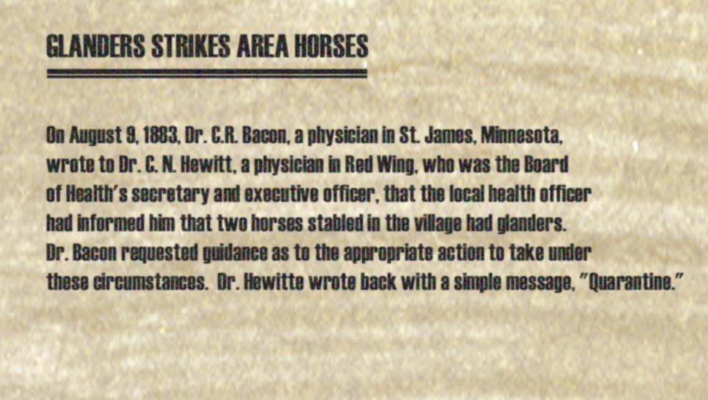
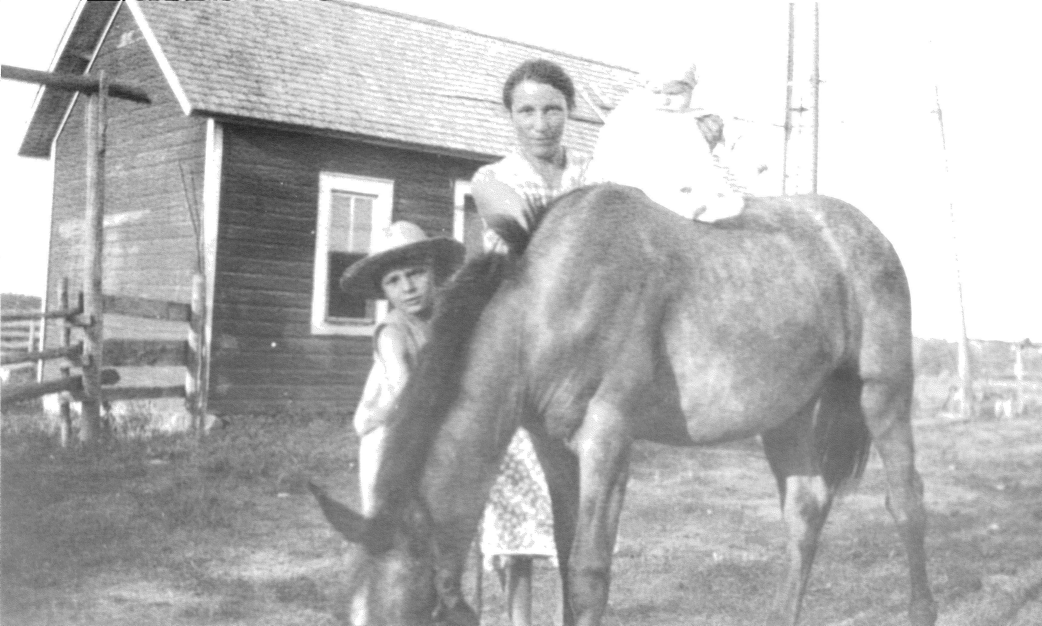
History

Slide 3
Board Members

Slide 4
Organizational Chart

Slide 5
In-State Testing

Slide 6
Detect, Control, Eradicate

Slide 7
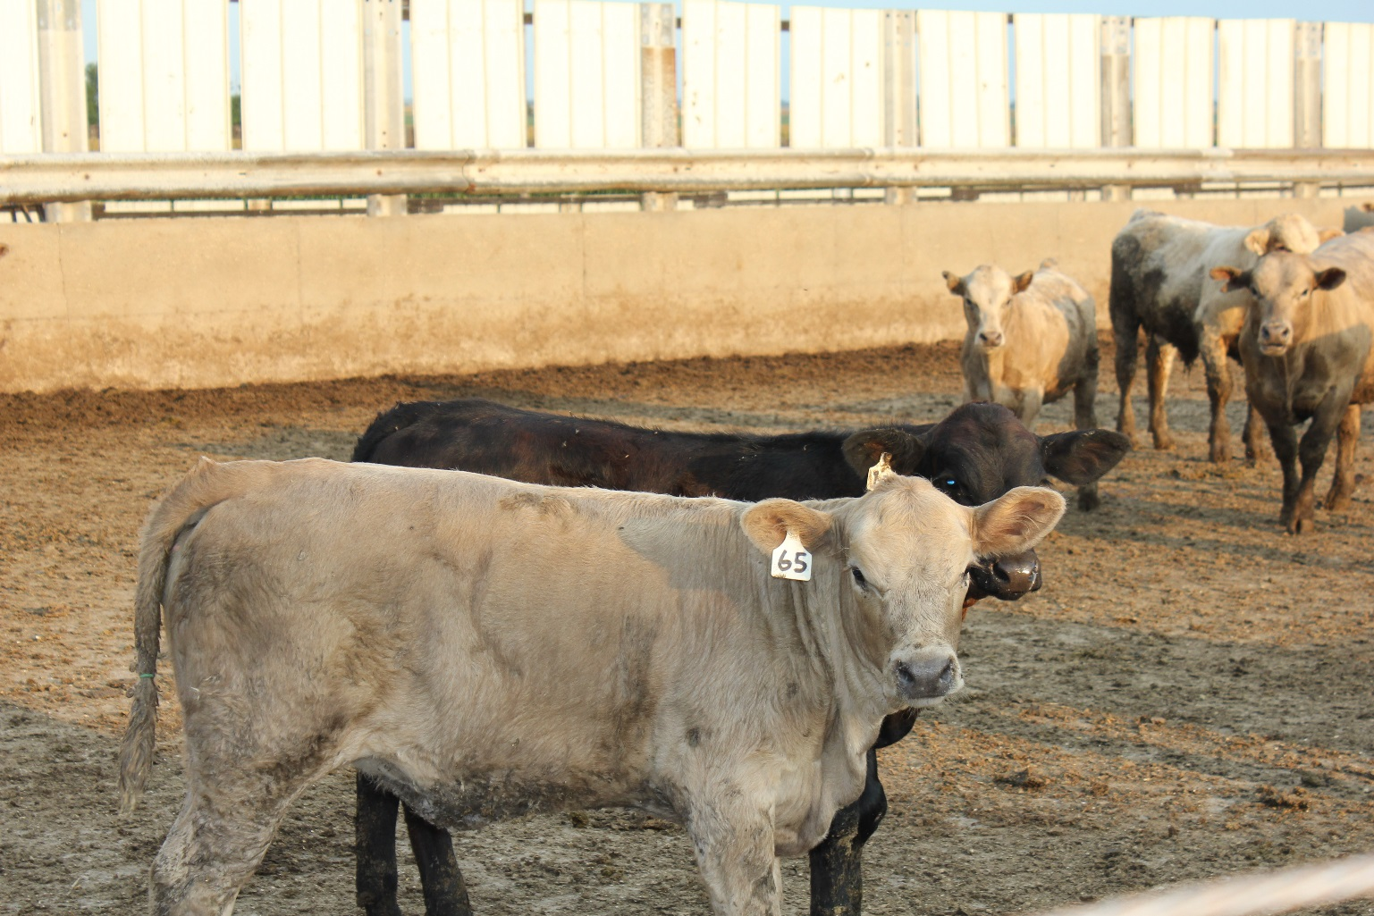
Import Standards and Animal Movement

Slide 8
Emergency Planning and Preparedness

Slide 9
Current Base and Governor’s Recommended
Note: $675,000 will be forwarded out to FY19

Slide 10
Current Base and Governor’s Recommended
Note: $35,000 will be forwarded out to FY20

Slide 11
Thank you!
Dr. Beth Thompson
beth.thompson@state.mn.us
651-201-6844
Morgan Grelson
morgan.grelson@state.mn.us
651-201-6846

