Slide 1
The Metropolitan Airports Commission and MSP International Airport
Jeff Hamiel, CEO
Metropolitan Airports Commission
House Transportation Policy and Finance Committee

Slide 2
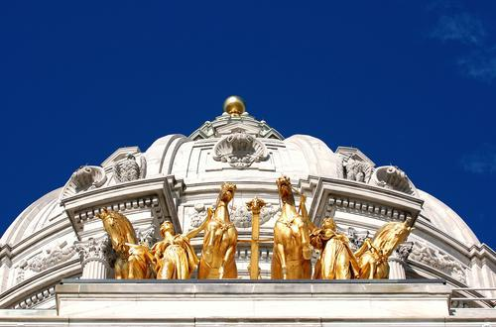
MAC: A Different Approach to Government
Public corporation created by Minnesota Legislature
Owns and operates airports within 35 miles of downtown St. Paul and Minneapolis
MSP International Airport
Six general aviation airports
User-fee based funding
Limited property taxing authority unused since 1960s
We provide and promote safe, convenient, environmentally sound, cost-competitive aviation services for our customers.
House Transportation Policy and Finance Committee

Slide 3
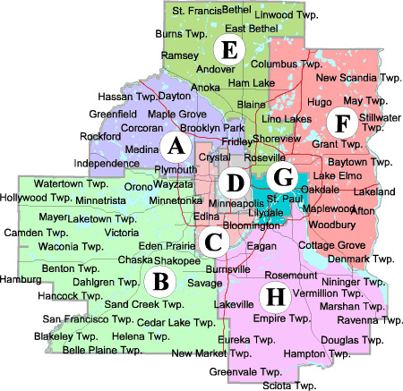
Board Makeup
Gov. appoints chairman and 12 commissioners (8 metro, 4 outstate)
Minneapolis and St. Paul mayors each appoint one
House Transportation Policy and Finance Committee

Slide 4
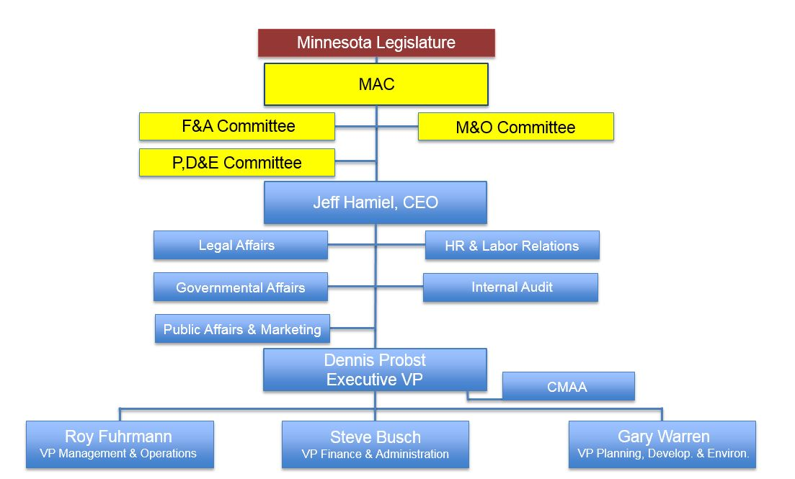
Although nearly 20,000 jobs are directly tied to MSP Airport operations, only 600 people are employed by the Metropolitan Airports Commission.
House Transportation Policy and Finance Committee

Slide 5
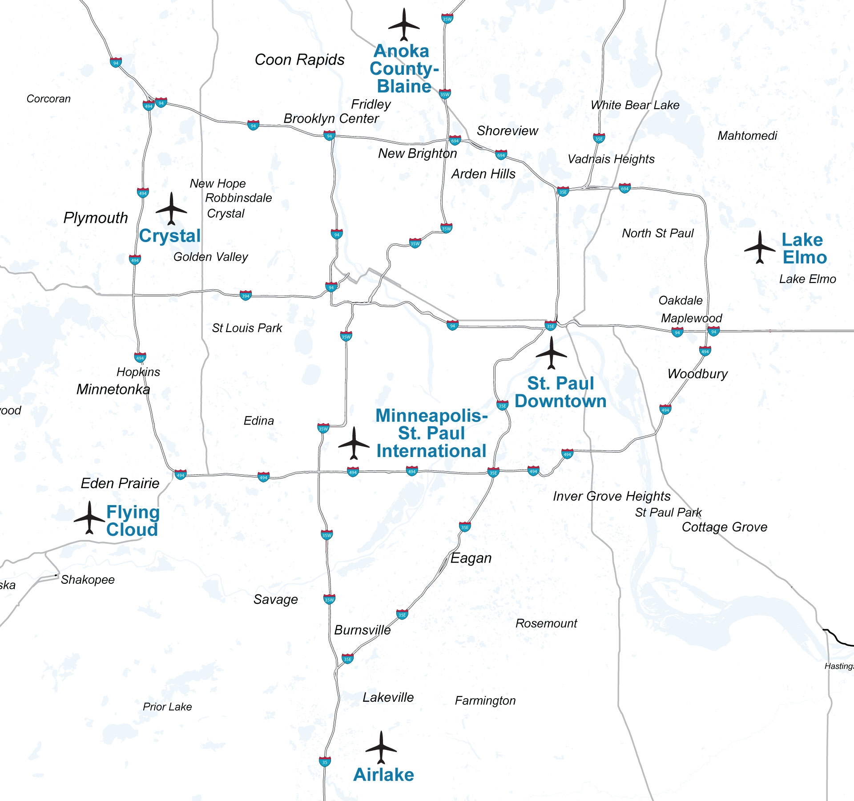
The MAC Airport System
House Transportation Policy and Finance Committee

Slide 6
Conservative Financial Approach
Conservative forecasting: nowhere to turn except reserves or short-term financing
Financial model predicated only on originating and destination passengers
Maintain six-month reserve
AA- bond rating
Airline cost per enplanement among the lowest in the nation
House Transportation Policy and Finance Committee

Slide 7
Cost Per Enplaned Passenger
Airport | Forecast 2014 ($)
Washington-Dulles | 29.86
John F. Kenney-New York | 26.42
Newark | 25.44
Miami | 20.39
Los Angeles | 17.65
LaGuardia-New York | 17.30
San Francisco | 15.68
Boston | 14.84
Chicago O’Hare | 13.30
Denver | 12.97
Philadelphia | 12.53
Washington-Reagan | 12.36
Las Vegas | 12.04
Seattle | 11.88
Dallas-Fort Worth | 10.78
San Diego | 10.72
Houston-Bush Intercontinental | 10.38
Detroit | 10.35
Portland | 9.98
Baltimore | 9.50
Minneapolis-St. Paul | 6.68
Orlando | 5.88
Phoenix | 5.87
Atlanta | 5.61
Tampa | 5.58
Fort Lauderdale-Hollywood | 5.55
Salt Lake City | 4.09
Charlotte-Douglas | 0.94
Average | 12.32
Airline costs per boarding passenger are significantly less at MSP than at most large hub airports
House Transportation Policy and Finance Committee

Slide 8
2015 MAC Finances
Operating revenues: $303 million
Operating expenses: $164 million
Gross debt service: $128 million
Outstanding debt: $1.5 billion
House Transportation Policy and Finance Committee

Slide 9
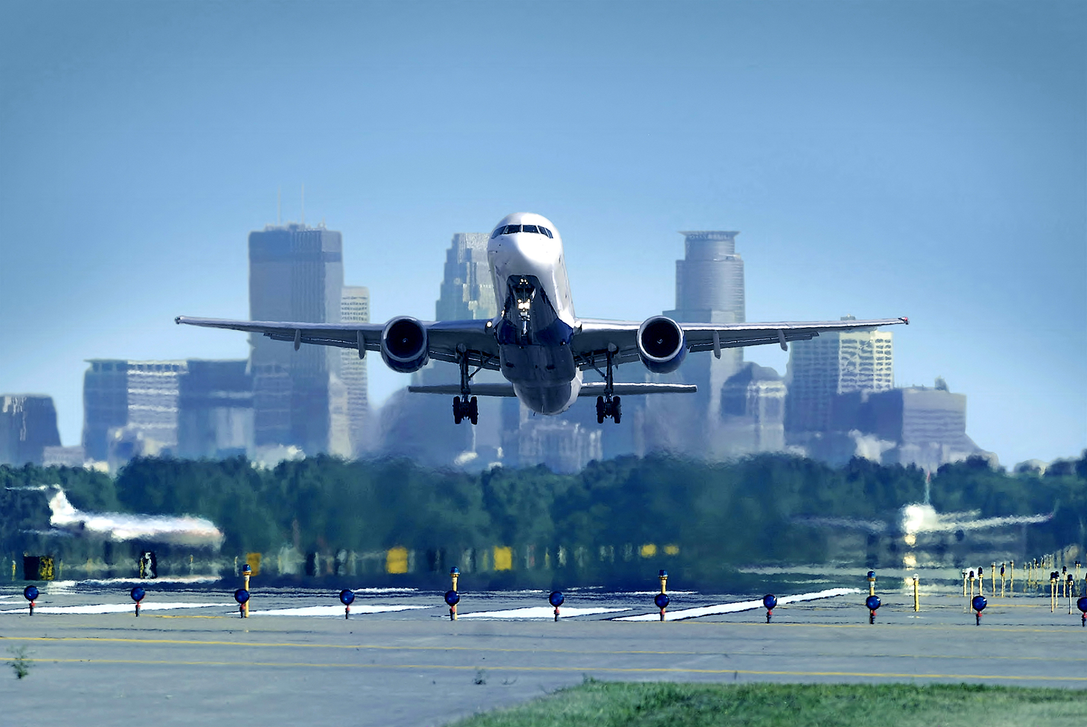
Minneapolis-St. Paul International
17th busiest airport in North America (passengers)
11th busiest in operations
Delta Air Lines’ 2nd largest hub
House Transportation Policy and Finance Committee

Slide 10
Most Efficiently Managed Airport - North America
Air Transport Research Society, 2013
What people are saying about our airport
Best Food & Beverage Program in North America
Airports Council International-North America, 2013
Best Overall Airport Concessions Program Airport Revenue News, 2014
Airport with the Most New Routes
anna.aero, airline network news & analysis, 2014
Third Best Airport in North America
Travel & Leisure Magazine, 2014
House Transportation Policy and Finance Committee

Slide 11
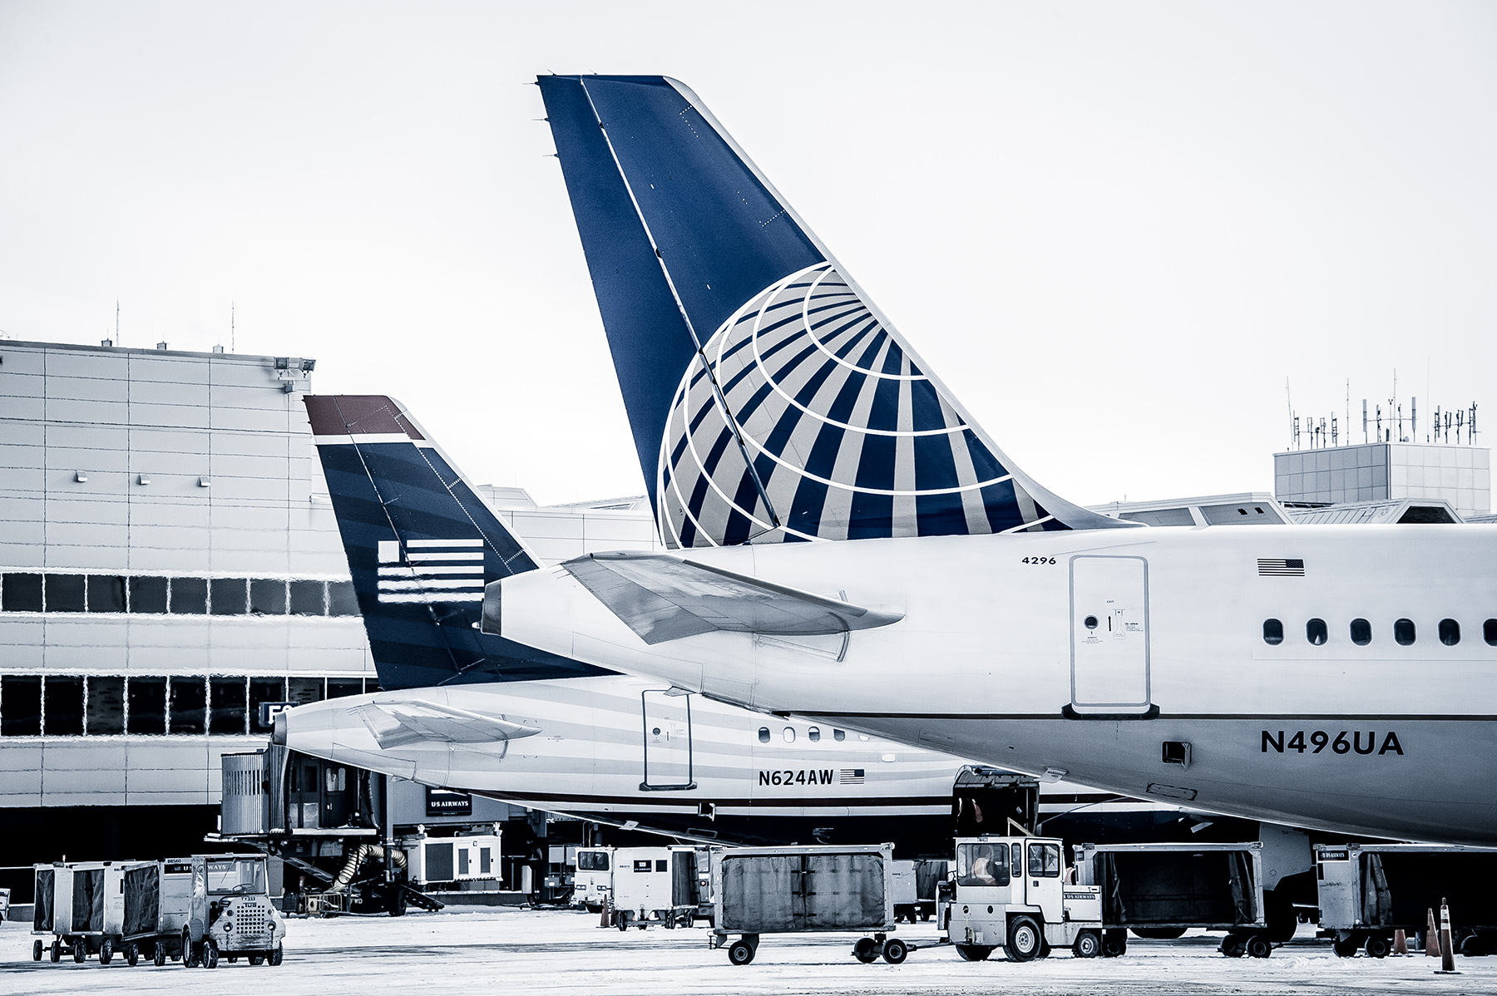
Air Service Success Measures
Major, stable Delta hub
Additions since 2008:
Alaska Air, 2008
Southwest Airlines, 2009
Great Lakes, 2011
Spirit, 2012
Air France, 2013
Condor, 2014
Competitive incentives program
House Transportation Policy and Finance Committee

Slide 12
MSP Passengers
House Transportation Policy and Finance Committee

Slide 13
MSP Aircraft Operations
House Transportation Policy and Finance Committee

Slide 14
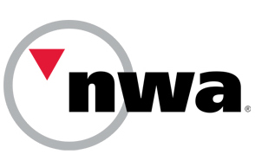
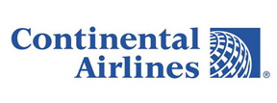
Industry Consolidation
House Transportation Policy and Finance Committee

Slide 15
A Return to Airline Profitability
Shareholder equity vs. market share
Big 4 (American, Delta, Southwest, United) expected to earn $10 billion+ in 2014, and $15 billion or more in 2015
Profits driven by:
Disciplined capacity control
Newer, right-sized aircraft
High travel demand
Low fuel costs
Ancillary revenues
Delta Air Lines saves
$40 million for every penny saved in fuel costs.
Bag and change fees generate nearly $7 billion a year for the airline industry.
House Transportation Policy and Finance Committee

Slide 16
Near-Term MSP Challenges
Lack of queueing space at Terminal 1
Inefficient security checkpoint layout
Insufficient Terminal 1 parking facilities
Expiring retail leases
Capacity constraints at Terminal 2
House Transportation Policy and Finance Committee

Slide 17
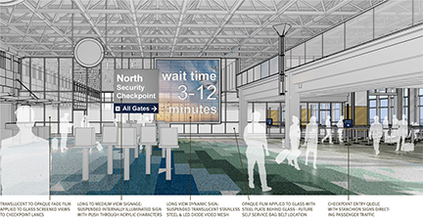
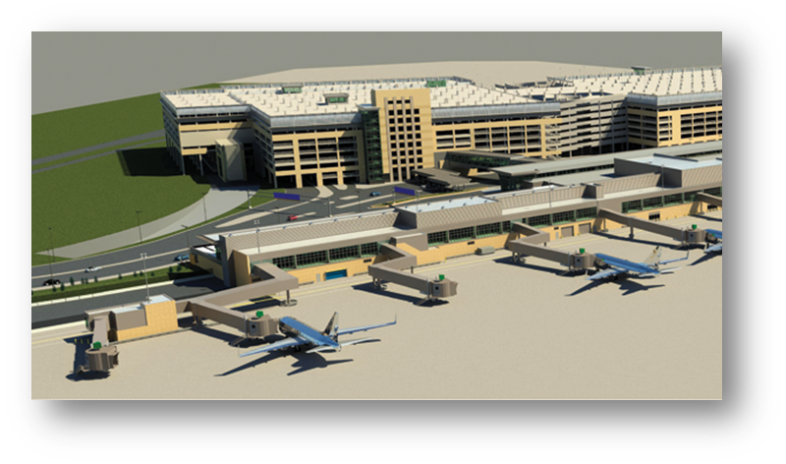
2015 Improvement Highlights
Consolidation of security checkpoints 1 thru 4 into single new checkpoint
Rebid of most retail and more than a dozen restaurant locations
Three-gate expansion of Terminal 2
New Quick Ride Ramp
Explore development of airport hotel
House Transportation Policy and Finance Committee

Slide 18
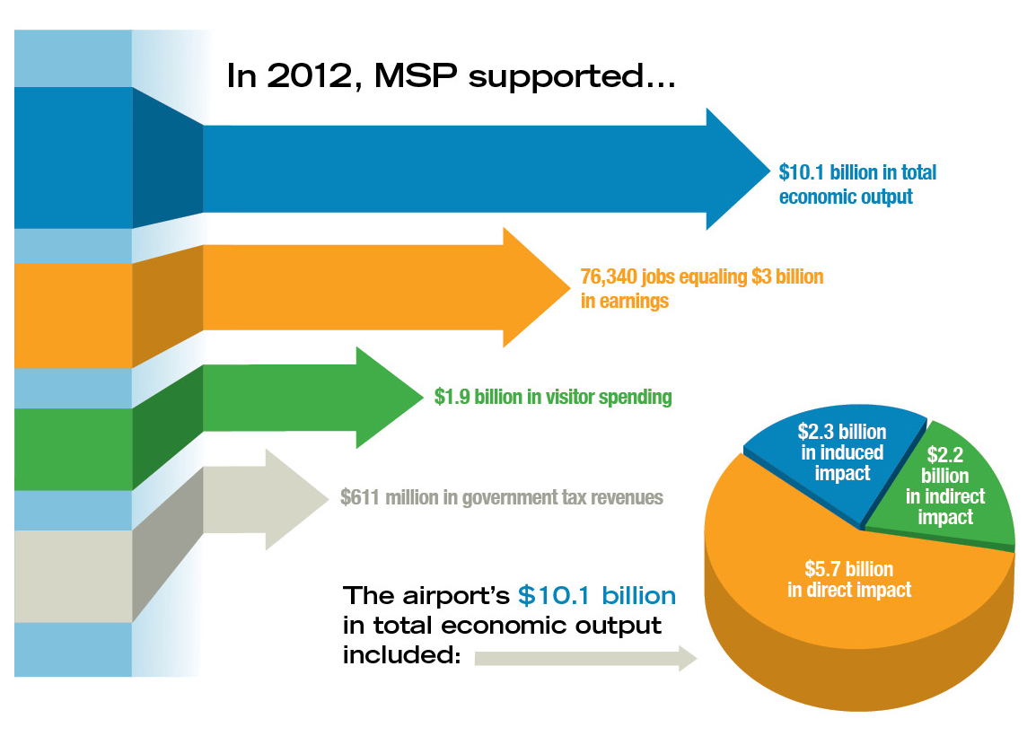
MSP Economic Impacts
House Transportation Policy and Finance Committee

Slide 19
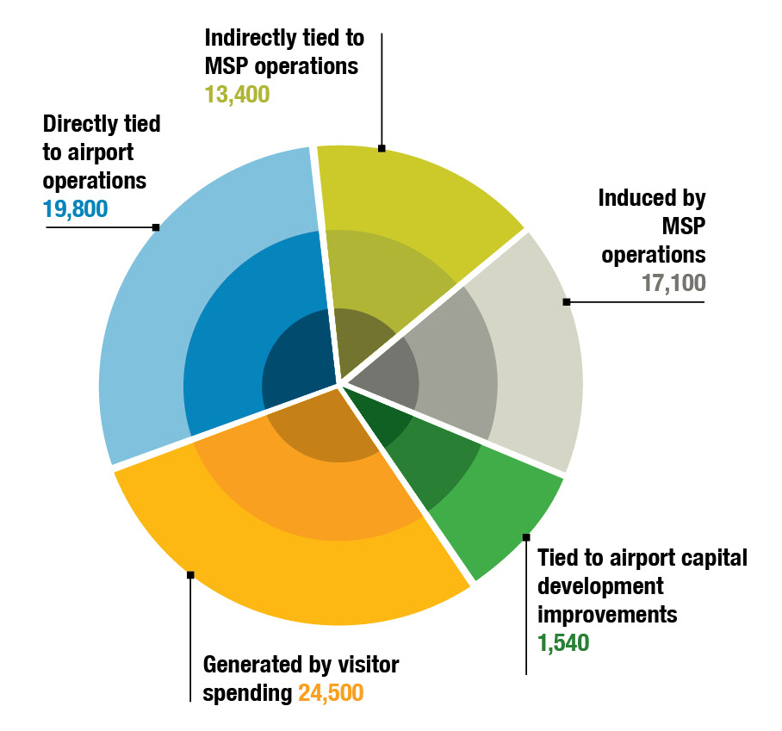
MSP Employment Impacts
MSP Supports 76,340 Jobs
House Transportation Policy and Finance Committee

Slide 20
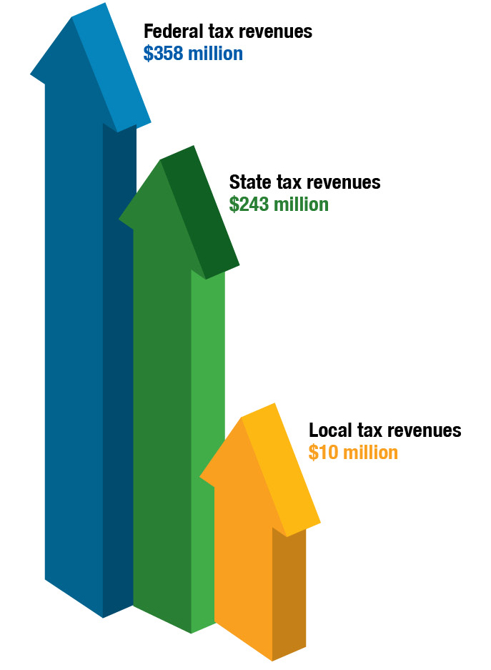
Tax Revenue Impacts
MSP generates $611 million in tax revenues
House Transportation Policy and Finance Committee

Slide 21
More Information
www.metroairports.org
www.mspairport.com
www.myMSPconnect.com
Follow us on Facebook and Twitter:
www.twitter.com/mspairport
www.facebook.com/mspairport
Download our app:
FlySmartTM
House Transportation Policy and Finance Committee

