Slide 1
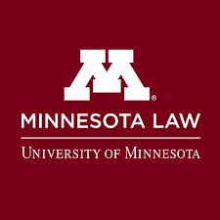
Juvenile Sentences of Life in Prison without the Possibility of Release
Perry Moriearty
Associate Professor
University of Minnesota Law School
Minnesota House Public Safety and Criminal Justice Reform Committee
March 6, 2019

Slide 2
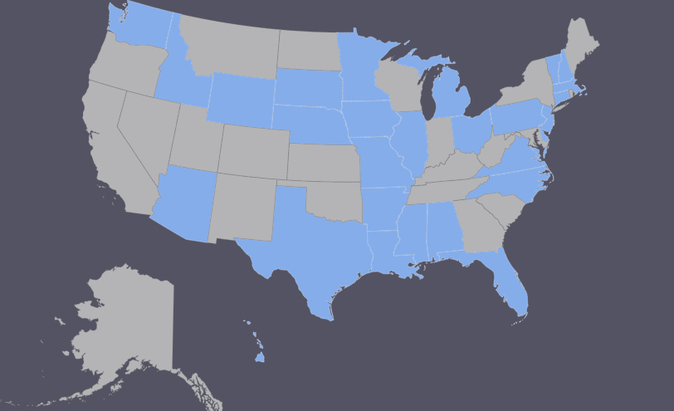
States Required to Amend Laws after Miller v. Alabama
Anne Teigen, Miller v. Alabama and Juvenile Life Without Parole Laws, National Conference of State Legislatures, Apr. 2017

Slide 3
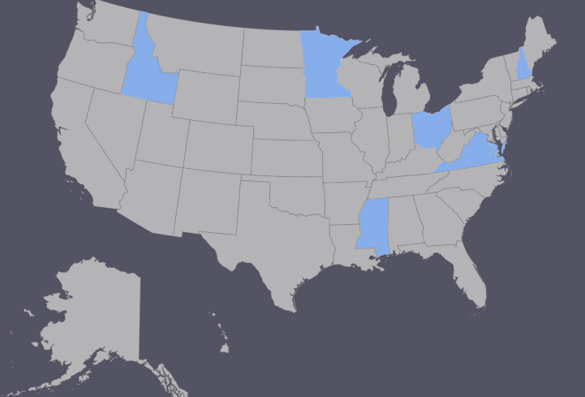
States that Have Not Amended Laws after Miller v. Alabama
Compiled from: Campaign for the Fair Sentencing of Youth, Mar. 2019; Robina Institute of Criminal Law and Criminal Justice, Feb. 2018; National Conference of State Legislatures, Apr. 2017

Slide 4
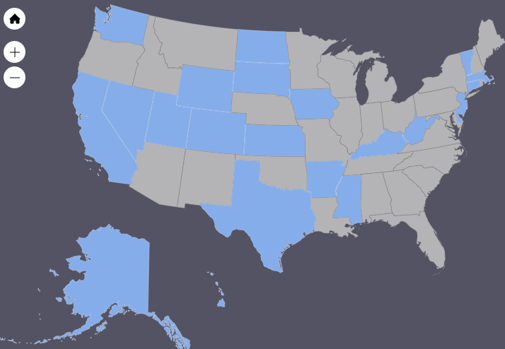
States that have Banned Juvenile Sentences of Life Without Release
Campaign for the Fair Sentencing of Youth, Mar. 2019

Slide 5
Bipartisan Support for Legislation Banning Juvenile Life Without Release
Campaign for the Fair Sentencing of Youth, Mar. 2019

Slide 6
Some Legislative Schemes in Other States
Arkansas: bans LWOR for juveniles; eligibility for parole after 20, 25 or 30 years depending on offense; applies to consecutive sentences and retroactively
California: bans LWOR for juveniles; eligibility for parole after 15, 20 or 25 years depending on offense; applies to consecutive sentences and retroactively
Delaware: bans LWOR for juveniles; eligibility for parole after 20, 25 or 30 years depending on offense; applies to consecutive sentences and retroactively
Nevada: bans LWOR for juveniles; eligibility for parole after 15 or 20 years depending on offense; generally applies to consecutive sentences
North Dakota: bans LWOR for juveniles; eligibility for parole after 20 years; applies to consecutive sentences
West Virginia: bans LWOR for juveniles; eligibility for parole after 15 years; applies to consecutive sentences and retroactively
Wyoming: bans LWOR for juveniles; eligibility for parole after 25 years; applies retroactively
Campaign for the Fair Sentencing of Youth, Mar. 2019

