Slide 1
Seeking Justice for All An Overview of Minnesota’s Civil Legal Services Network
House Judiciary Finance and
Civil Law Committee
January 31st, 2019
Drew Schaffer│ Mid-Minnesota Legal Aid
Anne Hoefgen│Legal Services of Northwest Minnesota

Slide 2
Presentation Summary
Overview of Minnesota’s Statewide Civil Legal Services Network
The Need for Civil Legal Aid
Funding for Minnesota’s Civil Legal Services Network
Outcomes for Minnesota families
Equal Access to Justice
2

Slide 3
Civil Legal Services Network Overview
What is Civil Legal Services?
Civil Legal Services (“CLS”) – or “civil legal aid” – is free legal help to people with low incomes who have civil legal problems. These problems are non-criminal.
CLS is the acronym in the budget line item.
Legal aid is the popular name for CLS.
Legal aid helps people access basic necessities such as safety, health care, housing, economic stability, employment, and education.
3
Notes:
Statewide Objectives
Strong and Stable Families
Prevent homelessness and stabilize safe housing
Ensure access to health care
People in Minnesota are Safe
Reduce domestic violence
Reduce financial exploitation
Efficient and Accountable Government
Create efficiency in the court system
Provide public and professional education and training; create web-based self-help resources for public and legal resources for professionals

Slide 4
Civil Legal Services Network Overview
What is Civil Legal Services?
Civil legal aid is provided free of charge by non-profit organizations, “pro bono” volunteers (including private attorneys, law students, and paralegals), and online technologies such as document assembly and legal information websites.
Statewide, there are 260 legal aid attorneys representing people in civil cases in court and administrative proceedings.
Legal aid attorneys often solve problems and screen out cases lacking merit before they end up in court or administrative hearings.
4
Notes:
Statewide Objectives
Strong and Stable Families
Prevent homelessness and stabilize safe housing
Ensure access to health care
People in Minnesota are Safe
Reduce domestic violence
Reduce financial exploitation
Efficient and Accountable Government
Create efficiency in the court system
Provide public and professional education and training; create web-based self-help resources for public and legal resources for professionals

Slide 5
Civil Legal Services Network Overview
Legal Help Provided by Civil Legal Services
Accessing basic necessities, including housing and health care.
This includes representing families to prevent illegal evictions and making sure seniors have appropriate health insurance and services for the settings where they live.
Ensuring safety and stability, including individual safety (domestic violence) and keeping children and youth in school.
This includes representing survivors of domestic violence seeking orders for protection and representing children to ensure access to education and nutrition regardless of ability or financial means.
Supporting individuals’ economic security, including employment, taxes, consumer protection, and public benefits for temporary support during crises.
5
Notes:
Statewide Objectives
Strong and Stable Families
Prevent homelessness and stabilize safe housing
Ensure access to health care
People in Minnesota are Safe
Reduce domestic violence
Reduce financial exploitation
Efficient and Accountable Government
Create efficiency in the court system
Provide public and professional education and training; create web-based self-help resources for public and legal resources for professionals

Slide 6
Civil Legal Services Network Overview
The Services We Deliver
Full Representation
Attorney representation in court and administrative proceedings
Advice and Limited Representation
Brief services to provide advice, consultation, negotiation, and referral
Education and Self-help Resources
Education programs for public and professionals
Web-based services, including LawHelpMN.org, ProJusticeMN.org, and Minnesota Legal Advice Online (mnlegaladvice.org)
6

Slide 7
Legal Aid preserves a client’s housing and reunites her with her children.
7
Notes:
Statewide Objectives
Strong and Stable Families
Prevent homelessness and stabilize safe housing
Ensure access to health care
People in Minnesota are Safe
Reduce domestic violence
Reduce financial exploitation
Efficient and Accountable Government
Create efficiency in the court system
Provide public and professional education and training; create web-based self-help resources for public and legal resources for professionals

Slide 8
Legal Aid helps a senior stay in a nursing home and avoid hospital dumping.
8
Notes:
Statewide Objectives
Strong and Stable Families
Prevent homelessness and stabilize safe housing
Ensure access to health care
People in Minnesota are Safe
Reduce domestic violence
Reduce financial exploitation
Efficient and Accountable Government
Create efficiency in the court system
Provide public and professional education and training; create web-based self-help resources for public and legal resources for professionals

Slide 9
Civil Legal Services Network Overview
The Impact We Have in Minnesota
Promote Strong and Stable Families
Prevent homelessness and stabilize safe housing
Reduce domestic violence
Ensure access to health care
Help Seniors and People With Disabilities Live Independently
Access supportive services to maximize independence
Reduce financial exploitation
Contribute to the Core Judicial Branch Goal of Access to Justice
Create web-based self-help resources for the public and web-based legal resources for professionals
Increase efficiency in the justice system by redirecting cases that are without merit or can be resolved in another manner, and by ensuring efficient use of the courts when CLS clients come before a judge
9
Notes:
Statewide Objectives
Strong and Stable Families
Prevent homelessness and stabilize safe housing
Ensure access to health care
People in Minnesota are Safe
Reduce domestic violence
Reduce financial exploitation
Efficient and Accountable Government
Create efficiency in the court system
Provide public and professional education and training; create web-based self-help resources for public and legal resources for professionals

Slide 10
Civil Legal Services Network Overview
CLS Promotes Innovation
CLS is a founding partner in seven Domestic Violence Court Partnerships in Minnesota – Stearns, Beltrami, Clay, Crow Wing, Itasca, Hennepin, and Mille Lacs Counties.
The domestic violence court partnerships address both offender accountability and victim safety. CLS providers work with the victims to assure they have the support and services needed to find safety, security, and independence.
The Stearns DV Court Partnership (the first in Minnesota) has received multiple national and state awards. It receives funding from the federal Office of Violence Against Women to train other agencies across the country on the Domestic Violence Court Partnership model it developed.
10
Notes:
Statewide Objectives
Strong and Stable Families
Prevent homelessness and stabilize safe housing
Ensure access to health care
People in Minnesota are Safe
Reduce domestic violence
Reduce financial exploitation
Efficient and Accountable Government
Create efficiency in the court system
Provide public and professional education and training; create web-based self-help resources for public and legal resources for professionals

Slide 11
Civil Legal Services Network Overview
CLS Promotes Innovation
CLS has expanded Medical Legal Partnerships in Minnesota– a nationally recognized model for improving health outcomes.
CLS partners with hospitals and clinics in communities all over the state, including Bemidji, Long Prairie, Mankato, Melrose, Minneapolis (2), Moorhead, Paynesville, St. Cloud (2), St. Paul (2), Sauk Center, and Willmar.
CLS works with hospital/clinic care teams to give on-site advice and representation on legal issues affecting health, such as improper denial of health care coverage, food access, housing conditions, and safety from abuse.
11

Slide 12
Civil Legal Services Network Overview
How We Deliver Service
Regional Programs
Six regional programs
Provide full range of civil legal services
Access in all 87 counties
Targeted Services Programs
Meet specific population or geographic needs
Approximately two dozen civil legal aid providers
12

Slide 13
Civil Legal Services Network Overview
The People We Serve
46,521 Cases
109,707 Minnesotans
Primary Income Test
At or below 125% FPG
$32,188 annual / family of 4
Basic Needs
Civil legal issue
Safety, shelter, health, and sustenance
Nature of Claim
Legal merit
Other appropriate referral and resolution
13

Slide 14
Civil Legal Services Network Overview
The Problems We Solve
Major Service Areas –
Family and Domestic Violence (28% of cases)
Protecting Elder Minnesotans (19% of cases)
Economic Stability (21% of cases)
Housing (24% of cases)
14
Notes:
2011 Case Mix
Family / DV –
13,415
Economic Stability
7,224 – Consumer / Employment
5,342 – Govt Benefits / income support and health care
Immigration
5,809
Incapacity [permanency] Planning
911
Individual Rights
1,504
Other
3,497
Housing [Gap]
19,595
2011 Cases Closed Family 12977 Housing 11009 Consumer 5341 Employment 1184 Benefits 5241 Immigration 5845 Other 6621 Total 48218

Slide 15
Civil Legal Services Network Overview
Who we serve
66% of our clients are female
53% of our clients are from communities of color
27% are African American
13% are Hispanic
4% are Native American
4% are Asian
19% of our clients are age 60 or older
3% of our clients are under age 18
How we serve
67% of cases are closed by staff at legal aid programs
33% of cases are closed by private volunteer attorneys working with CLS programs
15
Notes:
2011 Case Mix
Family / DV –
13,415
Economic Stability
7,224 – Consumer / Employment
5,342 – Govt Benefits / income support and health care
Immigration
5,809
Incapacity [permanency] Planning
911
Individual Rights
1,504
Other
3,497
Housing [Gap]
19,595
2011 Cases Closed Family 12977 Housing 11009 Consumer 5341 Employment 1184 Benefits 5241 Immigration 5845 Other 6621 Total 48218

Slide 16
The Need for Civil Legal Aid
Due to lack of resources, CLS is only able to serve 2 of 5 (40%) eligible people seeking service.
In Minnesota, there is one private attorney for every 324 potential paying clients, compared to one legal aid attorney for every 6,058 low-income individuals.
16

Slide 17
Minnesota Civil Legal Services Funding
Three Sources of State-Administered Funding
General Fund Appropriation
$13.72 million [Annual]
Legislature appropriates
85% for regional programs / 15% for grants for all CLS providers [MN 480.24]
IOLTA [Interest on Lawyers Trust Account]
$400,778 [Available for 2018]
Attorney Registration Fees
$2.01M [Available for 2018]
All are distributed through the Minnesota Supreme Court’s Legal Services Advisory Committee
17
Notes:
Statewide Objectives
Strong and Stable Families
Prevent homelessness and stabilize safe housing
Ensure access to health care
People in Minnesota are Safe
Reduce domestic violence
Reduce financial exploitation
Efficient and Accountable Government
Create efficiency in the court system
Provide public and professional education and training; create web-based self-help resources for public and legal resources for professionals

Slide 18
Minnesota Civil Legal Services Funding
2018 Civil Legal Services Funding
All Sources - $39,551,657
18

Slide 19
Minnesota Civil Legal Services Funding
Leveraging Resources
Robust Use of Technology to Increase Services
LawHelpMN.org (368,000 unique visits in 2018)
Document Assembly (2,381 documents assembled in 2018)
Minnesota Legal Advice Online (690 questions from 84 MN counties in 2018)
Volunteers
Attorneys
Law Clerks and Legal Fellows
Leveraging Funds
State Funds are a critical source of matching $ for a wide variety of grants
19

Slide 20
Civil Legal Services – Outcomes for Clients
For the 20,441 families and individuals that received extended representation from CLS—
Dollar Benefits Achieved for Clients
$11,056,363 in existing income and benefits protected for clients
$11,502,230 in new income or benefits established for clients
Major Non-Dollar Benefits Achieved for Clients
2,658 families and individual were better able to pay for daily necessities.
3,342 families and individuals were safer.
1,849 individuals were better able to keep or find a job.
3,245 families and individual were in a better position to keep or find housing or had improved, healthier, and safer housing conditions.
20

Slide 21
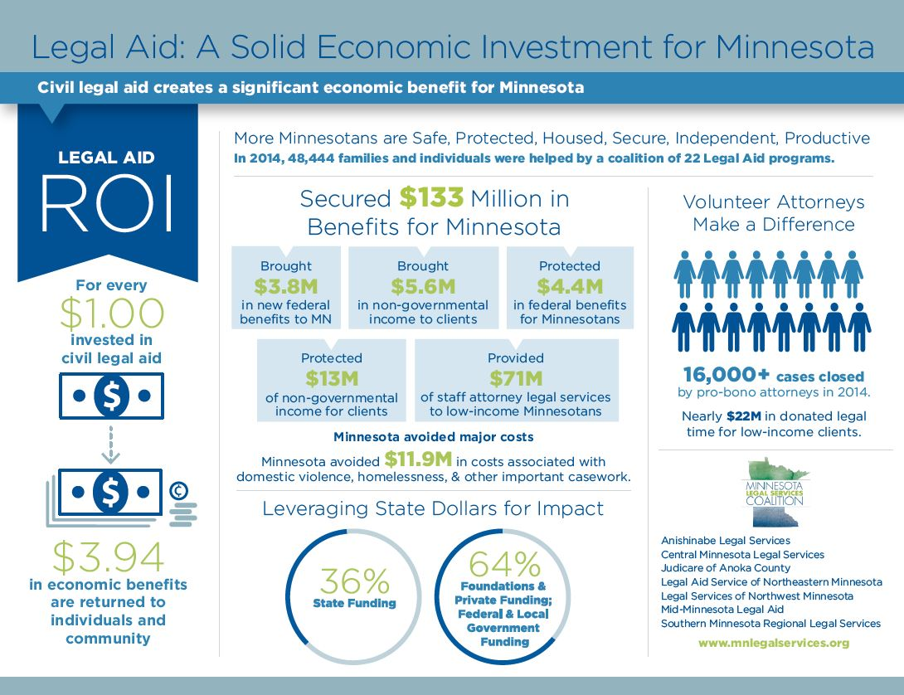

Slide 22
Minnesota Civil Legal Services Request
Highlight of Request
Current General Fund Appropriation
$27.44 million for FY2018-2019
Requested Increase
$1.646 million for FY 2020
$2.458 million for FY 2021
Total of $31.654 million for FY2020-2021
22
Notes:
Statewide Objectives
Strong and Stable Families
Prevent homelessness and stabilize safe housing
Ensure access to health care
People in Minnesota are Safe
Reduce domestic violence
Reduce financial exploitation
Efficient and Accountable Government
Create efficiency in the court system
Provide public and professional education and training; create web-based self-help resources for public and legal resources for professionals

Slide 23
Minnesota Civil Legal Services Request
Primary Reasons for Requested Increase
Salary improvement
CLS has the lowest salaries in the public sector, which has led to significantly increased turnover.
CLS has an average starting salary of $47,983, or 87% of the Public Defender, which is also comparatively lower than other public sector employers.
Resources have been flat, which affects CLS’s bottom line in light of increases in fixed costs, especially health insurance.
23
Notes:
Statewide Objectives
Strong and Stable Families
Prevent homelessness and stabilize safe housing
Ensure access to health care
People in Minnesota are Safe
Reduce domestic violence
Reduce financial exploitation
Efficient and Accountable Government
Create efficiency in the court system
Provide public and professional education and training; create web-based self-help resources for public and legal resources for professionals

Slide 24
Equal Access to Justice
Improve the lives of low-income Minnesotans by meeting critical needs for safety, shelter, and economic security.
Break the cycle of domestic violence and assist victims of domestic violence in obtaining safety and stability
Prevent homelessness and stabilize safe housing
Help more Minnesotans living with disabilities and seniors get health care and support to live independently
Increase public access to easily understood legal resources on LawHelpMN.org
Promote confidence and efficiency in the justice system
Ensuring efficient use of courts when CLS clients come before a judge
Redirecting cases that are without merit or have another resolution
24

Slide 25
