Slide 1
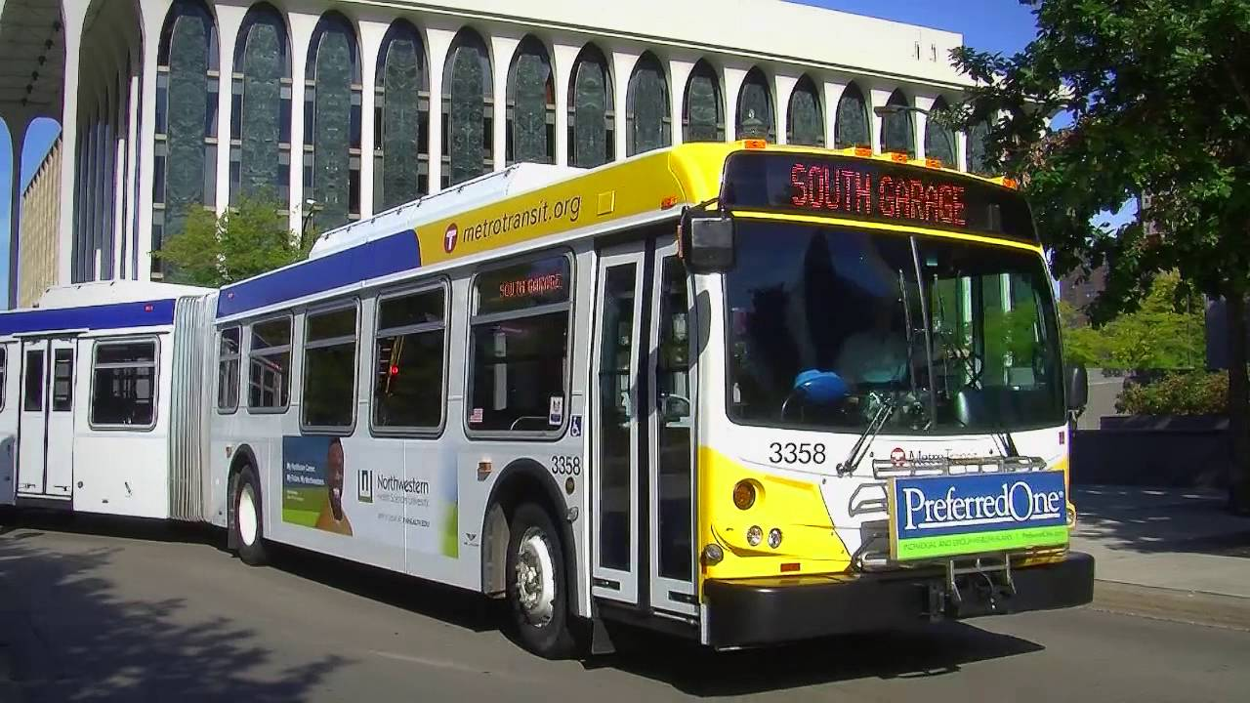
Biodiesel Usage at Metro Transit

Slide 2
Metro Transit Fuel Storage Capacity in Gallons
Heywood Garage 80,300
East Metro Garage 59,715
Nicollet Garage 60,225
South Garage 45,084
Martin J Ruter Garage 43,842
Total Storage Capacity 289,166

Slide 3
2016 Annual Metro Transit Blend Chart
 |  |  | Blend
Year | Start Date | End Date | Pct #1 Diesel | Pct #2 Diesel | Pct Biodiesel | B# | Cold Weather Additive
2016 | Jan 1 | Mar 3 | 50% | 45% | 5% | B5 | ü
2016 | Mar 4 | Mar 13 | 30% | 65% | 5% | B5 | ü
2016 | Mar 14 | Mar 31 | --- | 95% | 5% | B5
2016 | Apr 1 | Apr 28 | --- | 90% | 10% | B10
2016 | Apr 29 | Sept 26 | --- | 80% | 20% | B20
2016 | Sept 27 | Oct 16 | --- | 95% | 5% | B5
2016 | Oct 17 | Nov 14 | --- | 95% | 5% | B5 | ü
2016 | Nov 15 | Nov 30 | 30% | 65% | 5% | B5 | ü
2016 | Dec 1 | Dec 31 | 50% | 45% | 5% | B5 | ü

Slide 4
2016 Fuel Usage (Gallons)

Slide 5
(2011-2016) B100 Usage (Gallons)

Slide 6
Total Fuel Consumed
B100

Slide 7
Transit Bus Fleet Use of Biodiesel
All 16 fuel storage tanks are above ground and heated to 60 degrees F.
The vents on all fuel storage tanks have been fitted with water-inhibiting (desiccant) filters.
Metro Transit performs monthly maintenance checks on all fuel delivery systems.
All fuel dispensers are fitted with 10 micron filters.
B100 biodiesel must comply with Metro Transit’s fuel specification and BQ9000 producer requirements.
Fuel storage tanks are tested for water, mold and microbial growth on an annual basis.

