Slide 1
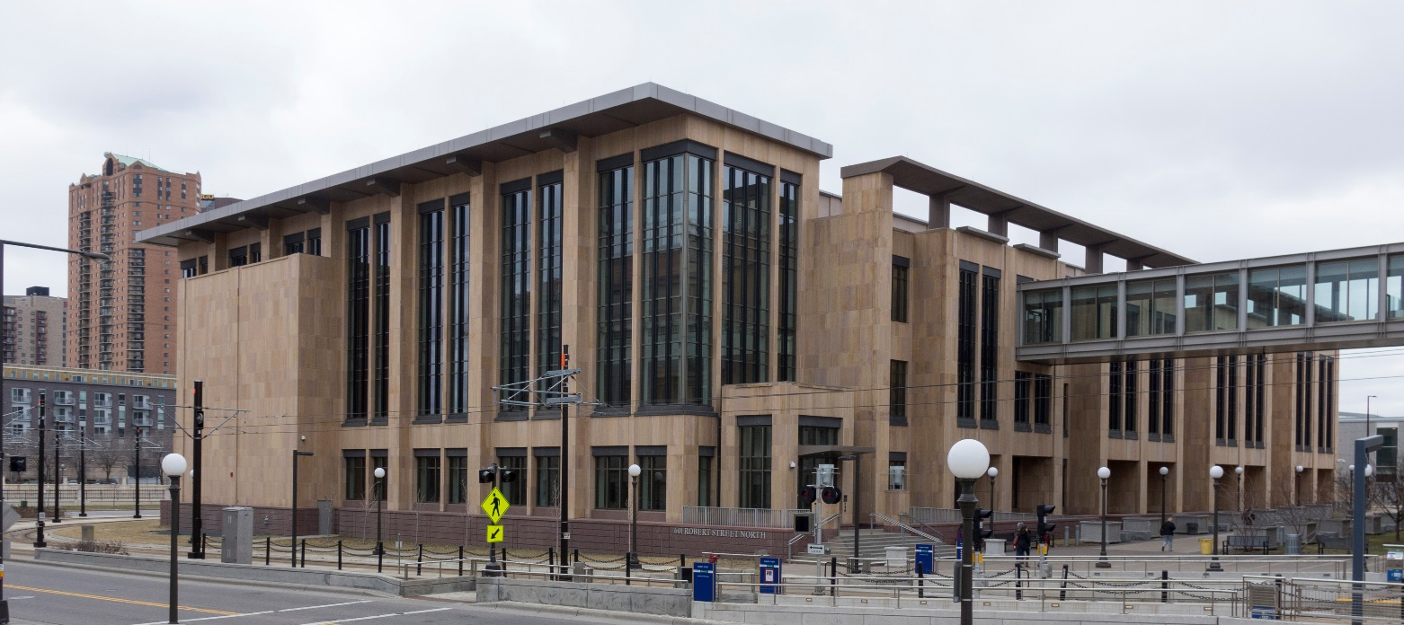


2018 MDA/MDH Laboratory Bonding Request

Slide 2

MDA-MDH Laboratory Building
$60 million state-of-the-art facility opened in 2005
$19.9 million needed for mechanical, architectural & electrical improvements
Notes:
Our laboratories require highly specialized facilities with:
Unique utilities: For example, systems that purify water for use in testing and then remove acids and bases from the water before it returns to the sewer system.
Tight controls: over temperature, humidity, and air flow direction to keep staff safe and to confine harmful contaminants within appropriate spaces.
Safety devices: fume hoods and biosafety cabinets that protect staff from exposure to harmful substances.
Since the building opened, we have routinely experienced problems with various building systems. These problems interrupt critical laboratory testing and reduce the speed and efficiency of vital work.
Periodic retro-commissioning is a best practice for these type of facilities in both the public and private sectors. Retro-commissioning helps to ensure the building and its systems are performing as designed and that the building provides a stable environment for laboratory testing.
The retro-commissioning study by Sebesta, an NV5 Global Company recommended $20 million in architectural, mechanical, and electrical improvements throughout the building to correct safety, energy, and operational efficiency problems.

Slide 3



MDA-MDH Laboratories
Human Health Infectious diseases
Newborn screening
Antibiotic resistance
Environment
Clean water
Chemical/biological threats
Radiation
Agricultural Economy
Food Safety
Misuse of Ag chemicals
Notes:
The MDA/MDH laboratories play a critical role in protecting human health, the environment, and the agricultural economy in Minnesota.
The labs perform testing and analyses to:
Ensure a safe, secure food supply free of pesticides, food-borne pathogens, and environmental contaminants by testing food samples and investigating foodborne disease outbreaks.
Detect, investigate, and control infectious diseases like Ebola, Zika and measles.
Monitor bacteria and viruses to watch out for signs of resistance to antibiotics or vaccines we rely on to protect people from illness.
Protect the environment and our drinking water from potentially harmful levels of hazardous chemicals, radioactive substances, pharmaceuticals, and agricultural chemicals.
Detect rare but treatable disorders in newborns, so they can receive treatment to prevent illness, physical disability, or death.
Detect and respond to potential biological and chemical terrorism threats, such as anthrax and nerve agents.
It is essential to ensure that those life safety activities are not hampered by inefficient or poorly functioning facilities.

Slide 4
Environmental Testing
Special Investigations
Radiation Preparedness
Biomonitoring
Drinking Water
Natural Disasters
Emerging Contaminants

Slide 5
Infectious Disease Testing
Rabies Testing
Emerging Diseases
Vectorborne Disease
Bioterrorism Response
Foodborne Illness
Vaccine Preventable Diseases

Slide 6
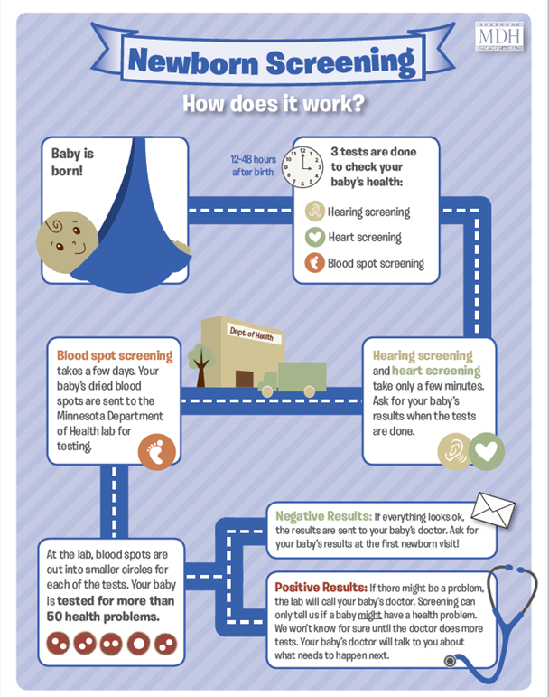
Newborn Screening
>70,000 babies screened annually
60 disorders
1 pending
369 infants identified with a treatable disorder in FY17

Slide 7
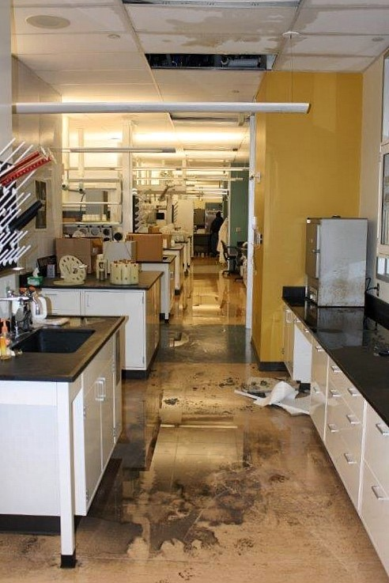
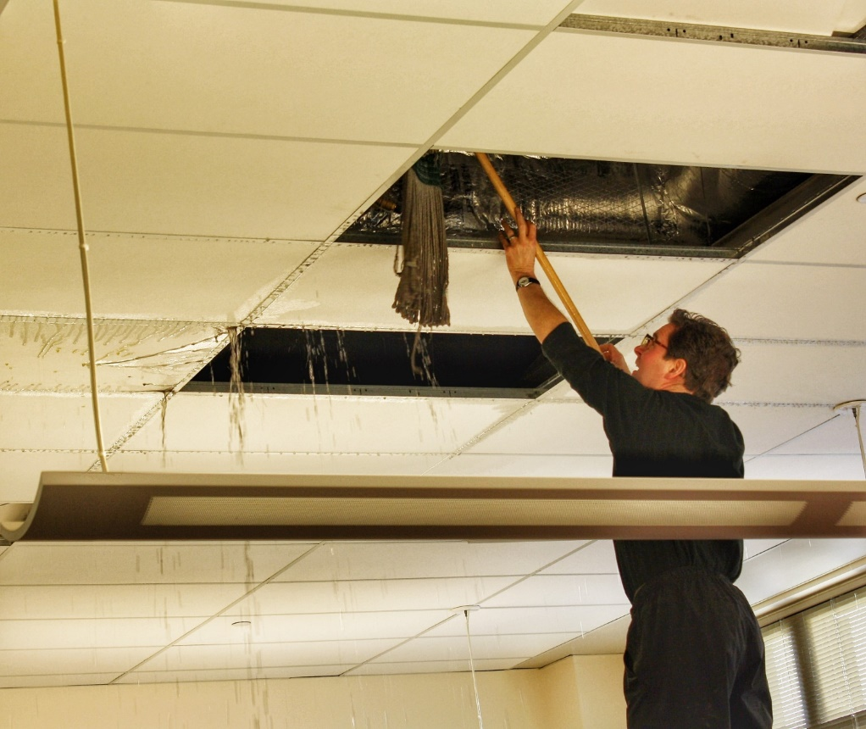
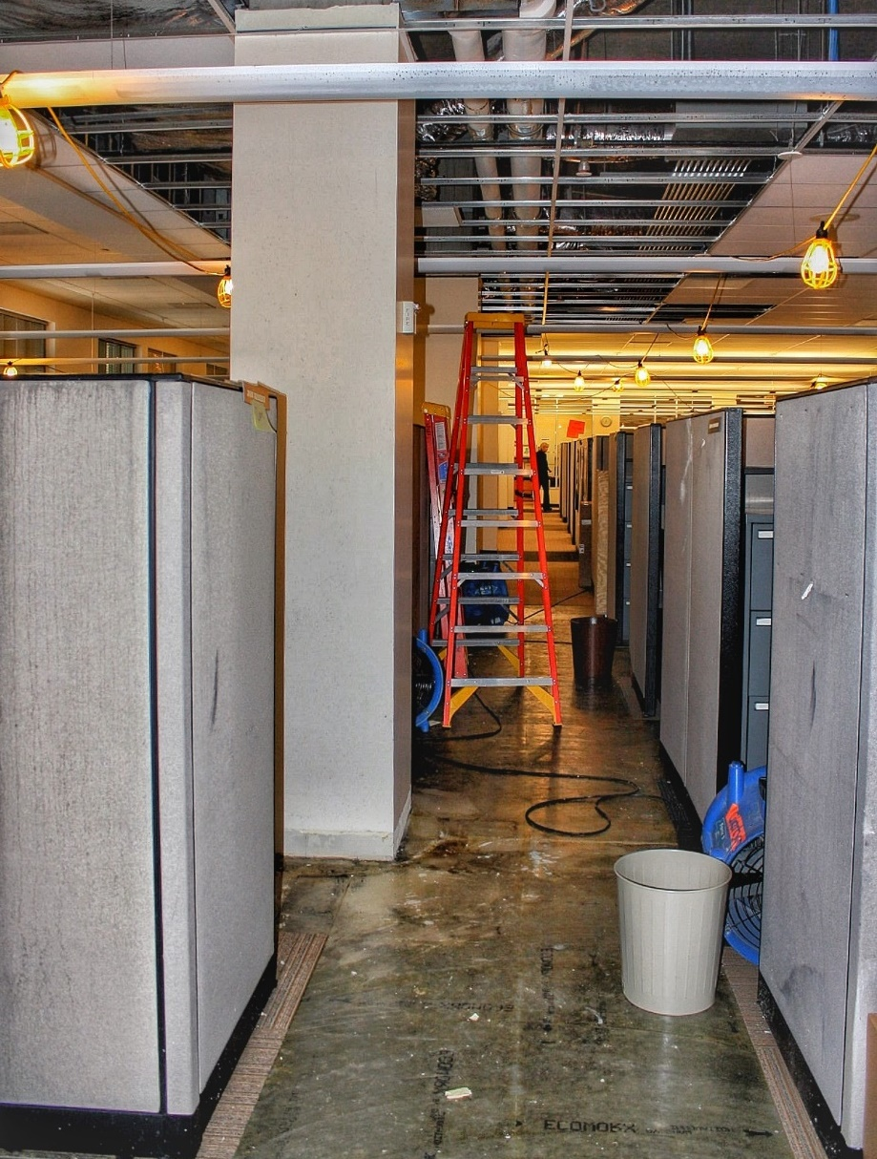
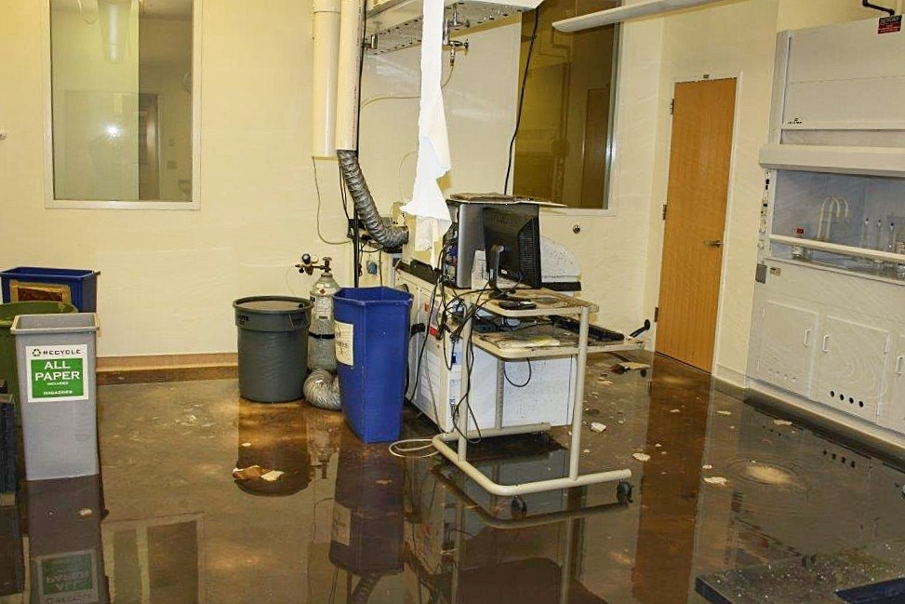
Precipitating Event
January 2014
HVAC system failure
Cost over $1 million for repairs and lost
revenue
Notes:
In January 2014, part of the HVAC system failed due to particularly cold weather.
Cold air entered duct work and froze heating coils that were full of water, causing them to burst and generate large leaks all over the building.
Building was evacuated, staff had to be sent home for multiple days; some laboratories were uninhabitable for months.
Significant impact to staff and to the programs and public that rely on timely laboratory testing
Cost over $1 million for clean up, repairs to the building, replacement of high priced laboratory equipment, and lost revenue
Because this was just the worst in a series of challenges with building systems, three agencies jointly initiated and funded the re-commissioning study to determine how to prevent these kinds of incidents in the future

Slide 8
Recommissioning Study
Identify other issues that might result in suboptimal building performance
Focused on mechanical systems (heating, cooling, ductwork, HVAC, electrical)
Notes:
Our laboratories require highly specialized facilities with:
Unique utilities: For example, systems that purify water for use in testing and then remove acids and bases from the water before it returns to the sewer system.
Tight controls: over temperature, humidity, and air flow direction to keep staff safe and to confine harmful contaminants within appropriate spaces.
Safety devices: fume hoods and biosafety cabinets that protect staff from exposure to harmful substances.
Since the building opened, we have routinely experienced problems with various building systems. These problems interrupt critical laboratory testing and reduce the speed and efficiency of vital work.
Periodic retro-commissioning is a best practice for these type of facilities in both the public and private sectors. Retro-commissioning helps to ensure the building and its systems are performing as designed and that the building provides a stable environment for laboratory testing.
The retro-commissioning study by Sebesta, an NV5 Global Company recommended $20 million in architectural, mechanical, and electrical improvements throughout the building to correct safety, energy, and operational efficiency problems.

Slide 9
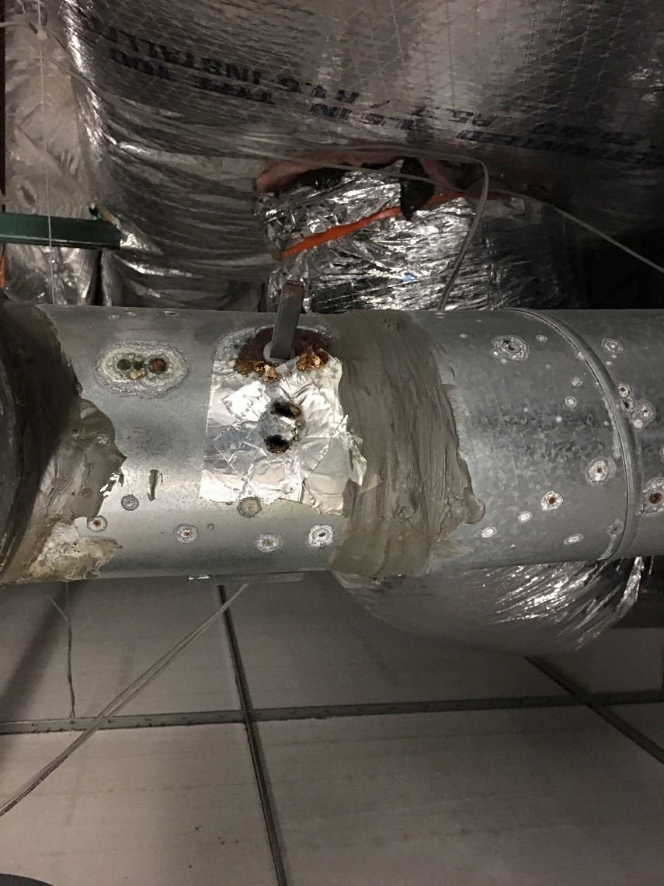
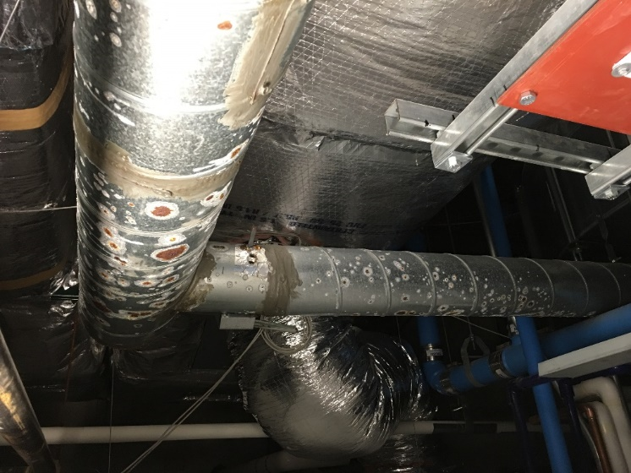
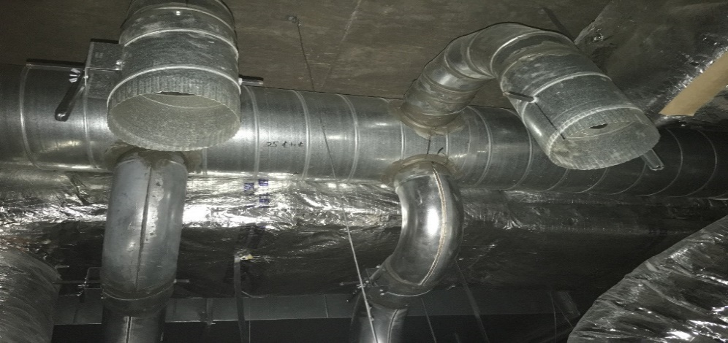
Project Scope: $19.9 million
Replace deteriorated ductwork
Update exhaust and airflow systems
Repair and replace HVAC components
Reconfigure laboratory space to meet changing needs
Install uninterruptible power supply on all outlets
Perform maintenance on building systems
Upgrade lighting to meet standards
Notes:
Replace deteriorated ductwork to reduce the risk of liquid and air contamination of laboratory spaces and to reduce the need to operate exhaust systems beyond design parameters.
Update exhaust and airflow systems to ensure that lab air contaminants do not enter office and meeting spaces.
Repair and replace components of HVAC systems to improve efficiency and to ensure safe and proper conditions for laboratory testing.
Redesign Ag microbiology laboratory to minimize the risk of cross contamination of samples.
Create a dedicated biosafety level 3 (BSL-3) laboratory space needed to test food for threat agents such as anthrax, plague, and ricin that meets federal standards and allows for safe handling of select agents.
Build out unfinished laboratory area as construction swing space that will be used later by Health for surge/flex space (BSL-2)
Install a centralized, building-wide uninterruptable power supply to ensure critical laboratory equipment does not shut down during a power outage.
Perform standard 10-year maintenance on building systems to protect the value of this $60 million asset.
The $720,000 general fund cash includes non-bondable project costs like:
Moving laboratory equipment to and from swing space
Cleaning contaminants from ductwork prior to construction
Recertifying laboratory equipment once it is returned to permanent locations

Slide 10
Tour
We are hosting a tour for interested Representatives:
Friday, March 2nd
1:30pm
Please contact Melissa Finnegan if you are interested in attending.
651-201-5805
Melissa.Finnegan@state.mn.us

Slide 11
Thank you!

