Slide 1
24-hours a day 7-days a week 365 days per year
Commissioner Paul Schnell
Deputy Commissioner Bruce Reiser
Deputy Commissioner Ron Solheid

Slide 2
Department Priorities
4,300 dedicated staff keeping Minnesota safe:
Priorities:
Ensure safety and security for fewer assaults and injuries
Reduce the prison population with
Education
Treatment
Evidence-based programming

Slide 3
Offender Statistics
105,420 offenders on probation in Minnesota
9,849 offenders incarcerated in the DOC
(court commits, probation violators, release violators)
6,568 people under supervision after prison

Slide 4
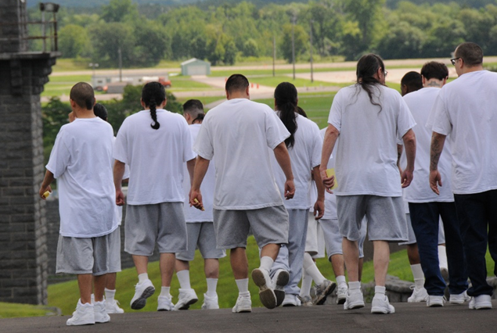
Under determinant sentencing, 2/3 of an offender’s sentence is spent incarcerated
95% of offenders are released back to the community
78% of offenders have previous violent crime convictions
Offenders average:
Ten prior criminal convictions
Four prior felony convictions

Slide 5
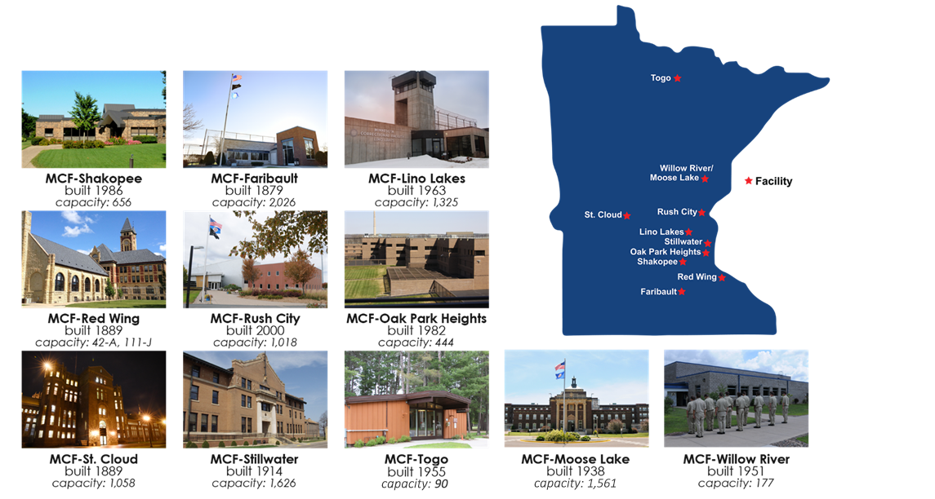
10 Correctional Facilities / 11 Locations

Slide 6
Minnesota Adult Prison Population 2008-2018*

Slide 7
Inmate Offense Profile – July 2018

Slide 8
Providing Security
Officers maintain security 24-hours a day/7-days a week
Security technology
Office of Special Investigations
Incident Management Team
K-9 officers
Special Operations Response Teams
Crisis Intervention Team

Slide 9
Staff Assault Data
Fiscal Year | Assault of Staff | Assault of Staff Causing Harm | Assault of Staff with Weapon | Assault of Staff with Weapon Causing Harm
FY13 | 66 | 7 | 19 | 2
FY14 | 84 | 11 | 9 | 1
FY15 | 81 | 3 | 15 | 2
FY16 | 63 | 9 | 9 | 1
FY17 | 74 | 12 | 27 | 1
FY18 | 120 | 30 | 31 | 7
FY19** | 59 | 17 | 16 | 1
*Data represents due process discipline convictions, NOT individual incidents of assault. A single incident may result in more than one conviction and more than one charge type for an individual offender. **FY19 data includes first six months of fiscal year, July 1 – December 31, 2018

Slide 10
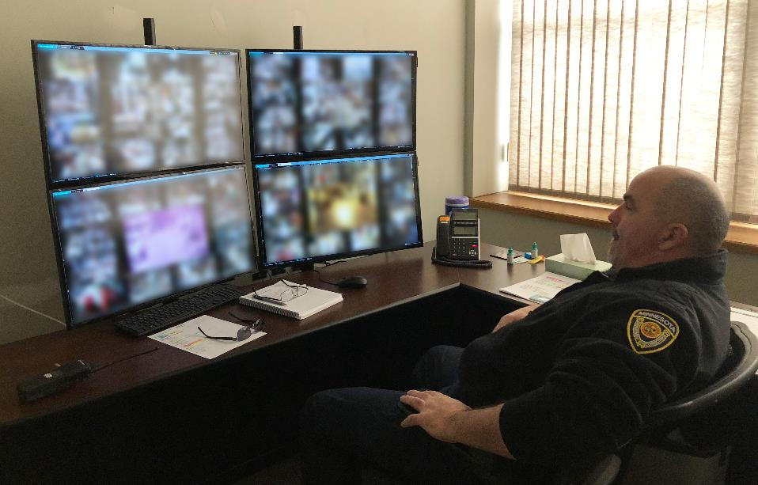
Security Improvements
What we are doing:
Technology security improvements
Additional cameras
Reducing double-bunking
Improved tool control
Reviewing offender work assignments

Slide 11
Evidence-Based Practices
Not merely “Best Practices” or trends of “What Works,” but:
Objective: Observable by others
Replicable: Observable by others using the same methods with same outcomes
Generalizable: Applied to others in producing original outcomes
Early emphasis on:
Assessment – Needs, Risks, Responsivity
Motivation to change – Supporting and motivating for change
Targeted Interventions – Proven interventions to address criminogenic need

Slide 12
Evidence-Based Programming – Minnesota’s Return on Investment (ROI)
Facility Programming | Cost Avoided Annually | Rearrests ↓ | Reconviction ↓ | Reincarceration ↓
Chemical Dependency Treatment | $22.3M | 17% | 21% | 25%
Education | $3.2M | 14% | 16% | 24%
Challenge Incarceration Program | $6M | 32% | 32% | 35%
EMPLOY | $2.8M | 35% | 32% | 55%
 | Cost Avoided Annually | Sex Offenses ↓ | Violent Offenses ↓ | General Offenses ↓
Sex Offender Treatment | $2.9M | 27% | 18% | 12%
Source: Grant Duwe – Director of Research, Minnesota Department of Corrections

Slide 13
Health Services
Health care is a legal requirement
The DOC provides medical, nursing, dental and mental health services in a clinic setting.
Challenges:
Rising cost of health care
Cost of pharmaceuticals
Infectious diseases
High-risk behaviors
Aging population
Lack of electronic health records

Slide 14
Education Programming
Prison-based educational programming increases an offender’s opportunity for post-release employment, improving their opportunity for a successful transition to the community.
Obtaining a secondary degree in prison increases post-release employment by 59 percent
Earning a career technical certification or other higher education degree results in more hours worked and higher overall wages post release
The Second Chance Pell initiative has increased career technical education enrollments by 50 students and added 100 students to a four year degree program utilizing tablet technology.
Obtaining a post-secondary degree significantly reduced recidivism by:
16%
14% rearrests
16% reconvictions
24% re-incarceration
Source: “What Works with Minnesota Prisoners” July 2013 available at mn.gov/DOC
3.69

Slide 15
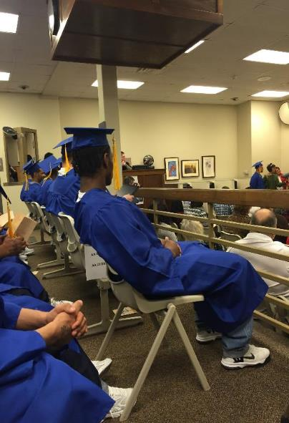
Education in FY 2018
In Fiscal Year 2018:
2,400 students were enrolled in the DOC’s Education Program each day
578 graduated with a post-secondary career technical certificate or diploma
31 graduated with an AA degree
587 earned a secondary (high school level) diploma. These include the GED, traditional credit-based high school diploma, and the Minnesota Standard Adult High School Diploma

Slide 16
Treatment programs
Chemical Dependency Treatment
85% who enter DOC are chemically abusive and/or dependent
Over 1,000 treatment beds – 1,572 offenders entered treatment with a 75% completion rate.
Continuum of care = best outcomes
17% rearrests
21% reconviction
25% reincarceration
*ROI: Return on Investment, for every dollar the DOC spends on CD Treatment, we eliminate potential future incarceration, treatment, and other expenditures by $6.50

Slide 17
Community Supervision
Under determinant sentencing
1/3 of an offender’s sentence is spent on community supervision

Slide 18
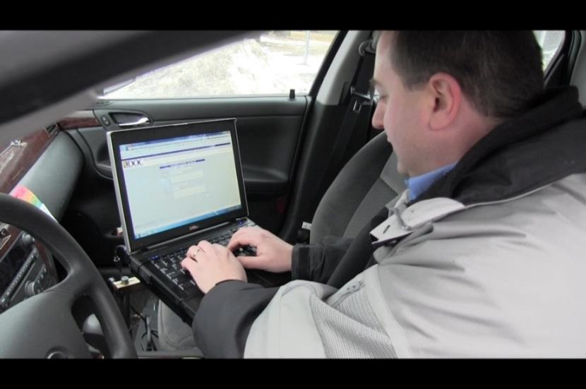
Community Services
Minnesota relies heavily on community supervision
Assists in transition from prison to the community
Assign risk levels to predatory offenders and assists with community notification
Inspects and licenses jails
Provides victim notification and restorative justice services

Slide 19
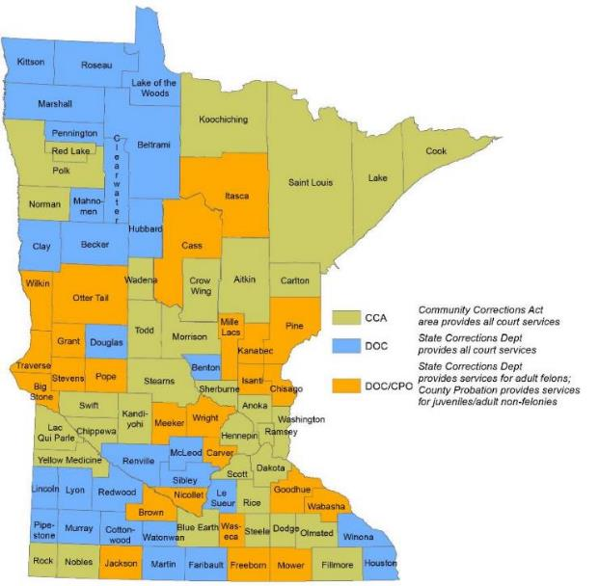
Community-Based Corrections
Three Delivery Systems
Department of Corrections (DOC)
53 counties, adult felon supervision
28 counties, juvenile & misdemeanant supervision
75 counties, Intensive Supervised Release (ISR)
Community Corrections Act (CCA)
34 counties, adult felon, misdemeanant & juvenile supervision
12 counties, ISR
County Probation Officers (CPO)
25 counties, juvenile & misdemeanant

Slide 20
Community Partners
Contract with community-based halfway houses for case management and transition services for offenders released from prison.
Provide outpatient sex offender treatment statewide through grants to 20 community based providers.
Partner with DEED at two metro workforce centers to provide the O4C program that assists high-risk offenders with employment, housing supports, mentoring, cognitive behavioral programming, and case management.
Collaborate with community stakeholders and facilitate “Transition Coalitions” in 5 locations around the state.

Slide 21
DOC Release Violator Admissions* Over Time

Slide 22
Annual Revocation Admissions (2014-18)

Slide 23
Priorities based on feedback/input
The safety of corrections officers is imperative. Those working in our prison must feel safe at work, with increases the safety of inmates.
Given the reality that 95% of offenders in our facilities will return to communities across Minnesota, we must prioritize opportunities for change – through effective programming – while people are incarcerated.
We must continue supporting our agents who supervise justice system-involved people living in or returning to our communities, remembering that their success reflects Minnesota’s broadest safety interests.
We need to collaborate with Minnesota’s educational community resources in an effort to:
Prevent Minnesota’s youth from entering the criminal justice system in the first place
Develop educational and business partnerships that increase the likelihood of successful reintegration upon return to home communities.

Slide 24
24-hours a day 7-days a week 365 days per year
Thank you

