Slide 1
Tackling the Opportunity Gaps
Dr. Marsha Baisch, Assistant Superintendent
Dr. Sylvia Huff, Director of Research, Evaluation & Assessment

Slide 2
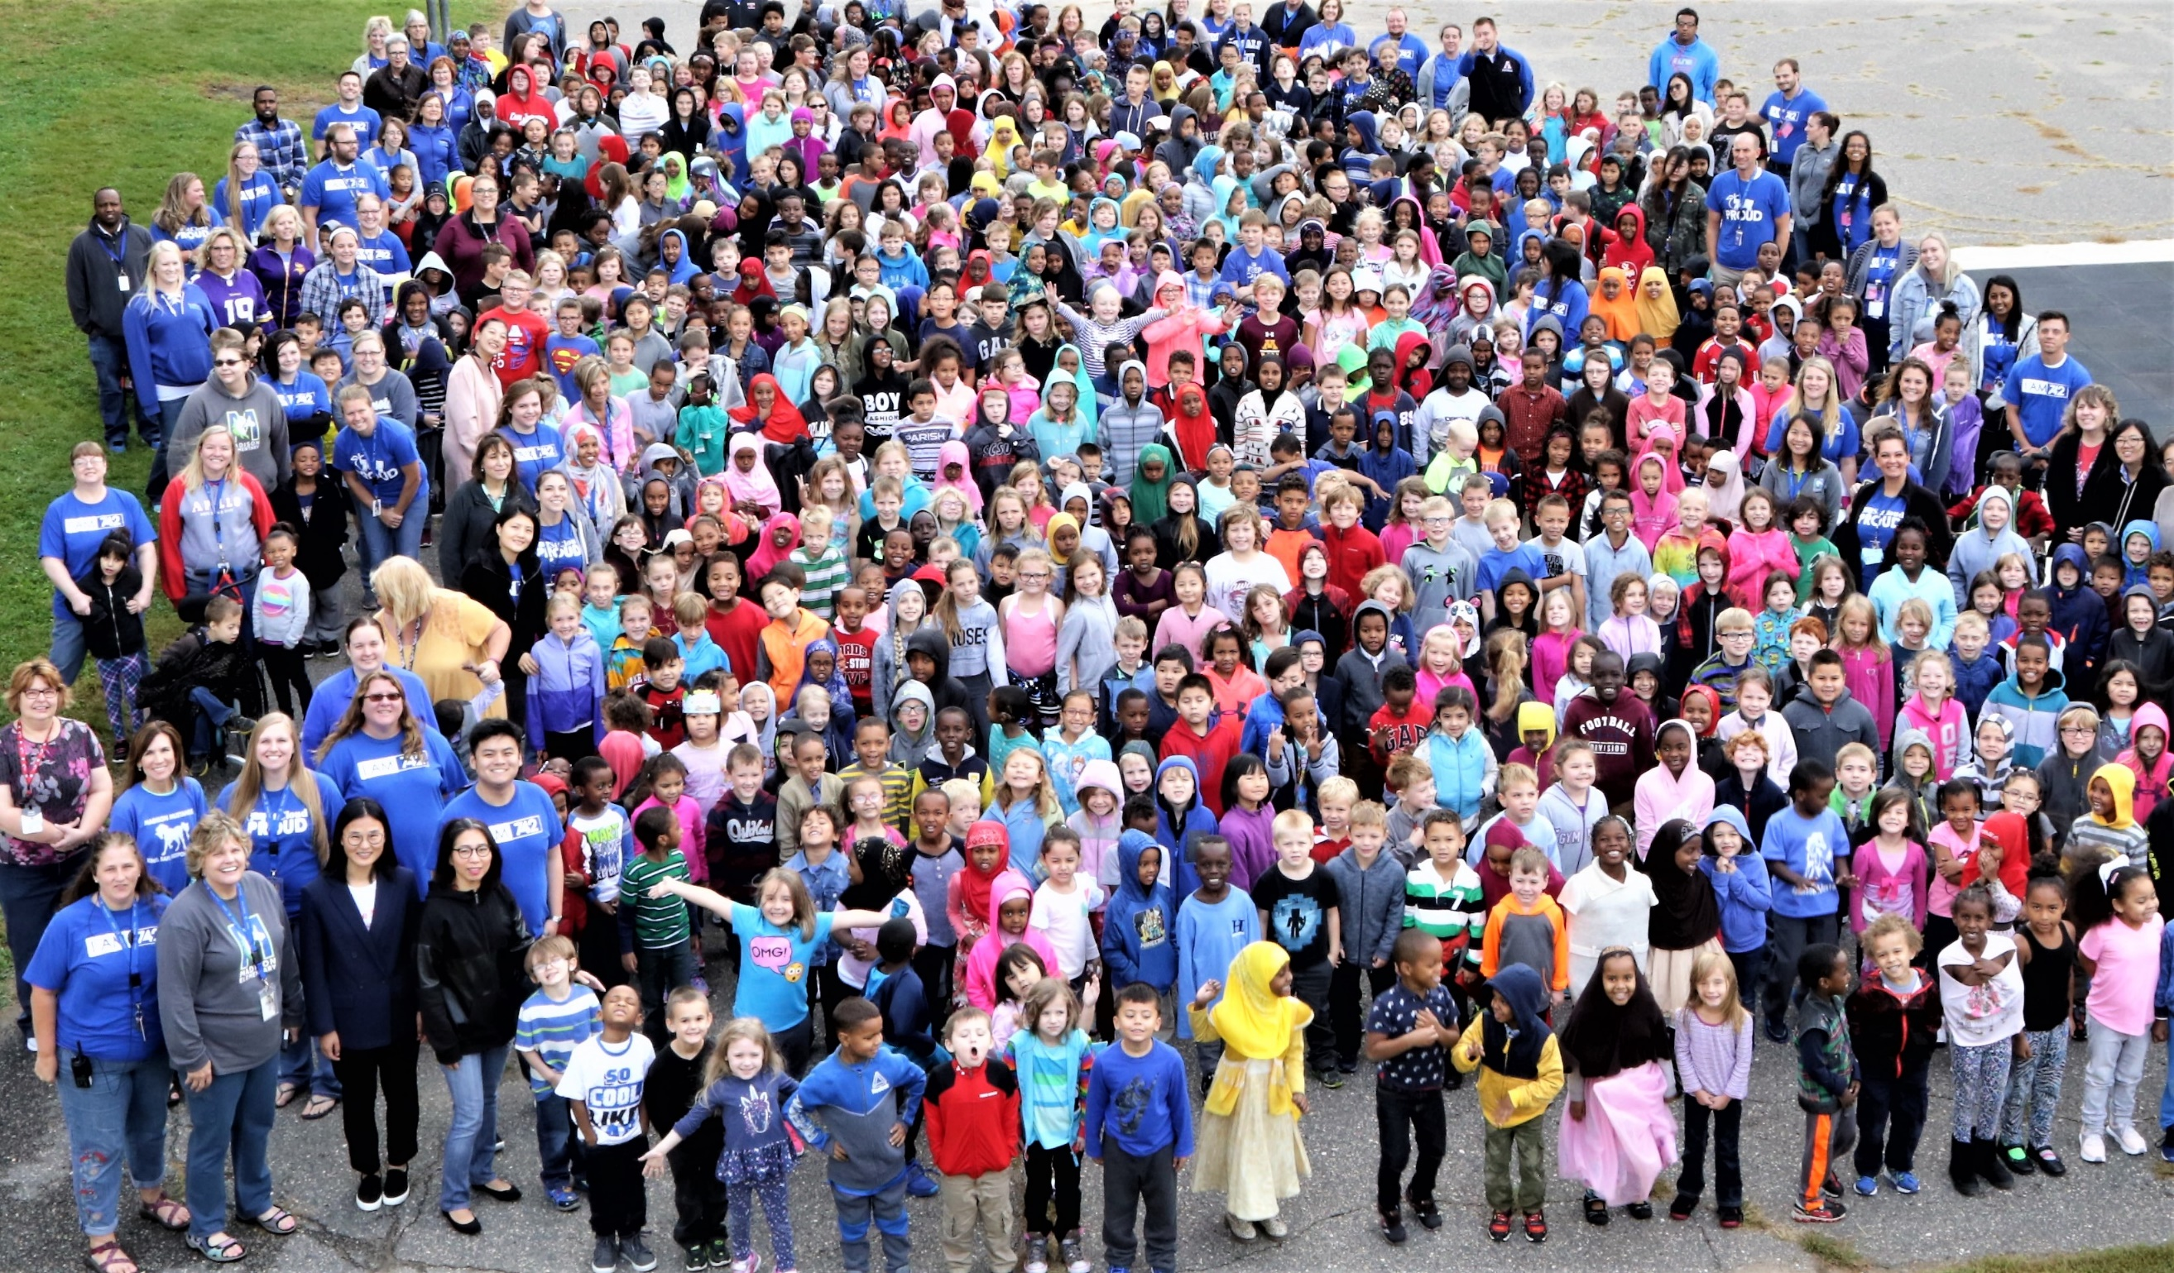
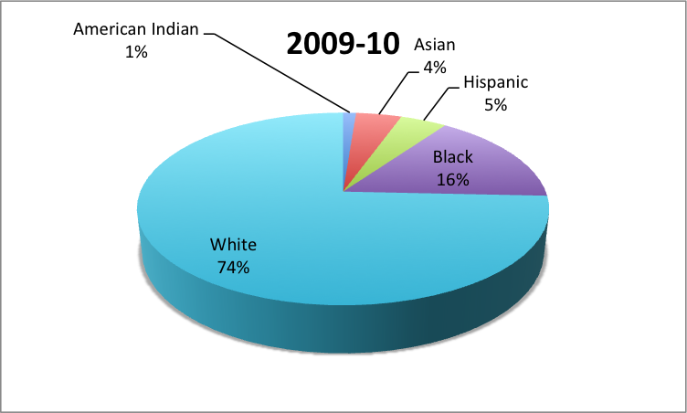
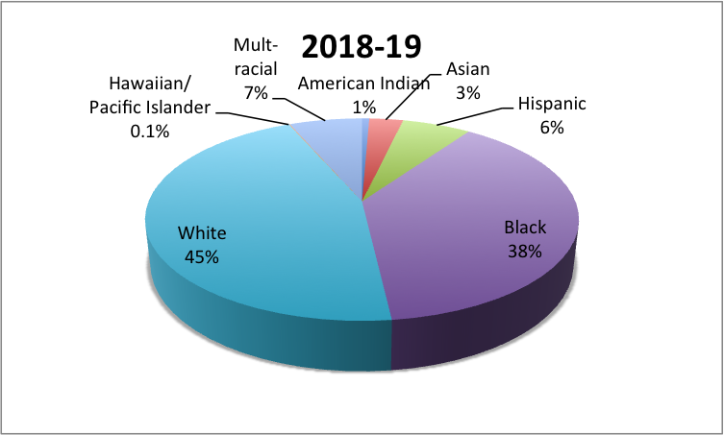
Who We Are
District Demographics

Slide 3
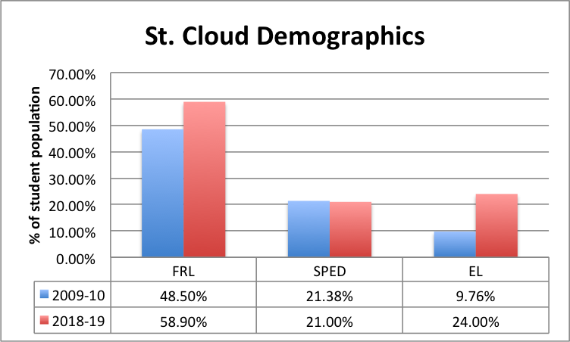
Who We Are

Slide 4
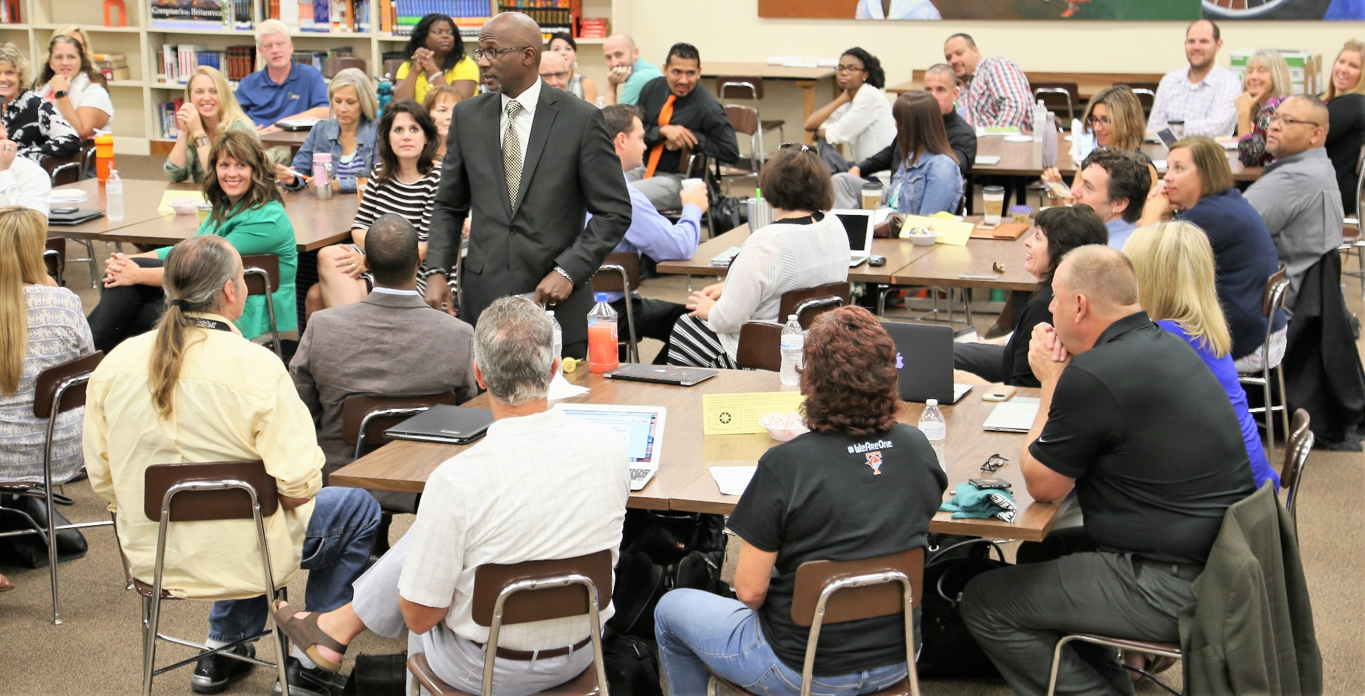
Tackling the Opportunity Gaps Leadership
Alternatives to Suspension Data
Better Way

Slide 5
Tackling the Opportunity Gaps Leadership
Beyond Diversity
Courageous Institute

Slide 6
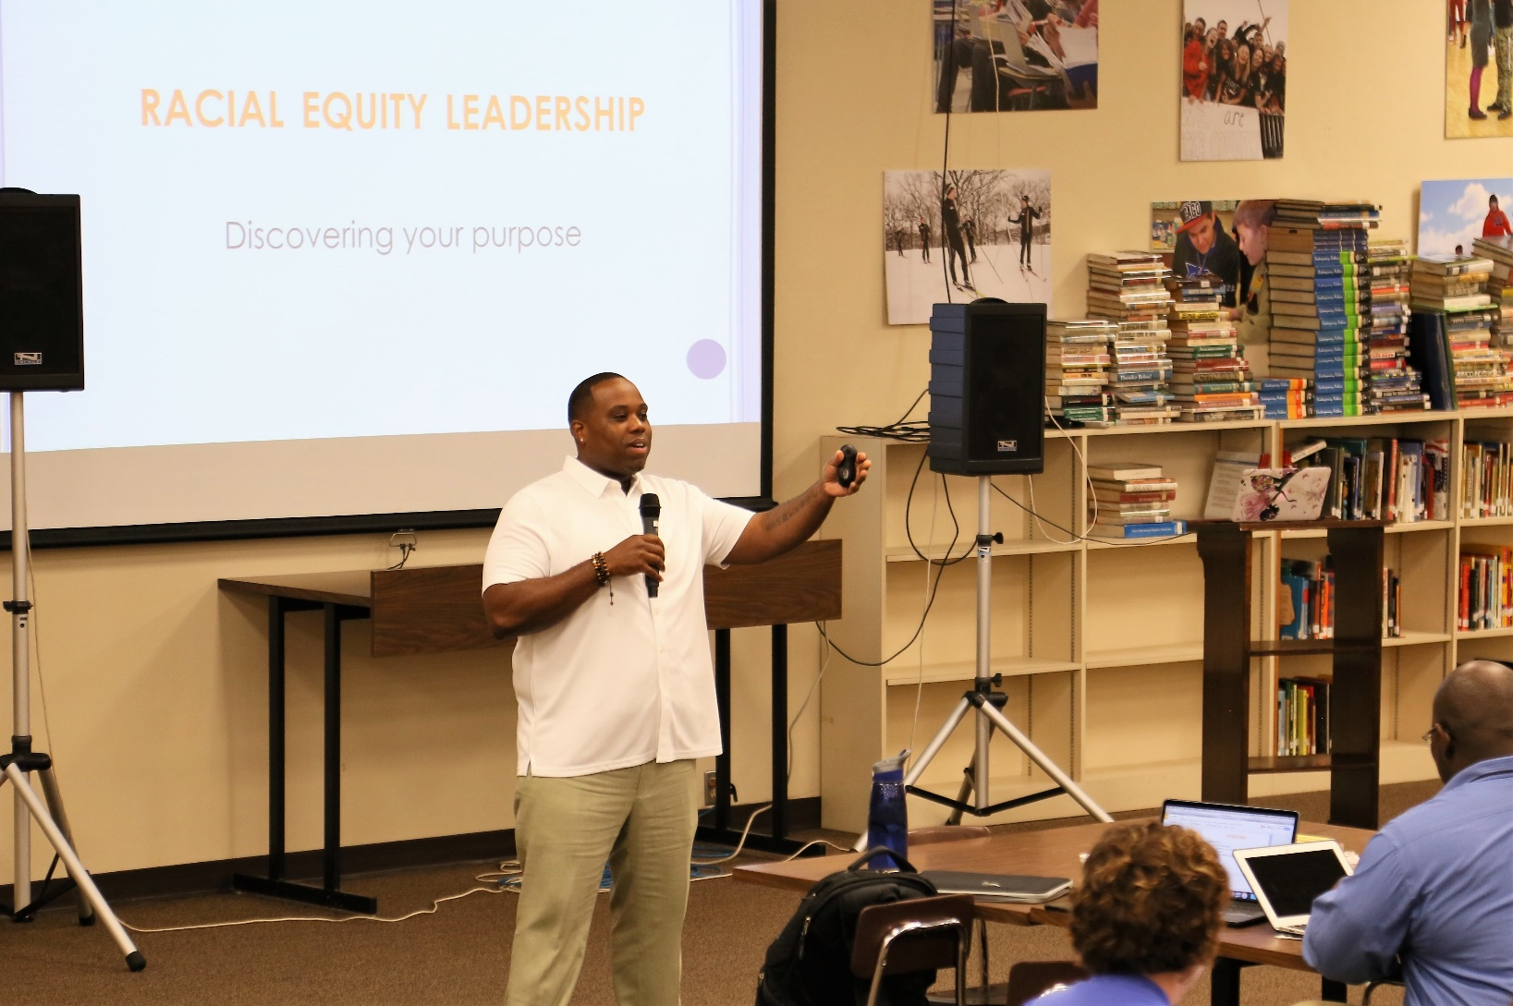
Tackling the Opportunity Gaps Leadership
Culturally and Linguistically Responsive Teaching (CLR)

Slide 7
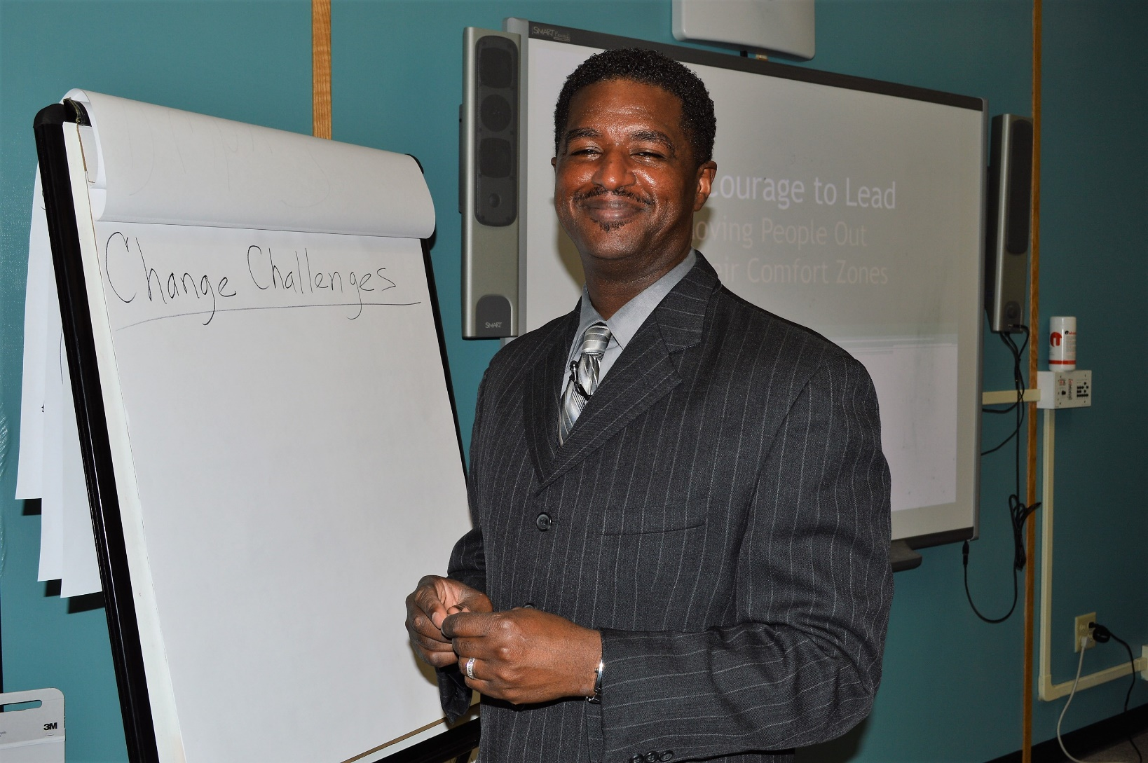
Tackling the Opportunity Gaps Leadership
"Skill and Will" – Dr. Anthony Muhammad
National Urban Alliance (NUA)
Personalized Learning

Slide 8

Tackling the Opportunity Gaps Programs
School Reviews
Site Improvement Plans
Target Pages
Site Leadership Teams
Data Retreats
Teacher Talks

Slide 9
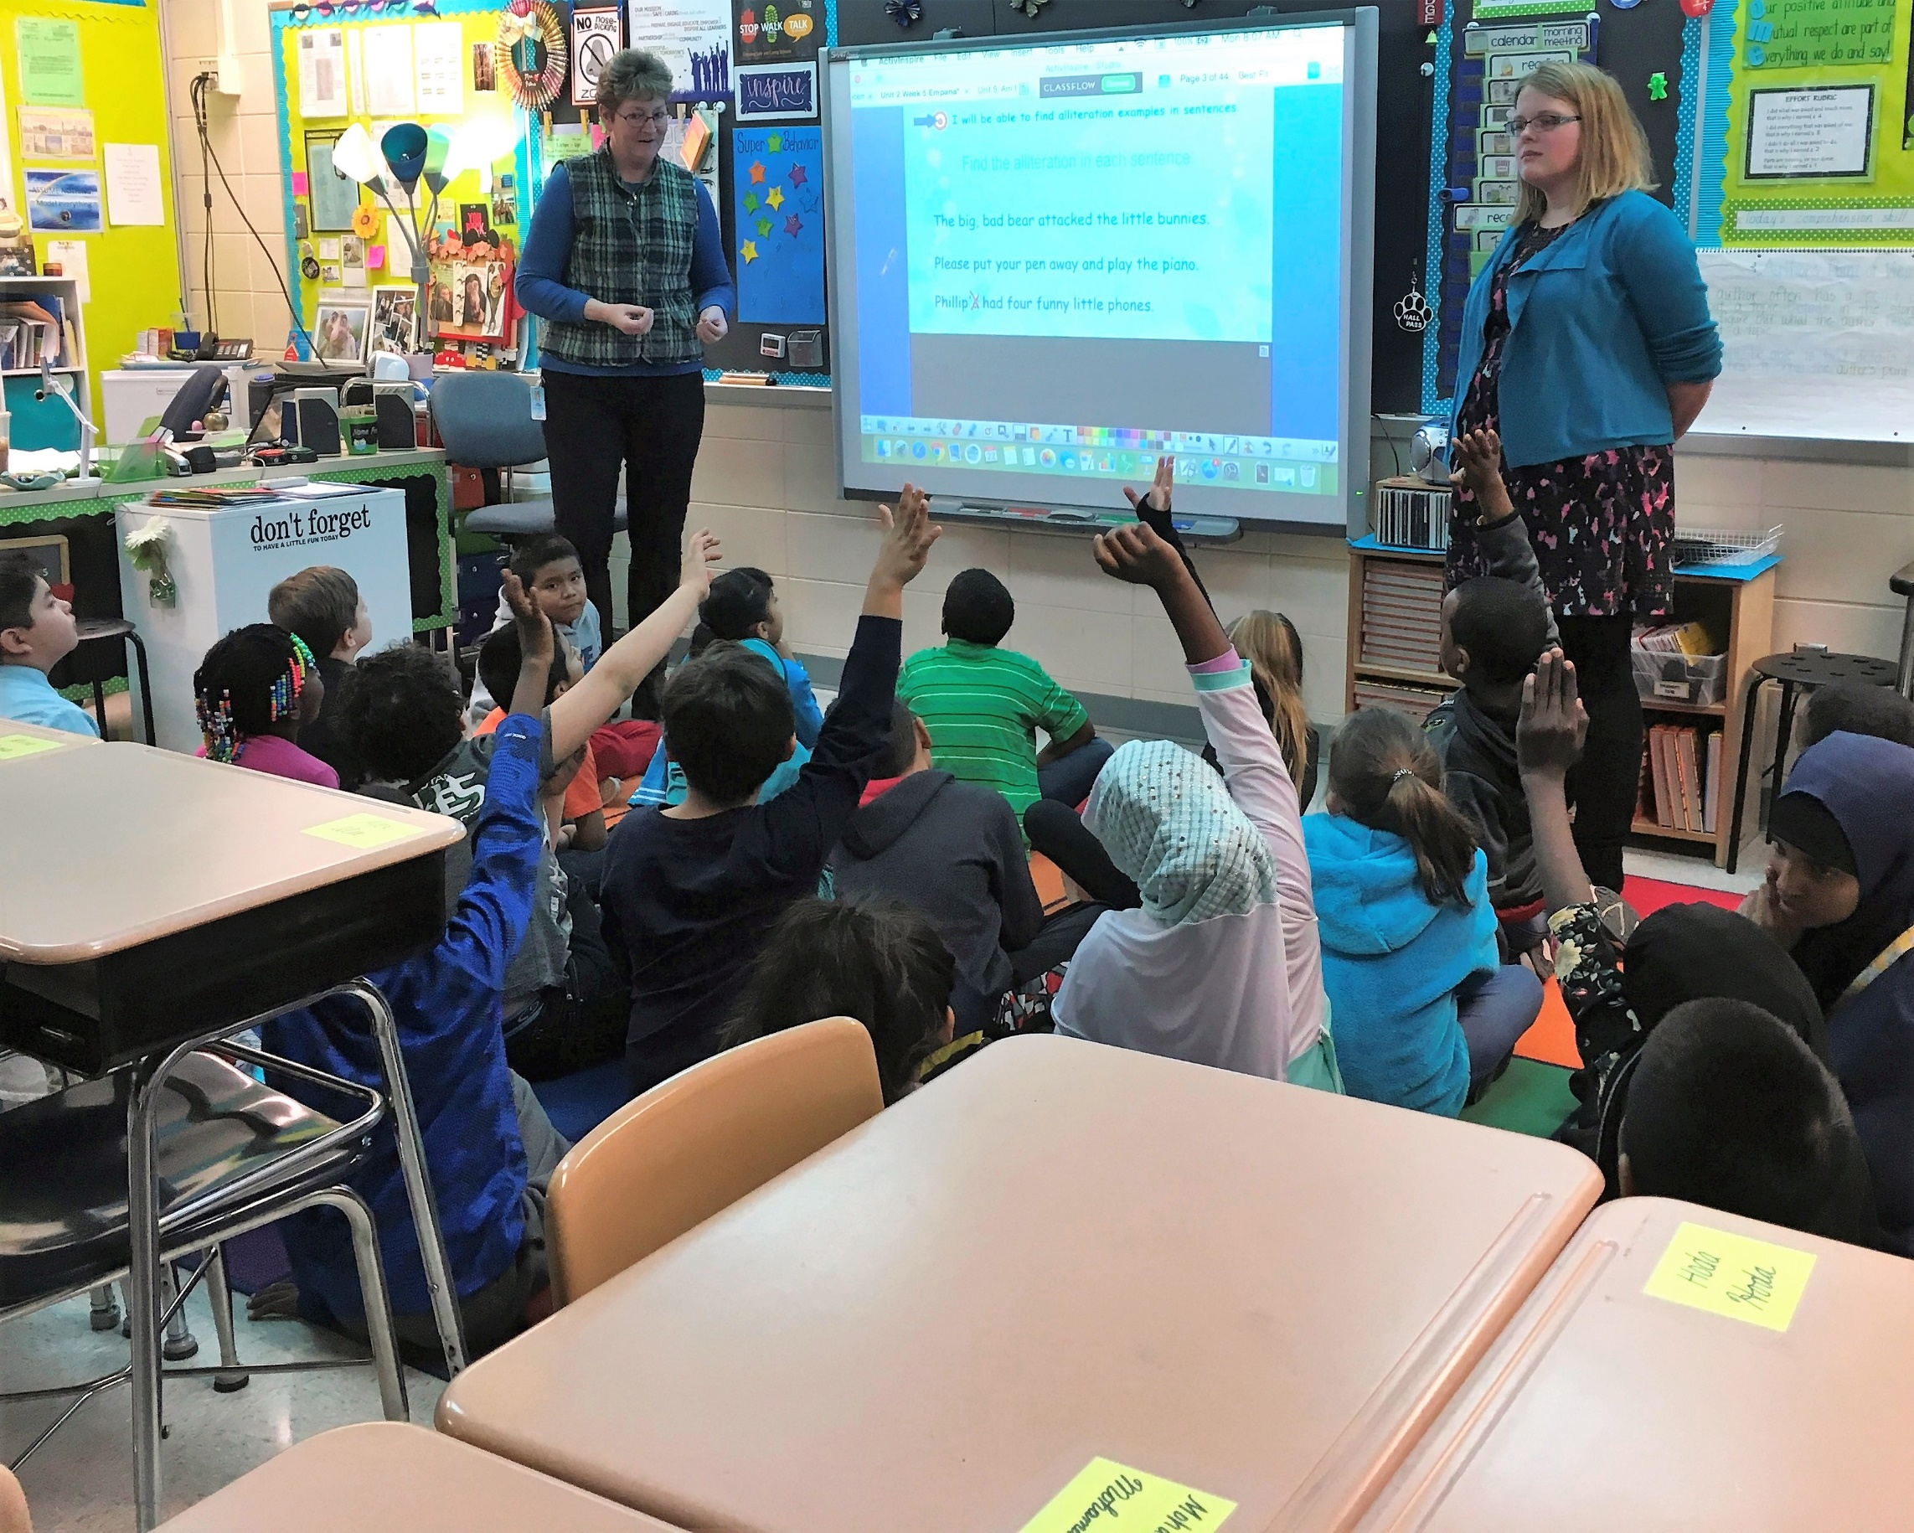
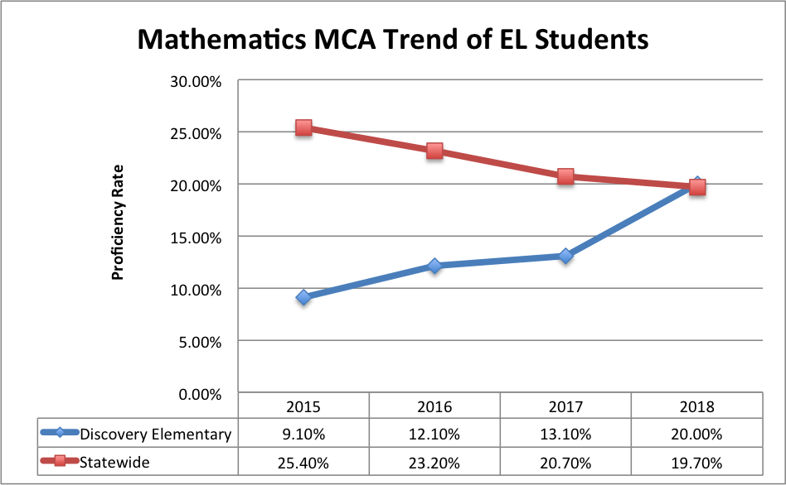
Tackling the Opportunity Gaps Programs
Co-Teaching

Slide 10
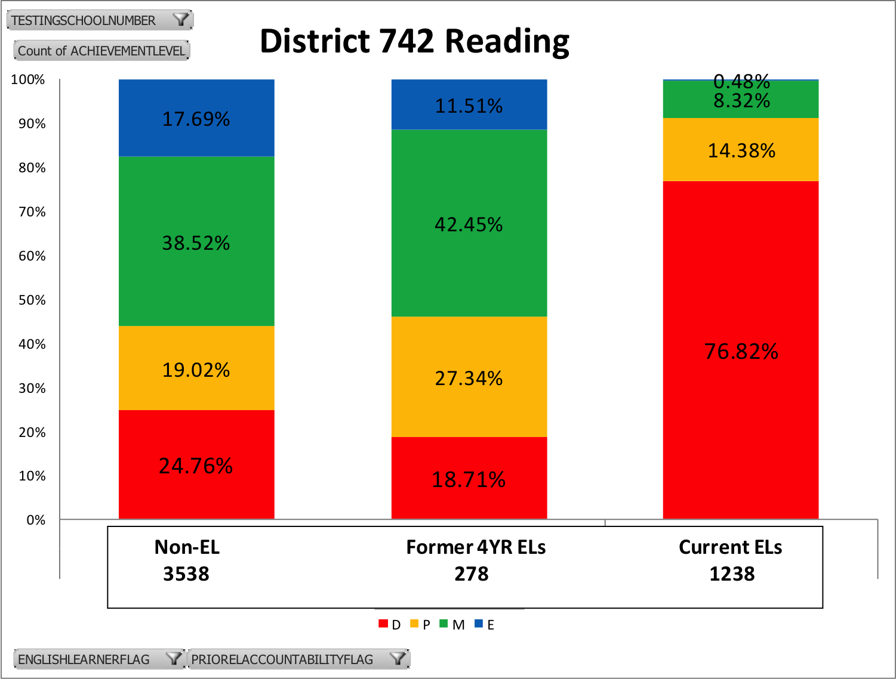
Tackling the Opportunity Gaps Programs
EL Audit
2018 MCA Reading Performance & EL Status

Slide 11
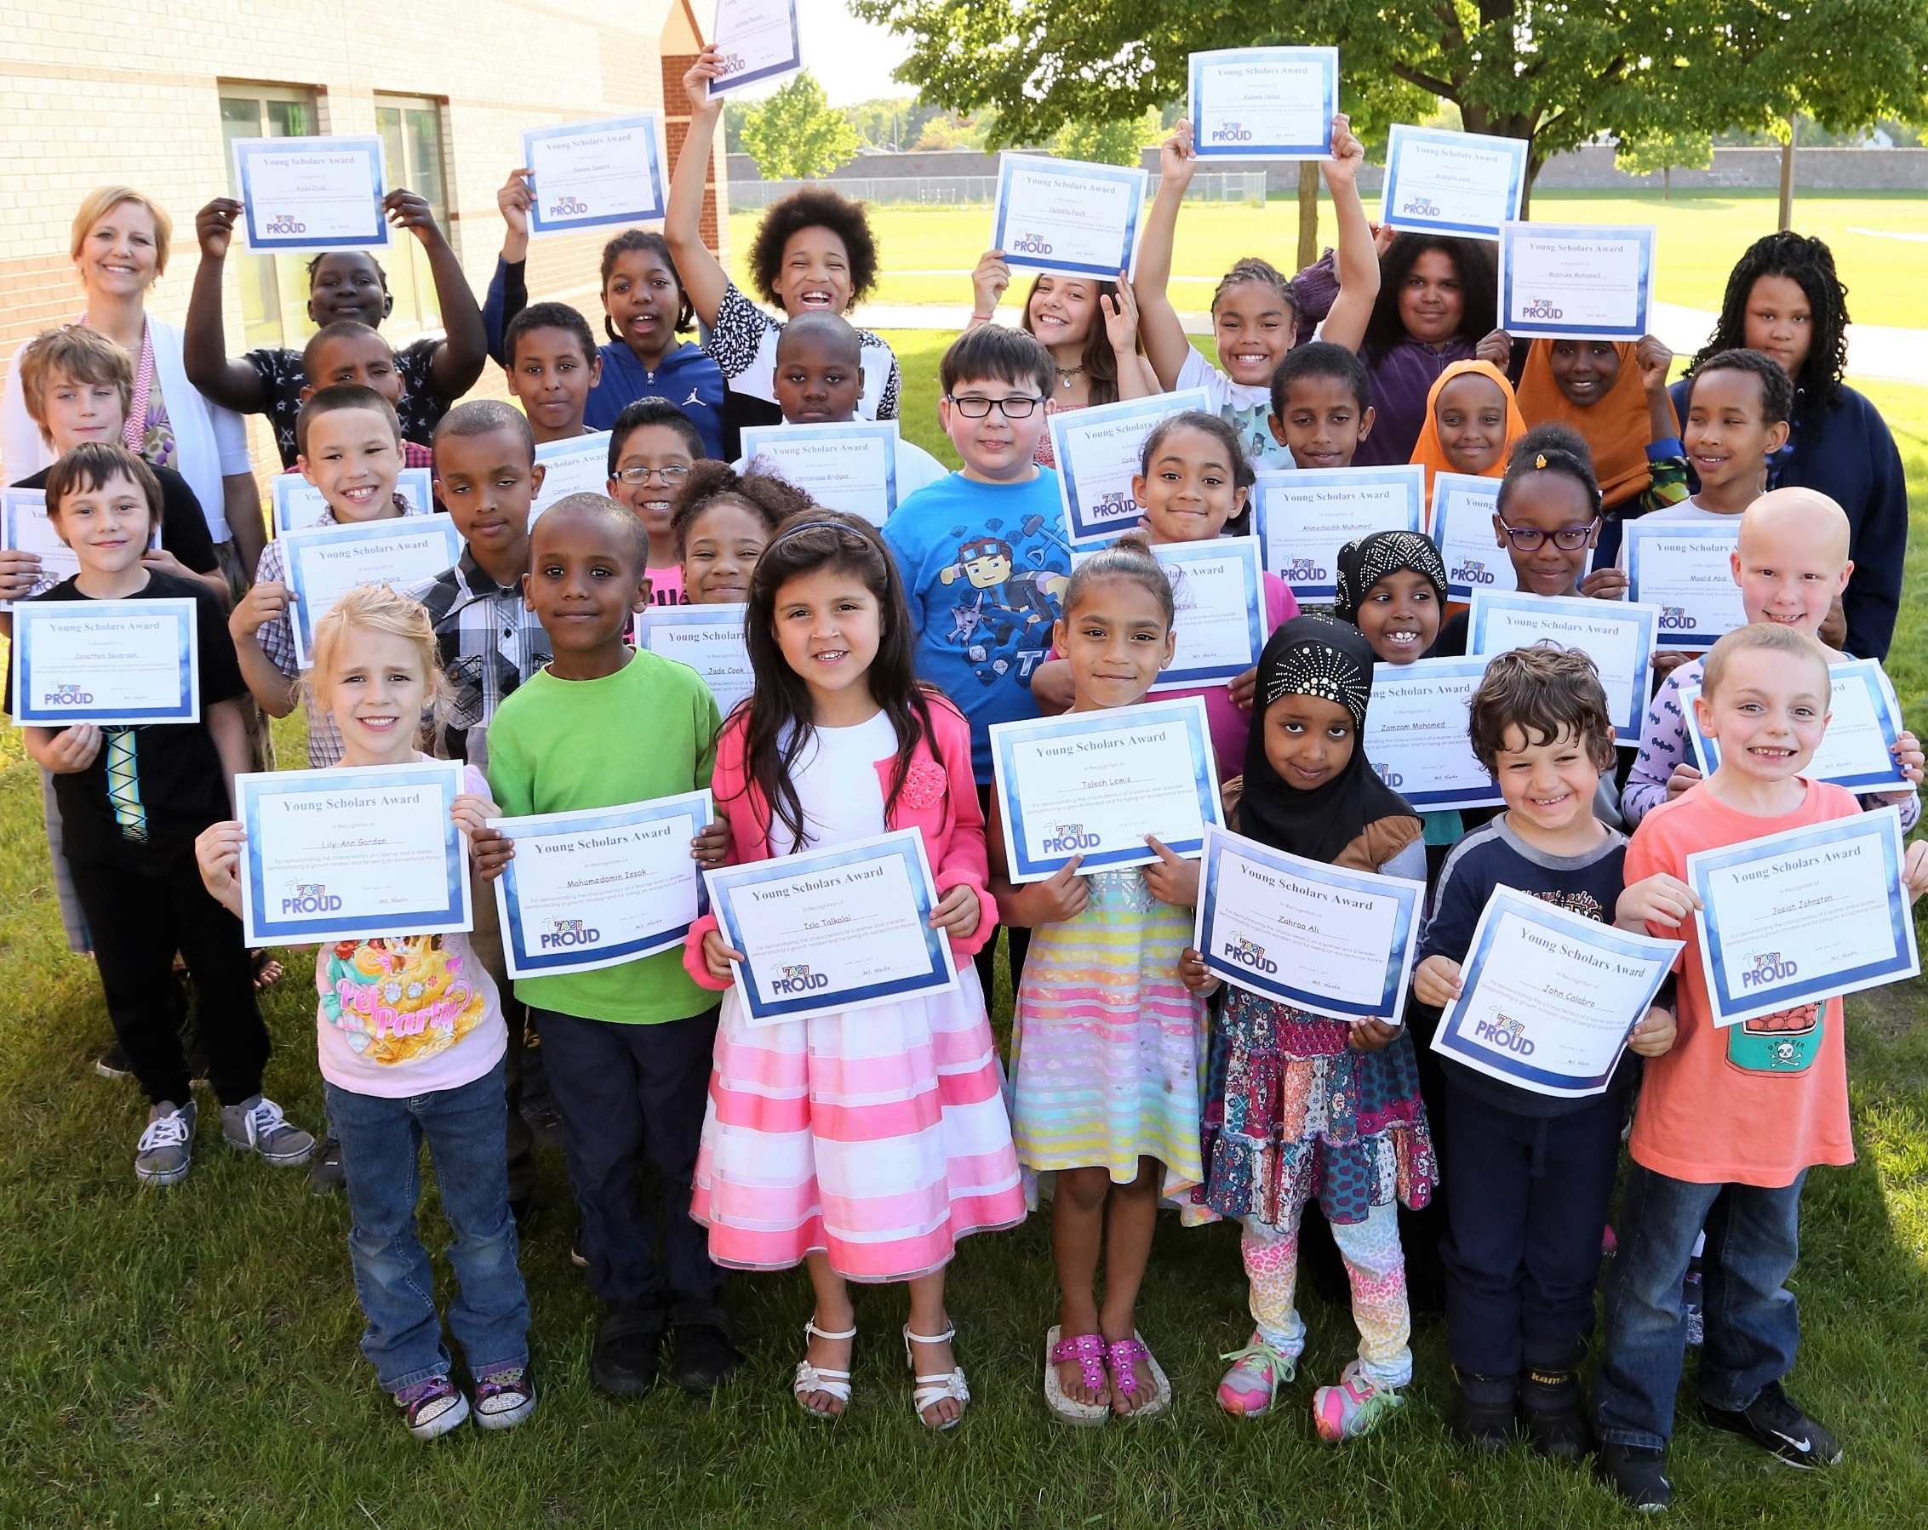
Tackling the Opportunity Gaps Programs
Talent Development Accelerated Service (TDAS) Young Scholars

Slide 12
Tackling the Opportunity Gaps Programs
2018 Young Scholars Data
33% of students increased a proficiency level on Reading MCA
58.5% of YS are proficient in reading
68% of Young Scholars are growing as much or more than national peers in math

Slide 13
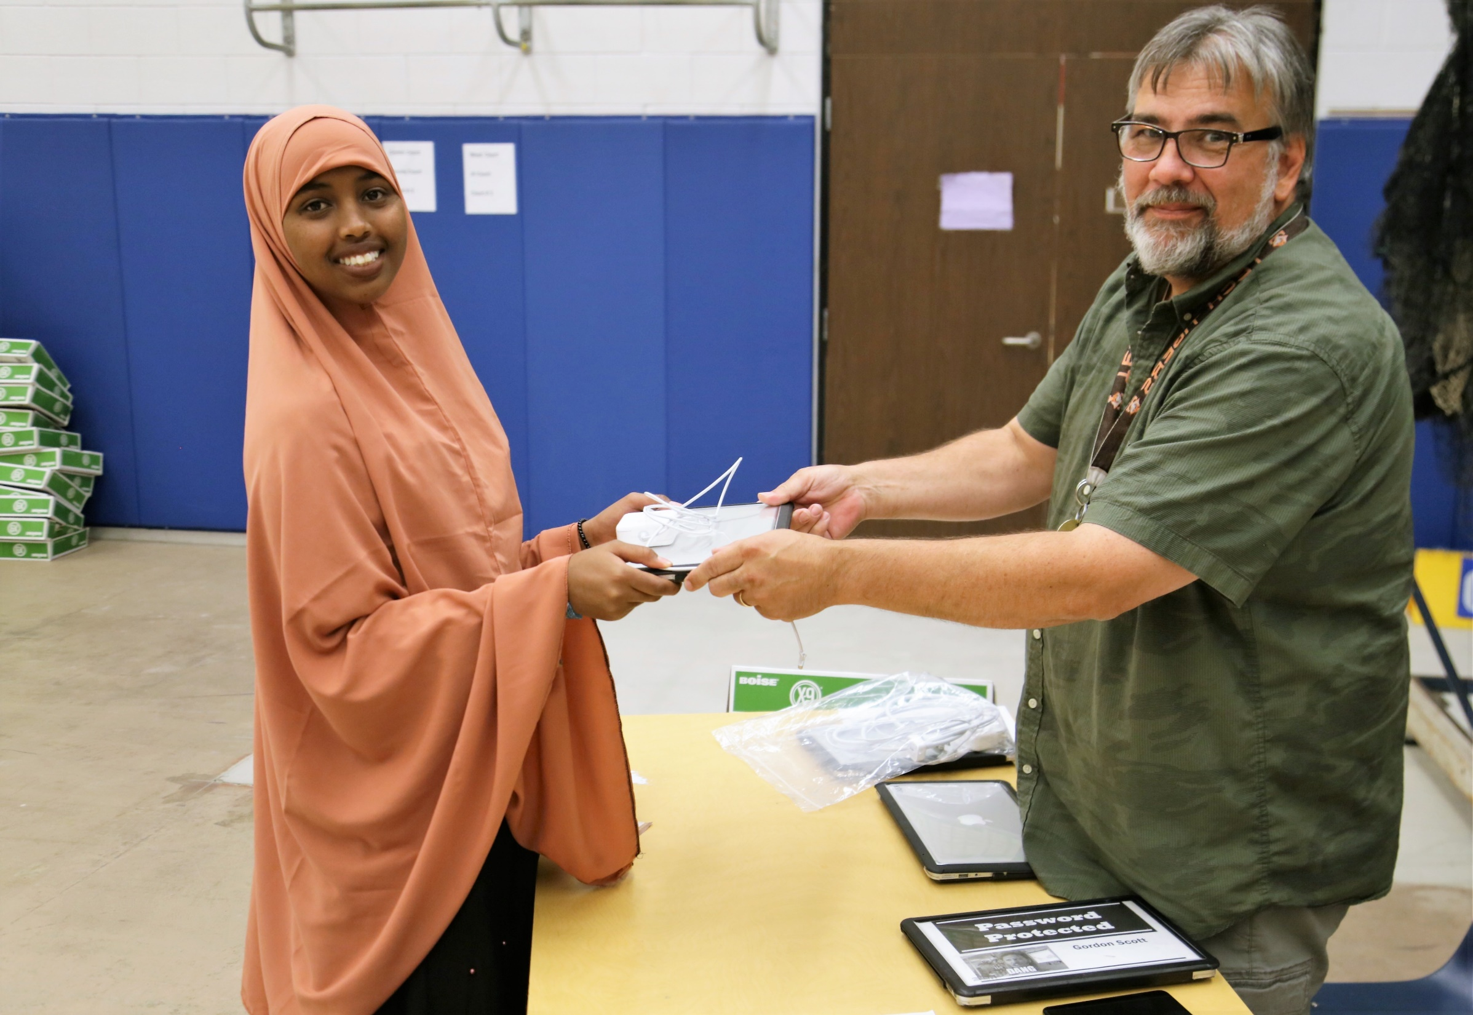
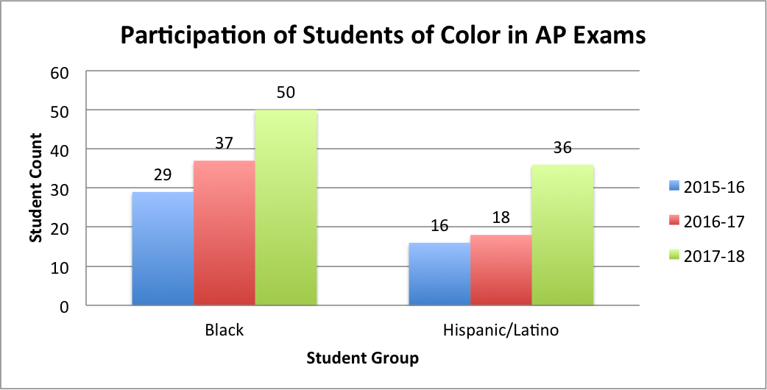
Tackling the Opportunity Gaps Programs
AP

Slide 14
Tackling the Opportunity Gaps Programs
1:1 Devices at Middle & High Schools
Hotspots

Slide 15
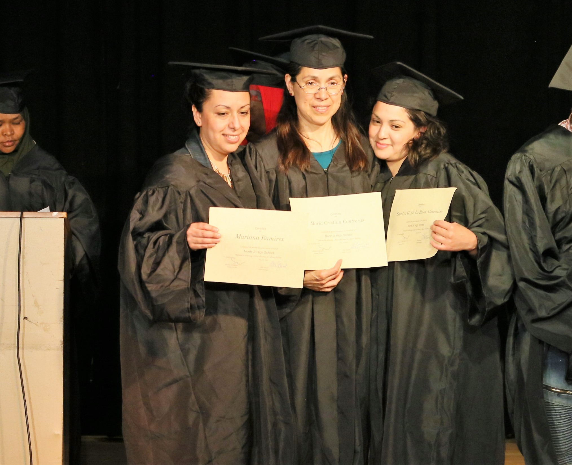
Tackling the Opportunity Gaps Amplifying Parent & Student Voice
Community Cafes
Parents in Action
Fall Amplify Student Voice Event (High Schools)

Slide 16
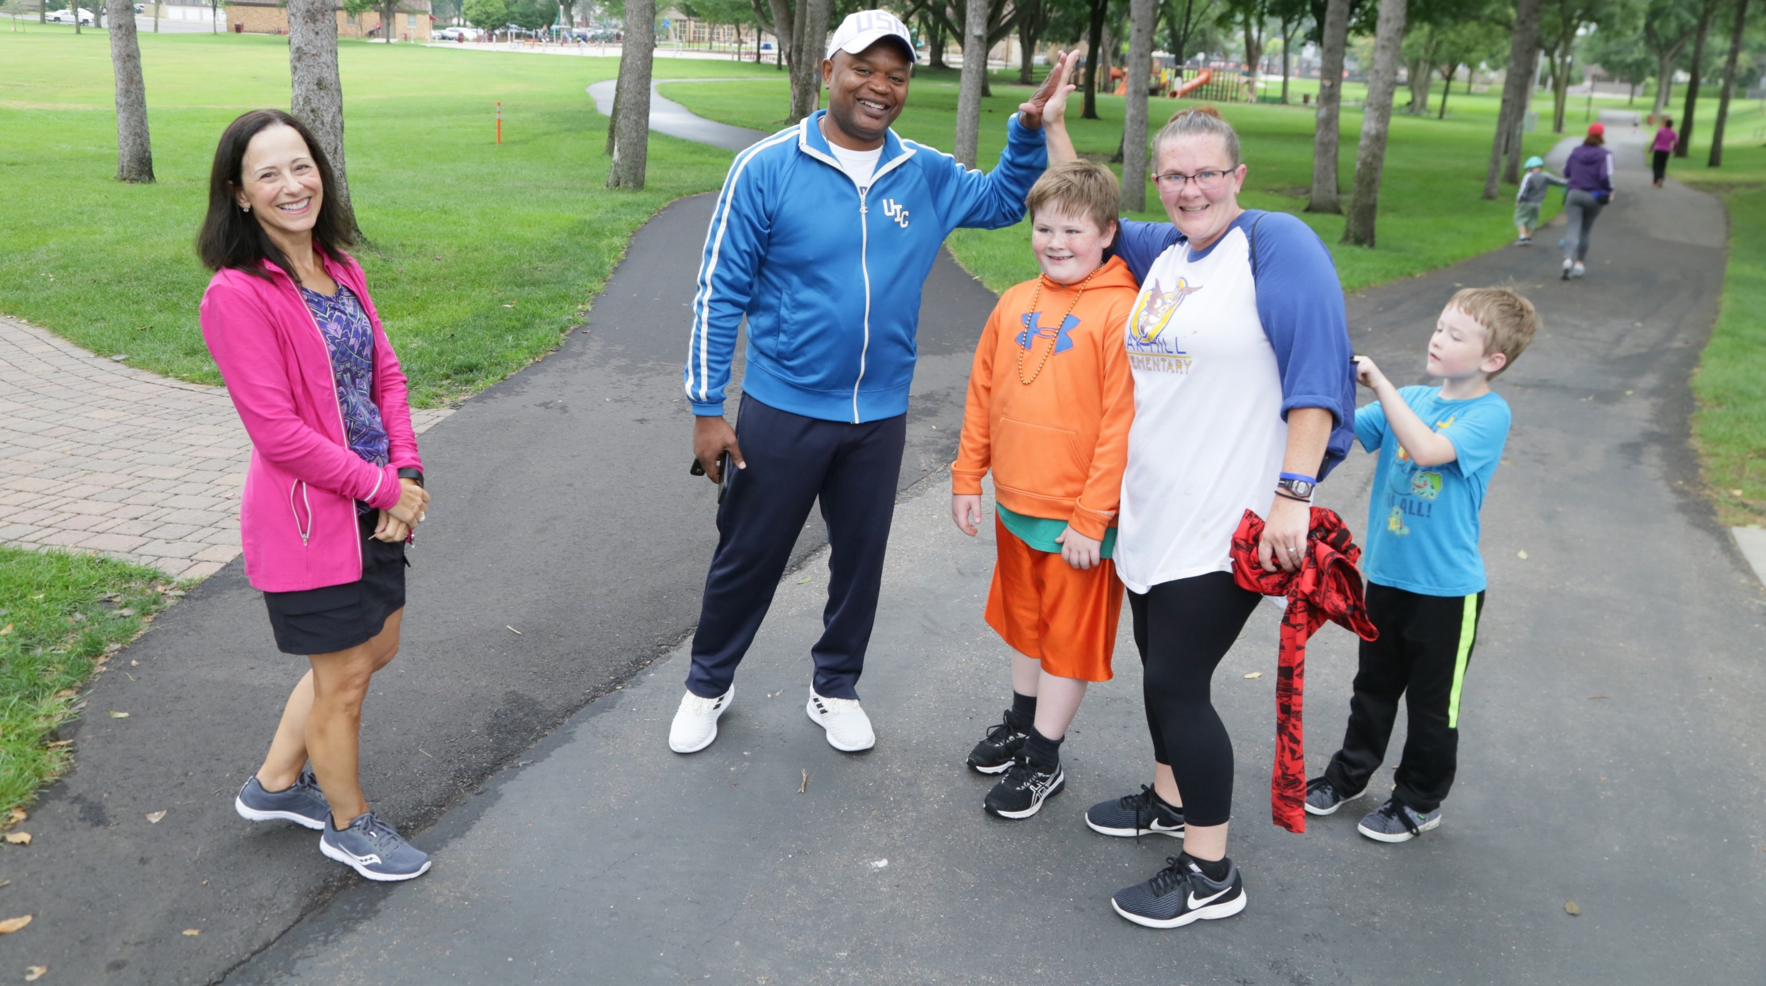
Tackling the Opportunity Gaps Amplifying Parent & Student Voice
Annual Fun Run & Resource Fair
Rock the Mic Event
School Equity Teams

Slide 17
Dr. Marsha Baisch, Assistant Superintendent
Dr. Sylvia Huff, Director of Research, Evaluation, & Assessment

