Slide 1
Emerging Farmers
Assistant Commissioner Patrice Bailey
Ariel Kagan, Ag Marketing & Development
2/13/2020

Slide 2
Background
"Minnesota agriculture is made stronger by our diversity. I'm excited to see farmers from every community engage in an industry that is foundational to our state's culture and economy. We know that farmers face unique challenges when it comes to weather and commodity prices, and these barriers can prevent new or potential farmers from entering the field, especially those from underrepresented communities. As we build the agricultural industry of the future, it's critical that all voices and ideas are at the table, and I commend the Minnesota Department of Agriculture for starting this conversation." - Lt. Governor Peggy Flanagan
Race | Percent of Minnesota Population | Percent of Minnesota Farmers
African-American/Black | 6.80% | 0.03%
American Indian/Alaska Native | 1.40% | 0.16%
Asian | 5.10% | 0.36%
Hispanic/Latino | 5.50% | 0.58%
Multiracial | 2.50% | 0.26%
Native Hawaiian/Pacific Islander | 0.10% | 0.02%
White | 84.10% | 99.16%

Slide 3
Process
Date | Location | Attendees
September 3, 2019 | St. Paul | 44
November 8, 2019 | Crookston | 8
November 12, 2019 | Marshall | 13
November 14, 2019 | Duluth | 19
December 4, 2019 | St. Cloud | 21
December 11, 2019 | Rochester | 39
Six listening sessions around the state, with over 200 responses in person and online
Collective brainstorming process

Slide 4
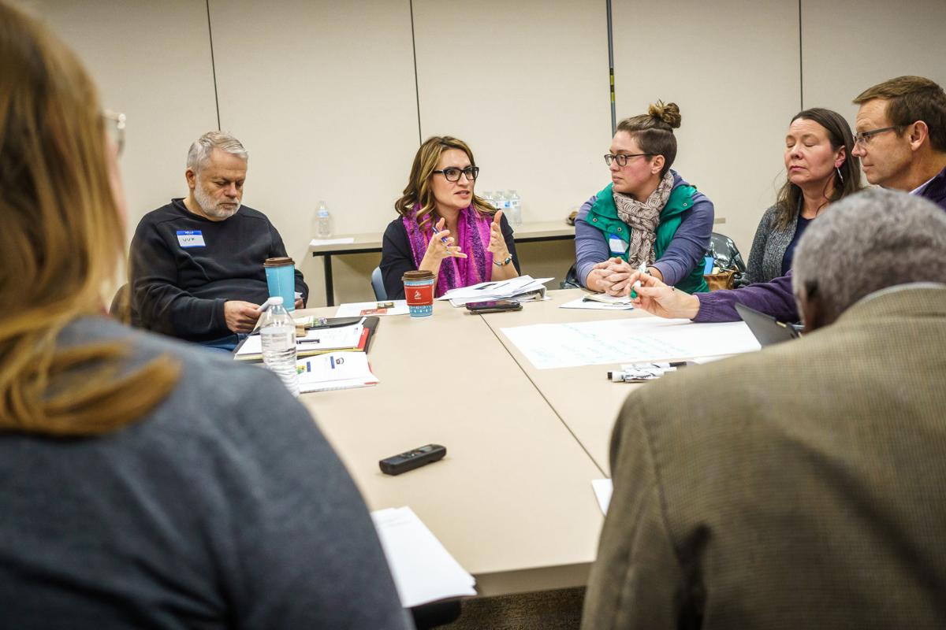
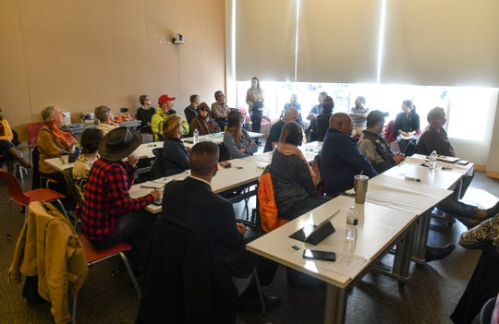
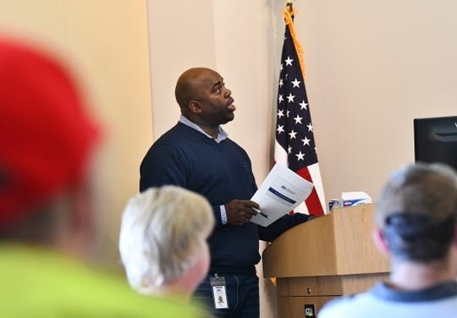

Slide 5
Scope
The Emerging Farmers Working Group was initiated by a legislative request (40.1, Sec 21), “No later than February 1, 2020, the commissioner of agriculture must report recommendations to the legislative committees and divisions with jurisdiction over agriculture finance regarding how best to cultivate and support emerging farmers, with priority given to emerging farmers who are women, veterans, persons with disabilities, American Indian or Alaskan Native, and members of communities of color.”
Identity | Practices | Values
Young Unrelated to a farmer/ no inherited land Limited capital Tech savvy Urban/suburban based Queer/LGBTQ+ | Vegetables Regenerative/sustainable practices Moving toward another kind of production Direct marketing Urban agriculture Indigenous and culturally relevant crops Specialty crops Indoor agriculture | Passionate about farming Care for the land Change the system for the better Solutions based Food sovereignty & food justice based
Selected answers to the question, “Who is an Emerging Farmer” from the Listening Sessions

Slide 6
Themes
*Land availability and prices
*Financial barriers
*Market access and infrastructure
*Education/training resources
*Discrimination/racism/sexism
Health insurance/rural healthcare
Available resources serve larger-scale agriculture
Broadband availability
Climate change
Culturally appropriate resources
Navigating regulations

Slide 7
Selected Recommendations
Establish an emerging farmers task force that can provide guidance on the development of programs and initiatives.
Increase the agricultural microloan program from $10,000 to $20,000
Implement advance payment options for grant funding modeled after the USDA NRCS advance payment program.
Incentivize translation of resources to farm service providers, including state agencies.

Slide 8
What we heard
“As an emerging farmer I’ve struggled to find farmland that I can afford near the markets I hope to sell to.”
“If your family won’t have healthcare where you want to start a farm, you might start elsewhere.”
“[There is] difficulty finding part-time childcare in rural areas.”
“Government has a role here as well in helping rebuild the infrastructure that used to support local.”
“It is difficult to know where to start when you are a beginning farmer and who you can trust to work with you.”
“Regarding climate change, my production field has flooded four times in three years.”
“More meat inspectors/make it easier for meat plants to work with inspectors, and encourage new plants to open in outstate Minnesota – animals raised here are rarely sold and eaten here – this is a drain of resources.”

Slide 9
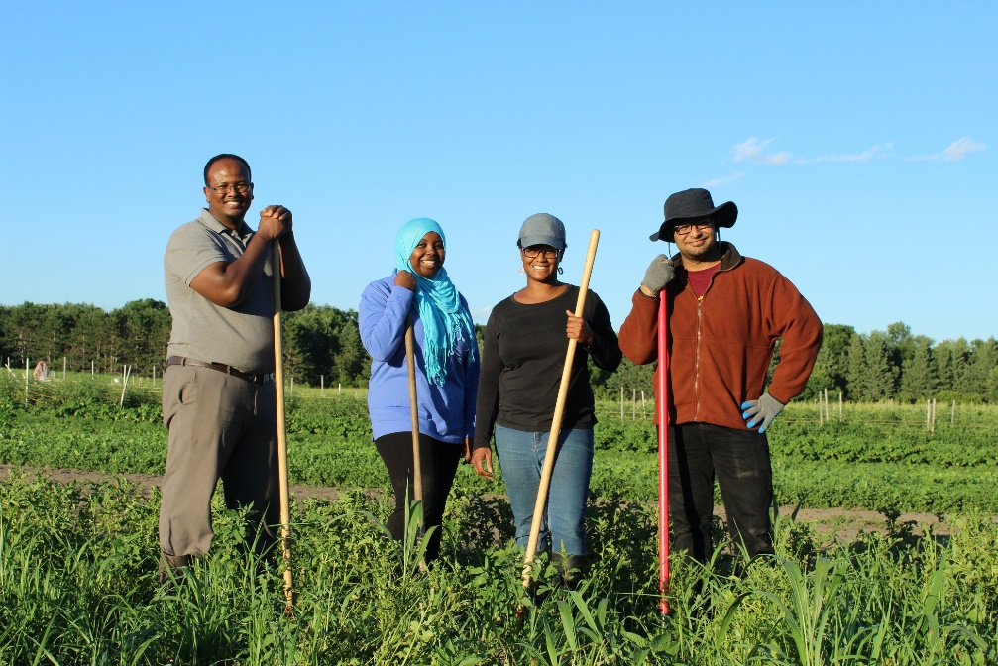
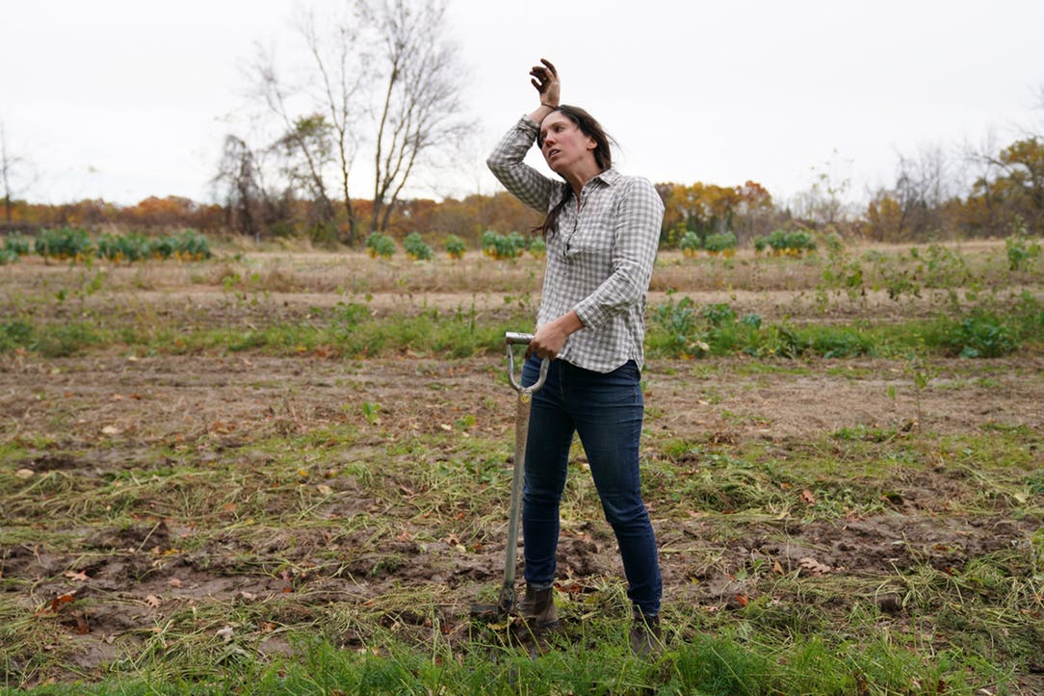
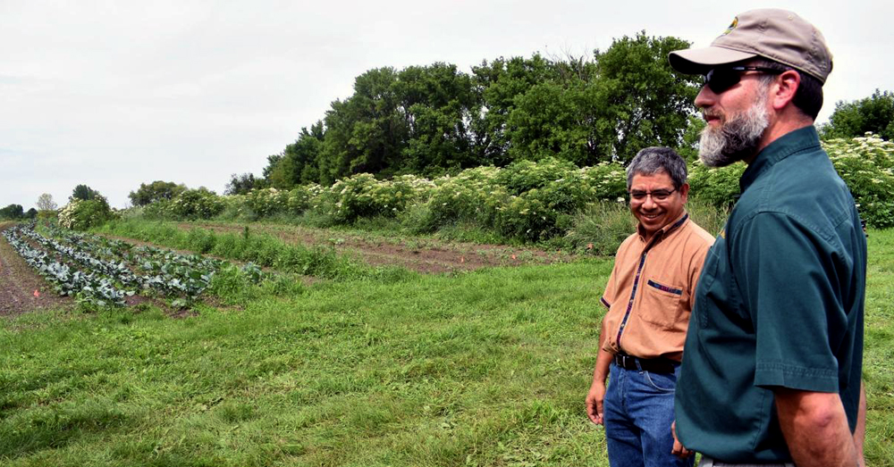
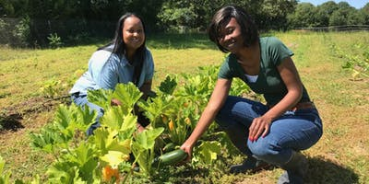
Voice of Emerging Farmers

Slide 10
Thank you!

