Slide 1
Climate Change and Natural Resources
Lee E. Frelich, Center for Forest Ecology
January 23, 2019

Slide 2
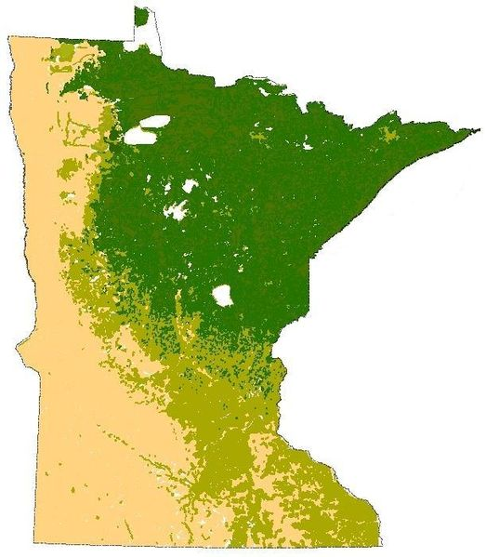
Minnesota at the crossroads;
Maple, spruce, or grassland?
Biomes of Minnesota:
Dark green, boreal conifers with birch and aspen
Light green, deciduous oak and maple
Yellow: grassland
Notes:
Minnesota is in one of the two places on the planet where boreal forest, temperate forest and grasslands come together in an interior continental setting. While this makes Minnesota an extremely interesting place, it also makes it vulnerable to changing climate.

Slide 3

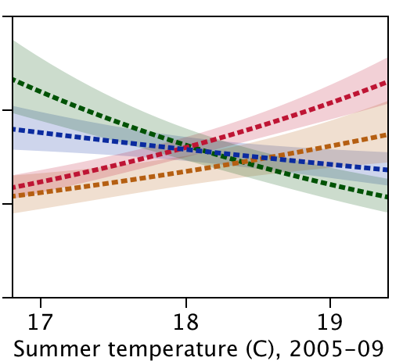

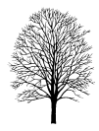

Mean summer temperature determines the balance between temperate and boreal forest
balsam fir
red maple
Height growth in./year
2 4 6
sugar maple
white
spruce
63 64 65 66
Summer temperature (°F)
Notes:
After Fisichelli, Frelich and Reich. (2012) Global Change Biology 18: 3455-3463. There is a tipping point in mean summer temperature between 64 and 65 degrees mean summer temperature. At cooler temperatures boreal trees like spruce and fir outgrow temperate trees like maple and oak, while the reverse occurs at warmer temperatures. A shift to summer temperatures above 66 F could eliminate boreal tree species.

Slide 4
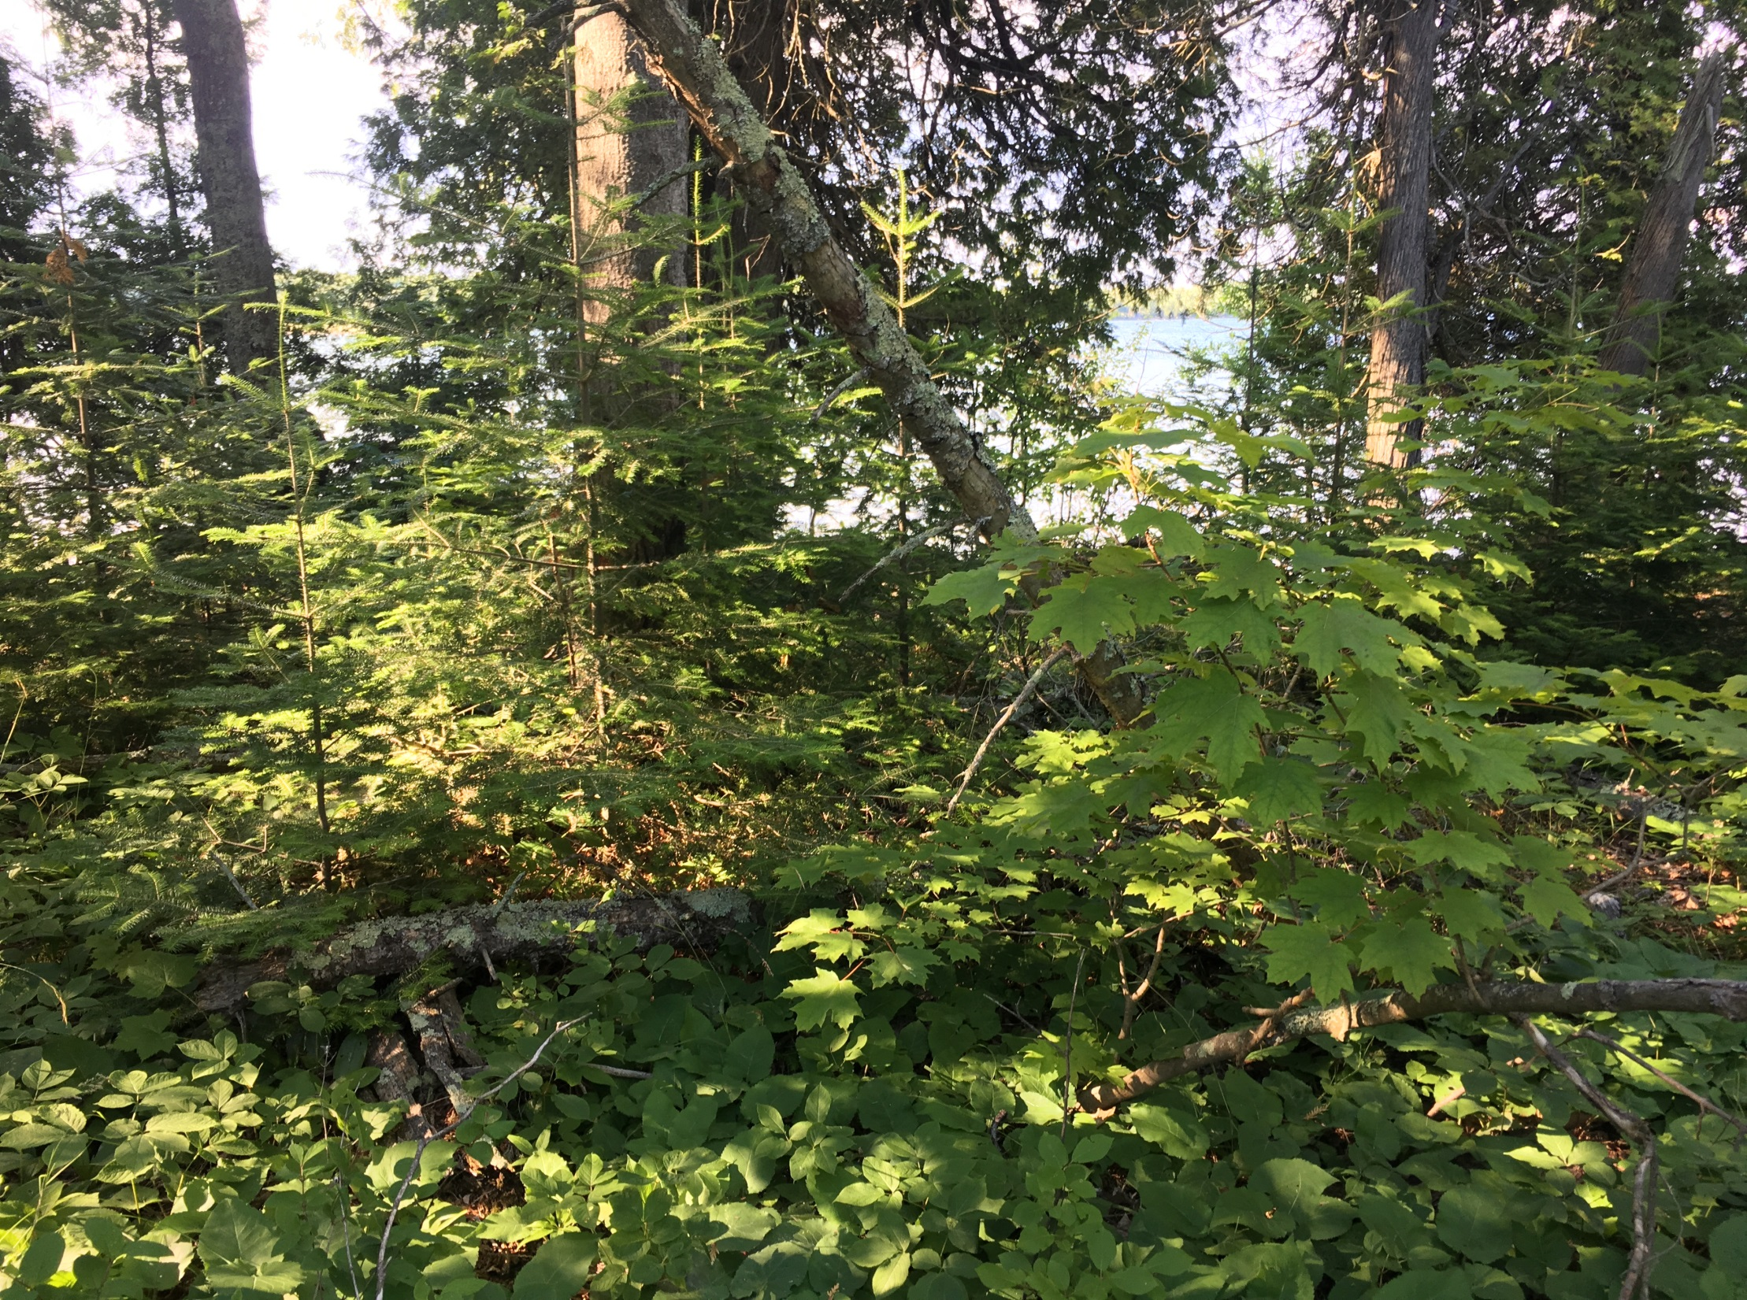
Sugar maple in a balsam fir
forest, summer 2016
Notes:
Photo by Lee Frelich. There was no balsam fir in this forest in 1980. Widespread invasion of boreal forests by temperate forest tree species is already occurring with the warming that has already occurred.

Slide 5
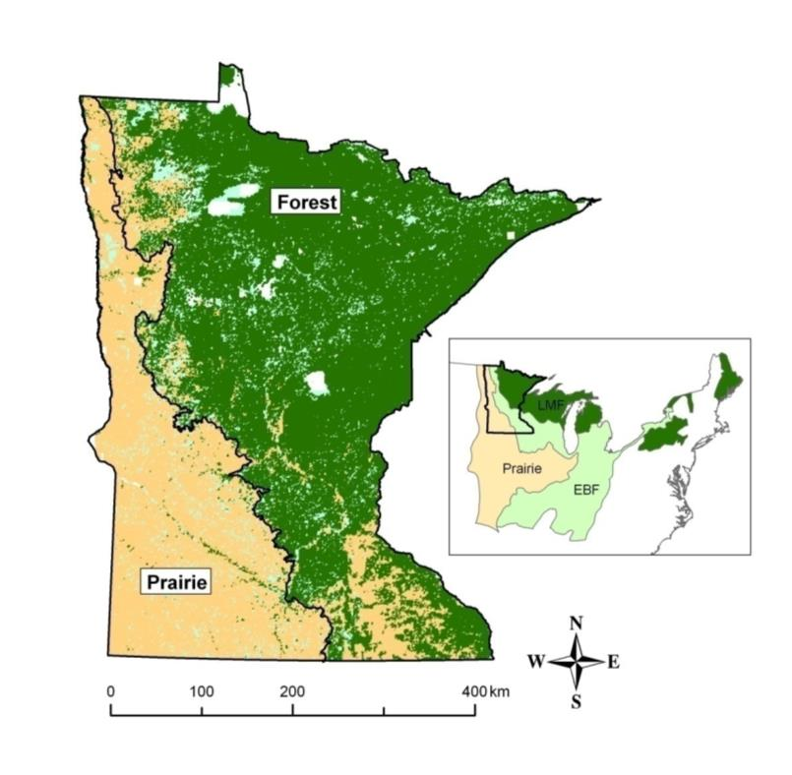
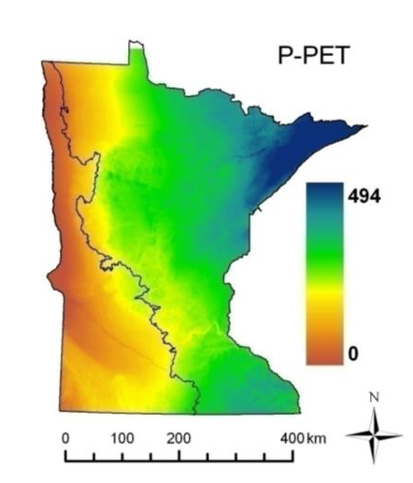
Location of the prairie-forest border in Minnesota depends
on the balance between precipitation and evaporation
Notes:
Where there is excess precipitation over evaporation (blue and green areas), forests occur, while grasslands occur in areas with negative water balance (brown).
From: Danz, Reich, Frelich and Niemi, 2011, Ecography 34: 402-414;
Danz, Frelich, Reich and Niemi, 2013, Journal of Vegetation Science, 24: 1129-1140

Slide 6
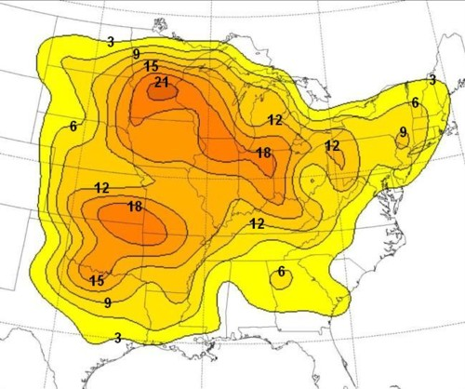
There is a 7-fold increase in
severe straightline wind events
from the boreal forest to southern
Minnesota
Notes:
Map from R.H. Johns and J.S. Evans: www.spc.noaa.gov/misc/AbtDerechos

Slide 7
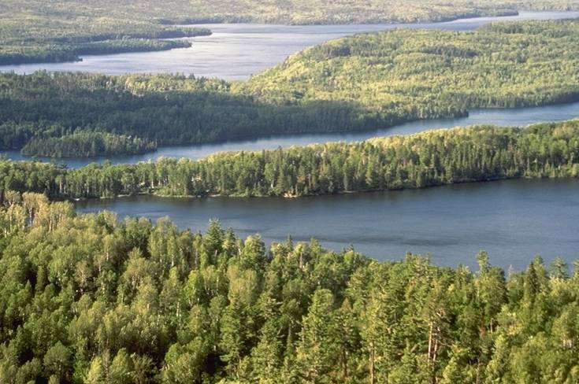
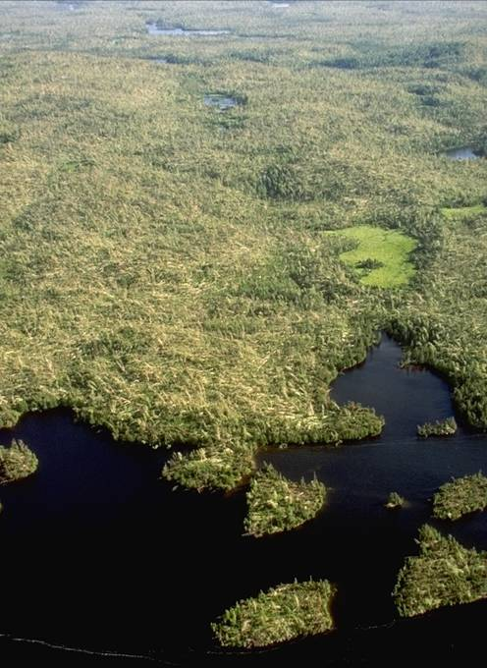
Before and after the 1999 ‘big blowdown’
in the Boundary Waters
Notes:
Seedlings on the forest floor released to grow when the big trees blew down were mostly boreal species in 1999.
Photos: Minneapolis Star Tribune

Slide 8
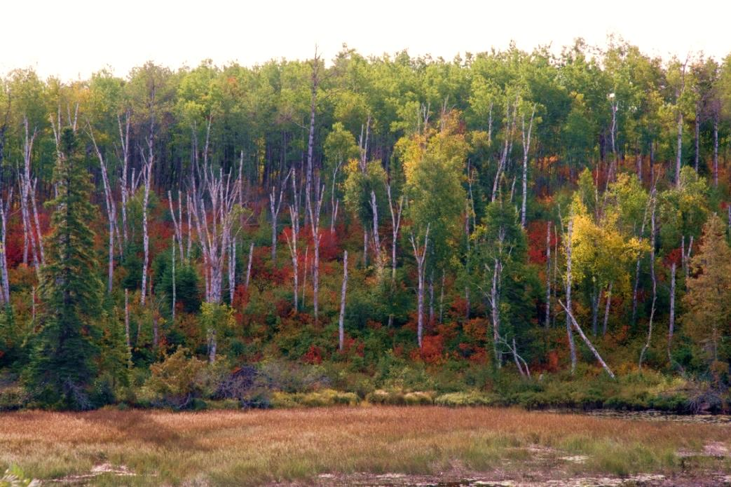
Understory invasion by temperate saplings followed by wind =
Instant conversion from boreal to temperate forest
Notes:
Note the red maple seedlings in the understory of the boreal forest in this autumn photograph. Photo by Dave Hansen, University of MN

Slide 9
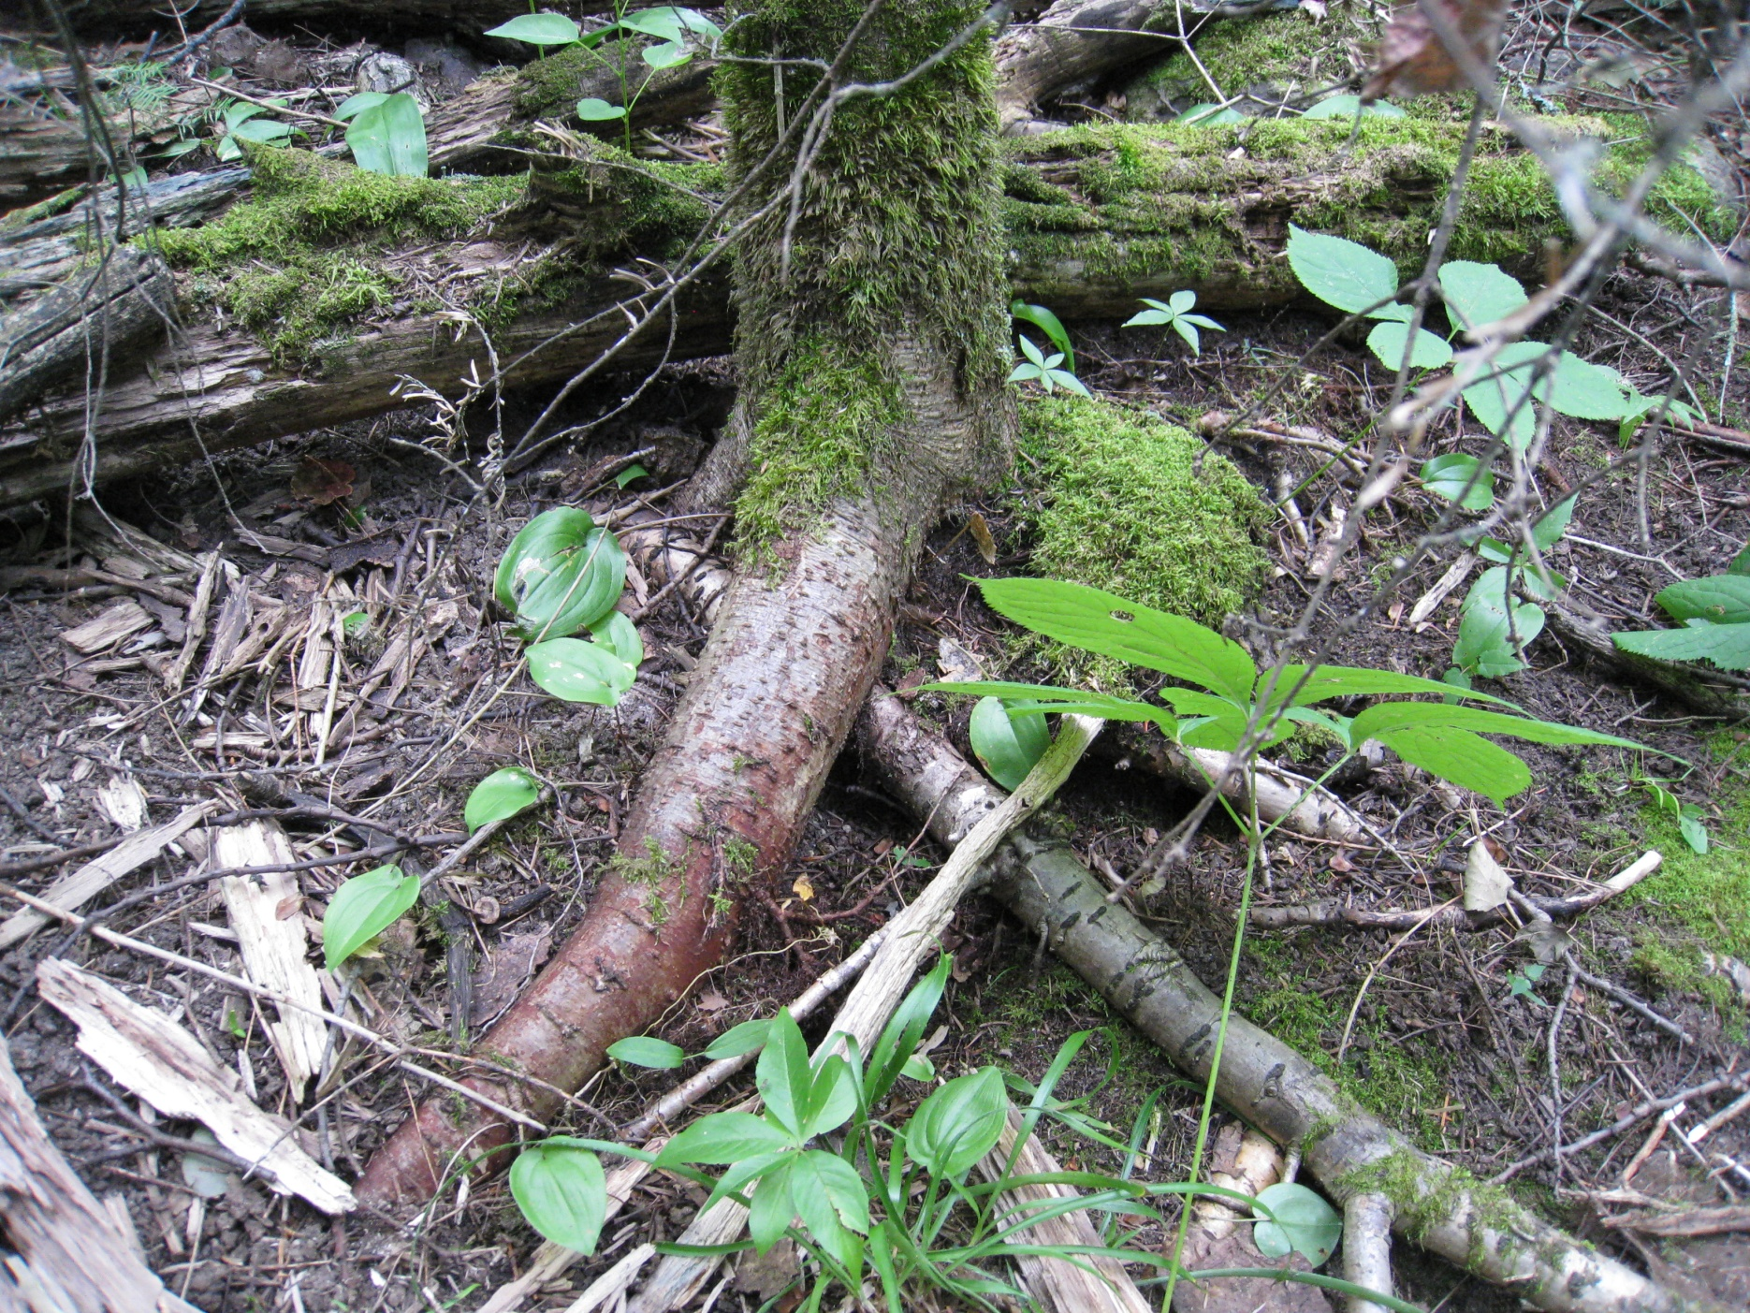
Exposed roots of
balsam fir, late-stage
of earthworm invasion
in the BWCAW.
Notes:
Earthworms eat the leaf-litter layer which would otherwise insulate the soil, keeping it cool during the summer. Earthworm invasion by itself can raise soil temperatures, an effect that will add to the warming caused by climate change. Photo: Doug Wallace, July 2011

Slide 10
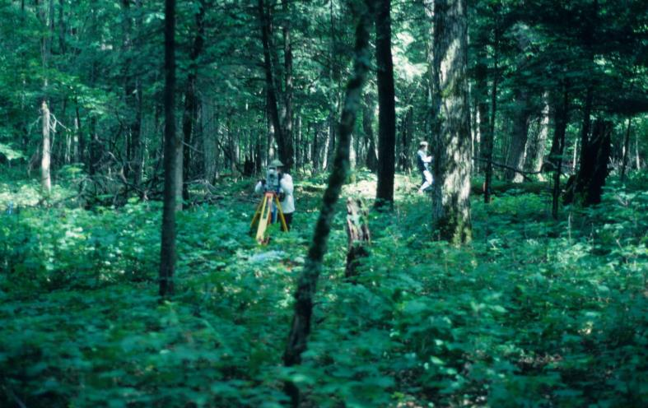
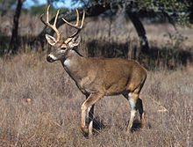
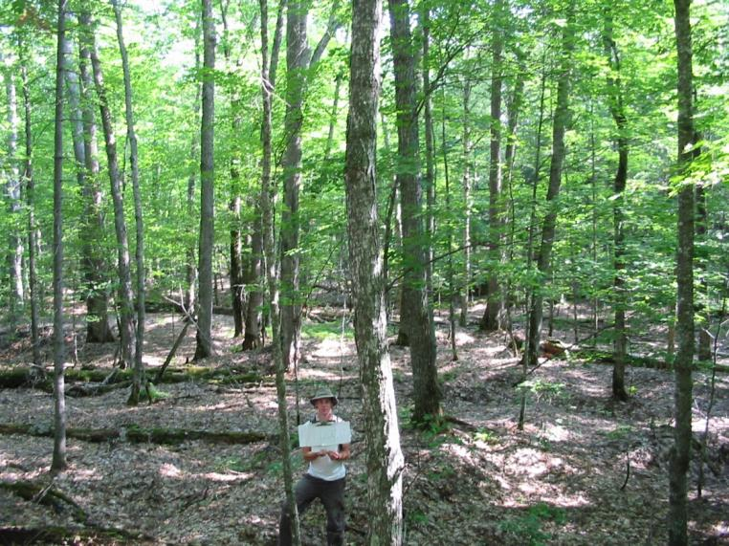
1990
2006
Deer and drought causing
failure of tree regeneration in the understory, Sylvania Wilderness from 1990 to 2006
Notes:
Deer populations can destroy regeneration of certain species of trees, and they will become more abundant in northern MN with warmer winters.
From Salk et al. 2011, Forest Ecology and Management

Slide 11
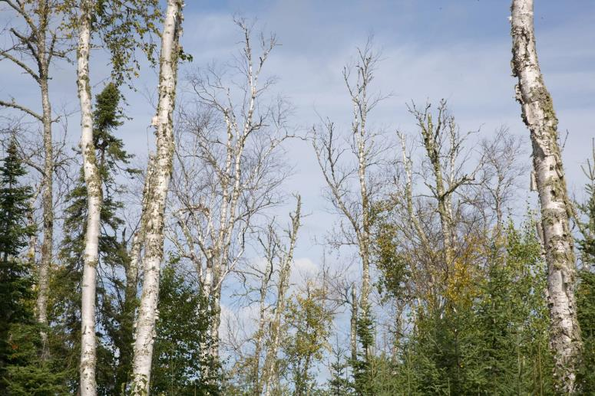
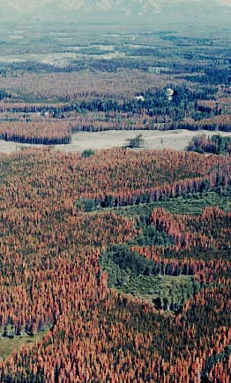
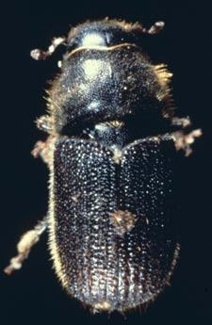
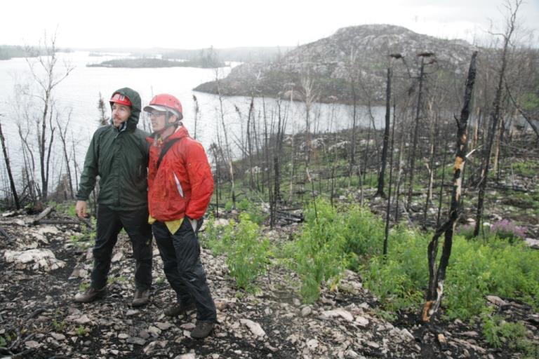
Drought, insect infestation,
wind and fire will accompany
climate change
Notes:
A variety of factors affecting forests will also change when the climate changes. More droughts and fires will occur and a number of insect pests currently limited by cold winter temperatures will be able to increase the extent of infested forests, including mountain pine beetle and emerald ash borer. Photos on left: Photos above and below: Dave Hansen, UMN

Slide 12
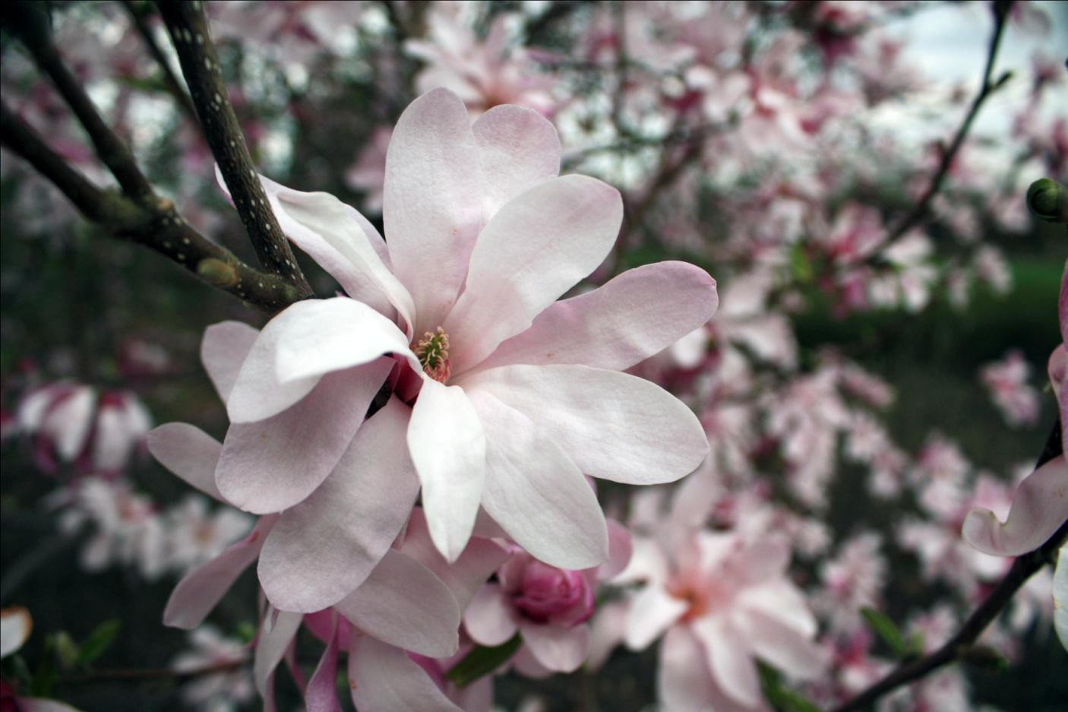
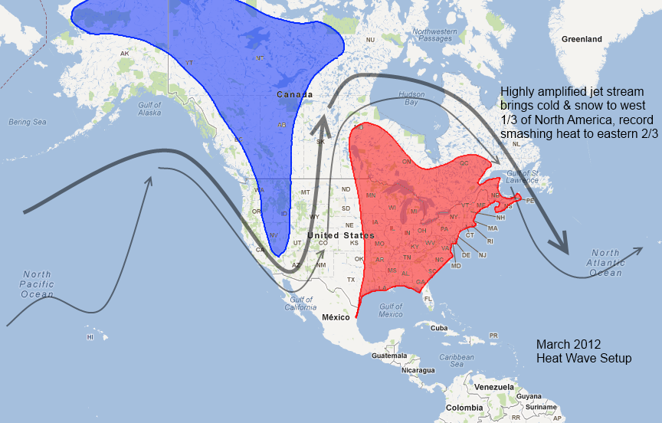
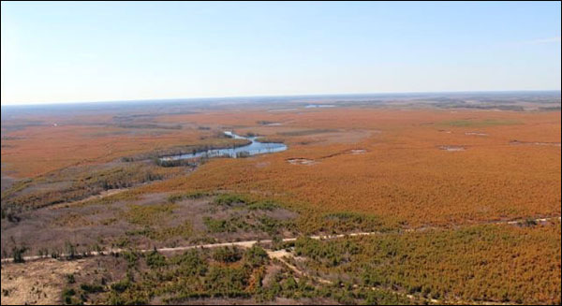
March 2012, extreme early spring, with temperatures
equal to an average spring by 2090
Magnolia in bloom,
St.Paul MN, March 27,
2012.
Winter browning of spruce
in Ontario, May 2012.
Notes:
Early springs in a warmer climate are good for grasslands and temperate forests, but will kill boreal forests. Upper Photo, Jenna Williams. Lower photo, Ontario
Ministry of Natural Resources.

Slide 13
Multiple drivers of change
on the prairie-forest border
Notes:
Diagram from Frelich and Reich, Frontiers in Ecology and the Environment, 2010. The blue ovals represent 6 factors changed by climate that will affect forests at least as much as direct impacts of rising temperature.

Slide 14
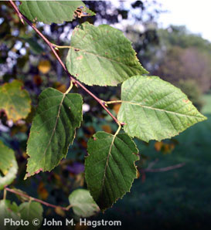
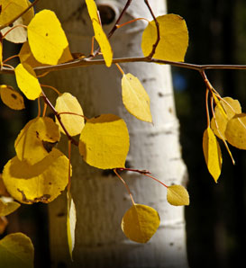
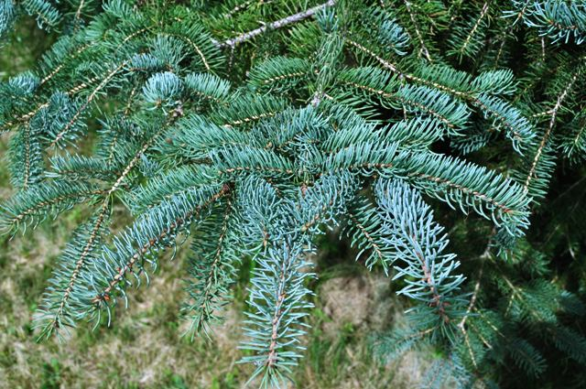
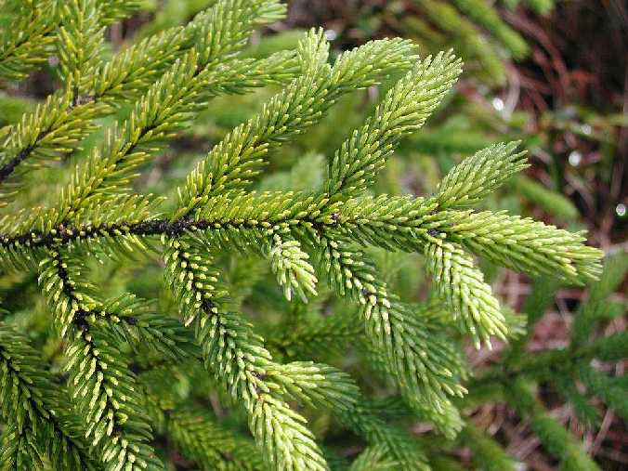
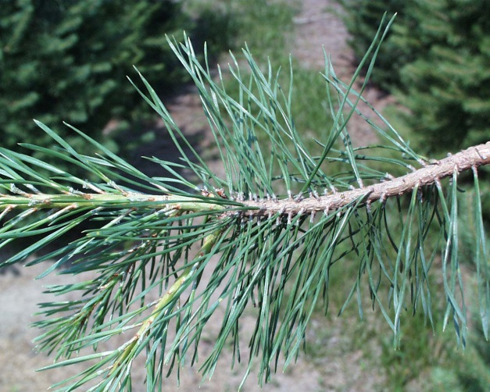
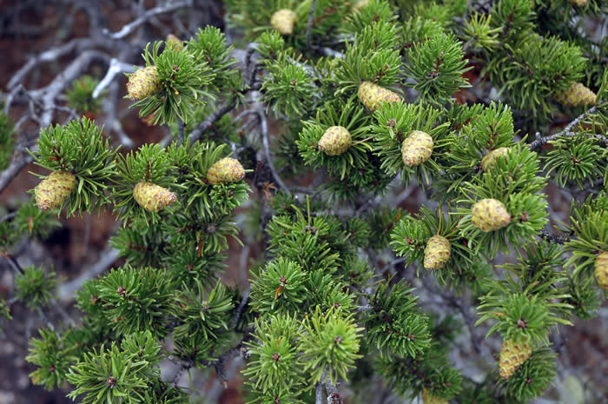
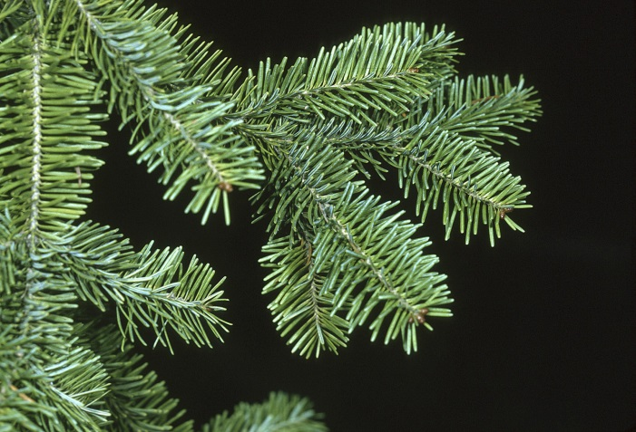
Boreal species: black spruce, white spruce, balsam fir, jack pine, red pine, quaking aspen and paper birch
Notes:
These are the most common species in northern MN today, but also the species most likely to be lost from MN in the future.

Slide 15
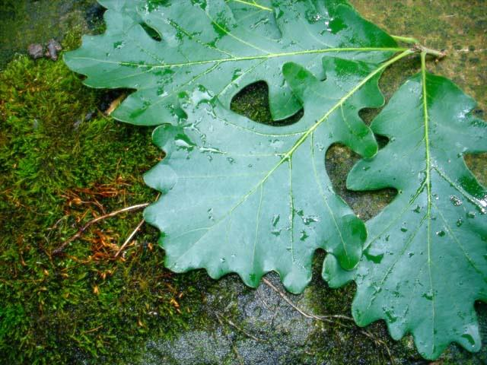
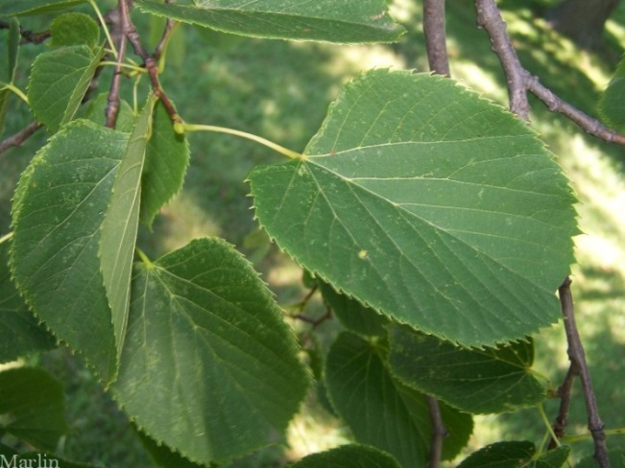
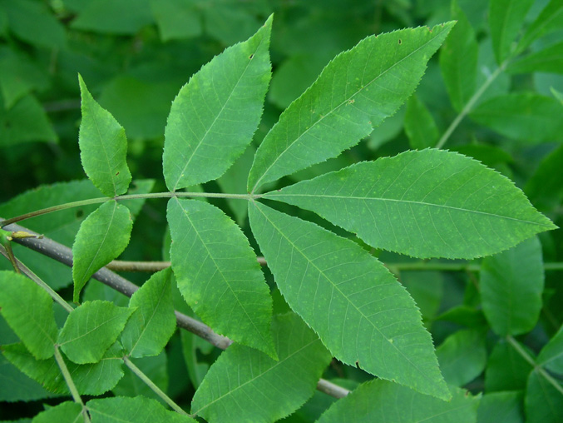
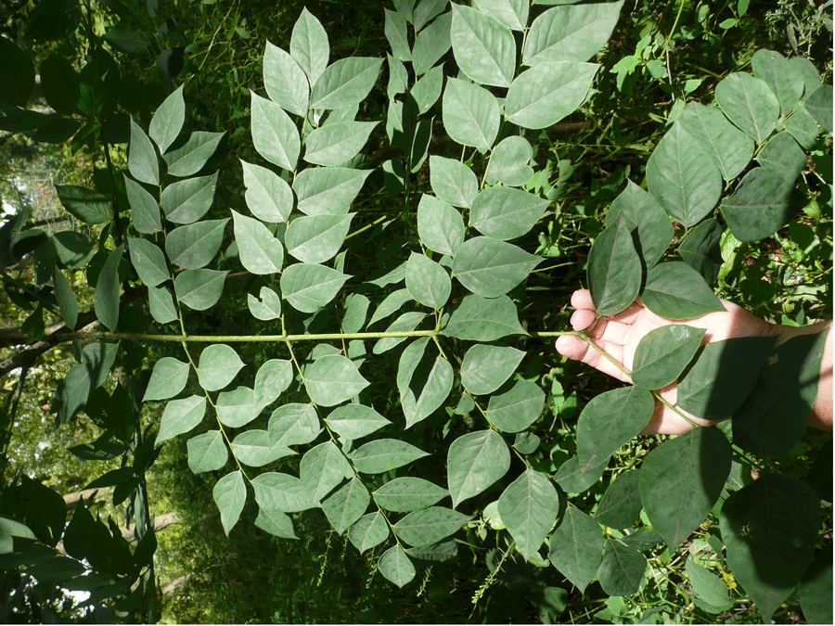
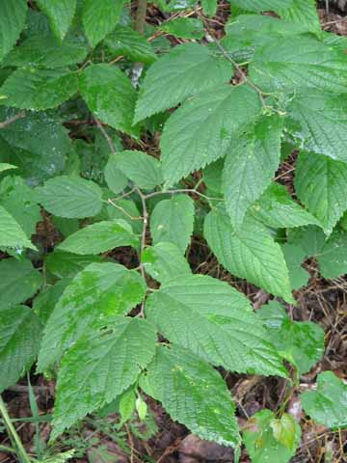
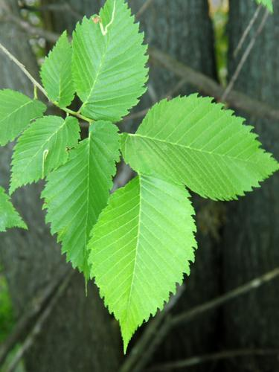
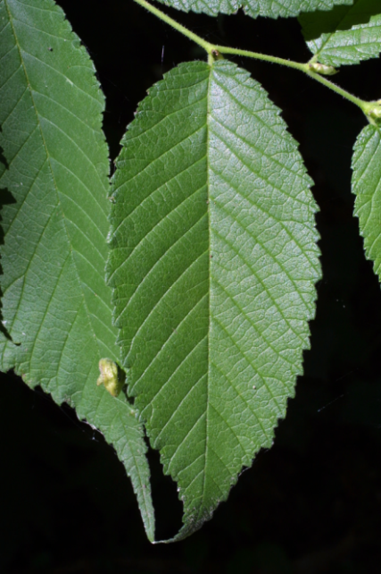
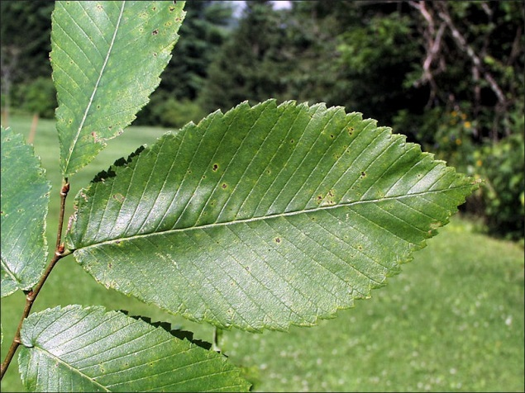
Temperate species: elms, bur oak,
basswood, bitternut hickory, hackberry and Kentucky coffee tree
Notes:
These are tree species most likely to replace boreal tree species in northern MN (in places that will support tree growth). Growth of new forests will lag behind the changing climate and likely take a few centuries to develop.

Slide 16
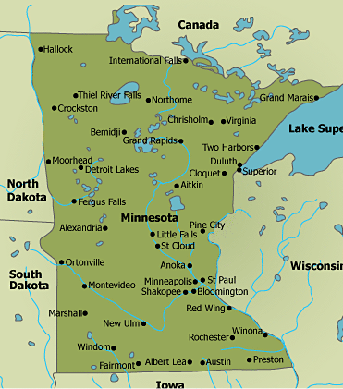
Climate analog:
Minnesota’s Boundary
Waters Canoe Area
Wilderness today (blue star) and analog climate by end of the 21st Century (orange star)

Slide 17
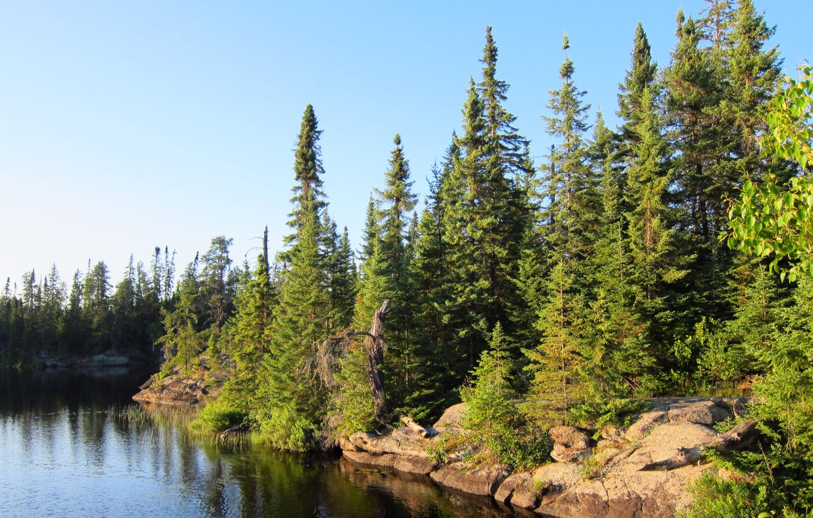
Boreal forest, Boundary Waters
Canoe Area Wilderness, MN
Notes:
Photo, Eli Anoszko. Typical boreal black spruce forest in the boundary waters of northern Minnesota

Slide 18
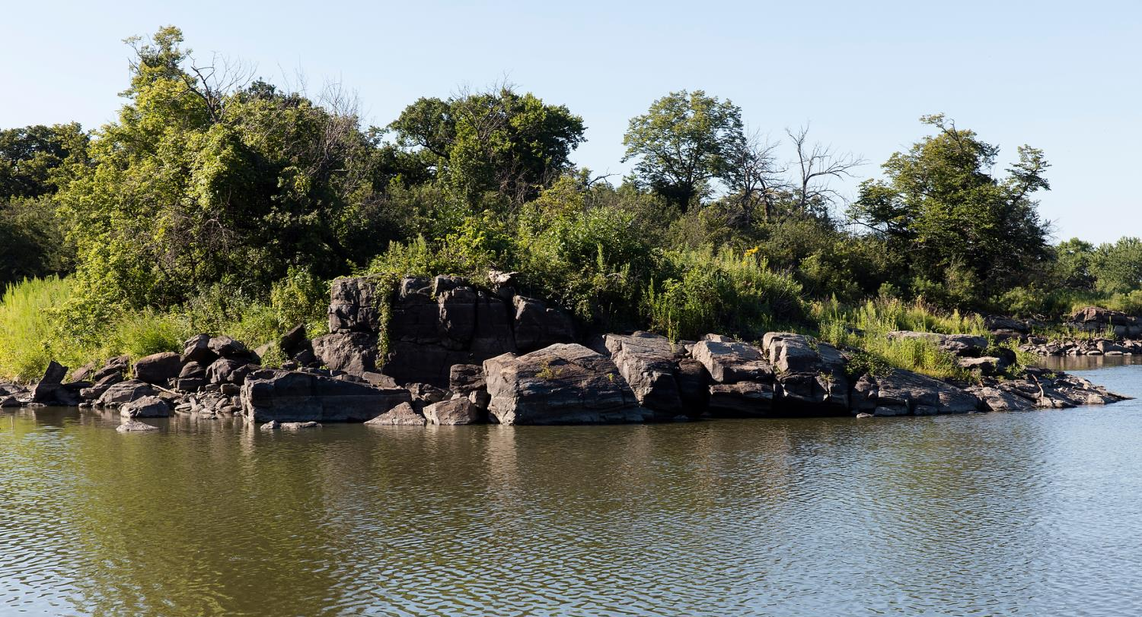
Analog for future of boreal forest in the BWCAW—lake and
rocky shore scenery, Gneiss Outcrops Natural Area
Notes:
Photo Dave Hansen, UMN. The natural area has savanna vegetation with mixtures of grasses and trees, near Granite Falls MN. This is a good analog for the future of the boundary waters because of the rocky terrain.

Slide 19
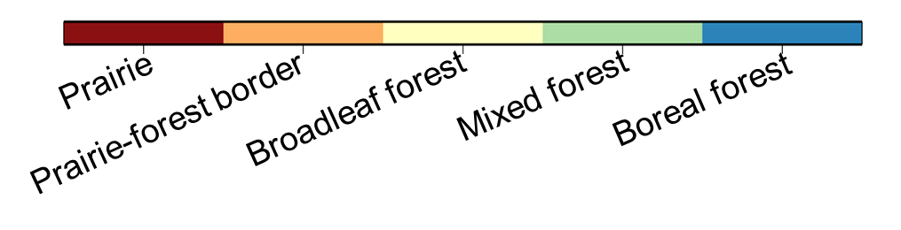
Future biome distribution in MN
depends on choices made now for
high or low CO₂ emission scenarios
Low
Future-2070
High
Current
Notes:
This is the result of new research on current and future biomes in the Western Great Lakes Region from the University of Minnesota Center for Forest Ecology
Lee E. Frelich (Director) and Ryan Toot (graduate student), with Peter B. Reich (Regents Professor), and Ethan Butler (post doc). Upper and lower future scenarios are based on the CCSM4 model and RCP 2.6 and 8.5, respectively. Funding from the National Park Service and a gift from Geri and Darby Nelson

Slide 20
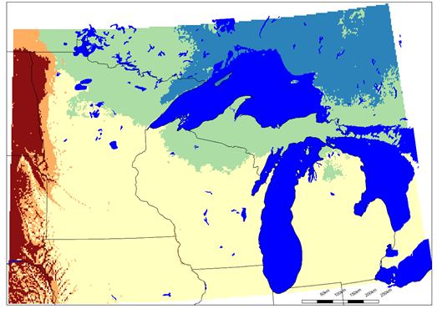
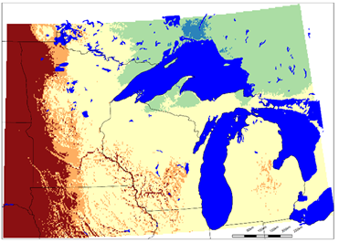
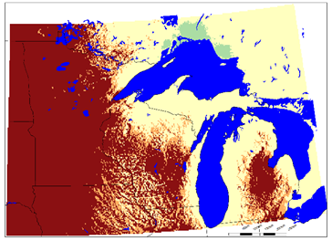
Range of possible scenarios by 2070
Low
Medium
Very High
Notes:
Examples of low, medium and high magnitudes of warming and effects on biomes. Low, ca 1.1 degrees C; Medium, ca 2.7 C, and high ca 6.7 C. Note that extent of prairie also depends on precipitation.

Slide 21
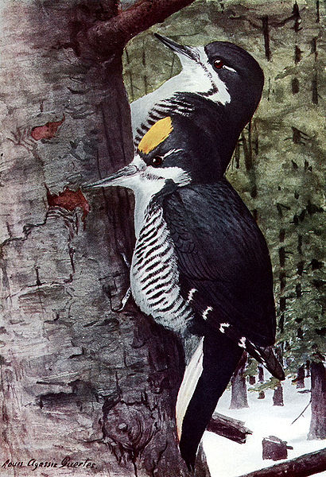
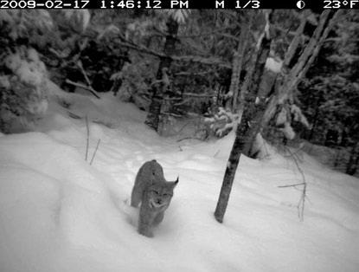
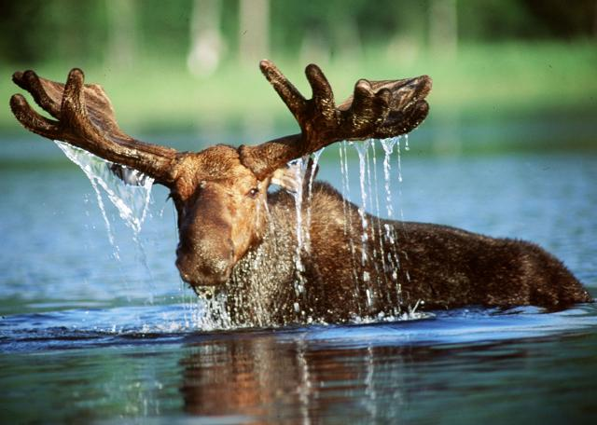
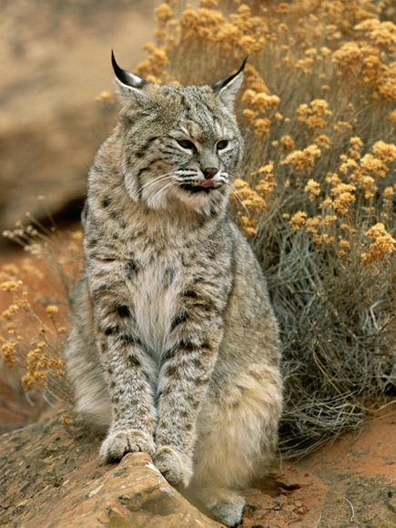
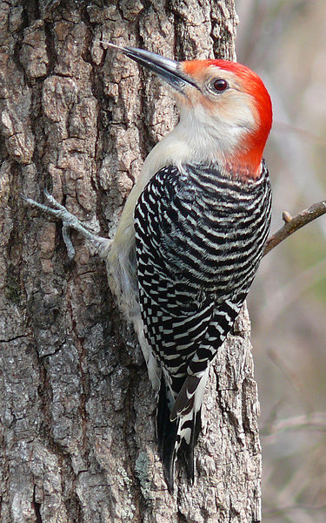
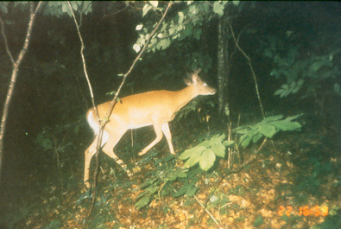
Some examples of potential changes in northern
Minnesota wildlife with a warmer climate
Painting by
Louis Agassiz
Fuertes
Black-backed
Woodpecker
Lynx
Bobcat
Moose
Deer
Photo: Ron Moen
Photo: Reuters
Red-Bellied
Woodpecker
Photo: Norbert Rosing
Photo: David Augustine
Photo: Ken Thomas
Notes:
Wildlife species depend on vegetation type, and when vegetation changes, wildlife species also change. Lynx depend on mixed aspen, birch and conifer forests with deep, long-duration snow cover. Moose cannot tolerate warm summers like those in southern MN today, and likely to occur in northern MN by end of the 21st Century. Many boreal forest bird species will not persist in a warmer climate, this is just one of dozens of possible examples.

Slide 22
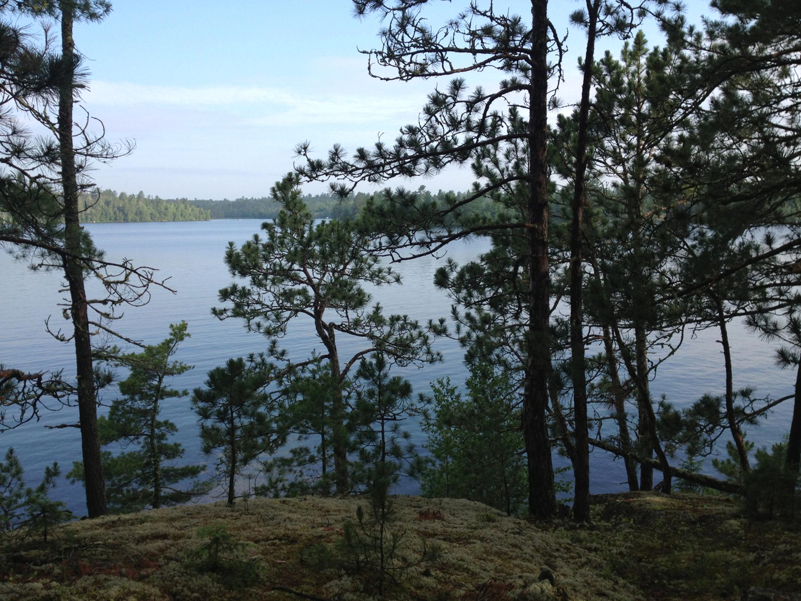
Conclusions
Big changes are coming to the Midwest because of global warming
For a business as usual CO₂ emission scenario, Minnesota could be the ‘new Kansas’
Boreal forest is likely to disappear from the region, along with 1/3 of all native species
There is still time to change the outcome of future climate. A low emission scenario could allow some conifer forest to remain in the Boundary Waters
Thank You!

