Slide 1
Data Practices Overview
MN House Judiciary Finance & Civil Law
January 17, 2023

Slide 2
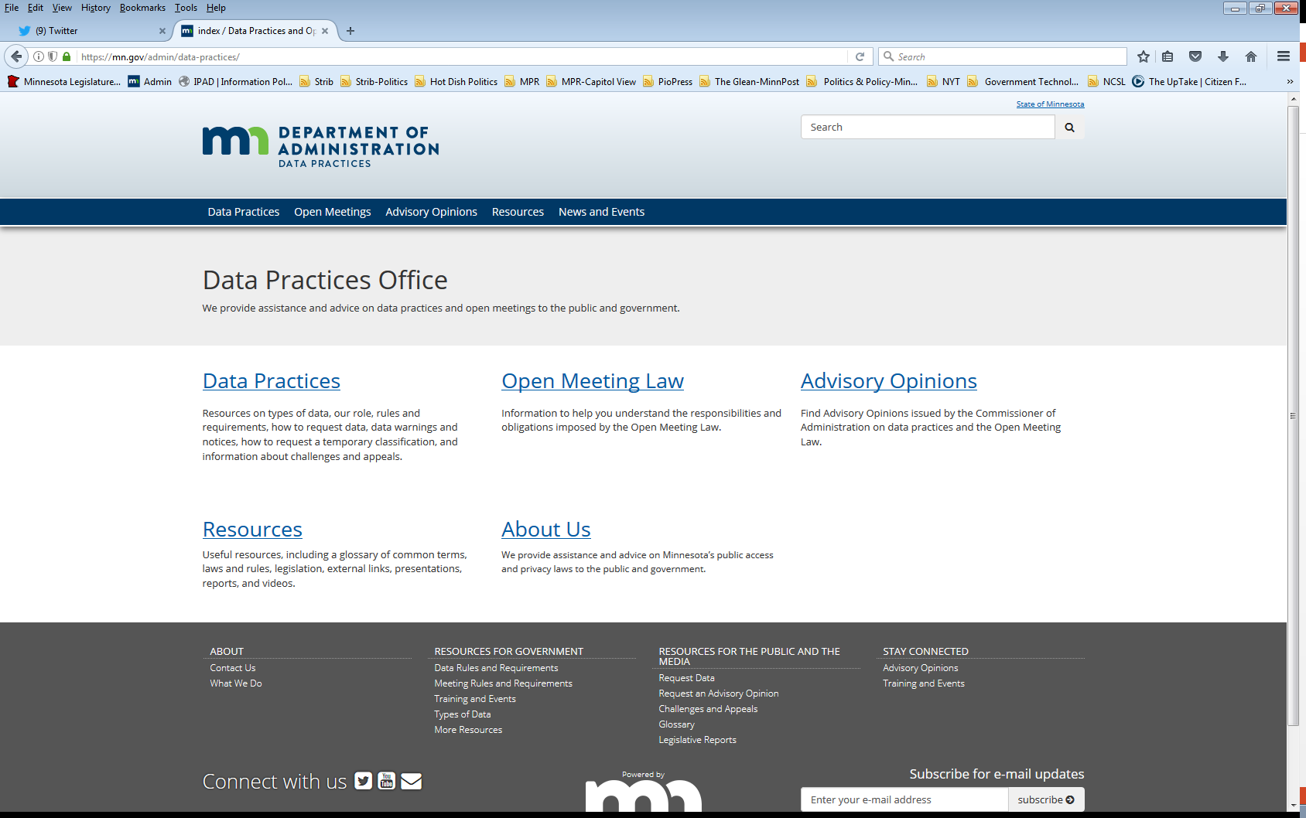
Data Practices Office Statewide resource on data practices and the Open Meeting Law
Informal advice/technical assistance
Commissioner of Administration advisory opinions
Website and informational materials: https://mn.gov/admin/data-practices/
Listserv and newsletters
Legislative assistance
Training

Slide 3
Why do you need to know about data practices?
The Legislature determines who can access government information by classifying government data and by permitting or requiring sharing.

Slide 4
Minnesota Government Data Practices Act Minnesota Statutes Chapter 13
Regulates how government administers government information
Tries to maintain a proper balance of:
Public’s right to know about the activities of their government
Privacy rights of individuals
Government’s need to have and use data to do its work

Slide 5
Public resumption and classification
Minnesota Statutes, Chapter 13
Establishes the classification structure for all data
Presumes government data are public
Classifies data as not public
Provides rights for the public and data subjects
Requires that data on individuals are accurate, complete, current, and secure
Minnesota Rules, Chapter 1205
Administrative rules implementing Ch. 13

Slide 6
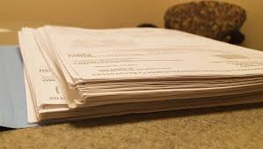
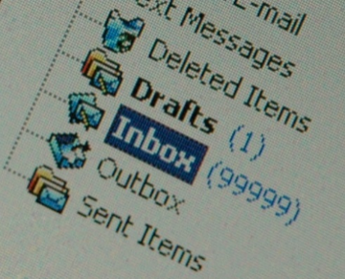
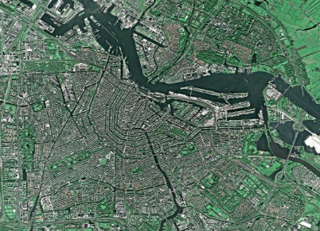
Government data defined
“All data collected, created, received, maintained or disseminated by any government entity regardless of its physical form, storage media or conditions of use.”
(Minn. Stat. § 13.02, subd. 7)

Slide 7
Application
The Data Practices Act applies to:
State agencies
Political subdivisions
Statewide systems
The Data Practices Act does not apply to:
The Legislature
The Courts
Most non-Metro townships
Non-governmental entities (e.g., condo associations)

Slide 8
Classification of government data
Data on individuals | Data not on individuals
Data that identify someone Public employee’s telephone number Name and address of adult arrestee Athlete of the week photograph | Data that do not identify someone Makes and models of fleet trucks Names of companies that are preferred vendors List of government websites

Slide 9
Classification of government data
Classification | Meaning of classification | Examples
Public | Available to anyone for any reason | Public employee name & salary
Private/ Nonpublic | Available to: Data subject Those in the entity whose work assignment requires access Entities authorized by law Those authorized by data subject | Public employee home address & home phone number
Confidential/Protected nonpublic | Available to: Those in the entity whose work assignment requires access Entities authorized by law Not available to the data subject | Data collected as part of an active criminal legal action

Slide 10
Response Time
 | Member of the Public (Section 13.03, subd. 2; Minn. Rules, part 1205.0300) | Data Subject (Section 13.04, subd. 3)
Inspection and/or copies | Appropriate and prompt, a reasonable amount of time | Immediately, if possible or 10 business days

Slide 11
Charging for Government Data
 | Member of the Public | Data Subject
Inspection | No charge allowed | No charge allowed
Copies | 25¢ per page 100 or fewer, black and white, legal/letter size paper copies Actual cost All other copies Time for search and retrieval Time to make and transmit Materials Cannot charge to redact | Actual cost Time to make and transmit Materials Cannot charge to search and retrieve Cannot charge to redact

Slide 12
Enforcement
Remedies (Minn. Stat. § 13.08)
Action to compel compliance
Action for damages, costs, and attorney fees
Administrative remedy (Minn. Stat. § 13.085)
Action to compel compliance within 2 years of alleged violation
Penalties (Minn. Stat. § 13.09)
Willful violation or data breach = misdemeanor
Dismissal or suspension
Advisory opinions (Minn. Stat. § 13.072)
Nonbinding, limited authority

Slide 13
Other data practices related laws
Official Records Act (Minn. Stat., section 15.17)
Make and preserve all records necessary to a full and accurate knowledge of official activities
Records Management Statute (Minn. Stat., section 138.17)
Records retention schedules and records disposition panel
MN State Archives website
www.mnhs.org/preserve/records/gov_services.htm

Slide 14
Official records are a subset of government data
Government Data
All data collected, created, maintained, used, disseminated by gov’t entity
Official Records Information that becomes part of an official transaction
Subject to records retention schedule

Slide 15
Contact the Data Practices Office
Phone: 651-296-6733
Email: info.dpo@state.mn.us
Website: mn.gov/admin/data-practices
Twitter: @MNgovdata
YouTube: https://www.youtube.com/user/INFOIPAD

