Slide 1
Minnesota’s Vulnerable Adult Act Redesign February 23, 2022
Mary McGurran, MSW | Adult Protection Supervisor

Slide 2
What is the Vulnerable Adult Act?
Creates our statewide system to protect vulnerable adults
Defines who is a vulnerable adult and what is maltreatment:
Abuse, Neglect & Financial Exploitation
Duties of state agencies responding to maltreatment in licensed facilities and of county agencies for adult protective services
Notes:
At the highest level, the Vulnerable Adult Act (called the VAA) establishes state policy for the protection of adults who are especially vulnerable to abuse, neglect or financial exploitation because they receive services licensed by DHS or MDH, or because they are an individual living in their own home in the community.
The VAA clarifies which agency is responsible to respond for the protection of the vulnerable adult – if the individual isn’t receiving licensed services from either a MDH or DHS licensed provider, the county is responsible for the adult protection services.

Slide 3
What is Maltreatment?
Abuse
Neglect
Financial Exploitation
Physical Abuse
Sexual Abuse
Emotional Abuse
Lacks food, shelter, clothing, health care or services necessary to maintain health, comfort or safety
Stealing property or assets
Drug diversion
Deception or fraud; forced services
Notes:
What exactly is maltreatment? These were listed in the previous slide, but I wanted to briefly show it to members listed out in a little more detail, as it just provides a little more detail behind what constitutes maltreatment under each category in the VAA.

Slide 4
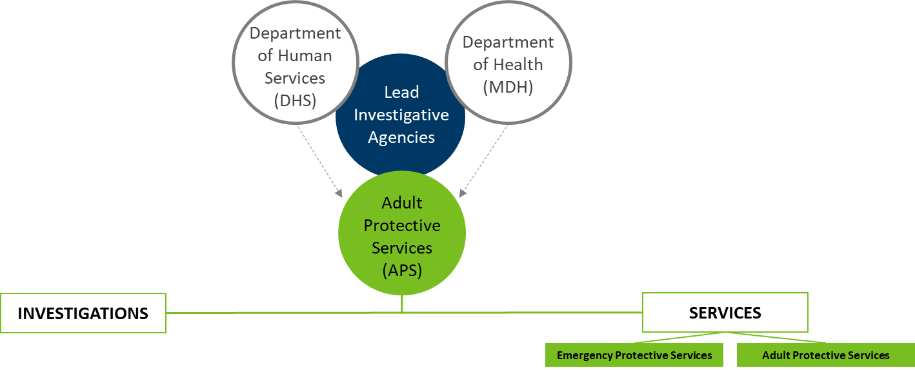
Minnesota’s Adult Protection System (APS)
Notes:
In Minnesota, we have a county administered adult protection system. This is actually somewhat unique, as many states have an state-administered APS system.
I know this slide might seem a little confusing, but the point is to show that county administered adult protection has a tough job and wears numerous hats.
If you follow all of the images in green you’ll see that we’re trying to illustrate that APS has a dual mandate to provide social services and investigate alleged maltreatment.
APS dual role can potentially be in conflict.
Services; works to engage vulnerable adult and support system to assesses strengths and needs, offer supports, services, and solutions
Investigator; fact gather, records and interview to assesses determine if the reported allegation is true and assign blame (or not)

Slide 5
Vulnerable Adults Reported to MAARC by LIA - CY 2019 and 2020
Notes:
We ultimately decided to include this slide because we think it is really telling. It ultimately reflects that county agencies are responsible for response to most reports of suspected vulnerable adult maltreatment in Minnesota.
Most media and other coverage talk about vulnerable adults in long-term care facilities licensed by MDH and DHS, but as you can see adult protection services is responsible for responding to more vulnerable adult complaints than MDH and DHS combined.

Slide 6
Adult Protection - Program Funding
Lack of sustained federal and state funding for county Adult Protection Services
First federal funding was limited, onetime grants in early COVID relief bills
Tribal Nations- no dedicated state or federal funding
State funding mechanisms are limited grants (through DHS) to county adult protection agencies
Legislature added partial state funding in 2012 and 2019
Currently most county adult protection services rely heavily on county funds for the majority of their operating expenses
Notes:
Like the slide mentions, there has been a historical lack of sustained federal and state funding for county APS.
For the Tribal Nations, there has no dedicated state or federal funding.
The legislature added partial state funding in 2012 and 2019.
Currently most county adult protection services rely heavily on county funds for the majority of their operating expenses that provide critical adult protection services for vulnerable adults living in their own homes in the community.

Slide 7
Vulnerable Adult Act Changes: Phase I

Slide 8
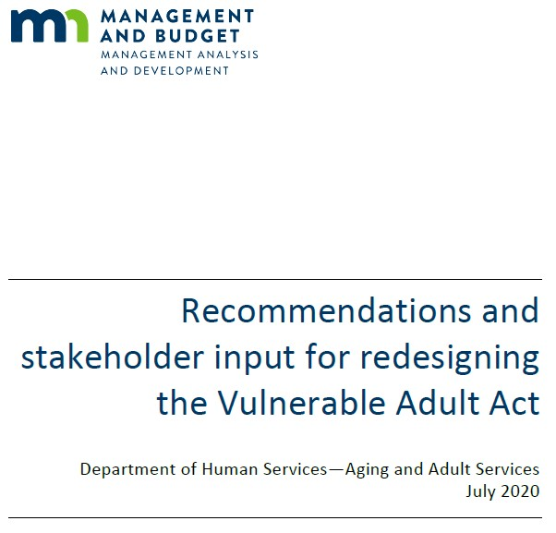
Vulnerable Adult Act Redesign
Key Takeaways
MN’s Adult Protection System lacks statewide consistency
Balance shift is needed for a response that supports safety and prevention
Data Sharing – protect privacy while allowing access to necessary information to support safety
Lack of a stable funding system contributes to inequities in service response
Recommendations and stakeholder input for redesigning the Vulnerable Adult Act (2020)
Notes:
As many of you may know, DHS is leading a re-design process designed to update and modernize the law based on what we heard from a group of more than 260 stakeholders.
We worked to get input on how to develop a more person-centered and equity-based adult protection system by redesigning the role of adult protective services under the Vulnerable Adult Act.
Some of the main takeaways are that the:
MN’s Adult Protection System lacks statewide consistency – vulnerable adults receive a different response depending on the county responsible
Balance shift needed – the balance needs to shift from focus on investigation and blame to a person-centered assessment and engagement with the vulnerable adult and their chosen supports for a response that supports safety and prevention
Data Sharing –there are some provisions to help with data sharing to both protect privacy while allowing access to necessary information to increase safety.
And, as previously mentioned, a lack of a stable funding system contributes to inequities in service response

Slide 9
What Included in HF 1432?
Clarifies investigation duties for all LIA’s
Improves clarity for counties to share necessary info with guardians/health care agents
Adds requirement for counties to make case acceptance guidelines public
Modernizes the definition of family neglect to align with current policy and best practices on informal supports
Notes:
As members may remember from when we presented this bill last year in this committee and as Rep. Frederick mentioned earlier, this bill is the first phase of the Vulnerable Adults Redesign. It is the product of a multi-year collaborative effort to develop policy changes to support statewide consistency and equity in safety, dignity and service outcomes for vulnerable adults.
Listed above are some of the outcomes from Phase I of the VAA bill - we anticipate bringing funding requests forward in phase II of the VAA Redesign.
I’ll let you read it for yourself, but just a few highlights from Phase I are:
It improves clarity for counties to share information with guardians and/or health care agents; and it
Adds that counties must make their guidelines for accepting vulnerable adult reports available to the public. This will:
Add consistency and transparency so vulnerable adults and families know which reports may meet a county’s threshold for services and investigation.
Help vulnerable adults and families understand why some reports are not accepted (or sometimes referred to as ‘screened out’).

Slide 10
What’s Included in the HF 1432 Amendment?
Supports county authority to share data with other LIAs, tribes and/or case managers
Allows counties to offer assistance even when the case is not accepted for a maltreatment investigation
Emphasizes connecting people to services, changing the focus from investigation to getting families and vulnerable adults support
Notes:
Supports county authority under the VAA to share data with other lead investigative agencies, tribes when the vulnerable adult is a tribal member and with a case manager when the vulnerable adult has a case manager.
Allows county agencies to offer assistance when the report is not accepted for adult protective service or an investigation.
Ultimately, this amendment emphasizes connecting individuals to services (rather than investigations) which will be an improvement for family caregivers.
As this will change the focus from investigation of who is responsible for the maltreatment when there is an informal caregiver, to families and vulnerable adults getting help and connected to services

Slide 11
Contact:
Nicole Stockert
Director of Legislative and External Affairs
651-431-6648
Nicole.Stockert@state.mn.us

