Slide 1

Disproportionality & Differential Treatment in
Suspension & Expulsions

Slide 2

Opportunity for All in Minnesota
Rebecca Lucero | Commissioner

Slide 3
Creating a Thriving Minnesota
The work of the Department of Human Rights is part of creating a world where people lead full lives, rich with dignity and joy.
We do this work through the Minnesota Human Rights Act (MHRA).
The MHRA has been in place for over 50 years.
Every person in Minnesota is protected by the Human Rights Act.
Critical time to maintain doing this work.

Slide 4
Creating a Thriving Minnesota – In Action
Partner with businesses to meet and exceed hiring goals.
Identify patterns and practices for education and outreach.
Investigate individual charges of discrimination.
Identify opportunities for policy changes.
Work in partnership to address systemic issues.

Slide 5
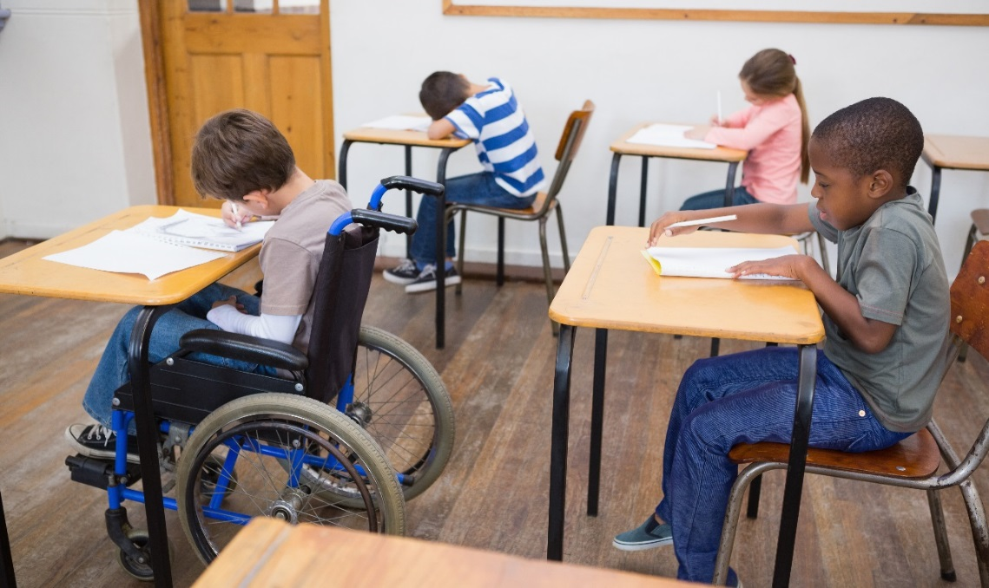
Positive School Experience
Providing all our children with access to a positive school experience is a matter of public concern—and our moral obligation.
Yet nationwide data shows that:
Students of color and Indigenous students are more likely to be suspended than their Caucasian peers.
Students with disabilities are more likely to be suspended than students without disabilities.
We must ask: Are our current discipline policies and practices working for all kids?

Slide 6
Not In Class
In our Minnesota schools, students of color, Indigenous, and students with disabilities are bearing the consequences of implicit bias.
Students with disabilities are 2x more likely to be suspended or expelled.
Students of color are 2x more likely to be suspended or expelled.
Black students are 8x more likely to be suspended or expelled.
Indigenous students are 10x more likely to be suspended or expelled.
How can kids learn if they are not in class?

Slide 7
MDE & MDHR Partnership
What does a child need to be successful? Safe, supportive, and welcoming schools play a pivotal role in ensuring students are engaged in learning and nothing hinders their ability to achieve their best in the classroom.
1) Diversion Committee – quarterly. Made up of the 41 schools/charters
2) Improving Academic Outcomes through Safe and Supportive Schools
  The School Safety Technical Assistance Center is dedicated to helping schools and community members develop safe and supportive learning environments, thereby increasing academic success for all students.

Slide 8

Disciplinary Incident Reporting System (DIRS)
1. Districts/charters provide data annually to MDE.
2. They enter their own data into DIRS.
3. Report suspensions and expulsions:
  1 day+ for General Ed students;
  ½ day+ for SPED students ;
  By ‘Incident’ - most egregious according to MDE; and
  By ‘Action’- student data on race/ethnicity, age, gender, SPED status & type.
4. MDHR reviewed 6 years of publically available data.
Suspension & expulsion data suggests that many MN districts and charter schools are denying some groups of kids equal access to education. [363A.13, subd. 2 ]

Slide 9
Why MN Kids are Suspended & Expelled
55% of all S/E are for subjective reasons.

Slide 10
Who is Suspended & Expelled in MN
SPED = 14% of enrollment but 42% of actions

Slide 11
MDE & MDHR Partnership
What does a child need to be successful? Safe, supportive, and welcoming schools play a pivotal role in ensuring students are engaged in learning and nothing hinders their ability to achieve their best in the classroom.
1) Diversion Committee – quarterly. Made up of the 41 schools/charters
2) Improving Academic Outcomes through Safe and Supportive Schools
  The School Safety Technical Assistance Center is dedicated to helping schools and community members develop safe and supportive learning environments, thereby increasing academic success for all students.

Slide 12
Questions?
Thank you!

