Slide 1
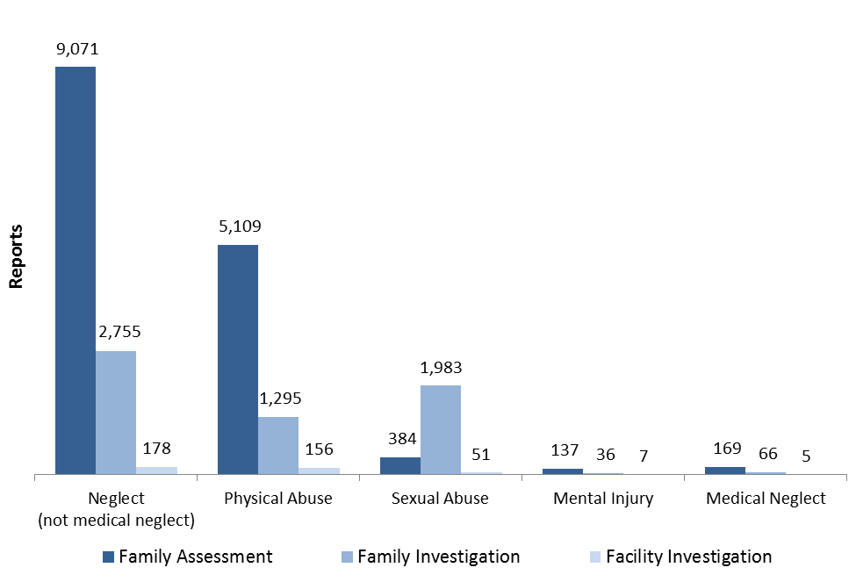
Reports by Maltreatment Type

Slide 2
Front End Child Protection Flow Chart January 2015
Family Investigation*
Services provided if needed or no services needed, case closed
No
Child protective services needed?
Call received by county/
tribe
Yes
Screening Decision*
Path Decision
Yes
Yes
Consult with County/Tribal Attorney
Possible Court Proceedings
No
Screened Out
No
Yes
Family Assessment*
Child protective services needed?
No
Family support services offered to family if needed, case closed
*If at any point an immediate safety concern is present, law enforcement is called.
**If a family is assessed as high risk for future maltreatment, the family’s case will be opened for child protective services.

Slide 3
Child Maltreatment Reports by Response Category, 2004–2013

Slide 4
Incidence per 1,000 by Race/Ethnicity and Maltreatment Type

Slide 5
Children in Out-of-home Care per 1,000 by Race/Ethnicity, 2004–2013

