Slide 1
Counties and Transportation 101
Abbey Bryduck
Association of MN Counties Transportation & Infrastructure Policy Analyst
March 2015

Slide 2
Minnesota Roadways Comparison of System Miles and
Traffic Volume - 2006
Total Local S Share
120,629 miles
89.1%
40.7% VMT
Total County Share
45,000 miles
33.5%
24.7% VMT
Source:
MN/DOT Traffic
Data and Analysis
System | Miles | Percent | VMT
US Interstates, & US and MN Trunk Highways | 11,870 | 8.8% | 59.2%
County State Aid Highways | 30,514 | 22.6% | 22.8%
County Roads | 14,483 | 10.8% | 1.9%
Municipal State Aid Roads – Large Cities | 3,069 | 2.3% | 7.8%
City Streets – Large and Small Cities | 16,036 | 11.9% | 6.3%
Townships | 56,257 | 41.5% | 2.0%
Other | 2,917 | 2.1% | <.01%
Total | 135,416 | 100% | 100%

Slide 3
Highway Funds
HUTDF Distribution
5% set-aside
95% distribution
62% Trunk Highway Fund
29% Count State Aid Highway (CSAH) Fund
9% Municipal State-Aid Street (MSAS) Fund

Slide 4
County Systems
County State Aid Highway System (CSAH)
30,600 miles of roadway - 67% of total county mileage
County Roads
14,500 miles of roadway, 33% of mileage
Notes:
Roads eligible for CSAH system are regionally significant enough to justify a state contribution

Slide 5
CSAH System
County State Aid System (CSAH)
Main Revenue Sources
Highway User Tax Distribution Fund (HUTDF)
Property tax, local option taxes for local matches

Slide 6
CSAH System
CSAH Allocation
Two separate statutory formulas for direct aid
Combination of factors:
Needs
Lane miles
Equalization
Vehicle registrations

Slide 7
County Roads
Roads which do not receive state aid funds are financed through:
Property taxes
Assessments
Local options
Wheelage tax
Sales tax

Slide 8
Greater MN Local Option Sales Tax
Rate: Up to ½ of 1 percent on retail sales within the county, and $20 per vehicle excise tax
Use: A specific transportation project, transit capital expenditures as well as operating costs
How Enacted: by County Board approval – a county not imposing a county sales tax as part of CTIB, previously by referendum
11 counties have adopted: Becker, Beltrami, Carlton, Douglas, Fillmore, Olmsted, Rice, St. Louis, Steele, Todd, Wadena

Slide 9
Wheelage Tax
Rate: $10 per charge on vehicles housed in the county
Collection: With annual tab fees
Use: Highway purposes; intended for local roads or CSAH matches
How enacted: By County Board approval. In 2018 will be able to collect amounts up to $20. Forty six counties have adopted.

Slide 10
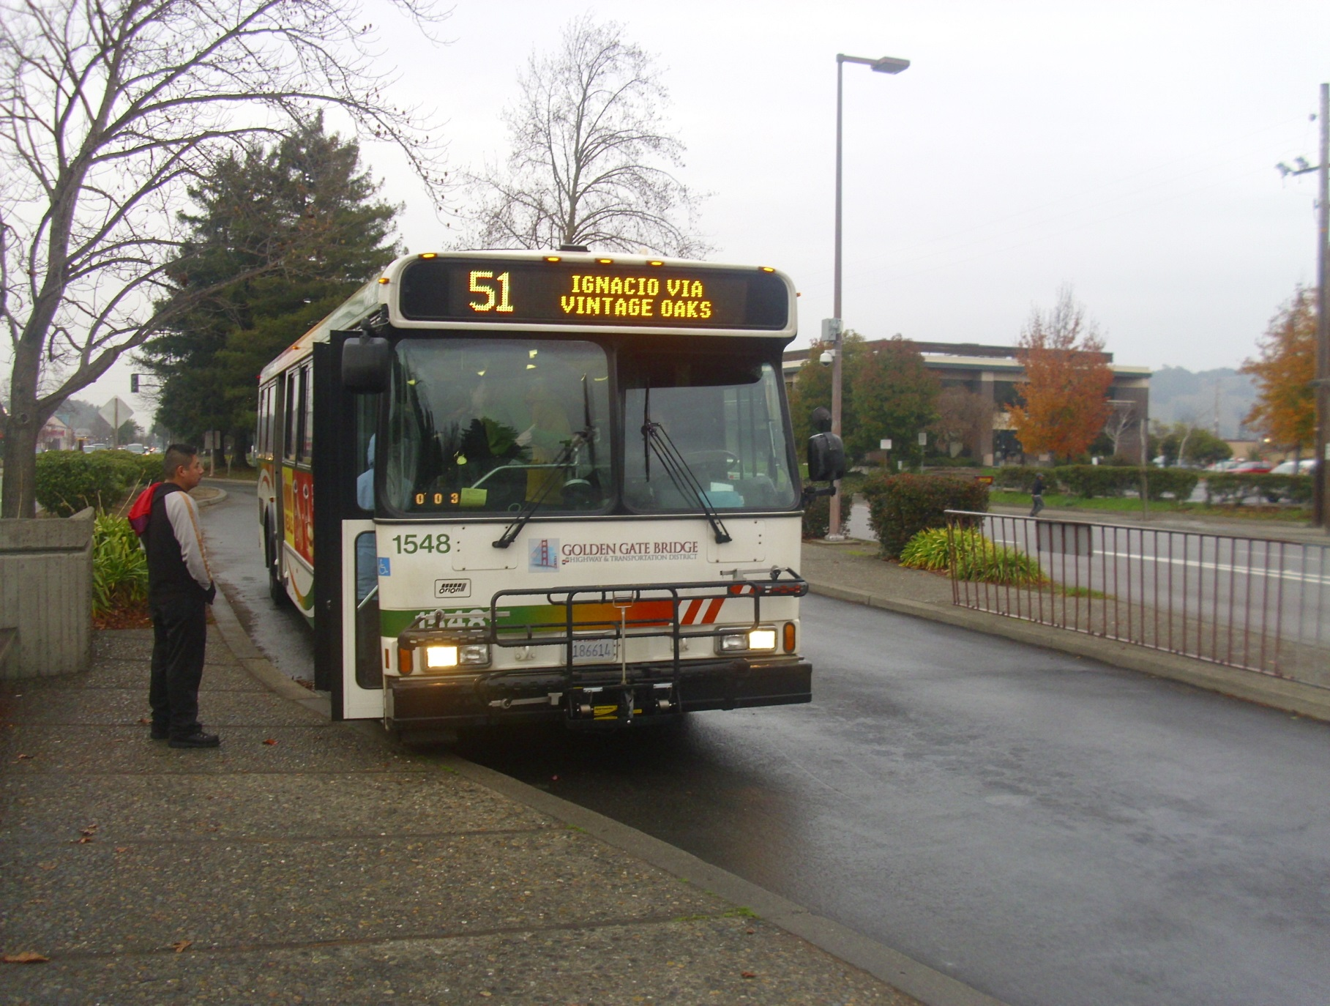
TRANSIT

Slide 11
Transit Finance
Transit provided by local units of government
Twin Cities metro area
Metropolitan Council
Suburban providers (opt-outs)
Independent provides
Variety of transit system and service in Greater MN
City-only and county-only service
Service across multiple counties

Slide 12
Transit Finance
Source of metro area transit funding: capital
0.25% transit sales tax, about $100M /year
Authorized local option sales tax
For transitway capital and ½ of operating costs
Administered by county joint powers board: Counties Transit Improvement Board (CTIB)
Hennepin, Ramsey, Anoka, Dakota, Washington

Slide 13
NEEDS
Counties have an identified annual funding gap of $450M for their CSAH system.
This is based on:
Deficient bridges
Strategic safety improvements
TED requests
Ten ton road system build-out
LRIP funding requests

Slide 14
NEEDS - Scale
MnDOT: $6 billion gap over 10 years for state system
Counties : $4.5 billion need over 10 years
6.5% gross receipts would bring $160M per year in annual funding to counties.
(1.6 billion/ ten years) about 30% of need

Slide 15
Needs- Scale
Increase per year with 6.5% GR and tab fee increase
Anoka | $ 7.1 |  | Pine | $ 2.8
Blue Earth | $ 3.1 |  | Ramsey | $ 7.1
Carlton | $ 1.8 |  | St Louis | $ 10.5
Carver | $ 2.5 |  | Stearns | $ 5.6
Cass | $ 2.0 |  | Steele | $ 1.9
Dakota | $ 6.2 |  | Todd | $ 1.4
Dodge | $ 1.4 |  | Wabasha | $ 1.6
Goodhue | $ 2.3 |  | Wadena | $ 1.1
Hennepin | $ 16.0 |  | Waseca | $ 1.2
Le Sueur | $ 1.7 |  | Washington | $ 4.1
Nicollet | $ 1.6 |  | Winona | $ 2.1
Olmsted | $ 3.0 |  | Wright | $ 3.9

Slide 16
Funding Positions
Gas tax reform: AMC supports reforming gas tax so that it is a sales tax on the wholesale fuel cost, rather than a flat, per gallon tax. Just as the flat gas tax, this tax would be collected at the wholesale level. It would increase with the cost of fuel. It would be constitutionally dedicated to roads and bridges.
New funding: AMC is a lead in the effort to secure new sustainable, multi-modal, dedicated, and balanced transportation funding.

Slide 17
Efficiencies
Long term funding:
Bundle projects for cost savings
Plan the lowest cost fix at the optimum time, rather than high cost when it’s available
Stable construction workload for contractors = overall lower construction costs
Project development costs increase dramatically by projects that need to be done on accelerated schedules.
Permit streamlining: AMC has been a lead in pursuing streamlining the business process of procuring environmental permits for road construction and maintenance.

Slide 18
Contact Information
Abbey Bryduck
Transportation & Infrastructure Policy Analyst
651-789-4339
abryduck@mncounties.org

