Slide 1
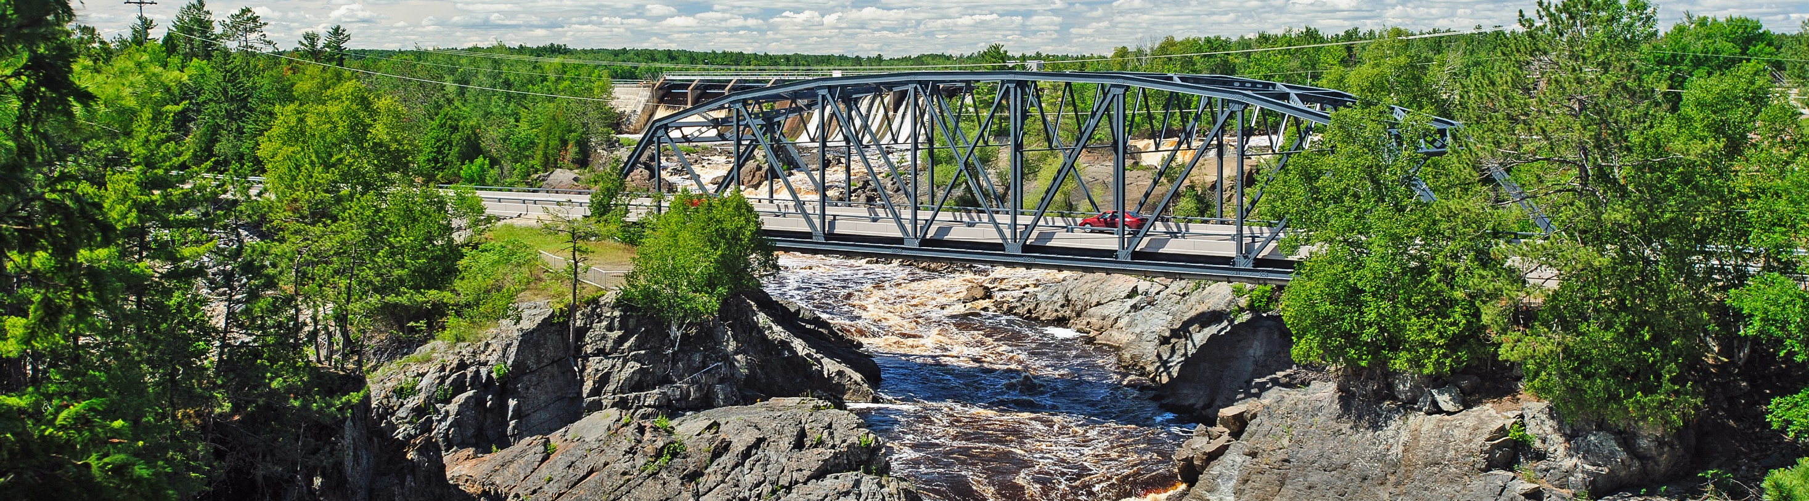
MnDOT Overview
Scott Peterson | Assistant Commissioner, MnDOT
Jan. 17, 2019

Slide 2
Creation of MnDOT Minnesota Statutes, Sections 174.01-174.03
Created by the Legislature in 1976
Combined former Department of Aeronautics, Department of Highways, State Planning Agency and Public Service Department
Develop and implement policies, plans and programs for highways, railroads, waterways, aeronautics, public transit and motor carriers
Provide safe, multimodal transportation
Recognize economic importance of transportation
Minimize impact on the environment

Slide 3

Vision and Mission
Vision – a multimodal transportation system that maximizes the health of people, the environment and our economy.
Mission – plan, build, operate and maintain a safe, accessible, efficient and reliable multimodal transportation system that connects people to destinations and markets throughout the state, regionally and around the world.

Slide 4

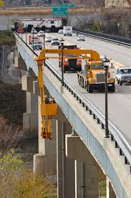
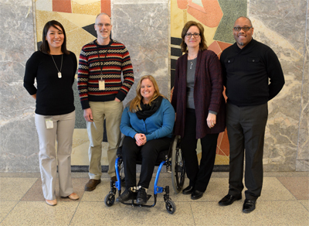
Core Values
Safety
Excellence
Service
Integrity
Accountability
Diversity and
Inclusion

Slide 5
MnDOT Districts
MnDOT is divided into eight regional areas – seven Greater Minnesota districts and the Minneapolis-St. Paul Metro District

Slide 6
Organization
State Aid
Engineering Services
Operations
Modal Planning and Program Management
Corporate Services
Chief Financial Officer
Chief Counsel
Chief of Staff
Policy and Government Affairs

Slide 7
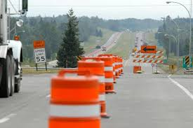

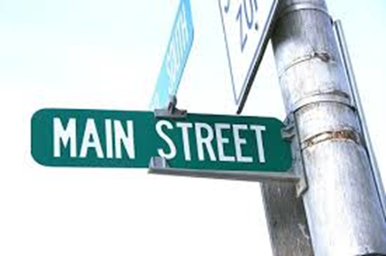
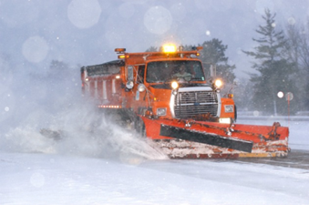
MnDOT Services
State Roads
Program Planning & Delivery
Construction
Operations & Maintenance
Local Roads
County & Municipal State Aid
Multimodal Systems
Aeronautics, Greater Minnesota Transit, Freight, Passenger Rail
Electronic Communications

Slide 8
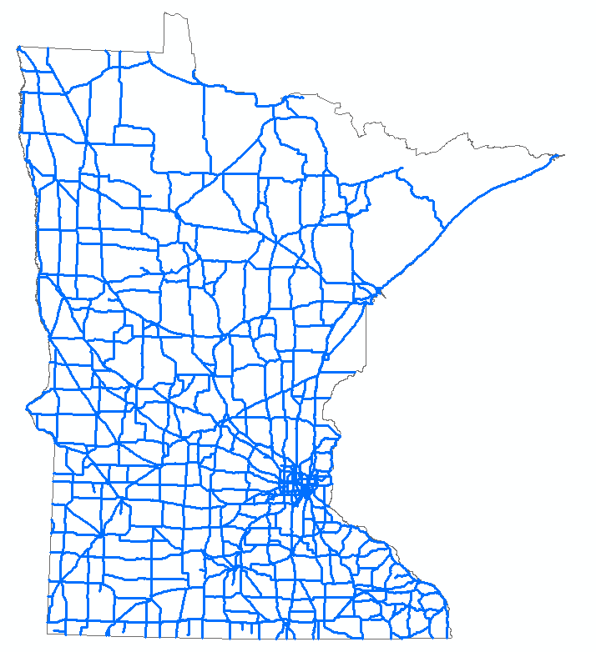
Roadway Network
Trunk Highways =
11,749 miles
Notes:
Official 2018 numbers ready later this month
State Aid number (from Jan 2018 brochure)
11,749 miles

Slide 9
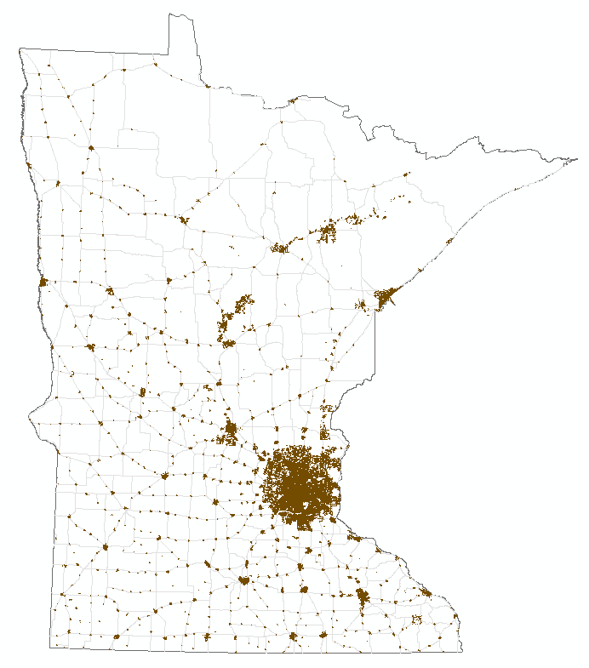
Municipal State Aid Streets =
3,752 miles
Other City Streets=18,831 miles
*Map shows all municipal roadways.
Notes:
3,752 Municipal State Aid Street miles
18,831 other city street miles

Slide 10
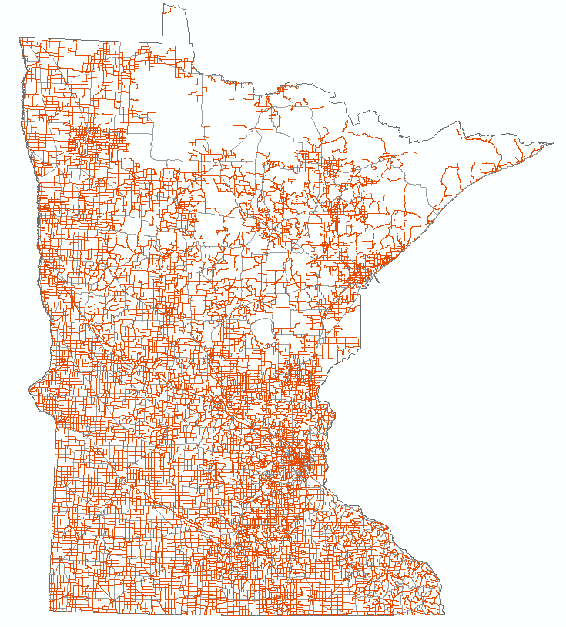
County State Aid Highways =
30,739 miles
Other County Roads=13,927 miles
*Map shows all county roadways.
Notes:
30,739 CSAH miles
13,927 county road miles

Slide 11
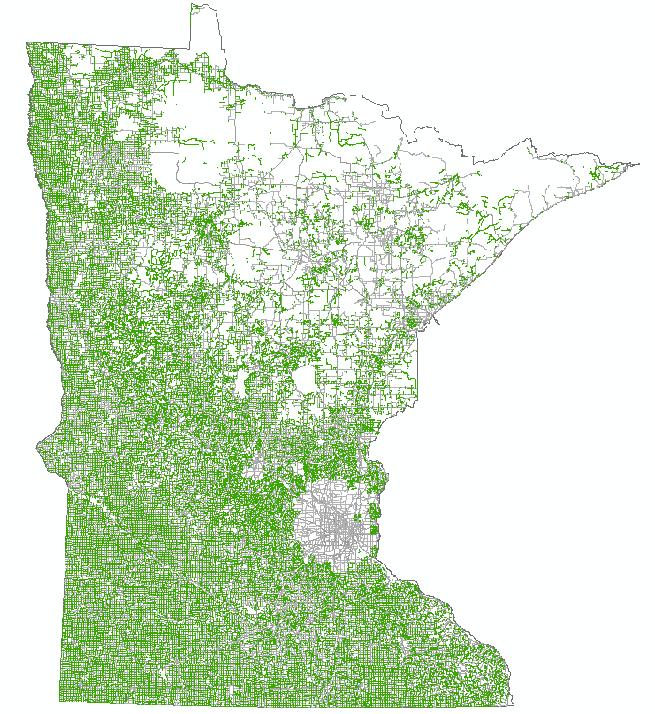
Township Roads =
56,844 miles
*Map also shows unorganized territory roads.
Notes:
State Aid number (from Jan 2018 brochure)
56,844 Township road miles

Slide 12
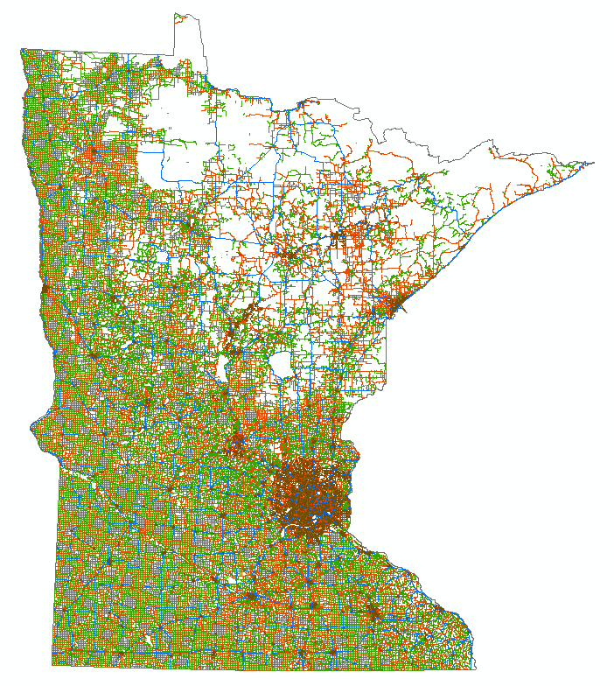
More than 139,400 Total Miles of Roadway
5th Largest Road System in the Nation
Notes:
State Aid number (from Jan 2018 brochure)
139,449 total miles of public roadway
Minnesota is 5th in the nation behind Texas, California, Illinois and Kansas.

Slide 13

State Transportation System
Highways
60 billion annual vehicle miles traveled
34.7 billion on trunk highways
Bridges (10+ feet)
19,800 bridges carry a roadway in Minnesota
More than 4,800 bridges carry or cross a trunk highway
Aviation
134 state-funded airports in Minnesota
More than half owned by cities under 5,000
Includes 9 commercial service airports
Includes 7 Metropolitan Airports Commission airports
Notes:
Highways
These will be 2017 values as 2018 traffic data will not be ready until around April or May.
59,970,745,401.900 – so 60.0 billion annual VMT
34,666,617,081.135 – 34.7 billion on trunk highways
Bridges (10+ feet)
19,800 bridges carry a roadway in Minnesota
More than 4,800 bridges carry or cross a trunk highway
Aviation
Minnesota's aviation system supports 300 aviation businesses and 14,500 pilots.

Slide 14
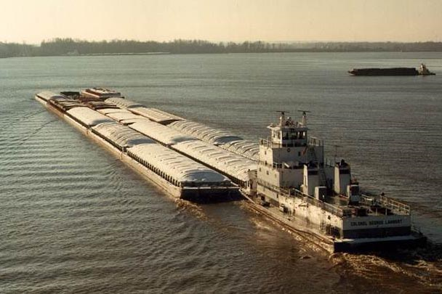
Freight
Water Freight
59 million tons shipped via Great Lakes
12.4 million tons via river
Public ports in Duluth, Winona, Red Wing and St. Paul
Rail Freight
250 million tons shipped
4,420 miles of railroads
21 railroad companies
Notes:
2016 Great Lakes Figure
2018 river tonnage data
2018 Rail data – MN Railroad Association

Slide 15
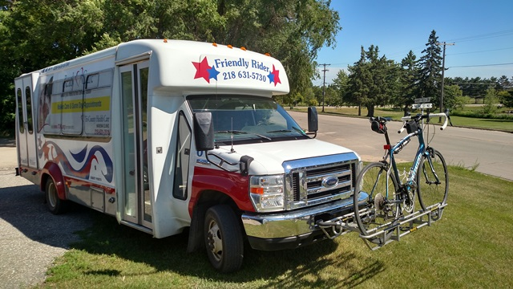
Greater Minnesota Transit
Transit
37 public bus systems and an annual state and federal program of more than $100 million
11.9 million greater Minnesota transit trips in 2017
Funding: approximately 75% state; 25% federal
Notes:
Transit
37 public bus systems and an annual state and federal program of more than $100 million
11.9 million greater Minnesota transit trips in 2017
For basic operating/capital for public transit in greater mn, it is about 75% state and 25% federal.

Slide 16
Pedestrians and Bicycles
More than 1,100 miles of designated state bicycle routes with …
Mississippi River Trail
North Star Route
2nd most bike-friendly state (League of American Cyclists)
Bicycle plan supports opportunities for local and regional bicycle travel
People who travel by bicycle 3 times a week decrease risk of chronic diseases
Streets where all people are able to safely and comfortably access destinations
Safe Routes to School program that helps students safely walk and bicycle to school
Notes:
Pedestrian and bicycle facilities throughout the state
Bicycle plan supports opportunities for local and regional bicycle travel
People who travel by bicycle 3 times a week decrease risk of chronic diseases
More than 1,100 miles of designated state bicycle routes with the Mississippi River Trail & North Star Route
Minnesota Walks provides a framework to have streets where all people are able to safely and comfortably walk or roll to desired destinations
Including our Safe Routes to School program that helps students safely walk and bicycle to school

Slide 17
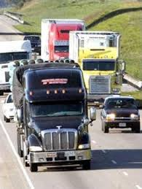
We Know What’s Ahead
Freight truck traffic to increase 40% by 2040
Nearly 1 million new Minnesotans by 2050
Projected growth in vehicle miles traveled to increase 21.3% by 2040; 72.8 billion statewide
Connected, automated and electric vehicles
Notes:
Truck traffic estimate from 2015 (most recent available)
New residents and more commerce are good for Minnesota’s economy – but only if our transportation system can keep up.

Slide 18
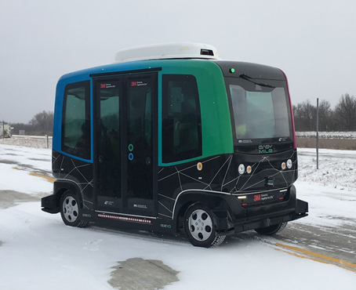
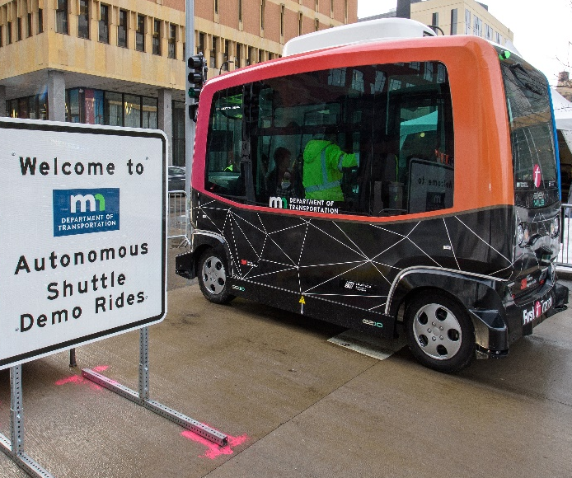
Connected and Automated Vehicles
Automated
Electric
Connected
Shared
Notes:
CAV
Connected and automated vehicles are more than driverless cars …
In Minnesota, our CAV program and policy development focuses on 4 main areas of technology and policy:
Automated vehicles (AV): Simply put, automated vehicles can take control of some or all aspects of human driving, including steering, accelerating and braking.
Connected vehicles (CV): These vehicles can “talk” to infrastructure like traffic signals, other vehicles, and even pedestrians and cyclists
Electric vehicles (EV): With a majority of AVs being built on electric platforms, it will be important to understand future infrastructure demands
Shared mobility: As Frank mentioned, this concept allows us to think more broadly about accessible transportation and expanding mobility opportunities. With TNCs and Uber, the world is experiencing a change in the way people travel.

Slide 19





Why CAV is important to Minnesota
Safety
Support deployment of CAV technology to improve safety and achieve Toward Zero Death (TZD) goals
Greater Mobility and Equity
Use CAV technology to improve transportation equity and accessibility for all Minnesotans
Economic and Workforce Development
Position Minnesota as a place to safely test and deploy CAV to harness public benefits and encourage workforce and economic development
Efficiency
Harness CAV technology to improve the efficiency of the transportation system for the movement of people, goods, and services
Maximize Health and Environment
Emphasize CAV technologies that have the potential to promote environmental sustainability and public health
Notes:
Safety: In 2017, an estimated 39,141 people were killed on the US transportation system. Nearly 94% of these collisions were caused by human factors, such as distracted driving, speeding or driving under the influence. Automation has the ability to greatly reduce - if not eliminate - these safety challenges, save lives, and meet the state’s Toward Zero Death goals.
Greater mobility and equity: CAV may reduce transportation barriers for persons with disabilities, the aging population, low income communities, communities of color and others.
Economic and workforce development: Minnesota is competing in a global market and must use these technologies to stay competitive. This technology provides Minnesota with an opportunity to maintain a competitive business edge nationally and internationally in the movement of goods, services and people.
Efficiency: CAV’s may reduce traffic congestion and improve traffic flow at intersections, work zones, during adverse weather, and may also assist in traffic rerouting and incident management.
Maximize health and environment: CAV could help the state rethink the way we plan communities to maximize health and sustainable multi-modal transportation. AV may reduce GHG and air pollutants with expansion of electric vehicles.

Slide 20
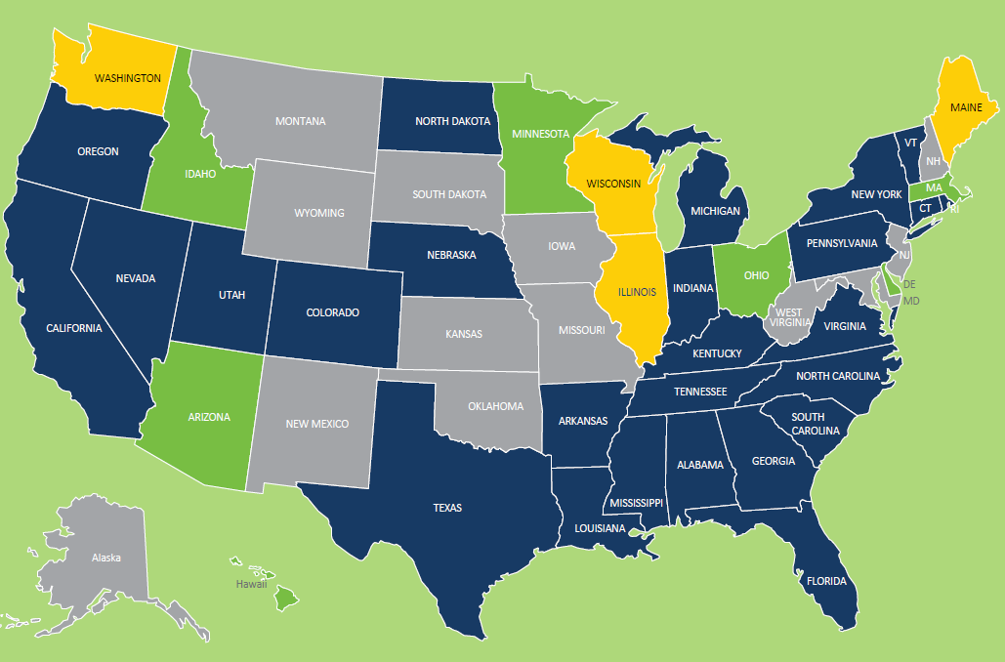
State Automated Vehicle Laws
Enacted legislation Executive Order Both None
Notes:
According to the National Conference on State Legislatures’ NCSL Automated Vehicles Enacted Legislation Database 29 states have enacted legislation. Alabama, Arkansas, California, Colorado, Connecticut, Florida, Georgia, Illinois, Indiana, Kentucky, Louisiana, Maine, Michigan, Mississippi, Nebraska, New York, Nevada, North Carolina, North Dakota, Oregon, Pennsylvania, South Carolina, Tennessee, Texas, Utah, Virginia, Vermont, Washington, Wisconsin and Washington D.C. have enacted legislation related to autonomous vehicles.
Other states – like Minnesota – have issued executive orders.
California, Arizona and Michigan are seen as leaders in testing AV.

Slide 21
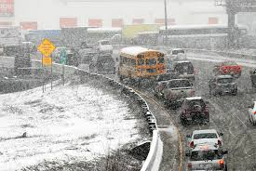
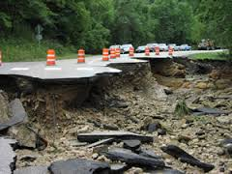
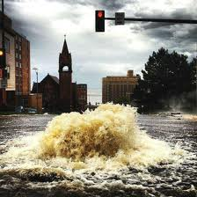
Harsh Climate, Heavy Use
52% state highway pavements more than 50 years old
17% have <3 years useful life
40% of MnDOT bridges more than 40 years old
Minnesota weather extremes, climate change impacts
Significant snow and ice costs
Notes:
So what does Minnesota’s transportation system look like today?
Many of our roads have passed the point of true usability, despite our best efforts.
MnDOT has hired a Chief Sustainability Officer who is directing activities to better adapt to a changing climate.

Slide 22
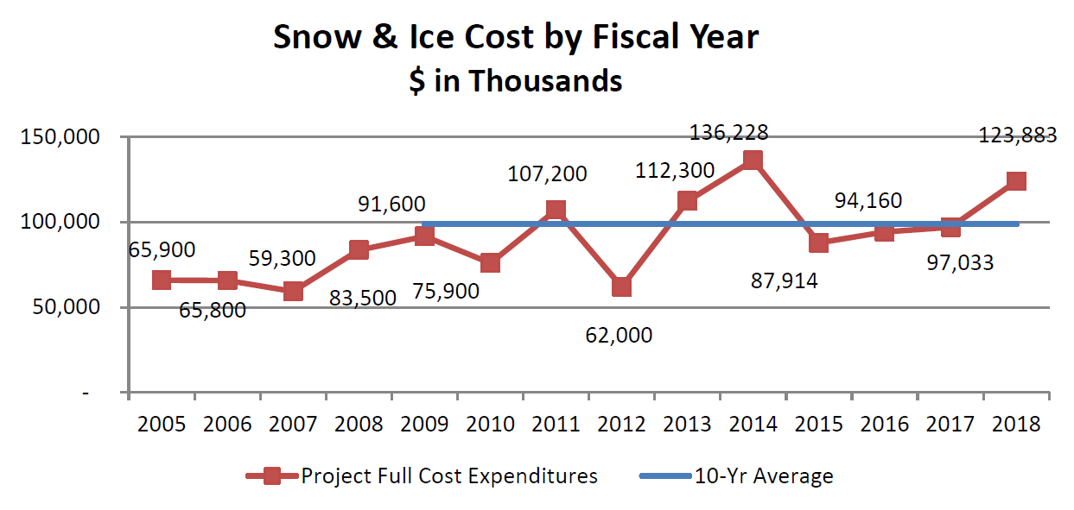
Snow & Ice Season
10-year average snow and ice costs: $98.8 million
Notes:
2013-2014 Record Setting ($136M); 2017=2018 next highest at $124M
5-Year average ~$107.8M
In the last 10 years, snow and ice costs to Minnesota’s transportation system have averaged $98.8 million per year. The winters of 2013 & 2014 averaged $124 million;
We are dealing with increased costs from climate change.
We can hope for milder winters to come, but we need to prepare for these greater costs

Slide 23
Transportation Funding Sources FY2017
FY2017 Transportation Funding Sources
$3.42 billion

Slide 24
Transportation Funding Uses FY2017
FY2017 Use of Transportation Funding
$3.45 billion

Slide 25
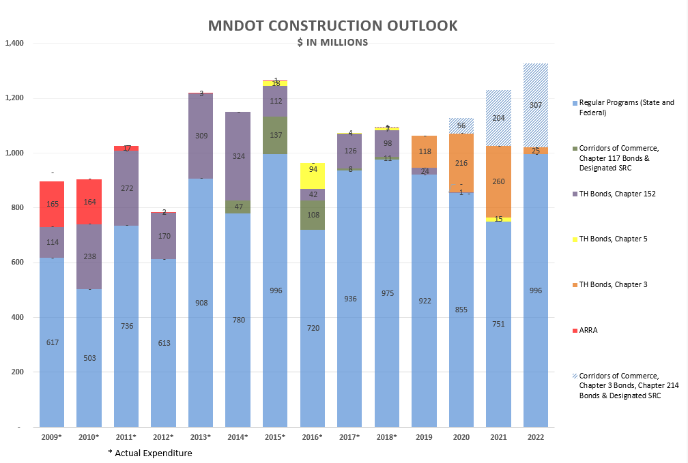
MnDOT Construction Outlook

Slide 26


The Perfect Storm of Need Drives the Funding Gap
A perfect storm of funding shortfalls and increasing costs
Aging Infrastructure
Population/Freight shipments increasing
Stable/Flat Federal Funding
10 year State System Funding Gap =
$6 billion
Increasing Fuel Efficiency; Flat VMT
Increased costs for Construction & Maintenance
Notes:
Talking Points:
Minnesotans expect more from an essential government service like transportation. Instead, this is what we get.
Aging Infrastructure
Years of neglect have continued to erode the quality of our roads and bridges..
Pavement
54.5% OR 7,803 rated roadway miles have a remaining service life of less than 10 Years:
52.4% OR 7,494 rated roadway miles on state highways in MN are older the 50 years (i.e., it been 50 or more years since last construction)
Bridges
8,128 of the 19,800,--or 41%--of bridges more than 40 years old
# of bridges in poor condition with breakdown between MnDOT and local agencies
90 trunk highway
920 local highway
550 bridges have work planned by 2028
This includes 350 bridges + 200 culverts (that meet 10' bridge definition) that are in the FY19-22 STIP and FY 23-28 CHIP. These are MnDOT bridges only, not local bridges.
750 bridges need work by 2028
This is based on an analysis in our BRIM planning tool to predict the right fix at the right time.
It predicts 750 bridges need work by 2028 (550 bridges, 200 culverts)

Slide 27
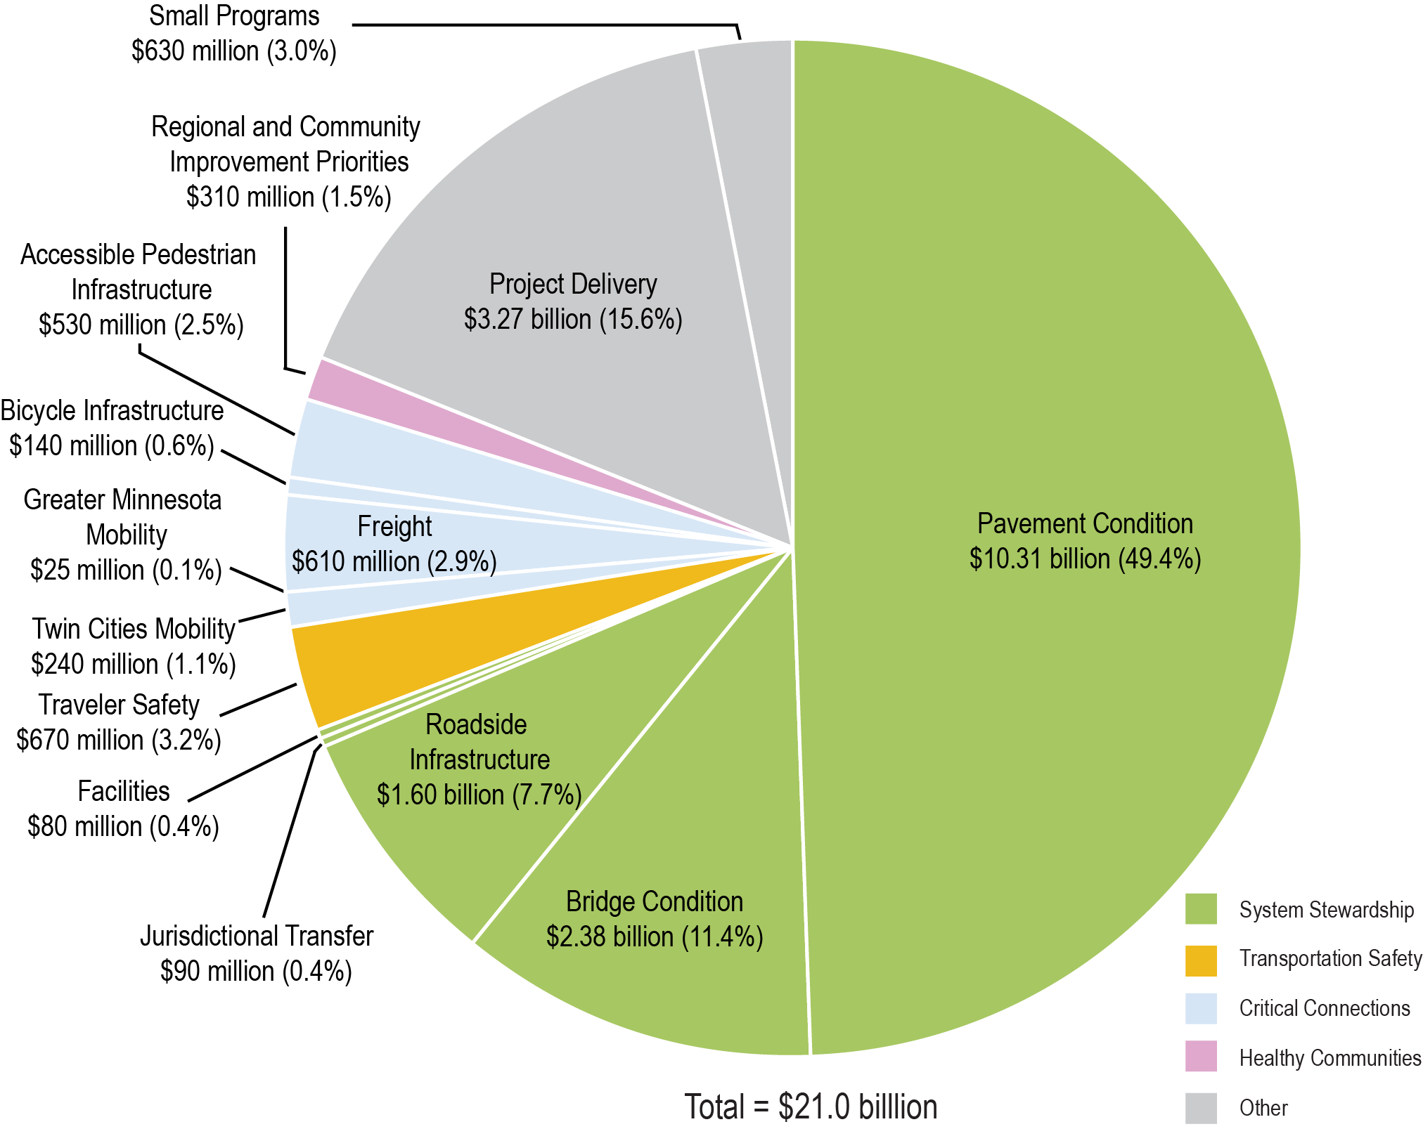
20-year Investment Plan (2018-2037)
20-Year Total: $21 billion
Notes:
Most of the existing funds have to be used for preservation. Very little funding left for expansion.
MnDOT has created a supplemental document to MnSHIP that outlines the impacts of the 2017 and 2018 Legislative Sessions on the 20-year MnSHIP investment direction
It will be included in the MnSHIP document and posted on the MinnesotaGO.org website by mid-to-late January

Slide 28
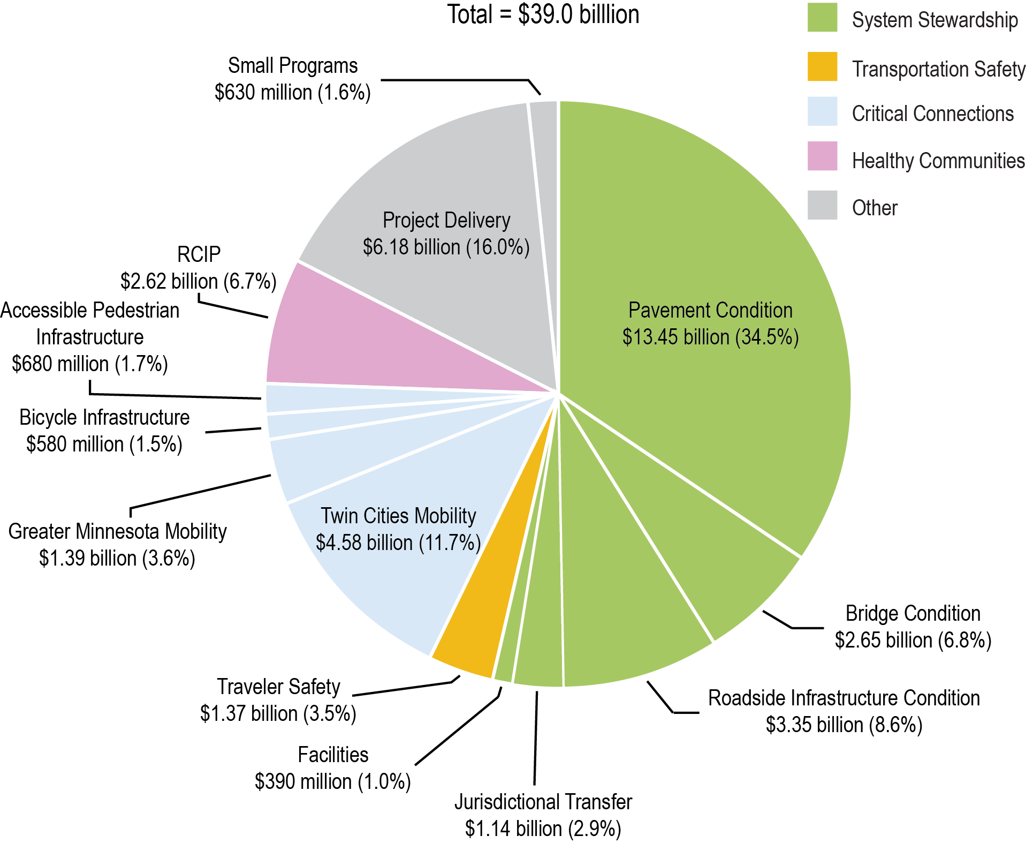
20-year Investment Need (2018-2037)
20-Year Total: $39 billion
First 10 years—$6 billion gap
Second 10 years—$12 billion gap
Notes:
Based on the information used in the plan…but not stated in the plan (Source: 2017 MnSHIP)
$21 billion investment
$38 million in need
Funding gap over 20 years
First 10 years—$6 billion gap
Second 10 years—$12 billion gap
Source: 2017 MnSHIP

Slide 29
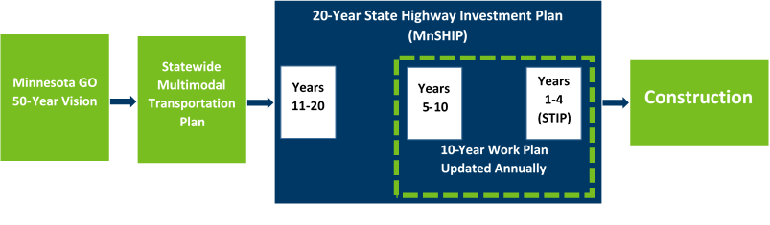
Project Selection

Slide 30
Project Selection
10-year Capital Highway Investment Plan (CHIP)
Communicates programmed and planned capital highway projects
Ensures MnDOT is meeting investment levels and performance outcomes from MnSHIP
Updated annually
4-year State Transportation Improvement Program (STIP)
Identifies schedule and funding of projects by state FY
Includes all state and local transportation projects with federal funding
Includes 100 percent state-funded transportation projects
Developed/updated annually
Notes:
CHIP (2019-2028)
The 10-year Capital Highway Investment Plan details MnDOT’s capital highway investments for the next ten years on the state highway network.
The CHIP is updated yearly to remove projects that are currently being constructed, adjust timing of existing planned projects, and add new planned projects.
The primary purpose of the document is to communicate programmed and planned capital highway projects over the next 10 years.
The document serves as a check to ensure that MnDOT is meeting the investment levels and performance outcomes identified in MnDOT's 20-year State Highway Investment Plan, MnSHIP, and explains any change in direction or outcomes from the investment direction.
STIP (2019-2022)
The STIP is Minnesota’s four year transportation improvement program.
The STIP identifies the schedule and funding of transportation projects by state fiscal year (July 1 through June 30).
It includes all state and local transportation projects with federal highway and/or federal transit funding along with 100% state funded transportation projects.
Rail and port projects are included for information purposes.
The STIP is developed/updated on an annual basis.

Slide 31
Project Selection
Project selection policy
Required by Minnesota Laws 2017, 1st Special Session, Chapter 3, Section 124
Policy statement—use transparent and objective process
MnDOT will document and make available:
Criteria/process—assigning numeric score and selecting projects
List of candidate projects
Project scores and reasoning behind selection decisions
New policy will be implemented
2020-2023 STIP
2020-2029 CHIP
Notes:
Background
In 2017, the Minnesota Legislature directed the Minnesota Department of Transportation to develop and implement a new transparent and objective project selection policy by November 1, 2018.
Before adopting the policy, MnDOT must consult with the Federal Highway Administration, metropolitan planning organizations, regional development commissions, area transportation partnerships, local governments, the Metropolitan Council, and other transportation stakeholders.
Project selection is the decision to fund a highway construction project and add it to the list of planned and programmed projects.
The new project selection policy will be implemented with the 2020-2023 State Transportation Improvement Program and 2020-2029 Capital Highway Investment Plan.
Policy statement
The Minnesota Department of Transportation will use an objective and transparent process to select construction projects on the state highway system to be included in the Capital Highway Investment Plan (CHIP) and State Transportation Improvement Program (STIP).
MnDOT will document and make publicly available for each selection process or program:
The criteria and process for assigning a numeric score and selecting projects
The list of candidate projects considered
The scores assigned to projects and reasoning behind selection decisions not included in the score

Slide 32
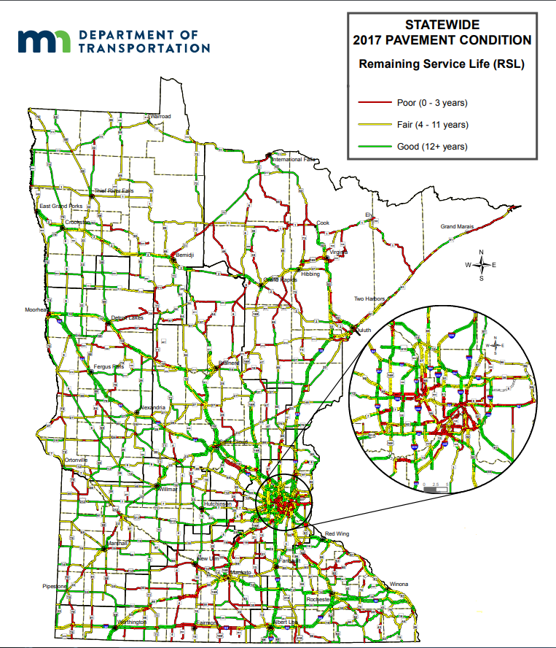
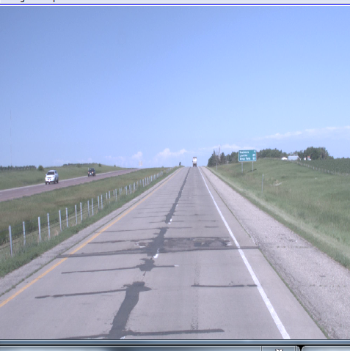
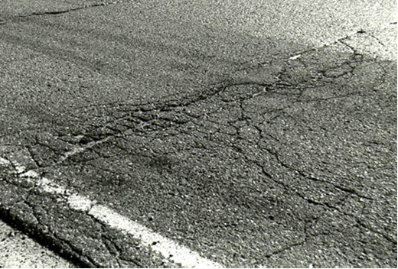
Pavement Conditions
Notes:
Remaining service life is an estimate of the time remaining until a pavement registers a ride quality poor enough where MnDOT will consider a major repair or replacement.
Pavement
54.5% OR 7,803 rated roadway miles have a remaining service life of less than 10 Years:
52.4% OR 7,494 rated roadway miles on state highways in MN are older the 50 years (i.e., it been 50 or more years since last construction)

Slide 33
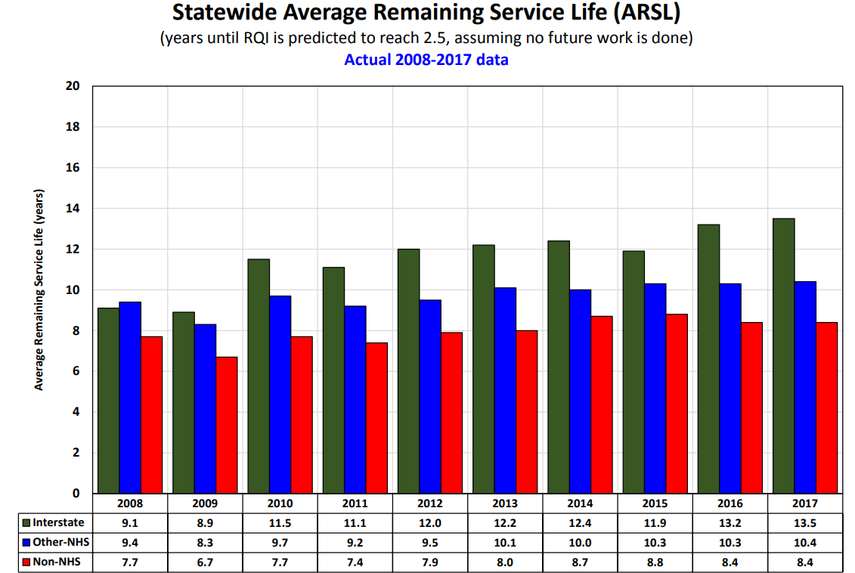
Pavement Conditions
Notes:
Remaining service life is an estimate of the time remaining until a pavement registers a ride quality poor enough where MnDOT will consider a major repair or replacement.
Pavement
54.5% OR 7,803 rated roadway miles have a remaining service life of less than 10 Years:
52% state highway pavements more than 50 years old
17% have <3 years useful life

Slide 34
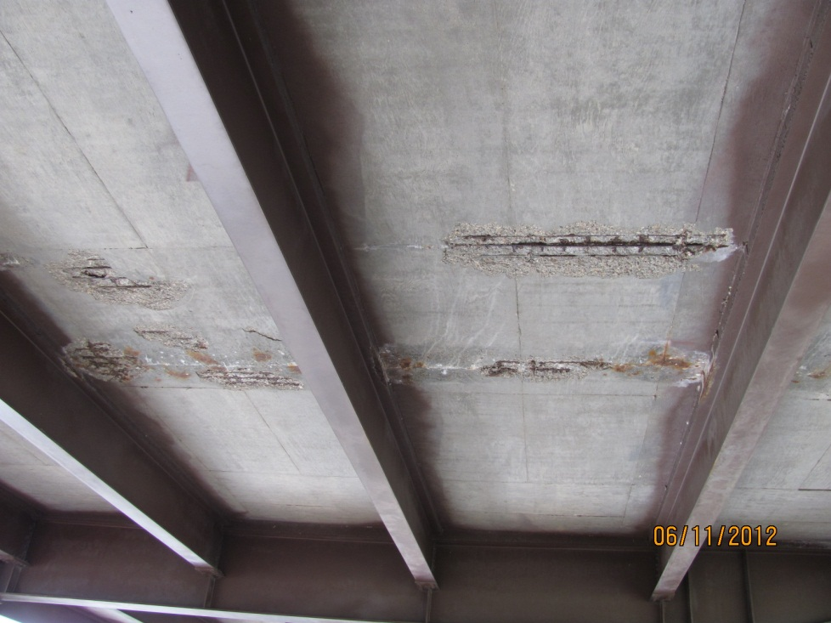
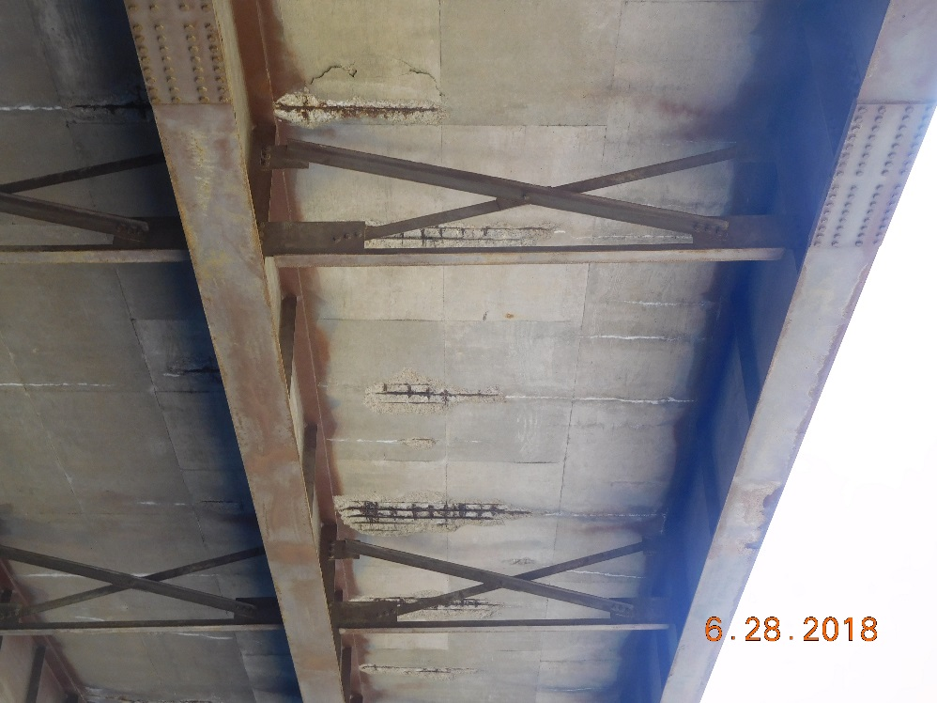
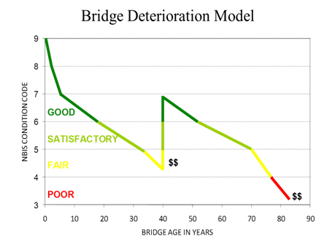
Bridge Conditions
Smith Ave./Hwy 149 High Bridge over Mississippi River in St. Paul (before deck reconstruction in 2017/2018)
Hwy 55 over I-35E in Eagan
Notes:
Smith Avenue High Bridge in St. Paul
High Bridge construction started in Sept. 2017 and was completed in Nov. 2018.
Project cost: $45.8 million as project final cost
2018 bridge stats:
Total number of bridges in MN
19,800
Breakdown of # of bridges between MnDOT and local agencies
4,595 trunk highway system
15,205 local highway system
% of bridges more than 40 years old
8,128 / 19,800 = 41%
# of bridges in poor condition with breakdown between MnDOT and local agencies
90 trunk highway
920 local highway

Slide 35
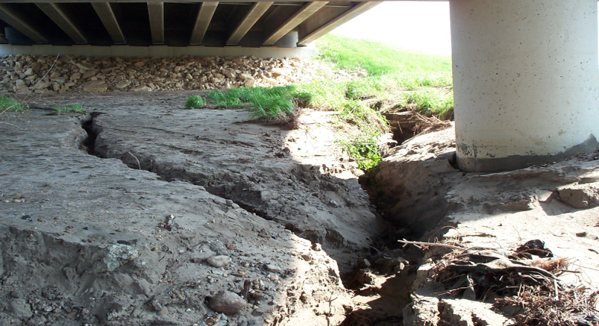
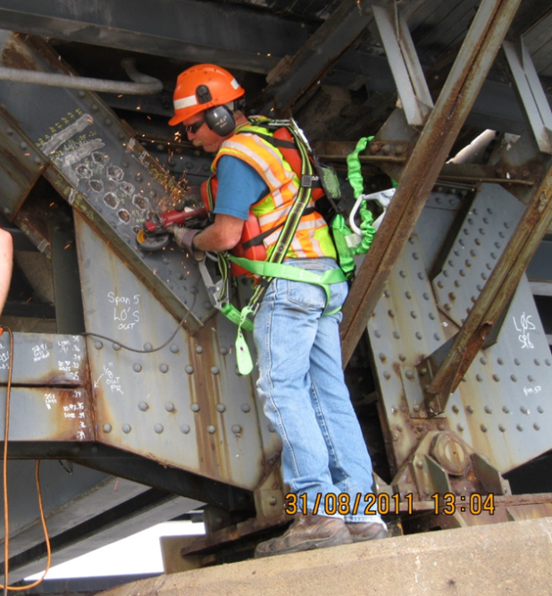
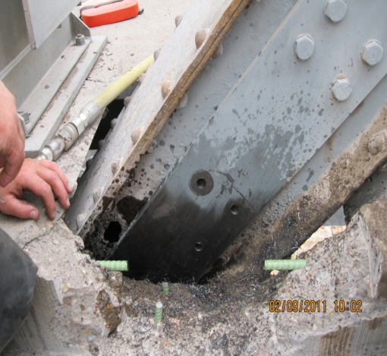
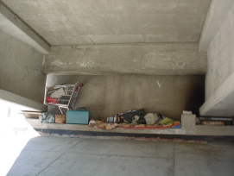
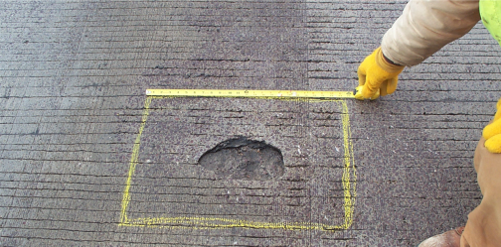
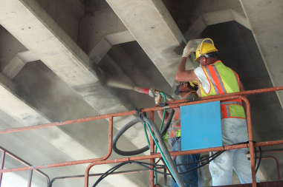
Reactive Bridge Maintenance
Notes:
Our district bridge crews also perform reactive maintenance. These are generally unplanned maintenance needs that are identified during inspections or routine site visits.

Slide 36
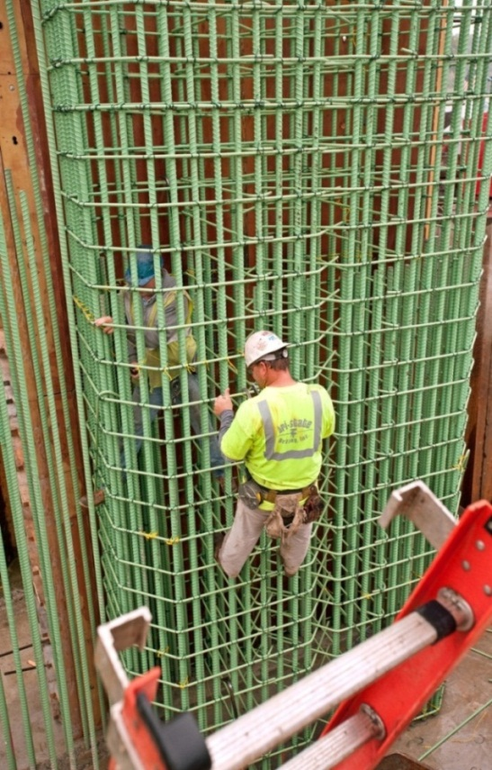
Chapter 152 Bridge Projects
2015 – Winona Bridge, Cayuga Bridge, Hwy 5 over Mississippi River (total 16 bridges worked on)
2016 – Hwy 36 over Lexington Ave, County Rd E2 over I-35W, Hwy 7 over Hwy 100, Hwy 250 over Root River (total 14 bridges worked on)
2017 – Kennedy Bridge, Red Wing Bridge, Hwy 99 over Minnesota River in St. Peter (total 5 bridges worked on)
2018 – Baudette, Smith Ave High Bridge, I-35W over Hwy 65 and I-35W to I-94 in Minneapolis, Hwy 14 over Minnesota River in New Ulm (total 12 bridges worked on)
MnDOT will invest $2.1 billion in state bridges under the Chapter 152 program
Funding Source: Transportation Bonds, Federal and State Funds
Notes:
In 2008, the Legislature created the Chapter 152 Bridge Improvement Program to provide funds to rehabilitate or reconstruct those bridges that fell below the “fair” target.
The 172 bridges identified were separated into one of three tiers.
The funding provided through the Chapter 152 program replaced or rehabbed 136 of the 172 originally identified bridges.
Of the 36 remaining, three are privately owned or no longer on the trunk highway system and 33 received normal maintenance and/or minor repairs.
Many of the 33 bridges that only had minor work or repairs during the Chapter 152 program years are scheduled to be replaced, rehabbed or have major repairs within the next 10 years.
The Chapter 152 program helped to improve the overall bridge condition across the state.
Now, Minnesota is meeting the bridge condition target and as of 2017 is at 1.4 percent.
Chapter 152 dollars spent
Amount of money that has been spent on Ch. 152 bridges: more than $1 billion has been spent on these bridges with eight bridges still in construction
Amount of money provided in the CH. 152 statute: $2.1 billion
There are still bridges spending Ch. 152 bond dollars so we haven’t spent all of the money yet

Slide 37
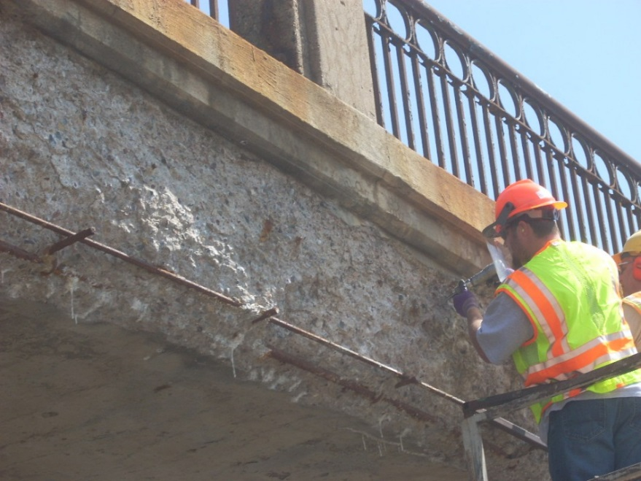
Post-Chapter 152 Bridge Projects
U.S. Hwy 169 Nine Mile Creek in Hopkins (2016 – complete)
I-35W Minnesota River bridge in Burnsville (2018 – under construction)
I-394 Dunwoody Blvd. in Minneapolis (2019)
I-35/535 Twin Ports Interchange in Duluth (2020)
U.S. Hwy 10 Rum River bridge in Anoka (2022)
I-494 Minnesota River bridge in Bloomington (2023)
U.S. Hwy 61 Hay Creek bridge in Red Wing (2023)
Hwy 1 Red River bridge in Oslo (2025)
I-535 St. Louis River (Blatnik) bridge in Duluth (2028)
Stone Arch Bridge in Minneapolis (TBD)
Highway 65/Third Ave. Mississippi River bridge in
Minneapolis (TBD)
Notes:
TOTAL BRIDGE INVESTMENT by 2028…approximately $1 billion
Significant bridge works remains, even after the Chapter 152 bridge program is completed.
This list of bridges are those with estimated costs more than $7 million, with the exception of I-394 Dunwoody Blvd … STIP total approximately $2.9 million).
U.S. Hwy 169 Nine Mile Creek in Hopkins (2016 – complete)
I-35W Minnesota River bridge in Burnsville (2018 – under construction …Aug. 20, 2018 to Nov. 2021), $127 million estimated total project cost
I-394 Dunwoody Blvd in Minneapolis (rehab 4 bridges) (2019)
I-35/535 Twin Ports Interchange in Duluth (2020-2023) … $342 million estimated total project cost
US Hwy 10 Rum River in Anoka (2022)….Currently in design, construction expected to begin in 2022, Cost TBD
I-494 Minnesota River bridge in Bloomington (rehab) (2023)
US 61 Hay Creek in Red Wing (2023)
TH 1 Red River in Oslo (2025)
I-535 St. Louis River (Blatnik) in Duluth (2028)
Stone Arch Bridge in Minneapolis (TBD)
Highway 65 Mississippi River in Minneapolis (rehab) (TBD)
Bridge: The message right now on the 3rd Ave Bridge is that this is a CMGC project and there may be a work package in 2020. However, Metro District is coordinating with the city of Minneapolis and others regarding the timing of the major work that requires bridge closure. There are other projects in the area and so the main work may move a season or two. They plan to have a decision by February.

Slide 38
Highway User Tax Distribution (HUTD) Sources and Uses FY 2018 Actuals
5% Set Aside
95% Distribution
Highway User Tax Distribution Fund
Motor Vehicle Sales Tax
$463M
(21%)
Gas Taxes
$926M (41%)
General Fund Transfers
$85M
(4%)
DNR Transfers
(~2.5% of Gas Tax)
CSAH
(29%)
THF
(62%)
MSAS
(9%)
Town Roads
(30.5%)
Flexible Highway Account
(53.5%)
Town Bridges
(16%)
Tab Fees
$782M
(35%)
Other
$4M
(0%)

Slide 39
HUTD Revenues, FY 2020-21
FY 2020-21 HUTD revenues are up $42.6 million (0.9%) compared to the End of Session (EOS) 2018 forecast:
Gas tax is up $20.2 million (1.1%)
Registration tax is down $1.9 million (0.1%)
Motor vehicle sales tax is up $16.7 million (1.7%)
General Fund Transfers are up $2.3 million (0.6%)

Slide 40
HUTD Revenues, FY 2020-21 Nov. 2018 vs. EOS 2018 Forecast
($ in millions)

Slide 41
Minnesota Highway User Tax Revenue
General Funds
Notes:
Gas tax is smaller portion overtime
MVST and Tab fees remain steady
Reliance of General Fund – discuss as part GF reduction and funding package

Slide 42
HUTD Fund Revenues Forecast Nov. 2018 vs. EOS 2018

Slide 43
HUTD Fund Revenues Change Year Over Year
Percent Change (Year Over Year)
 | FY 2016 (act) | FY 2017 (act) | FY 2018 (act) | FY 2019 | FY 2020 | FY 2021 | FY 2022 | FY 2023
Gas Tax | 1.3% | 1.3% | 1.7% | 1.0% | -0.4% | -0.6% | -1.3% | -1.4%
Tab Fees | 2.2% | 7.3% | 3.9% | 3.6% | 2.1% | 1.2% | 0.6% | 0.3%
MVST | 2.9% | 5.5% | 2.4% | 3.3% | 3.5% | 5.1% | 4.7% | 4.4%
Other | 5.0% | -27.9% | 2360.1% | 9.1% | 121.5% | 1.5% | 1.3% | 1.2%
Total | 2.0% | 4.2% | 6.6% | 2.7% | 6.4% | 1.3% | 0.8% | 0.7%

Slide 44
Consumer and Highway Construction Price Indexes

Slide 45
FY2020-21 HUTD Allocations by Fund Nov. 2018 Forecast
Notes:
HUTD revenues are transferred to the Trunk Highway, County State Aid Highway (CSAH) and Municipal State Aid Street (MSAS) funds based on formulas established in the Minnesota Constitution and statute. Total HUTD revenues increased slightly in both biennia.

Slide 46
General Fund Transfers FY2018-19
Auto Parts Sales Tax (fixed portion)
$63.1M
Rental Car Tax (9.2% rate)
$54.5M
Rental Car Sales Tax (6.5% rate)
$36.9M
Lease Sales Tax (11% of total)
$21.5M
Highway User Tax Distribution Fund
$176M

Slide 47
General Fund Transfers Nov. 2018 vs. EOS 2018 Forecast

Slide 48
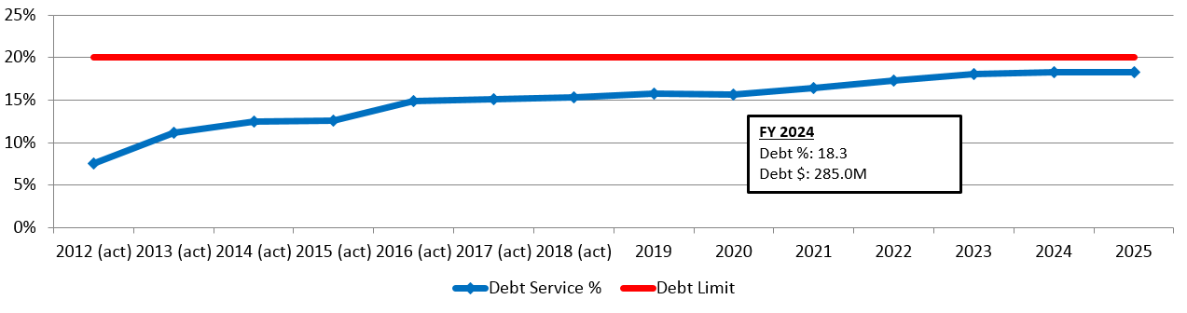
Debt Policy Limit
MnDOT’s internal policy states annual debt service costs cannot exceed 20% of annual state revenues and transfers in
Notes:
We can bond an additional $270 million according to our November 2018 Forecast.

Slide 49
Cumulative Debt Transfers vs. Trunk Highway Debt Service Surcharge Laws of Minnesota 2008, Chapter 152
Notes:
Bonds Authorized since 2000 = $4.325B
Bonds Sold = $2.939B
Remaining Bonds to be Sold = $1.386B
Full amount to pay off ALL DEBT would be:
Pay off debt transfer each year – average of ~11 additional cents (first ten years)
Smooth over the life – additional ~6 cents

Slide 50
Fund Balance Policy
The Trunk Highway Fund should maintain an undesignated, unreserved fund balance of not less than the sum:
6% of annual projected state revenues to the fund, plus
2% of authorized but unissued debt, plus
Debt service projection that exceeds 20 percent of annual state revenues as estimated for the future debt service-funding shortfall.
Policy Target is approximately $90 million in FY2018
($ in millions)
 | FY16 | FY17 | FY18 | FY19 | FY20 | FY21 | FY22 | FY23
Total | $382 | $377 | $437 | $249 | $295 | $404 | $577 | $746
Reserved | $85 | $85 | $91 | $92 | $100 | $104 | $100 | $96
Unreserved | $297 | $292 | $346 | $157 | $195 | $301 | $477 | $650
*Unreserved Fund Balance reflects amounts available to be appropriated for specific purposes
Notes:
Reasons to maintain reserve balance:
Delayed congressional action or inaction regarding federal revenues creates uncertainly.
A major disruption to fuel supplies could result in reduced motor fuel tax revenue, which might result in reduced federal highway funding made available to Minnesota.
Excessive use of Federal Advance Construction Agreements could affect future federal revenue in that large amounts of funding needed for “conversions”, may reduce the amount of funding available for current year federal aid agreements.
Unexpected contingencies such as providing flood relief efforts necessitate a sufficient fund balance to enable MnDOT to take action as required.

Slide 51
State Airports Sources of Revenue FY2018
($ in millions)
Sales Tax on Aircraft
$6.2M
Airline Flight Property Tax
$8M
Aircraft Registration Tax
$3.4M
Aviation Gas and Special Fuel Tax
$6.0M
State Airport Fund
Hangar Revolving Loan Fund
Air Transportation Services Revolving Fund

Slide 52
Primary State Airports Fund Revenues Nov. 2018 Forecast

Slide 53
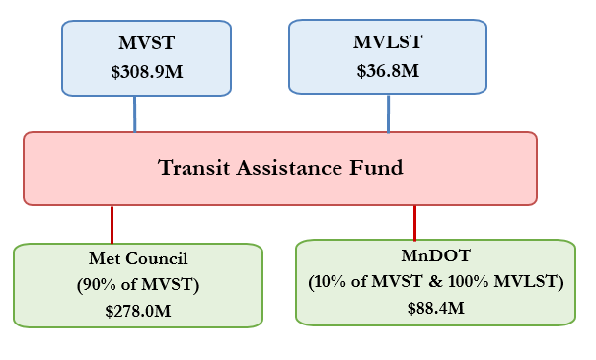
Transit Assistance Fund Sources of Revenue FY2018
($ in millions)
MVST: Motor Vehicle Sales Tax
MVLST: Motor Vehicle Lease Sales Tax

Slide 54
Motor Vehicle Lease Sales Tax (MVLST) Nov. 2018 vs. EOS 2018 Forecast
MVLST revenues are deposited in the General Fund and transferred as follows at the end of the fiscal year:
38% to County State Aid Highway (CSAH)
38% to Greater Minnesota Transit
13% to Minnesota Transportation Fund (to be used for Local Bridge Program)
11% to the HUTD Fund (to be used for Trunk Highway Fund, CSAH, MSAS)

Slide 55
Federal Government Shutdown
Federal Highway Administration remains open
Potential delay in obtaining federal permits for construction projects
Federal Transit Administration reimbursements ineligible during shutdown
No major Federal Aviation Administration impacts
Substantial impacts to Tribes
Transit, law enforcement, disaster relief, road maintenance, etc.

Slide 56
Questions?
Scott Peterson, Assistant Commissioner for Policy and Government Affairs
651-366-4817
scott.r.peterson@state.mn.us
www.mndot.gov

