Slide 1
MNsure IT 2015 Overview
March 26, 2015

Slide 2
Contents
MNsure IT Governance
Focus Areas / Priority Initiatives
Iterative IT Development / Deployment
2015 Plan Overview
Strategies for Efficient Delivery
IT Expenditures

Slide 3
MNsure IT Governance
Business Owners/Sponsors
MN.IT
MNsure
(Board and Exec Leadership)
County
Intra-agency management structure and processes for alignment of:
Strategic direction
Decision-making
Operational management
Clearly defined responsibilities
Prevents “scope creep”
Brings structure and discipline to IT efforts
Use of resources
Timelines, schedules
Executive Steering Committee (ESC)
Program Management Team (PMT)
Program Manager
Change Control Board (CCB)
MN.IT Project Management Office (PMO)
DHS Business
MNsure Business
2015 IT Project
2015 IT Project
2015 IT Project
2015 IT Project
2015 IT Project
2015 IT Project
2015 IT Project
2015 IT Project
2015 IT Project
2015 IT Defect Fixes
2015 IT Change Requests
Release Management / Deployment
Testing
Defect Management
Training
Communication

Slide 4
MNsure IT Governance Governing Bodies
A joint committee comprised of senior-level management from MNsure, DHS and MN.IT, as well as senior-level representation from our county service delivery partners
Communication and coordination with MNsure Board & Legislature
Strategic direction, goal-setting
Oversees communications with Counties, Insurance Carriers, Navigators/Brokers
Executive Steering Committee
Program Management Team
Comprised of management level representatives from MNsure, DHS and MN.IT.
Coordination with Executive Steering Committee & Change Control Board
Monitors system performance
Operational, day-to-day management
Status reporting
Change Control Board
The Board is comprised of representatives from MNsure, DHS and MN.IT.
Oversight of all requests to improve / fix IT system
Intake
Approval/Denial/Next Step decisions
Prioritization of IT projects
IT Program Manager
Manages IT Program work plan
Oversees all project management support resources dedicated to MNsure IT

Slide 5
2015 IT Focus Areas
Focus Areas | Improvement Examples* *Not comprehensive; illustrative only
Enhance the Customer Experience
Faster, simpler renewals with pre-populated forms
Easier online plan comparisons & shopping
Enhance Program Integrity
More timely and accurate generation of invoices and processing of payments
Ability to auto-process life event changes (births, divorces, etc.)
Improve Case Management Functionality
County workers will not have to enter certain types of data multiple times on multiple forms
Brokers/Navigators will be able to provide enhanced customer service
Enhance Back-Office Functions
Data reconciliation between MNsure and key state databases
Standardized system performance reports for management
This is a preliminary roadmap. The exact quantity, list and resulting functionality of 2015 MNsure IT projects will be finalized following a formal scoping of all projects.

Slide 6
Focus Areas
Work Underway
Focus Areas
Priority Initiatives
Life event processing
Streamline case worker task lists
Continued improvements in eligibility processing
QHP (Commercial insurance) Open Enrollment Period and Renewal Processing improvements
Enrollment System of Record. Data Reconciliation and improved user interface
Reports: automatic creation of standardized system performance reports
Security enhancement for case worker log on (Multi-Factored Authentication)
IT Infrastructure Improvement – additional testing/training environments
Data transmission of enrollments to carriers (834 EDI files to Carriers)
2014 IRS 1095 Files, sent to enrollees and transmitted to IRS
Public program renewals – January, February, March complete, April in-process
Enhance the Customer Experience
Enhance Program Integrity
Improve Case Management Functionality
Enhance Back-Office Functions
This is a preliminary roadmap. The exact quantity, list and resulting functionality of 2015 MNsure IT projects will be finalized following a formal scoping of all projects.

Slide 7
Focus Areas
Additional Work
Focus Areas
Priority Initiatives
Navigator/Broker Portal: provide tools to more efficiently assist consumers
MinnesotaCare Premium Invoice Generation and Payment Processing
Child Support System Interface
Special Enrollment Period
Medical Assistance and MinnesotaCare Renewals – Phase II
MNsure interface improvements to Medicaid system (MMIS)
Enrollment System of Record Phase II
Citizen / Worker Portal Integration
Notices – Limited Denial / Termination Reasons
Notices – Infrastructure, Generating and Issuing Notices
Usability Enhancements/Plan Comparison
Enhance the Customer Experience
Enhance Program Integrity
Improve Case Management Functionality
Enhance Back-Office Functions
This is a preliminary roadmap. The exact quantity, list and resulting functionality of 2015 MNsure IT projects will be finalized following a formal scoping of all projects.

Slide 8
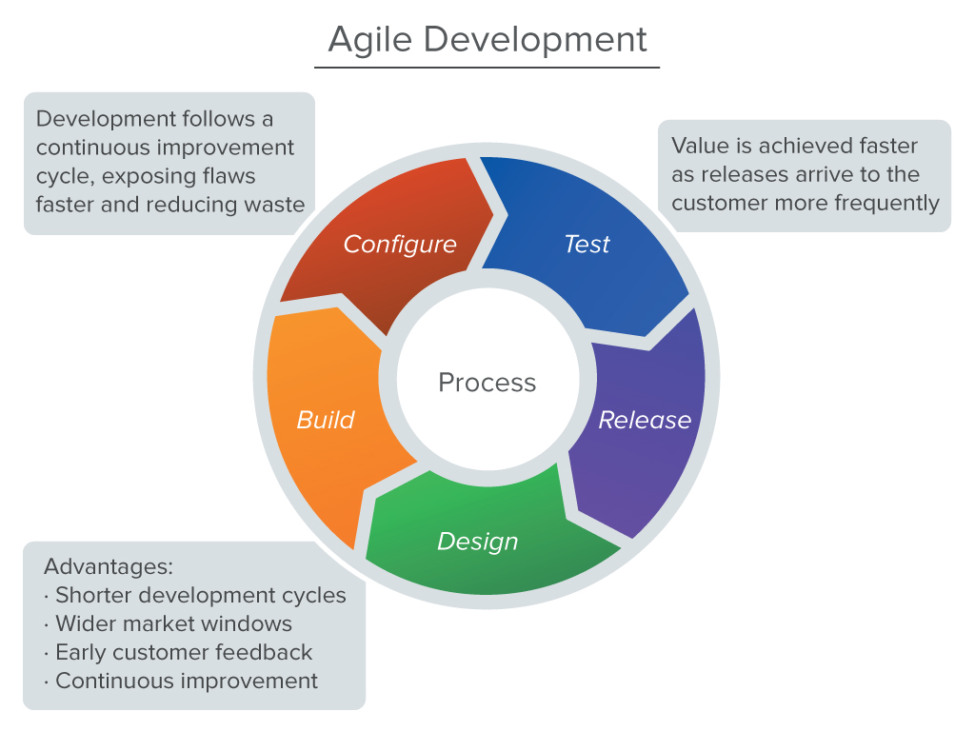
Iterative IT Development / Deployment
INPUT
DEPLOY

Slide 9
Work Currently Underway
2015 Plan Overview
Work in Scope/Planning Phase
Work in On Deck for project Scope/Planning
Open Enrollment Nov. 1-Dec. 31
March
May
July
Sept.
Dec.
Federal Hub Service Upgrade (VLP) | Life Event Entry Phase 1 (2 of 6 high priority items) | Security Enhancements (Multi-Factor Authentication) –Pilot | QHP Renewals and Open Enrollment | PRISM Interface
Public Programs Renewal Functionality (415) | Caseworker functionality simplification - Phase 1 (task management) | Life Event Entry Phase 2 (4 remaining high priority items) | Improvements to client eligibility processing (Effective dates) Phase 2 | Reporting Functionality Phase 2
41 System Defect Fixes | Enrollment data to carriers (Phase 1 – EDI transaction) | Caseworker functionality simplification Phase 2 (task management/UI simplification) | Security Enhancement Multi-Factor Authentication full implementation | Usability Enhancements Phase 2
Eligibility System of Record Fixes 14 | Enhanced MA Renewal Functionality | Improvements to client eligibility processing (Effective dates) Phase 1 | Citizen/Worker Integration Phase 1 | Navigator/Broker Portal Phase 2
Finance Fixes (5) EP | Eligibility Software Product Upgrade | MinnesotaCare Payment Processing | Notices – Limited Denial/Termination | Citizen Worker Portal Phase 2
Cost-Effective determination logic change | System Defects | MA and BHP Renewals Processing Functionality Phase 2 | Usability Enhancements Phase 1
Case generation functionality fix-Product Development Case |  | Enrollment System of Record Phase 2 | Reporting Functionality Phase 1
 |  | Special Enrollment | MNsure MMIS Interface Functionality
 |  |  | Navigator/Broker Portal Phase 1

Slide 10
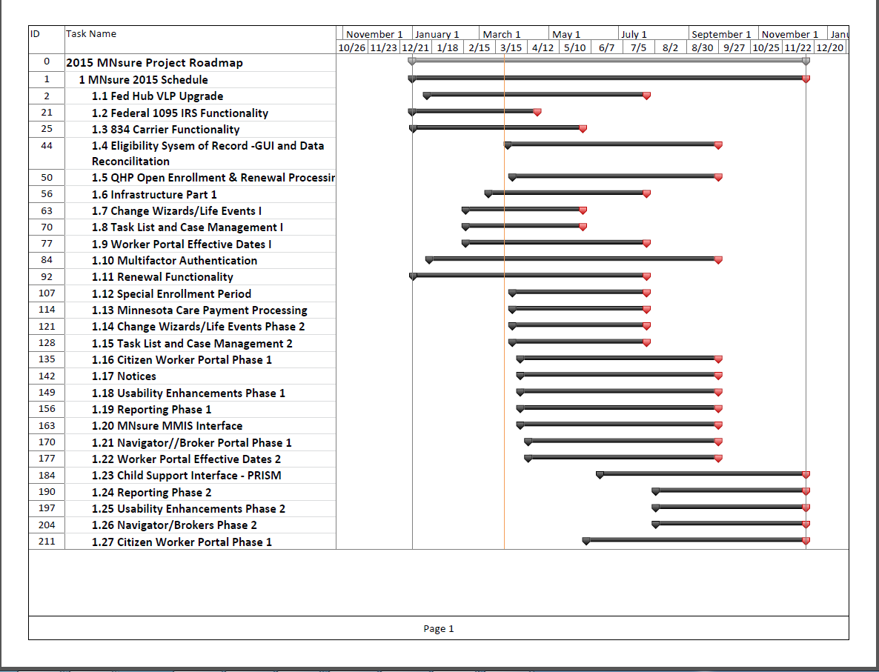
Mnsure 2015 Project Schedule 11/2014-12/2015

Slide 11
Strategies for Efficient Delivery
Staff Augmentation: Addressing significant resource constraints through the augmentation of IT resources assigned to MNsure. Staff augmentation is needed to replace vendor resources due to contract expiration, as well as increase MN.IT resource capacity to address the scope of work. IT resource augmentation will include: Hiring temporary unclassified MN.IT staff Hiring temporary vendor/contract staff Reallocation of MN.IT staff Work stream Approach: Efficiencies in approaching all work that utilizes the same set of skills and knowledge to design, develop, and test specific systems. External Resource/Fast Track Approach: Certain functionality improvements may be able to be developed independently through the use of external resources. This allows us to undertake multiple initiatives concurrently without significant impact to our resource capacity. MN.IT In-house: A number of MN.IT staff have developed expertise in the eligibility solution and are able to independently address certain functionality needs.

Slide 12
IT Expenditure Categories
Categories | Expenditures
Staff Augmentation
12 Current MN.IT staff augmentation contracts released including project management, business analysis, quality assurance, development and database resources.
Vendor
Security vendor, eligibility vendor, plan shopping vendor:
State Staff
Project Managers, Business Analysts, Quality Assurance Analysts, application administrators, database administrators, supervisory
Hardware
Software
Environments: Needed to support multiple work-streams including training and additional development environments:
Software: Additional license costs for environments
Back Office Functions
Reporting, tuning, auditing, disaster recovery, support services:

Slide 13
Thank you!

