Slide 1
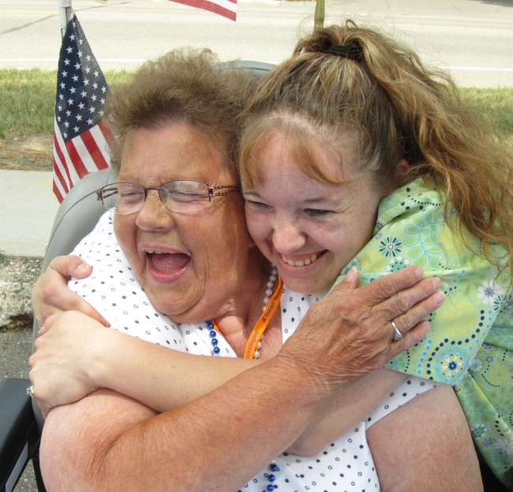
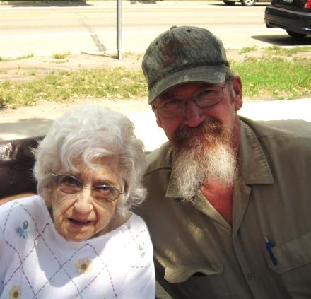
Metro Rate legislation proposal HF 173 / SF 90
Mille Lacs, Isanti, Pine, Chisago, & Kanabec Counties
Aging and Long Term Care Policy Committee - March 4

Slide 2
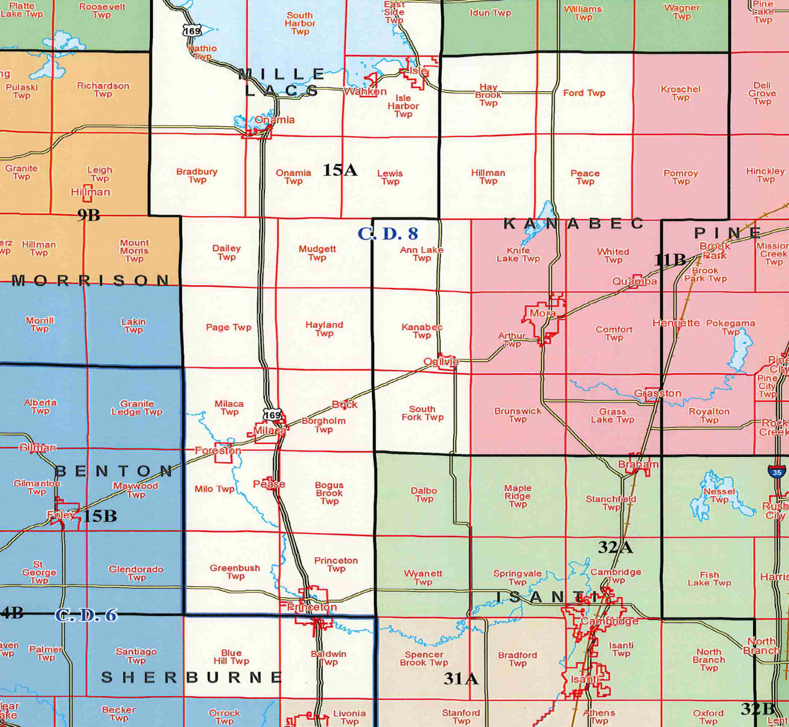
Mille Lacs, Isanti, kanabec, pine & chisago Counties
….labeled & funded as “Rural”
Metro County line
Non-metro nursing homes

Slide 3
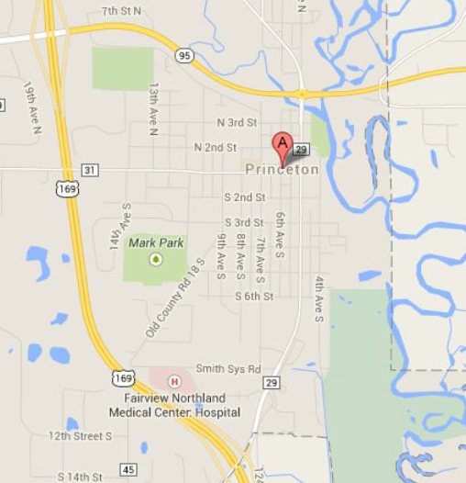
Princeton
….a city divided
Rural
Elim - Princeton
Metro County line
Metro

Slide 4
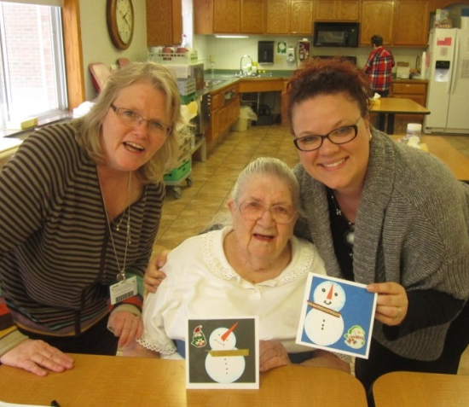
Metro County line ---
Where Elim’s Nurses live
RN
20 miles
LPN
30 miles
nearby Metro pay NH’s
17 miles
nearby Hospitals & clinics
Non-metro nursing homes

Slide 5
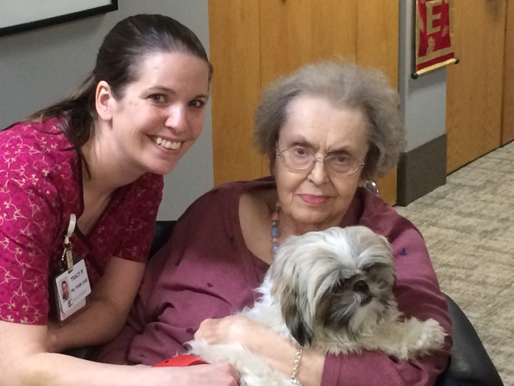
Metro County line ---
Where Elim’s NARs live
20 miles
30 miles
nearby Metro pay NH’s
17 miles

Slide 6
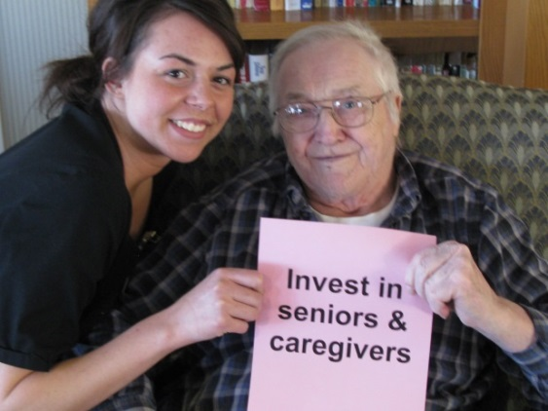
Yearly Fulltime - starting salaries
ELIM (NON-Metro nursing home)
vs “Metro” Competition
vs
NARs – $ 27–32K
NARs – $ 22K
Nearby Metro SNF’s
LPNs – $ 40–49K
LPNs – $ 34K
RNs – $ 52–61K
RNs – $ 44K
NARs – $ 33–47K
Nearby Hospitals
LPNs – $ n / a
RNs – $ 62-97K

Slide 7
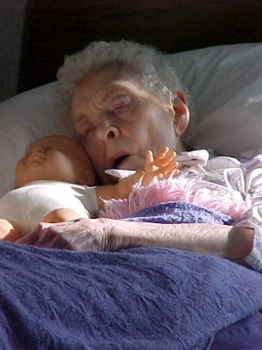
Of all hires,
Elim Care & Rehab Center - Princeton
2013 & 2014 only
…. these
23 LOST to higher paying jobs at Metro SNFs:
18 NARs – nursing asst’s
3 RNs
1 LPN
1 Plant Operations

Slide 8
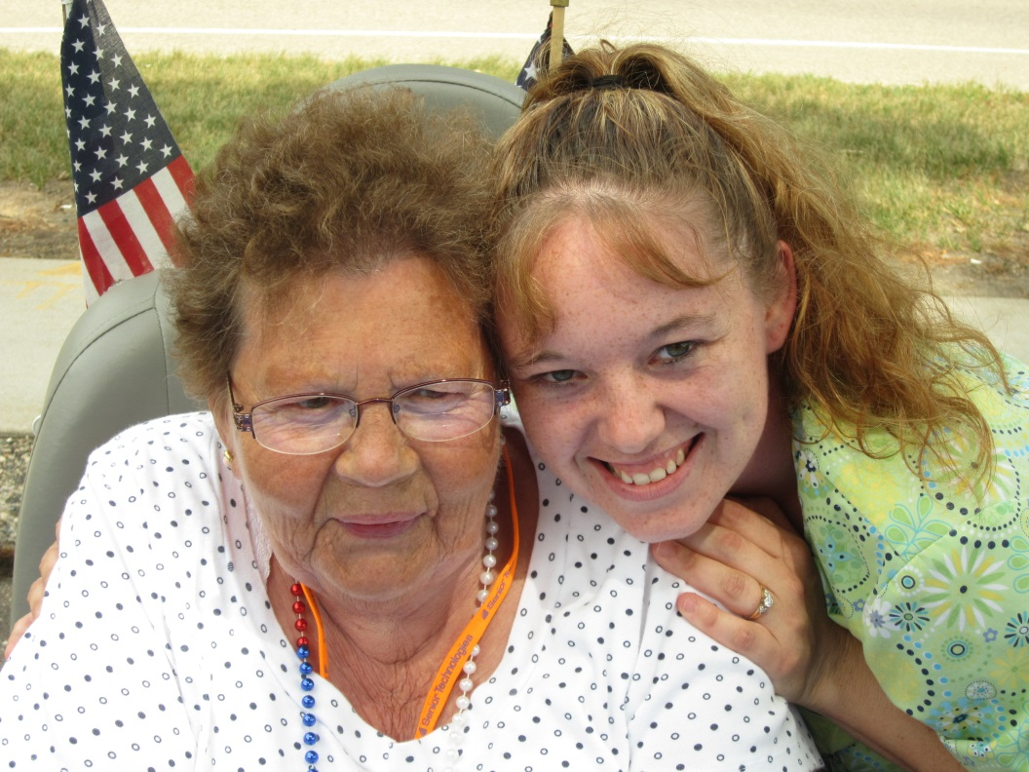
We Need Your Help!

