Slide 1
DEED Presentation to the House
Job Growth and Energy Affordability Committee
Commissioner Shawntera M. Hardy
January 10, 2017

Slide 2
Presentation Agenda
Agency Overview
Economic Development Programs
  Minnesota Investment Fund
  Job Creation Fund
Workforce Development Programs
  Workforce Development Fund
  Workforce Development Fund Employment and Training Competitive Grant Programs
  Outcomes Report Card
  Unemployment Insurance Trust Fund and calculation of the 1.0 AHCM

Slide 3
Mission and Program Focus
Workforce Development
Ensures that businesses have the talent they need to be globally competitive and that workers have the skills that businesses need
Economic Development
Contributes to Minnesota’s economic success by providing services that support the growth of businesses and communities
Research and Analysis
Provides data, data tools, research, and analysis that give a comprehensive, nuts-and-bolts look at Minnesota’s economy and workforce
“Our mission is to enhance the economic success of individuals, businesses and communities”
Agency Programs

Slide 4

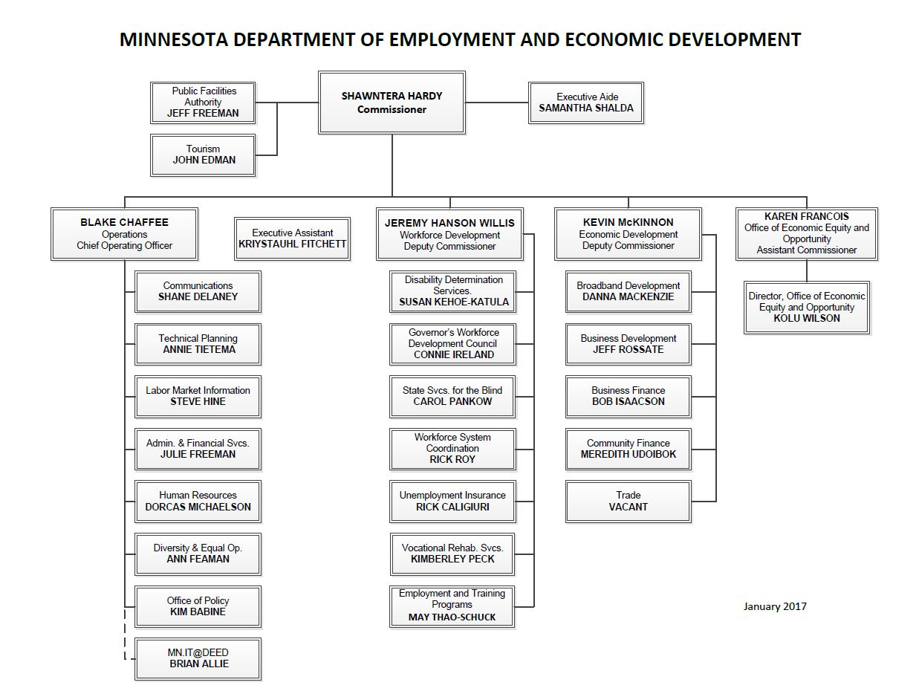

Slide 5
Agency Budget

Slide 6
Agency Budget

Slide 7
Team DEED – FY09 – FY18
PROGRAM | FY09 | FY10 | FY11 | FY12 | FY13 | FY14 | FY15 | FY16 | FY17 | FY18
Broadband Development Office |  |  |  |  |  | 0.5 | 2 | 2.8 | 3.5 | 4
Business and Community Development | 45.8 | 45.8 | 44.4 | 45.08 | 45.07 | 46 | 49.5 | 48.4 | 50.2 | 49.9
Disability Determination | 159 | 176.2 | 205 | 162.12 | 145.08 | 136.2 | 162 | 149.8 | 153 | 153
General Support Services | 149.9 | 149.9 | 156.8 | 167.02 | 160.45 | 141 | 144.6 | 144.8 | 130 | 128
Minnesota Trade Office | 15 | 13.4 | 14 | 13.26 | 13.55 | 13.1 | 14 | 12.5 | 13 | 13
Services for The Blind | 115.6 | 122.6 | 127.7 | 104.68 | 113.19 | 112.8 | 112.1 | 108 | 112.2 | 112.2
Unemployment Insurance | 445 | 533.4 | 547.2 | 455.52 | 469.07 | 419.5 | 392.4 | 357.8 | 356.4 | 368.5
Vocational Rehabilitation | 385.8 | 404.3 | 401.2 | 324.43 | 340.09 | 333.7 | 330.9 | 339.4 | 347.2 | 347.2
Workforce Development | 348.6 | 366 | 343.8 | 294.79 | 312.2 | 273.5 | 296.6 | 293.6 | 318.2 | 317.9
Grand Total | 1664.7 | 1811.6 | 1840.1 | 1566.9 | 1598.7 | 1476.3 | 1504.1 | 1457.1 | 1483.7 | 1493.7

Slide 8
Economic Development Programs

Slide 9
Economic Development Programs Overview
Business
Finance
Business Development
Small Business Assistance
Business Assistance Programs
Minnesota Trade Office
Community Assistance Programs
Broadband
Development
Redevelopment
Grant Program
Infrastructure Programs

Slide 10

Economic Development Incentives
Purpose
  Position Minnesota to Compete to Retain and Attract Companies
Approach
  Modest
  Strategic
  Transparent
  Accountable

Slide 11

Job Creation Fund (JCF) - History
Launched January 1, 2014
Pay for performance
  No funds provided until businesses meet program requirements
Nationally recognized best practice, next generation business finance program

Slide 12

JCF – Business Eligibility + Award Criteria
Be in an eligible industry
Have location options outside Minnesota
Certify that project would not occur without JCF
Have at least $500K in real property improvements within one year
Create 10 full-time jobs with compensation of at least $12.85/hour within two years

Slide 13

JCF – Total Performance
Projected to create/retain 4,682 jobs
Projected to average $24.80 in hourly pay
$33.4M in program awards
expected to leverage more than
$1B in private investment

Slide 14
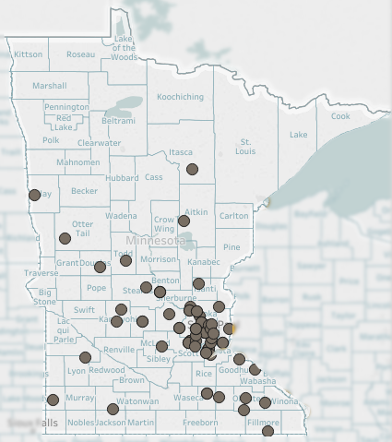
JCF - Map of Approved Projects
75 projects approved
  39 in the Twin Cities
  36 in Greater Minnesota

Slide 15

Minnesota Investment Fund (MIF) - History
Launched in 1985
Nearly $150M loaned to 500 projects
  69% of funds awarded to Greater Minnesota
Repayments to local governments have seeded revolving loan funds in more than 100 local communities

Slide 16

MIF - Business Eligibility + Award Criteria
Be in an eligible industry and need MIF assistance to proceed
Match MIF financing with private financing
Increased tax base
Meet required wage levels
Applications scored on variety of business factors to determine eligibility

Slide 17
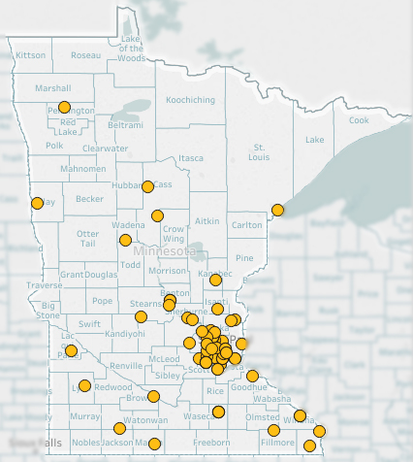
MIF - Map of Approved Projects
Since FY14:
71 projects approved
  38 in the Twin Cities
  33 in Greater Minnesota

Slide 18

MIF – Total Performance
Expected to create nearly 5,000 new jobs and retain more than 500 at risk jobs
Projects projected to average $24.09 per hour
$39.8M in program awards expected to leverage more than $960M in investment

Slide 19
Workforce Development Programs

Slide 20
Workforce Development Programs Overview
Individual Placement & Supports
Extended Employment
Independent Living
Vocational Rehabilitation
State
Services for
the
Blind
Employment and Training – Youth Programs
Employment and Training for People with Disabilities
Unemployment Insurance Division
Employment and Training – Adult Programs

Slide 21
Workforce Development Fund
Total Receipts into the Fund
FY 2016: $53m | FY 2017: $55m | 16-17 Biennium: $108m
Dislocated Worker Program
Total Receipts minus Legislative Appropriations equals Amount Available for Dislocated Worker Program
FY 2016: $26m | FY 2017: $24m | 16-17 Biennium: $50m
Small Layoffs
61% of what the funds available for the Dislocated Worker program is allocated, by formula, to local workforce development areas and other providers to provide services for small layoffs.
FY 2016: $16m | FY 2017: $14.5m | 16-17 Biennium: $30.5m
Legislative Appropriations from the Fund
FY 2016: $27m | FY 2017: $31m | 16-17 Biennium: $58m
Mass Layoffs
The remaining 39% of the Dislocated Worker Program funds available are used by DEED to respond to mass layoffs.
FY 2016: $10m | FY 2017: $9.5m | 16-17 Biennium: $19.5m
DEED and DLI Programs
FY 2016: $24m | FY 2017: $26m | 16-17 Biennium: $50m
Pathways to Prosperity, Youth at Work, YouthBuild, Minnesota Youth Program, Job Training Incentive Program, Funding for Report Card, DLI Apprenticeship, DLI Prevailing Wage Enforcement, Small Business Development Centers, Extended Employment, DT&H Grants, Rural Career Counselors, Expansion of Business Assistance Services, Bureau of Small Business
Other Direct Appropriations
FY 2016: $3m | FY 2017: $5m | 16-17 Biennium: $8m
Twin Cities Rise!, Resource Inc, SciTechsperience, Boys and Girls Club, Big Brothers Big Sisters, Opportunities Industrialization Centers, Minnesota Diversified Industries, Occupational Development Corporation, Historic Preservation Corps, North East Higher Education District

Slide 22
Workforce Development Fund

Slide 23

Competitive Grant Programs - History
In 2011 biennial budgeting session, 3 new competitive grant programs created – Move from direct funding
In 2013 legislature decided to continue grant programs
In 2015 biennial budget session, due to strong performance, Governor recommended continued funding

Slide 24
Competitive Grant Programs – Last Grant Cycle
2016 Equity Article Appropriated $35 million
Pathways to Prosperity Program
Youth at Work Program
Women in High Wage, High Demand, Nontraditional Jobs Competitive Grant Program
Southeast Asian Economic Relief Competitive Grant Program
Support Services Competitive Grant Program
Somali Youth Competitive Grant Program
Minnesota Emerging Entrepreneur Program
Capacity Building Grant Program

Slide 25
Competitive Grant Programs – Last Grant Cycle Process
Legislature Appropriates Funds
DEED Develops Programs
DEED Develops RFPs
Open RFP Period
Applications Review – Review Panels
Award Decisions Made
Grant Agreements Negotiated and Executed

Slide 26
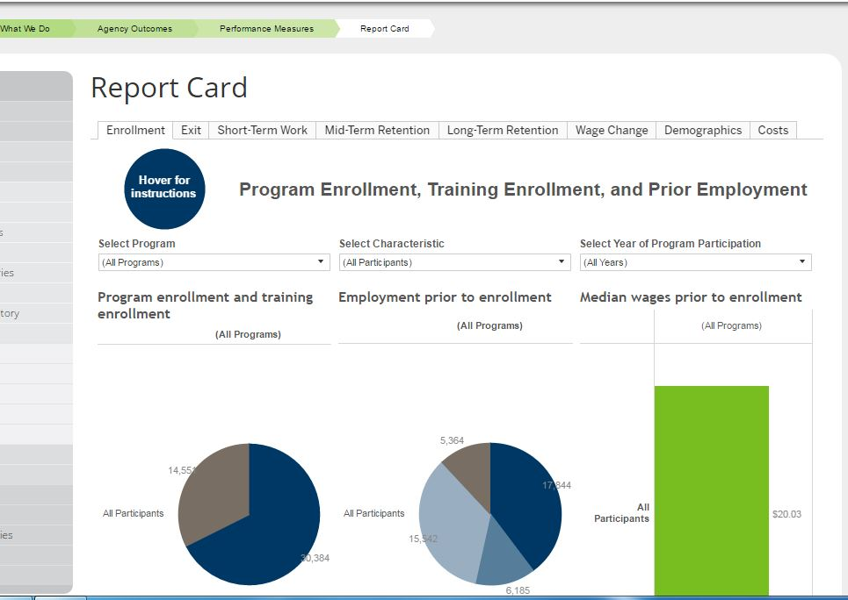
Workforce Development Programs Outcome Report Card

Slide 27

Unemployment Insurance - Trust Fund
Trust Fund balance on December 31, 2016: $1,565,460,415
This Trust Fund balance results in an AHCM of 0.90

Slide 28

Thank You!

