Slide 1
MARINE CORPS RECRUITING STATION
TWIN CITIES
MAJOR ANDREW D. NICHOLSON
COMMANDING OFFICER

Slide 2
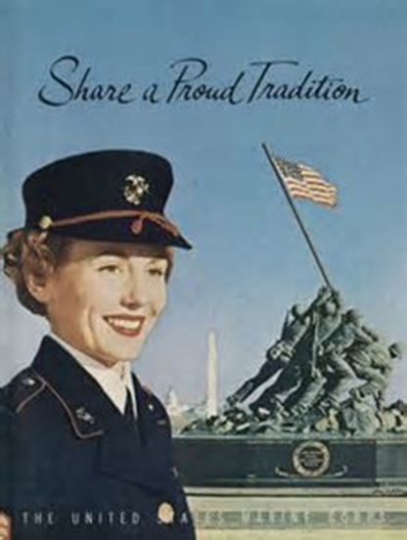
Mission
We Make Marines
We Win Our Nation’s Battles
We Return Quality Citizens to the U.S.

Slide 3
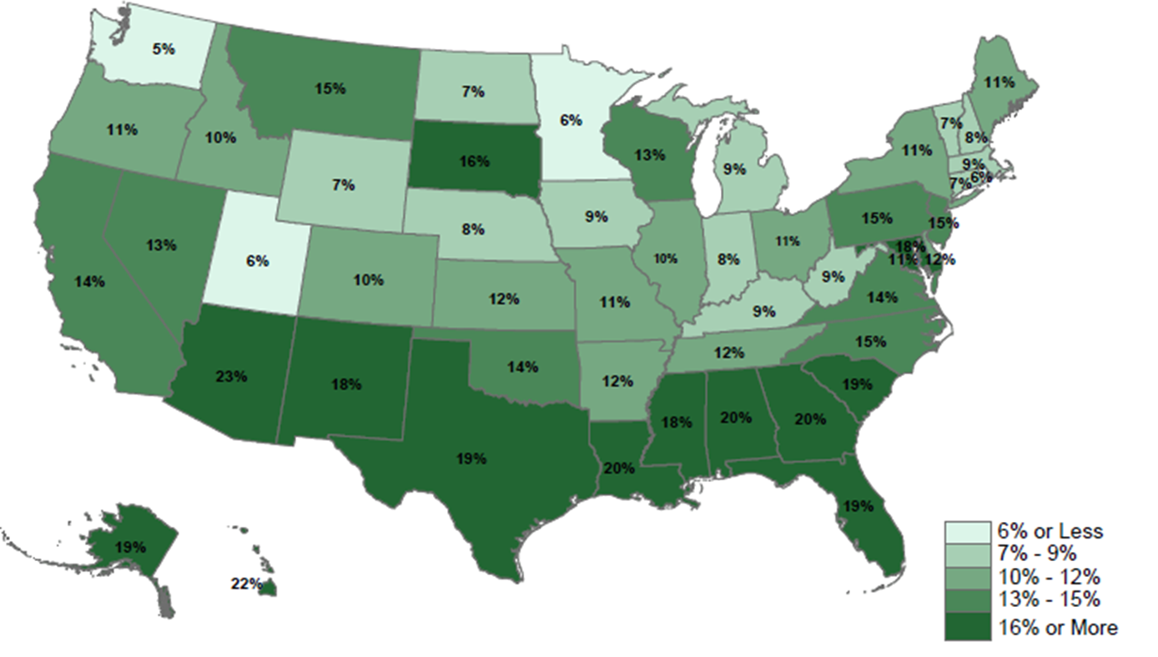
Propensity To Serve By State

Slide 4
State of the Market

Slide 5
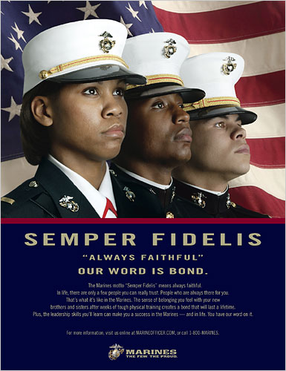
QUESTIONS
CORE VALUES
Honor
Courage
Commitment
Once a Marine, Always a Marine
andrew.nicholson@marines.usmc.mil

