Slide 1
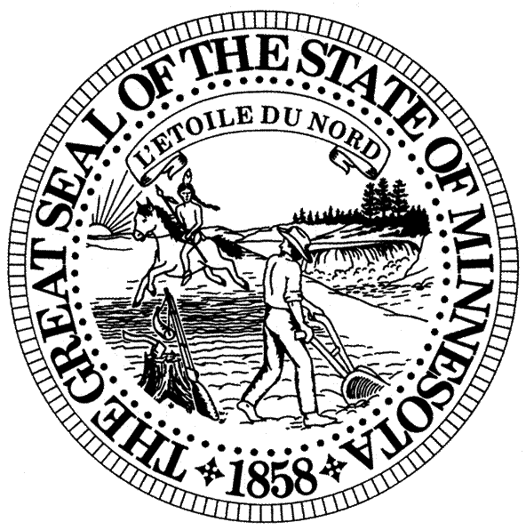
Office of the Minnesota
Secretary of State
2018 Election Overview

Slide 2
Election Administration
  Work with counties, cities, and towns in the administration of elections
  Operate and maintain the Statewide Voter Registration System (SVRS), the database of all Minnesota voters
  Certify voting systems
  Accept candidate filings for federal and state offices
  Train local election officials
  Conduct most recounts

Slide 3
Voter Outreach
Work with the Office’s Disability Advisory Committee on voting issues and outreach
Encourage youth civic engagement
  Ballot Bowl
  Students Vote mock elections
Partner with business and sports communities to promote upcoming elections and voting
Direct outreach to service members and their families

Slide 4
2018 in Numbers
3,529,626 million registered voters
2,611,365 million voted
Approximately 28,700 Minnesotans
served as election judges
Minnesota #1 in Voter Participation (64.25%)

Slide 5
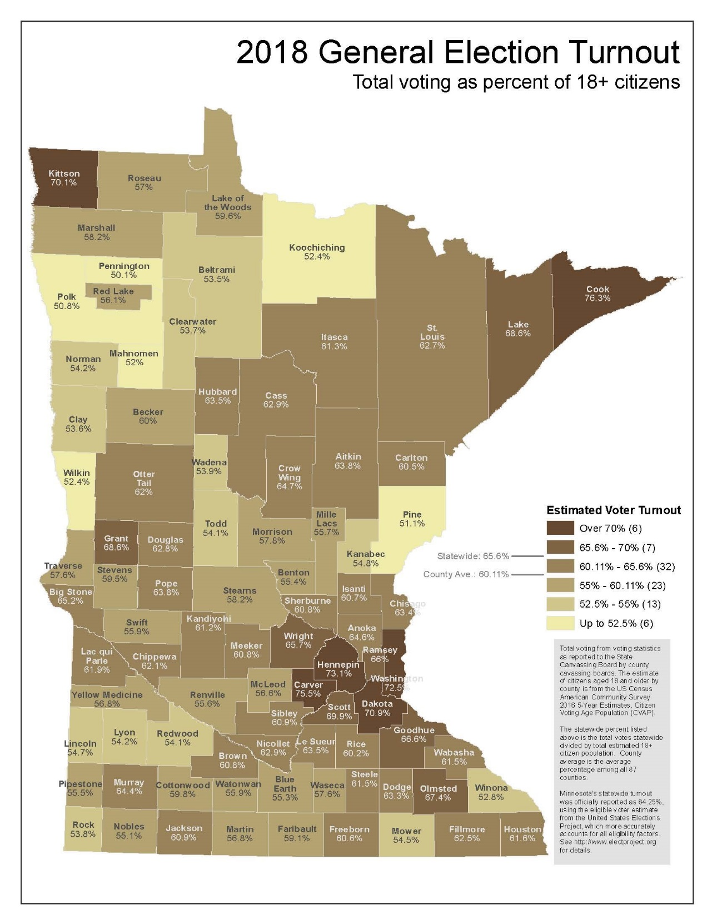

Slide 6
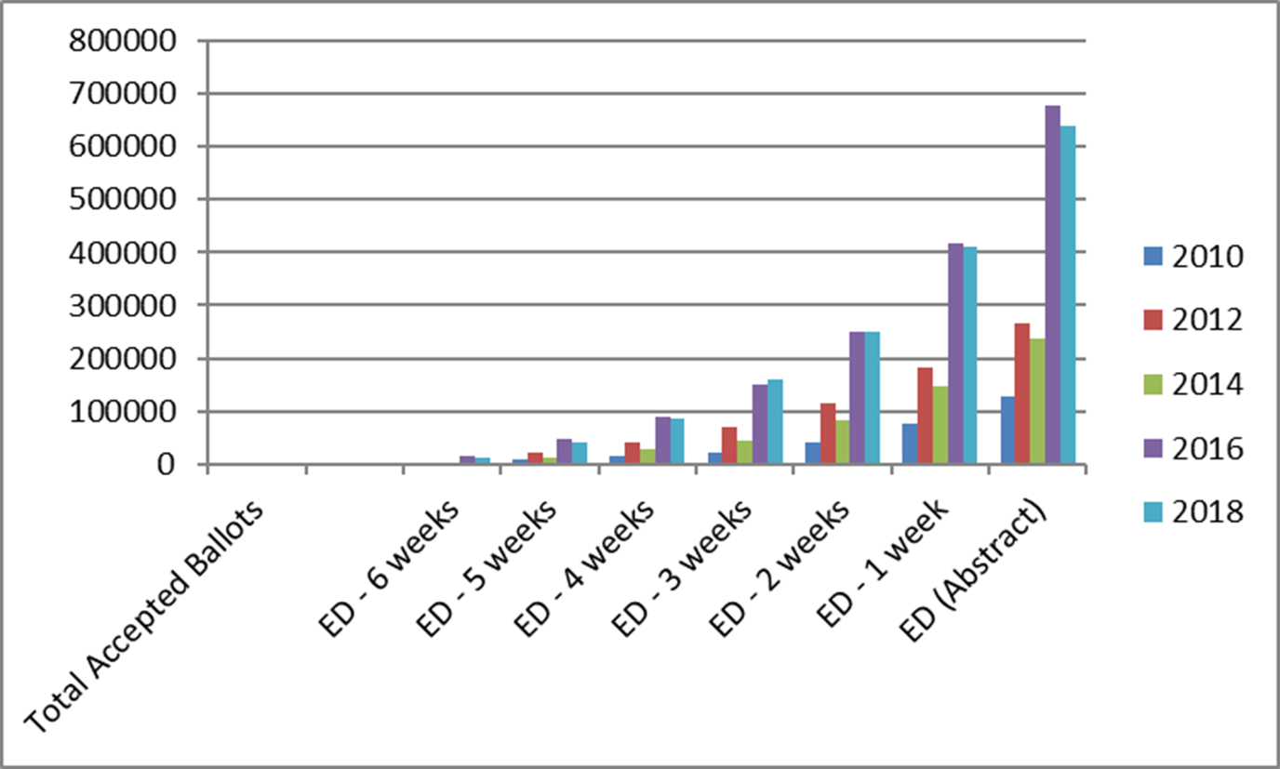
Absentee Voting
638,846 voted by mail or absentee ballot (24.5% of the total votes)

Slide 7
Use of Online Tools
Use of Online Absentee Ballot Requests:
  168,012 voters requested a regular absentee ballot
  8,388 UOCAVA ballots requested
Use of Online Voter Registration Tool:
  142,063 online voter registration applications
  Of those, 77,108 were new registrants and 57,058 were updates to registrations

Slide 8
2018 Issues
SVRS Performance
  Continued issues as identified in the OLA report
Political Apparel
  First election after the Supreme Court held portions of Minn. Stat. 211B.11 unconstitutional
Cyber Security
  Partnership with DHS and the National Guard

Slide 9
Questions

