Slide 1

HF 2901: Bolstering Minnesota’s Disaster Volunteers
February 13, 2020
Public Safety and Criminal Justice Reform Finance and Policy Division
Notes:
Rep. Baker

Slide 2
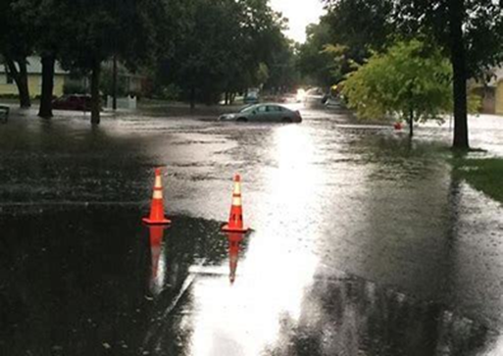
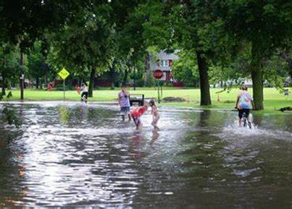
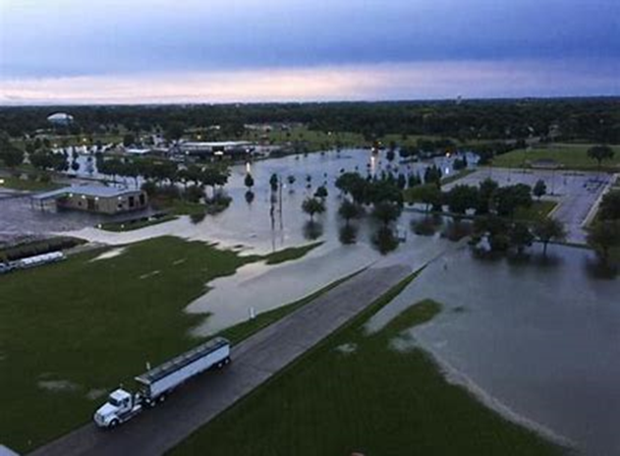
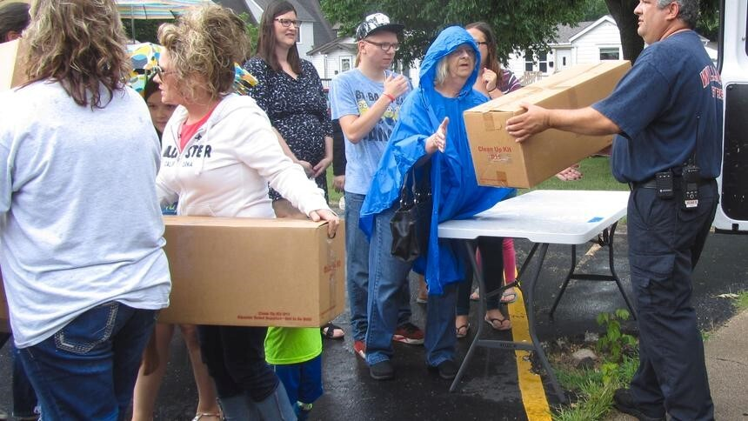
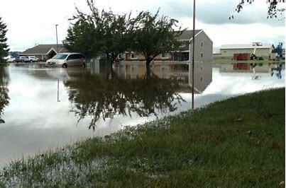
Wilmar, MN 2016
Notes:
Rep. Baker: Why bill matters (mention Wilmar flood)

Slide 3
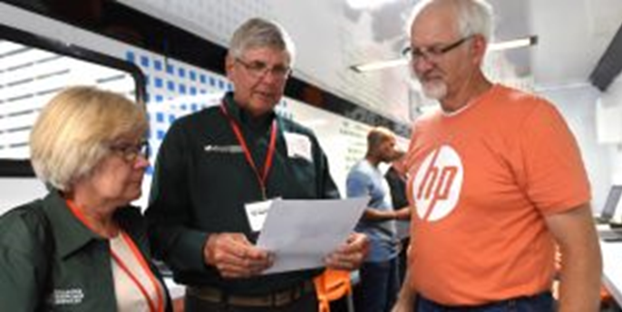
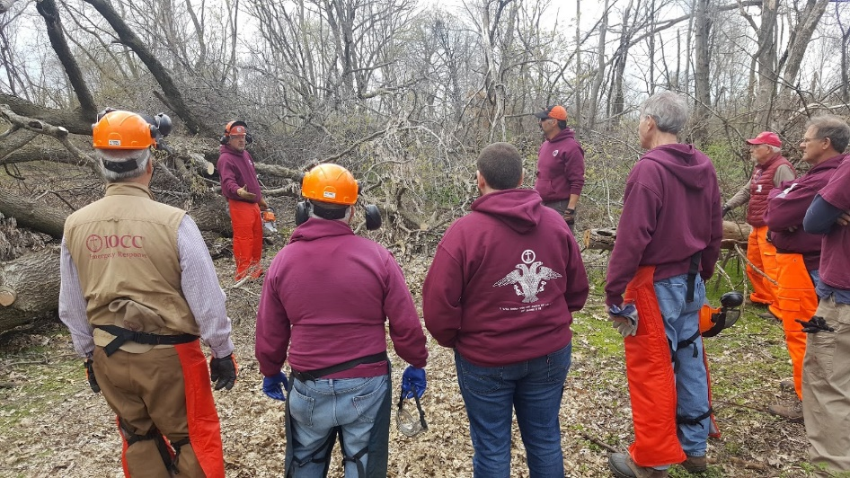
This bill would:
Providing funding to staff MN VOAD (Minnesota Voluntary Organizations Active in Disaster)
Creating a grant program to develop and expand disaster volunteer capacity across the state
Notes:
Rep. Baker: Introduce bill

Slide 4
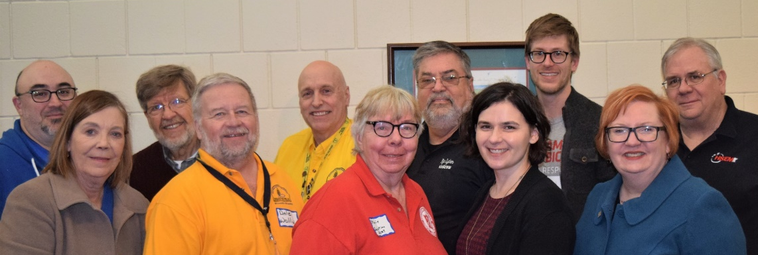
Minnesota VOAD Overview
Association for voluntary agencies and local partners to network, exchange ideas, and work together during disaster
Brings together 30+ Member Organizations & dozens of valued community and government partners
Is a designated Support Organization in the Minnesota Emergency Operations Plan (MEOP)
Has a desk in the State Emergency Operation Center (SEOC)
Notes:
R. Talford

Slide 5
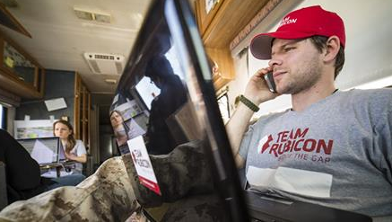
MNVOAD’s role in a local disaster
Facilitates conference calls to assist in interagency communication and allocate resources efficiently
Provides a coordination point for emergency managers; represents all member agencies at all levels
Helps to identify unmet needs, locate additional resources and support the establishment of Long-Term Recovery Committees (LTRCs)
Notes:
K. Mortensen: Express that volunteers and nonprofits are critical to our disaster recovery system.

Slide 6

MNVOAD Participating Organizations
Notes:
R. Talford

Slide 7
Services Provided by MNVOAD Members:
Disaster planning and preparedness
Mass care (feeding & sheltering)
Disaster mental health, emotional and spiritual care
Community outreach
Long-Term Recovery Group support
Donations management
Volunteer management
Child Care
Pet Care/Sheltering
Damage Assessment
Debris Cleanup / “muckout”
Home Rebuilding & Repair
Communications
Disaster Case Management
Notes:
R. Talford

Slide 8
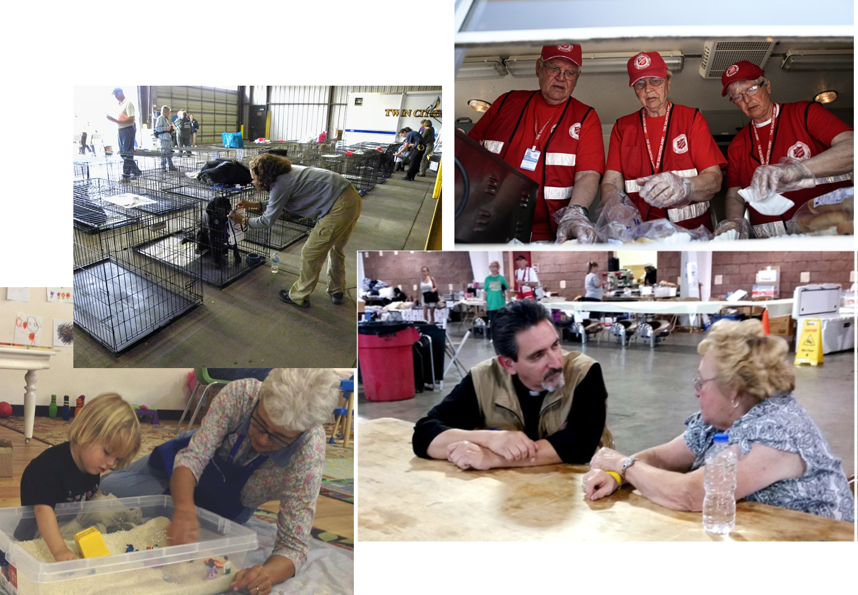
Immediate Needs

Slide 9
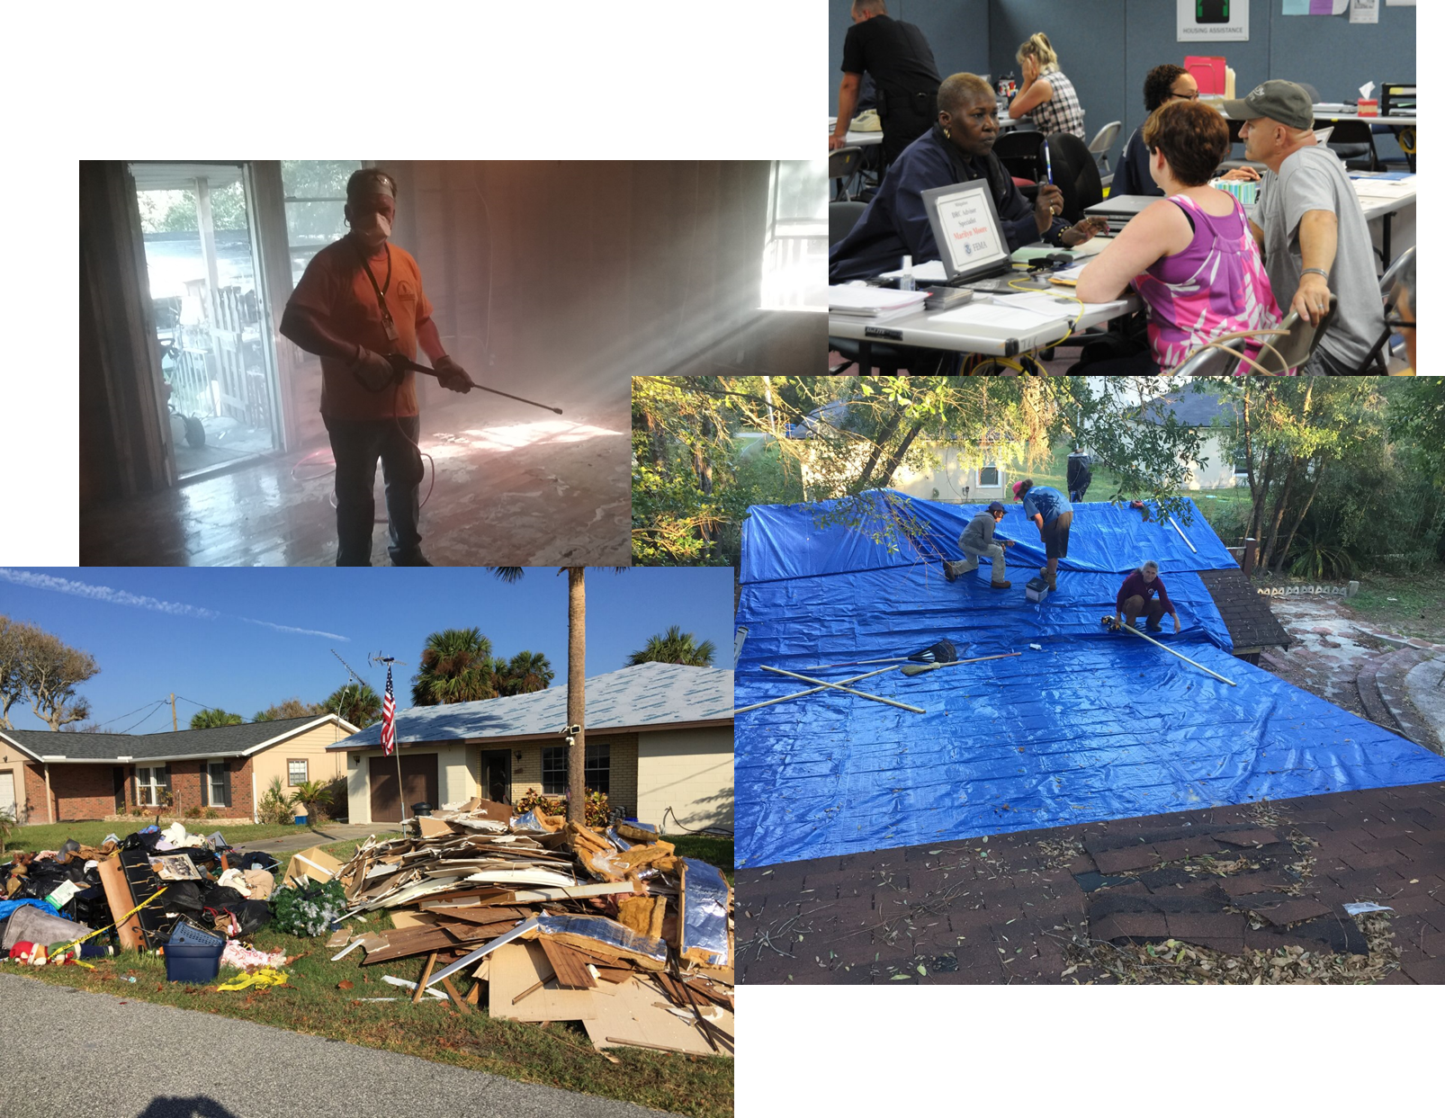
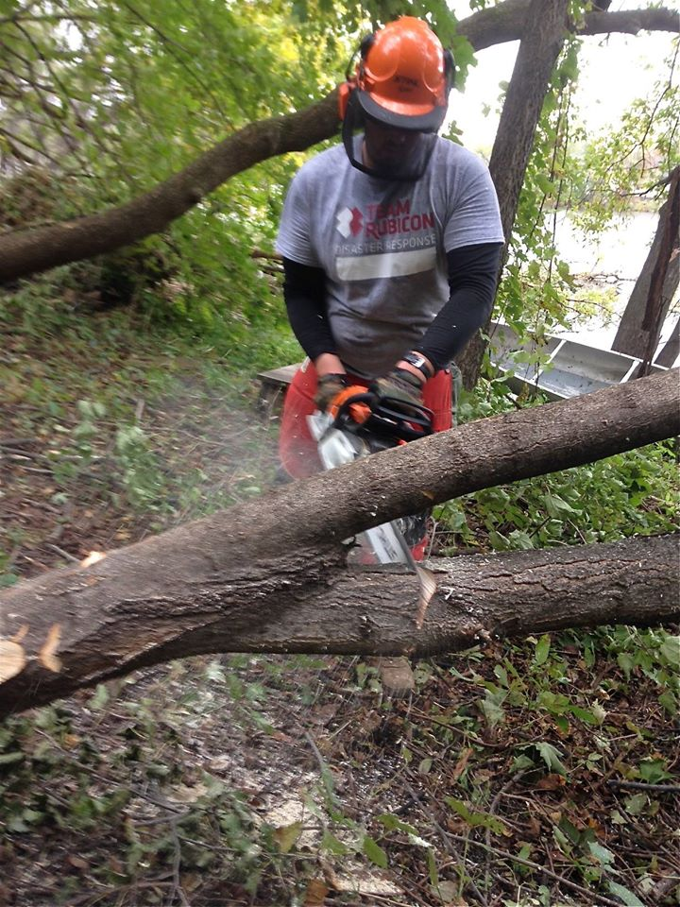
Early Recovery

Slide 10
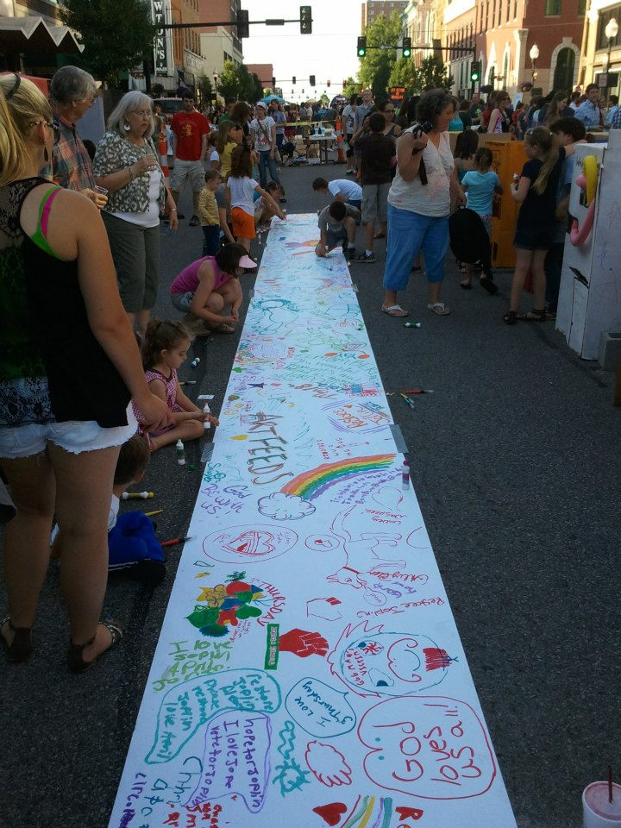
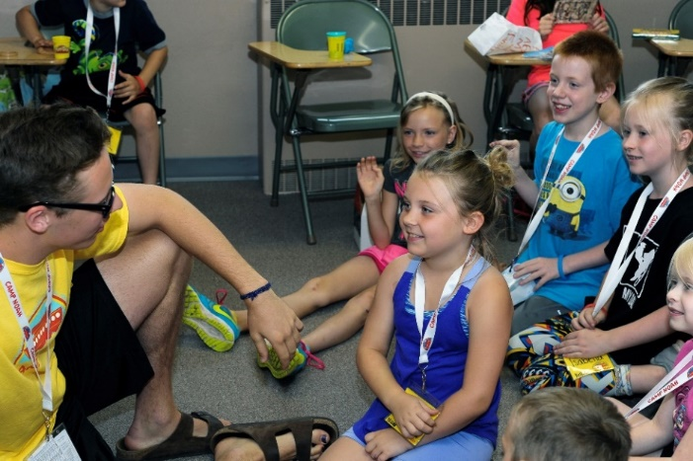
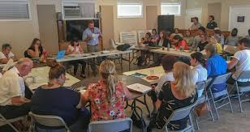
Long-Term Recovery

Slide 11
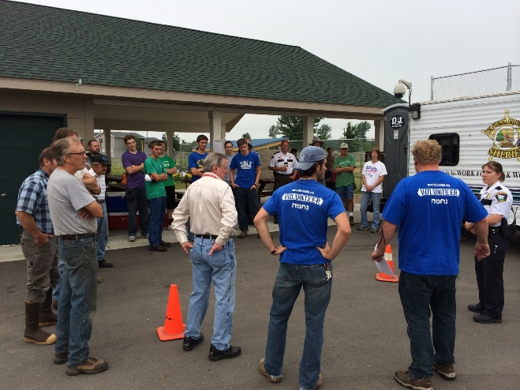
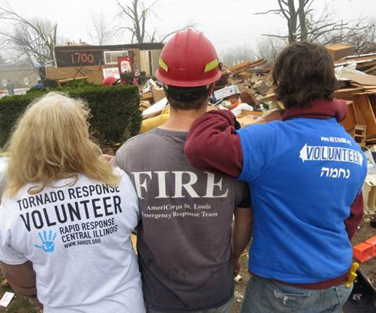
Mobilizing the Community
MNVOAD members integrate with whole community response and recovery
Lend expertise and equipment to enable engagement of local volunteers
Can solicit and manage donated resources where government entities cannot
As non-profits, are generally trusted by the public
Are flexible, innovative, resourceful, and adaptive to disaster-specific needs
Focus on most vulnerable or underserved populations
Notes:
R. Talford: Give an example of what MN VOAD can do when it is functioning well & what types of things the capacity grants could pay for

Slide 12
The bill aims to address these challenges:
MN VOAD use of all volunteer leadership; individuals with day-jobs and competing commitments
Volunteers being deployed in other parts of the country when low-attention disasters happen in Minnesota
Diminished volunteer capacity in many communities
Need to engage more diverse volunteer groups to reflect changing populations

Slide 13
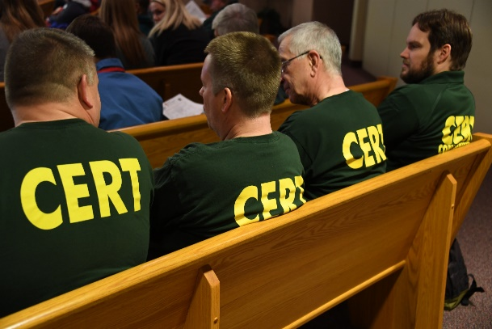
Potential impact of the bill:
Establish consistent MN VOAD leadership to ensure volunteer and resource coordination for local (esp. low attention) disasters
Support a more reliable volunteer infrastructure
Strengthen local volunteer capacity across Minnesota
Enhance partnerships and mechanisms to mobilize volunteer groups to disaster-impacted areas within the state
Build capacity to better serve our most vulnerable populations following disasters

Slide 14
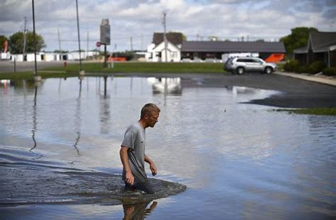
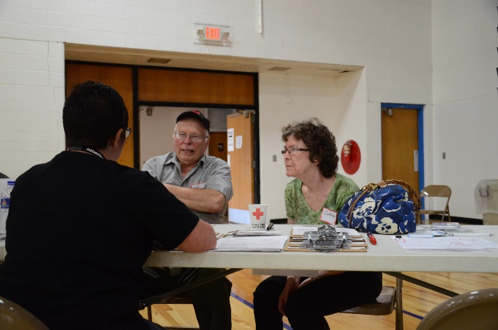
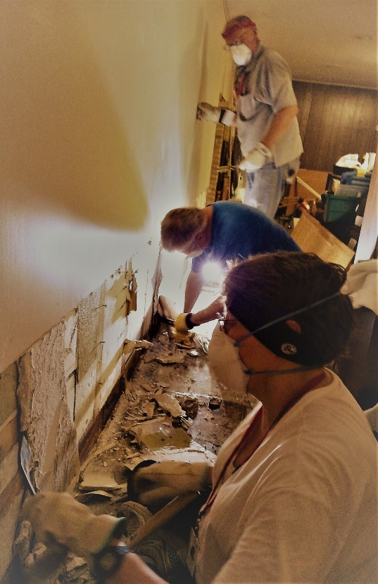
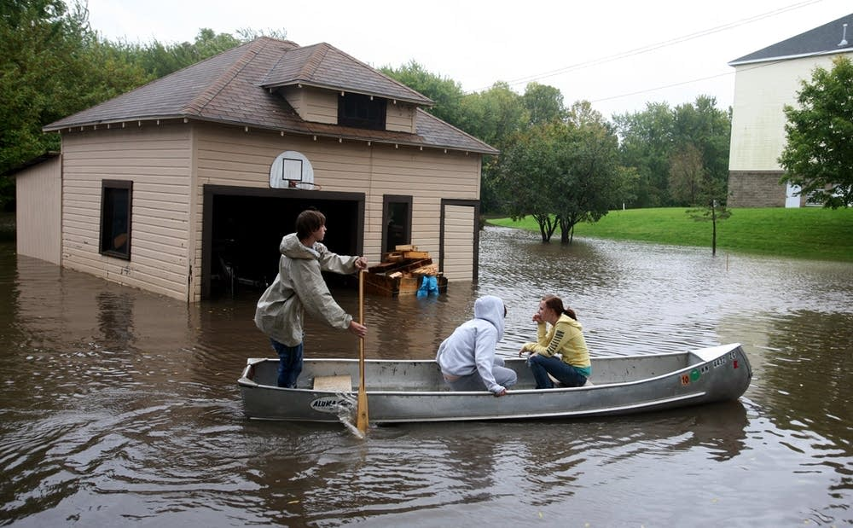
SWMN Flooding 2018
Notes:
N. Fasching: Share about SWIF involvement in disaster work (including work with the voluntary agencies) and why you think this bill will improve the system (share example from Tracy, MN).

Slide 15
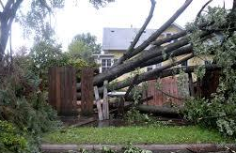
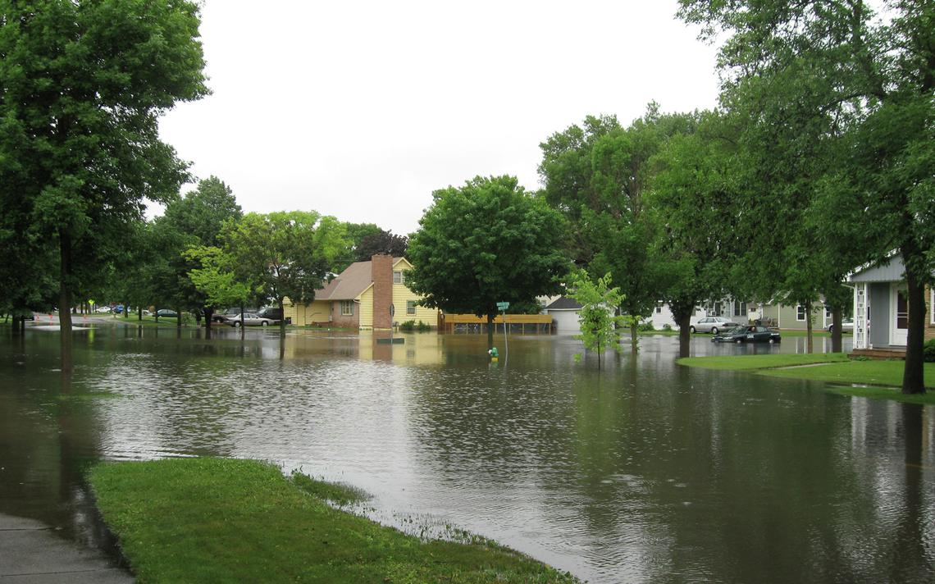
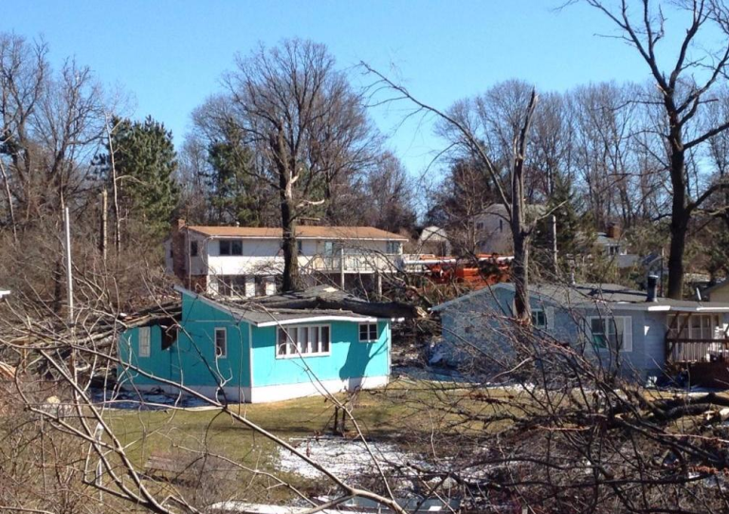
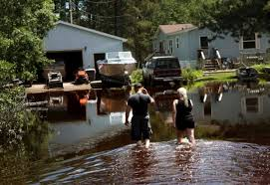
Minneapolis, MN
Tornado 2011
Wilmar Flooding 2010
Duluth Flooding 2012
Elk Lake, MN
Tornado 2017
Notes:
K. Mortensen: Reiterate that bill will help individuals and families across the state recover from disasters, including lower-attention events in Greater MN.

