Slide 1
State of Asian Pacific Minnesotans
Higher Education Finance & Policy Division
January 29, 2019

Slide 2
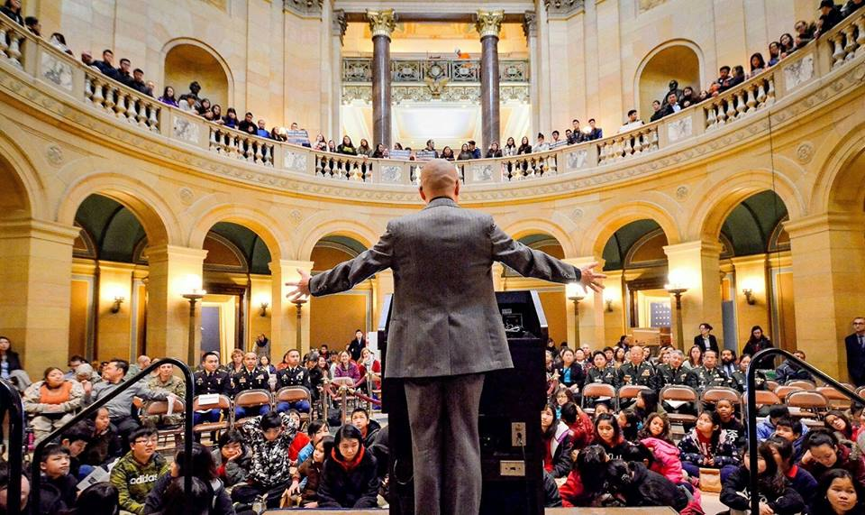
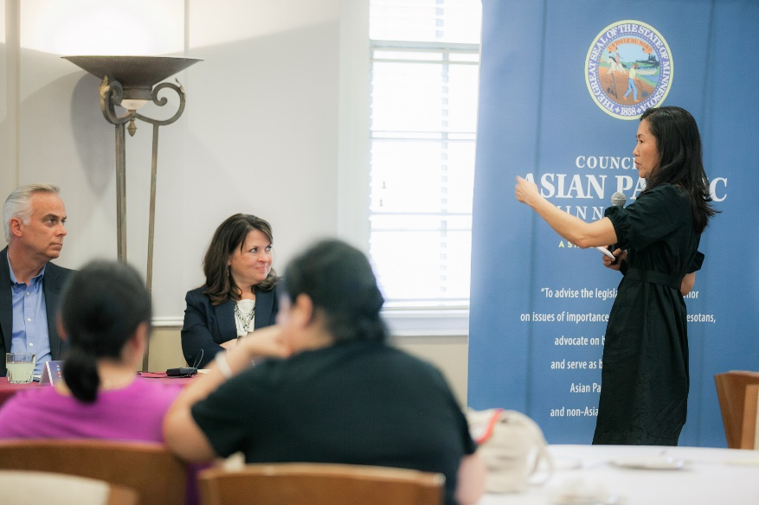
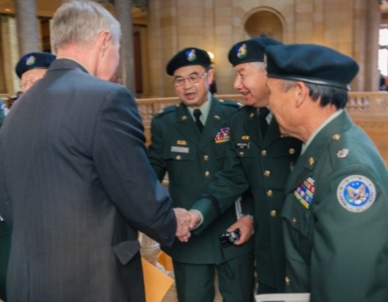
Bridge Builder
Our Council
Advocate
Advisor
Minn. Stat. § 15.0145

Slide 3
Our Community
Asian Pacific Minnesotan Population: 294,881
*“Other API” includes the U.S. Census Bureau categories: Bangladeshi, Bhutanese, Indonesian, Malaysian, Melanesian, Micronesian, Mongolian, Nepalese, Okinawan, Pakistani, Polynesian, Sri Lankan, Thai, Other Asian (specified), Other Asian (not specified), and Other Pacific Islander (not specified).
Source: U.S. Census Bureau, 2015 American Community Survey

Slide 4
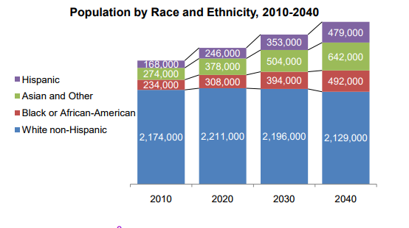
Our Community
1 in 3 Asian Pacific Minnesotans are under 18 years old
Source: U.S. Census Bureau, 2015 American Community Survey
Source: Metropolitan Council

Slide 5
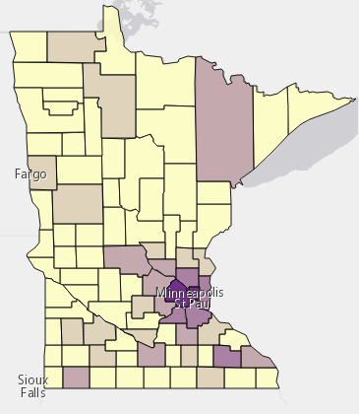
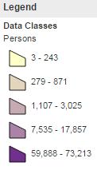
In Communities
Source: U.S. Census Bureau, 2015 American Community Survey

Slide 6
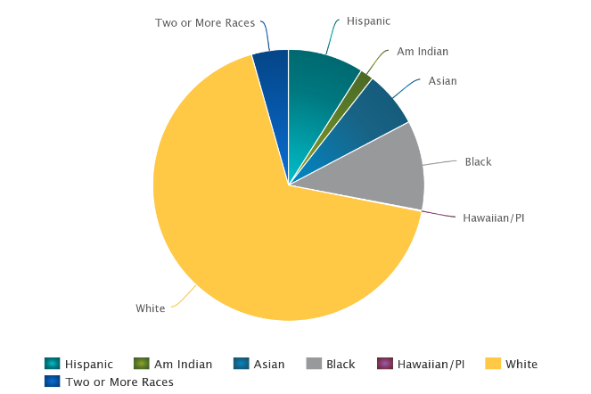
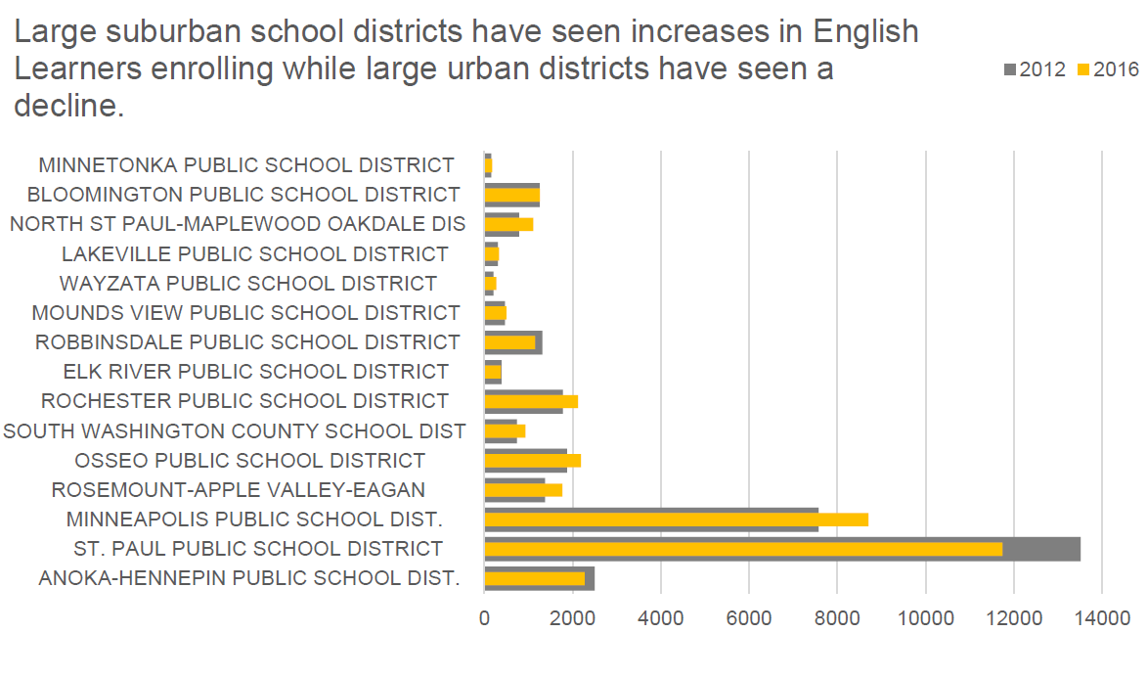
K-12 Education
MCA-III Math, Grade 11
 | Asian Students | White Students
2015 | 47.3% | 55.2%
2016 | 47.4% | 53.5%
2017 | 52.0% | 54.9%
MCA-III Reading, Grade 10
 | Asian Students | White Students
2015 | 48.3% | 64.2%
2016 | 54.3% | 65.8%
2017 | 55.3% | 67.8%
Source: Minnesota Department of Education

Slide 7
Educational Attainment
Source: U.S. Census Bureau, 2015 American Community Survey

Slide 8
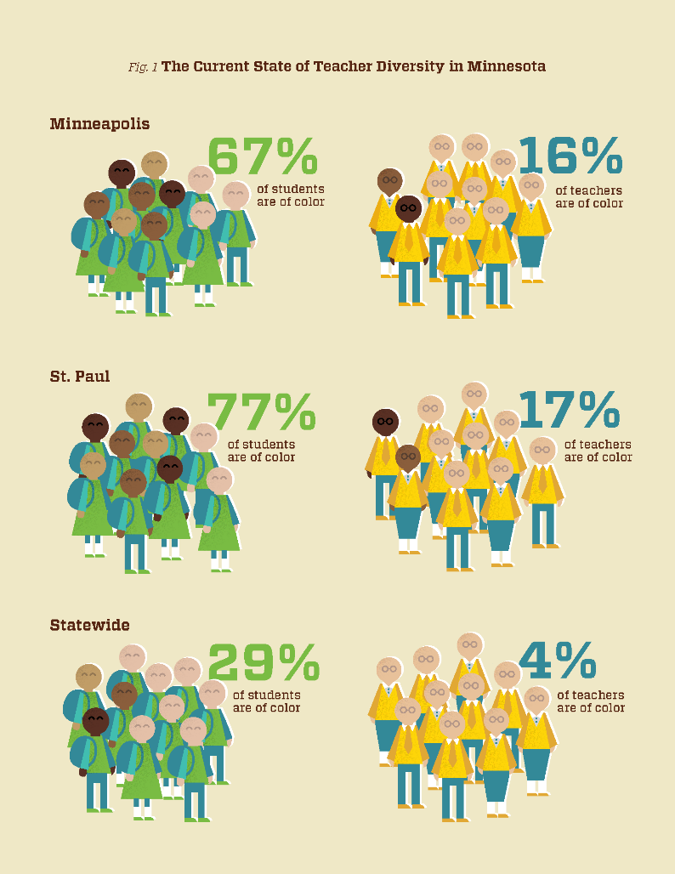
Teachers of Color and American Indian Teachers
Source: Educators 4 Excellence

Slide 9
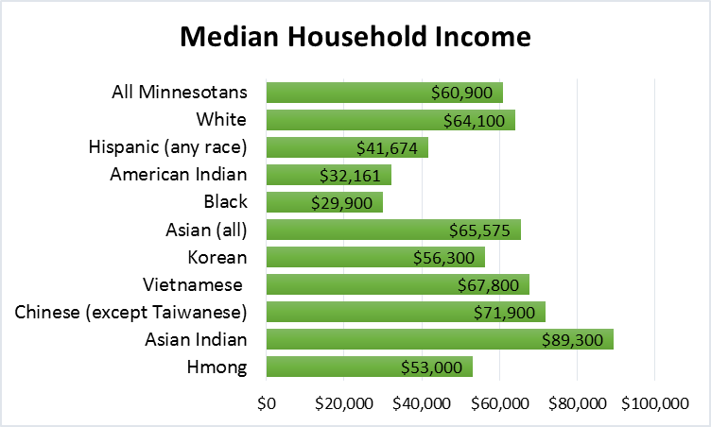
Economic Indicators - Employment
Source: U.S. Census Bureau, 2015 American Community Survey

Slide 10
Economic Indicators - Housing
Source: U.S. Census Bureau, 2015 American Community Survey

Slide 11
Linguistic Barriers
Source: U.S. Census Bureau, 2015 American Community Survey

Slide 12
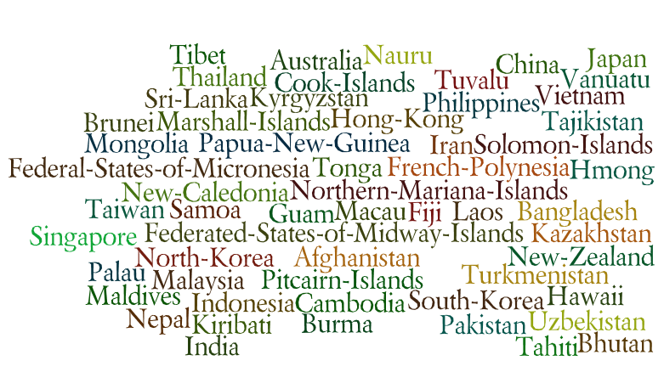
A Community of Contrasts

Slide 13

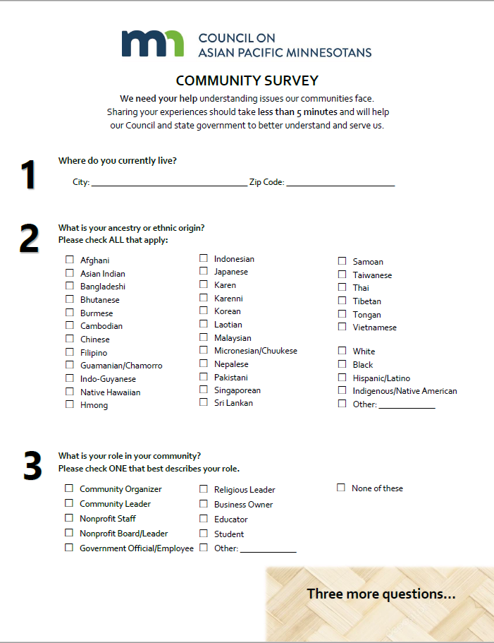
Legislative Community Survey 2019

Slide 14
Sampling
Number of Responses | N
Total completed | 827
Total, by response type
- Online | 253
- Paper | 574

Slide 15
Legislative Priorities

Slide 16
Legislative Agenda
2019-2020 Legislative Priorities
Priority Issues
The Council will actively track and pursue legislation in the following areas:
Higher Education Affordability and Access
Data Disaggregation
Healthcare Access
Equity and Social Justice
Immigration Rights
On-going Positions:
The Council will actively advocate for legislation that achieves the following:
Programs and services that are respectful of and responsive to the linguistically and culturally diverse communities of Minnesota, including Asian Pacific Minnesotans.
Collection of disaggregated data to better inform policy-making on issues of importance to Asian Pacific Minnesotans.
Increased understanding of violence against Minnesota’s Asian Pacific women and children.

Slide 17
Why is Higher Education Important to You?
Major Themes | Subthemes | Representative Quotes
Access (19) | College Readiness | "I'm a first generation Asian American student. Finding support to continue education was hard."
 |  | "Many students I know do not know much about college and higher education"
 |  | "Support more education and resources programs and support schools."
Affordability (21) | Cost | "Less and less people can afford to attend colleges and university."
 | Financial Aid | "Provide additional funding/grants to lower costs of attending college"
 |  | "Subsidize college expenses, reduce tuition"
 | Student Debt | "Students should not be burdened with college debt that will cripple their ability to buy a house and build equity."
Economic Impact (6) | Communities | "Higher education impacts the economic health and stability of the community."
 | Career Readiness | "Create more jobs/internships that will give students more experiences while still in college."

Slide 18
Why is Higher Education Important to You?
“With four children in my family and two in college, we still struggle to find support for our children to continue their secondary education. My children are having challenges with adjusting to school and I would like to see support services available for the whole family would be appreciated….I would like to learn about services that are available.”
– Chinese Minnesotan Parent, Lino Lakes
“Being a student from one of many marginalized and historically underrepresented groups, it's important [for] me to see that there are resources for others like myself in my community to achieve the same as those not in those groups.”
– Vietnamese Minnesotan Student, Eagan
“Not many opportunities for higher education for students after high school especially for a low income family. Financial aid does help, but it does not cover 100% of college expense. More students are not going for higher education.”
– Hmong Minnesotan Student, Minneapolis

Slide 19
How Can the State Help You and Your Community?
“Expose and restrict for-profit schools, educate high school students and their parents about the danger of debt, prepare and encourage students to commit to graduating as quickly as possible.”
– Chinese Community Member, Edina
“Many parents want their kids to be educated. Such as going to college but can't afford…Find a way for everyone to be educated, and for people who want to go to college [to] go.”
– Karen Minnesotan Student, St. Paul
“Reach out to local residents and listen to understand their stories of struggles. Create more policies that cater towards to the people who are in need. Create more community events that are inclusive to everyone.”
– Vietnamese Minnesotan Student, Blaine

Slide 20

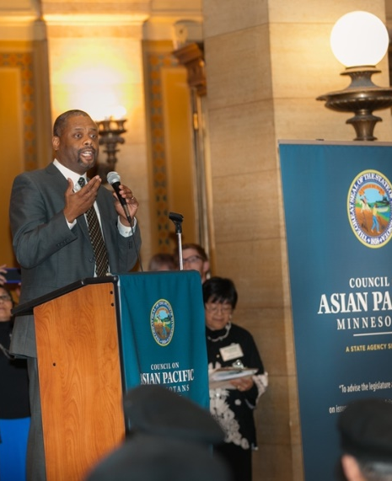
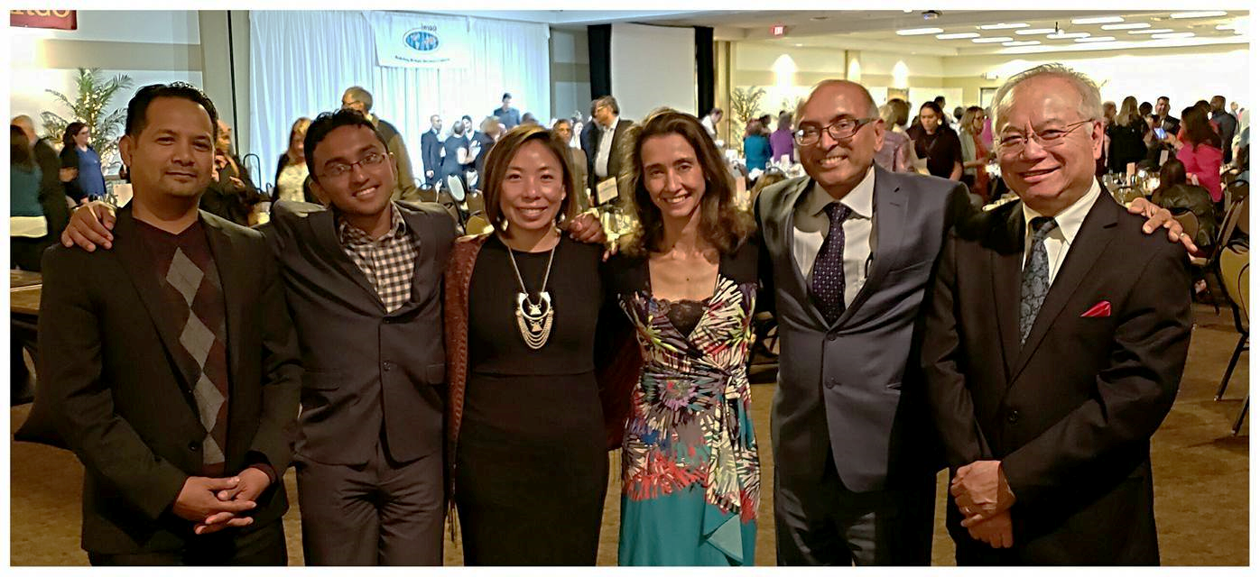
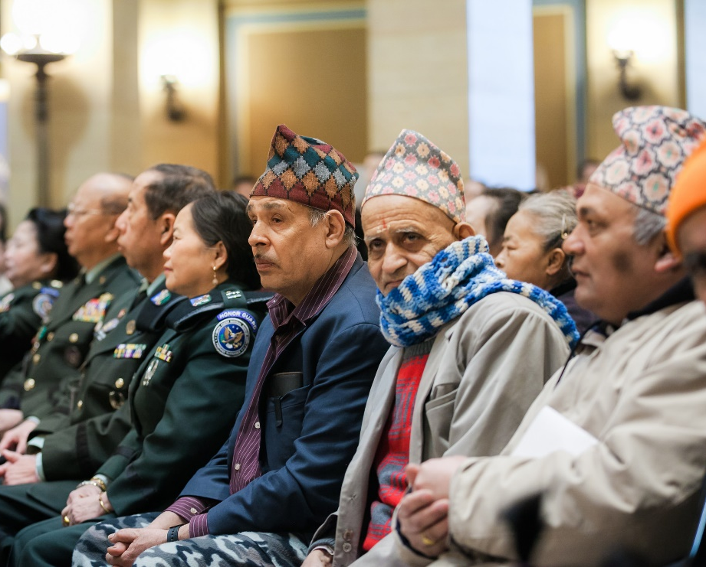
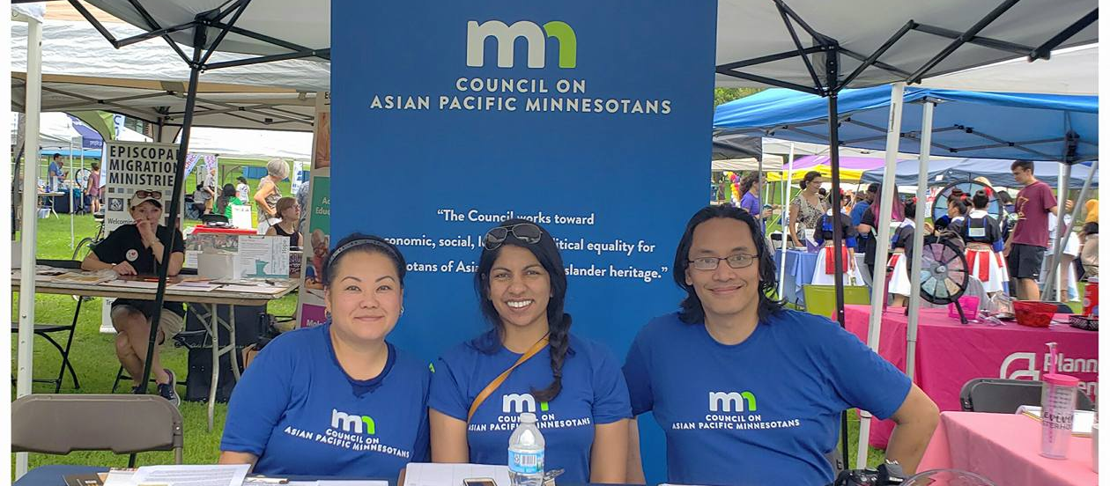
Thank You

