Slide 1
Counties Transit Improvement Board
Structure and Performance: 2008 - 2014
MN House Transportation Policy and Finance Committee
February 2, 2015
Notes:
1

Slide 2
Who we are

Slide 3
2008 Transportation Legislation
Authorization of County Tax
For Transit Expansion
Imposed by 5 of 7
Metro Counties
¼ of 1% sales tax
$20 motor vehicle excise tax
Anoka, Dakota, Hennepin, Ramsey, & Washington

Slide 4
2008 Transportation Legislation
Requirement: Joint Powers Board of elected county commissioners & Met Council Chair to govern tax proceeds (297A.992 subd. 4)
Requirement: Grant Evaluation and Ranking System Committee (“GEARS”) of city and county elected officials to advise CTIB (297A.992 subd. 5)
Notes:
So how did we get here? By working together. We all worked together to advocate for transit funding.
For more than 25 years, metro counties worked together to advocate for transit.

Slide 5
Legislative Expectations
Expansion of transitways
“Supplement not Supplant” (297A.992 subd. 12)
Construction, not studies*
Minimal administrative expenses
3/4 of 1% of tax proceeds (297A.992 subd. 4)
*Exception: Washington County Guaranteed Grants
Notes:
Example of studies funded through Washington County Grants: AA for Gateway

Slide 6
Legislative Expectations
Property tax relief
50% of net operating costs of transitways
Previously borne by County RRAs
Reduced reliance on state bonding
33% state project share down to 10%
Maximized federal funds (297A.992 subd.5)
Notes:
Property tax relief since 2008: $69.77 million
Total operating grants, excluding $45 million operating subsidies to Met Council.
The $69.77 million relates to the specific 50% obligation to the four operating transitways: Hiawatha, Northstar, Cedar BRT and I35W South BRT

Slide 7
How we work

Slide 8
Accountability
Local Elected Officials from Five Counties
Anoka, Dakota, Hennepin, Ramsey & Washington
> 90% of metro population
> 95% of metro sales tax revenues

Slide 9
2015 Board Members
Member Organization | Members | Alternate
Anoka County | Commissioner Matt Look Commissioner Scott Schulte | Commissioner Mike Gamache
Dakota County | Commissioner Nancy Schouweiler Commissioner Thomas Egan | Commissioner Mary Liz Holberg
Hennepin County | Commissioner Peter McLaughlin Commissioner Mike Opat | Commissioner Marion Greene
Ramsey County | Commissioner Jim McDonough Commissioner Rafael Ortega | Commissioner Victoria Reinhardt
Washington County | Commissioner Lisa Weik Commissioner Karla Bigham | Commissioner Ted Bearth
Metropolitan Council | Chair Adam Duininck
Carver County (Ex officio) | Commissioner Randy Maluchnik
Scott County (Ex officio) | Commissioner Jon Ulrich Commissioner Mike Beard
GEARS Committee (Ex officio) | Council Member Ady Wickstrom City of Shoreview
Notes:
In addition to 2 elected county commissioners from each of the 5 counties, the Metropolitan Council Chair also sits on the Board, along with ex-officio members from Scott and Carver counties, and the GEARS Committee

Slide 10
13 Colonies Population (1780)

Slide 11
Balancing Regional Differences
Sales Tax
Population
Notes:
Together, these five counties generate more than half of the sales tax revenue in Minnesota
Collectively export $125 m per year to other counties thru CSAH formula

Slide 12
CTIB Voting Structure
100 total votes
63 votes, from at least 3 counties, required to pass anything
75 votes, from at least 3 counties, required to make long-term funding commitments or approve issuance of debt
Notes:
Beats a bicameral legislative body
Show me the money: $100m / year jump start for system expansion

Slide 13
A Lean Organization ¾ of 1% for administrative expenses (297A.992 subd. 4)
Live within our means
No buildings, property or land
No employees
Use county legal, financial and communications staff
Contract for services as needed
Notes:
Statutorily limited to ¾ of 1% of sales tax revenue.

Slide 14
What we do

Slide 15
Focus: Transitway Expansion
Invest in:
Engineering, construction and operations
BRT, commuter rail, and LRT
Do not invest in:
Studies*
Passenger rail, regular route buses, arterial BRT
*Exception: Washington County Guaranteed Grants
Notes:
We promised expansion and that’s what we’ve invested in.
Really focused on expanding transit service along major high volume corridors.

Slide 16
CTIB: Largest Non-Federal Investor
Notes:
CTIB is the largest Minnesota funding partner for transitways.
30% capital costs
50% net operating

Slide 17
Counties Also Invest Heavily
Counties provide 80% of non-Federal share (pre-FFGA)
Counties assume significant early risk
Invest in early planning, environmental work, engineering, and ROW acquisition before federal commitment (FFGA)
Capital Cost Share Pre-FFGA
17
Notes:
Because CTIB is a county-led organization, in effect, counties are providing 40% of total capital costs and 80% of early project funding.
Counties assume the highest level of risk during early project phases and provide the leadership necessary to advance projects into construction

Slide 18
Secure federal funding

Slide 19
19
Notes:
Reduction of state bonding obligations:
The state share of CCLRT at 10% is $91,548,000.
If the state had to pay a 33% share, their costs would have been $315,777,000.
A difference of $224,229,000.

Slide 20
Federal New Starts & Small Starts
Nationally competitive funding programs administered by the Federal Transit Administration (FTA)
Projects rated on merit and local financial commitments
Up to 50% federal funding provided when construction begins

Slide 21
CTIB’s Role
30% or more of total capital cost
60% of funding for Project Development and Engineering (upfront risk)
50% of the net operating subsidy
Cash flow
Funding commitments to secure federal funding

Slide 22
Role of Funding Commitments
Included in submittals to FTA
Used by FTA to evaluate financial plans and rate projects
Local financial plan 50% of project rating
Relied upon by FTA as rock-solid commitment of funds

Slide 23
Status of CTIB Funding Commitments
Status | Funding Commitments | Grants to Date | Commitments Outstanding
Green Line LRT | $283,950 | $283,950 | $0
Red Line BRT | $17,700 | $17,700 | $0
Southwest LRT | $496,000 | $97,701 | $398,299
Bottineau LRT | $27,600 | $18,300 | $9,300
Orange Line | $6,000 | $3,000 | $3,000
Total | $831,250 | $420,651 | $410,599
In millions

Slide 24
Making MN’s Transportation Pie Bigger: ~$1.5 Billion in Federal Funds
Bottineau LRT | Red Rock Corridor
Cedar Avenue BRT | Robert Street Corridor
Central Corridor LRT | Rush Line Corridor
Hiawatha LRT | Southwest LRT
Gateway BRT | Target Field Station
Northstar Commuter Rail | Union Depot
Orange Line BRT
Notes:
Authorizing legislation directs CTIB to maximize the availability and use of federal funds. Pretty successful.
Rogoff: The dedicated sales tax boosts rating of our transit projects in the eyes of the FTA.
Because of CTIB, we are making MN’s transportation pie bigger. Making the Twin Cities much more competitive. Federal gov’t provides 50% of the money.

Slide 25
Annual grants

Slide 26
$648M: CTIB Investments to Date

Slide 27
CTIB’s financial resources $115M (2015)

Slide 28
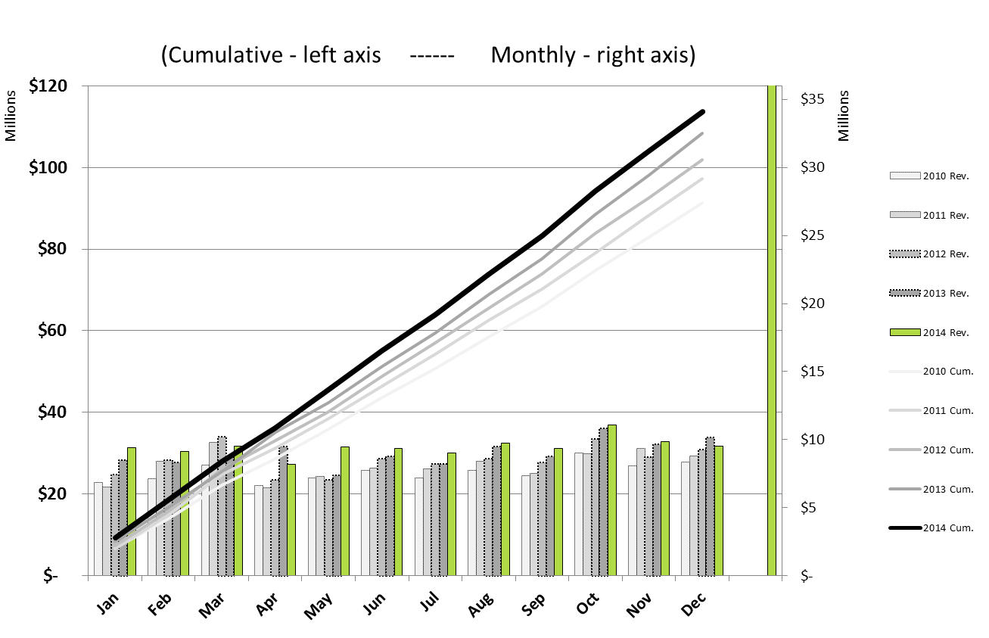
Historical Sales Tax Collections

Slide 29
Prudent Use of Debt
Fiduciary responsibility to county taxpayers
Primarily pay-as-we-go
Oversight of expenditures
Assessment of risk
Regional consensus on investments
CTIB use of bonding
$110M for Central Corridor LRT (Green Line)
Hennepin County issued bonds at ~$3M savings

Slide 30
Meeting expectations

Slide 31
Expand System Across the Region
First Generation
Second Generation
Hiawatha LRT Blue Line | Operational 2004
Northstar Commuter Rail | Operational 2009
Cedar Ave. BRT Red Line | Operational 2013
Central LRT Green Line | Operational 2014
Southwest LRT | Project Development
Bottineau LRT | Project Development
Orange Line BRT | Project Development
Gateway Corridor BRT | Entry into Project Development, 2015
Robert Street Corridor TBD | Pre-Project Development
Riverview Corridor TBD | Pre-Project Development
Notes:
Because of CTIB, we got the first generation of projects done.
Ready to do more.
CTIB’s grants and funding commitments have helped Central and Cedar Avenue BRT through construction.
Now we are ready to do more and are turning our attention to the next generation of projects.

Slide 32
Washington County Guaranteed Grants
Part of original Joint Powers Agreement
$11.77 million to jumpstart east metro projects
Gateway Dedicated BRT (Gold Line)
In Council’s 2040 Transportation Policy Plan (TPP)
Next transitway to enter federal pipeline
Red Rock Corridor
Newport Station built and open for service
Implementation Plan underway

Slide 33
Vision for the Future

Slide 34
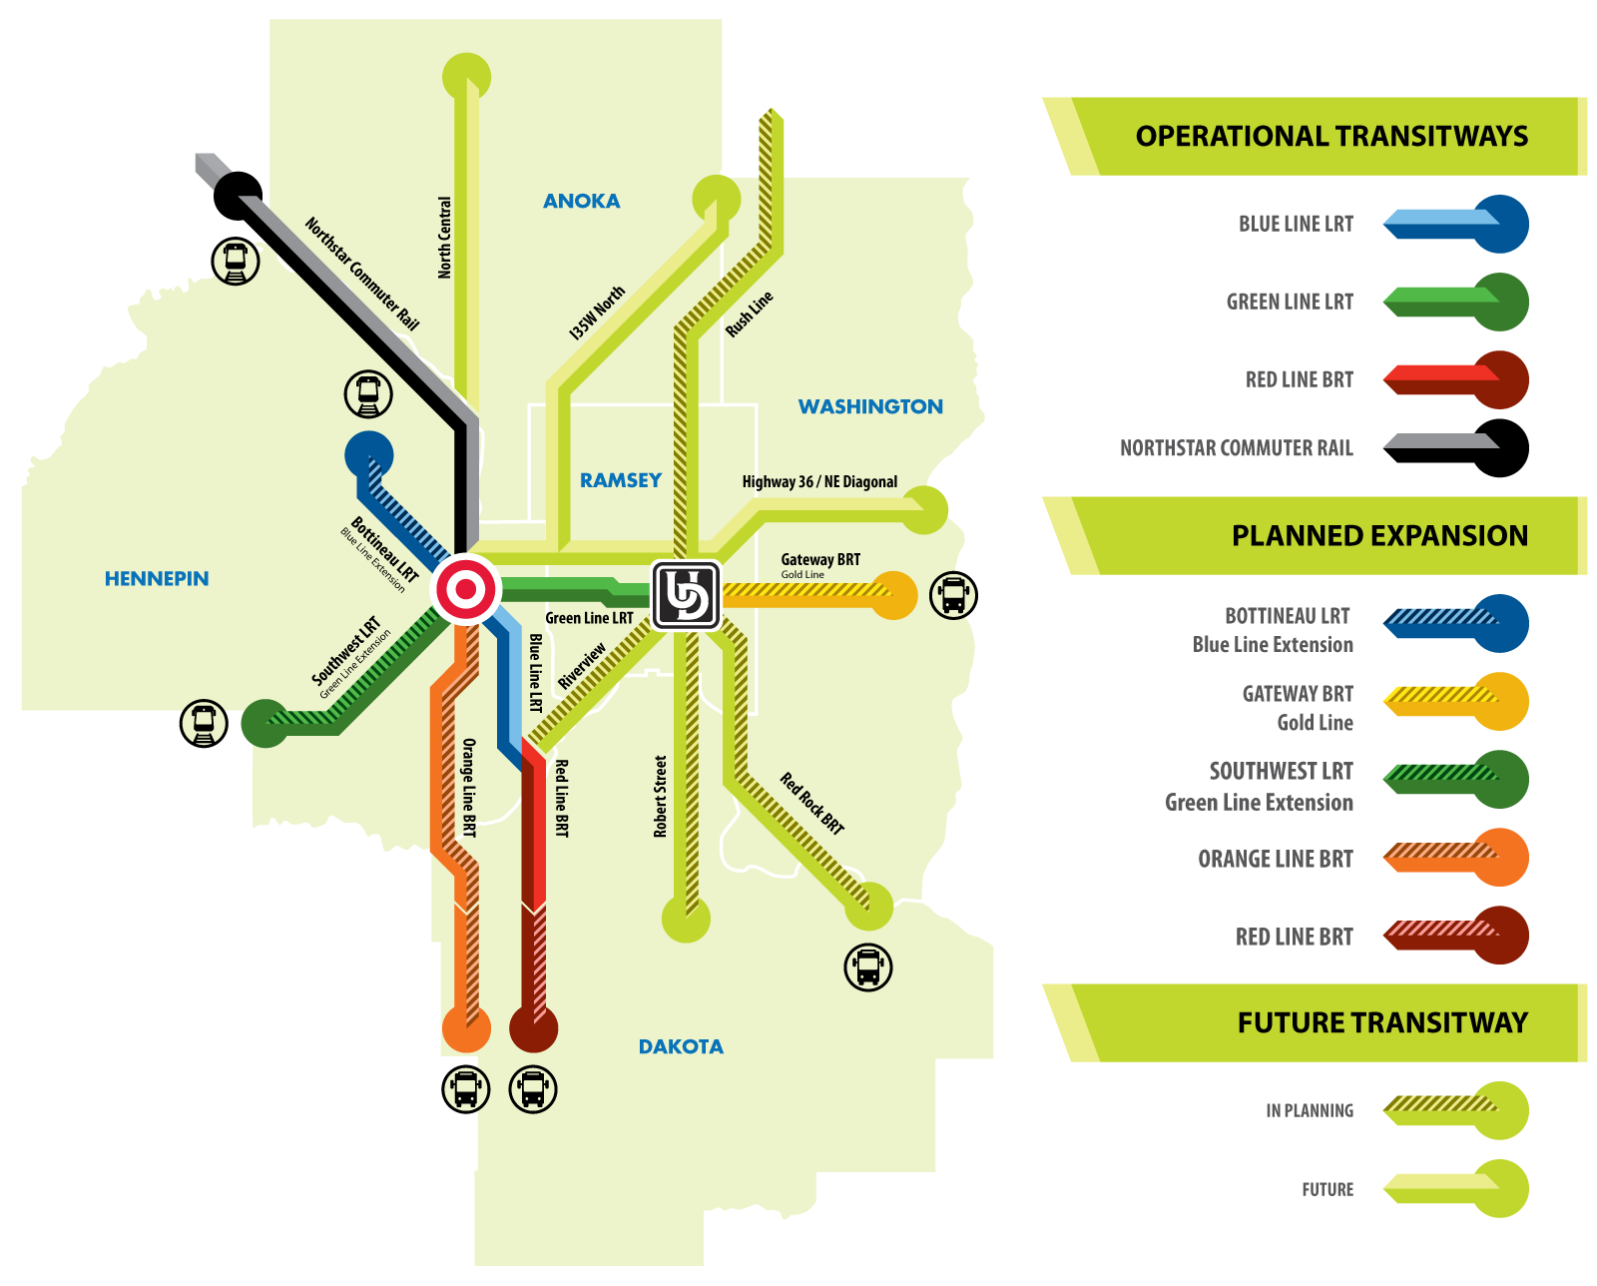
CTIB Vision for Regional Transitways

Slide 35
Thank You
Commissioner Peter McLaughlin, Chair
Counties Transit Improvement Board
612-348-3085
www.mnrides.org
Notes:
35

