Slide 1
Railroad Safety Update
Joint Hearing of the Minnesota
House Transportation Policy & Finance Committee
&
Senate Transportation and Public Safety Committee
February 15, 2016

Slide 2
Safety = Investment
Infrastructure
Technology
Training & Preparation

Slide 3
Infrastructure
Capital Intensive - Reinvest at 6 times the rate of the average manufacturer.
Privately Owned - Most U.S. freight railroads are privately owned and operated. Funds to maintain, improve, and operate the freight rail network come from the railroads, not taxpayers.
Record Investments - Railroads are reinvesting record amounts on tracks, signaling systems, locomotives, freight cars and more – including more than $25 billion in both 2012 and 2013 - $600 billion reinvested since 1980.
Growing Freight Demand - 56 tons of freight/person moved in America each year. Increase 33+% expected in next 30 years.

Slide 4
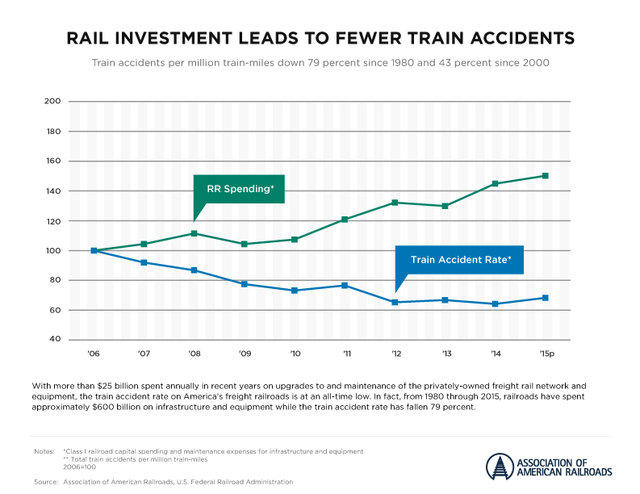
Infrastructure Investment

Slide 5
MN Railroads Infrastructure
Minnesota’s Class I railroads invested
$500+ million in infrastructure in 2015
  BNSF $326 million
  UP $26 million
  CP $75 million
  CN $80 million

Slide 6
Technology
Advanced Inspection Equipment — Specialized track monitoring equipment such as track geometry cars, ground-penetrating radar and laser technology. Additionally, wayside detectors monitor the condition of the wheels on passing trains.
Improved Tank Cars —Rail industry advocated for stricter tank car standards to ensure the safe transport of hazardous materials.
Asset Health Strategic Initiative (AHSI) — Information technology processes to improve the safety and performance of freight cars and locomotives by consolidating equipment information, ownership information, repair and inspection history, company recalls and more.
Positive Train Control (PTC) — Cutting-edge technology is designed to automatically stop or slow a train before certain accidents occur.

Slide 7
Positive Train Control (PTC)
PTC
Meeting the Challenge &
Getting it Right

Slide 8

AskRail®
Available to 1st Responders through Class I Railroads and the AAR

Slide 9
Training & Preparation
Minnesota railroads provide on-site training for 1st responders upon request
  4,000 trained in Minnesota
  150 trained in Pueblo, CO

Slide 10
Security Emergency Response Train Center (SERTC)

