Slide 1
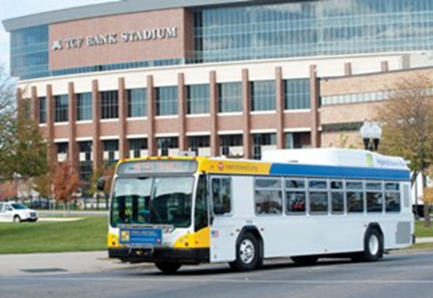
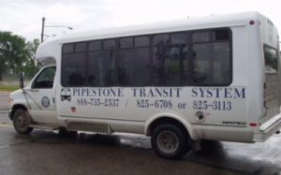
Minnesota Public Transit Association
House Transportation Committee
February 4, 2015
Marc Hall, MPTA President

Slide 2
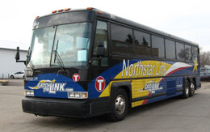
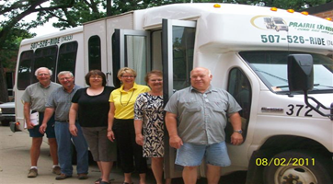
Greater Minnesota
54 public transit providers.
Total system count is now 54 (from 59 last year) as a result of various mergers of existing systems and the addition of two new tribal systems (White Earth and Fond-du-Lac).
Includes Metropolitan Council Transit Link (rural service inside the seven county metro area);
Northstar Commuter Rail (Greater Mn portion of Sherburne County commuter rail service); and
St. Cloud Transit's Northstar Link system (commuter bus service between St. Cloud and Big Lake).

Slide 3
Greater Minnesota Transit
Statistics from 2010 Greater MN Transit Plan
50% use transit at least 5 days a week
86% ride at least twice a week
33% are going to work
20% are going to school
50% of users in rural counties are 65 years or older
76% of seniors are female
33% of senior trips are medical and basic shopping needs

Slide 4
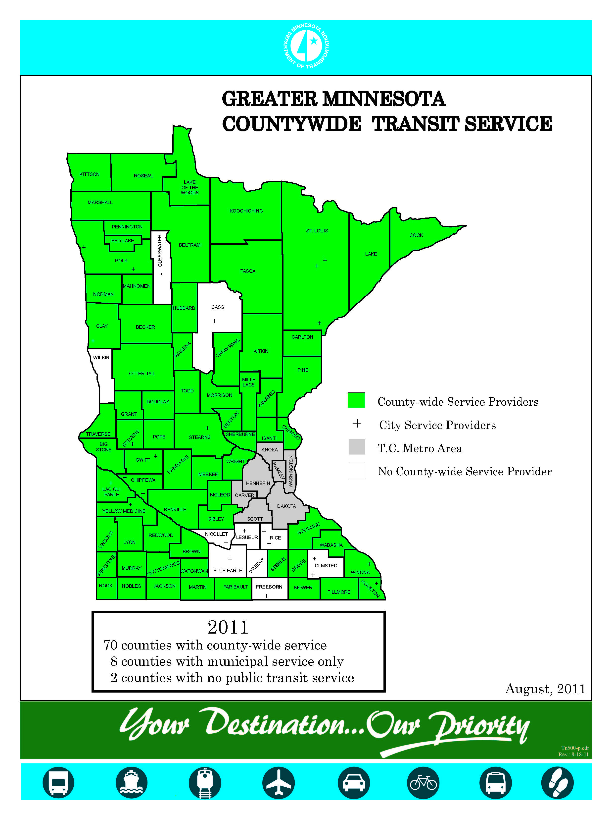
Greater Minnesota Transit Service
70 counties with countywide service
9 counties with municipal service only
Clearwater, Cass, Nicollet, Le Sueur, Rice, Blue Earth, Olmstead, Faribault, Wilkin
1 counties with no public transit service
Waseca
_______________________________
6 Urbanized
St. Cloud, Rochester, Duluth, East Grand Forks, La Crescent and Moorhead

Slide 7
Meeting State Goals
Minnesota Statutes §174.24
Meet 80% of transit needs by July 1, 2015
Meet 90% of transit needs by July 1, 2025
In Greater Minnesota
Address unmet need in existing systems, add service in un-served counties and in un-served communities.
Add evening and weekend service.
Funding Service Expansion
TFAC REPORT recommended increasing annual investment of $45 million for Greater Minnesota Transit by 2020

